Slide 1
Housing Algorithm
By Ryan Neumann

Slide 2
Buy land, they’re not making it anymore
Mark Twain

Slide 3
Problems
Real Estate Agents hold all the power in the housing market
Individual buyers/sellers are usually clueless
Housing appraisal is done in a vague/sketchy way

Slide 4
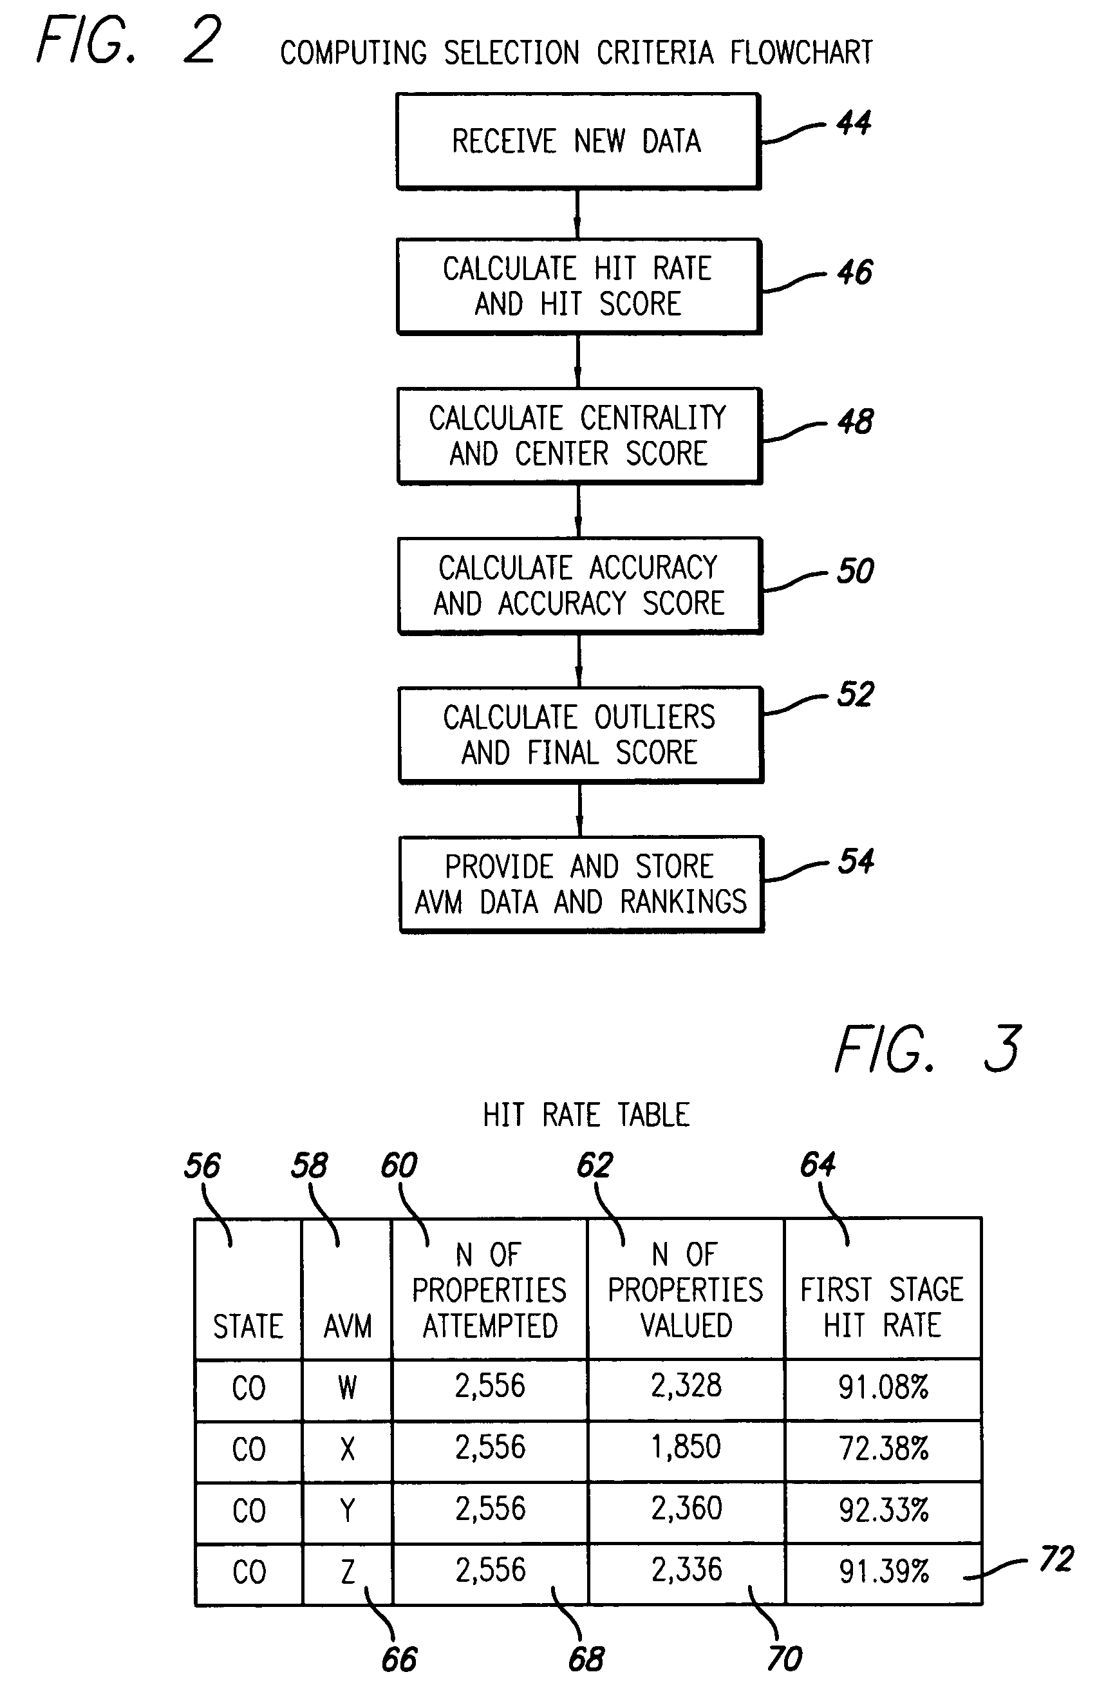
Current Algorithm
Automated Valuation Model (AVM)
Considers:
Previous sales of home
Previous sales of houses around location
Search rate
Click rate

Slide 5
Solution
Create a transparent algorithm for every day people to use
Understandable Variables
House Appraisal with in depth detail

Slide 6
What to consider
Variables
Location
Distance to schools
Type of Neighborhood
General Environment
House Details
Denoted by a 1 or 0 (Yes or No)
Size
Amount of Bedrooms

Slide 7
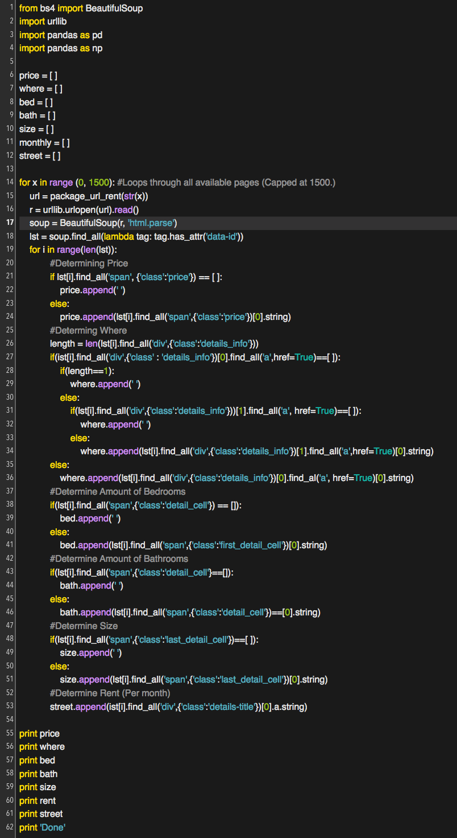
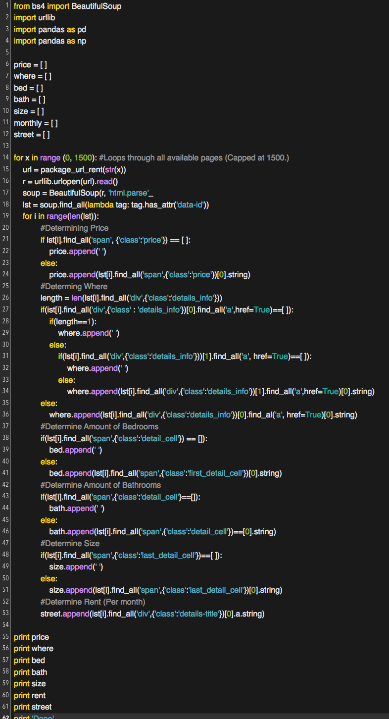

Slide 8

What does this do?

Slide 9
What does this do?
Accesses given URL (Variable: r)
Determines:
Address of house
Amount of Rooms
Size of Property
Current Estimated Price
Distance to nearby locations

Slide 10
Looking towards the future
These factors will be used to determine
Proper Appraisal for home
Seller Profit
How it will save money?
No more real estate agents (5% alone)
Direct transactions - No middleman

Slide 11
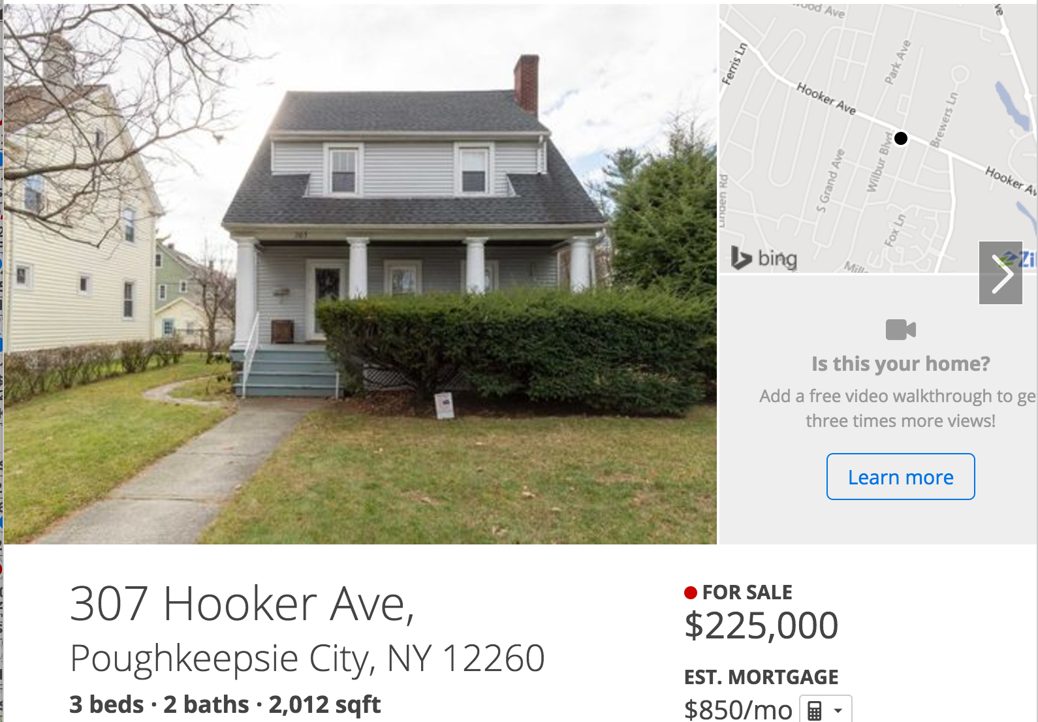
Real Estate Agent Cut: $11,250
Seller’s Cut: $213,750 (Before Tax)

Slide 12
My valuation
Worth approximately $215,000.
However, both the buyer and seller would be getting a better deal
Real Estate Agents Cut - $0
Seller’s Cut - $215,000 (Before Tax)

