Slide 1

Welcome to Hereford
For updates follow us on twitter: @smartdevsug
http://www.meetup.com/Smart-Devs-User-Group/

Slide 2
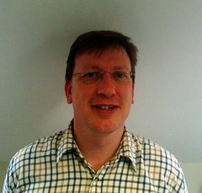
Ryan O’ Neill @ryanoneill1970 r@ryanoneill.com
@smartdevsug

Slide 3
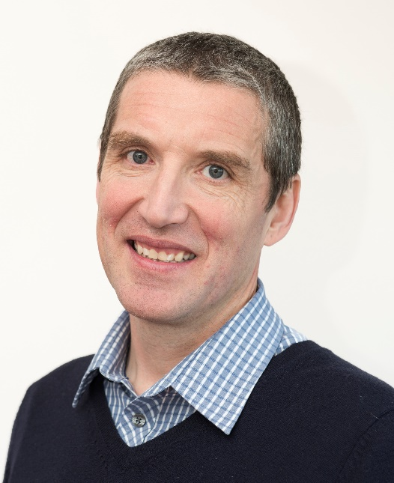
Richard Wilde @rippo richard@wildesoft.net
@smartdevsug

Slide 4
Upcoming Events..
Thanks to our sponsors;
OzCode
JetBrains
Rippo/Ryan – Pizza + Venue Donations gladly accepted
@smartdevsug

Slide 5
Upcoming Events..
Coming up Joseph Woodward - deep dive into ASP.NET core/razor Docker – Ashley Poole The Secrets of MonoGame Trump wants banned! – Andy Clarke
Mark Rendle on the released .Net core 2.0 standard
@smartdevsug

Slide 6
Upcoming Events..
What do you want to see?
Email us.
...
@smartdevsug

Slide 7
Upcoming Events..
Tonight Local Legend Ben Serverless Applications and FasS (Functions-as-a-Ser­vice)
@smartdevsug

