Slide 1

Welcome to Hereford
For updates follow us on twitter: @smartdevsug
http://www.meetup.com/Smart-Devs-User-Group/

Slide 2
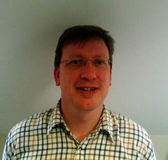
Ryan O’ Neill @ryanoneill1970 r@ryanoneill.com
@smartdevsug

Slide 3
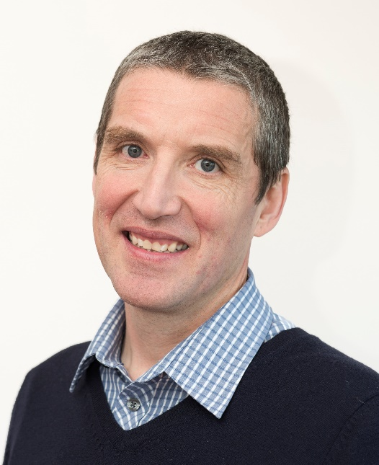
Richard Wilde @rippo richard@wildesoft.net
@smartdevsug

Slide 4
Upcoming Events..
Thanks to our sponsors;
- OzCode
- JetBrains
- Rippo/Ryan – Pizza + Venue
Donations gladly accepted!
@smartdevsug

Slide 5
Upcoming Events..
Coming up NOV – CI/CD for Containers and Microcontainers – Thom Legget
DEC – Azurey stuff – Shahid Iqbal
JAN – Resilient and scalable ML – Steve Spencer
FEB – UI Testing with Chromeless – Rippo
APR - Building an End to End IoT Solution Using Pi Sensors & Azure – Paul Andrew
@smartdevsug

Slide 6
Upcoming Events..
What do you want to see?
Email us. Send us a tweet
@smartdevsug

Slide 7
Upcoming Events..
Tonight Elastic Search and Kibana Neil Barnwell
@smartdevsug

