Slide 1

Welcome to Hereford
For updates follow us on twitter: @smartdevsug
http://www.meetup.com/Smart-Devs-User-Group/

Slide 2
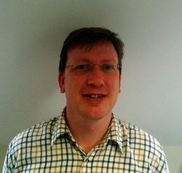
Ryan O’ Neill @ryanoneill1970 r@ryanoneill.com
@smartdevsug

Slide 3
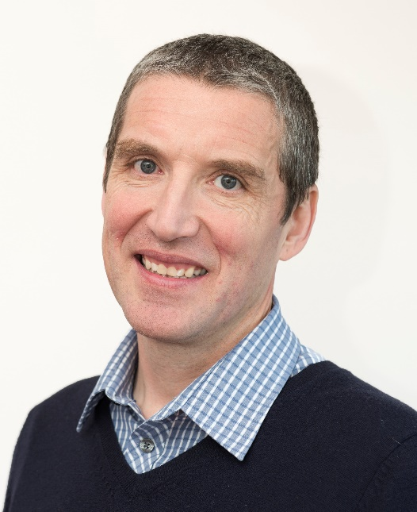
Richard Wilde @rippo richard@wildesoft.net
@smartdevsug

Slide 4
Upcoming Events..
Thanks to our sponsors;
- OzCode
- JetBrains
- Rippo/Ryan – Pizza + Venue
Donations gladly accepted!
@smartdevsug

Slide 5
Upcoming Events..
Progressive .NET 2017 Discount for Smartdev members, use
SMARTDEVS_PROGNET20 to get 20% off ticket price
https://skillsmatter.com/conferences/8268-progressive-dot-net-2017
@smartdevsug

Slide 6
Upcoming Events..
Coming up SEP - The Secrets of MonoGame Trump wants banned! – Andy Clarke
OCT - Elastic Search and Kibana – Neil Barnwell
NOV - YOU CHOOSE! – Thom Legget
@smartdevsug

Slide 7
Upcoming Events..
VOTE for 2
1. Kubernetes 101
2. Developing a new cloud provider for Kube
3. Serverless with docker
4. ci/cd for containers
5. Microcontainers
...
@smartdevsug

Slide 8
Upcoming Events..
What do you want to see?
Email us. Send us a tweet
@smartdevsug

Slide 9
Upcoming Events..
Tonight A beginner’s overview of Docker – Ashley Poole
@smartdevsug

