Slide 1

Welcome to Hereford
For updates follow us on twitter: @smartdevsug
http://www.meetup.com/Smart-Devs-User-Group/

Slide 2
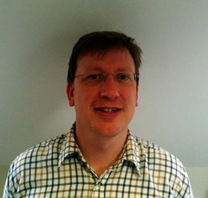
Ryan O’ Neill @ryanoneill1970 r@ryanoneill.com
@smartdevsug

Slide 3
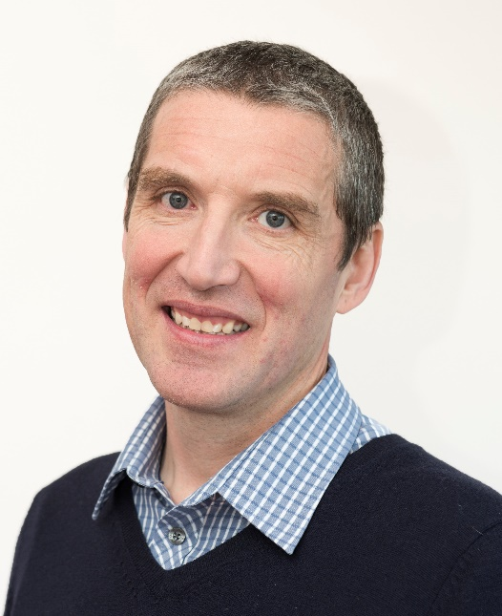
Richard Wilde @rippo richard@wildesoft.net
@smartdevsug

Slide 4
Upcoming Events..
Thanks to our sponsors;
OzCode
JetBrains
Rippo/Ryan – Pizza + Venue Donations gladly accepted
@smartdevsug

Slide 5
Upcoming Events..
Coming up DevOps with Matteo Emili, we need a vote…
1. Hybrid DevOps stacks in action
2. A year of SonarQube and TFS/VSTS: ten tips from the real world
3. Packages as the first choice when deploying: how?
@smartdevsug

Slide 6
Upcoming Events..
Coming up DevOps with Matteo Emili
Joel Hammond Turner on being a good technical leader
Mark Rendle on the released .Net core 2.0 standard
@smartdevsug

Slide 7
Upcoming Events..
What do you want to see?
Email us.
...
@smartdevsug

Slide 8
Upcoming Events..
Tonight Mark Allan Azure Functions DocumentDB
@smartdevsug

