Slide 1

Welcome to Hereford
For updates follow us on twitter: @smartdevsug
http://www.meetup.com/Smart-Devs-User-Group/

Slide 2
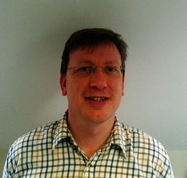
Ryan O’ Neill @ryanoneill1970 r@ryanoneill.com
@smartdevsug

Slide 3
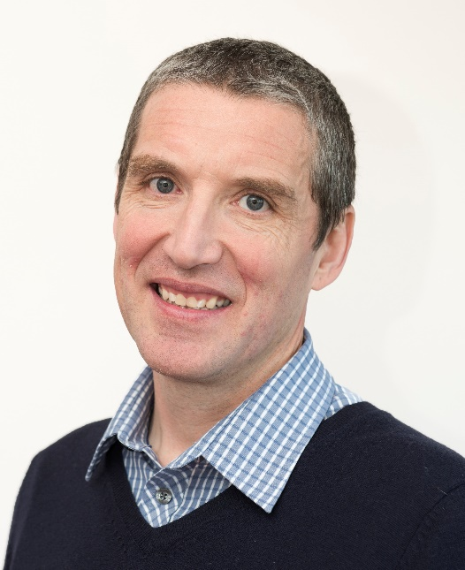
Richard Wilde @rippo richard@wildesoft.net
@smartdevsug

Slide 4
Upcoming Events..
Thanks to our sponsors;
- OzCode
- JetBrains
- Cloudflare
- Rippo/Ryan – Pizza + Venue
Donations gladly accepted!
@smartdevsug

Slide 5
Upcoming Events..
Coming up DEC – Kubernetes for .net developer – Shahid Iqbal
JAN – Resilient and scalable ML – Steve Spencer
FEB – Ui Testing with Headless Chrome – ME ☹
Mar – d3.js – Tess Barnes
Apr – Building IOT end to end using Pi
@smartdevsug

Slide 6
Upcoming Events..
What do you want to see?
Do you want to present <INSERT TALK HERE>? Talk to us, email us, send us a tweet, we promise not to bite!
@smartdevsug

Slide 7
Upcoming Events..
Tonight NOV – CI/CD for Containers and Microcontainers – Thom Legget/Rik Gibson
@smartdevsug

