Slide 1

Team 8
Group Assignment 3: Part 2
SWE 6653
Fall Semester 2023
Members:
Ryan O'Connor
Charles Walker
Gandhampodi Saikumar
Krishna Boddu

Slide 2
Team 8
Contributions:
Ryan O'Connor: Document/PowerPoint Editor, Data Section, UI Section, Design Rationale, Architecture Section
Charles Walker: System Section, General Design
Gandhampodi Saikumar: PowerPoint Editor, Architecture Section
Krishna Boddu: Main Scenarios Section

Slide 3
Recap Introduction
Purpose:
Develop a user-friendly Online Voting System (OVS).
Provide a secure and transparent platform for non-governmental polls.
Simplify the process of voting in unofficial elections.
Scope:
Tailored for non-official, remote voting.
Offers multi-factor authentication, encryption, and auditing.
Users can join organizations and vote, register as candidates, register organizations, and become admins.
Problems Solved:
Inefficient non-official polling methods.
Lack of transparency and accountability in private voting systems.
Complexity in inter-organizational e-governance.

Slide 4
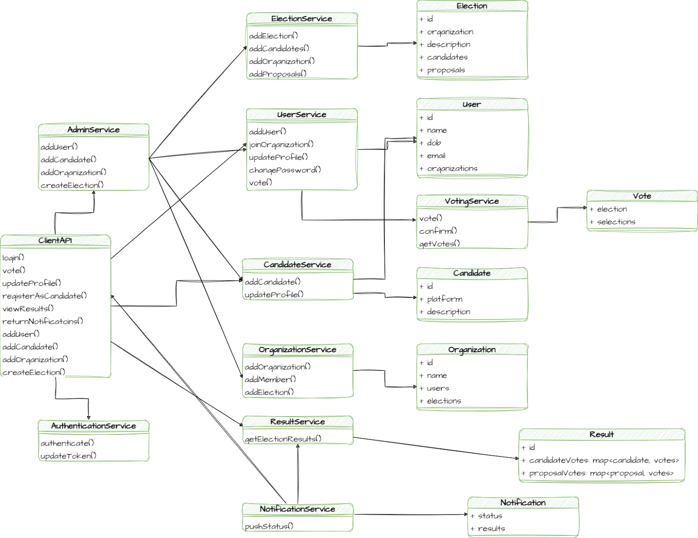
Logical View

Slide 5
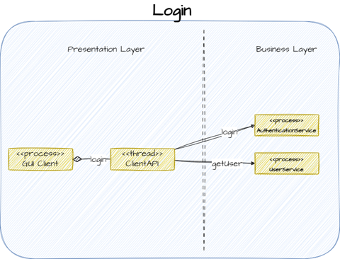
Process Views

Slide 6
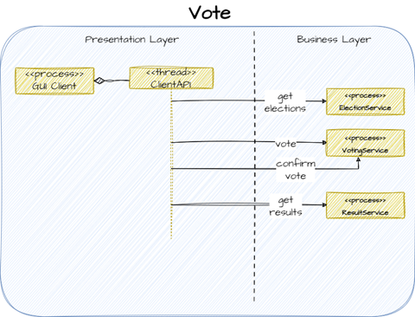
Process Views

Slide 7
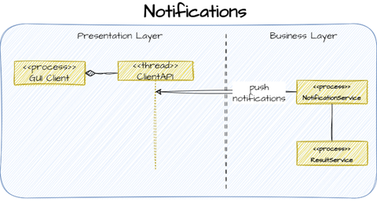
Process Views

Slide 8
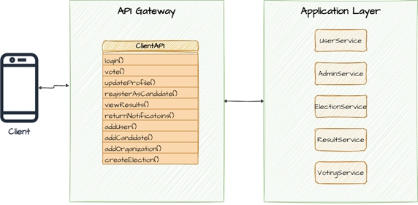
Interface View

Slide 9
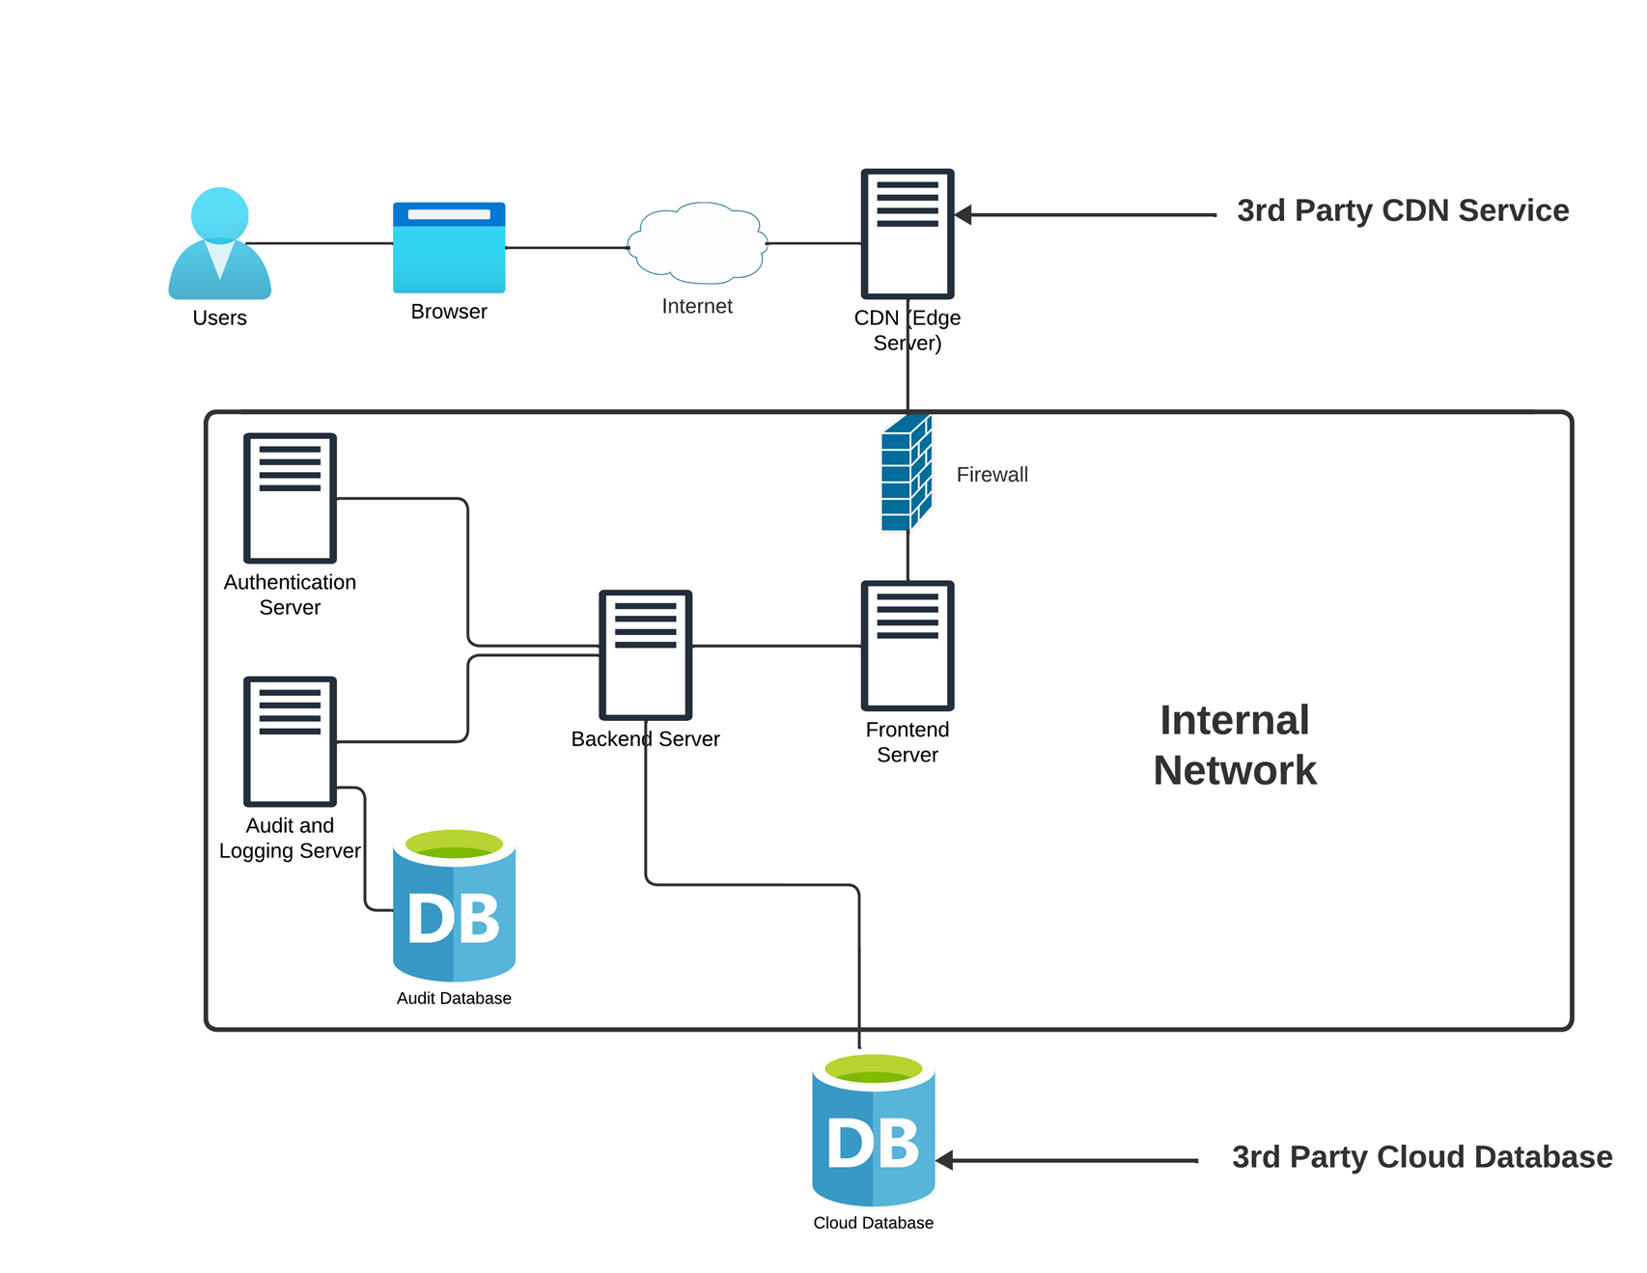
Architecture and Design
High-Level Component View

Slide 10
Architecture and Design
Frontend Components:
Voter Interface: For login, ballot access, and vote submission.
Admin Interface: Enables poll creation, management, and result viewing.
Candidate Interface: Allows electoral registration, profile management, and election monitoring.
Identification Component: Handles user registration and login processes.
Backend Components:
Backend Server: Manages APIs, user, admin, ballot, routing, auditing, load balancing, voting, and election logic.
Authentication Server: Ensures user authentication and authorized access.
Cloud Database: Stores voter, ballot, and poll result data.
Audit Server: Logs system activities and maintains transparency.
Audit Database: Contains system logs and activity data.
Connectors:
Event Connector: For example, clicking the 'Submit Vote' button in the Voter Interface generates an event that is sent to the backend server.
Procedure Call Connector: For example, when a user clicks “submit vote” in the UI an event is triggered which initiates a procedure call to the backend, specifically to the ‘voting logic’ service. This procedure call facilitates the actions between the user’s submission and the service.
Shared Data Access Connectors: For example, when a user attempts to log in, his request needs access the database to check to see if the user exists.

Slide 11

Architecture and Design
Client-Server Architecture: The frontend components interact with the backend services in a request-response pattern.
Microservices Architecture: Individual pieces of business logic can be seen as separate microservices that can be independently developed, deployed, and scaled.
Service-Oriented Architecture (SOA): The backend components provide services that are reusable and can be integrated into multiple frontend applications.

Slide 12
Architecture and Design
MVC (Model-View-Controller): We planned to develop the front end using the MVC design pattern. This design pattern calls for the UI (View) to be separate from the business logic (Controller) and data (Model).
Repository Pattern: For data access logic, encapsulating the logic required to access the data source from the Cloud Database.
Singleton Pattern: The singleton pattern is good for classes that only have 1 instance in operation. For example, logging mechanisms within the audit and monitoring server will likely contain singleton-type classes.
Proxy Pattern: This pattern can be used for auditing and authentication. A proxy can be used to check whether the client has the necessary access rights before forwarding the request to the target object. For example, if a user tries to login, his request will be sent to the proxy, which sends it to the auth server, which makes a decision on how to process the request, then the response is sent back to the user from the auth server through the proxy.

Slide 13
Architecture and Design
MVC (Model-View-Controller): We planned to develop the front end using the MVC design pattern. This design pattern calls for the UI (View) to be separate from the business logic (Controller) and data (Model).
Repository Pattern: For data access logic, encapsulating the logic required to access the data source from the Cloud Database.
Singleton Pattern: The singleton pattern is good for classes that only have 1 instance in operation. For example, logging mechanisms within the audit and monitoring server will likely contain singleton-type classes.
Proxy Pattern: This pattern can be used for auditing and authentication. A proxy can be used to check whether the client has the necessary access rights before forwarding the request to the target object. For example, if a user tries to login, his request will be sent to the proxy, which sends it to the auth server, which makes a decision on how to process the request, then the response is sent back to the user from the auth server through the proxy.

Slide 14
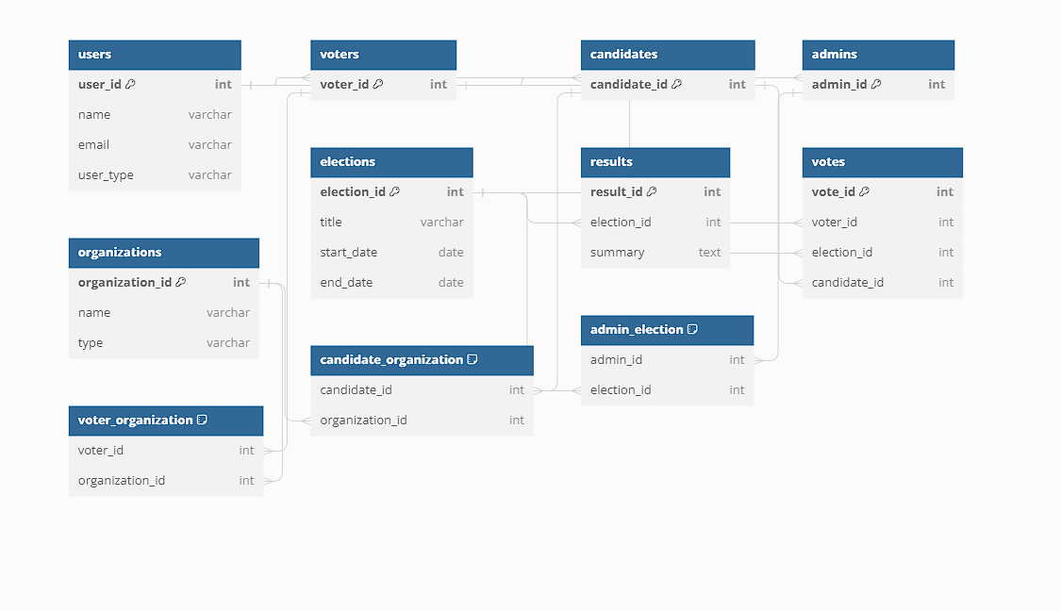
Data Components

Slide 15
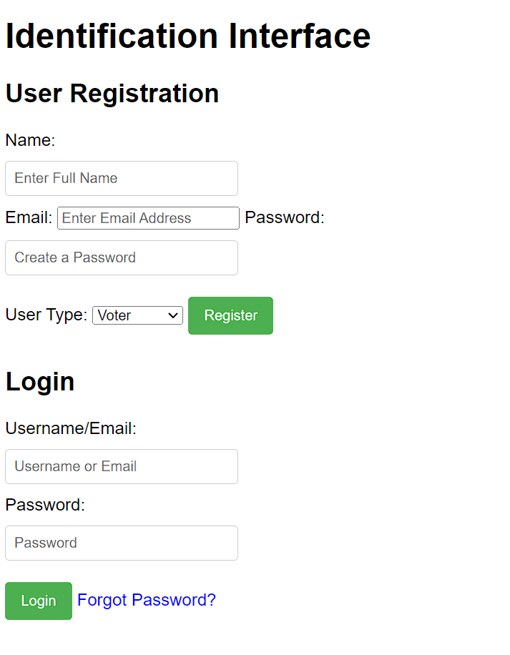
Identification Interface

Slide 16
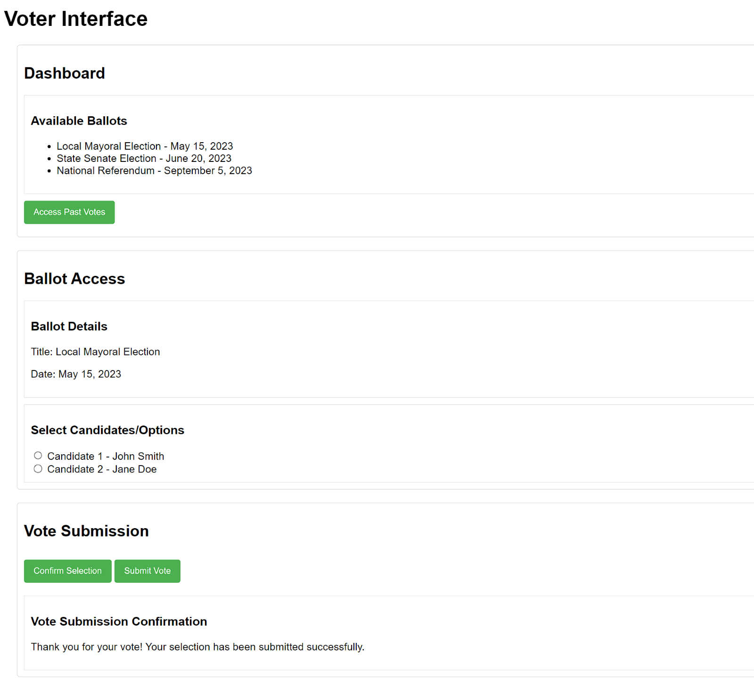
Voter interface

Slide 17
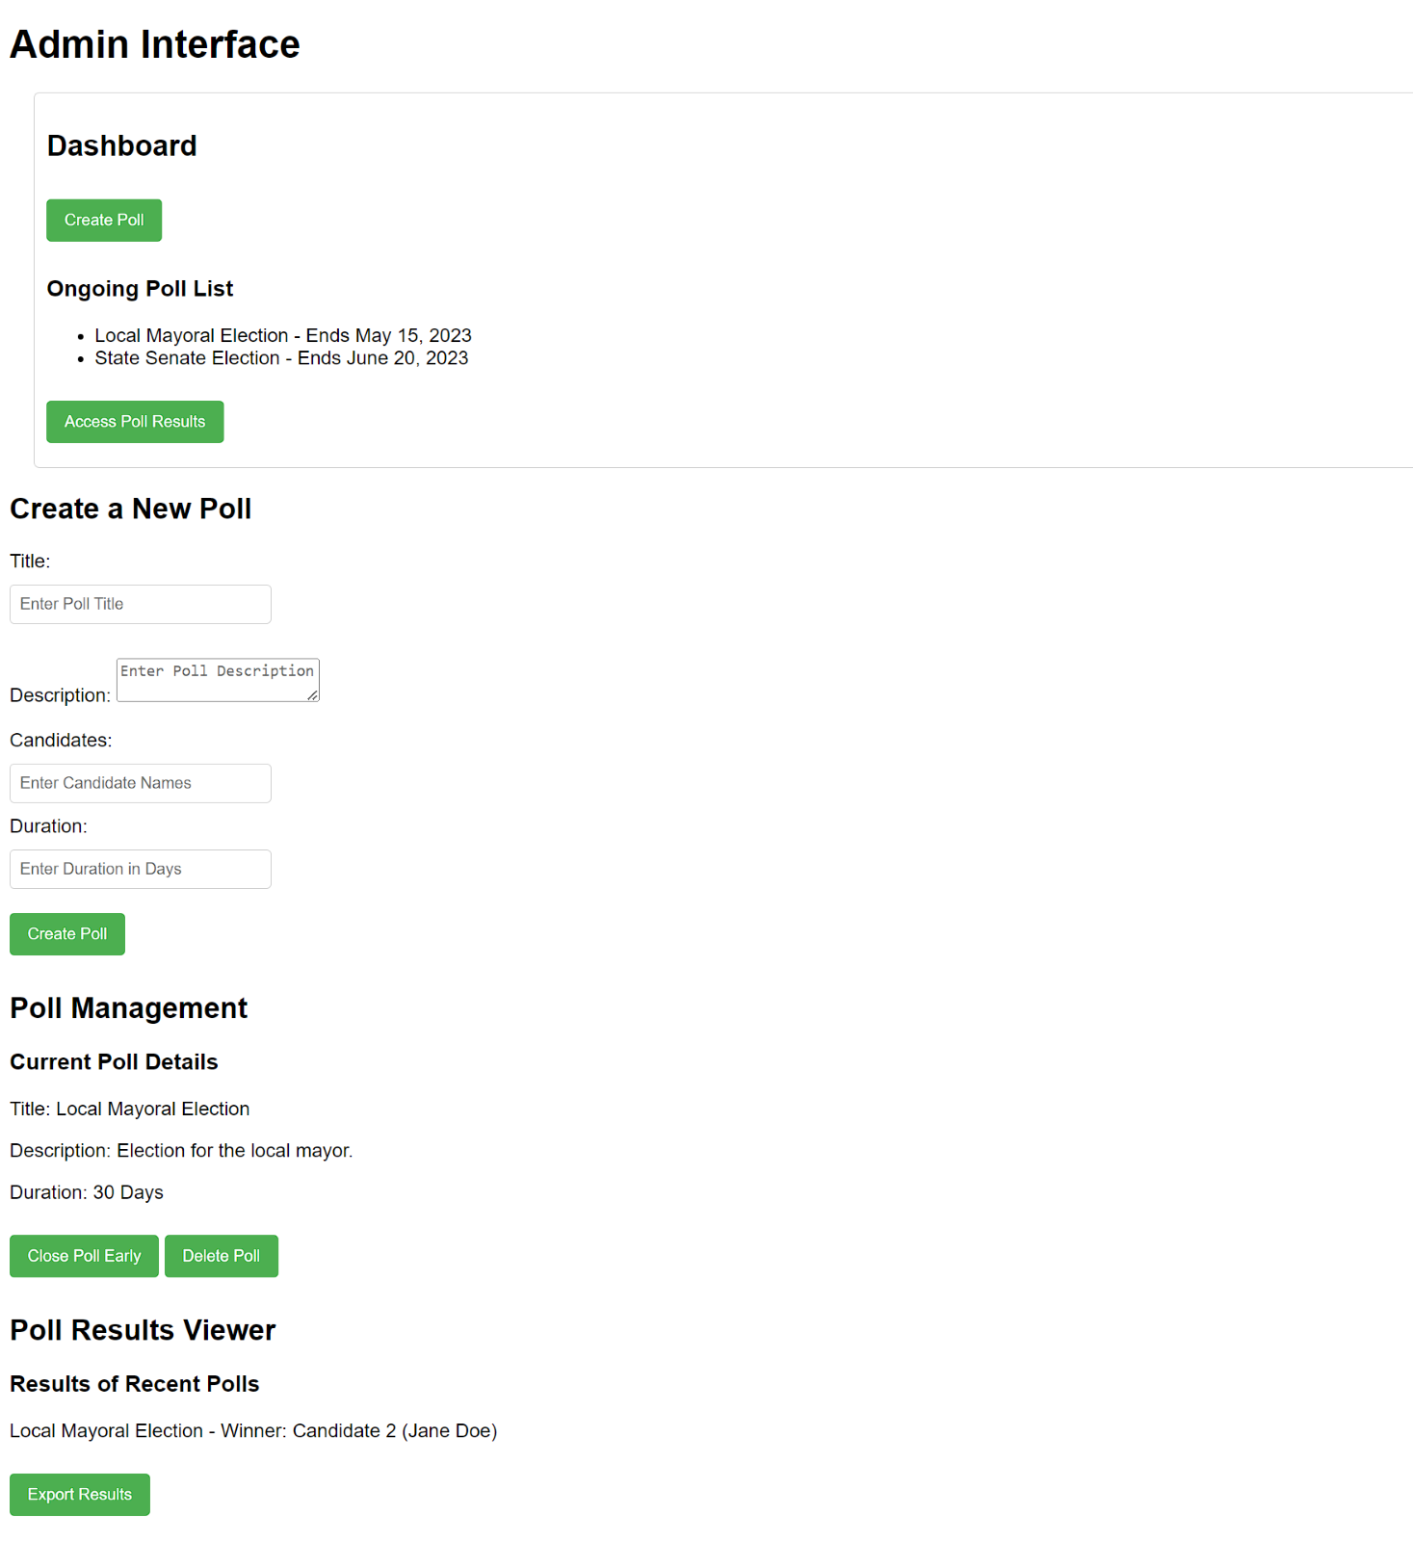
Admin Interface

Slide 18
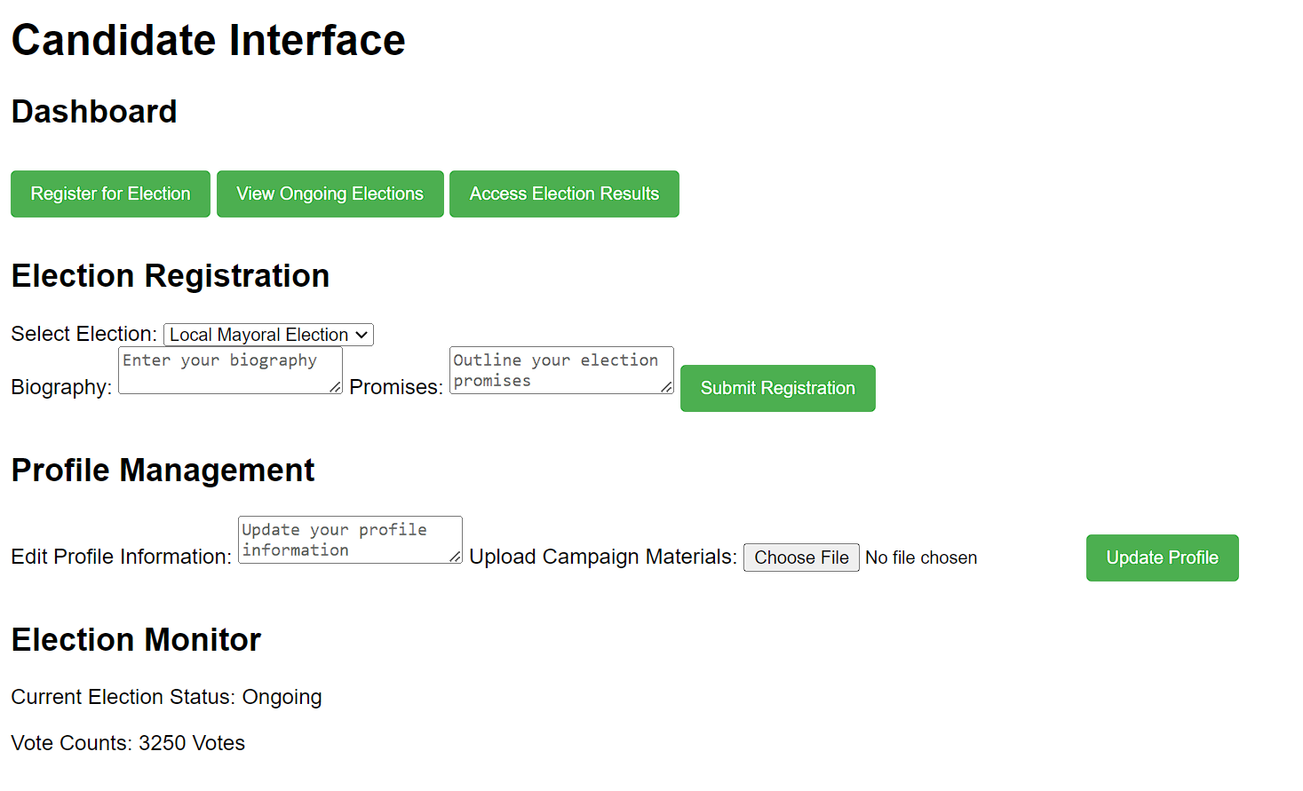
Candidate Information

Slide 19
Three Main Scenarios
Normal
Error
Special point of variation

Slide 20
Design Rationale
Security
Performance
Reliability
Availability
Scalability

Slide 21

Conclusion
Thank you

