Slide 1

Testing Frameworks: Jest
Ryan O’Connor
SWE 6673
Spring 2023

Slide 2


Agenda
Intro
Setting Up Jest
Running Tests
Customizing Tests
Conclusion

Slide 3

Introduction
Jest is a popular JavaScript testing framework developed by Facebook that is used for testing code written in JavaScript.
Jest provides an easy-to-use platform for writing and executing tests, and it is highly configurable to suit the needs of individual developers or teams.

Slide 4
Introduction
Jest is used to write unit tests and integration tests for JavaScript code, and it can also be used to test React components.
Jest is the recommended testing framework for React applications. Jest provides a number of features that make it well-suited to testing React components, including built-in support for JSX, snapshot testing, and the ability to mock dependencies.

Slide 5
Introduction
Some of the key features of Jest include:
Automatic mocking: Jest can automatically mock any JavaScript module or library, making it easy to test components in isolation.
Snapshot testing: Jest allows developers to create and compare snapshots of component renderings, making it easy to detect changes in component output.
Coverage reports: Jest can generate coverage reports that show how much of the codebase is covered by tests, helping developers identify areas of the code that may require more testing.
Parallel test execution: Jest can run tests in parallel, which can significantly reduce the time required to run large test suites.
Test watch mode: Jest can run tests in watch mode, automatically re-running tests when code changes are detected.

Slide 6
Introduction
While React projects are built using the React library and JavaScript, it is also a Node.js project that uses Node.js to manage dependencies, run scripts, and provide a development environment. Node Package Manger (NPM) is a package manager for Node.js packages, and it comes bundled with Node.js when you install it. It provides a command-line interface that allows you to install, update, and manage packages and their dependencies, as well as run scripts defined in the package.json file.
You may be wondering what a json file is, well JSON (JavaScript Object Notation) is a lightweight data interchange format that is easy for humans to read and write, and easy for machines to parse and generate. It is a text-based format that is derived from JavaScript object literals, but it can be used with many programming languages.
JSON is used for exchanging data between client-side and server-side applications. It is also used for storing configuration data and for transmitting data between different parts of a system.

Slide 7
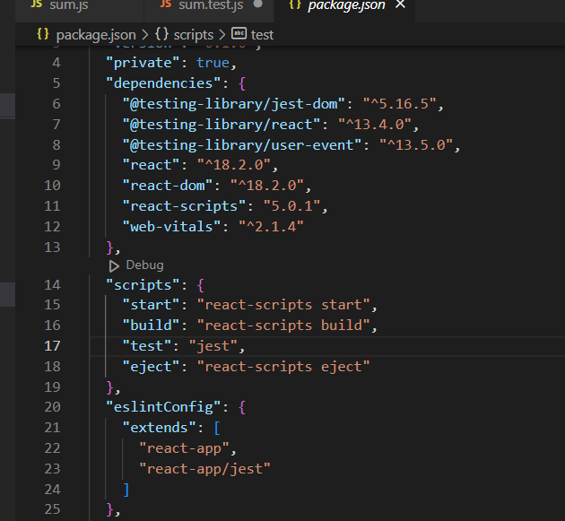
Introduction
JSON is comprised of two basic structures:
A collection of name/value pairs, also known as an object. In JSON, an object is defined as a set of key/value pairs, where the keys are strings and the values can be any JSON value.
An ordered list of values, also known as an array. In JSON, an array is defined as an ordered list of values, where each value can be any JSON value.
← My project only contains both

Slide 8



Setting Up Jest
For React testing

Slide 9
Setup
First, I setup a simple React application and downloaded and installed Node.js on my system which includes the Node Package Manage (NPM). I’m using VS-Code as my IDE which has an integrated terminal feature which allows me to run commands at the shell level on my Windows system. Here are the steps you can follow to get to this point:
1. Download/install vscode and node
2. npm -v in powershell
3. npm install -g create-react-app
4. Restart your system
5. Within VS-code terminal or another terminal use the command: create-react-app my-app
6. cd my-app

Slide 10
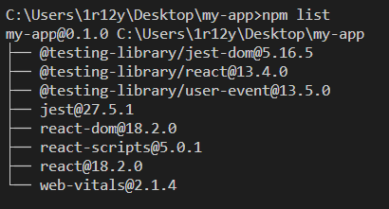
Setup
For a little bit of extra context before we dive deeper, we will specifically be focused on setting up, running, and customizing unit tests with Jest.
First thing to do in setting up Jest is downloading and installing it with the following command: ‘npm install –save-dev jest’
Then, check you check which dependencies are installed in your app with the following command: ‘npm list’

Slide 11
Setup
Now that everything is installed we will first want to create a simple javascript file called sum.js and stick it inside of a new folder called components within the source code folder. The file contains a single function that adds two numbers together and returns the sum.
function sum(a, b)
{ return a + b; } module.exports = sum;
After that, we want to create a new folder in the main app directory called tests. Here we will create our first test call sum.test.js
const sum = require("../src/components/sum"); test('adds 1 + 2 to equal 3', () => {
expect(sum(1, 2)).toBe(3);
});

Slide 12
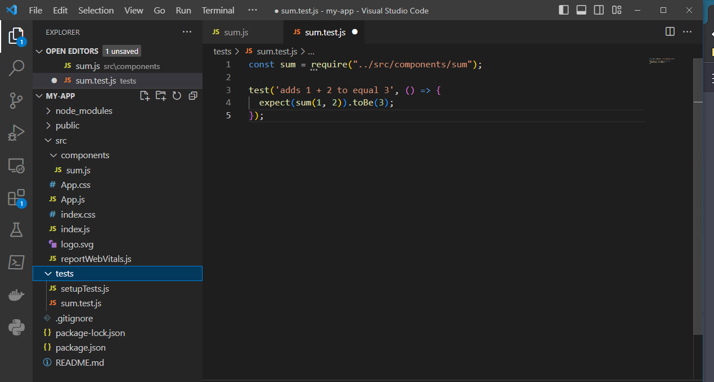
Setup

Slide 13
Running Jest Tests
On React Components

Slide 14
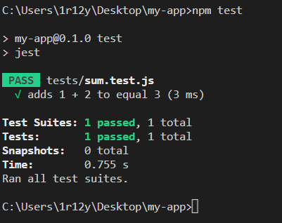
Running Tests
To run the test we setup, you would open your terminal and type the command: npm test
This npm command runs a script named ‘test’ defined in the scripts section of the package.json file.
What we are seeing is a unit test being run on a single javascript file in isolation.
Unit testing is a software testing technique in which individual units or components of a software application are tested in isolation from the rest of the system. A unit is the smallest testable part of an application, such as a function or method.

Slide 15
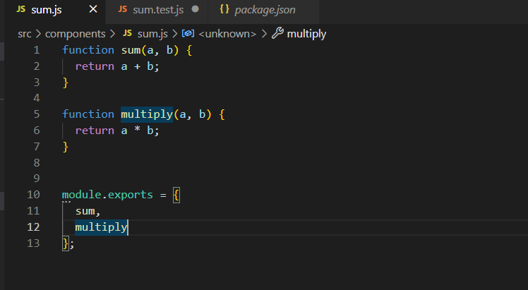
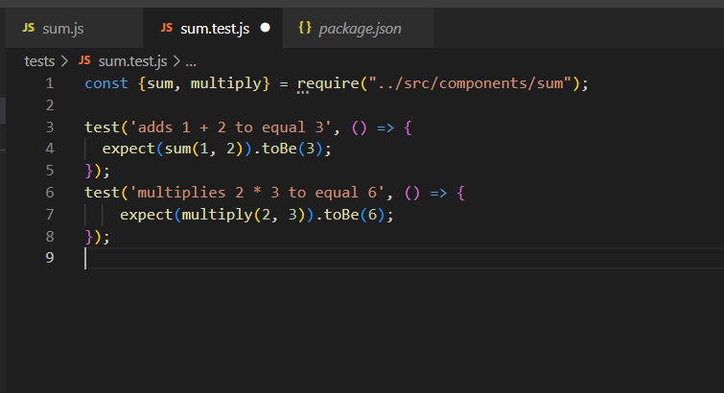
Customizing Tests
So let’s say we added more code to the sum.js file like another function that handles multiplication
New code to be tested:
We would then have to customize the test file by adding a new test case. This code imports both sum and multiply using destructuring and defines two test cases: one for the sum function and one for the multiply function.
The new test:

Slide 16
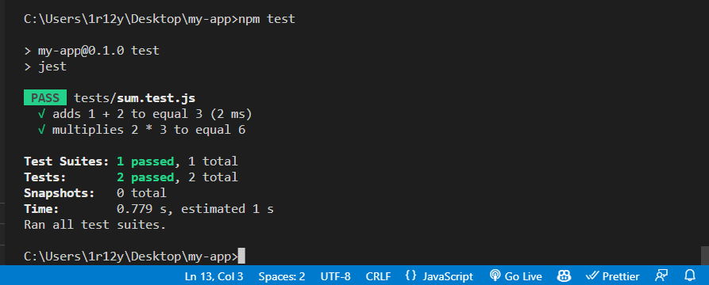
Customizing Tests
Here is the result of running our new test:

Slide 17




Conclusion
https://nodejs.org/en/docs/guides/getting-started-guide
https://react.dev/learn
https://jestjs.io/docs/getting-started

Slide 18


Thank you
Ryan O’Connor
SWE 6673
Spring 2023

