Slide 1

Team 8
Group Assignment 1: Presentation
SWE 6653
Fall Semester 2023
Members:
Ryan O'Connor
Charles Walker
Gandhampodi Saikumar
Krishna Boddu

Slide 2
Introduction
Purpose:
Develop a user-friendly Online Voting System (OVS).
Provide a secure and transparent platform for non-governmental polls.
Simplify the process of voting in unofficial elections.
Scope:
Tailored for non-official, remote voting.
Offers multi-factor authentication, encryption, and auditing.
Users can join organizations and vote, register as candidates, register organizations, and become admins.
Problems Solved:
Inefficient non-official polling methods.
Lack of transparency and accountability in private voting systems.
Complexity in inter-organizational e-governance.

Slide 3
Domain Specification
E-Governance in Context: Previously, our system aimed at public-sector e-governance, targeting national and local official elections. However, to navigate complex legal and logistical challenges, we've adjusted our aim to now focus on inter-organizational e-governance.
Our system now focuses on unofficial voting processes like, internal organizational polls, surveys, and other non-governmental elections.

Slide 4
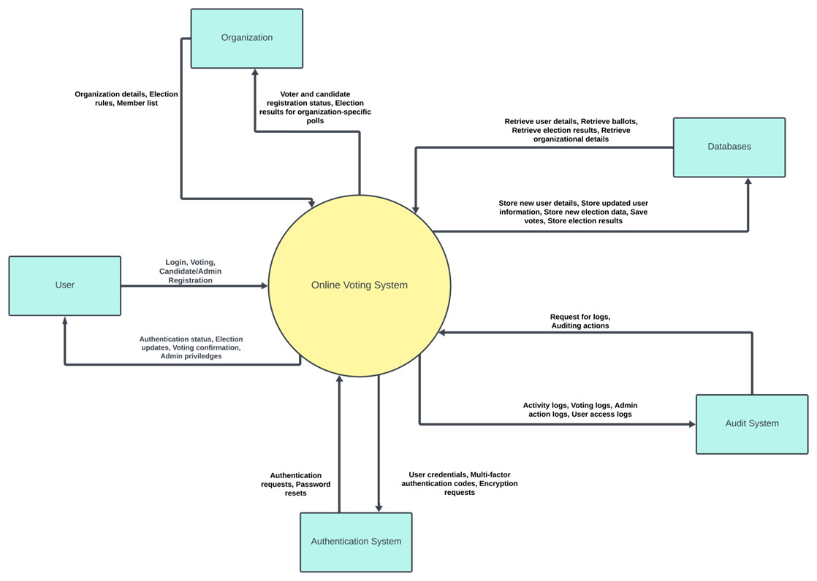
Context Diagram

Slide 5

Users and Actors
User:
Generic registered individual.
Can register/edit profiles.
Can verify identity.
Can register/join organizations.
Can vote and receive results.
Admin:
Elevated privileges within the system.
Manages users in an organization.
Controls election processes within their organization.
Elevates users to admin roles.
Handles candidate selection.
Candidate:
Runs for positions in elections.
Registers their candidacy.
Monitors election progress.

Slide 6
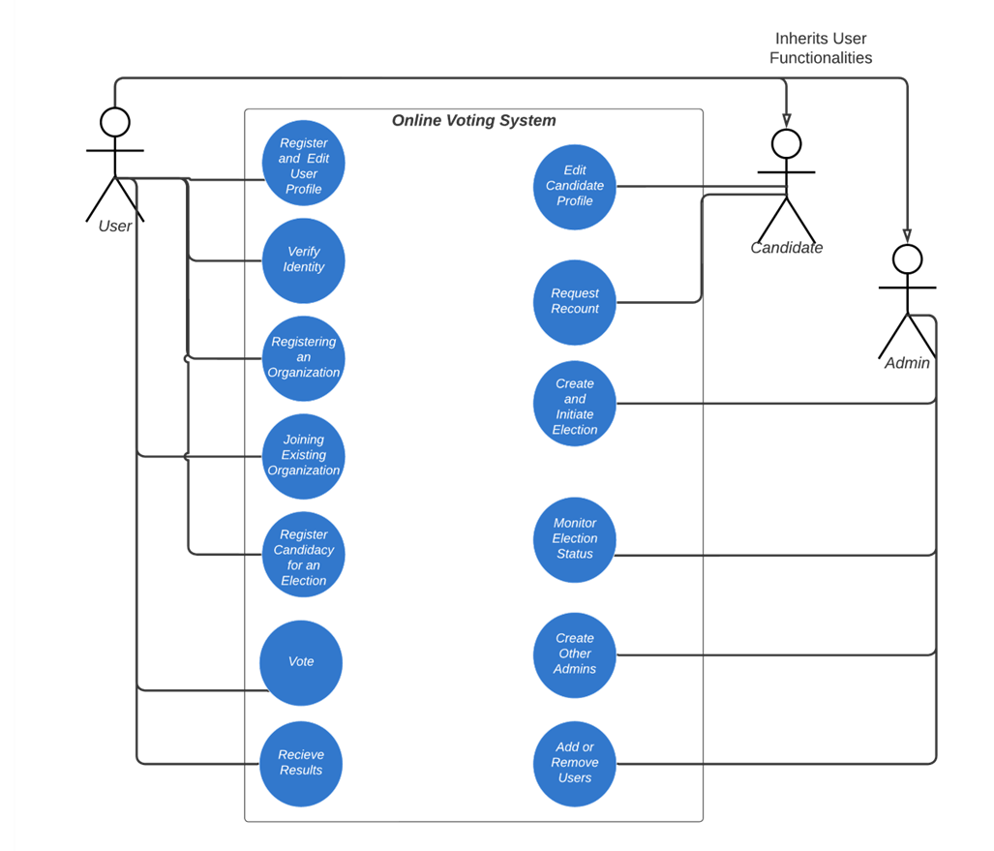
Use-Case Diagram

Slide 7
Entities and Relationships
User:
Registered individual in the system.
Interactions: Profile management, organization registration/joining.
Admin:
Defines elections.
Manages users and elections within an organization.
Voter:
A user with voting rights.
Primary Interaction: Casting votes.
Candidate:
Individuals running for election positions.
Interactions: Registering candidacy, monitoring election.
Election:
Electoral events managed by admins.
Organization:
Groups of users with shared goals.
Can host multiple voters, candidates, and admins.
Results:
Election outcomes.
Authentication:
User login credentials and process.

Slide 8
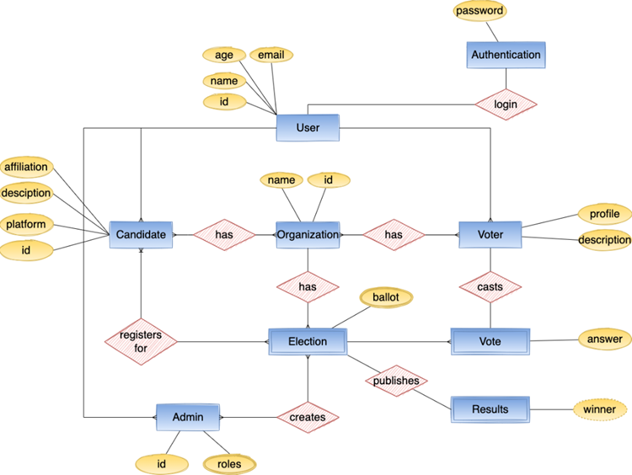
ER Diagram

Slide 9
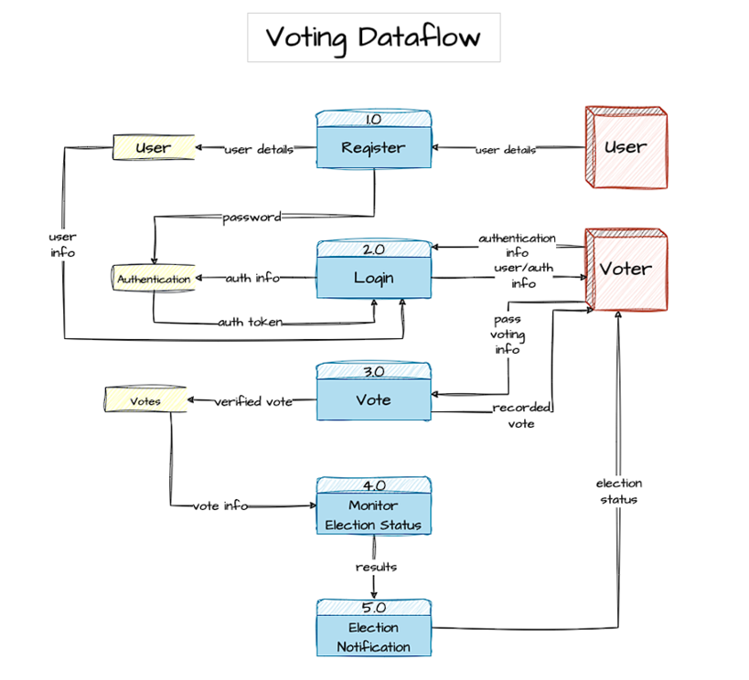
Data Flow Diagram 1

Slide 10
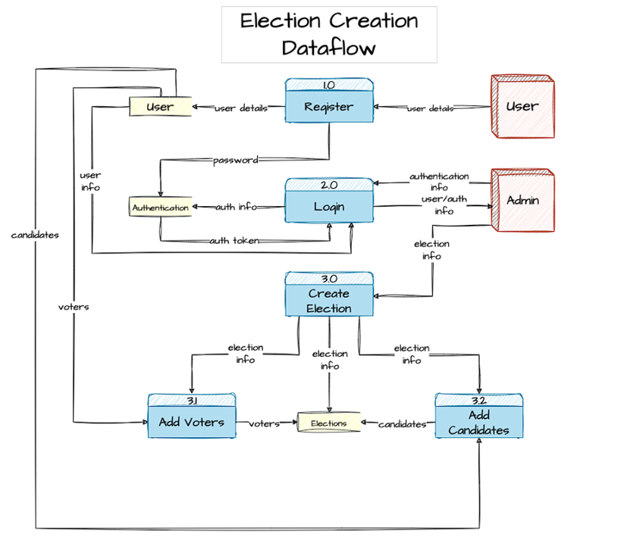
Data Flow Diagram 2

Slide 11
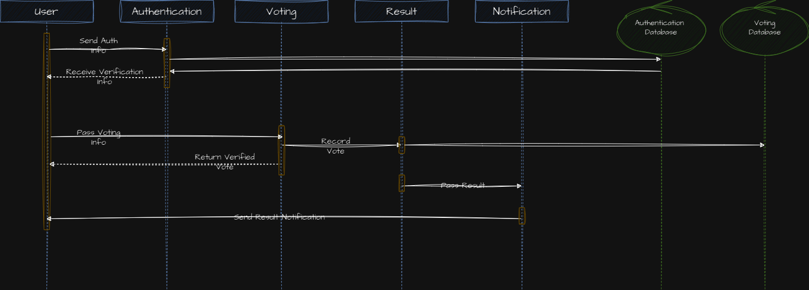
Voting Sequence Diagram

Slide 12
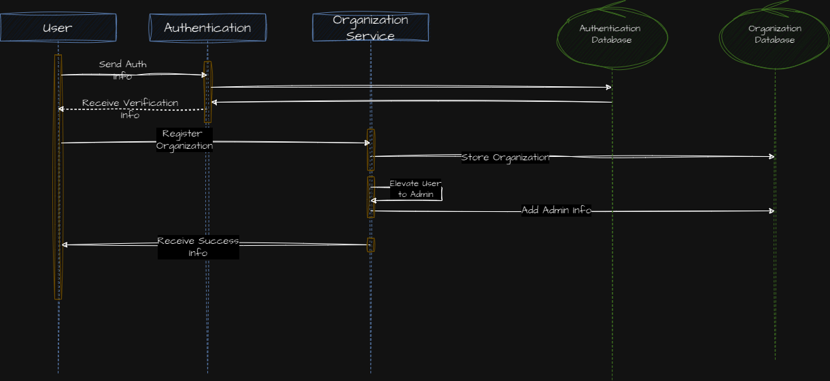
User Creating Organization Diagram

Slide 13
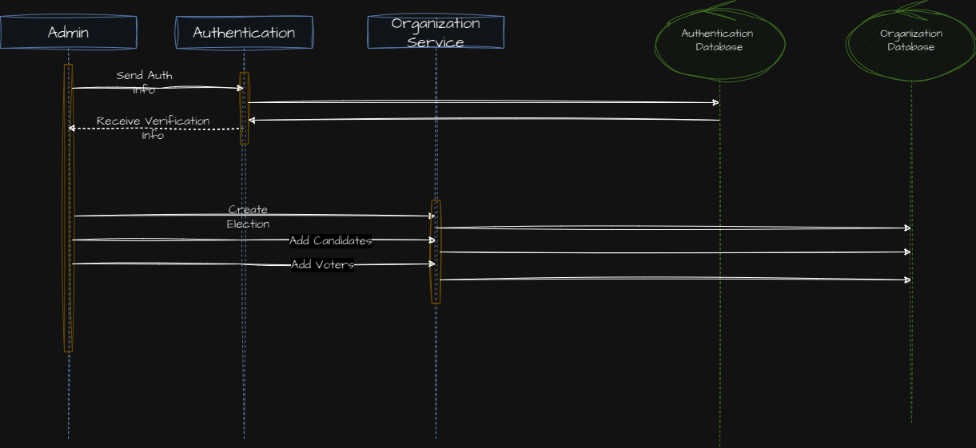
Admin Creating Election Diagram

Slide 14
Conclusion
Design Strengths:
Comprehensive coverage of the online voting system for non-official polls.
In-depth details of user roles and interactions, ensuring clarity of system operations.
Enhanced security measures such as multi-factor authentication and encryption to ensure data safety.
Design Discrepancies:
Moving Forward:
Regular review and iterations to continuously refine the architecture.
Utilize newly found resources to draw information from, such as Sweden and Estonia's online voting systems.
Maintain frequent communication with our teammates to coordinate better.
The transition from e-governance to inter-organizational voting is causing us to rework our concepts, designs, terminology, etc.
There should be a clearer distinction between 'User' and specific roles like 'Admin', 'Candidate', and 'Voter'.
Mixed abstraction levels in design documentation.

