Slide 1
Ranking Trend
Forecasting
of Songs on
Yuan Qu
Weiting Gao

Slide 2
1973, The Carpenters
Yesterday Once More
1992, Whitney Houston
I Will Always Love You
2004, Usher
Yeah!
2008, Beyoncé
If I Were A Boy
MUSIC
2011, Adele
Rolling In The Deep
2017, Ed Sheeran
Shape of You
2015, Bruno Mars
Uptown Funk

Slide 4
Data
Since 08/15/2009
Song ranking
Since 07/26/2014
Artist ranking
Hot 100
Artist 100
Raw Data
Billboard 200
Social 50
Album ranking
Since 08/15/2009
The most influential
50 artists in
social networking sites
Since 12/18/2010

Slide 5
Billboard 200
Ranking | Album | Last wk | Peak | Wks on rank | Artist | Date
1 | More Life | 1 | 1 | 2 | Drake | 4/15/2017
2 | Divide | 2 | 1 | 4 | Ed Sheeran | 4/15/2017
3 | Tremaine The Album | -- | 3 | 1 | Trey Songz | 4/15/2017
4 | Beauty And The Beast | 4 | 3 | 3 | Soundtrack | 4/15/2017
Artist 100
Ranking | Artist | Last wk | Peak | Wks on rank | Date
1 | Drake | 1 | 1 | 144 | 4/15/2017
2 | Ed Sheeran | 2 | 1 | 138 | 4/15/2017
3 | Bruno Mars | 3 | 1 | 132 | 4/15/2017
4 | The Chainsmokers | 6 | 1 | 70 | 4/15/2017

Slide 6
Hot 100
Ranking | Song | Last wk | Peak | Wks on rank | Artist | Date
1 | Shape of You | 1 | 1 | 12 | Ed Sheeran | 4/15/2017
2 | That's What I Like | 2 | 2 | 11 | Bruno Mars | 4/15/2017
3 | Something Just Like This | 7 | 3 | 6 | The Chainsmokers | 4/15/2017
4 | I Feel It Coming | 5 | 4 | 19 | The Weeknd | 4/15/2017
Social 50
Ranking | Artist | Last wk | Peak | Wks on rank | Date
1 | BTS | 1 | 2 | 25 | 4/15/2017
2 | Ariana Grande | 4 | 2 | 228 | 4/15/2017
3 | Justin Bieber | 2 | 1 | 332 | 4/15/2017
4 | Shawn Mendes | 5 | 2 | 119 | 4/15/2017

Slide 7
Problem Formulation
Classification problem:
Predict ranking goes up or down next week
Time series data:
Regard time points as instances
Regard time series relation as labels
Various charts:
Extract relation as attributes

Slide 8
Derivation
Time Series
Missing Value
Labels
Preprocessing
Peak
Feature Selection
Standardization

Slide 9
Derivation
Song | Ranking | Date
Closer | 5 | 2017/03/04
Closer | 5 | 2017/03/11
Closer | 10 | 2017/03/18
Closer | 10 | 2017/03/25
Closer | 13 | 2017/04/01
Closer | 17 | 2017/04/08
Closer | 20 | 2017/04/15
Closer | 21 | 2017/04/22
Closer | 23 | 2017/04/29
Ranking | Date
5 | 2017/03/11
10 | 2017/03/18
10 | 2017/03/25
13 | 2017/04/01
17 | 2017/04/08
20 | 2017/04/15
21 | 2017/04/22
23 | 2017/04/29
Unknown | 2017/05/06
Label
UP
DOWN
UP
DOWN
DOWN
DOWN
DOWN
DOWN
Unknown
DOWN: The ranking number is greater than last week
UP: The ranking number is less or equal to last week

Slide 10
Missing Labels
Null Value
Missing Value
Labels
Preprocessing
Peak
Feature Selection
Standardization

Slide 11
Missing Labels
Song | Ranking | Date
Closer | 5 | 2017/03/04
Closer | 5 | 2017/03/11
Closer | 10 | 2017/03/18
Closer | 10 | 2017/03/25
Closer | 13 | 2017/04/01
Closer | 17 | 2017/04/08
Closer | 20 | 2017/04/15
Closer | 21 | 2017/04/22
Closer | 23 | 2017/04/29
Label
UP
DOWN
UP
DOWN
DOWN
DOWN
DOWN
DOWN
Unknown
Delete
DOWN: The ranking number is greater than last week
UP: The ranking number is less or equal to last week

Slide 12
Null Value
Ranking | Song | Last wk | Wks on rank | Date
1 | Shape Of You | -- | 1 | 2017/01/28
1 | Shape Of You | 1 | 2 | 2017/02/04
2 | Humble | -- | 1 | 2017/04/22
The new songs have no last week data.
Ranking | Song | Last wk | Wks on rank | Artist Ranking | Album Ranking | Social Ranking | Date
1 | Shape Of You | 1 | 2 | 2 | 2 | 6 | 2017/04/15
2 | Humble | -- | 1 | -- | -- | -- | 2017/04/22
Some songs may not appear in other charts.

Slide 13

Ranking Score
Ranking Score $S=T+1−R$
Where $T$ is ceiling of ranking, $R$is ranking. Set null as 0.
Ranking | Song | Last wk | Wks on rank | Date
1 | Shape Of You | -- | 1 | 2017/01/28
1 | Shape Of You | 1 | 2 | 2017/02/04
2 | Humble | -- | 1 | 2017/04/22
Ranking Score | Song | Last wk Score | Wks on rank | Date
100 | Shape Of You | 0 | 1 | 2017/01/28
100 | Shape Of You | 100 | 2 | 2017/02/04
99 | Humble | 0 | 1 | 2017/04/22

Slide 14
Peak Position
Something Never Change
Missing Value
Labels
Preprocessing
Peak
Feature Selection
Standardization

Slide 15
Peak – Rank
Ranking Score | Song | Peak Position Score | Date
88 | Closer | 100 | 2017/04/01
84 | Closer | 100 | 2017/04/08
81 | Closer | 100 | 2017/04/15
80 | Closer | 100 | 2017/04/22
78 | Closer | 100 | 2017/04/29
Ranking Score | Song | Peak - Rank | Date
88 | Closer | 12 | 2017/04/01
84 | Closer | 16 | 2017/04/08
81 | Closer | 19 | 2017/04/15
80 | Closer | 20 | 2017/04/22
78 | Closer | 22 | 2017/04/29

Slide 16
Standardization
Missing Value
Labels
Preprocessing
Peak
Feature Selection
Standardization

Slide 17
Standardization
Ranking scores are in different scale
Ranking Score (1 – 100) | Artist Score (0 – 100) | Album Score (0 – 200) | Social Score (0 – 50)
88 | 80 | 192 | 45
84 | 54 | 180 | 12
81 | 40 | 40 | 0
Ranking Score (1 – 100) | Artist Score (0 – 100) | Album Score (0 – 100) | Social Score (0 – 100)
88 | 80 | 96 | 90
84 | 54 | 90 | 24
81 | 40 | 45 | 0

Slide 18
Feature Selection
Missing Value
Labels
Preprocessing
Peak
Feature Selection
Standardization

Slide 19
Feature Selection
Attribute Evaluator: InfoGainAttributeEval
Search Method: Ranker
Attribute | Average merit | Average rank
Weeks on rank | 0.067 + - 0.001 | 1 + - 0
Peak - rank | 0.031 + - 0.001 | 2 + - 0
Last week’s ranking | 0.015 + - 0.001 | 3 + - 0
Ranking | 0.009 + - 0.001 | 4 + - 0.4
Album | 0.006 + - 0.001 | 5.2 + - 0.4
Artist | 0.006 + - 0 | 5.8 + - 0.4
Social | 0.004 + - 0 | 7 + - 0

Slide 20
Training Data
Ranking: ranking score of the instance (song) on Hot 100
Last week ranking: ranking score of last week on Hot 100
Weeks on rank: total weeks on Hot 100
Peak - rank: peak position score minus the ranking score.
*Artist: artist ranking score on Artist 100
*Album: album ranking score on Billboard 200
*Social: ranking score on Social 50
Class: False – decrease, True – otherwise

Slide 21
Rank | Last wk | Wks on rank | Artist | Social | Album | Peak - rank | Class
100 | 100 | 11 | 99 | 90 | 99.5 | 0 | FALSE
99 | 99 | 10 | 98 | 58 | 97.5 | 0 | FASLE
98 | 97 | 15 | 0 | 0 | 0 | 1 | TRUE
TRUE (or +) | FALSE (or -)
47.20% | 52.80%
 | Minimum | Maximum | Mean | Standard Deviation
Last week | 0 | 100 | 48.278 | 31.024
Weeks on rank | 1 | 68 | 12.39 | 9.918
artist | 0 | 100 | 37.725 | 39.452
social | 0 | 100 | 13.078 | 29.152
album | 0 | 100 | 36.417 | 41.371
peak-rank | 0 | 99 | 19.263 | 18.427
Notes:
For last week’s rank, artist, social and album, if the value is equal to 0, it means it’s a missing value.
For artist, social and album, the standard deviation is larger than mean because there are too much value that are zero.
Peak-rank shows the gap between the present performance and best performance.

Slide 22
Classifier
kNN
Logistic Regression
Decision Tree
AdaBoost
Bagging
Random Forest
Rule-based classifier

Slide 23
kNN
Realized by R
10-folds cross validation
Compare with different feature selection
Use Minkowski Distance
Traversal all the possible k

Slide 24
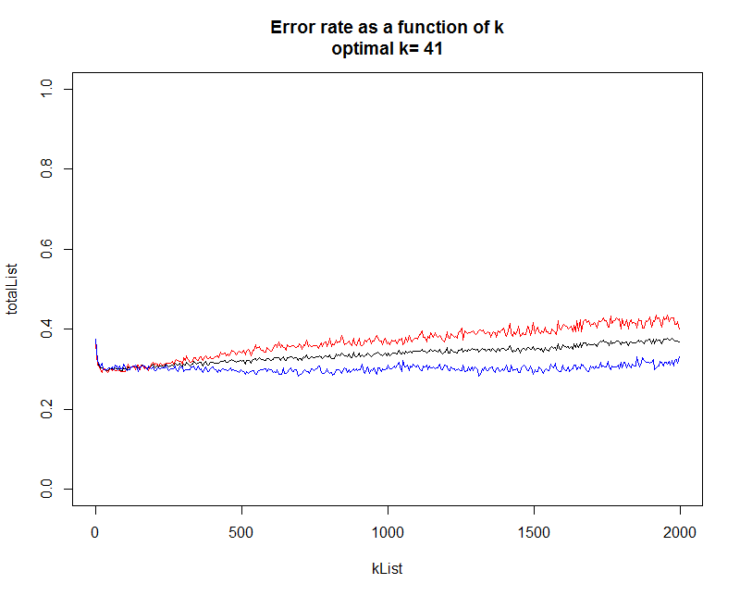
Negative data
Positive data
Total
All attributes in.
Optimal k = 41
Error rate: 0.2957

Slide 25
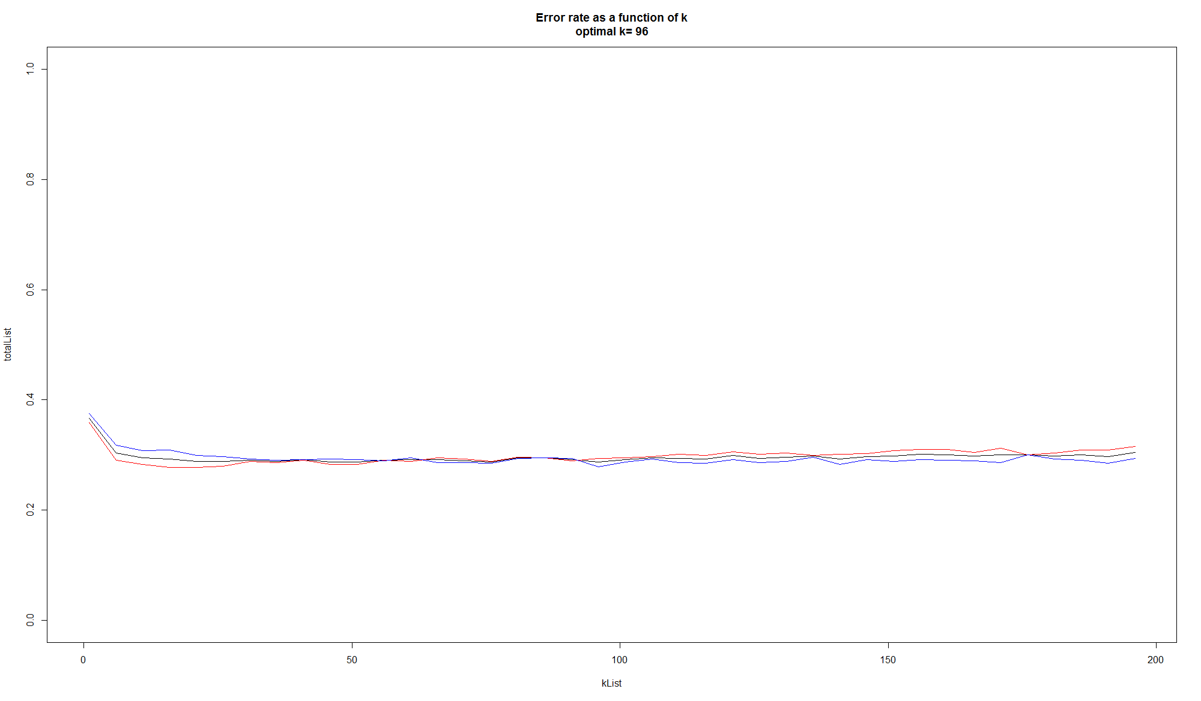
Negative data
Positive data
Total
Drop 3 features.
Optimal k = 96
Error rate: 0.2868
All attributes in.
Optimal k = 41
Error rate: 0.2957
<

Slide 26
Decision Tree
Realized by Weka
Use J48 Method
10-folds cross validation
Compare with different feature selection
Traversal different parameters

Slide 27
Ordered by the minimum number of instances per leaf
 | 5 |  | 10 |  | 20 |  | 50 |  | 60
Attributes | 7 | 4 | 7 | 4 | 7 | 4 | 7 | 4 | 7 | 4
TP Rate | 0.706 | 0.699 | 0.706 | 0.701 | 0.706 | 0.701 | 0.705 | 0.705 | 0.703 | 0.704
Precision | 0.706 | 0.699 | 0.706 | 0.701 | 0.706 | 0.701 | 0.705 | 0.705 | 0.703 | 0.704
F-Measure | 0.706 | 0.699 | 0.706 | 0.701 | 0.706 | 0.701 | 0.705 | 0.705 | 0.703 | 0.704
 | 80 |  | 100 |  | 200 |  | 500 |  | 1000 |  | 2000
Attributes | 7 | 4 | 7 | 4 | 7 | 4 | 7 | 4 | 7 | 4 | 7 | 4
TP Rate | 0.699 | 0.703 | 0.700 | 0.698 | 0.695 | 0.691 | 0.683 | 0.676 | 0.674 | 0.675 | 0.661 | 0.661
Precision | 0.699 | 0.703 | 0.700 | 0.698 | 0.696 | 0.692 | 0.682 | 0.677 | 0.677 | 0.675 | 0.611 | 0.661
F-Measure | 0.699 | 0.703 | 0.700 | 0.698 | 0.695 | 0.692 | 0.682 | 0.676 | 0.674 | 0.675 | 0.611 | 0.661

Slide 28
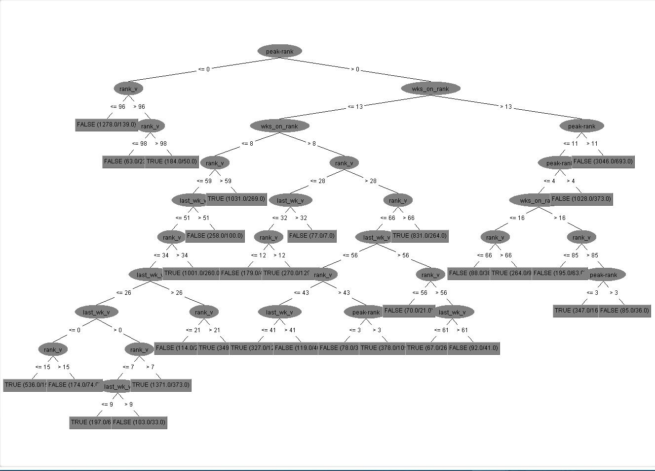
Peak-rank
rank
Wks on rank
rank
Wks on rank
Peak-rank
rank
rank
Peak-rank

Slide 29
Rule-based Classifier
Realized by Weka
Use JRip Method
10-folds cross validation
Compare with different feature selection
Traversal different parameters

Slide 30
Ordered by the minimum total weight of the instances in a rule.
 | 5 |  | 10 |  | 20 |  | 50 |  | 60
Attributes | 7 | 4 | 7 | 4 | 7 | 4 | 7 | 4 | 7 | 4
TP Rate | 0.707 | 0.707 | 0.707 | 0.709 | 0.706 | 0.709 | 0.706 | 0.705 | 0.707 | 0.706
Precision | 0.707 | 0.707 | 0.706 | 0.709 | 0.706 | 0.709 | 0.706 | 0.705 | 0.707 | 0.706
F-Measure | 0.707 | 0.707 | 0.706 | 0.709 | 0.706 | 0.708 | 0.706 | 0.705 | 0.707 | 0.706
 | 80 |  | 100 |  | 200 |  | 500 |  | 1000 |  | 2000
Attributes | 7 | 4 | 7 | 4 | 7 | 4 | 7 | 4 | 7 | 4 | 7 | 4
TP Rate | 0.702 | 0.709 | 0.702 | 0.710 | 0.696 | 0.696 | 0.686 | 0.686 | 0.681 | 0.675 | 0.674 | 0.673
Precision | 0.702 | 0.709 | 0.702 | 0.710 | 0.696 | 0.696 | 0.685 | 0.686 | 0.681 | 0.676 | 0.675 | 0.674
F-Measure | 0.702 | 0.709 | 0.702 | 0.710 | 0.696 | 0.696 | 0.686 | 0.686 | 0.681 | 0.675 | 0.674 | 0.673

Slide 31
Random Forest
Realized by Weka
10-folds cross validation
Ordered by size of each bag
0.725
0.722

Slide 32
Logistic Regression
Realized by Weka
10-folds cross validation
Attributes | 7 | 4
TP Rate | 0.651 | 0.643
Precision | 0.651 | 0.643
F-Measure | 0.650 | 0.642

Slide 33
AdaBoost
Realized by Weka
10-folds cross validation
 | Decision tree |  | K-NN |  | Logistic regression |  | Rule based
Attributes | 7 | 4 | 7 | 4 | 7 | 4 | 7 | 4
TP Rate | 0.709 | 0.706 | 0.698 | 0.714 | 0.651 | 0.643 | 0.712 | 0.712
Precision | 0.709 | 0.706 | 0.698 | 0.715 | 0.651 | 0.643 | 0.712 | 0.712
F-Measure | 0.709 | 0.706 | 0.698 | 0.715 | 0.650 | 0.642 | 0.712 | 0.712

Slide 34
Bagging
Realized by Weka
10-folds cross validation
 | Decision tree |  | K-NN |  | Logistic regression |  | Rule based
Attributes | 7 | 4 | 7 | 4 | 7 | 4 | 7 | 4
TP Rate | 0.715 | 0.706 | 0.697 | 0.715 | 0.652 | 0.643 | 0.717 | 0.720
Precision | 0.716 | 0.706 | 0.697 | 0.715 | 0.652 | 0.643 | 0.717 | 0.720
F-Measure | 0.716 | 0.706 | 0.697 | 0.715 | 0.651 | 0.643 | 0.716 | 0.719

Slide 35
Comparison & Analysis
Method | kNN |  | Decision Tree |  | Rule based |  | Random Forest |  | Logistic Regression |  | AdaBoost |  | Bagging
Attributes | 7 | 4 | 7 | 4 | 7 | 4 | 7 | 4 | 7 | 4 | 7 | 4 | 7 | 4
TP Rate | 0.698 | 0.714 | 0.706 | 0.705 | 0.707 | 0.710 | 0.725 | 0.722 | 0.651 | 0.643 | 0.712 | 0.714 | 0.717 | 0.720
Precision | 0.698 | 0.715 | 0.706 | 0.705 | 0.707 | 0.710 | 0.725 | 0.722 | 0.651 | 0.643 | 0.712 | 0.715 | 0.717 | 0.720
F-Measure | 0.698 | 0.715 | 0.706 | 0.705 | 0.707 | 0.710 | 0.725 | 0.722 | 0.650 | 0.642 | 0.712 | 0.715 | 0.716 | 0.719
Error rate: 27.5%
Feature selection
Linear non-separable
Time complexity

Slide 36
Conclusion
152,050 records from Billboard
14,200 songs training data
7 data mining classifiers
72.5% Accuracy
And 1 advice for music industry:
When to strengthen the media campaign?

Slide 37
Ranking Trend
Forecasting
of Songs on
Thank You!
Yuan Qu
Weiting Gao

