Slide 1
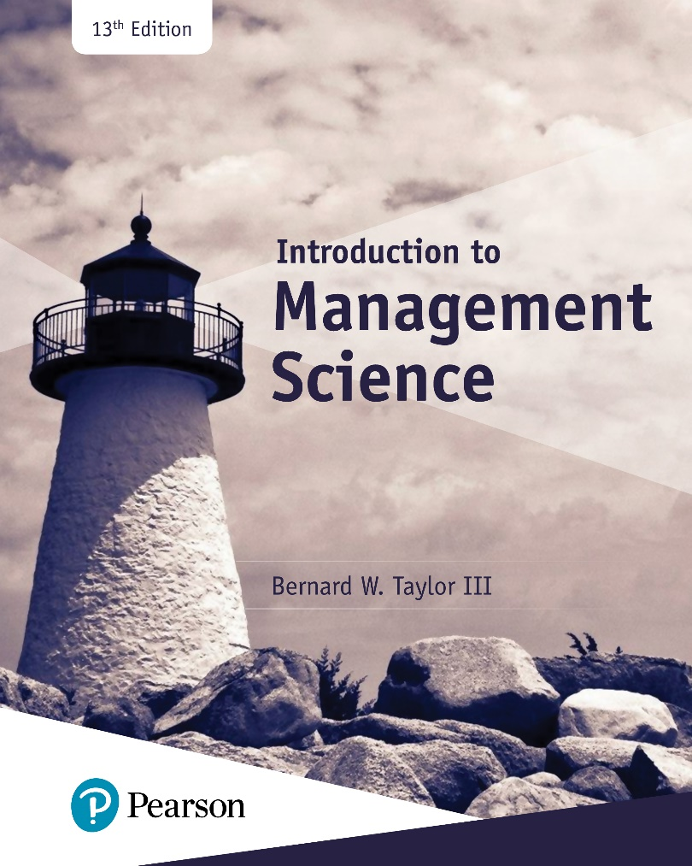
Introduction to Management Science
Thirteenth Edition
Chapter 1
Management Science
Copyright © 2019, 2016, 2013 Pearson Education, Inc. All Rights Reserved
Notes:
If this PowerPoint presentation contains mathematical equations, you may need to check that your computer has the following installed:
1) MathType Plugin
2) Math Player (free versions available)
3) NVDA Reader (free versions available)

Slide 2
Learning Objectives
1.1 The Management Science Approach to Problem Solving
1.2 Management Science and Business Analytics
1.3 Model Building: Break-Even Analysis
1.4 Computer Solution
1.5 Management Science Modeling Techniques
1.6 Business Usage of Management Science Techniques
1.7 Management Science Models in Decision Support Systems

Slide 3
Learning Objective 1.1
The Management Science Approach to Problem Solving

Slide 4
The Management Science Approach
Management science is a scientific approach to solving management problems.
It is used in a variety of organizations to solve many different types of problems.
It encompasses a logical mathematical approach to problem solving.
Management science, also known as operations research, quantitative methods, business analytics, etc., involves a philosophy of problem solving in a logical manner.

Slide 5
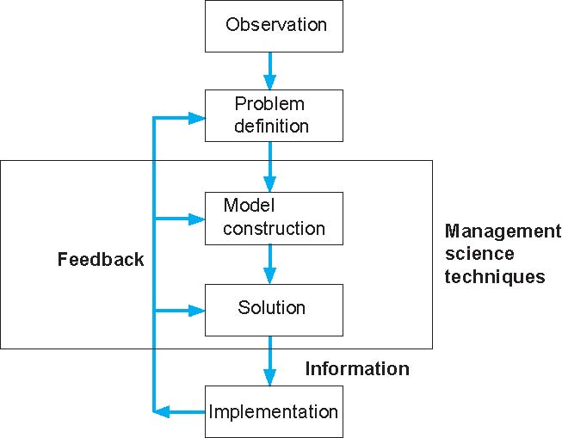
Figure 1.1 The Management Science Process

Slide 6
Steps in the Management Science Process
Observation - Identification of a problem that exists (or may occur soon) in a system or organization.
Problem Definition - The problem must be clearly and consistently defined, showing its boundaries and interactions with the objectives of the organization.
Model Construction - Development of the functional mathematical relationships that describe the decision variables, objective function and constraints of the problem.
Model Solution - The model is solved using management science techniques.
Model Implementation - Actual use of the model or its solution.

Slide 7
Example of Model Construction (1 of 3)
Information and Data:
Business firm makes and sells a steel product
Product costs $5 to produce
Product sells for $20
Product requires 4 pounds of steel to make
Firm has 100 pounds of steel
Business Problem:
Determine the number of units to produce to make the most profit, given the limited amount of steel available.

Slide 8
Example of Model Construction (2 of 3)
Variables: x = # units to produce (decision variable)
Z = total profit (in $)
Model: Z = $20x − $5x (objective function)
4x = 100 lb of steel (resource constraint)
Parameters: $20, $5, 4 lbs, 100 lbs (known values)
Formal Specification of Model:
maximize Z = $20x − $5x
subject to 4x <= 100

Slide 9
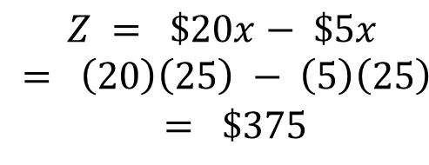
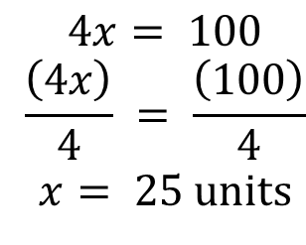
Example of Model Construction (3 of 3)
Model Solution:
Solve the constraint equation:
$$\begin{matrix} 4x= 100 \\ \frac{\left(4x\right)}{4} = \frac{\left(100\right)}{4} \\ x= 25 units\end{matrix}$$
Substitute this value into the profit function:
$$\begin{matrix}Z = \$20x− \$5x \\ = \left(20\right)\left(25\right) − \left(5\right)\left(25\right) \\ = \$375\end{matrix}$$
(Produce 25 units, to yield a profit of $375)

Slide 10
Learning Objective 1.2
Management Science and Business Analytics

Slide 11
Management Science and Business Analytics
Business analytics uses large amounts of data with management science techniques to help managers make decisions
Brings together information technology, statistics, management science, computer science, engineering, and data science
Big data

Slide 12
Developing Analytical Career Skills
Critical thinking – purposeful and goal-oriented problem definition and solution
Collaborating – necessary in a project team-based environment
Information Technology & Computing – reliance on computer software
Data Literacy – ability to access, interpret, manipulate, communicate and summarize data

Slide 13
Learning Objective 1.3
Model Building: Break-Even Analysis

Slide 14
Break-Even Analysis (1 of 9)
Used to determine the number of units of a product to sell or produce that will equate total revenue with total cost.
The volume at which total revenue equals total cost is called the break-even point.
Profit at break-even point is zero.

Slide 15
Break-Even Analysis (2 of 9)
Model Components
Fixed Cost (c_{f}) - costs that are independent of the number of units produced and remain constant.
Variable Cost (c_{v}) - unit production cost of product.
Volume (v) - the number of units produced or sold
Total variable cost (v c_{v}) - function of volume (v) and unit variable cost.

Slide 16
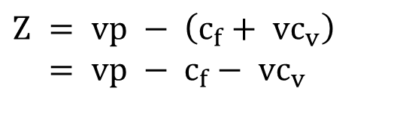

Break-Even Analysis (3 of 9)
Total Cost (T C) - total fixed cost plus total variable cost.
$$TC=c_{f}+vc_{v}$$
Profit (Z) - difference between total revenue v p (p = unit price) and total cost, i.e.
$$Z = vp − \left(c_{f}+ vc_{v}\right) \\ = vp − c_{f}− vc_{v}$$

Slide 17
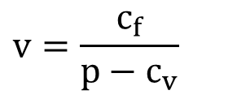
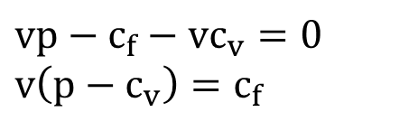
Break-Even Analysis (4 of 9)
Computing the Break-Even Point
The break-even point is the volume at which total revenue equals total cost and profit is zero:
$$vp−c_{f}−vc_{v}=0 \\ v\left(p−c_{v}\right)=c_{f}$$
The break-even point
$$v=\frac{c_{f}}{p−c_{v}}$$

Slide 18
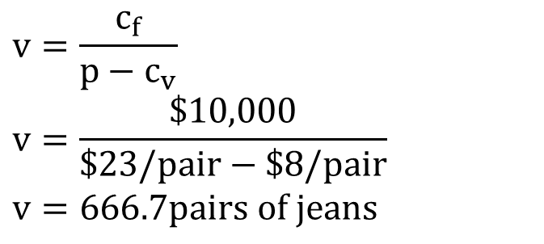
Break-Even Analysis (5 of 9)
Example: Western Clothing Company
Fixed Costs: | c_{f} = $10,000
Variable Costs: | c_{v} = $8 per pair
Price: | p = $23 per pair
The Break-Even Point is:
$$v=\frac{c_{f}}{p−c_{v}} \\ v=\frac{\$10,000}{\$23/pair−\$8/pair} \\ v=666.7pairs of jeans$$

Slide 19
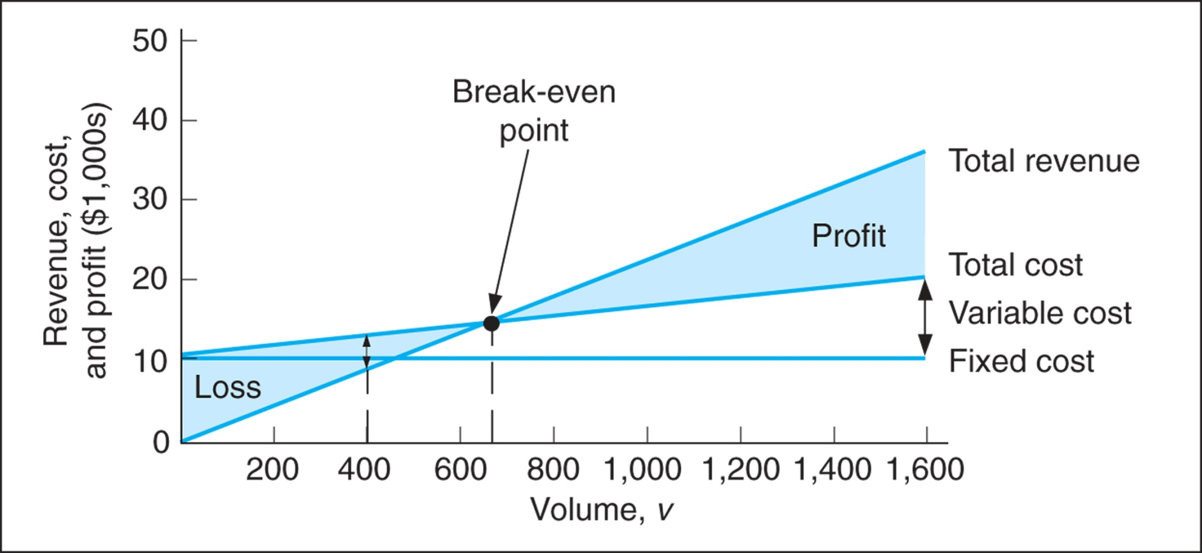
Break-Even Analysis (6 of 9)
Figure 1.2 Break-even model

Slide 20
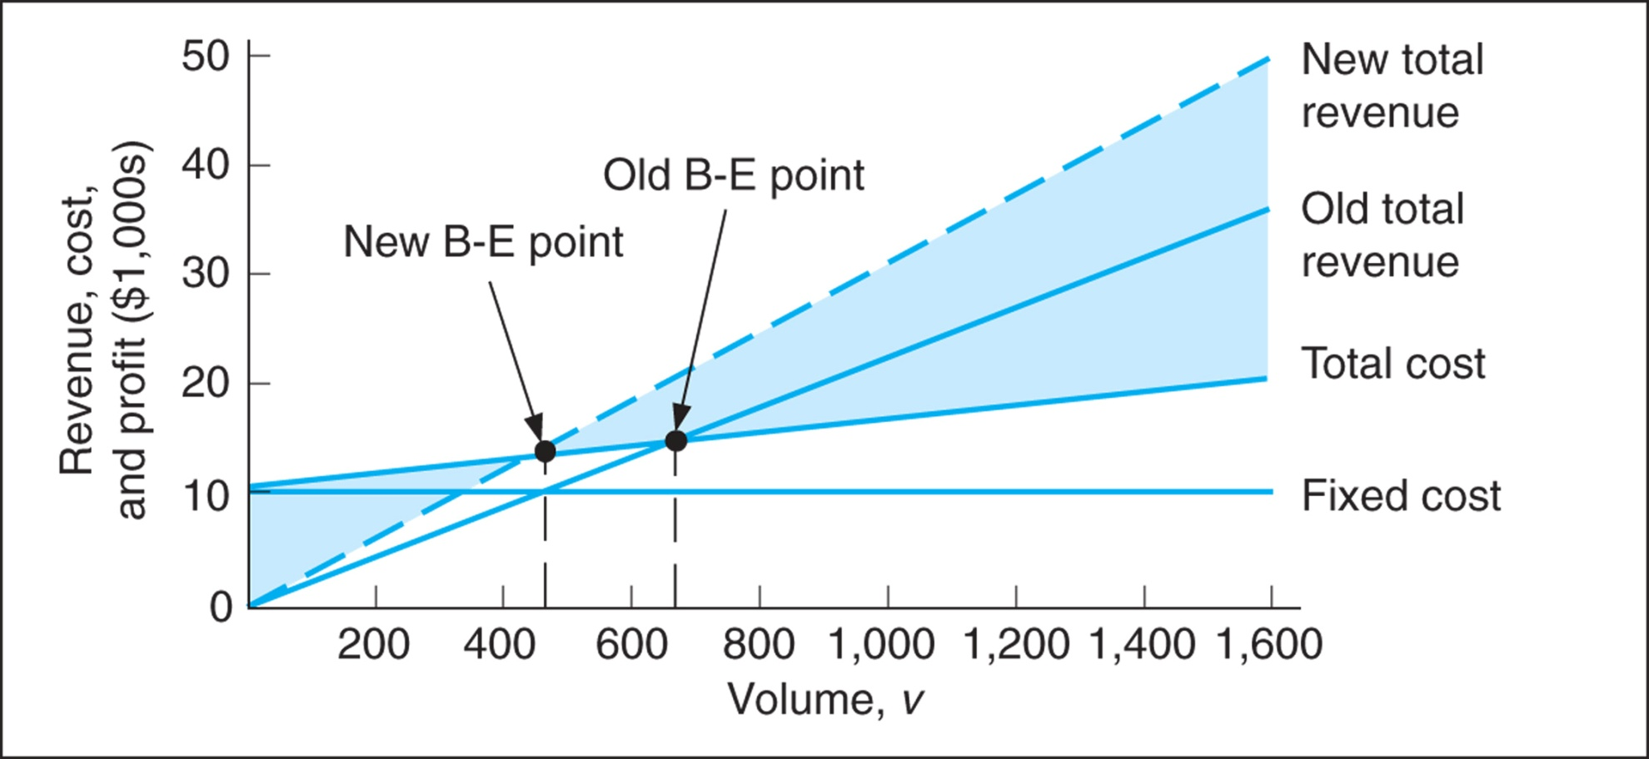
Break-Even Analysis (7 of 9)
Figure 1.3 Break-even model with an increase in price

Slide 21
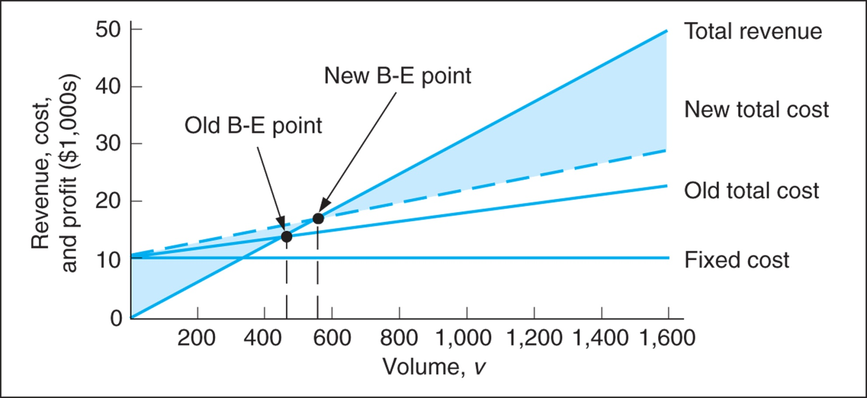
Break-Even Analysis (8 of 9)
Figure 1.4 Break-even model with an increase in variable cost

Slide 22
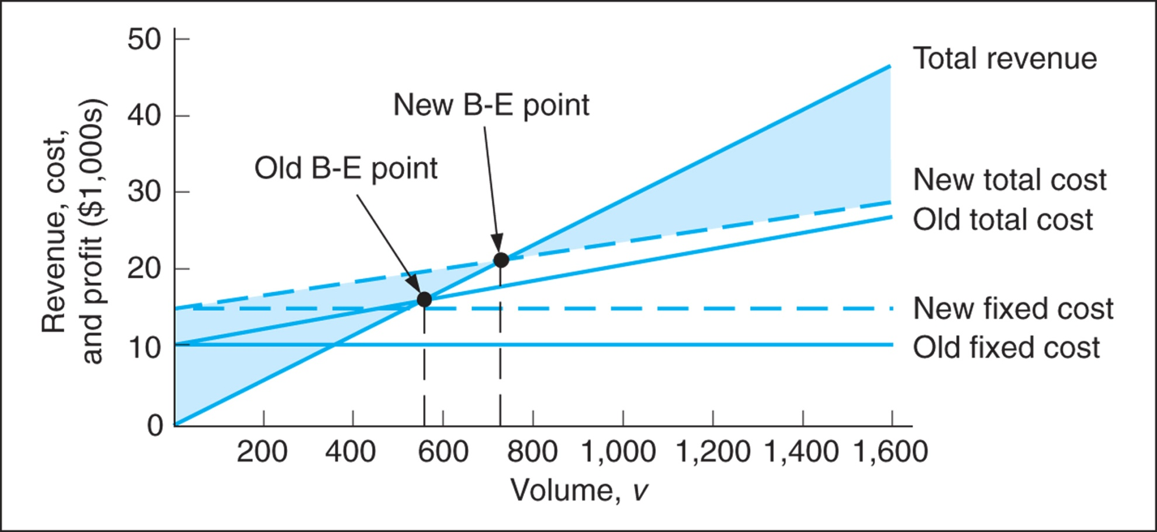
Break-Even Analysis (9 of 9)
Figure 1.5 Break-even model with a change in fixed cost

Slide 23
Learning Objective 1.4
Computer Solution

Slide 24
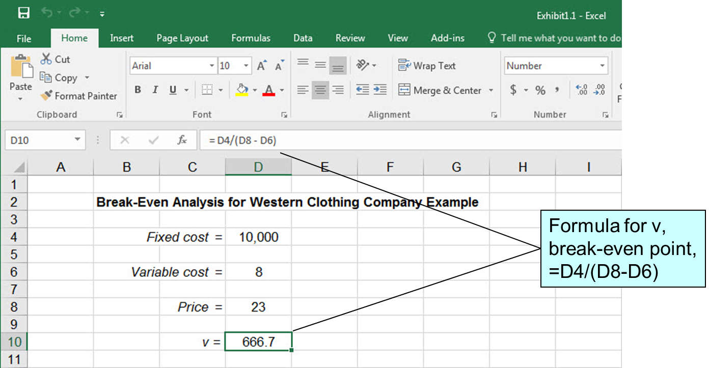
Break-Even Analysis: Excel Solution
Exhibit 1.1

Slide 25
Learning Objective 1.6
Business Usage of Management Science Techniques

Slide 26
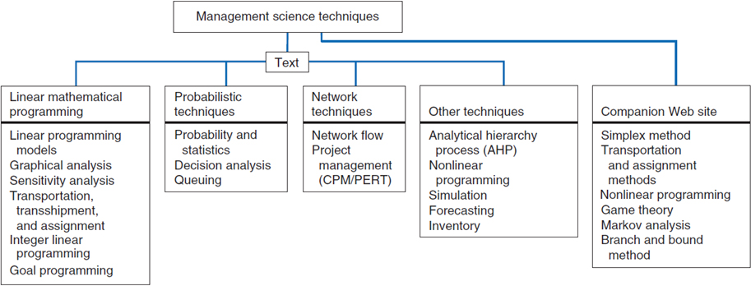
Figure 1.6 Classification of Management Science Techniques

Slide 27
Management Science Modeling Techniques: Characteristics of Modeling Techniques
Linear Mathematical Programming - clear objective; restrictions on resources and requirements; parameters known with certainty. (Chapter 2-6, 9)
Probabilistic Techniques - results contain uncertainty. (Chapter 11-13)
Network Techniques - model often formulated as diagram; deterministic or probabilistic. (Chapter 7-8)
Other Techniques - variety of deterministic and probabilistic methods for specific types of problems including forecasting, inventory, simulation, multicriteria, A H P (analytic hierarchy process), etc. (Chapter 9, 14-16)

Slide 28
Business Usage of Management Science
Some application areas:
Project Planning
Capital Budgeting
Inventory Analysis
Production Planning
Scheduling, and many others
Interfaces - Applications journal published by Institute for Operations Research and Management Sciences (I N F O R M S)

Slide 29
Learning Objective 1.7
Management Science Models in Decision Support Systems

Slide 30
Management Science Models in Decision Support Systems (D S S) (1 of 2)
A decision support system is a computer-based information system that a manager can use to assist in a support decision making.
Features of Decision Support Systems
Interactive
Uses databases & management science models
Address “what if” questions
Perform sensitivity analysis
Increasingly used over the Internet
Examples include:
E R P – Enterprise Resource Planning
O L A P – Online Analytical Processing

Slide 31
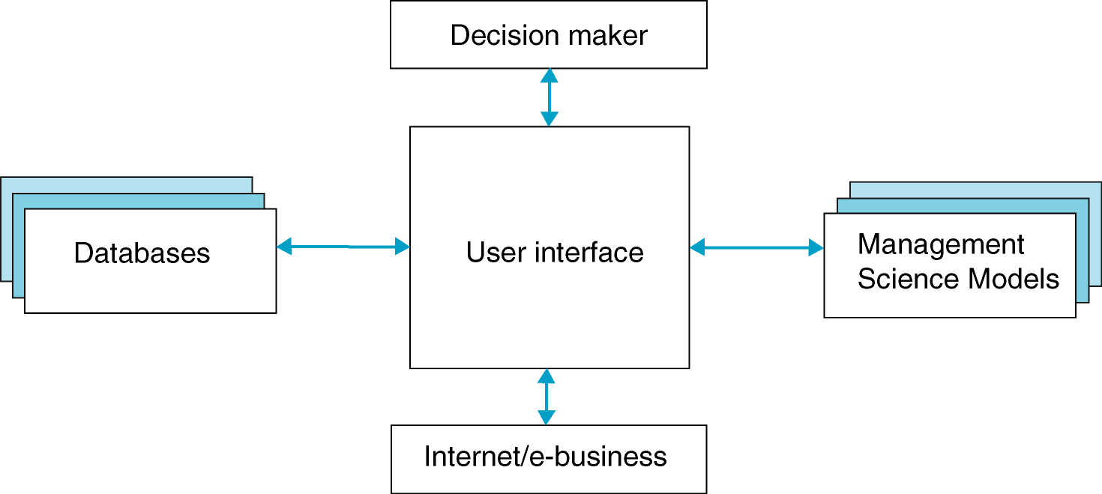
Management Science Models in Decision Support Systems (D S S) (2 of 2)
Figure 1.7 A decision support system

