Slide 1
Around-The-Pipe Audio Based Water Tracker For Home Residents
Ryan Rana
Project Number - 060

Slide 2
Water Waste is Excessive.
900 Billion
6.3 Thousand
1 Trillion
Gallons wasted per year during Leaks in US
Gallons wasted unknowingly per person monthly in US
Dollars wasted per year in US

Slide 3
Hypothesis
If devices exist that utilize machine learning models to measure water flow through household pipes, then homeowners will be able to save money on their water bill and become more concerned with their environmental impact.

Slide 4


Concept
A device strapped around a water pipe with a microcomputing chip which will be connected to a microphone via usb to measure the decibel range of sound created when water flows through and will use supervised ML models to estimate the water flow quantity.
Pipe
Device

Slide 5
Experimental Procedure
Build Device using the Hardware Materials
Split Data into training and testings sets
Optimize Model by tuning the hyperparameters.
1
3
5
2
4
6
Collect Data by Running Water through pipe and display on display, then adding it to a CSV file.
Train and Test Data on Different Models
Analyze Results and choose the highest performing model.
‹#›

Slide 6
Materials
Hardware
Micro Computing Chip (MCC) - To record all data and test and train the ML models whilst connected to a microphone. For Prototype Purpose this is a Raspberry Pi.
Microphone - Connected to MCC and used to record decibel range of water flowing through.
7” LED Screen - Relay Decibel Range Readings during Data Collection Phase.
Water Pipes - To actually test and design project
Velcro Adjustable Strap - To secure fit the prototype around various types of pipes.
Software
Jupyter Notebook - The editor where the ML models will be tested
CSV - File Type to store data
Scikit-Learn: library with all the packages for ML Models.
‹#›

Slide 7
Data Collection
Collected by running different amounts of water (full valve, half valve, quarter valve, eight valve) through 7 household pipes(to eliminate data bias) and recording decibel range (max sound - min sound) as shown on raspberry pi monitor. Both inputs and outputs are put into a csv, as shown in the sample. Over 100 attempts were recorded.
Water Flow(X) | Decibel Range (Y)
Full | ###
Half | ###
Quarter | ###

Slide 8
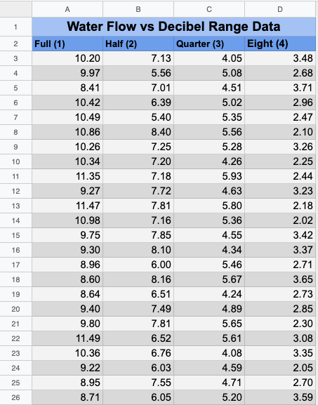
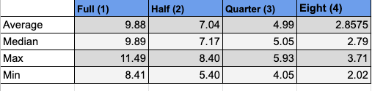
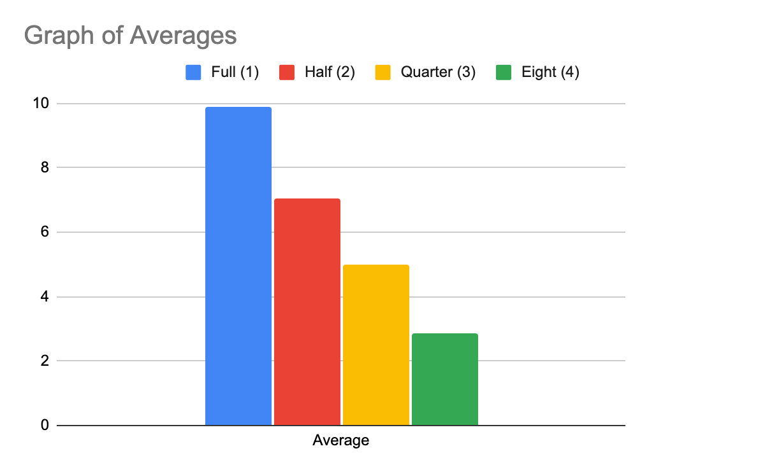
Data
‹#›

Slide 9
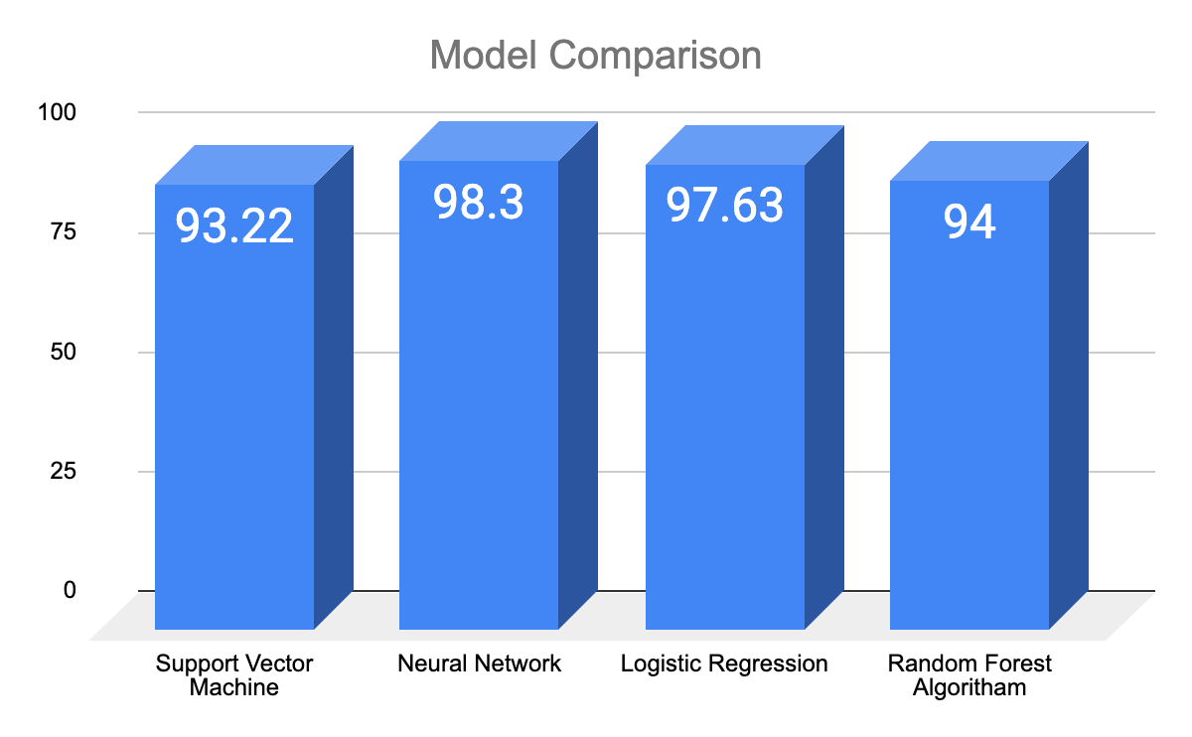
Model Comparison
All models were built and tested here are the following results of accuracies. Multiple models were created in order to find the best possible model.
All models had an accuracy between 93.22% to 98.3%.
Neural Network had the best accuracy at 98.3%.
The Average of all Models is 97.79
‹#›

Slide 10
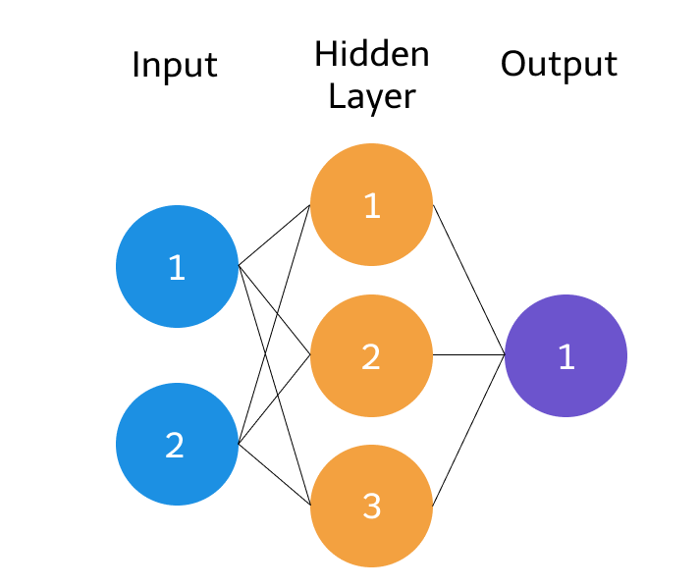
How Neural Network Works
Neural Networks are based off the way that brains process information. In a brain there are over a 100 billion neurons and they are connected by a series of synapses that are used to process information. Similarly, in a machine learning neural network, artificial neurons are used to precisely spit out an output.
The circles represent neurons while the lines represent synapses. The role of a synapse is to multiply the inputs and weights. You can think of weights as the “strength” of the connection between neurons. Weights primarily define the output of a neural network. However, they are highly flexible. After, an activation function is applied to return an output.
Each synapse has a weight and each neuron has a bias and activation function, which determines whether the neuron will be activated

Slide 11
How Neural Network Works
Parameters fined tuned for better accuracy: cost function, hidden layer layout, and type of activation function were fine tuned in the process.
After fine tuning the model:
Best cost function: Cross entropy
Best activation function: Sigmoid function
Best hidden layer layout: Two layer with four hidden nodes
Forward propagation
Backward propagation
Fine tune
Initially all weights are assigned random values and the final output is calculated in the forward propagation process.
In backward propagation, the weights and biases are modified to minimize the cost function for each neuron and create the optimal neural network.
Multiple hyperparameters are modified to optimize the accuracy of the neural network and training is repeated.

Slide 12
How Neural Network Works
Equation of a Neural Network:
Gradient Descent: Loss Function to calculate error and shift weights
Z = B + W1X1 + W2X2 + …+ WnXn
Z is the representation of the Neural Network
W is the weights
X is the inputs
B is the bias
C is the Cost value
A is the final output
Y is the desired output
N is number of independent variable
X is the sum of input attributes.

Slide 13
Conclusion
A low-cost device can track water flow through pipes without interfering with pipes at a 98.3% accuracy using Neural Networks.
This is better than traditional methods because
It does not interfere with pipes
It is cheap
It has an easy setup
The accuracy is near 100%
The algorithm can always be improved and changed
It has possibility for future expansion
The data is easily obtainable and expandable.
This will allow homeowners to track their water usage in order to save money and analyze there environmental impact.

Slide 14
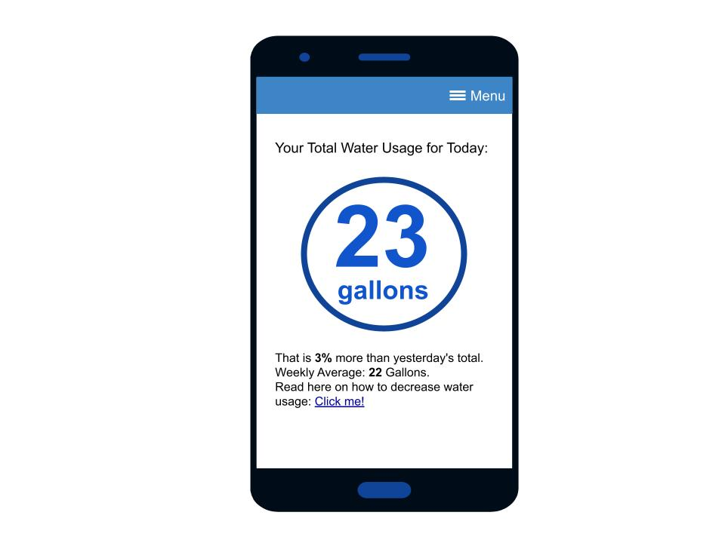
Future Expansion
Develop an user app to connect to device to monitor water from mobile phone
Add extra data to detect possible flooding based on water amount
Add Features for better accuracy
Pipe Size
Age of Pipe
Material of Pipe
Water Pressure
Identify what type of household tools are used (showerhead, bathtub, hose, etc.)
Possible App Design

Slide 15
Abstract
Water is one of the most necessary resources within an average household that cannot be quantitatively tracked on a regular basis. There are no methods to this without interfering with the pipeline and flow of water itself. This research presents a revolutionary approach that utilizes audio to measure the amount of water going through a household pipe at any given time with supervised machine learning models. First, different amounts of water were run throughout residential homes with a microphone mounted around the pipe. The output of the microphone is converted into a series of vibrations measured in decibels. The microphone was tested on seven different pipes in 7 different homes to decrease the data bias. It outputs the string of decibel values with a micro-computing device connected to it. The amount of water and received audio is documented into a CSV file with over 100 data points. The data was imported into the Jupyter Notebook and the features (water amount, range of decibels) were scaled and the dataset was split into training and testing subsets at a 70/30 ratio in order to assess the model’s accuracy. Neural Networks, Random Forest, Support Vector Machine, and Logistic Regression were the five models being used. After all the models were trained and edited to improve hyperparameters, they were compared by testing the data, Neural Networks ended up with the highest classification accuracy at 98.3% as reported testing data.

