Slide 1
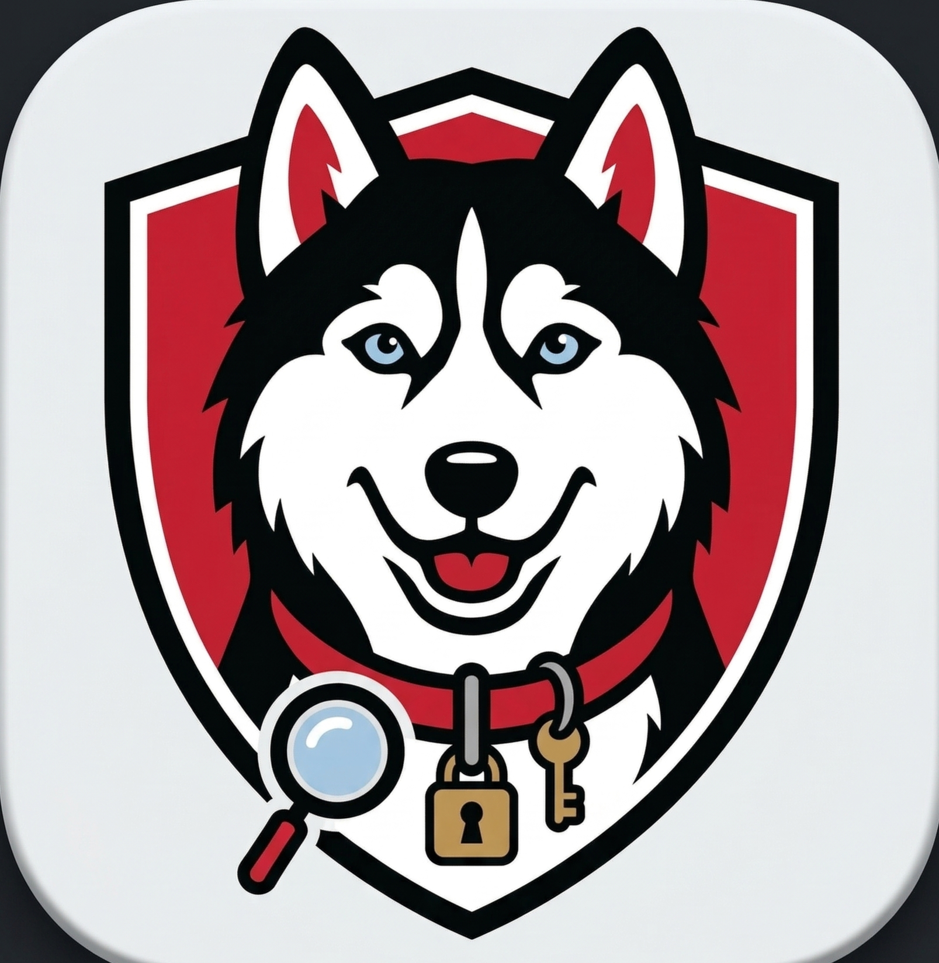
Lost & Hound
SGA Campus Services Committee Overview
For Grace — Incoming Director, Campus Services Committee

Slide 2
How to Access Lost & Hound
1
Visit the Website
Go to thelostandhound.com to see the landing page and learn about the platform.
2
Try the Preview Demo
Click "Preview Demo" on the site to explore the app with sample data — no account needed.
3
Sign Up (NEU Email)
If you have a Northeastern email, sign up to access the real site with live student posts.
Why do we require NEU email + Duo authentication?
Email confirmation verifies the user is a real Northeastern student. Duo authentication adds a second layer of identity verification. Together, these ensure only NEU students can post and message — and if a stolen item is reported, we can identify the responsible party through their verified university identity.

Slide 3
Now on the App Store
Lost & Hound is available as a native iOS app — download it directly from the Apple App Store.
[ App Store Screenshot ]

Slide 4
Moderation Dashboard
[ Moderation Dashboard Screenshot ]
A dedicated tool for the moderation team to keep the platform safe and organized.
Review flagged posts & user reports
Handle stolen item disputes
Track bugs, feedback & support tickets
Real-time updates — no refresh needed

Slide 5
Live Finance Page
[ Finance Page Screenshot ]
Tracks all infrastructure costs in real time so we know exactly what the platform costs to run.
Railway, Supabase, Google APIs, OneSignal
Monthly cost breakdown per service
Billing cycles & plan tiers
API usage tracking & projections

Slide 6
Platform Statistics
[ Statistics Page Screenshot ]
Live Numbers
___
Current Posts
___
Registered Users
___
Resolved Posts
Fill in the numbers above before presenting — pull them from the live Stats page!

