Slide 1
Data Processing and Visualization Pipeline
Ryan Schlenz
Github Repository

Slide 2
Overview
Objective:
Demonstrate a Python-based pipeline to:
Load demographic data from an XML file.
Clean and validate the data.
Generate a summary report (JSON).
Create a visualization (bar chart).

Slide 3
Workflow
Steps in the Pipeline:
Load raw XML data.
Clean the data (calculate ages, remove invalid records).
Generate a summary report of adults and children by city.
Visualize insights with a bar chart (average age by city).
Workflow Diagram:
Input XML → Clean Data → JSON Report → Chart Visualization

Slide 4
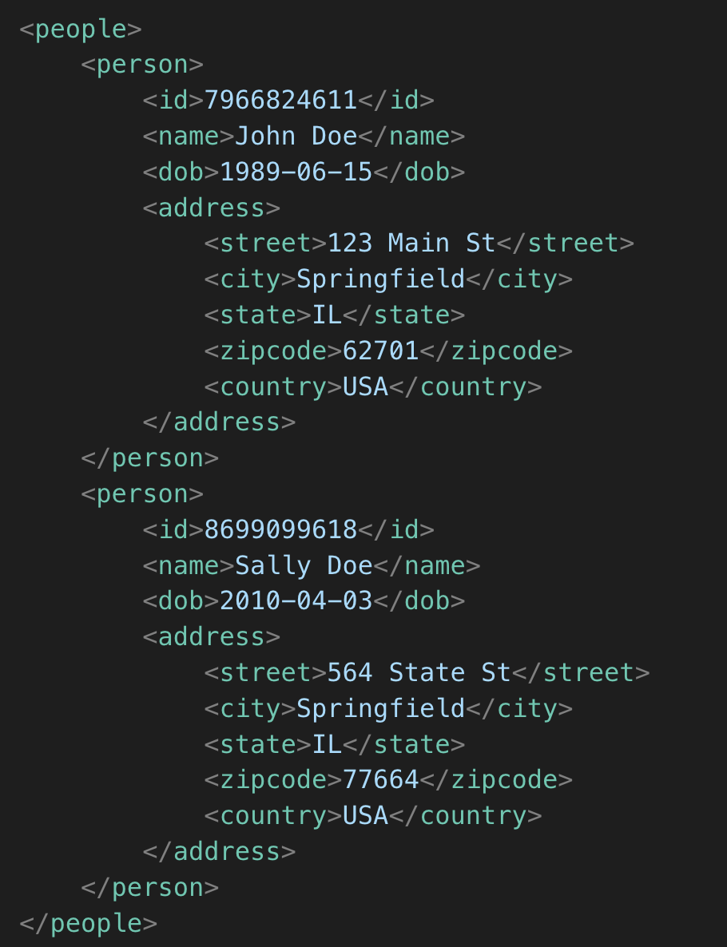
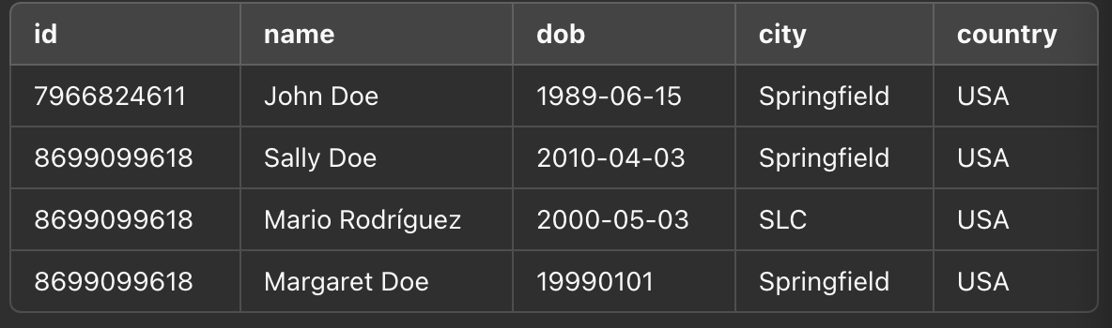
Loading Data
Key Function: load_data
Input: XML file with <person> elements.
Process:
Parse XML with xml.etree.ElementTree.
Extract fields: id, name, dob, city, country.
Log invalid records to discarded_files.txt.
Output: Pandas DataFrame.
Visual: [XML snippet and DataFrame example]

Slide 5
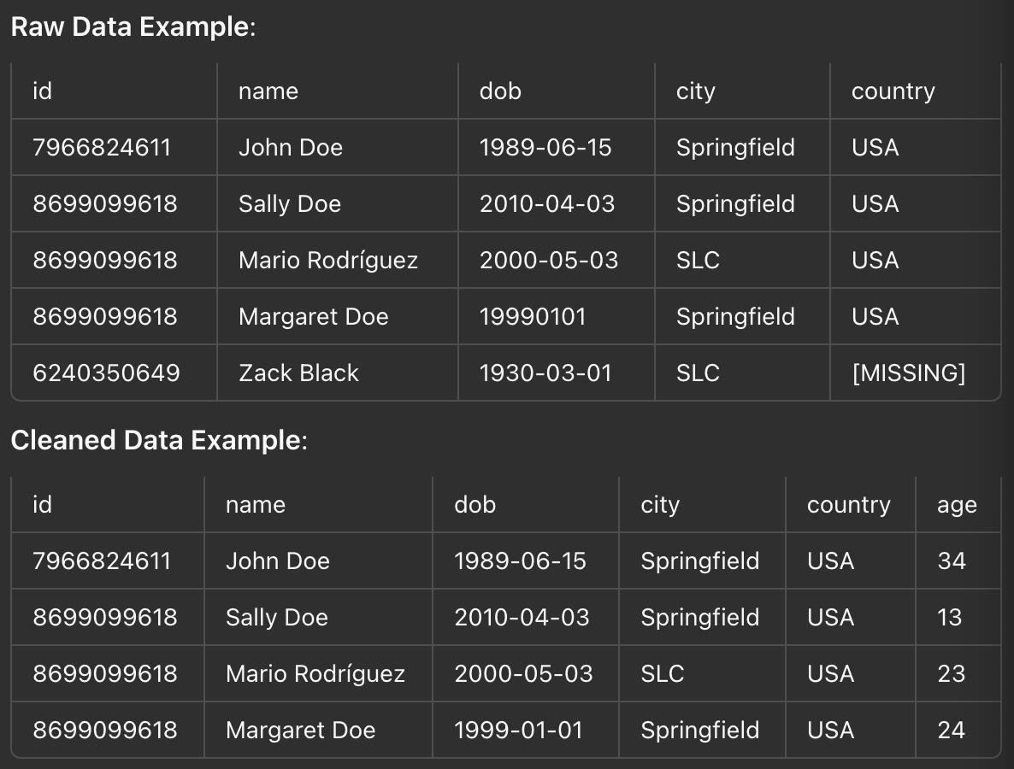
Cleaning Data
Key Function: clean_data
Process:
Calculate age from dob using calculate_age.
Remove rows with missing values.
Convert age column to integer.
Output: Cleaned DataFrame, ready for analysis.
Visual:

Slide 6
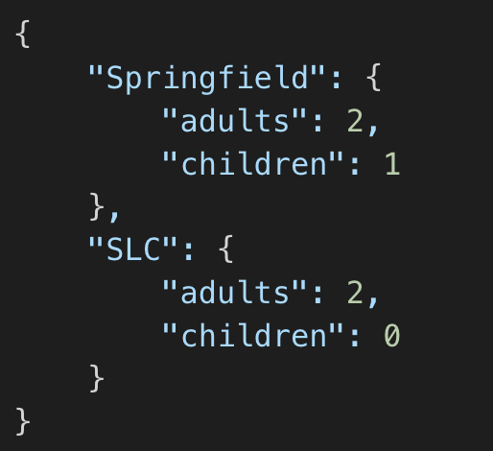
Generating Report
Key Function: generate_report
Process:
Group data by city.
Count adults (age > 18) and children (age <= 18).
Save results as a JSON file.
Output: JSON report summarizing population by city.
Visual:

Slide 7
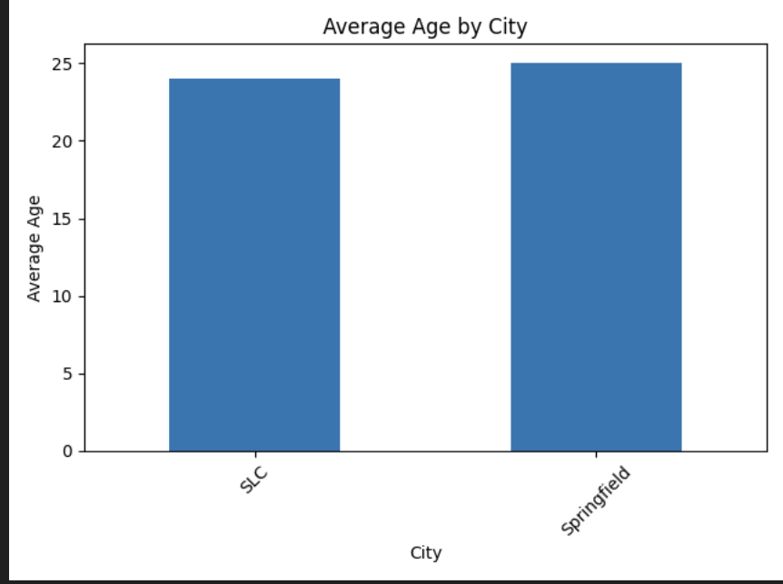
Creating Visualization
Key Function: generate_chart
Process:
Calculate average age by city.
Create a bar chart using matplotlib.
Save the chart as an image file.
Output: Bar chart (“Average Age by City”).
Visual:

Slide 8
Robustness and Scalability
Key Features:
Error Handling:
Logs invalid records for debugging.
Modularity:
Each function handles a specific task.
Easy to update or extend.
Scalability:
Can handle larger datasets or additional data fields.
Adaptable for other data formats (e.g., JSON, CSV).

Slide 9
Conclusion
Key Takeaways:
The pipeline processes raw data into actionable insights.
Outputs include structured reports (JSON) and visualizations (charts).
Robust, modular, and scalable design.

