Slide 1
Correlation Between Superhero Traits and Box Office Sales and Rating
Team Aurora Marvels
Carrie, Farai, James, Ryan, Shirley

Slide 2
Research Question
Do certain superhero attributes (i.e., power level, race (human vs. non-human), gender, and alignment (good vs. bad vs. neutral) lead to higher or lower box office sales and ratings in the U.S.? International Sales?
Notes:
We did not get ratings for international

Slide 3
Case References
Black Panther Racial and Ethnic Socialization
Captain Marvel Feminism
Superhero Movies Need More Diversity

Slide 4
Data Sources
APIs
Superhero
ComicVine
Marvel
OMDb
URLs
IMDb
Marvel Wiki
Box Office Mojo
Notes:
Pulled data from the APIs and used URLs to fill in data that was missing

Slide 5
Movie Population Selected for Analysis
31 movies released with one primary character lead during 2008 – 2019
Ranked movies by U.S. Sales (adjusted for inflation)
Ranked movies by Rotten Tomato ratings (popular with viewers)

Slide 6
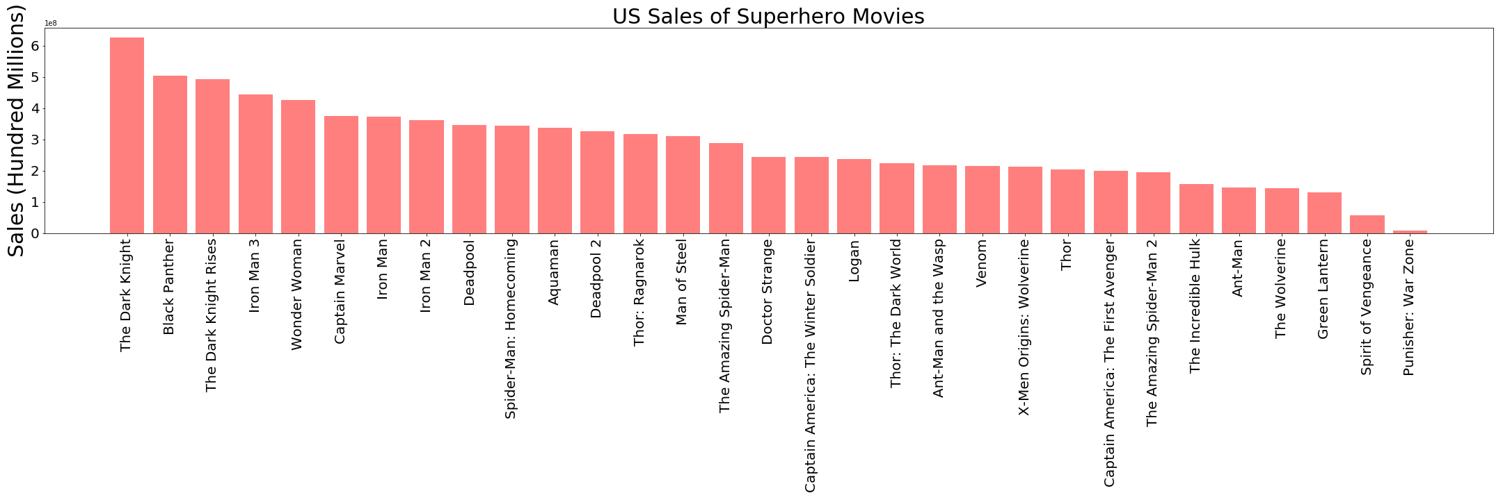
Superhero Movies by U.S. Box Office Sales
Notes:
Top 5 movies: Dark Knight, Black Panther, Dark Knight Rises, Iron Man 3, Wonder Woman
Two of the 5 top movies had minority leads

Slide 7
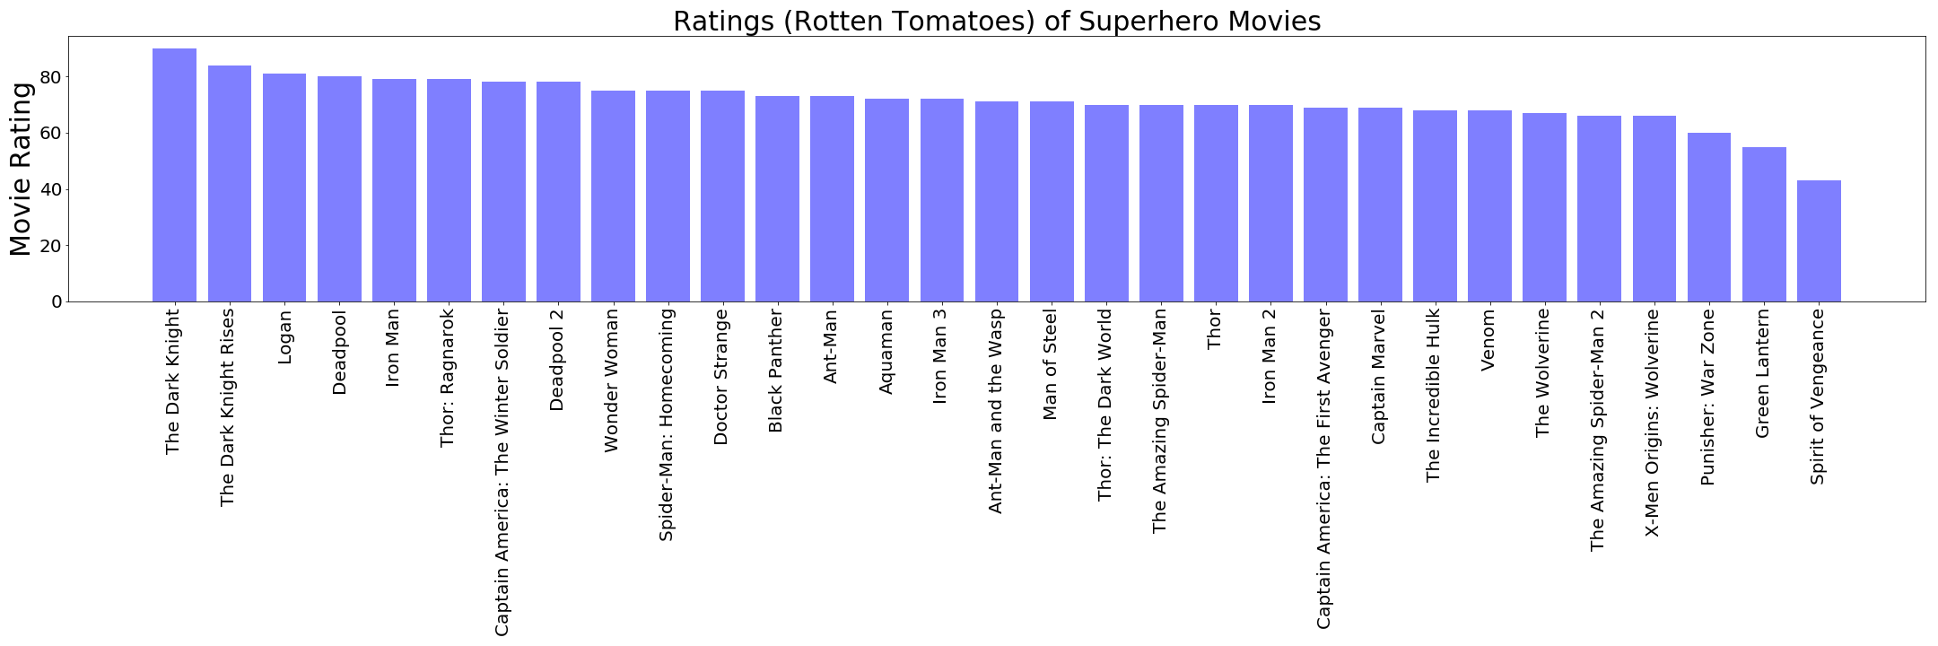
Superhero Movies by Viewer Rating (Rotten Tomatoes)
Notes:
Top 5 movies: Dark Knight, Dark Knight Rises, Logan, Deadpool, Iron Man

Slide 8
Superhero Plots
Calculated the average US sales and average viewer rating for each superhero
Batman is consistently the highest rated superhero and has the most box office sales
Two of the top 5 movies in sales have minority leads
One of the top 5 movies in ratings has a minority lead
Wonder Woman was included in the top 5 for both sales and ratings

Slide 9
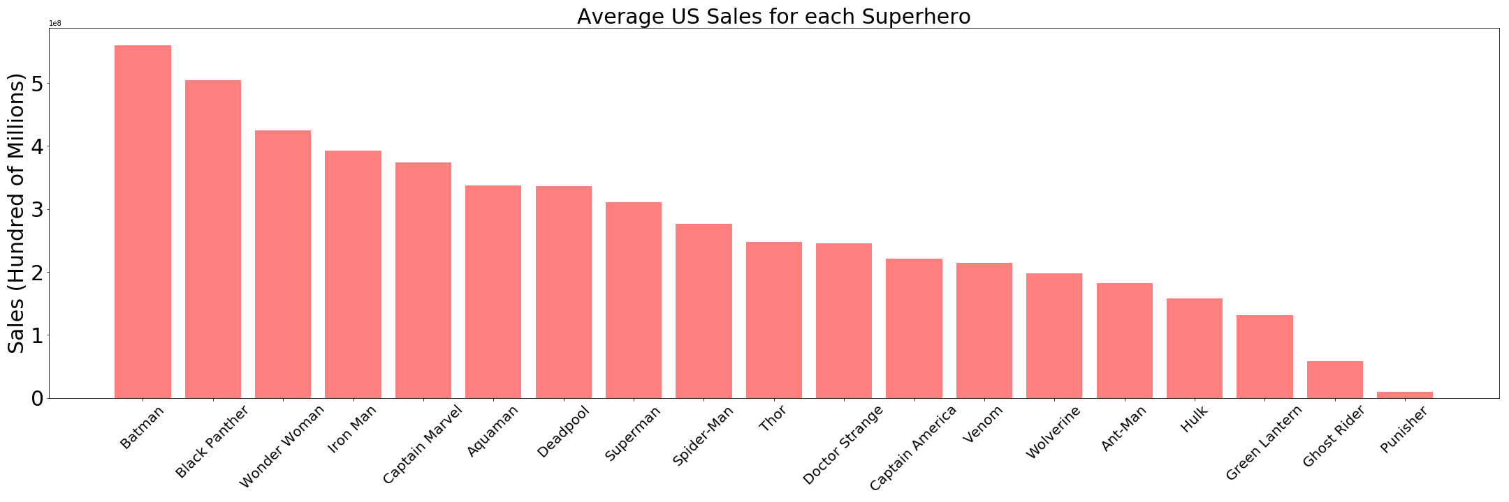
Average U.S. Sales by Superhero
Notes:
Top 5: Batman, Black Panther, Wonder Woman, Iron Man, Captain Marvel

Slide 10
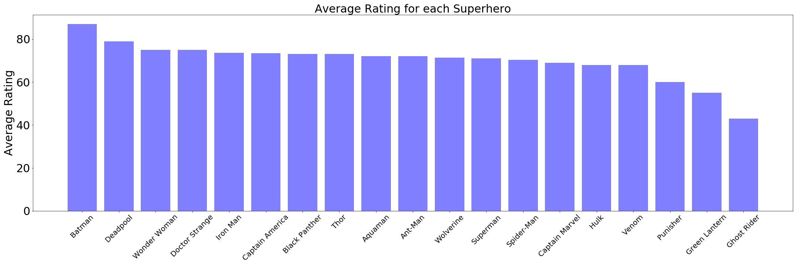
Average Rating by Superhero (Rotten Tomatoes)
Notes:
Top 5: Batman, Deadpool, Wonder Woman, Doctor Strange, Iron Man

Slide 11
Attributes Analyzed
Gender
Power level
Alignment (lead is considered good, neutral, or bad)
Race (human vs. non-human)

Slide 12
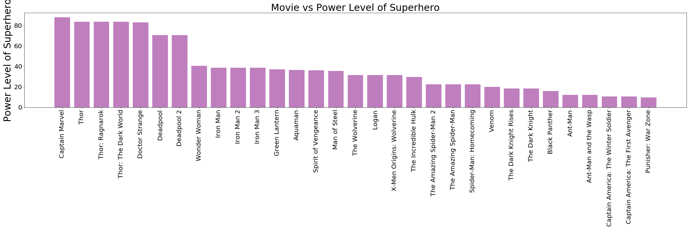
Power Level by Superhero

Slide 13
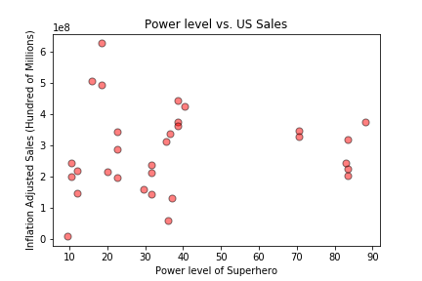
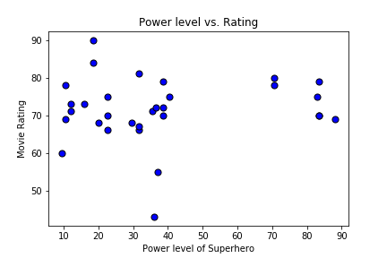
Power Level by Superhero Test Results
No correlation between power level and box office sales
Sales: p-value = 0.4051
No correlation between power level and viewer ratings
Rating: p-value = 0.9693

Slide 14
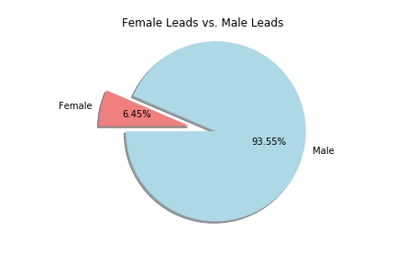
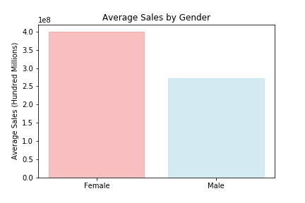
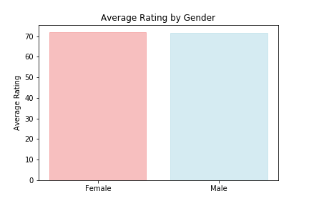
Gender Breakdown
Female led movies resulted in higher sales
No correlation between viewer ratings and gender
p-value = 0.2019
Notes:
Only 2 of the 31 movies had women leads

Slide 15
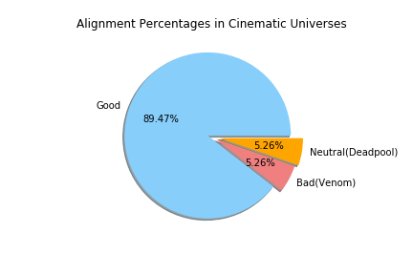
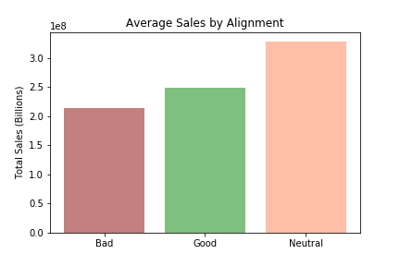
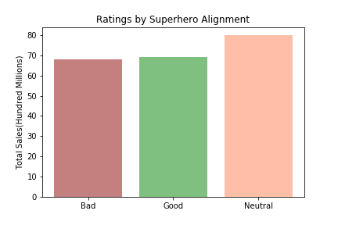
Alignment Breakdown (Good vs. Bad Vs. Neutral)
Good superheroes generate more sales
No correlation between good or bad superhero in viewer ratings
p-value = 0.8439

Slide 16
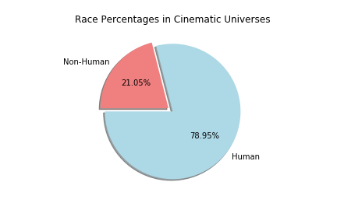
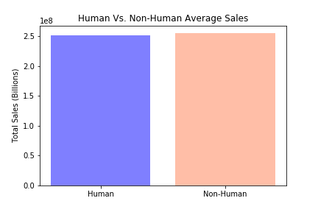
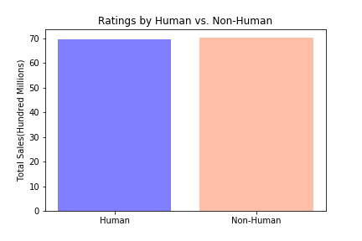
Race Breakdown (Human vs. Non-Human)
Human superheroes generate more box office sales
No correlation in viewer ratings based on race
p-value = 0.7939

Slide 17
Superhero Movies and International Sales Trends
Selected two movies from each attribute that had similar inflation adjusted sales and ratings
Compared international sales trends for each movie

Slide 18
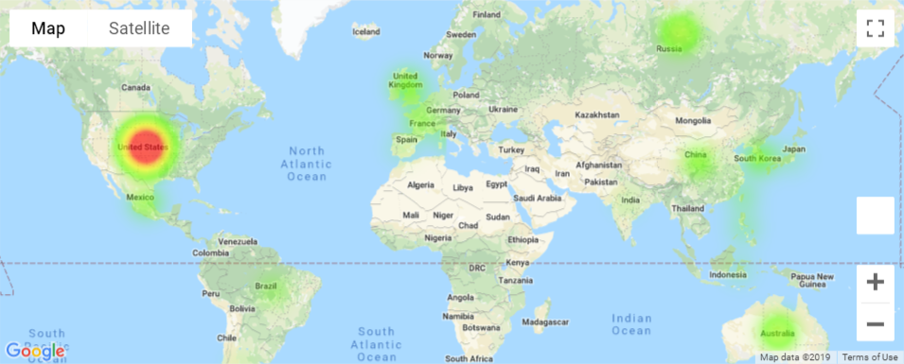
Gender Comparison for International Sales
Iron Man 3

Slide 19
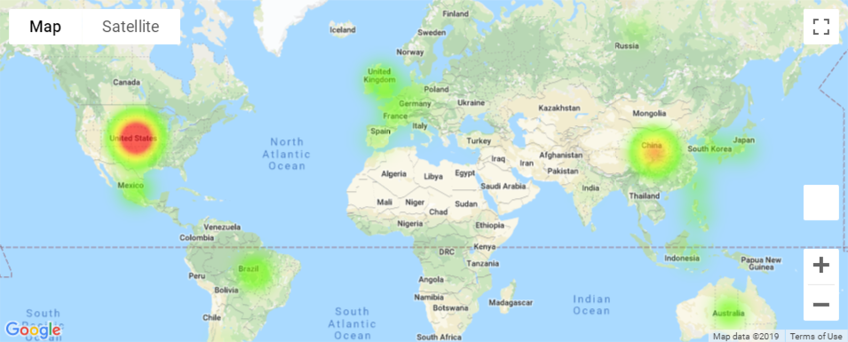
Gender Comparison for International Sales
Wonder Woman

Slide 20
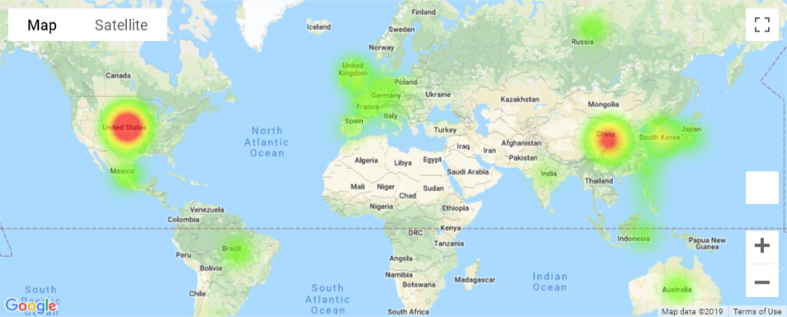
Alignment Comparison for International Sales
Ant-Man and The Wasp

Slide 21
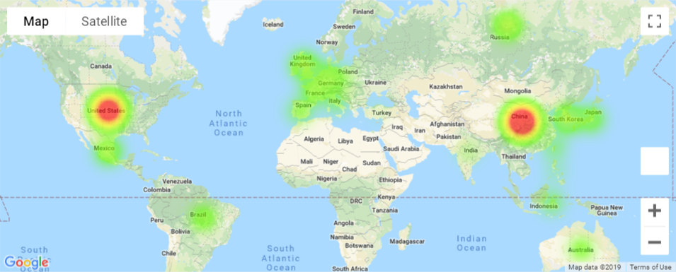
Alignment Comparison for International Sales
Venom

Slide 22
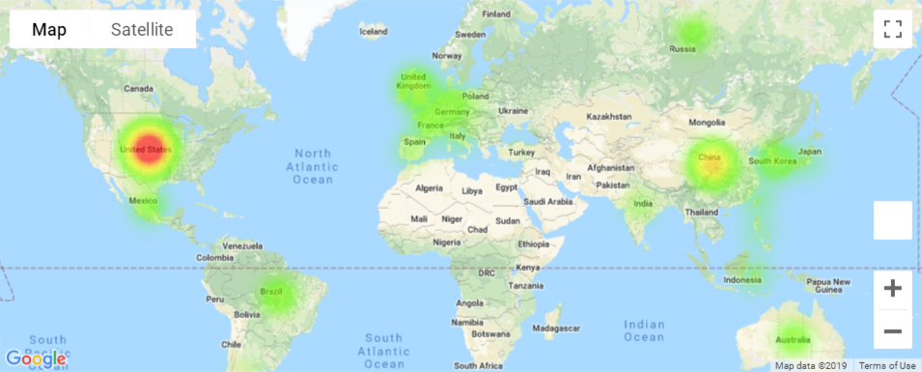
Race Comparison for International Sales
Thor: Ragnarok

Slide 23
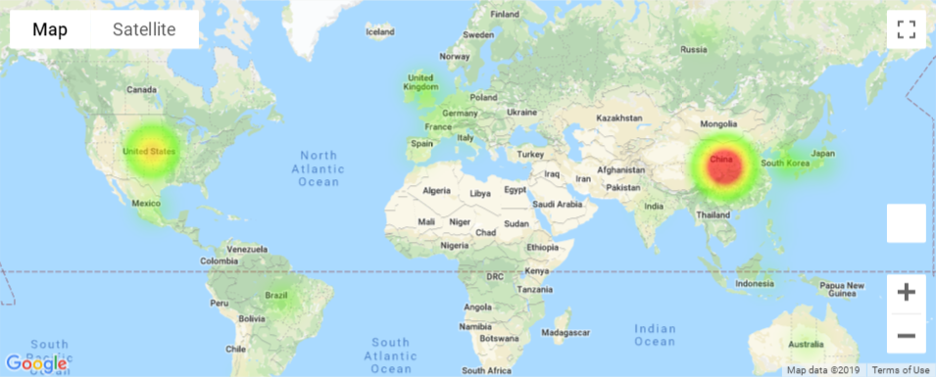
Race Comparison for International Sales
Spider-Man: Homecoming

Slide 24
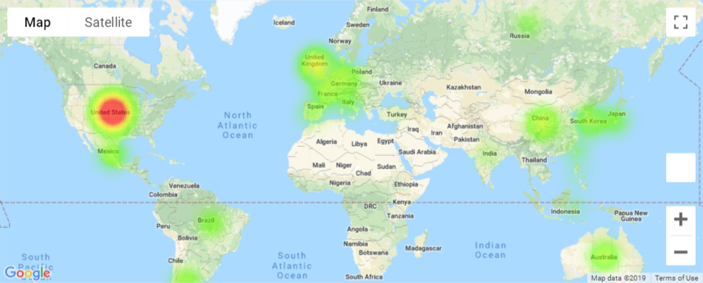
Ethnicity Comparison for International Sales
Dark Knight Rises

Slide 25
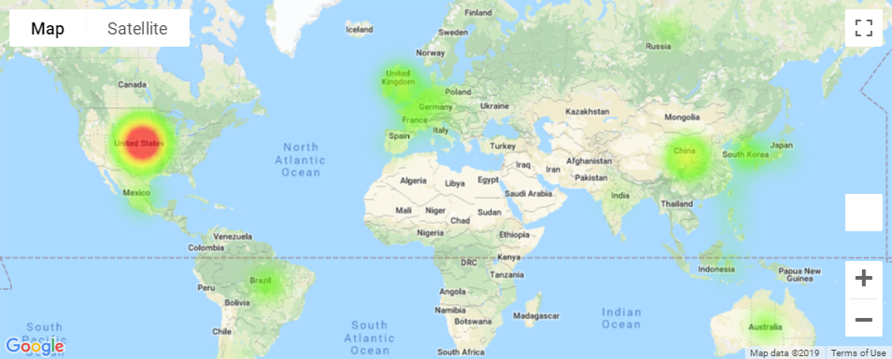
Ethnicity Comparison for International Sales
Black Panther

Slide 26
Final Conclusions
No correlation between Superhero attributes and U.S. sales or ratings
There is some variation in international sales depending on the Superhero movie and the Superhero’s attributes
Recent releases in movies with increased diversity appear to do well; however, substantial data to prove this does not yet exist
Two limitations of this project:
There are 31 movies with a single lead Superhero
The period selected was from 2008 - 2019

