Slide 1
Correlation Between Superhero Traits and Box Office Sales and Rating
Team Aurora Marvels

Slide 2
Team Members
Carrie Cook: carriecook82@gmail.com
- Shirley Quintana: quintanashirl@gmail.com
- Farai Chinanayi: showfara2011@gmail.com
- Ryan Schraeder: rschraeder2@gmail.com
- James Lee: jamesbradfordlee@gmail.com

Slide 3
Research Questions
Do certain superhero attributes (i.e. power(s), race (human vs. non-human), gender) lead to higher or lower box office sales in the US? International?

Slide 4
Case References
Black Panther Racial and Ethnic Socialization
Captain Marvel Feminism
Superhero Movies Need More Diversity

Slide 5
Data Sets
Data sets used found in the "Datasets" folder here
SOURCE APIs
Superhero API
ComicVine API
MARVEL API
OMDb API
SOURCE URLs
IMDB
MARVEL Wiki
Box Office Mojo

Slide 6
Movie Plots

Slide 7
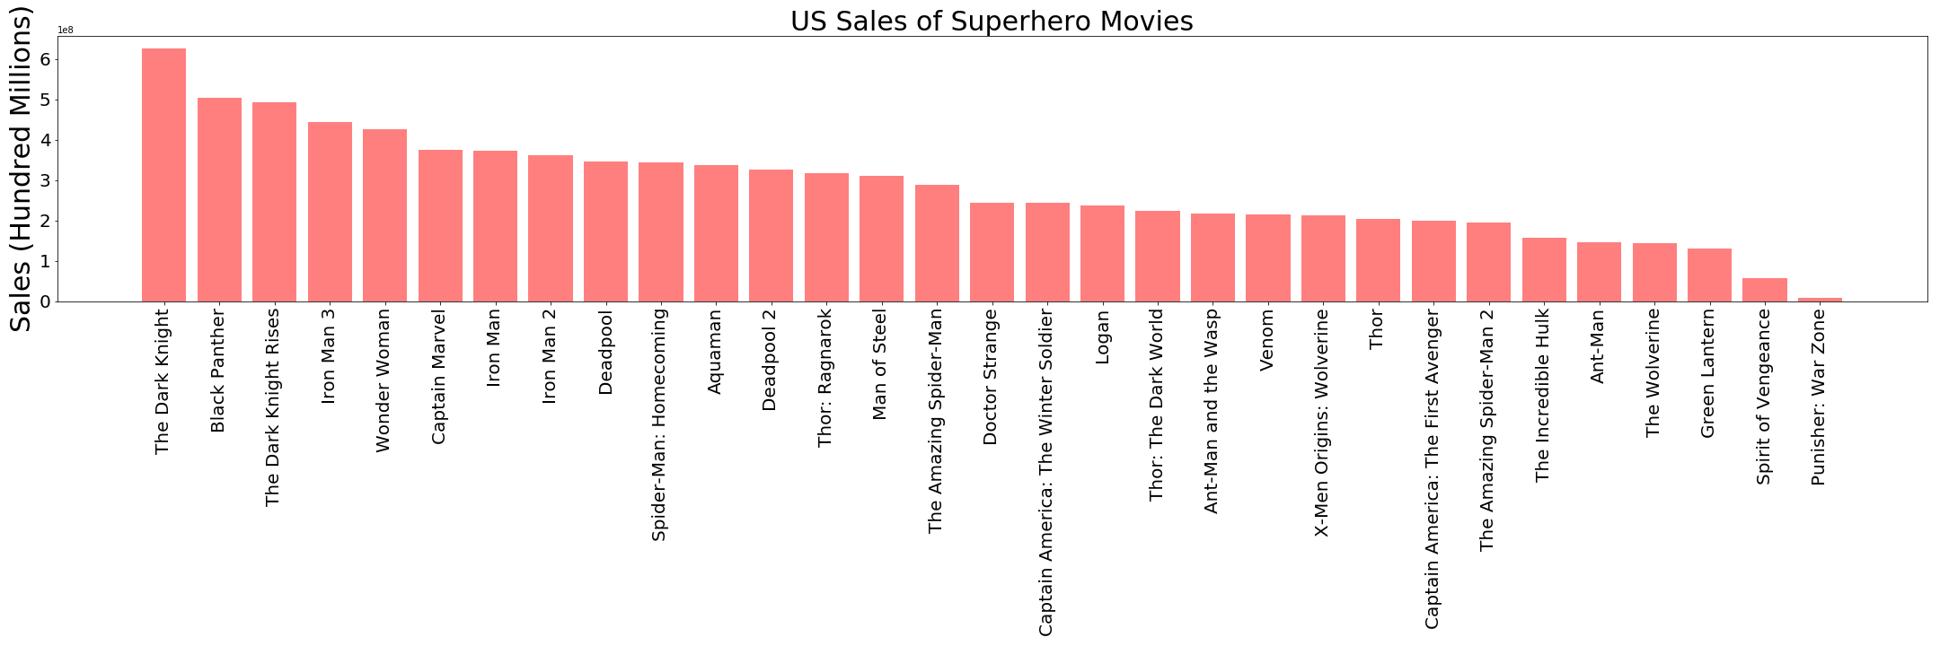

Slide 8
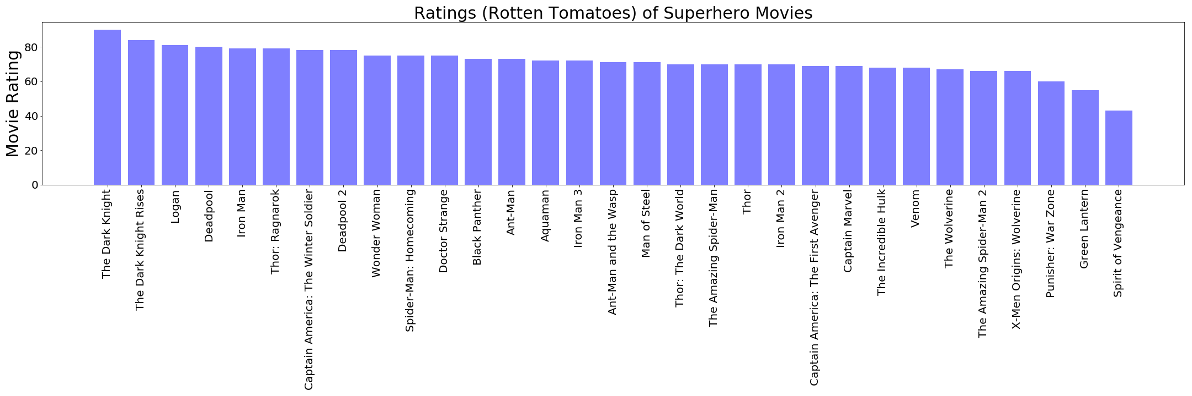

Slide 9
Superhero Plots

Slide 10
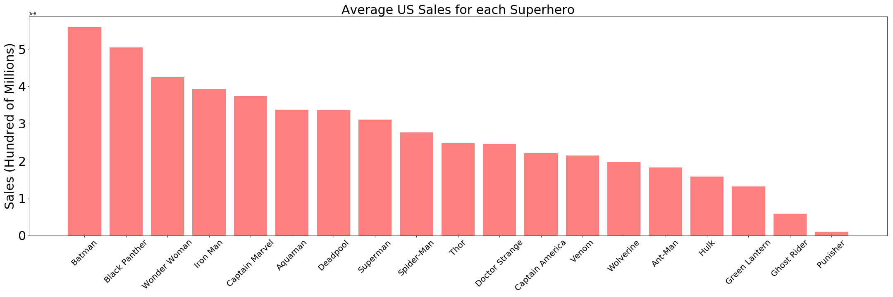

Slide 11
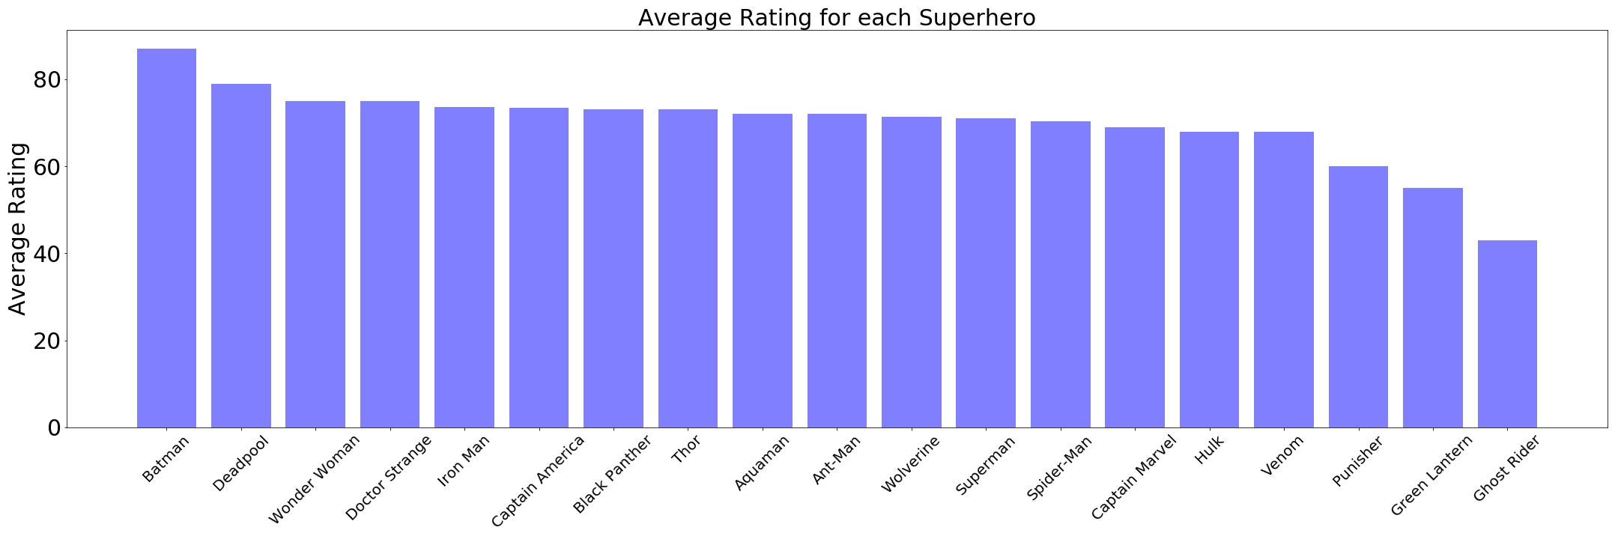

Slide 12
Gender

Slide 13
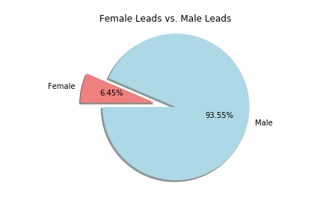

Slide 14
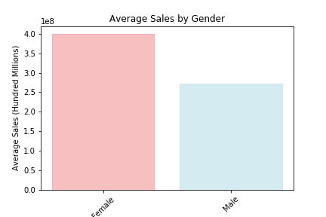

Slide 15
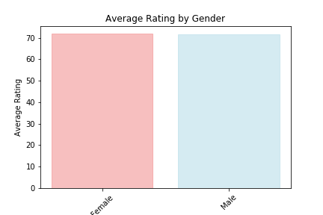

Slide 16
Power

Slide 17
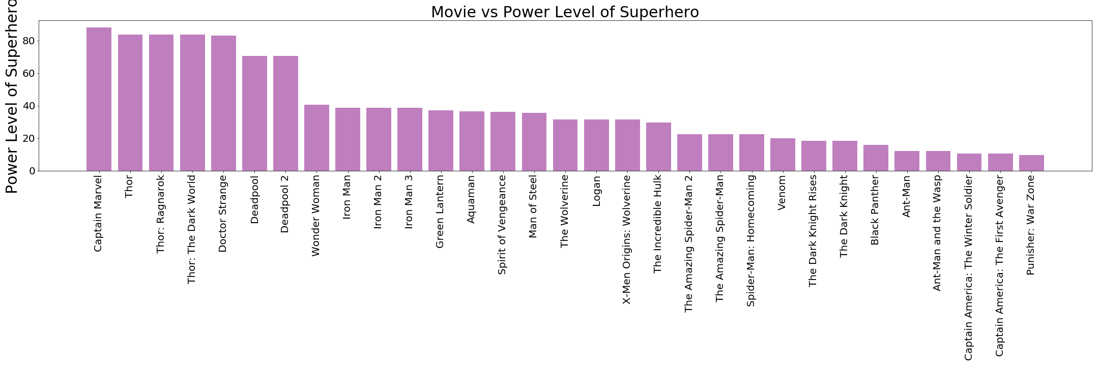

Slide 18
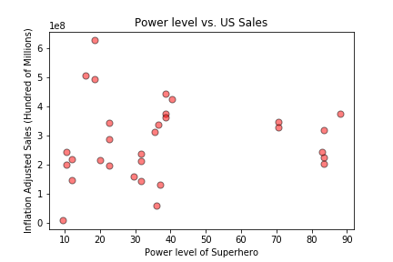

Slide 19
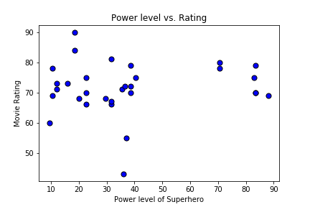

Slide 20
Alignment

Slide 21
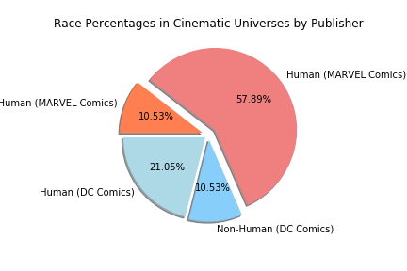

Slide 22
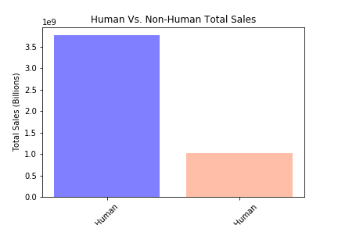

Slide 23
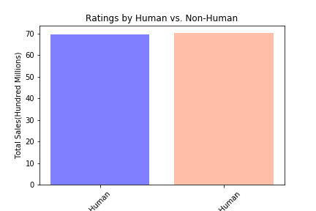

Slide 24
Superhero Origin

Slide 25
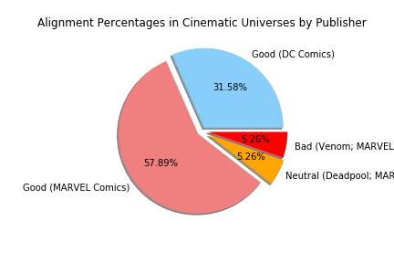

Slide 26
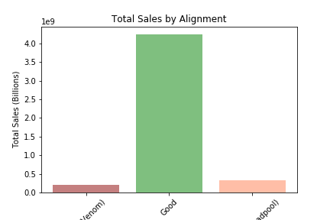

Slide 27
