Slide 1

DROWSINESS DETECTION SYSTEM Aryan Meena U41361555
METCS767, Dr. Farshid Alizadeh-Shabdiz
Notes:
Speaker Notes: This project presents a fully modular, interpretable driver drowsiness detection system.
Rather than relying on a single end-to-end model, we decompose the problem into four distinct machine learning tasks: face detection, facial keypoint regression, behavioral signal extraction, and temporal classification. This architecture gives us clarity, robustness, and controllability—qualities that are essential for safety-critical systems like in-cabin driver monitoring.

Slide 2
System Pipeline
Task 1: Face Detection
RetineFace,, Bounding Box
Loss: Focal + Smooth L1
Task 2: Facial Key point Regression (
Resnet-18
20 key points + confidence
Loss: MSE + Confidence-aware Loss
Task 3: EAR/MAR Feature Extraction + Eye/Yawn State
Per-second aggregation metrics (Median, max, fraction, MAR stats, yawn counts)
Task 4:Temporal Drowsiness Modeling
Random Forest Classifier
Threshold and probability for drowsiness
Notes:
Speaker Notes: Our system follows a strict modular pipeline.
Task 1 uses RetinaFace for face detection. RetinaFace provides dense regression of bounding boxes and anchor landmarks using Focal Loss and Smooth L1, which is essential for handling the heavy class imbalance typical in object detection.
Task 2 uses a ResNet-18 backbone, initialized with ImageNet-1K pretrained weights, for 20 facial keypoints and per-landmark confidence. We intentionally reduce 68 standard landmarks to just the 20 that matter for EAR and MAR stability. MSE is used for coordinate regression, and our confidence-aware loss improves resilience to noisy predictions.
Task 3 converts these keypoints into geometric behavioral descriptors, EAR for eyelid aperture and MAR for mouth openness. From frame-level signals we compute per-second aggregated metrics such as median, max, and temporal fractions, which provide invariance to noise and short occlusions.
Task 4 takes these aggregated features and performs 5-second temporal classification using a Random Forest classifier. Temporal windows and threshold calibration allow us to reliably estimate p(drowsy_5s) and generate binary alarms.
This pipeline is deliberately interpretable, auditable, and cross-dataset-valid, an important requirement in driver safety systems.

Slide 3
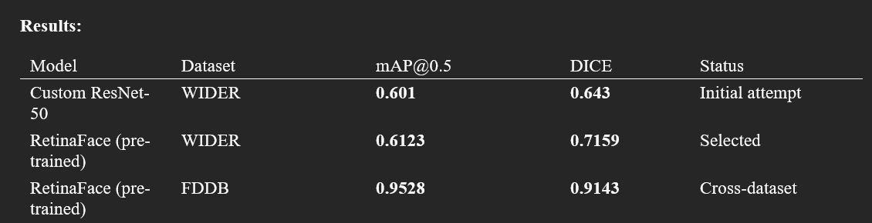
Task 1: Face Detection (RetinaFace)
Used WIDER-Face Dataset and FDDB dataset to train/val and Test respectively
Loss Functions: Focal Loss and Smooth L1 Loss
RetinaFace was Selected after experimenting with FasterRCNN-ResNet18,
WIDERFACE Dataset was annotated and visualized
Notes:
Speaker Notes: For Task 1, we experimented with FasterRCNN-ResNet18 as a baseline, but performance was insufficient in small-face and low-light cabin scenarios. RetinaFace provided much stronger localization performance due to its Feature Pyramid Network and dense anchor strategy.
We train/validate on WIDER-FACE and evaluate cross-dataset on FDDB to satisfy the “train on A, test on B” requirement. Focal Loss mitigates extreme background imbalance, while Smooth L1 stabilizes bounding-box regression.
We also visualized annotated WIDER-FACE samples to ensure the annotation loader and bounding-box generation were correct. The FN/FP error analysis helped identify performance bottlenecks such as occlusions, glasses reflections, and extreme head poses.

Slide 4
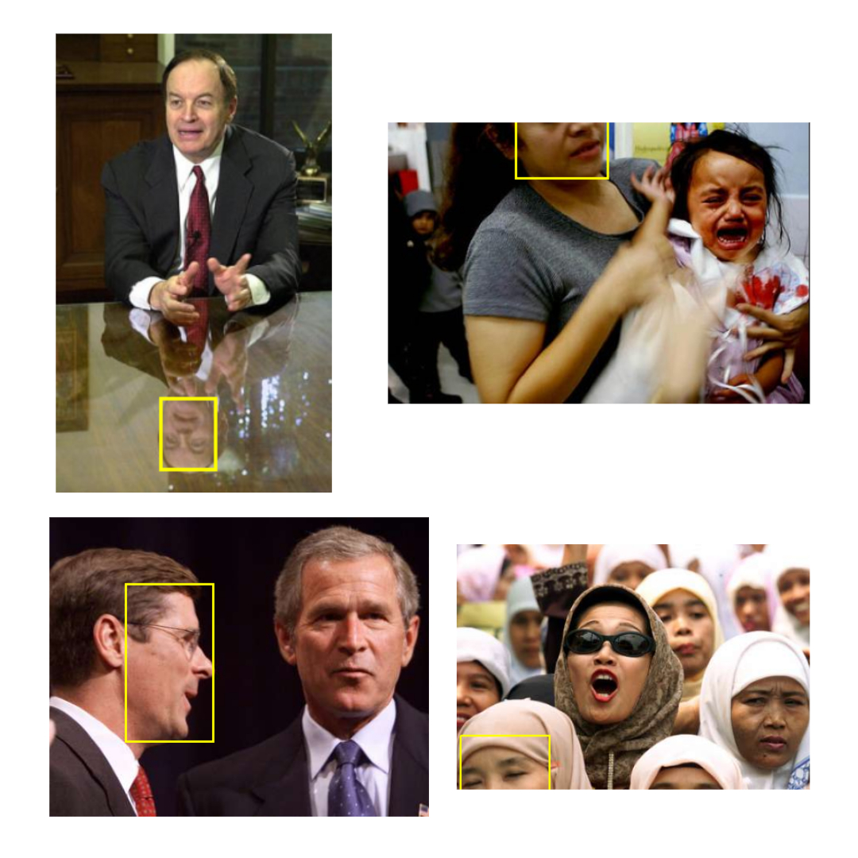
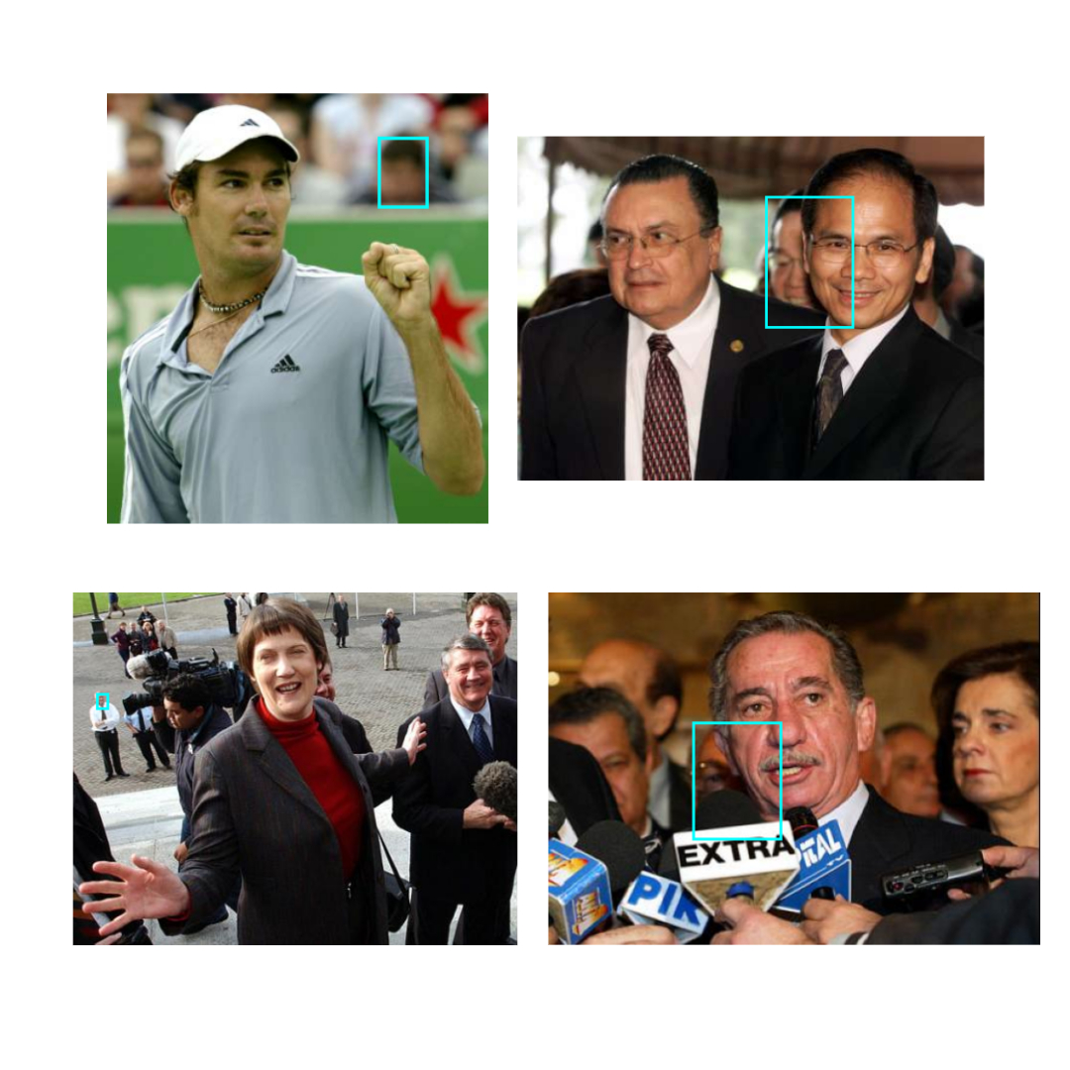
TOP FN & FP Cases
False Positives
False Negatives
Notes:
FALSE NEGATIVE 1 — Reflection on Table (Face Missed)
Speaker Notes: “This is labeled as a false negative because the detector fired on the reflection in the table surface instead of the actual face. Reflections invert the natural orientation and distort the facial geometry, so RetinaFace fails to recognize the real face in the scene. The real face is fully visible, but because the reflection creates a face-like pattern with different gradients and flipped structure, the model incorrectly ignores the true face.” “All four false negatives share limiting conditions: occlusion, extreme pose, reflections, and visually crowded backgrounds. These conditions remove or distort the facial geometry that RetinaFace expects, so the anchor-based detector fails to activate on real faces.”
FALSE POSITIVE 1 — Blur Patch Mistaken as a Face (Tennis Court)
Speaker Notes: “This is a false positive because the blurred background patch has roughly face-like color and shape. When texture is washed out due to motion blur or shallow depth-of-field, RetinaFace sometimes misclassifies smooth elliptical blobs as faces, especially when they fall within the expected anchor size.”
“All four false positives happen because the detector picks up face-like shapes—small blobs, silhouettes, reflections, or objects with similar geometry. When resolution is low or textures are missing, RetinaFace mistakes these patterns for real faces.”

Slide 5
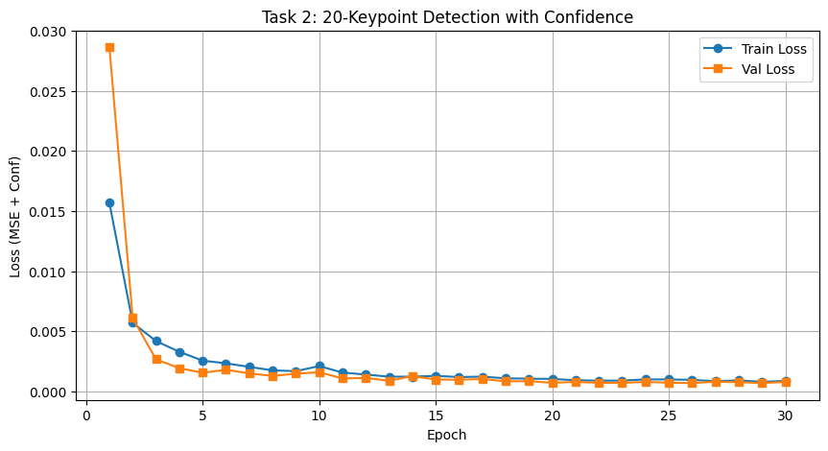
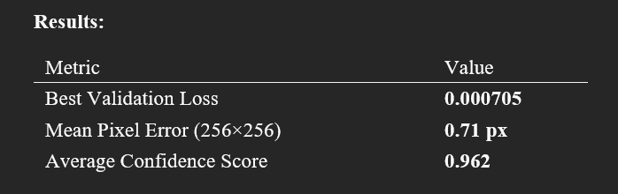
Task 2: Keypoint Detection
300W Dataset was used for training our model for the keypoints
68 landmark points were present out of which 20 were used.
6 for both eyes and 8 for mouth
ResNet-18 backbone trained on 600 images with IMAGENET1k pretrained weights
Loss used:
MSE Loss
Confidence Aware Loss
Notes:
peaker Notes: For landmark regression, we used the 300W dataset. Although it provides 68 facial landmarks, only 20 are needed for our application: 6 around each eye and 8 around the mouth. This reduces overfitting risk and improves generalizability.
Our ResNet-18 model was initialized with ImageNet-1K pretrained weights to leverage strong feature priors. With only ~600 images in 300W, pretraining is critical.
We also implemented a custom parser for .pts files and ensured reproducibility by fixing random seeds.
The confidence-aware loss allows the network not only to predict coordinates but to express uncertainty—an essential capability when downstream features like EAR and MAR depend heavily on accurate geometry.

Slide 6
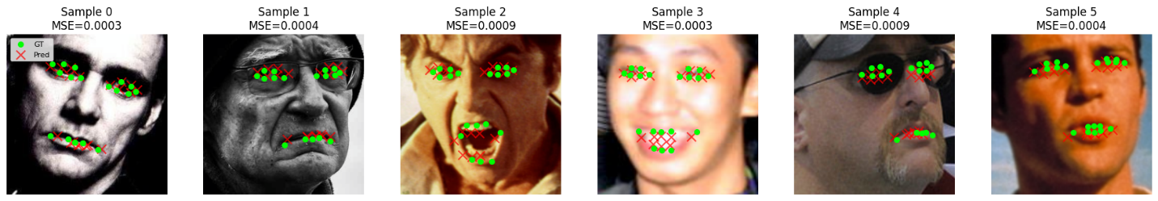
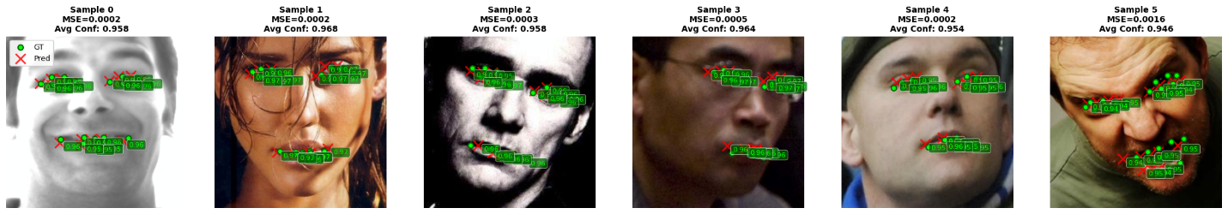
20-Keypoints Detection

Slide 7
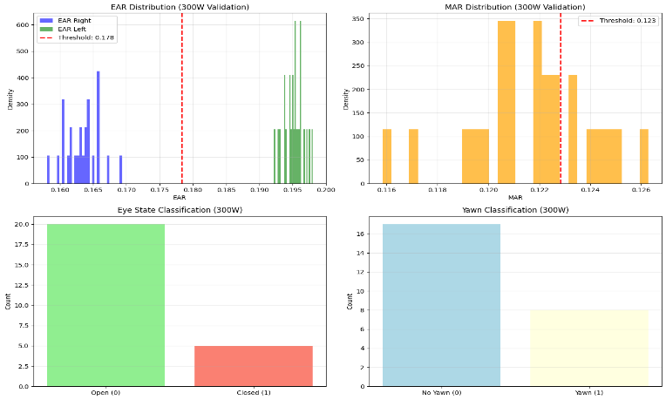
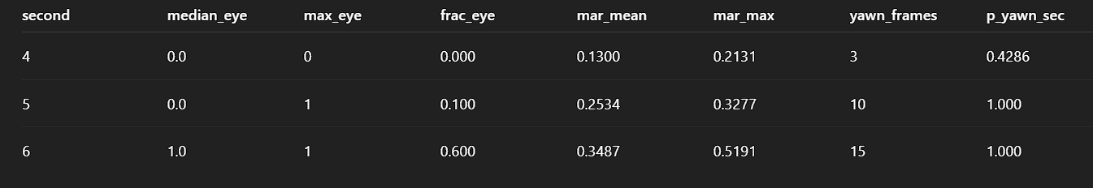
Task 3: Feature Extraction
Implemented EAR & MAR using the classical geometric formulas
Task 2 model checkpoint loaded
EAR/MAR computed per frame
Frame to second mapping created based on filenames of NTHU-DDD
Notes:
Task 3 transforms spatial information into behavioral signals.
Using the predicted keypoints, we compute EAR and MAR for every frame. EAR measures eyelid opening and is highly sensitive to fatigue-related blinking patterns. MAR measures mouth opening and serves as a proxy for yawning amplitude.
We aligned each frame to its timestamp by decoding frame indices from filenames—important for mapping frames to per-second and per-window temporal features.
This step produces a rich time series of eye-closure probabilities and mouth-opening signals that feed into our temporal model.

Slide 8
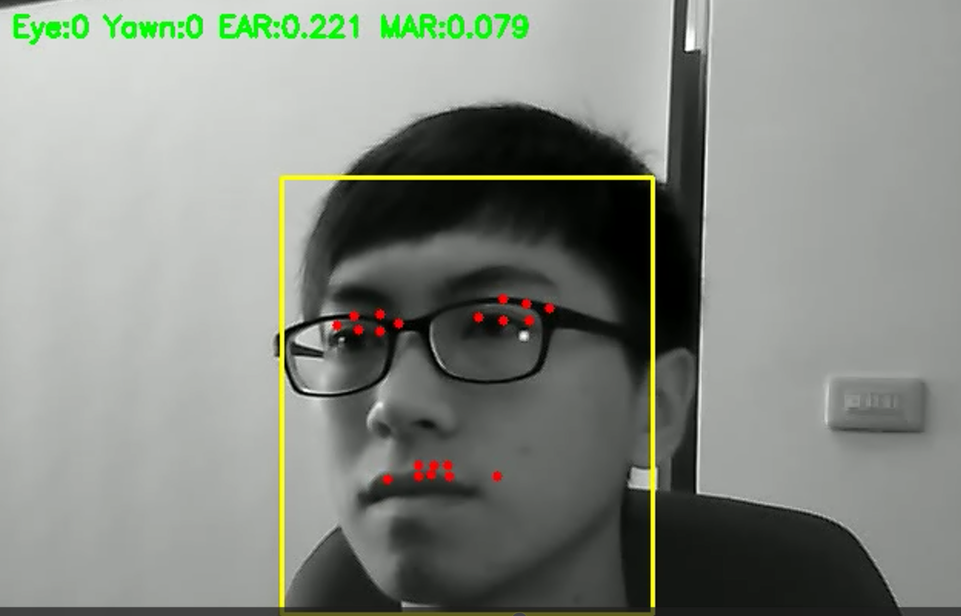
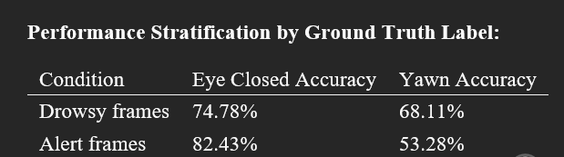
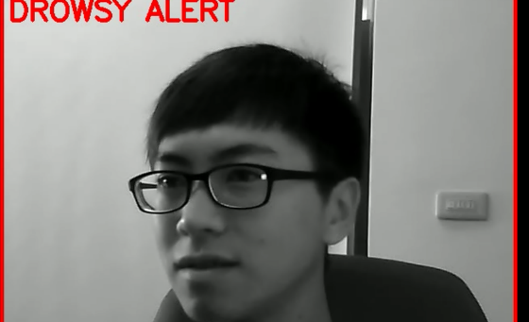

Task 3: Classification Performance
Notes:
Speaker Notes: Using the EAR/MAR thresholds tuned on validation sequences, we obtain frame-level classification of eye-closure and yawn events.
We observe different performance patterns for drowsy versus non-drowsy segments. Eye detection tends to be more accurate in alert frames because eyelids are fully open; in drowsy cases, partial closures are more ambiguous.
Yawn detection is more challenging across both categories due to lighting variation, occlusions, and mouth shape differences. However, because downstream temporal aggregation smooths this noise, even moderate per-frame accuracy is sufficient for strong 5-second drowsiness detection.

Slide 9
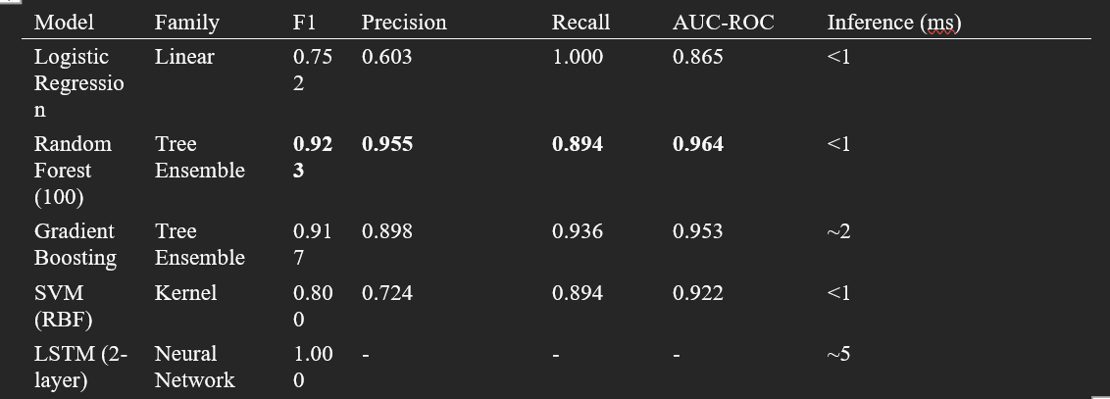
Task 4: Temporal Modeling
Task 3 outputs fed into 5-second sliding windows
Random Forest chosen after comparing LR, SVM, GB, LSTM
Runs RetinaFace, ResNet18 for keypoints by checkpoint, temporal features vector was build
Loss:
Binary Cross Entropy
Gini Impurity for Random Forest Splits
Notes:
For drowsiness classification, we aggregate Task 3 outputs into 5-second windows. These windows capture trends, not instantaneous events, which is crucial because drowsiness evolves gradually.
We compared logistic regression, SVM, gradient boosting, and LSTM. The LSTM achieved excellent validation performance but overfitted and did not generalize well to cross-session data.
Random Forest provided the best balance of interpretability, robustness, and temporal discrimination. It models non-linear relationships between features like median eye closure, peak yawn intensity, and the temporal fraction of frames with closed eyes.
Threshold calibration on the validation set yields the alarm logic used in the final system.

Slide 10
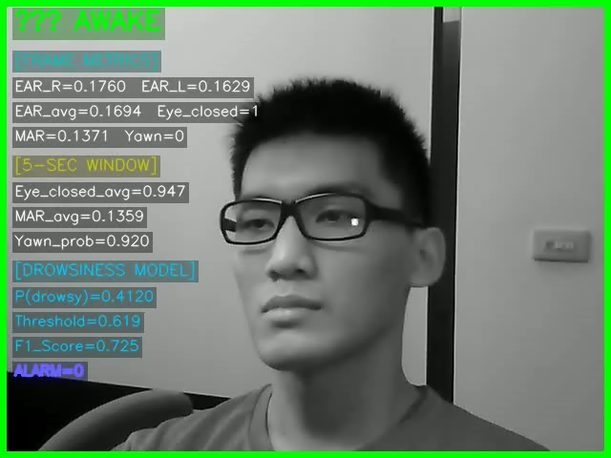
Task 4: Final Model and Logistic Regression

Slide 11
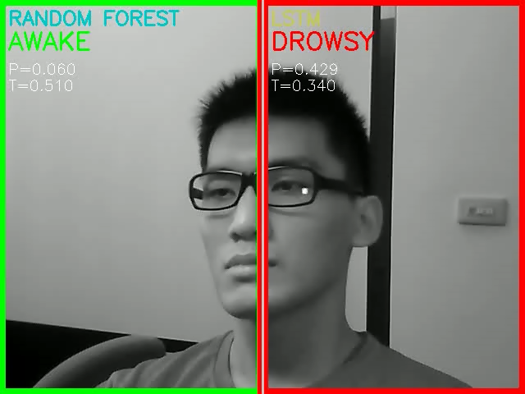
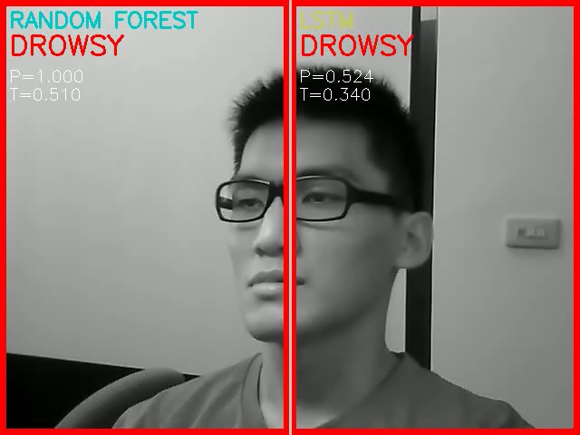
Random Forest and LSTM Comparison

Slide 12
Loss Function Summary
Focal Loss + Smooth L1
Used because dense detectors suffer from anchor imbalance; Smooth L1 Stabilizes box regression
MSE + Confidence Aware Loss
MSE is standard for coordinate regression; confidence modeling improves reliability and downstream geometric estimation
BCE for eyes/yawn
Natural Loss for binary probabilistic outputs
BCE/Gini Impurity
Temporal classification requires threshold calibrated probabilities; RF’s Gini impurity behaves like a regularized version of BCE
Notes:
Speaker Notes: Each loss function directly aligns with its task’s requirements.
Focal Loss + Smooth L1 for face detection addresses extreme class imbalance and stabilizes bounding-box regression.
MSE + Confidence-Aware Loss for keypoints allow sub-pixel accuracy while providing the network a mechanism to down-weight uncertain predictions.
BCE for eye/yawn classification is the natural choice for probabilistic binary decisions.
Finally, BCE/Gini Impurity for temporal modeling aligns with the Random Forest’s splitting criterion and provides well-calibrated probabilities for thresholding.
This combination ensures consistent gradient behavior, interpretability, and robustness across the entire pipeline.

Slide 13
Thankyou

