Slide 1

Classification for Early Screening of Childhood Learning Difficulties (NHIS 2024)
METCS699 – Data Mining
Aryan Meena & Aman Nishad
Dr. Jae Young LEE
Notes:
Hello my name is Aryan Meena

Slide 2
Introduction & Problem Statement
Develop an end-end classification pipeline for early screening of childhood learning difficulties using NHIS 2024 data.
Challenges: High class imbalance – far fewer “Yes” cases than the “No” cases.
Approach: Implement comprehensive preprocessing, multiple data balancing techniques and evaluate 9 different ML algorithms with different sampling method, which gives us 36 models to get the best performer.
Outcome: Found a top model XGBoost + upsampling that exceeded the required TPR thresholds and achieved strong overall accuracy.

Slide 3
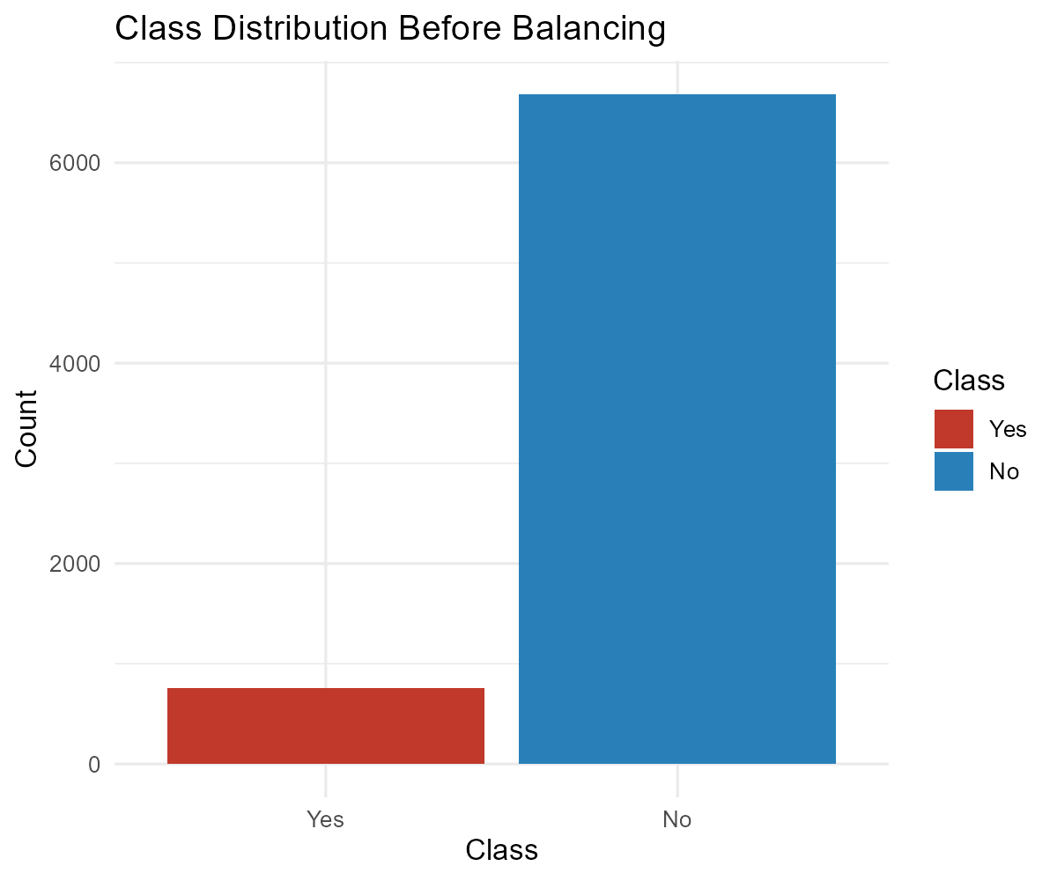
Dataset Overview
Data Source: 2024 National Health Interview Survey. A nationwide survey capturing children’s health, behavior and family context.
Dataset size: 7,439 children with 353 variables each. Ages range from 0-17 years.
Target Variable: Class = “Yes” (child has a learning difficulty) or “No” (no learning difficulty). Only a minority of children have learning difficulties which shows class imbalance.
Feature Domains: Includes demographics(Age, sex, region), family structure, socioeconomics, physical health, developmental disorders (e.g., ADHD, autism) and behavioral context.

Slide 4
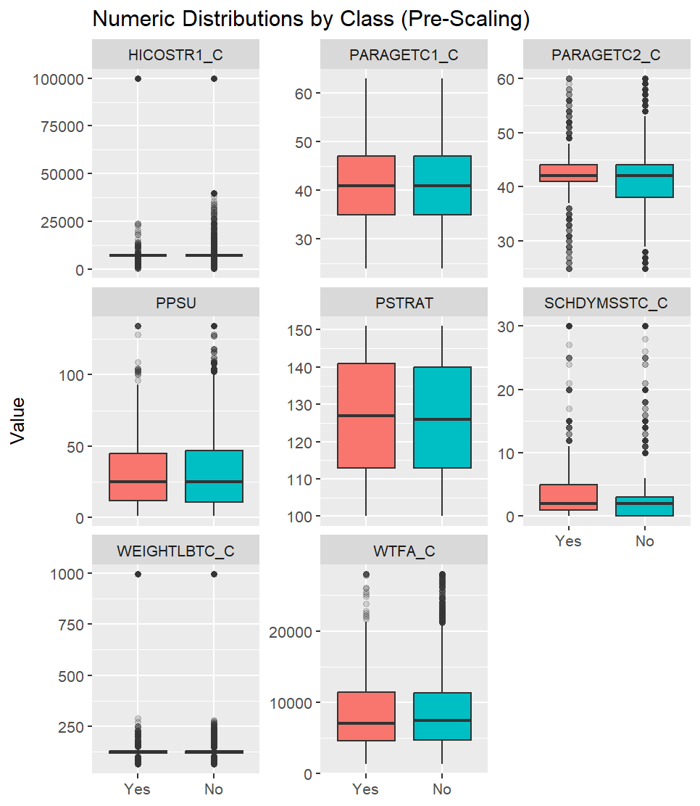
Data Characteristics & Key Distributions
Class Imbalance Impact: The imbalance can bias models to predict the majority class. We address this latest via re-sampling techniques.
Feature Distribution Differences: Certain numeric traits show different distributions between classes (Yes vs No).
Holistic Features: Many variables are categorical (e.g. diagnoses present or not) and some numeric (e.g. BMI). We looked at distributions to ensure no obvious data issues and to do feature engineering.
The data is high-dimensional and varied, requiring robust preprocessing to handle missing values and to ensure features are on comparable scale before modeling.

Slide 5
Preprocessing – Cleaning & Filtering
Missing Data Encoding: First, we standardized all missing value codes in the raw data (blank entries, “NA”, special codes like 7/8/9) into true NA values. This ensured consistency before imputation.
High-Missingness Drop: We removed any features with >= 90% missing data. (For e.g. 11 survey variables were entirely blank for all 7,439 records and were dropped). This avoids unreliable imputations and reduces noise.
Near-Zero Variance Removal: Using caret’s nearZeroVar, we dropped features that had almost no variance or extremely imbalanced distributions. These quasi-constant features carry little information and cause issues in modeling.

Slide 6
Preprocessing – Imputation & Transformation
Imputation: For remaining missing values, we imputed numerical features with the median and categorical features with the mode on training set. This simple strategy avoids data loss and prevents leaking information from the test set.
Winsorization: We capped extreme outliers by winsorizing numeric features at the 1st and 99th percentiles. Rather than removing outliers, this brings them to a reasonable range, reducing undue influence while keeping all data.
ID/Unique Feature Removal: We dropped any ID-like fields and columns with >90% unique values.
Correlation Pruning: Highly correlated features(Pearson r >= 0.80) among numeric were pruned to remove redundancy.
At the end we were left with 148 variables and then the ZeroVar function left us with 147 by removing one more feature.

Slide 7
Train/Test Split & Data Preparation
Stratified Split: We partitioned the data into 80% training and 20% testing, stratified by the target class. This helps in preserving the imbalance proportion.
No Leakage: All preprocessing steps were fit on the training set only. The test set was strictly held out until final evaluation.
Rare Category Consolidation: For categorical variables, any factor level with <10 samples in the training set was combined into an “Other” category. This prevents tiny categories from causing overfitting or errors.
Feature Scaling: We standardized numerical features by centering and scaling (z-scores).
Reproducibility: We set random seeds and saved the split data to ensure results can be reproduced exactly.

Slide 8
Addressing Class Imbalance – Four Balancing Strategies
Need for Balancing: In the training data, “No” cases vastly outnumber “Yes” cases. This skew can cause models to perform poorly on the minority class, so we created balanced training sets using four methods.
Down-Sampling: Randomly remove majority-class(No) samples until the classes are equal.
Up-Sampling: Randomly duplicate minority-class samples until classes equal.
Synthetic Oversampling: Generate new minority samples by adding slight noise to existing ones (a custom SMOTE-like jitter).
NearMiss-1 Undersampling: Select a subset of majority class examples that are closest to minority class examples in feature space.

Slide 9
Modeling Approach – Algorithms and Training
We trained log regression, decision tree, random forest, xgboost, bagging, naïve bayes, k-nearest neighbors, support vector machine, multi layer perceptron(single hidden layer).
Each algorithm was trained using 3-fold cross validation and 10-fold cross validation on the training set, we used grid search for key hyperparameters.
We trained all 36 models separately and also; we fixed random seeds and frozen CV splits so that the training is reproducible.

Slide 10
Evaluation Metrics & Model Selection Criteria
Evaluation Procedure: After training, we evaluated each model on the untouched 20% test set, using a fixed probability threshold of 0.5 for classification.
Metrics: For each model, we calculated TPR, FPR, precision, F1-score, ROC, AUC, MCC and kappa. Confusion matrices were also recorded.
To select the best model, we designed a composite scoring system. This score incorporated whether models met the TPR minima and combined the two class
Best models were then ranked by the composite score and the top performer which meets the TPR thresholds was chosen as our final model, we then analyzed that model in depth.
Notes:
Speaker Notes: Once the models were trained, we needed to pick the winner systematically. We tested each model on the same unseen test set and looked at a variety of metrics. True Positive Rate (which is recall or sensitivity) for both classes was particularly important – in plain terms, what fraction of “Yes” cases we caught and what fraction of “No” cases we correctly identified. We also kept an eye on precision and F1 to ensure the model wasn’t just guessing “Yes” for everything. ROC AUC gave us an overall sense of discrimination ability, and MCC and Kappa are helpful single-number summaries for imbalanced problems. We set minimum acceptable TPRs for both classes because, in a screening tool, you might say “we need to catch at least X% of children with difficulties and at least Y% of those without.” Any model that didn’t reach those bars was ruled out. For the ones that cleared the bar, we created a composite scoring system – essentially rewarding models for strong performance across metrics – and used that to rank them. Our final chosen model is the one with the top composite score while meeting all requirements.

Slide 11
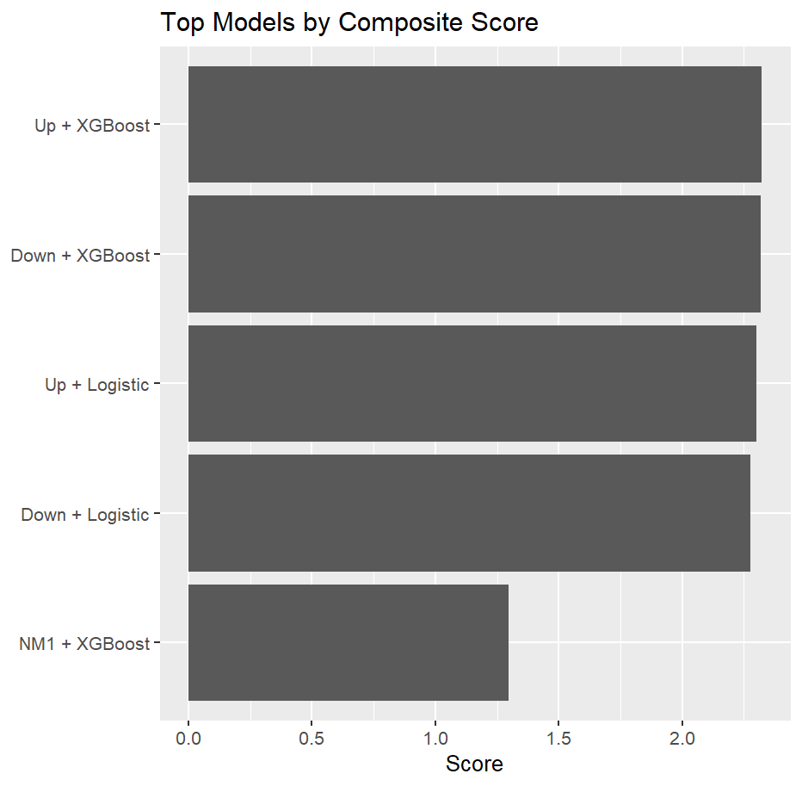
Top Models
The highest-ranking model was Upsampling + XGBoost, which achieved the best composite score across all metrics and comfortably met both TPR min. thresholds with TPR Yes = 75.7% and TPR No 86.3%.
Achieved the best balance of sensitivity and specificity
The top 3 models were:
Up + XGBoost
Down + XGBoost
Up + Logistic
Why Up XGBoost worked?
Notes:
Speaker Notes: Here we list the top four model configurations and some of their key numbers. The star of the show is the up-sampled XGBoost model – it identifies about 75–76% of the children with difficulties and correctly recognizes about 86% of those without, which is a very good trade-off for our purposes. Its ROC AUC of ~0.88 indicates strong overall discrimination, and the MCC of 0.47 shows a good balance considering the imbalance problem. Close on its heels was the down-sampled XGBoost. That one actually caught a bit more of the “Yes” cases (around 80% of them) but it was slightly less accurate on the “No” cases. The difference between these two is small; both are high-performing, but we favored the balance that the up-sampling approach gave us. We also show results for logistic regression with both up- and down-sampling. The logistic models did quite well for such a simple method – the down-sampled logistic just met the thresholds, and the up-sampled logistic traded some specificity for a bit more sensitivity. They serve as a strong baseline and validate that our data processing and resampling were effective, even for linear models. However, neither could match the boosted tree models in overall performance.

Slide 12
Extended Validation and Best Model Update
The models were retested on 10-fold cross validation, as this reduces variance across folds and confirms our model's robustness.
Up + XGBoost gave us the second-best results with respect to thresholds provided in our project, missing the best TPR_YES value of 76% by 0.3% for 10-fold but it was the best performing with 10-fold cross validation
Down + XGBoost performed the best with clearing all the thresholds previously in 3-fold cross validation, but 10-fold cross validation makes our model more robust. That’s why the results for this was finalized at last
Notes:
Speaker Notes: After identifying our top contenders, we put them through a more rigorous test: 10-fold cross-validation. Instead of relying only on the single train-test split, we effectively retrained and validated the models across 10 different splits to see if their performance holds up. The up-sampled XGBoost continued to shine – it consistently hit the required sensitivity levels fold after fold, which gave us confidence that its performance generalizes well and isn’t just a fluke on one split. The down-sampled XGBoost was not far behind at all; it did great in most folds, but we noticed its recall for the “Yes” class fluctuated a bit more between folds. This could be due to the random reduction of data each fold – sometimes you might drop informative examples in down-sampling.

Slide 13
Evolution of XGBoost Hyperparameter Tuning
We started with max_depth 2-3, eta 0.05-0.07, nrounds 60-80
CV results showed TPR_Yes too low around 0.68-0.71.
So, we moved eta to 0.05-0.09, n rounds to 90 from 80, but not 100.
Max depth fixed at 2, as 3 improved tpr_yes but hurt tpr_no, as shallow trees generalize better.
Gamma from 0 or 1 went to 3, which helped in avoiding weak splits, and stabilizing boundaries for No-class
Reduced tiny unstable leaves by changing min_child_weight from 5 to 6, for which we paid the cost
These tunings gave us our best result initially.
After checking our models with 10-fold cross validation, our best model was still XGBoost with the same manually set hyperparameter.
Upsampling gave us our best results this time.

Slide 14
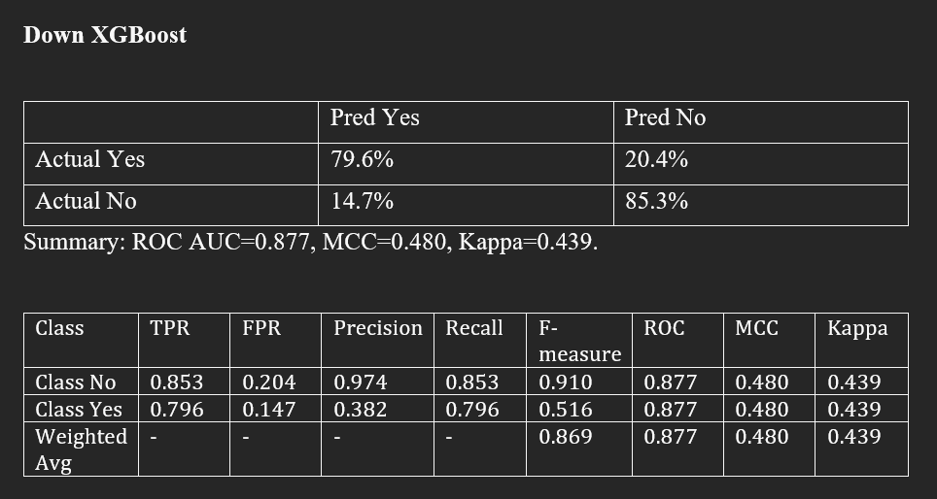
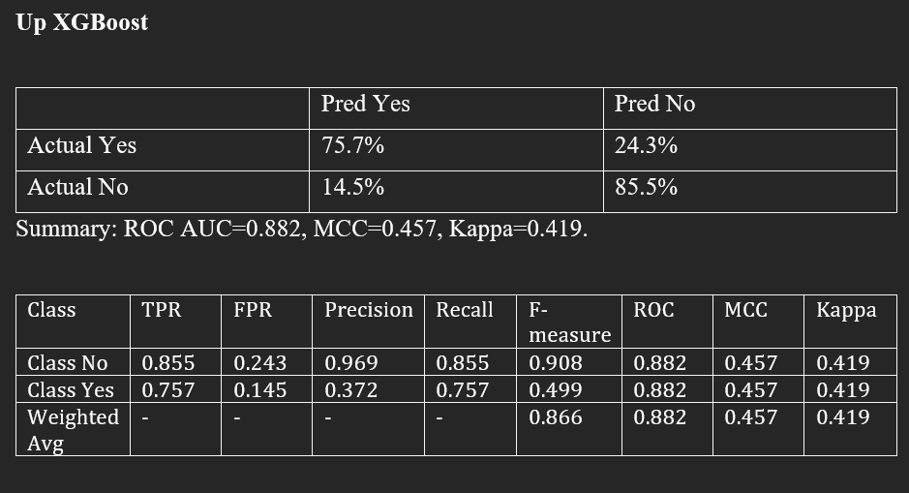
3-Fold Cross Validation Selected Model Performance & Comparison

Slide 15
10-Fold Cross Validation Selected Models and Performance
Rank | Model | TPR_No | TPR_Yes | ROC | F1_Yes | MCC | Kappa
1 | Up + XGBoost | 0.8631 | 0.7566 | 0.8798 | 0.5111 | 0.4689 | 0.4347
2 | Down + XGBoost | 0.8362 | 0.7763 | 0.8756 | 0.4826 | 0.4431 | 0.3979
3 | Up + Logistic | 0.8459 | 0.7434 | 0.8663 | 0.4798 | 0.4349 | 0.3964
4 | Down + Logistic | 0.8160 | 0.7434 | 0.8509 | 0.4423 | 0.3960 | 0.3489
Model | TP | FN | FP | TN
Up + XGBoost (Best) | 115 | 37 | 183 | 1154
Down + XGBoost | 118 | 34 | 219 | 1118
Up + Logistic | 113 | 39 | 206 | 1131
Down + Logistic | 113 | 39 | 246 | 1091

Slide 16
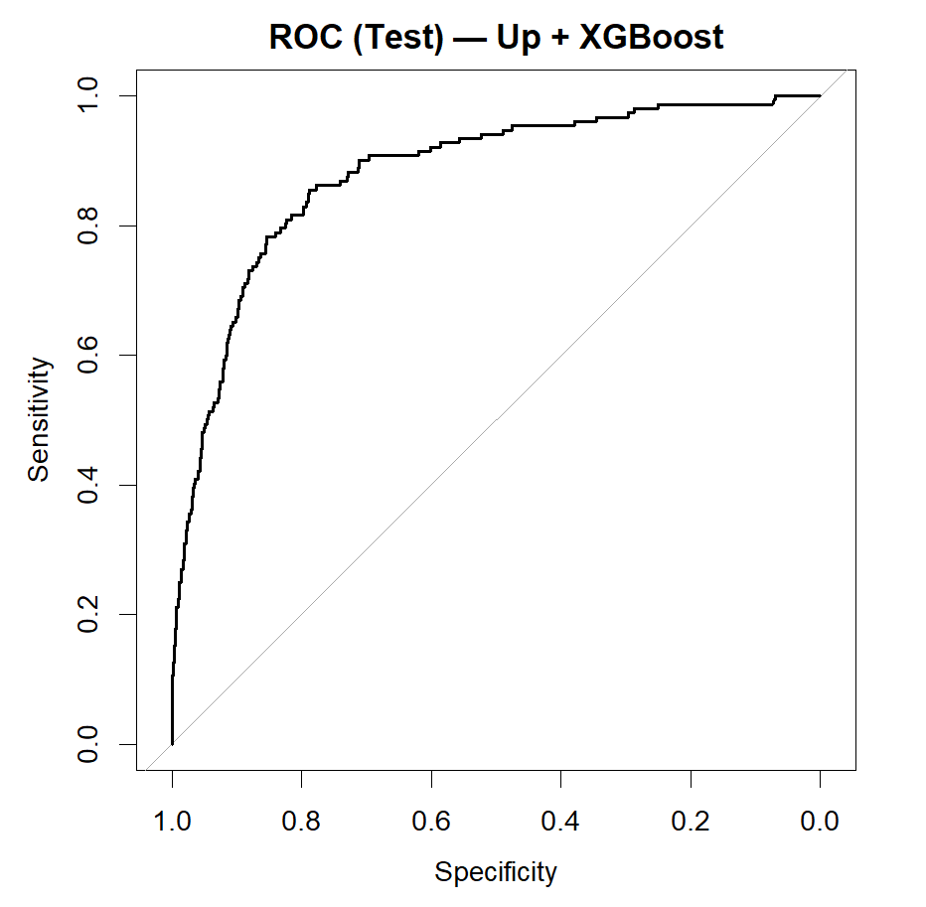
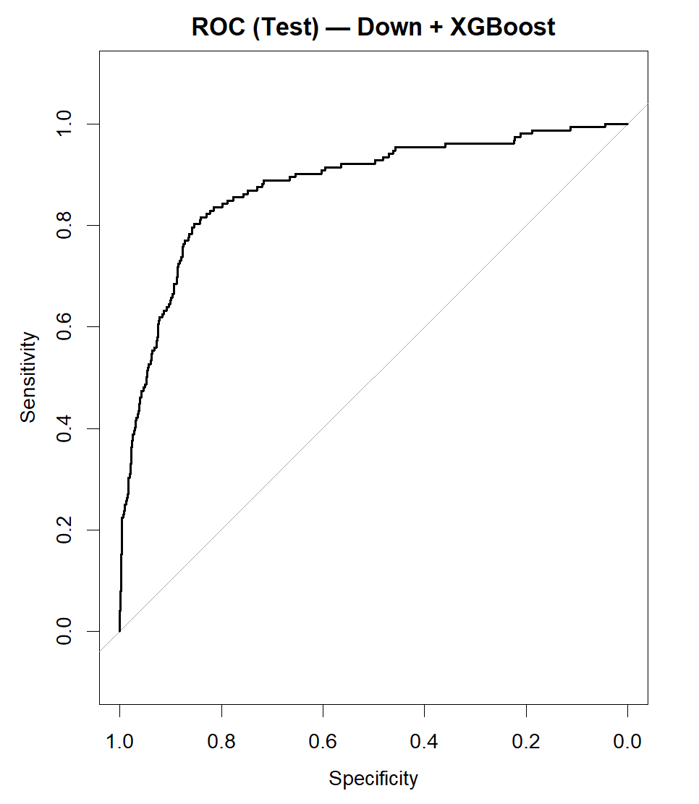
ROC Curve
The ROC curve is well above the diagonal baseline, confirming the model has strong discriminative power beyond random guessing.
Also, the curve’s shape and distance from 45-degree line suggest the model generalizes well, without overfitting to odd patterns in training.
The AUC 0.88 confirms that the model has excellent overall ability to rank-order positive vs negative cases.
Notes:
One way to visualize our model’s performance is with the ROC curve – plotting the true positive rate against the false positive rate at various thresholds. For our final XGBoost model, the ROC curve is pretty far up towards the top-left corner, which is where you want to be. In plain terms, the model achieves a high sensitivity while keeping the false positive rate low. The area under this curve is around 0.88, which is considered quite high. This gives us confidence that the model is doing a good job distinguishing children who have learning difficulties from those who don’t, across the spectrum of possible threshold settings. Moreover, the shape of the curve is nice and smooth, without any weird dips – a sign that the model’s performance is consistent and not just due to overfitting some quirks in the data.

Slide 17
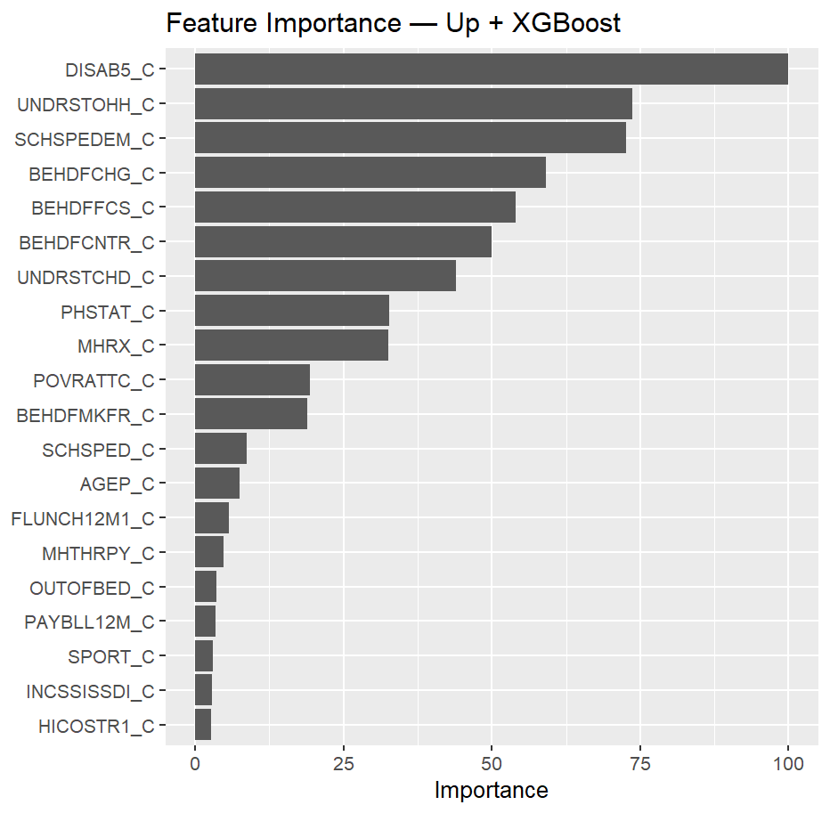
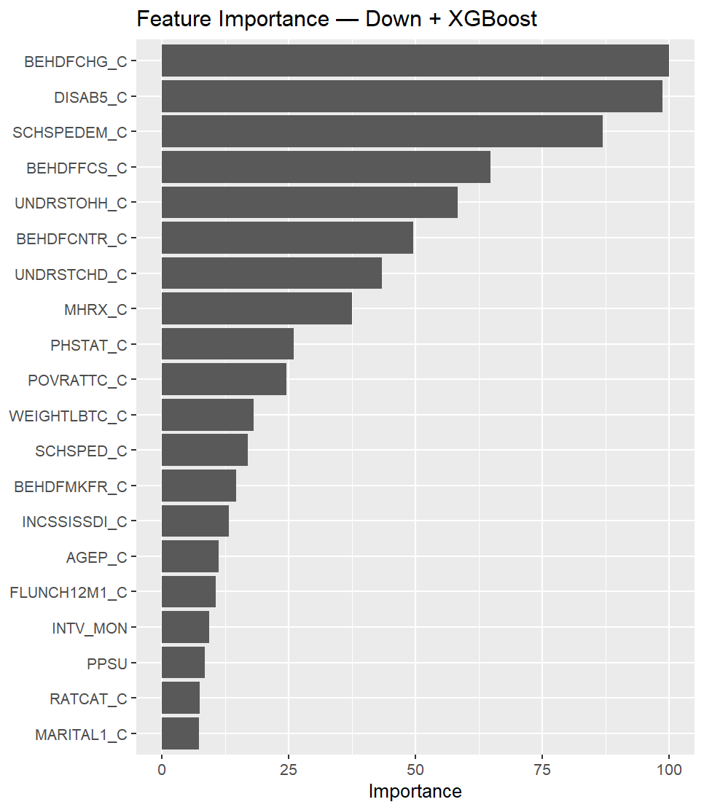
Feature Importance – What Drives the Model
Top Predictors: The XGBoost model provides feature importance scores, revealing which inputs most influence the predictions.
DISAB5_C – A consistent top feature across both models, flagging some form of disability.
BEHDFCHG_C – Strongly predictive of behavioral change difficulties.
SCHSPEDEM_C – Indicates special education or medical needs.
BEHDFFCS_C – Suggests trouble with family/peer interaction.
UNDSTROHH_C –Speech clarity issues, which means how often other people have difficulty understanding child’s speech..
Notes:
Speaker Notes: We also wanted to peek under the hood of the model to see what factors it’s leveraging. XGBoost can give us an importance ranking of features. The features you see listed here came out on top. For example, DISAB5_C – without needing to know the exact survey code, we identified it corresponds to some disability status indicator. It’s logical that this is a top predictor: if a child is reported to have a certain disability, that likely correlates with learning difficulties. Similarly, BEHDFCHG_C refers to behavioral change difficulties, and SCHSPEDEM_C is about special education or medical needs at school – both very intuitively linked to learning challenges. We also saw features related to social behavior and speech clarity. The fact that these features are driving the model’s decisions is a good sanity check. It means the model is focusing on meaningful attributes that experts might also consider warning signs, rather than latching onto random noise or artifacts in the data. This gives us an extra layer of trust in the model’s outputs.

Slide 18
Algorithm Comparison
XGBoost Dominance: Across the board, XGBoost models tended to outperform others, regardless of sampling method. The ensemble approach with boosting provide the best balance of higher recall for Yes while controlling FP for No.
Strong Baselines: Bagging and logistic Regression proved to be very reliable second tier models. Bagging helped stabilize the high-variance nature of individual trees and produced balanced performance.
Random forest did well overall but showed some instability especially with NM1, likely due to losing diversity in data. SVM and the neural network benefited from having more minority examples.
Naïve Bayes and k-NN were consistently outperformed by other models, because its independence assumption broke down with our many correlated features, and they also suffered with high dimensionality and the curse of distance.
Notes:
When we compare all the algorithms we tried, some clear trends emerged. First and foremost, XGBoost was the top performer. No matter how we balanced the data, the XGBoost models tended to come out with the best metrics. This isn’t too surprising – boosting is a very powerful technique, and in this case it let us have our cake and eat it too: we got high sensitivity on the rare class while still keeping false positives in check. Next, we found that bagging and logistic regression were consistently in the upper tier of performance as well. Bagging (which is an ensemble of random trees) gave us a robust model that didn’t overfit easily; it’s a good method for variance reduction. Logistic regression, although simple, actually did quite well especially when we fed it balanced data. It’s a reminder that a well-prepared dataset can make even simple models effective. Random forest was decent, but interestingly it wasn’t as stable under certain sampling strategies – for example, in the NearMiss scenario, removing so many normal cases seems to have thrown it off a bit. SVM and our one-hidden-layer neural network both needed more minority examples to learn effectively, which is why they did better with up-sampling; however, they showed signs of overfitting if not carefully tuned, likely due to their flexibility. Finally, the algorithms that didn’t shine were Naïve Bayes and k-NN. With hundreds of features, Naïve Bayes’ assumption that everything is independent just doesn’t hold – many health and social variables in our data are correlated, and that method can’t handle that. k-NN suffered from the high dimensional space; distance-based methods can become unreliable when you have so many features, many of which may be irrelevant or noisy for the task.

Slide 19
Impact of Balancing Strategies
Downsampling: Training on a down-sampled dataset yielded models that generalized to the test set. By training on an evenly reduced dataset, models like XGBoost and Bagging could focus on truly discriminative patterns without being distracted by majority data.
Upsampling: It improved recall for the minority class in many models. It also gave us our best working models by increasing the minority class and balancing the dataset for both, it helped model to learn nicely the Yes values and it also enhanced Kappa a lot with XGBoost and logistic regression
Synthetic Oversampling: The synthetic jitter approach gave a richer set of minority examples, which enhanced sensitivity/recall and sometimes AUC for models. But we observed that if the synthetic points were too far from real data, then they don’t give that much learning to our model
NearMiss-1: NearMiss undersampling made the training data very focused on difficult “borderline” examples. This benefited methods like k-NN and SVM that rely on distance,.
Notes:
We applied four different strategies to cope with class imbalance, and each influenced the model training in a distinct way. Down-sampling was a surprisingly effective blunt tool – by cutting down the majority class, we reduced noise and made the training task easier in some sense. Many models trained on down-sampled data did very well on the test set, likely because they weren’t overwhelmed by the abundance of “No” cases. Up-sampling, on the other hand, made sure models saw a lot of “Yes” cases. This was great for improving sensitivity – models simply had more opportunities during training to learn what a “Yes” looks like. The cost was that models might start seeing “Yes” everywhere, including where it’s not – hence more false positives. We certainly saw that pattern: recall went up, but precision and some overall metrics could dip. Interestingly, our best model is an up-sampled one, which goes to show that a strong algorithm like XGBoost can take advantage of those extra positives without overly freaking out about them – it kept false positives at a reasonable level. The synthetic oversampling method was a bit of a mixed bag. It gave us additional minority examples which in theory cover variations that weren’t present originally. This helped some models in terms of raw recall and even AUC. But we had to be careful – generating synthetic data can sometimes introduce unrealistic samples. If a model starts to fit to those, it might not perform as well on real data. Finally, NearMiss undersampling was like training with only the toughest negative examples. It really helped methods that look at local relationships (like k-NN or SVM), by making the class boundary very clear. But because we threw away a lot of “easy” majority examples, some models ended up not generalizing as well – they somewhat forgot what typical “No” cases look like. The bottom line is each strategy has pros and cons. In practice, you often have to try multiple approaches. For us, down-sampling and up-sampling were the standouts, and ultimately up-sampling combined with XGBoost gave the best result, showing that method-algorithm synergy is important.

Slide 20
Conclusion & Future Directions
We built a fully reproducible machine learning pipeline that meets the problem’s requirements.
We achieved TPR approx. 0.80 for learning difficulty cases and TPR approx. 0.85 for no-cases on test data initially and then we achieved 86.3 TPR for no cases and 75.7 TPR for yes cases. AUC = 0.88 and stable metrics across folds indicate the model generalizes well. The pipeline’s use of balancing, CV tuning and rigorous evaluation ensures confidence in the results.
Feature importance analysis confirmed that the model is leveraging meaningful predictors.
The chosen model could be used as a decision support tool for early screening of learning difficulties. For e.g., health practitioner’s or educators could flag at risk children.
To further improve, we could explore ensemble-of-ensemblers(combining top models), voting classifiers, advanced hyperparameters tuning using Bayesian optimization.

Slide 21
THANKYOU

