Slide 1
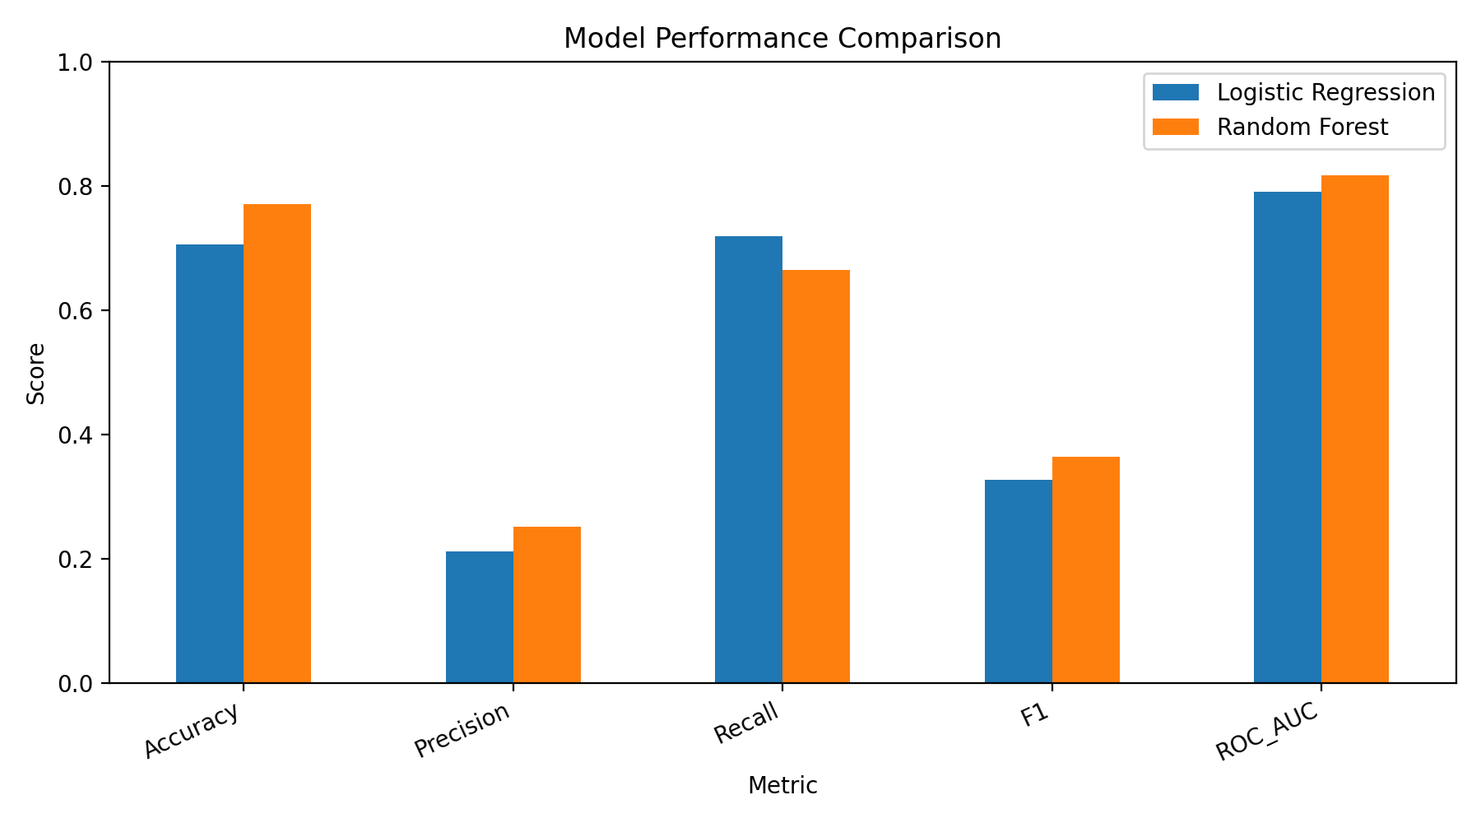
Self-Learning Tutorial
Predicting In-Hospital Mortality with MIMIC-III
Machine learning tutorial using demographics and first-24-hour lab values
Final model comparison from notebook results
Notes:
Github repo link: https://github.com/RyanSolanki/AI_In_Healthcare/settings

Slide 2
Tutorial Roadmap
OVERVIEW
What a peer should be able to rebuild after following this deck
1
Load MIMIC-III tables
Admissions, patients, lab events, and lab-item dictionary.
Learning goal: build a healthcare ML workflow that is explainable, reproducible, and careful about data leakage.
2
Engineer early-admission features
Age, demographics, target label, and first-24-hour lab summaries.
Analysis topic: predicting in-hospital mortality
ML methods: baseline linear model + nonlinear ensemble
Tutorial elements: commented code, plots, model interpretation, and rebuild checklist
3
Train models
Compare Logistic Regression and Random Forest using the same preprocessing pipeline.
4
Evaluate and explain
Use ROC AUC, recall, precision, F1, confusion matrices, and feature importance.

Slide 3
Healthcare ML Task
PROBLEM
Predict mortality risk using information available early in the hospital stay
Prediction target
target_col = "TARGET"
# 1 = died during admission
# 0 = survived to discharge
df["TARGET"] = df["HOSPITAL_EXPIRE_FLAG"]
Outcome: HOSPITAL_EXPIRE_FLAG
1 = patient died during hospital admission
0 = patient survived to discharge
Unit of analysis: hospital admission, identified by HADM_ID
Model inputs
Demographics and admission categories
Age calculated at admission
Lab values measured only within first 24 hours
No discharge time, death time, or length of stay used as features
Why early data? It makes the prediction problem realistic and reduces leakage from future events.

Slide 4
Data Sources and Table Join Strategy
DATA
Four MIMIC-III tables create one modeling dataset
ADMISSIONS
LABEVENTS
Admission time, type, insurance, ethnicity, diagnosis, outcome
Time-stamped numeric lab results
PATIENTS
D_LABITEMS
Gender and date of birth for age calculation
Lab test labels used to select common labs
Final dataset: one row per hospital admission, with demographics + first-24-hour lab summaries
ADMISSIONS_PATH = "ADMISSIONS.csv.gz"
PATIENTS_PATH = "PATIENTS.csv.gz"
LABEVENTS_PATH = "LABEVENTS.csv.gz"
D_LABITEMS_PATH = "D_LABITEMS.csv.gz"

Slide 5
Step 1: Load Data and Merge Demographics
STEP 1
Keep only columns needed for the tutorial to reduce memory usage
admissions = pd.read_csv(
ADMISSIONS_PATH,
compression="gzip",
usecols=["SUBJECT_ID", "HADM_ID", "ADMITTIME",
"DISCHTIME", "ADMISSION_TYPE", "INSURANCE",
"ETHNICITY", "HOSPITAL_EXPIRE_FLAG"]
)
patients = pd.read_csv(
PATIENTS_PATH,
compression="gzip",
usecols=["SUBJECT_ID", "GENDER", "DOB"]
)
df = admissions.merge(patients, on="SUBJECT_ID", how="left")
Tutorial design choice: load only the columns used later so a peer can run the notebook more easily.
Convert ADMITTIME, DISCHTIME, and DOB to datetime
Merge admissions and patients on SUBJECT_ID
Preserve HADM_ID as the admission-level identifier
Do not load raw columns that are never used in the tutorial

Slide 6
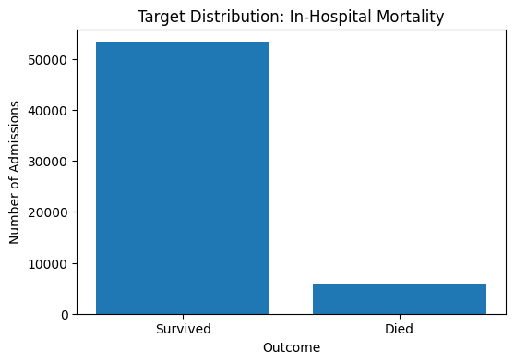
Step 2: Create Target and Demographic Features
STEP 2
Outcome imbalance matters for model evaluation
df["AGE"] = df["ADMITTIME"].dt.year - df["DOB"].dt.year
birthday_not_reached = (
(df["ADMITTIME"].dt.month < df["DOB"].dt.month) |
((df["ADMITTIME"].dt.month == df["DOB"].dt.month) &
(df["ADMITTIME"].dt.day < df["DOB"].dt.day))
)
df.loc[birthday_not_reached, "AGE"] -= 1
df["AGE"] = df["AGE"].clip(lower=0, upper=90)
df["TARGET"] = df["HOSPITAL_EXPIRE_FLAG"]
The target is imbalanced: most admissions survive, so accuracy alone is not enough.
Target distribution from notebook
Use recall to measure how many deaths are detected
Use precision to understand false alarms
Use ROC AUC to compare risk-ranking ability

Slide 7
Step 3: Select Common Lab Tests
STEP 3
Use clinically meaningful labs that are often available early
Select a small list of common labs to keep the tutorial focused
Use D_LABITEMS to map ITEMID values to human-readable lab names
Filter LABEVENTS to selected ITEMIDs and non-missing numeric values
Convert CHARTTIME to datetime for the 24-hour window filter
common_labs = [
"HEMATOCRIT", "HEMOGLOBIN", "PLATELET COUNT",
"WHITE BLOOD CELLS", "CREATININE", "UREA NITROGEN",
"SODIUM", "POTASSIUM", "CHLORIDE", "BICARBONATE",
"GLUCOSE", "ANION GAP"
]
d_labitems["LABEL_UPPER"] = d_labitems["LABEL"].str.upper().str.strip()
selected_labitems = d_labitems[d_labitems["LABEL_UPPER"].isin(common_labs)]
Rebuild tip: start with a limited lab list first; expand only after the pipeline works end-to-end.
selected_itemids = selected_labitems["ITEMID"].unique().tolist()
labevents = labevents[labevents["ITEMID"].isin(selected_itemids)]
labevents = labevents.dropna(subset=["VALUENUM"])

Slide 8
Step 4: Prevent Leakage with a First-24-Hour Window
STEP 4
Use lab values collected shortly after admission
lab_with_admit = labevents.merge(
admissions[["HADM_ID", "ADMITTIME"]],
on="HADM_ID",
how="inner"
)
lab_with_admit["HOURS_FROM_ADMIT"] = (
lab_with_admit["CHARTTIME"] - lab_with_admit["ADMITTIME"]
).dt.total_seconds() / 3600
first_24h_labs = lab_with_admit[
(lab_with_admit["HOURS_FROM_ADMIT"] >= 0) &
(lab_with_admit["HOURS_FROM_ADMIT"] <= 24)
]
Leakage example to avoid
Using discharge time, death time, or labs after the prediction point can make the model look better than it really is.
A
Admission time
Start the clock at ADMITTIME.
B
Early lab window
Keep labs between 0 and 24 hours.
C
Prediction point
Train the model using only early information.

Slide 9
Step 5: Aggregate Labs into Model Features
STEP 5
Convert repeated lab measurements into one row per admission
lab_features = first_24h_labs.pivot_table(
index="HADM_ID",
columns="LABEL_UPPER",
values="VALUENUM",
aggfunc=["mean", "min", "max"]
)
lab_features.columns = [
f"{stat}_{lab}".replace(" ", "_")
for stat, lab in lab_features.columns
]
lab_features = lab_features.reset_index()
model_df = df.merge(lab_features, on="HADM_ID", how="left")
Notebook output: model_df shape = 58,976 rows × 54 columns
Multiple measurements of the same lab are summarized
Mean captures central tendency
Minimum and maximum capture abnormal low/high values
Missing labs are handled later through median imputation
Why aggregate? Most sklearn models expect a fixed feature matrix: one row per case and one column per feature.

Slide 10
Step 6: Preprocess and Split the Data
STEP 6
Use one sklearn pipeline for reproducible training and testing
X_train, X_test, y_train, y_test = train_test_split(
X, y,
test_size=0.2,
random_state=42,
stratify=y
)
numeric_transformer = Pipeline([
("imputer", SimpleImputer(strategy="median")),
("scaler", StandardScaler())
])
categorical_transformer = Pipeline([
("imputer", SimpleImputer(strategy="constant", fill_value="Unknown")),
("onehot", OneHotEncoder(handle_unknown="ignore"))
])
Train/test split from notebook
47,180 training rows
11,796 testing rows
Stratification keeps mortality prevalence similar across train and test sets
Numeric features: median imputation + scaling
Categorical features: fill missing + one-hot encode
The same preprocessing is applied inside each model pipeline

Slide 11
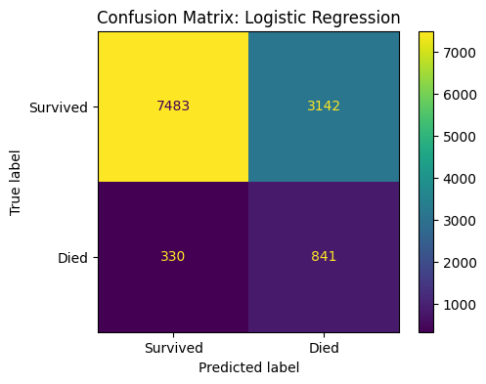
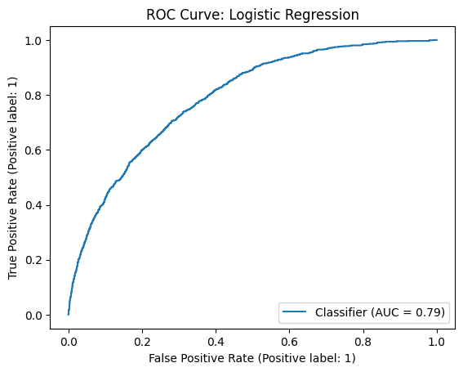
Model 1: Logistic Regression Baseline
MODEL 1
Interpretable model with balanced class weights
log_reg_model = Pipeline([
("preprocessor", preprocessor),
("classifier", LogisticRegression(
max_iter=1000,
class_weight="balanced",
random_state=42
))
])
log_reg_model.fit(X_train, y_train)
Confusion matrix
ROC curve
Result: ROC AUC = 0.791 | Recall = 0.718 | Precision = 0.211
Strength: identifies a large share of mortality cases
Weakness: many false positives because precision is low
Use case: simple baseline and interpretable comparison model

Slide 12

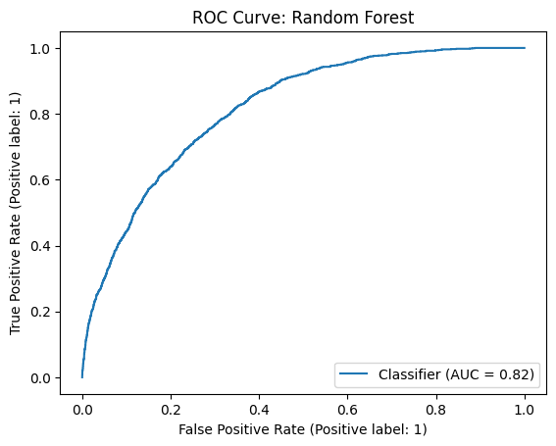
Model 2: Random Forest
MODEL 2
Nonlinear model that captures interactions among labs and demographics
rf_model = Pipeline([
("preprocessor", preprocessor),
("classifier", RandomForestClassifier(
n_estimators=300,
max_depth=10,
min_samples_leaf=10,
class_weight="balanced",
random_state=42,
n_jobs=-1
))
])
rf_model.fit(X_train, y_train)
Confusion matrix
ROC curve
Result: ROC AUC = 0.816 | Recall = 0.664 | Precision = 0.251
Higher ROC AUC than logistic regression
Better F1 score because precision improves more than recall drops
Chosen as the final tutorial model for overall balance

Slide 13
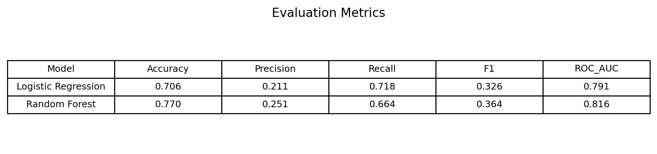
Model Comparison and Final Selection
RESULTS
Random Forest performs best overall
Metric table
Random Forest has the highest ROC AUC: 0.816
Random Forest has the highest F1 score: 0.364
Logistic Regression has higher recall: 0.718
Clinical tradeoff: high recall reduces missed mortality cases, but low precision can cause alert fatigue
Bar chart created from notebook metrics
Final tutorial model: Random Forest, because it gives the best overall risk-ranking and precision/recall balance.

Slide 14
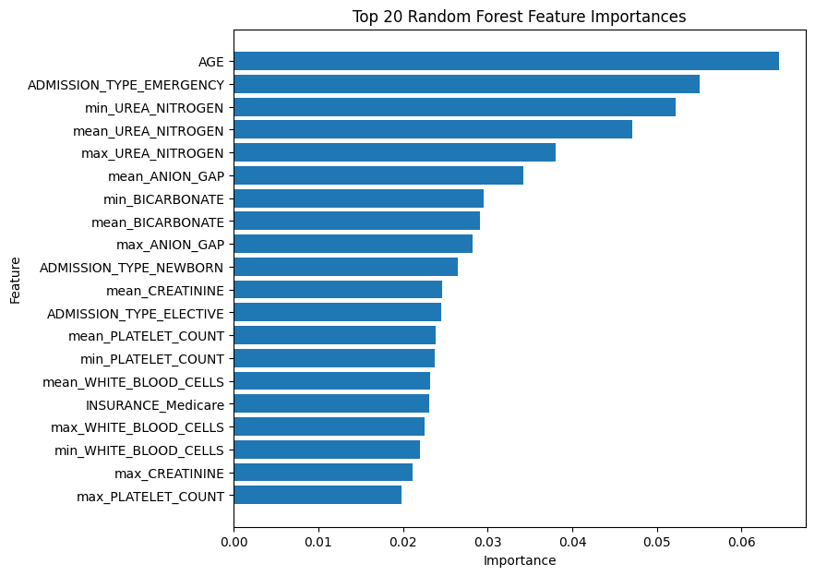
Explainability: Random Forest Feature Importance
EXPLAIN
Interpret which features contributed most to predictions
Age is the strongest predictor in this model
Emergency admission type is highly informative
Urea nitrogen, bicarbonate, anion gap, creatinine, platelet count, and white blood cell labs contribute strongly
Feature importance does not prove causality; it shows model usage
Teaching point: model explanations should be described as associations learned from data, not causal medical conclusions.
Top 20 Random Forest feature importances

Slide 15
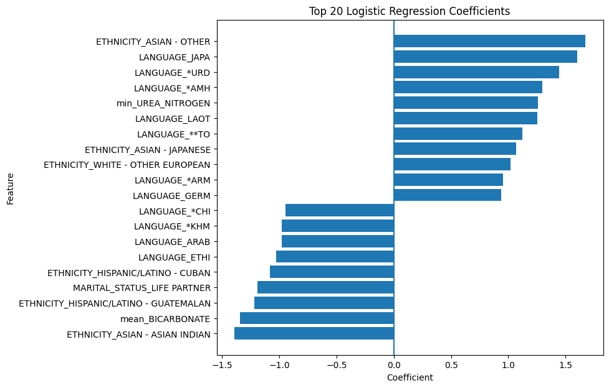
Optional Interpretation: Logistic Regression Coefficients
EXPLAIN
A second explanation view from the baseline model
Positive coefficients increase predicted mortality risk
Negative coefficients decrease predicted mortality risk
Because features are scaled and one-hot encoded, values are interpreted in the transformed feature space
Use this as a teaching comparison to the random forest feature-importance plot
coef_df = pd.DataFrame({
"Feature": log_reg_feature_names,
"Coefficient": log_reg_coefficients
})
coef_df["AbsCoefficient"] = coef_df["Coefficient"].abs()
Top 20 logistic regression coefficients

Slide 16
How to Rebuild This Tutorial
REBUILD
Checklist for peer reviewers and future reuse
Place ADMISSIONS.csv.gz, PATIENTS.csv.gz, LABEVENTS.csv.gz, and D_LABITEMS.csv.gz in the notebook directory
Run cells in order: load data → engineer features → filter first-24-hour labs → aggregate labs → train models → evaluate
Confirm no leakage variables are used: DEATHTIME, DISCHTIME, LOS_DAYS, and HOSPITAL_EXPIRE_FLAG are excluded from X
Compare models using ROC AUC, recall, precision, F1, confusion matrices, and ROC curves
Submit slides as PowerPoint to preserve speaker notes and submit code as PDF
# Minimal reproducibility check
print(model_df.shape)
print(results)
print(importance_df.head(20))
Final conclusion: first-24-hour MIMIC features can train a useful mortality-risk model, but deployment would require external validation, fairness checks, and clinical review.
Privacy reminder: do not share raw MIMIC data publicly.

