Slide 1
Two Shuffling Techniques in Poker
Yu Chao
Geoffrey Wong
*Desclaimer: This presentation does not encourage any gambling behaviour.
*You are also like a decade too late to try using these knowledges to make money from gambling

Slide 2
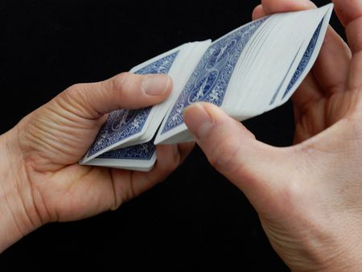
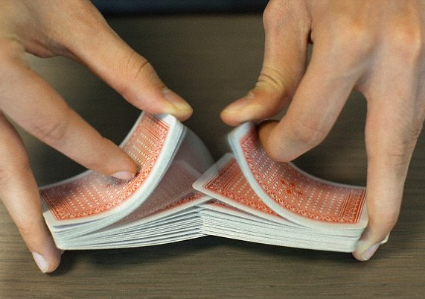
The Two Shuffling Techniques
Overhand Shuffle
Riffle Shuffle
We are going to…
1. Formally model them.
2. Evaluate their effectiveness
3. Come up with card guessing algorithms.

Slide 3
Overhand Shuffle Model
Pick a card A uniformly random from the deck, excluding the first and the last card.
Pick a card B uniformly random from [the next card of A] to the [last card of the deck].
Take out the packet of cards from A to B (inclusively) and place them on the top of the deck.
Python Code:
deck = list(range(1, 53))
# Start the shuffle.
a = random.randint(1, 51)
b = random.randint(a+1, 52)
deck = deck[a:b+1] + deck[:a] + deck[b+1:]
https://repl.it/@YuChao1/ESTR2002

Slide 4
Riffle Shuffle Model
The Gilbert-Shanon-Reeds (GSR) Model (1955):
The deck is divided into two packets, with K and 52-K cards respectively. K = k is a random variable which P(K = k) = (52 choose k) / (2^n) , where k = 0, 1, 2, 3, …, 52. (aka Binomial Random Variable)
The cards are moved from the bottom of the two packets one at a time, with x / (x + y) and y / (x + y) probability of choosing from the left and right packet respectively, when the left packet contains x cards and the right packet contains y cards.

Slide 5
Python Code for GSR Model
deck = list(range(1, 53))
# Start the shuffle.
coin_flips = [random.randint(0, 1) for _ in range(len(self.cards))]
heads, tails = coin_flips.count(1), coin_flips.count(0)
left_packet, right_packet = cards[:heads], cards[heads:]
result = []
for coin in coin_flips:
if coin == 1:
result.append(left_packet[0])
left_packet = left_packet[1:]
else:
result.append(right_packet[0])
right_packet = right_packet[1:]
deck = result

Slide 6
Evaluation of Randomness
Through repeated card guessing experiments.
Card Guessing Procedure:
Starting from an ordered deck.
The deck is shuffled in a predetermined way. (For example, overhand shuffle, twice.)
Guess the card one at a time from the top. The card is revealed immediately after guessing. Repeat this step until the deck is empty.
(Record the number of correct guesses.)

Slide 7
Expected Value of Correct Guesses
If we guess randomly, the probability of a correct guess each turn is 1/52, thus the expected value is E[X] = 52 * E[Xi] = 52 * (1/52) = 1.
If we eliminate the possibility of the cards thrown to the discard pile, the expected value is E[X] = E[X1] + E[X2] + … + E[X52] = (1/52) + (1/51) + … + (1/1) ≈ 4.538.
Therefore, if we manage to derive information from the shuffling method, the average correct guesses should be higher than 4.538.

Slide 8
Increasing Sequence
A core concept in our card guessing algorithm.
An increasing sequence is a subsequence in the deck where every next element is greater than the current element by exactly 1.
Example:
[1,2,3,4,5,6,7,8,9,10] has only one increasing sequence: [1,2,3,4,5,6,7,8,9,10].
[1,2,7,3,4,8,9,5,10,6] has two increasing sequences: [1,2,3,4,5,6], [7,8,9,10].
[4,1,2,7,8,9,5,10,3,6] has three increasing sequences: [1,2,3], [4,5,6], [7,8,9,10].

Slide 9
Machine Learning Agent
deck_size = 52
embedding_size = 128
batch_size = 500
hidden_size = 1024
layers = 3
learning_rate = 1e-4
x = tf.placeholder(tf.int32, [batch_size, deck_size])
y = tf.placeholder(tf.int32, [batch_size, deck_size])
embedding = tf.Variable(tf.random_normal([deck_size+1, embedding_size]))
card_embed = tf.nn.embedding_lookup(embedding, x)
cell = rnn.MultiRNNCell([rnn.LSTMCell(hidden_size) for _ in range(layers)] + [rnn.LSTMCell(deck_size)])
fc, state = tf.nn.dynamic_rnn(cell, card_embed, dtype = tf.float32)
Loss = tf.nn.sparse_softmax_cross_entropy_with_logits(labels = y, logits = fc)

Slide 10
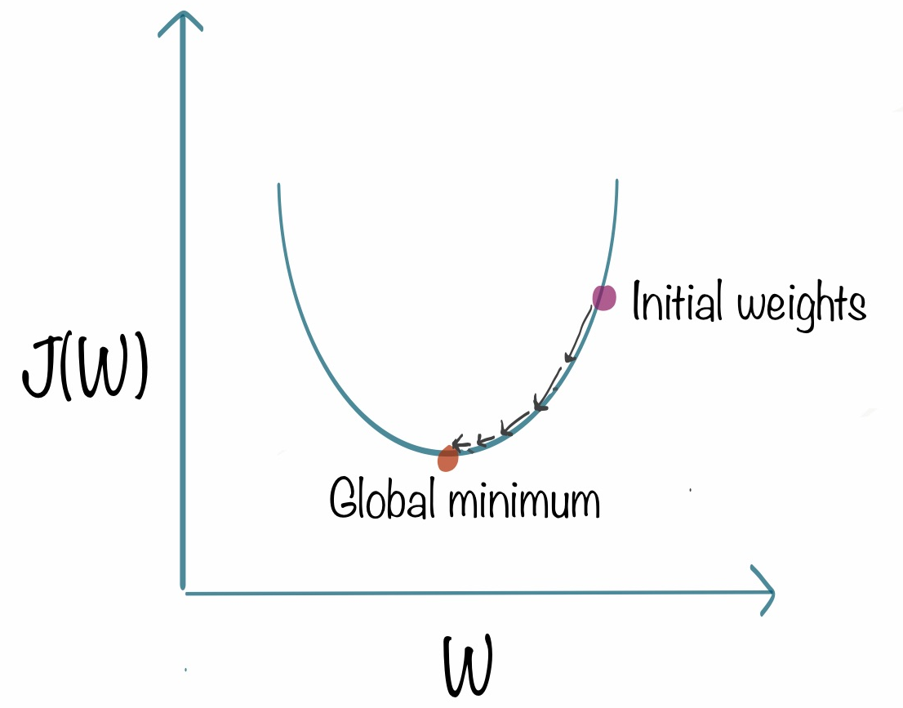
Machine Learning Agent
Purpose:
Insurence
Approximate Accuracy for Algorithm
Expectation:
Acc. ML Agent would be Below Optimal

Slide 11
Card Guessing Algorithms for Overhand Shuffle
If it is the first round, we guess 1.
Otherwise, we take the revealed card C from the last turn as reference, and make our prediction as the smallest possible valid card V such that:
It has not been revealed yet.
It is larger than C.
It is in range of the numbers in the deck.
If no such V exists, we guess randomly from the possible cards (i.e. the cards which have not been revealed yet).
Reveal the target card and compare it to our prediction. Record the results.

Slide 12
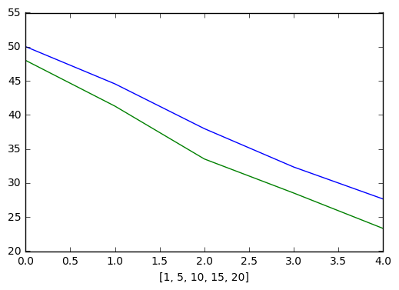
Results
Accuracy Over Number of Shuffle
Overhand Shuffle 1, 5, 10, 15, 20 times
Algorithm
Neural Network
0 overhand shuffle: 52.0 cards
1 overhand shuffle: 50.00 cards
5 overhand shuffle: 44.5481 cards
10 overhand shuffle: 37.9937 cards
15 overhand shuffle: 32.3651 cards
20 overhand shuffle: 27.6372 cards
…
250 overhand shuffle: 4.5374 cards
Around 4.538 after that

Slide 13
Card Guessing Algorithm for Riffle Shuffle
Each round, we construct a list of Valid Guesses by taking the next number K of each Known Increase Sequence by adding 1 to them.
If K is strictly greater than 52 or K was already flipped out of the deck, we discard K.
Otherwise, we append K to Valid Guesses and assign Valid Guesses to Known Increase Sequence.
If there is no element in Known Increase Sequences, we guess the first available card (i.e. 1 at the very beginning). Otherwise, we pick a random element from Known Increase Sequences as our guess.
Reveal the target card and record the result.
If the revealed card C belongs to one of the Known Increase Sequences, we update the encountered number of that sequence to C. Otherwise, this is a new Increase Sequence, so we append C to Known Increase Sequences.

Slide 14
Card Guessing Algorithm for Riffle Shuffle Examples
Current Sequences: [] → Guess 1
Revealed: [1, 2, 5, 3, 6], then it forms the following 2 increasing sequences
Current Sequences: [[1, 2, 3], [5, 6]] → Guess 4 or 7
Current Sequences: [[1, 2, 3, 4], [5, 6]] → Guess 7
Current Sequences: [[1, 2, 3, 4], [5, 6], [8], [51, 52]] → Guess 7 or 9
Orange : Exhausted Sequences

Slide 15
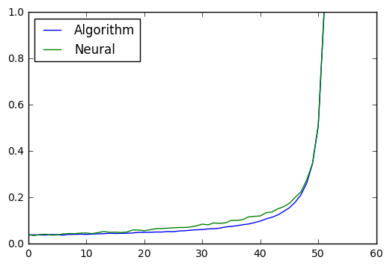
Results
Accuracy Over Timesteps (5 shuffle)
Algorithm:
1 shuffle: 27.01 cards
2 shuffle: 14.86 cards
3 shuffle: 9.12 cards
4 shuffle: 6.58 cards
5 shuffle: 5.43 cards
…
13 shuffle: 4.5365 cards
Neural Network
26.67 cards
15.09 cards
9.33 cards
6.83 cards
5.86 cards
Patterns exist for Better Prediction
→ Better Algorithm
* If we did not make mistake in the implementation of algorithm

Slide 16
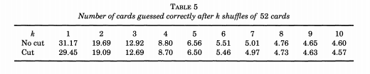
Conjectural Optimal
Card Trick Algorithm
27.01 | 14.86 | 9.12 | 6.58 | 5.43 | 4.96 | 4.72 | 4.65 | 4.60 | 4.56
→ Theoretically Achievable Optimal Algorithm
→ No Actually Algorithm Yet

Slide 17
End
Q&A

