Slide 1
Data and Computer Communications
Chapter 20 – Internetwork Quality
of Service
Ninth Edition
by William Stallings
Notes:
“Data and Computer Communications”, 9/e, by William Stallings, Chapter 20 “Internetwork Quality of Service”.

Slide 2
Transport Protocols
At St. Paul's a great throng crammed the platform. She saw a sea of faces, each stamped with a kind of purposeful, hungry urgency, a determination to get into this train. As before, when she was on the Northern Line, she thought there must be some rule, some operating law, that would stop more than a limited, controlled number getting in. Authority would appear and stop it.
—King Solomon's Carpet,
Barbara Vine (Ruth Rendell)
Notes:
This quote is from the start of Stallings DC9e Chapter 20.

Slide 3
Transport Protocols
Internet traffic continues to grow and change
demand for real-time responses
increasing use of audio, image, and video
heavy use of the World Wide Web
packet-switching technology with routers functioning as switches was not designed to handle voice and video
strong need to support a variety of traffic with QoS requirements within TCP/IP
Notes:
The traffic that the Internet and these internetworks must carry continues to grow and change. The demand generated by traditional data-based applications, such as electronic mail, Usenet news, file transfer, and remote logon, is sufficient to challenge these systems. But the driving factors are the heavy use of the World Wide Web, which demands real-time response, and the increasing use of audio, image, and video over internetwork architectures.
These internetwork schemes are essentially datagram packet-switching technology with routers functioning as the switches. This technology was not designed to handle voice and video and is straining to meet the demands placed on it.
To cope with these demands, it is not enough to increase internet capacity. Sensible and effective methods for managing the traffic and controlling congestion are needed. Historically, IP-based internets have been able to provide a simple best-effort delivery service to all applications using an internet. But the needs of users have changed. A company may have spent millions of dollars installing an IP-based internet designed to transport data among LANs but now finds that new real-time, multimedia, and multicasting applications are not well supported by such a configuration.
Thus, there is a strong need to be able to support a variety of traffic with a variety of quality-of-service (QoS) requirements, within the TCP/IP architecture. This chapter looks at the internetwork functions and services designed to meet this need.
Next, we look at the Integrated Services Architecture (ISA), which provides a framework for current and future internet services. We then look at a key protocol related to ISA called RSVP. Then, we examine differentiated services. Finally, we introduce the topics of service level agreements and IP performance metrics.

Slide 4
Integrated Service Architecture (ISA)
intended to provide QoS transport over IP-based Internets
defined in RFC 1633
portions already being implemented in routers and end-system software
Notes:
To meet the requirement for QoS-based service, the IETF is developing a suite of standards under the general umbrella of the Integrated Services Architecture (ISA). ISA, intended to provide QoS transport over IP-based internets, is defined in overall terms in RFC 1633, while a number of other documents fill in the details. Already, a number of vendors have implemented portions of the ISA in routers and end-system software.
This section provides an overview of ISA.

Slide 5
Internet Traffic - Elastic
traffic that can adjust, over wide ranges, to changes in delay and throughput and still meet the needs of its applications
traditional type of traffic supported on TCP/IP-based Internets
applications classified as elastic include:
FTP
SMTP
TELNET
SNMP
HTTP
Notes:
Traffic on a network or internet can be divided into two broad categories: elastic and inelastic. A consideration of their differing requirements clarifies the need for an enhanced internet architecture.
ELASTIC TRAFFIC
Elastic traffic is that which can adjust, over wide ranges, to changes in delay and throughput across an internet and still meet the needs of its applications. This is the traditional type of traffic supported on TCP/IP-based internets and is the type of traffic for which internets were designed. Applications that generate such traffic typically use TCP or UDP as a transport protocol. In the case of UDP, the application will use as much capacity as is available up to the rate that the application generates data. In the case of TCP, the application will use as much capacity as is available up to the maximum rate that the end-to-end receiver can accept data. Also with TCP, traffic on individual connections adjusts to congestion by reducing the rate at which data are presented to the network; this is described in Chapter 22.
Applications that can be classified as elastic include the common applications that operate over TCP or UDP, including file transfer (FTP), electronic mail (SMTP), remote login (TELNET), network management (SNMP), and Web access (HTTP). However, there are differences among the requirements of these applications. For example,
E-mail is generally insensitive to changes in delay.
When file transfer is done interactively, as it frequently is, the user expects the delay to be proportional to the file size and so is sensitive to changes in throughput.
With network management, delay is generally not a serious concern. However, if failures in an internet are the cause of congestion, then the need for SNMP messages to get through with minimum delay increases with increased congestion.
Interactive applications, such as remote logon and Web access, are sensitive to delay.
It is important to realize that it is not per-packet delay that is the quantity of interest. As noted in [CLAR95], observation of real delays across the Internet suggest that wide variations in delay do not occur. Because of the congestion control mechanisms in TCP, when congestion develops, delays only increase modestly before the arrival rate from the various TCP connections slow down. Instead, the QoS perceived by the user relates to the total elapsed time to transfer an element of the current application. For an interactive TELNET-based application, the element may be a single keystroke or single line. For a Web access, the element is a Web page, which could be as little as a few kilobytes or could be substantially larger for an image-rich page. For a scientific application, the element could be many megabytes of data.
For very small elements, the total elapsed time is dominated by the delay time across the internet. However, for larger elements, the total elapsed time is dictated by the sliding-window performance of TCP and is therefore dominated by the throughput achieved over the TCP connection. Thus, for large transfers, the transfer time is proportional to the size of the file and the degree to which the source slows due to congestion.
It should be clear that even if we confine our attention to elastic traffic, a QoS-based internet service could be of benefit. Without such a service, routers are dealing evenhandedly with arriving IP packets, with no concern for the type of application and whether a particular packet is part of a large transfer element or a small one. Under such circumstances, and if congestion develops, it is unlikely that resources will be allocated in such a way as to meet the needs of all applications fairly. When inelastic traffic is added to the mix, the results are even more unsatisfactory.

Slide 6
Internet Traffic - Inelastic
does not easily adapt, if at all, to changes in delay and throughput across an internet
real-time traffic
new internet architecture requirements:
resource reservation protocol
elastic traffic still needs to be supported
requirements for inelastic traffic include:
Throughput
Delay
Jitter
Packet loss
Notes:
INELASTIC TRAFFIC
Inelastic traffic does not easily adapt, if at all, to changes in delay and throughput across an internet. The prime example is real-time traffic. The requirements for inelastic traffic may include the following:
Throughput: A minimum throughput value may be required. Unlike most elastic traffic, which can continue to deliver data with perhaps degraded service, many inelastic applications absolutely require a given minimum throughput.
Delay: An example of a delay-sensitive application is stock trading; someone who consistently receives later service will consistently act later, and with greater disadvantage.
Jitter: The magnitude of delay variation, called jitter, is a critical factor in real-time applications. Because of the variable delay imposed by the Internet, the inte-rarrival times between packets are not maintained at a fixed interval at the destination. To compensate for this, the incoming packets are buffered, delayed sufficiently to compensate for the jitter, and then released at a constant rate to the software that is expecting a steady real-time stream. The larger the allowable delay variation, the longer the real delay in delivering the data and the greater the size of the delay buffer required at receivers. Real-time interactive applications, such as teleconferencing, may require a reasonable upper bound on jitter.
Packet loss: Real-time applications vary in the amount of packet loss, if any, that they can sustain.
These requirements are difficult to meet in an environment with variable queuing delays and congestion losses. Accordingly, inelastic traffic introduces two new requirements into the internet architecture. First, some means is needed to give preferential treatment to applications with more demanding requirements. Applications need to be able to state their requirements, either ahead of time in some sort of service request function, or on the fly, by means of fields in the IP packet header. The former approach provides more flexibility in stating requirements, and it enables the network to anticipate demands and deny new requests if the required resources are unavailable. This approach implies the use of some sort of resource reservation protocol.
A second requirement in supporting inelastic traffic in an internet architecture is that elastic traffic must still be supported. Inelastic applications typically do not back off and reduce demand in the face of congestion, in contrast to TCP-based applications. Therefore, in times of congestion, inelastic traffic will continue to supply a high load, and elastic traffic will be crowded off the internet. A reservation protocol can help control this situation by denying service requests that would leave too few resources available to handle current elastic traffic.

Slide 7
ISA
purpose is to enable QoS support over IP-based internets
sharing capacity during congestion is the central design issue
to manage congestion and provide QoS transport ISA makes use of:
Admission control
Routing algorithm
Queuing discipline
Discard policy
Notes:
ISA Approach
The purpose of ISA is to enable the provision of QoS support over IP-based internets. The central design issue for ISA is how to share the available capacity in times of congestion.
For an IP-based internet that provides only a best-effort service, the tools for controlling congestion and providing service are limited. In essence, routers have two mechanisms to work with:
Routing algorithm: Most routing protocols in use in internets allow routes to be selected to minimize delay. Routers exchange information to get a picture of the delays throughout the internet. Minimum-delay routing helps to balance loads, thus decreasing local congestion, and helps to reduce delays seen by individual TCP connections.
Packet discard: When a router's buffer overflows, it discards packets. Typically, the most recent packet is discarded. The effect of lost packets on a TCP connection is that the sending TCP entity backs off and reduces its load, thus helping to alleviate internet congestion.
These tools have worked reasonably well. However, as the discussion in the preceding subsection shows, such techniques are inadequate for the variety of traffic now coming to internets.
ISA is an overall architecture within which a number of enhancements to the traditional best-effort mechanisms are being developed. In ISA, each IP packet can be associated with a flow. RFC 1633 defines a flow as a distinguishable stream of related IP packets that results from a single user activity and requires the same QoS. For example, a flow might consist of one transport connection or one video stream distinguishable by the ISA. A flow differs from a TCP connection in two respects: a flow is unidirectional, and there can be more than one recipient of a flow (multicast). Typically, an IP packet is identified as a member of a flow on the basis of source and destination IP addresses and port numbers, and protocol type. The flow identifier in the IPv6 header is not necessarily equivalent to an ISA flow, but in future the IPv6 flow identifier could be used in ISA.
ISA makes use of the following functions to manage congestion and provide QoS transport:
Admission control: For QoS transport (other than default best-effort transport), ISA requires that a reservation be made for a new flow. If the routers collectively determine that there are insufficient resources to guarantee the requested QoS, then the flow is not admitted. The protocol RSVP is used to make reservations.
Routing algorithm: The routing decision may be based on a variety of QoS parameters, not just minimum delay. For example, the routing protocol OSPF, discussed in Section 19.2, can select routes based on QoS.
Queuing discipline: A vital element of the ISA is an effective queuing policy that takes into account the differing requirements of different flows.
Discard policy: A discard policy determines which packets to drop when a buffer is full and new packets arrive. A discard policy can be an important element in managing congestion and meeting QoS guarantees.

Slide 8
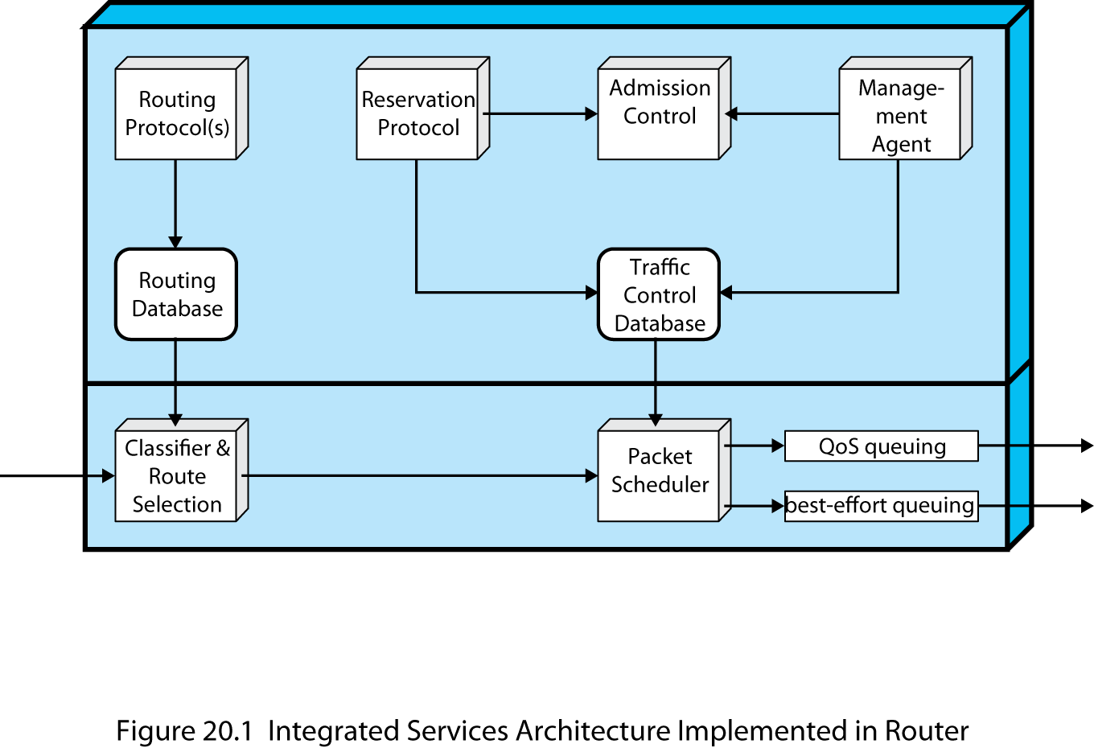
ISA Components
Notes:
Stallings DCC9e Figure 20.1 is a general depiction of the implementation architecture for ISA within a router. Below the thick horizontal line are the forwarding functions of the router; these are executed for each packet and therefore must be highly optimized. The remaining functions, above the line, are background functions that create data structures used by the forwarding functions.
The principal background functions are:
Reservation protocol: This protocol is to reserve resources for a new flow at a given level of QoS. It is used among routers and between routers and end systems. The reservation protocol is responsible for maintaining flow-specific state information at the end systems and at the routers along the path of the flow. RSVP is used for this purpose. The reservation protocol updates the traffic control database used by the packet scheduler to determine the service provided for packets of each flow.
Admission control: When a new flow is requested, the reservation protocol invokes the admission control function. This function determines if sufficient resources are available for this flow at the requested QoS. This determination is based on the current level of commitment to other reservations and/or on the current load on the network.
Management agent: A network management agent is able to modify the traffic control database and to direct the admission control module in order to set admission control policies.
Routing protocol: The routing protocol is responsible for maintaining a routing database that gives the next hop to be taken for each destination address and each flow.
These background functions support the main task of the router, which is the forwarding of packets. The two principal functional areas that accomplish forwarding are the following:
Classifier and route selection: For the purposes of forwarding and traffic control, incoming packets must be mapped into classes. A class may correspond to a single flow or to a set of flows with the same QoS requirements. For example, the packets of all video flows or the packets of all flows attributable to a particular organization may be treated identically for purposes of resource allocation and queuing discipline. The selection of class is based on fields in the IP header. Based on the packet's class and its destination IP address, this function determines the next-hop address for this packet.
Packet scheduler: This function manages one or more queues for each output port. It determines the order in which queued packets are transmitted and the selection of packets for discard, if necessary. Decisions are made based on a packet's class, the contents of the traffic control database, and current and past activity on this outgoing port. Part of the packet scheduler's task is that of policing, which is the function of determining whether the packet traffic in a given flow exceeds the requested capacity and, if so, deciding how to treat the excess packets.

Slide 9
ISA Services
traffic specification (TSpec)
three categories of service:
Guaranteed
token bucket traffic scheme
traffic sources can be defined easily and accurately
Controlled load
Best effort
provides a concise description of the load
provides the input parameters to a policing function
Notes:
ISA service for a flow of packets is defined on two levels. First, a number of general categories of service are provided, each of which provides a certain general type of service guarantees. Second, within each category, the service for a particular flow is specified by the values of certain parameters; together, these values are referred to as a traffic specification (TSpec). Currently, three categories of service are defined:
Guaranteed
Controlled load
Best effort
An application can request a reservation for a flow for a guaranteed or controlled load QoS, with a TSpec that defines the exact amount of service required. If the reservation is accepted, then the TSpec is part of the contract between the data flow and the service. The service agrees to provide the requested QoS as long as the flow's data traffic continues to be described accurately by the TSpec. Packets that are not part of a reserved flow are by default given a best-effort delivery service.
Before looking at the ISA service categories, one general concept should be defined: the token bucket traffic specification. This is a way of characterizing traffic that has three advantages in the context of ISA:
1. Many traffic sources can be defined easily and accurately by a token bucket scheme.
2. The token bucket scheme provides a concise description of the load to be imposed by a flow, enabling the service to determine easily the resource requirement.
3. The token bucket scheme provides the input parameters to a policing function.
A token bucket traffic specification consists of two parameters: a token replenishment rate R and a bucket size B. The token rate R specifies the continually sustainable data rate; that is, over a relatively long period of time, the average data rate to be supported for this flow is R. The bucket size B specifies the amount by which the data rate can exceed R for short periods of time. The exact condition is as follows: during any time period T, the amount of data sent cannot exceed RT + B.

Slide 10
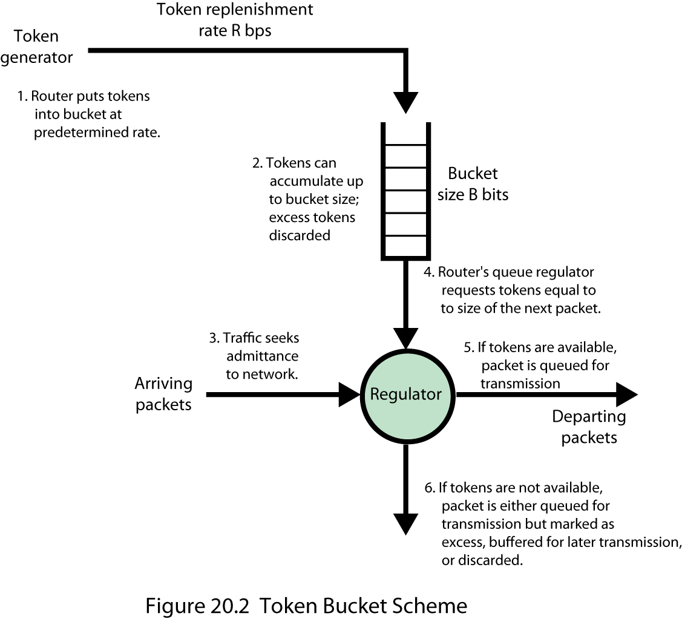
Token Bucket Scheme
Notes:
Stallings DCC9e Figure 20.2 illustrates this scheme and explains the use of the term bucket. The bucket represents a counter that indicates the allowable number of octets of IP data that can be sent at any time. The bucket fills with octet tokens at the rate of R (i.e., the counter is incremented R times per second), up to the bucket capacity (up to the maximum counter value). IP packets arrive and are queued for processing. An IP packet may be processed if there are sufficient octet tokens to match the IP data size. If so, the packet is processed and the bucket is drained of the corresponding number of tokens. If a packet arrives and there are insufficient tokens available, then the packet exceeds the TSpec for this flow. The treatment for such packets is not specified in the ISA documents; common actions are relegating the packet to best-effort service, discarding the packet, or marking the packet in such a way that it may be discarded in future.
Over the long run, the rate of IP data allowed by the token bucket is R. However, if there is an idle or relatively slow period, the bucket capacity builds up, so that at most an additional B octets above the stated rate can be accepted. Thus, B is a measure of the degree of burstiness of the data flow that is allowed.

Slide 11
Guaranteed Service
key elements are:
service provides assured capacity
specified upper bound on the queuing delay through the network
there are no queuing losses
application provides a characterization of expected traffic profile and the service determines the end-to-end delay that it can guarantee
most demanding service provided by ISA
Notes:
GUARANTEED SERVICE
The key elements of the guaranteed service are:
The service provides assured capacity, or data rate.
There is a specified upper bound on the queuing delay through the network. This must be added to the propagation delay, or latency, to arrive at the bound on total delay through the network.
There are no queuing losses. That is, no packets are lost due to buffer overflow; packets may be lost due to failures in the network or changes in routing paths.
With this service, an application provides a characterization of its expected traffic profile, and the service determines the end-to-end delay that it can guarantee.
One category of applications for this service is those that need an upper bound on delay so that a delay buffer can be used for real-time playback of incoming data, and that do not tolerate packet losses because of the degradation in the quality of the output. Another example is applications with hard real-time deadlines.
The guaranteed service is the most demanding service provided by ISA. Because the delay bound is firm, the delay has to be set at a large value to cover rare cases of long queuing delays.

Slide 12
Controlled Load
key elements are:
tightly approximates the behavior visible to applications receiving best-effort service under unloaded conditions
no specified upper bound on the queuing delay through the network
high percentage of transmitted packets will be successfully delivered
useful for adaptive real-time applications
Notes:
CONTROLLED LOAD
The key elements of the controlled load service are:
The service tightly approximates the behavior visible to applications receiving best-effort service under unloaded conditions.
There is no specified upper bound on the queuing delay through the network. However, the service ensures that a very high percentage of the packets do not experience delays that greatly exceed the minimum transit delay (i.e., the delay due to propagation time plus router processing time with no queuing delays).
A very high percentage of transmitted packets will be successfully delivered (i.e., almost no queuing loss).
As was mentioned, the risk in an internet that provides QoS for real-time applications is that best-effort traffic is crowded out. This is because best-effort types of applications employ TCP, which will back off in the face of congestion and delays. The controlled load service guarantees that the network will set aside sufficient resources so that an application that receives this service will see a network that responds as if these real-time applications were not present and competing for resources.
The controlled service is useful for applications that have been referred to as adaptive real-time applications [CLAR92]. Such applications do not require an a priori upper bound on the delay through the network. Rather, the receiver measures the jitter experienced by incoming packets and sets the playback point to the minimum delay that still produces a sufficiently low loss rate (e.g., video can be adaptive by dropping a frame or delaying the output stream slightly; voice can be adaptive by adjusting silent periods).

Slide 13
Queuing Discipline
routers use first-in-first-out (FIFO) queuing discipline
drawbacks of FIFO
no special treatment given to higher priority packets
smaller packets get delayed behind larger packets
a greedy TCP connection can crowd out more altruistic connections
Notes:
Queuing Discipline
An important component of an ISA implementation is the queuing discipline used at the routers. Routers traditionally have used a first-in-first-out (FIFO) queuing discipline at each output port. A single queue is maintained at each output port. When a new packet arrives and is routed to an output port, it is placed at the end of the queue. As long as the queue is not empty, the router transmits packets from the queue, taking the oldest remaining packet next.
There are several drawbacks to the FIFO queuing discipline:
No special treatment is given to packets from flows that are of higher priority or are more delay sensitive. If a number of packets from different flows are ready to be forwarded, they are handled strictly in FIFO order.
If a number of smaller packets are queued behind a long packet, then FIFO queuing results in a larger average delay per packet than if the shorter packets were transmitted before the longer packet. In general, flows of larger packets get better service.
A greedy TCP connection can crowd out more altruistic connections. If congestion occurs and one TCP connection fails to back off, other connections along the same path segment must back off more than they would otherwise have to do.

Slide 14
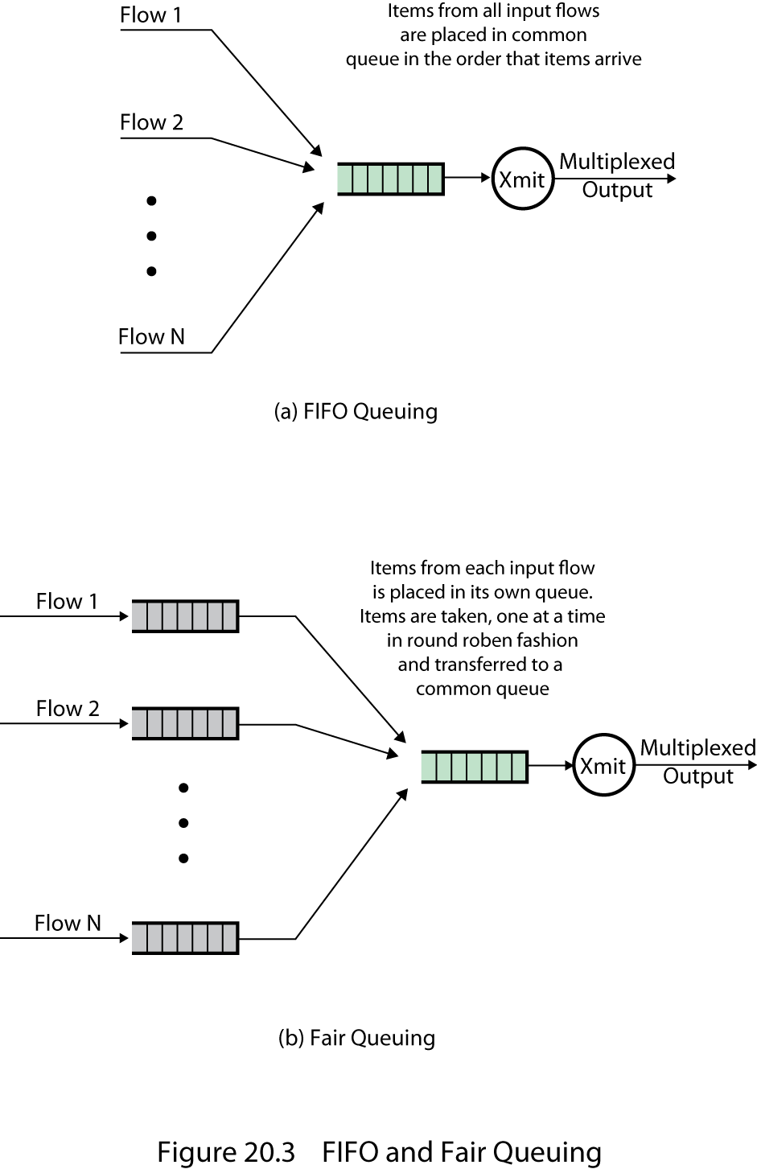
FIFO and Fair Queuing
Notes:
To overcome the drawbacks of FIFO queuing, some sort of fair queuing scheme is used, in which a router maintains multiple queues at each output port (Stallings DCC9e Figure 20.3). With simple fair queuing, each incoming packet is placed in the queue for its flow. The queues are serviced in round-robin fashion, taking one packet from each nonempty queue in turn. Empty queues are skipped over. This scheme is fair in that each busy flow gets to send exactly one packet per cycle. Further, this is a form of load balancing among the various flows. There is no advantage in being greedy. A greedy flow finds that its queues become long, increasing its delays, whereas other flows are unaffected by this behavior.
A number of vendors have implemented a refinement of fair queuing known as weighted fair queuing (WFQ). In essence, WFQ takes into account the amount of traffic through each queue and gives busier queues more capacity without completely shutting out less busy queues. In addition WFQ can take into account the amount of service requested by each traffic flow and adjust the queuing discipline accordingly.

Slide 15
Resource ReSerVation Protocol (RSVP)
RFC 2205
provides supporting functionality for ISA
prevention strategy
have unicast applications reserve resources in order to meet a given QoS
enables routers to decide ahead of time if they can meet the delivery requirement for a multicast transmission
must interact with a dynamic routing strategy
soft state
Notes:
RFC 2205 defines Resource ReSerVation Protocol (RSVP), which provides supporting functionality for ISA. This subsection provides an overview.
A key task, perhaps the key task, of an internet is to deliver data from a source to one or more destinations with the desired QoS (throughput, delay, delay variance, etc.). This task becomes increasingly difficult on any internet with increasing number of users, data rate of applications, and use of multicasting. One tool for coping with a high demand is dynamic routing. A dynamic routing scheme, supported by protocols such as OSPF and BGP (Part Five), can respond quickly to failures in the internet by routing around points of failure. More important, a dynamic routing scheme can, to some extent, cope with congestion, first by load balancing to smooth out the load across the internet, and second by routing around areas of developing congestion using least-cost routing. In the case of multicasting, dynamic routing schemes have been supplemented with multicast routing capabilities that take advantage of shared paths from a source to multicast destinations to minimize the number of packet duplications.
Another tool available to routers is the ability to process packets on the basis of a QoS (quality of service) label. We have seen that routers can (1) use a queue discipline that gives preference to packets on the basis of QoS; (2) select among alternate routes on the basis of QoS characteristics of each path; and (3) when possible, invoke QoS treatment in the subnetwork of the next hop.
All of these techniques are means of coping with the traffic presented to the internet but are not preventive in any way. Based only on the use of dynamic routing and QoS, a router is unable to anticipate congestion and prevent applications from causing an overload. Instead, the router can simply supply a best-effort delivery service, in which some packets may be lost and others delivered with less than the requested QoS.
As the demands on internets grow, it appears that prevention as well as reaction to congestion is needed. As this section shows, a means to implement a prevention strategy is resource reservation.
Preventive measures can be useful in both unicast and multicast transmission. For unicast, two applications agree on a specific QoS for a session and expect the internet to support that QoS. If the internet is heavily loaded, it may not provide the desired QoS and instead deliver packets at a reduced QoS. In that case, the applications may have preferred to wait before initiating the session or at least to have been alerted to the potential for reduced QoS. A way of dealing with this situation is to have the unicast applications reserve resources in order to meet a given QoS. Routers along an intended path could then preallocate resources (queue space, outgoing capacity) to assure the desired QoS. If a router could not meet the resource reservation because of prior outstanding reservations, then the applications could be informed. The applications may then decide to try again at a reduced QoS reservation or may decide to try later.
Multicast transmission also present a compelling case for implementing resource reservation. A multicast transmission can generate a tremendous amount of internet traffic if either the application is high volume (e.g., video) or the group of multicast destinations is large and scattered, or both. What makes the case for multicast resource reservation is that much of the potential load generated by a multicast source may easily be prevented. This is so for two reasons:
1. Some members of an existing multicast group may not require delivery from a particular source over some given period of time. For example, there may be two "channels" (two multicast sources) broadcasting to a particular multicast group at the same time. A multicast destination may wish to "tune in" to only one channel at a time.
2. Some members of a group may only be able to handle a portion of the source transmission. For example, a video source may transmit a video stream that consists of two components: a basic component that provides a reduced picture quality, and an enhanced component. Some receivers may not have the processing power to handle the enhanced component, or may be connected to the internet through a subnetwork or link that does not have the capacity for the full signal.
Thus, the use of resource reservation can enable routers to decide ahead of time if they can meet the requirement to deliver a multicast transmission to all designated multicast receivers and to reserve the appropriate resources if possible.
Internet resource reservation differs from the type of resource reservation that may be implemented in a connection-oriented network, such as ATM or frame relay. An internet resource reservation scheme must interact with a dynamic routing strategy that allows the route followed by packets of a given transmission to change. When the route changes, the resource reservations must be changed. To deal with this dynamic situation, the concept of soft state is used. A soft state is simply a set of state information at a router that expires unless regularly refreshed from the entity that requested the state. If a route for a given transmission changes, then some soft states will expire and new resource reservations will invoke the appropriate soft states on the new routers along the route. Thus, the end systems requesting resources must periodically renew their requests during the course of an application transmission.
We now turn to the protocol that has been developed for performing resource reservation in an internet environment: RSVP, defined in RFC 2205.

Slide 16
RSVP Characteristics
Unicast and multicast
Simplex
Receiver-initiated reservation
Maintaining soft state in the internet
Providing different reservation styles
Transparent operation through non-RSVP routers
Notes:
RSVP Goals and Characteristics
Based on these preceding considerations, RFC 2205 lists the following characteristics of RSVP:
Unicast and multicast: RSVP makes reservations for both unicast and multicast transmissions, adapting dynamically to changing group membership as well as to changing routes, and reserving resources based on the individual requirements of multicast members.
Simplex: RSVP makes reservations for unidirectional data flow. Data exchanges between two end systems require separate reservations in the two directions.
Receiver-initiated reservation: The receiver of a data flow initiates and maintains the resource reservation for that flow.
Maintaining soft state in the internet: RSVP maintains a soft state at intermediate routers and leaves the responsibility for maintaining these reservation states to end users.
Providing different reservation styles: These allow RSVP users to specify how reservations for the same multicast group should be aggregated at the intermediate switches. This feature enables a more efficient use of internet resources.
Transparent operation through non-RSVP routers: Because reservations and RSVP are independent of routing protocol, there is no fundamental conflict in a mixed environment in which some routers do not employ RSVP. These routers will simply use a best-effort delivery technique.
It is worth elaborating on two of these design characteristics: receiver-initiated reservations, and soft state.

Slide 17
Receiver-Initiated Reservation
since receivers specify the desired QoS it makes sense for them to make resource reservations
different members of the same multicast group may have different resource requirements
QoS requirements may differ depending on the output equipment, processing power, and link speed of the receiver
routers can aggregate multicast resource reservations to take advantage of shared path segments
Notes:
RECEIVER-INITIATED RESERVATION
In previous attempts at resource reservation, including the approach taken in frame relay and ATM networks, the source of a data flow requests a given set of resources. In a strictly unicast environment, this approach is reasonable. A transmitting application is able to transmit data at a certain rate and has a given QoS designed into the transmission scheme. However, this approach is inadequate for multicasting. As was mentioned, different members of the same multicast group may have different resource requirements. If the source transmission flow can be divided into component subflows, then some multicast members may only require a single subflow. If there are multiple sources transmitting to a multicast group, then a particular multicast receiver may want to select only one or a subset of all sources to receive. Finally, the QoS requirements of different receivers may differ depending on the output equipment, processing power, and link speed of the receiver.
It therefore makes sense for receivers rather than senders to make resource reservations. A sender needs to provide the routers with the traffic characteristics of the transmission (data rate, variability), but it is the receivers that must specify the desired QoS. Routers can then aggregate multicast resource reservations to take advantage of shared path segments along the distribution tree.

Slide 18
Soft State
connectionless
reservation state is cached information in the routers that is installed and periodically refreshed
if a new route becomes preferred the end systems provide the reservation to the new routers on the route
Notes:
SOFT STATE
RSVP makes use of the concept of a soft state. This concept was first introduced by David Clark in [CLAR88], and it is worth quoting his description:
While the datagram has served very well in solving the most important goals of the Internet, the goals of resource management and accountability have proved difficult to achieve. Most datagrams are part of some sequence of packets from source to destination, rather than isolated units at the application level. However, the gateway cannot directly see the existence of this sequence, because it is forced to deal with each packet in isolation. Therefore, resource management decisions or accounting must be done on each packet separately.
This suggests that there may be a better building block than the datagram for the next generation of architecture. The general characteristic of this building block is that it would identify a sequence of packets traveling from source to destination. I have used the term flow to characterize this building block. It would be necessary for the gateways to have flow state in order to remember the nature of the flows which are passing through them, but the state information would not be critical in maintaining the described type of service associated with the flow. Instead, that type of service would be enforced by the end points, which would periodically send messages to ensure that the proper type of service was being associated with the flow. In this way, the state information associated with the flow could be lost in a crash without permanent disruption of the service features being used. I call this concept soft state.
In essence, a connection-oriented scheme takes a hard-state approach, in which the nature of the connection along a fixed route is defined by the state information in the intermediate switching nodes. RSVP takes a soft-state, or connectionless, approach, in which the reservation state is cached information in the routers that is installed and periodically refreshed by end systems. If a state is not refreshed within a required time limit, the router discards the state. If a new route becomes preferred for a given flow, the end systems provide the reservation to the new routers on the route.
Gateway is the term used for router in most of the earlier RFCs and TCP/IP literature; it is still occasionally used today (e.g., Border Gateway Protocol).

Slide 19
Data Flows
Basis of RSVP operation:
Session
Destination IP address
Flow specification
Service class
IP protocol identifier
Destination port
Rspec
Tspec
Filter specification
Source address
UDP/TCP source port
Notes:
Data Flows
Three concepts relating to data flows form the basis of RSVP operation: session, flow specification, and filter specification.
A session is a data flow identified by its destination. The reason for using the term session rather than simply destination is that it reflects the soft-state nature of RSVP operation. Once a reservation is made at a router by a particular destination, the router considers this as a session and allocates resources for the life of that session. In particular, a session is defined by:
Session: Destination IP address
IP protocol identifier
Destination port
The destination IP address may be unicast or multicast. The protocol identifier indicates the user of IP (e.g., TCP or UDP), and the destination port is the TCP or UDP port for the user of this transport-layer protocol. If the address is multicast, the destination port may not be necessary, because there is typically a different multicast address for different applications.
A reservation request issued by a destination end system is called a flow descriptor and consists of a flowspec and a filter spec. The flowspec specifies a desired QoS and is used to set parameters in a node's packet scheduler. That is, the router will transmit packets with a given set of preferences based on the current flowspecs. The filter spec defines the set of packets for which a reservation is requested. Thus, the filter spec together with the session define the set of packets, or flow, that are to receive the desired QoS. Any other packets addressed to the same destination are handled as best-effort traffic.
The content of the flowspec is beyond the scope of RSVP, which is merely a carrier of the request. In general, a flowspec contains the following elements:
Flowspec: Service class
Rspec
Tspec
The service class is an identifier of a type of service being requested; it includes information used by the router to merge requests. The other two parameters are sets of numeric values. The Rspec (R for reserve) parameter defines the desired QoS, and the Tspec (T for traffic) parameter describes the data flow. The contents of Rspec and Tspec are opaque to RSVP.
In principle, the filter spec may designate an arbitrary subset of the packets of one session (i.e., the packets arriving with the destination specified by this session). For example, a filter spec could specify only specific sources, or specific source protocols, or in general only packets that have a match on certain fields in any of the protocol headers in the packet. The current RSVP version uses a restricted filter spec consisting of the following elements:
Filter spec: Source address
UDP/TCP source port

Slide 20
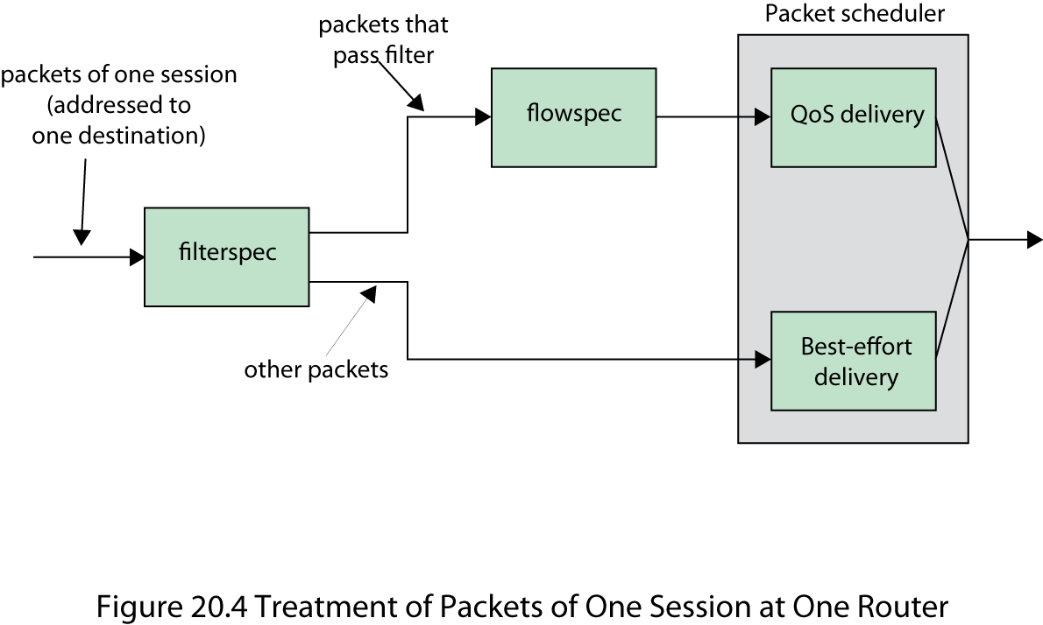
Data Flow Relationship
Notes:
Stallings DCC9e Figure 20.4 indicates the relationship among session, flowspec, and filter spec. Each incoming packet is part of at most one session and is treated according to the logical flow indicated in the figure for that session. If a packet belongs to no session, it is given a best-effort delivery service.

Slide 21
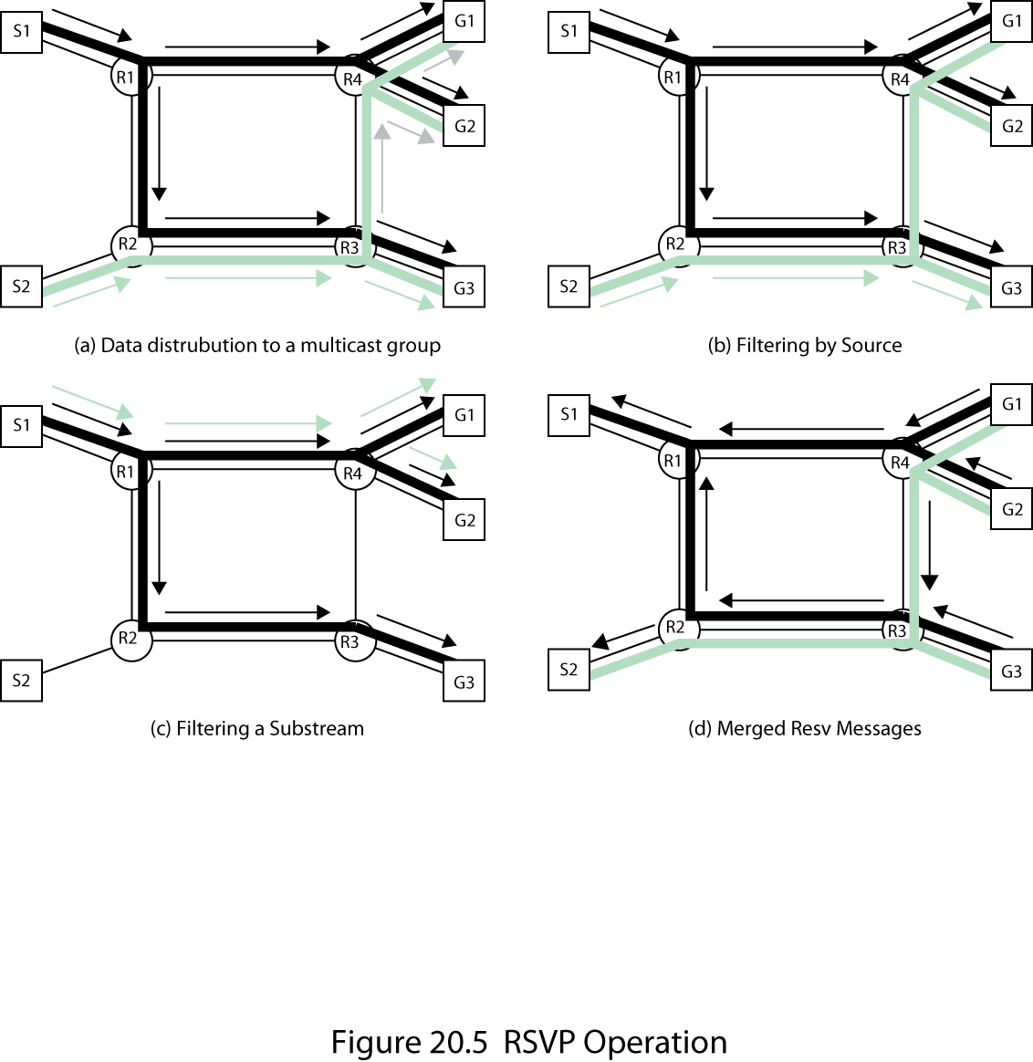
RSVP Operation
Notes:
RSVP Operation
Much of the complexity of RSVP has to do with dealing with multicast transmission. Unicast transmission is treated as a special case. In what follows, we examine the general operation of RSVP for multicast resource reservation. The internet configuration shown in Stallings DCC9e Figure 20.5a is used in the discussion. This configuration consist of four routers connected as shown. The link between two routers, indicated by a line, could be a point-to-point link or a subnetwork. Three hosts, G1, G2, and G3, are members of a multicast group and can receive datagrams with the corresponding destination multicast address. Two hosts, S1 and S2, transmit data to this multicast address. The thick black lines indicate the routing tree for source S1 and this multicast group, and the thick shaded lines indicate the routing tree for source S2 and this multicast group. The arrowed lines indicate packet transmission from S1 (black) and S2 (gray).
We can see that all four routers need to be aware of the resource reservations of each multicast destination. Thus, resource requests from the destinations must propagate backward through the routing trees toward each potential host.
FILTERING
Stallings DCC9e Figure 20.5b shows the case that G3 has set up a resource reservation with a filter spec that includes both S1 and S2, whereas G1 and G2 have requested transmissions from S1 only. R3 continues to deliver packets from S2 for this multicast address to G3 but does not forward such packets to R4 for delivery to G1 and G2. The reservation activity that produces this result is as follows. Both G1 and G2 send an RSVP request with a filter spec that excludes S2. Because G1 and G2 are the only members of the multicast group reachable from R4, R4 no longer needs to forward packets for this session. Therefore, it can merge the two filter spec requests and send these in an RSVP message to R3. Having received this message, R3 will no longer forward packets for this session to R4. However, it still needs to forward such packets to G3. Accordingly, R3 stores this reservation but does not propagate it back up to R2.
Data packets that are addressed to a particular session but do not match any of the filter specs are treated as best-effort traffic.
A more fine-grained example of filtering is illustrated in Figure 20.5c. Here we only consider transmissions from S1, for clarity. Suppose that two types of packets are transmitted to the same multicast address representing two substreams (e.g., two parts of a video signal). These are illustrated by black and gray arrowed lines. G1 and G2 have sent reservations with no restriction on the source, whereas G3 has used a filter spec that eliminates one of the two substreams. This request propagates from R3 to R2 to R1. R1 then blocks transmission of part of the stream to G3. This saves resources on the links from R1 to R2, R2 to R3, and R3 to G3, as well as resources in R2, R3, and G3.

Slide 22
Reservation Attributes and Styles
Notes:
RESERVATION STYLES
The manner in which resource requirements from multiple receivers in the same multicast group are aggregated is determined by the reservation style. These styles are, in turn, characterized by two different options in the reservation request:
Reservation attribute: A receiver may specify a resource reservation that is to be shared among a number of senders (shared) or may specify a resource reservation that is to be allocated to each sender (distinct). In the former case, the receiver is characterizing the entire data flow that it is to receive on this multicast address from the combined transmission of all sources in the filter spec. In the latter case, the receiver is saying that it is simultaneously capable of receiving a given data flow from each sender characterized in its filter spec.
Sender selection: A receiver may either provide a list of sources (explicit) or implicitly select all sources by providing no filter spec (wild card).
Based on these two options, three reservation styles are defined in RSVP, as shown in Stallings DCC 9e Table 20.1. The wildcard-filter (WF) style specifies a single resource reservation to be shared by all senders to this address. If all of the receivers use this style, then we can think of this style as a shared pipe whose capacity (or quality) is the largest of the resource requests from all receivers downstream from any point on the distribution tree. The size is independent of the number of senders using it. This type of reservation is propagated upstream to all senders. Symbolically, this style is represented in the form WF(*{Q}), where the asterisk represents wildcard sender selection and Q is the flowspec.

Slide 23
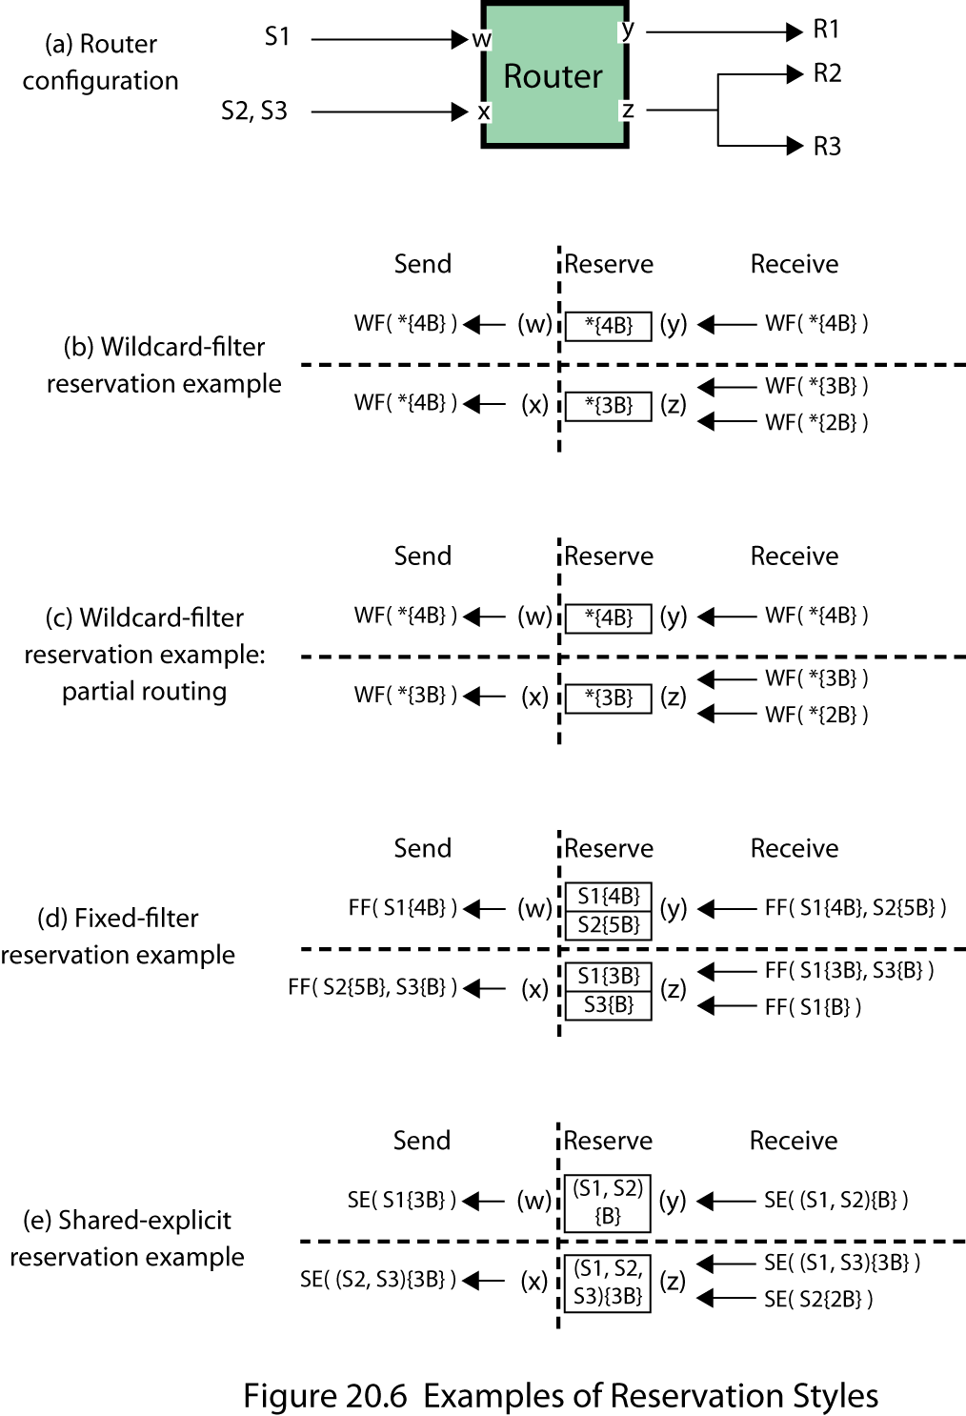
Reservation Styles
Notes:
To see the effects of the WF style, we use the router configuration of Stallings DCC9e Figure 20.6a, taken from the RSVP specification. This is a router along the distribution tree that forwards packets on port y for receiver R1 and on port z for receivers R2 and R3. Transmissions for this group arrive on port w from S1 and on port x from S2 and S3. Transmissions from all sources are forwarded to all destinations through this router.
Stallings DCC9e Figure 20.6b shows the way in which the router handles WF requests. For simplicity, the flowspec is a one-dimensional quantity in multiples of some unit resource B. The Receive column shows the requests that arrive from the receivers. The Reserve column shows the resulting reservation state for each outgoing port. The Send column indicates the requests that are sent upstream to the previous-hop nodes. Note that the router must reserve a pipe of capacity 4B for port y and of capacity 3B for port z. In the latter case, the router has merged the requests from R2 and R3 to support the maximum requirement for that port. However, in passing requests upstream the router must merge all outgoing requests and send a request for 4B upstream on both ports w and x.
Now suppose that the distribution tree is such that this router forwards packets from S1 on both ports y and z but forwards packets from S2 and S3 only on port z, because the internet topology provides a shorter path from S2 and S3 to R1. Figure 20.6c indicates the way in which resource requests are merged in this case. The only change is that the request sent upstream on port x is for 3B. This is because packets arriving from this port are only to be forwarded on port z, which has a maximum flowspec request of 3B.
A good example of the use of the WF style is for an audio teleconference with multiple sites. Typically, only one person at a time speaks, so a shared capacity can be used by all senders.
The fixed-filter (FF) style specifies a distinct reservation for each sender and provides an explicit list of senders. Symbolically, this style is represented in the form FF(S1{Q1}, S2{Q2}, …), where Si is a requested sender and Qi is the resource request for that sender. The total reservation on a link for a given session is the sum of the Qi for all requested senders.
Figure 20.6d illustrates the operation of the FF style. In the Reserve column, each box represents one reserved pipe on the outgoing link. All of the incoming requests for S1 are merged to send a request for 4B out on port w. The flow descriptors for senders S2 and S3 are packed (not merged) into the request sent of port x; for this request, the maximum requested flowspec amount for each source is used.
A good example of the use of the FF style is for video distribution. To receive video signals simultaneously from different sources requires a separate pipe for each of the streams. The merging and packing operations at the routers assure that adequate resources are available. For example, in Figure 20.5a, R3 must reserve resources for two distinct video streams going to G3, but it needs only a single pipe on the stream going to R4 even though that stream is feeding two destinations (G1 and G2). Thus, with FF style, it may be possible to share resources among multiple receivers but it is never possible to share resources among multiple senders.
The shared-explicit (SE) style specifies a single resource reservation to be shared among an explicit list of senders. Symbolically, this style is represented in the form SE(S1, S2, …{Q}). Figure 20.6e illustrates the operation of this style. When SE-style reservations are merged, the resulting filter spec is the union of the original filter specs, and the resulting flowspec is the largest flowspec.
As with the WF style, the SE style is appropriate for multicast applications in which there are multiple data sources but they are unlikely to transmit simultaneously.

Slide 24
RSVP Protocol
RSVP uses two basic message types:
Resv
originate at multicast group receivers and propagate upstream
create soft states within routers that define resources reserved for the session
hosts set up traffic control parameters for the first hop
Path
used to provide upstream routing information
reverse routing
each router and host creates a path state that indicates the reverse hop for source
Notes:
RSVP Protocol Mechanisms
RSVP uses two basic message types: Resv and Path. Resv messages originate at multicast group receivers and propagate upstream through the distribution tree, being merged and packed when appropriate at each node along the way. These messages create soft states within the routers of the distribution tree that define the resources reserved for this session (this multicast address). Ultimately, the merged Resv messages reach the sending hosts, enabling the hosts to set up appropriate traffic control parameters for the first hop. Figure 20.5d indicates the flow of Resv messages. Note that messages are merged so that only a single message flows upstream along any branch of the combined distribution trees. However, these messages must be repeated periodically to maintain the soft states.
The Path message is used to provide upstream routing information. In all of the multicast routing protocols currently in use, only a downstream route, in the form of a distribution tree, is maintained. However, the Resv messages must propagate upstream through all intermediate routers and to all sending hosts. In the absence of reverse routing information from the routing protocol, RSVP provides this with the Path message. Each host that wishes to participate as a sender in a multicast group issues a Path message that is transmitted throughout the distribution tree to all multicast destinations. Along the way, each router and each destination host creates a path state that indicates the reverse hop to be used for this source. Figure 20.5a indicates the paths taken by these messages, which is the same as the paths taken by data packets.

Slide 25
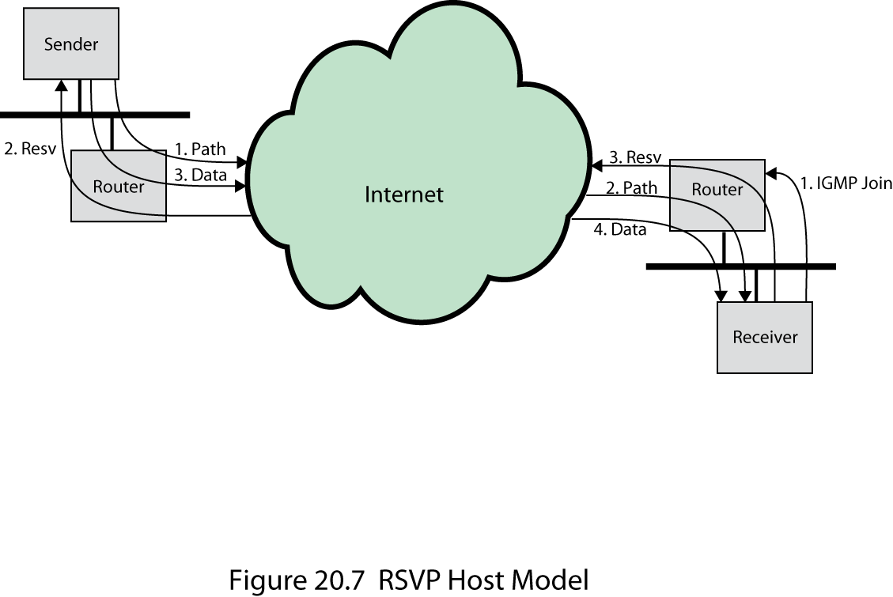
RSVP Host Model
Notes:
Stallings DCC9e Figure 20.7 illustrates the operation of the protocol from the host perspective. The following events occur:
a. A receiver joins a multicast group by sending an IGMP (Internet Group Message Protocol) join message to a neighboring router.
b. A potential sender issues a Path message to the multicast group address.
c. A receiver receives a Path message identifying a sender.
d. Now that the receiver has reverse path information, it may begin sending Resv messages, specifying the desired flow descriptors.
e. The Resv message propagates through the internet and is delivered to the sender.
f. The sender starts sending data packets.
g. The receiver starts receiving data packets.
Events a and b may happen in either order.

Slide 26
Differentiated Services (DS)
RFC 2475
designed to provide a tool to support a range of network services
key characteristics:
no change to IP is required
SLA is established prior to use of DS
applications do not need to be modified
provides a built-in aggregation mechanism
good scaling to larger networks and traffic loads
DS is implemented in individual routers
most widely accepted QoS in enterprise networks
Notes:
The Integrated Services Architecture (ISA) and RSVP are intended to support QoS capability in the Internet and in private internets. Although ISA in general and RSVP in particular are useful tools in this regard, these features are relatively complex to deploy. Further, they may not scale well to handle large volumes of traffic because of the amount of control signaling required to coordinate integrated QoS offerings and because of the maintenance of state information required at routers.
As the burden on the Internet grows, and as the variety of applications grow, there is an immediate need to provide differing levels of QoS to different traffic flows. The differentiated services (DS) architecture (RFC 2475) is designed to provide a simple, easy-to-implement, low-overhead tool to support a range of network services that are differentiated on the basis of performance.
Several key characteristics of DS contribute to its efficiency and ease of deployment:
IP packets are labeled for differing QoS treatment using the existing IPv4 (Figure 18.5) or IPv6 (Figure 18.10) DS field. Thus, no change is required to IP.
A service level agreement (SLA) is established between the service provider (internet domain) and the customer prior to the use of DS. This avoids the need to incorporate DS mechanisms in applications. Thus, existing applications need not be modified to use DS.
DS provides a built-in aggregation mechanism. All traffic with the same DS octet is treated the same by the network service. For example, multiple voice connections are not handled individually but in the aggregate. This provides for good scaling to larger networks and traffic loads.
DS is implemented in individual routers by queuing and forwarding packets based on the DS octet. Routers deal with each packet individually and do not have to save state information on packet flows.
Today, DS is the most widely accepted QoS mechanism in enterprise networks.

Slide 27
Terminology for Differentiated Services
Notes:
Although DS is intended to provide a simple service based on relatively simple mechanisms, the set of RFCs related to DS is relatively complex. Stallings DCC9e Table 20.2 summarizes some of the key terms from these specifications.

Slide 28
DS Services
typically DS domain is under the control of one administrative entity
services provided across a DS domain are defined in an SLA
service contract between a customer and the service provider
customer submits packets with DS octet marked to indicate the packet class
service provider must assure that the customer gets the agreed QoS for each packet class
Notes:
The DS type of service is provided within a DS domain, which is defined as a contiguous portion of the Internet over which a consistent set of DS policies are administered. Typically, a DS domain would be under the control of one administrative entity. The services provided across a DS domain are defined in an SLA, which is a service contract between a customer and the service provider that specifies the forwarding service that the customer should receive for various classes of packets. A customer may be a user organization or another DS domain. Once the SLA is established, the customer submits packets with the DS octet marked to indicate the packet class. The service provider must assure that the customer gets at least the agreed QoS for each packet class. To provide that QoS, the service provider must configure the appropriate forwarding policies at each router (based on DS octet value) and must measure the performance being provided for each class on an ongoing basis.
If a customer submits packets intended for destinations within the DS domain, then the DS domain is expected to provide the agreed service. If the destination is beyond the customer's DS domain, then the DS domain will attempt to forward the packets through other domains, requesting the most appropriate service to match the requested service.

Slide 29
Performance Parameters in an SLA
detailed service performance parameters such as expected throughput, drop probability, latency
constraints on the ingress and egress points at which the service is provided, indicating the scope of the service
traffic profiles that must be adhered to for the requested service to be provided, such as token bucket parameters
disposition of traffic submitted in excess of the specified profile
Notes:
A draft DS framework document lists the following detailed performance parameters that might be included in an SLA:
Detailed service performance parameters such as expected throughput, drop probability, latency
Constraints on the ingress and egress points at which the service is provided, indicating the scope of the service
Traffic profiles that must be adhered to for the requested service to be provided, such as token bucket parameters
Disposition of traffic submitted in excess of the specified profile

Slide 30
Services Provided in a SLA
traffic offered at service level A will be delivered with low latency
traffic offered at service level B will be delivered with low loss
ninety percent of in-profile traffic delivered at service level D will be delivered
traffic offered at service level E will be allotted twice the bandwidth of traffic delivered at service level F
traffic with drop precedence X has a higher probability of delivery than traffic with drop precedence Y
Notes:
The framework document also gives some examples of services that might be provided:
1. Traffic offered at service level A will be delivered with low latency.
2. Traffic offered at service level B will be delivered with low loss.
3. Ninety percent of in-profile traffic delivered at service level C will experience no more than 50 ms latency.
4. Ninety-five percent of in-profile traffic delivered at service level D will be delivered.
5. Traffic offered at service level E will be allotted twice the bandwidth of traffic delivered at service level F.
6. Traffic with drop precedence X has a higher probability of delivery than traffic with drop precedence Y.
The first two examples are qualitative and are valid only in comparison to other traffic, such as default traffic that gets a best-effort service. The next two examples are quantitative and provide a specific guarantee that can be verified by measurement on the actual service without comparison to any other services offered at the same time. The final two examples are a mixture of quantitative and qualitative.

Slide 31
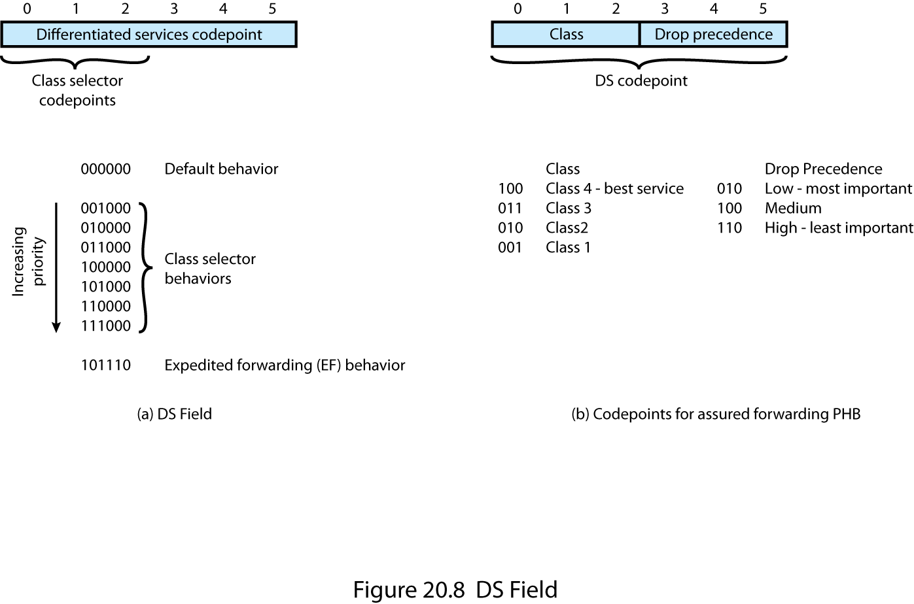
DS Field
Notes:
DS Field
Packets are labeled for service handling by means of the 6-bit DS field in the IPv4 header or the IPv6 header. The value of the DS field, referred to as the DS codepoint, is the label used to classify packets for differentiated services. Stallings DCC9e Figure 20.8a shows the DS field.
With a 6-bit codepoint, there are in principle 64 different classes of traffic that could be defined. These 64 codepoints are allocated across three pools of codepoints, as follows:
Codepoints of the form xxxxx0, where x is either 0 or 1, are reserved for assignment as standards.
Codepoints of the form xxxx11 are reserved for experimental or local use.
Codepoints of the form xxxx01 are also reserved for experimental or local use but may be allocated for future standards action as needed.
Within the first pool, several assignments are made in RFC 2474. The codepoint 000000 is the default packet class. The default class is the best-effort forwarding behavior in existing routers. Such packets are forwarded in the order that they are received as soon as link capacity becomes available. If other higher-priority packets in other DS classes are available for transmission, these are given preference over best-effort default packets.
Codepoints of the form xxx000 are reserved to provide backward compatibility with the IPv4 precedence service. To explain this requirement, we need to digress to an explanation of the IPv4 precedence service. The IPv4 type of service (TOS) field includes two subfields: a 3-bit precedence subfield and a 4-bit TOS subfield. These subfields serve complementary functions. The TOS subfield provides guidance to the IP entity (in the source or router) on selecting the next hop for this datagram, and the precedence subfield provides guidance about the relative allocation of router resources for this datagram.
The precedence field is set to indicate the degree of urgency or priority to be associated with a datagram. If a router supports the precedence subfield, there are three approaches to responding:
Route selection: A particular route may be selected if the router has a smaller queue for that route or if the next hop on that route supports network precedence or priority (e.g., a token ring network supports priority).
Network service: If the network on the next hop supports precedence, then that service is invoked.
Queuing discipline: A router may use precedence to affect how queues are handled. For example, a router may give preferential treatment in queues to datagrams with higher precedence.
RFC 1812, Requirements for IP Version 4 Routers, provides recommendations for queuing discipline that fall into two categories:
Queue service
(a) Routers SHOULD implement precedence-ordered queue service. Precedence-ordered queue service means that when a packet is selected for output on a (logical) link, the packet of highest precedence that has been queued for that link is sent.
(b) Any router MAY implement other policy-based throughput management procedures that result in other than strict precedence ordering, but it MUST be configurable to suppress them (i.e., use strict ordering).
Congestion control. When a router receives a packet beyond its storage capacity, it must discard it or some other packet or packets.
(a) A router MAY discard the packet it has just received; this is the simplest but not the best policy.
(b) Ideally, the router should select a packet from one of the sessions most heavily abusing the link, given that the applicable QoS policy permits this. A recommended policy in datagram environments using FIFO queues is to discard a packet randomly selected from the queue. An equivalent algorithm in routers using fair queues is to discard from the longest queue. A router MAY use these algorithms to determine which packet to discard.
(c) If precedence-ordered queue service is implemented and enabled, the router MUST NOT discard a packet whose IP precedence is higher than that of a packet that is not discarded.
(d) A router MAY protect packets whose IP headers request the maximize reliability TOS, except where doing so would be in violation of the previous rule.
(e) A router MAY protect fragmented IP packets, on the theory that dropping a fragment of a datagram may increase congestion by causing all fragments of the datagram to be retransmitted by the source.
(f) To help prevent routing perturbations or disruption of management functions, the router MAY protect packets used for routing control, link control, or network management from being discarded. Dedicated routers (i.e., routers that are not also general purpose hosts, terminal servers, etc.) can achieve an approximation of this rule by protecting packets whose source or destination is the router itself.
The DS codepoints of the form xxx000 should provide a service that at minimum is equivalent to that of the IPv4 precedence functionality.

Slide 32
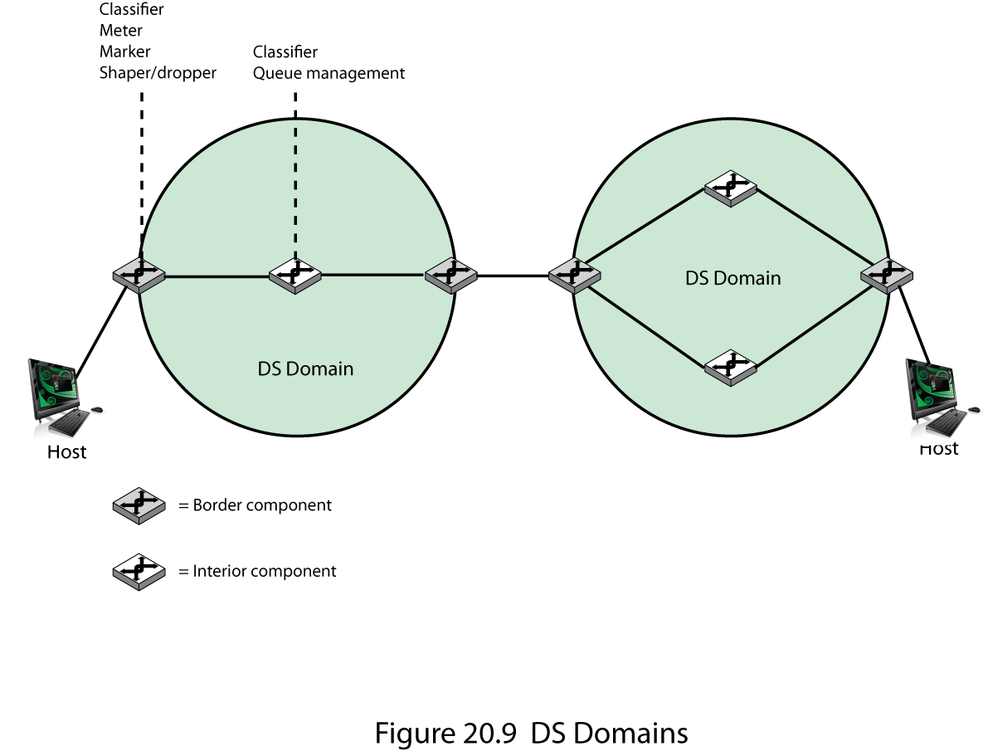
DS Domains
Notes:
DS Configuration and Operation
Stallings DCC9e Figure 20.9 illustrates the type of configuration envisioned in the DS documents. A DS domain consists of a set of contiguous routers; that is, it is possible to get from any router in the domain to any other router in the domain by a path that does not include routers outside the domain. Within a domain, the interpretation of DS codepoints is uniform, so that a uniform, consistent service is provided.
Routers in a DS domain are either boundary nodes or interior nodes. Typically, the interior nodes implement simple mechanisms for handling packets based on their DS codepoint values. This includes queuing discipline to give preferential treatment depending on codepoint value, and packet dropping rules to dictate which packets should be dropped first in the event of buffer saturation. The DS specifications refer to the forwarding treatment provided at a router as per-hop behavior (PHB). This PHB must be available at all routers, and typically PHB is the only part of DS implemented in interior routers.
The boundary nodes include PHB mechanisms but more sophisticated traffic conditioning mechanisms are also required to provide the desired service. Thus, interior routers have minimal functionality and minimal overhead in providing the DS service, while most of the complexity is in the boundary nodes. The boundary node function can also be provided by a host system attached to the domain, on behalf of the applications at that host system.
The traffic conditioning function consists of five elements:
Classifier: Separates submitted packets into different classes. This is the foundation of providing differentiated services. A classifier may separate traffic only on the basis of the DS codepoint (behavior aggregate classifier) or based on multiple fields within the packet header or even the packet payload (multifield classifier).
Meter: Measures submitted traffic for conformance to a profile. The meter determines whether a given packet stream class is within or exceeds the service level guaranteed for that class.
Marker: Re-marks packets with a different codepoint as needed. This may be done for packets that exceed the profile; for example, if a given throughput is guaranteed for a particular service class, any packets in that class that exceed the throughput in some defined time interval may be re-marked for best effort handling. Also, re-marking may be required at the boundary between two DS domains. For example, if a given traffic class is to receive the highest supported priority, and this is a value of 3 in one domain and 7 in the next domain, then packets with a priority 3 value traversing the first domain are remarked as priority 7 when entering the second domain.
Shaper: Delays packets as necessary so that the packet stream in a given class does not exceed the traffic rate specified in the profile for that class.
Dropper: Drops packets when the rate of packets of a given class exceeds that specified in the profile for that class.

Slide 33
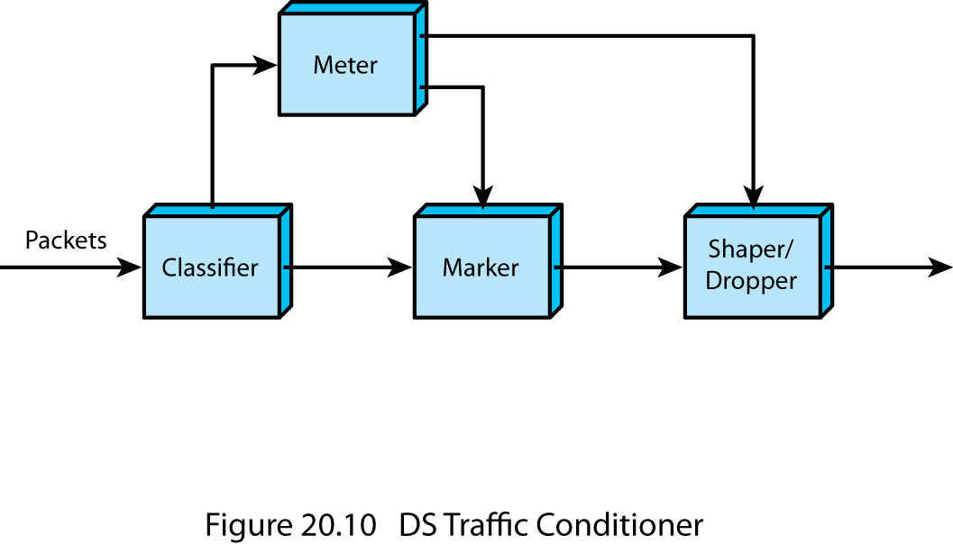
DS Traffic Conditioner
Notes:
Stallings DCC9e Figure 20.10 illustrates the relationship between the elements of traffic conditioning. After a flow is classified, its resource consumption must be measured. The metering function measures the volume of packets over a particular time interval to determine a flow's compliance with the traffic agreement. If the host is bursty, a simple data rate or packet rate may not be sufficient to capture the desired traffic characteristics. A token bucket scheme, such as that illustrated in Stallings DCC9e Figure 20.2, is an example of a way to define a traffic profile to take into account both packet rate and burstiness.
If a traffic flow exceeds some profile, several approaches can be taken. Individual packets in excess of the profile may be re-marked for lower-quality handling and allowed to pass into the DS domain. A traffic shaper may absorb a burst of packets in a buffer and pace the packets over a longer period of time. A dropper may drop packets if the buffer used for pacing becomes saturated.

Slide 34
Expedited Forwarding PHB (EF PHB)
RFC 3246
building block for low-loss, low-delay, and low-jitter end-to-end services through DS domains
difficult to achieve
cause is queuing behavior at each node
intent is to provide a PHB in which packets encounter short or empty queues
configures nodes so traffic has a well-defined minimum departure rate
Notes:
Per-Hop Behavior
As part of the DS standardization effort, specific types of PHB need to be defined, which can be associated with specific differentiated services. Currently, two standards-track PHBs have been issued: expedited forwarding PHB (RFCs 3246 and 3247) and assured forwarding PHB (RFC 2597).
EXPEDITED FORWARDING PHB
RFC 3246 defines the expedited forwarding (EF) PHB as a building block for low-loss, low-delay, and low-jitter end-to-end services through DS domains. In essence, such a service should appear to the endpoints as providing close to the performance of a point-to-point connection or leased line.
In an internet or packet-switching network, a low-loss, low-delay, and low-jitter service is difficult to achieve. By its nature, an internet involves queues at each node, or router, where packets are buffered waiting to use a shared output link. It is the queuing behavior at each node that results in loss, delays, and jitter. Thus, unless the internet is grossly oversized to eliminate all queuing effects, care must be taken in handling traffic for EF PHB to assure that queuing effects do not result in loss, delay, or jitter above a given threshold. RFC 3246 declares that the intent of the EF PHB is to provide a PHB in which suitably marked packets usually encounter short or empty queues. The relative absence of queues minimizes delay and jitter. Furthermore, if queues remain short relative to the buffer space available, packet loss is also kept to a minimum.
The EF PHB is designed to configuring nodes so that the traffic aggregate has a well-defined minimum departure rate. (Well-defined means "independent of the dynamic state of the node." In particular, independent of the intensity of other traffic at the node.) The general concept outlined in RFC 3246 is this: the border nodes control the traffic aggregate to limit its characteristics (rate, burstiness) to some predefined level. Interior nodes must treat the incoming traffic in such a way that queuing effects do not appear. In general terms, the requirement on interior nodes is that the aggregate's maximum arrival rate must be less than the aggregate's minimum departure rate.
RFC 3246 does not mandate a specific queuing policy at the interior nodes to achieve the EF PHB. The RFC notes that a simple priority scheme could achieve the desired effect, with the EF traffic given absolute priority over other traffic. So long as the EF traffic itself did not overwhelm an interior node, this scheme would result in acceptable queuing delays for the EF PHB. However, the risk of a simple priority scheme is that packet flows for other PHB traffic would be disrupted. Thus, some more sophisticated queuing policy might be warranted.
The term traffic aggregate refers to the flow of packets associated with a particular service for a particular user.

Slide 35
Assured Forwarding PHB (AF) PHB
RFC 2597
designed to provide a service superior to best-effort but one that does not require the reservation of resources within an internet
referred as to as explicit allocation
expands by defining four AF classes and marking packets with one of three drop precedence values
Notes:
ASSURED FORWARDING PHB
The assured forwarding (AF) PHB is designed to provide a service superior to best-effort but one that does not require the reservation of resources within an internet and does not require the use of detailed discrimination among flows from different users. The concept behind the AF PHB was first introduced in [CLAR98] and is referred to as explicit allocation. The AF PHB is more complex than explicit allocation, but it is useful to first highlight the key elements of the explicit allocation scheme:
1. Users are offered the choice of a number of classes of service for their traffic. Each class describes a different traffic profile in terms of an aggregate data rate and burstiness.
2. Traffic from a user within a given class is monitored at a boundary node. Each packet in a traffic flow is marked out or in based on whether it does or does not exceed the traffic profile.
3. Inside the network, there is no separation of traffic from different users or even traffic from different classes. Instead, all traffic is treated as a single pool of packets, with the only distinction being whether each packet has been marked in or out.
4. When congestion occurs, the interior nodes implement a dropping scheme in which out packets are dropped before in packets.
5. Different users will see different levels of service because they will have different quantities of in packets in the service queues.
The advantage of this approach is its simplicity. Very little work is required by the internal nodes. Marking of the traffic at the boundary nodes based on traffic profiles provides different levels of service to different classes.
The AF PHB defined in RFC 2597 expands on the preceding approach in the following ways:
1. Four AF classes are defined, allowing the definition of four distinct traffic profiles. A user may select one or more of these classes to satisfy requirements.
2. Within each class, packets are marked by the customer or by the service provider with one of three drop precedence values. In case of congestion, the drop precedence of a packet determines the relative importance of the packet within the AF class. A congested DS node tries to protect packets with a lower drop precedence value from being lost by preferably discarding packets with a higher drop precedence value.
This approach is still simpler to implement than any sort of resource reservation scheme but provides considerable flexibility. Within an interior DS node, traffic from the four classes can be treated separately, with different amounts of resources (buffer space, data rate) assigned to the four classes. Within each class, packets are handled based on drop precedence. Thus, as RFC 2597 points out, the level of forwarding assurance of an IP packet depends on
How much forwarding resources has been allocated to the AF class to which the packet belongs
The current load of the AF class, and, in case of congestion within the class
The drop precedence of the packet
RFC 2597 does not mandate any mechanisms at the interior nodes to manage the AF traffic. It does reference the RED algorithm as a possible way of managing congestion.

Slide 36
Service Level Agreements (SLA)
contract between a network provider and a customer that defines specific aspects of the service that is to be provided
SLA includes:
a description of the nature of service to be provided
the expected performance level of the service
the process for monitoring and reporting the service level
Notes:
A service level agreement (SLA) is a contract between a network provider and a customer that defines specific aspects of the service that is to be provided. The definition is formal and typically defines quantitative thresholds that must be met. An SLA typically includes the following information:
A description of the nature of service to be provided: A basic service would be IP-based network connectivity of enterprise locations plus access to the Internet. The service may include additional functions such as Web hosting, maintenance of domain name servers, and operation and maintenance tasks.
The expected performance level of the service: The SLA defines a number of metrics, such as delay, reliability, and availability, with numerical thresholds.
The process for monitoring and reporting the service level: This describes how performance levels are measured and reported.
The types of service parameters included in an SLA for an IP network are similar to those provided for frame relay and ATM networks. A key difference is that, because of the unreliable datagram nature of an IP network, it is more difficult to realize tightly defined constraints on performance, compared to the connection-oriented frame relay and ATM networks.

Slide 37
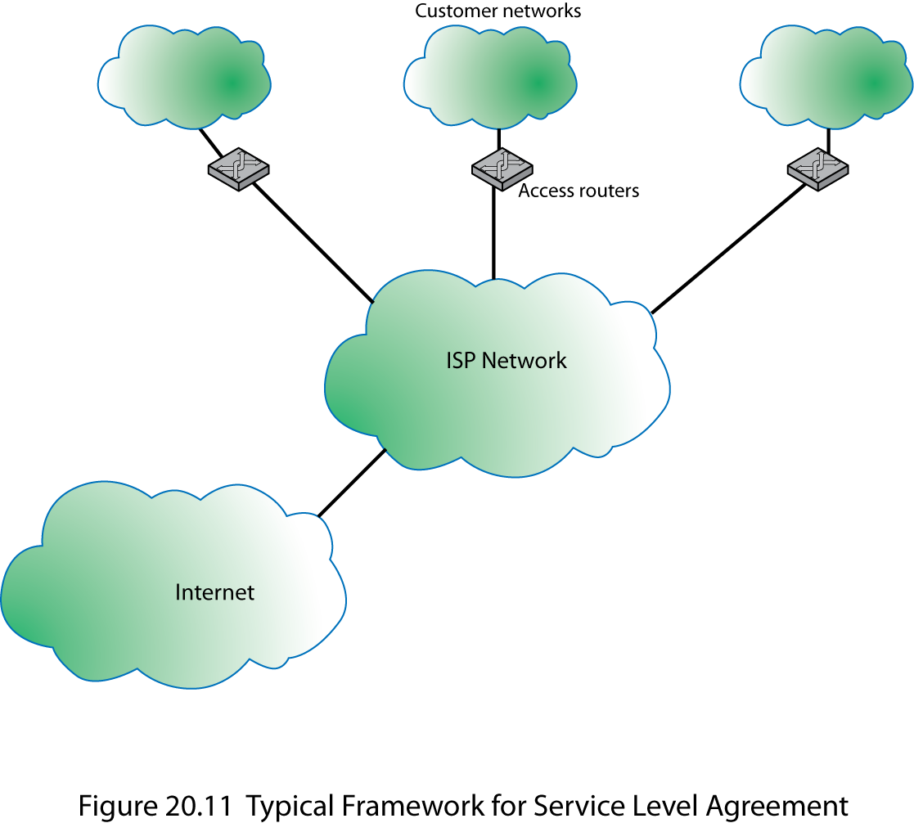
Framework for SLA
Notes:
Stallings DCC9e Figure 20.11 shows a typical configuration that lends itself to an SLA. In this case, a network service provider maintains an IP based network. A customer has a number of private networks (e.g., LANs) at various sites. Customer networks are connected to the provider via access routers at the access points. The SLA dictates service and performance levels for traffic between access routers across the provider network. In addition, the provider network links to the Internet and thus provides Internet access for the enterprise. For example, for the Internet Dedicated Service provided by MCI (http://global.mci.com/terms/us/products/dsl), the SLA includes the following items:
Availability: 100% availability.
Latency (delay): Average round-trip transmissions of ≤ 45 ms between access routers in the contiguous U.S. Average round-trip transmissions of ≤ 90 ms between an access router in the New York metropolitan area and an access router in the London metropolitan area. Latency is calculated by averaging sample measurements taken during a calendar month between routers.
Network packet delivery (reliability): Successful packet delivery rate of ≥ 99.5%.
Denial of service (DoS): Responds to DoS attacks reported by customer within 15 minutes of customer opening a complete trouble ticket. MCI defines a DoS attack as more than 95% bandwidth utilization.
Network jitter: Jitter is defined as the variation or difference in the end-to-end delay between received packets of an IP or packet stream. Jitter performance will not exceed 1 ms between access routers.
An SLA can be defined for the overall network service. In addition, SLAs can be defined for specific end-to-end services available across the carrier's network, such as a virtual private network, or differentiated services.

Slide 38
IP Performance Metrics
IPPM chartered by IETF to develop standard metrics that relate to the quality, performance, and reliability of Internet data delivery
need for standardization:
Internet has grown and continues to grow at a dramatic rate
Internet serves a large and growing number of commercial and personal users across an expanding spectrum of applications
Notes:
The IPPM Performance Metrics Working Group (IPPM) is chartered by IETF to develop standard metrics that relate to the quality, performance, and reliability of Internet data delivery. Two trends dictate the need for such a standardized measurement scheme:
1. The Internet has grown and continues to grow at a dramatic rate. Its topology is increasingly complex. As its capacity has grown, the load on the Internet has grown at an even faster rate. Similarly, private internets, such as corporate intranets and extranets, have exhibited similar growth in complexity, capacity, and load. The sheer scale of these networks makes it difficult to determine quality, performance, and reliability characteristics.
2. The Internet serves a large and growing number of commercial and personal users across an expanding spectrum of applications. Similarly, private networks are growing in terms of user base and range of applications. Some of these applications are sensitive to particular QoS parameters, leading users to require accurate and understandable performance metrics.
A standardized and effective set of metrics enables users and service providers to have an accurate common understanding of the performance of the Internet and private internets. Measurement data is useful for a variety of purposes, including
Supporting capacity planning and troubleshooting of large complex internets
Encouraging competition by providing uniform comparison metrics across service providers
Supporting Internet research in such areas as protocol design, congestion control, and quality of service
Verification of service level agreements

Slide 39
IP Performance Metrics
Notes:
Stallings DCC9e Table 20.3 lists the metrics that have been defined in RFCs at the time of this writing. Table 20.3a lists those metrics which result in a value estimated based on a sampling technique. The metrics are defined in three stages:
Singleton metric: The most elementary, or atomic, quantity that can be measured for a given performance metric. For example, for a delay metric, a singleton metric is the delay experienced by a single packet.
Sample metric: A collection of singleton measurements taken during a given time period. For example, for a delay metric, a sample metric is the set of delay values for all of the measurements taken during a one-hour period.
Statistical metric: A value derived from a given sample metric by computing some statistic of the values defined by the singleton metric on the sample. For example, the mean of all the one-way delay values on a sample might be defined as a statistical metric
The measurement technique can be either active or passive. Active techniques require injecting packets into the network for the sole purpose of measurement. There are several drawbacks to this approach. The load on the network is increased. This in turn can affect the desired result. For example, on a heavily loaded network, the injection of measurement packets can increase network delay, so that the measured delay is greater than it would be without the measurement traffic. In addition, an active measurement policy can be abused for denial-of-service attacks disguised as legitimate measurement activity. Passive techniques observe and extract metrics from existing traffic. This approach can expose the contents of Internet traffic to unintended recipients, creating security and privacy concerns. So far, the metrics defined by the IPPM working group are all active.
For the sample metrics, the simplest technique is to take measurements at fixed time intervals, known as periodic sampling. There are several problems with this approach. First, if the traffic on the network exhibits periodic behavior, with a period that is an integer multiple of the sampling period (or vice versa), correlation effects may result in inaccurate values.
Also, the act of measurement can perturb what is being measured (for example, injecting measurement traffic into a network alters the congestion level of the network), and repeated periodic perturbations can drive a network into a state of synchronization (e.g., [FLOY94]), greatly magnifying what might individually be minor effects. Accordingly, RFC 2330 (Framework for IP Performance Metrics) recommends Poisson sampling. This method uses a Poisson distribution to generate random time intervals with the desired mean value.
Most of the statistical metrics listed in Table 20.3a are self-explanatory. The percentile metric is defined as follows: The xth percentile is a value y such that x% of measurements ≥ y. The inverse percentile of x for a set of measurements is the percentage of all values ≤ x.

Slide 40
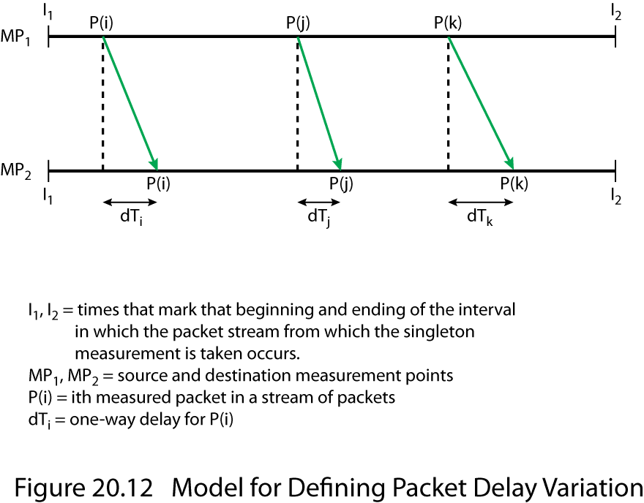
Packet Delay Variation
Notes:
Stallings DCC9e Figure 20.12 illustrates the packet delay variation metric. This metric is used to measure jitter, or variability, in the delay of packets traversing the network. The singleton metric is defined by selecting two packet measurements and measuring the difference in the two delays. The statistical measures make use of the absolute values of the delays.
Table 20.3b lists two metrics that are not defined statistically. Connectivity deals with the issue of whether a transport-level connection is maintained by the network. The current specification (RFC 2678) does not detail specific sample and statistical metrics but provides a framework within which such metrics could be defined. Connectivity is determined by the ability to deliver a packet across a connection within a specified time limit. The other metric, bulk transfer capacity, is similarly specified (RFC 3148) without sample and statistical metrics but begins to address the issue of measuring the transfer capacity of a network service with the implementation of various congestion control mechanisms.

Slide 41

Summary
Integrated services architecture
Elastic and inelastic traffic
ISA approach, components, services
Resource reservation protocol
RSVP goals and characteristics
RSVP operation, filtering, reservation styles
Differentiated services
DS fields, configuration, operation
Service level agreements
IP performance metrics
Notes:
Stallings DCC9e Chapter20 summary.

