Slide 1
Data and Computer Communications
Chapter 12 – Routing in Switched Data Networks
Ninth Edition
by William Stallings
Notes:
“Data and Computer Communications”, 9/e, by William Stallings, Chapter 12 “Routing in Switched Networks”.

Slide 2
Routing in Switched Data Networks
"I tell you," went on Syme with passion, "that every time a train comes in I feel that it has broken past batteries of besiegers, and that man has won a battle against chaos. You say contemptuously that when one has left Sloane Square one must come to Victoria. I say that one might do a thousand things instead, and that whenever I really come there I have the sense of hairbreadth escape. And when I hear the guard shout out the word 'Victoria', it is not an unmeaning word. It is to me the cry of a herald announcing conquest. It is to me indeed 'Victoria'; it is the victory of Adam."
—The Man Who Was Thursday,
G.K. Chesterton
Notes:
This quote is from the start of Stallings DCC9e Chapter 12, hints at the complexities of the routing decision, the choice of path to destination.

Slide 3
Routing in Packet Switching Networks
key design issue for (packet) switched networks
select route across network between end nodes
characteristics required:
correctness
simplicity
robustness
stability
fairness
optimality
efficiency
Notes:
A key design issue in switched networks, including packet-switching, frame relay, and ATM networks, and with internets, is that of routing. In general terms, the routing function seeks to design routes through the network for individual pairs of communicating end nodes such that the network is used efficiently. The primary function of a packet-switching network is to accept packets from a source station and deliver them to a destination station. To accomplish this, a path or route through the network must be determined; generally, more than one route is possible. Thus, a routing function must be performed. The requirements for this function are shown on the slide.
The first two items on the list, correctness and simplicity, are self-explanatory. Robustness has to do with the ability of the network to deliver packets via some route in the face of localized failures and overloads. The designer who seeks robustness must cope with the competing requirement for stability. Techniques that react to changing conditions have an unfortunate tendency to either react too slowly to events or to experience unstable swings from one extreme to another. A tradeoff also exists between fairness and optimality. Some performance criteria may give higher priority to the exchange of packets between nearby stations compared to an exchange between distant stations. This policy may maximize average throughput but will appear unfair to the station that primarily needs to communicate with distant stations. Finally, any routing technique involves some processing overhead at each node and often a transmission overhead as well, both of which impair network efficiency. The penalty of such overhead needs to be less than the benefit accrued based on some reasonable metric, such as increased robustness or fairness.

Slide 4

Performance Criteria
used for selection of route
simplest is to choose “minimum hop”
can be generalized as “least cost” routing
because “least cost” is more flexible it is more common than “minimum hop”
Notes:
The selection of a route is generally based on some performance criterion. The simplest criterion is to choose the minimum-hop route (one that passes through the least number of nodes) through the network. This is an easily measured criterion and should minimize the consumption of network resources. A generalization of the minimum-hop criterion is least-cost routing. In this case, a cost is associated with each link, and, for any pair of attached stations, the route through the network that accumulates the least cost is sought. In either the minimum-hop or least-cost approach, the algorithm for determining the optimum route for any pair of stations is relatively straightforward, and the processing time would be about the same for either computation. Because the least-cost criterion is more flexible, this is more common than the minimum-hop criterion. Several least-cost routing algorithms are in common use. These are described in Stallings DCC9e Section 12.3

Slide 5
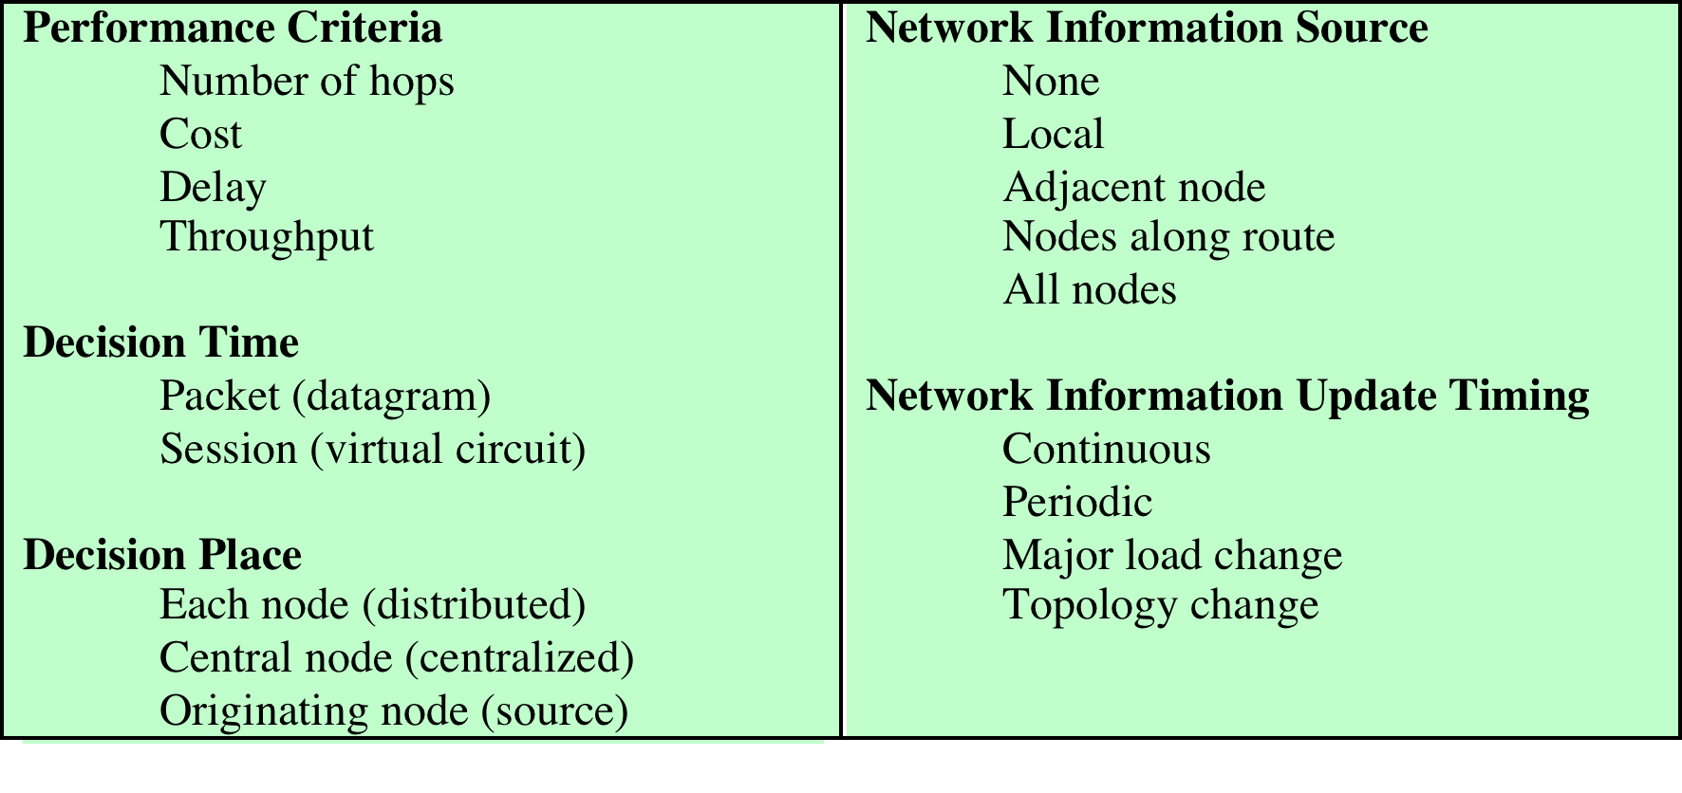
Elements of Routing Techniques for Packet-Switching Networks
Notes:
Stallings DCC9e Table 12.1.

Slide 6
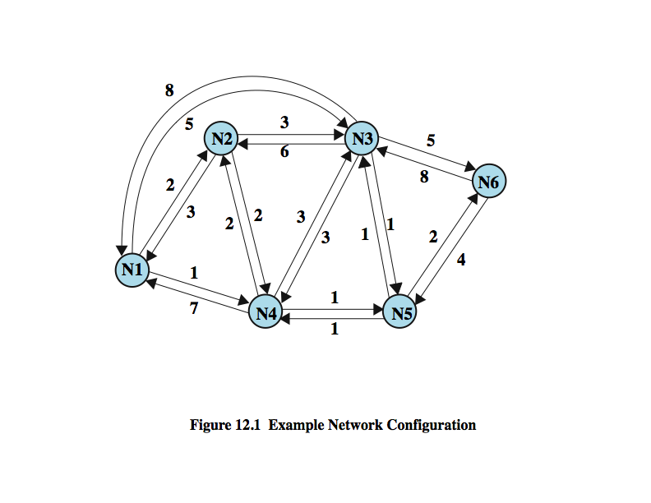
Example of Packet Switched Network
Notes:
Stallings DCC9e Figure 12.1 illustrates a network in which the two arrowed lines between a pair of nodes represent a link between these nodes, and the corresponding numbers represent the current link cost in each direction. The shortest path (fewest hops) from node 1 to node 6 is 1-3-6 (cost = 5 + 5 = 10), but the least-cost path is 1-4-5-6 (cost = 1 + 1 + 2 = 4). Costs are assigned to links to support one or more design objectives. For example, the cost could be inversely related to the data rate (i.e., the higher the data rate on a link, the lower the assigned cost of the link) or the current queuing delay on the link. In the first case, the least-cost route should provide the highest throughput. In the second case, the least-cost route should minimize delay.

Slide 7
Decision Time and Place
decision time
packet or virtual circuit basis
decision place
distributed - made by each node
fixed or dynamically changing
more complex, but more robust
centralized – made by a designated node
source – made by source station
Notes:
Routing decisions are made on the basis of some performance criterion. Two key characteristics of the decision are the time and place that the decision is made.
Decision time is determined by whether the routing decision is made on a packet or virtual circuit basis. When the internal operation of the network is datagram, a routing decision is made individually for each packet. For internal virtual circuit operation, a routing decision is made at the time the virtual circuit is established. In the simplest case, all subsequent packets using that virtual circuit follow the same route. In more sophisticated network designs, the network may dynamically change the route assigned to a particular virtual circuit in response to changing conditions (e.g., overload or failure of a portion of the network).
The term decision place refers to which node or nodes in the network are responsible for the routing decision. Most common is distributed routing, in which each node has the responsibility of selecting an output link for routing packets as they arrive. For centralized routing, the decision is made by some designated node, such as a network control center. The danger of this latter approach is that the loss of the network control center may block operation of the network. The distributed approach is perhaps more complex but is also more robust. A third alternative, used in some networks, is source routing. In this case, the routing decision is actually made by the source station rather than by a network node and is then communicated to the network. This allows the user to dictate a route through the network that meets criteria local to that user.

Slide 8
Network Information Source and Update Timing
routing decisions usually based on knowledge of network, traffic load, and link cost
distributed routing
using local knowledge, information from adjacent nodes, information from all nodes on a potential route
central routing
collect information from all nodes
issue of update timing
depends on routing strategy
fixed - never updated
adaptive - regular updates
Notes:
Most routing strategies require that decisions be based on knowledge of the topology of the network, traffic load, and link cost.
With distributed routing, in which the routing decision is made by each node, the individual node may make use of only local information, such as the cost of each outgoing link. Each node might also collect information from adjacent (directly connected) nodes, such as the amount of congestion experienced at that node. Finally, there are algorithms in common use that allow the node to gain information from all nodes on any potential route of interest. In the case of centralized routing, the central node typically makes use of information obtained from all nodes.
A related concept is that of information update timing, which is a function of both the information source and the routing strategy. Clearly, if no information is used (as in flooding), there is no information to update. If only local information is used, the update is essentially continuous. For all other information source categories (adjacent nodes, all nodes), update timing depends on the routing strategy. For a fixed strategy, the information is never updated. For an adaptive strategy, information is updated from time to time to enable the routing decision to adapt to changing conditions.
As you might expect, the more information available, and the more frequently it is updated, the more likely the network is to make good routing decisions. On the other hand, the transmission of that information consumes network resources.

Slide 9
Routing Strategies - Fixed Routing
use a single permanent route for each source to destination pair of nodes
determined using a least cost algorithm
route is fixed
until a change in network topology
based on expected traffic or capacity
advantage is simplicity
disadvantage is lack of flexibility
does not react to network failure or congestion
Notes:
A large number of routing strategies have evolved for dealing with the routing requirements of packet-switching networks, we survey four key strategies: fixed, flooding, random, and adaptive.
For fixed routing, a single, permanent route is configured for each source-destination pair of nodes in the network. Either of the least-cost routing algorithms described in Section 12.3 could be used. The routes are fixed, or at least only change when there is a change in the topology of the network. Thus, the link costs used in designing routes cannot be based on any dynamic variable such as traffic. They could, however, be based on expected traffic or capacity.
With fixed routing, there is no difference between routing for datagrams and virtual circuits. All packets from a given source to a given destination follow the same route. The advantage of fixed routing is its simplicity, and it should work well in a reliable network with a stable load. Its disadvantage is its lack of flexibility. It does not react to network congestion or failures.

Slide 10
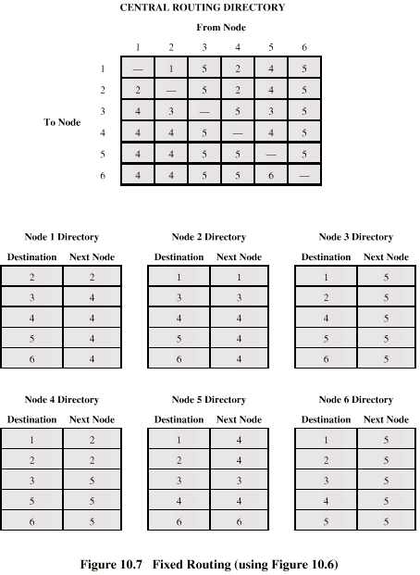
Fixed Routing Tables
Notes:
Stallings DCC9e Figure 12.2 suggests how fixed routing might be implemented. A central routing matrix is created, to be stored perhaps at a network control center. The matrix shows, for each source-destination pair of nodes, the identity of the next node on the route. Note that it is not necessary to store the complete route for each possible pair of nodes. Rather, it is sufficient to know, for each pair of nodes, the identity of the first node on the route. To see this, suppose that the least-cost route from X to Y begins with the X-A link. Call the remainder of the route R₁; this is the part from A to Y. Define R₂ as the least-cost route from A to Y. Now, if the cost of R₁ is greater than that of R₂, then the X-Y route can be improved by using R₂ instead. If the cost of R₁ is less than R₂, then R₂ is not the least-cost route from A to Y. Therefore, R₁ = R₂. Thus, at each point along a route, it is only necessary to know the identity of the next node, not the entire route. In our example, the route from node 1 to node 6 begins by going through node 4. Again consulting the matrix, the route from node 4 to node 6 goes through node 5. Finally, the route from node 5 to node 6 is a direct link to node 6. Thus, the complete route from node 1 to node 6 is 1-4-5-6.
From this overall matrix, routing tables can be developed and stored at each node. From the reasoning in the preceding paragraph, it follows that each node need only store a single column of the routing directory. The node's directory shows the next node to take for each destination.

Slide 11
Routing Strategies - Flooding
packet sent by node to every neighbor
eventually multiple copies arrive at destination
no network information required
each packet is uniquely numbered so duplicates can be discarded
need to limit incessant retransmission of packets
nodes can remember identity of packets retransmitted
can include a hop count in packets
Notes:
Another simple routing technique is flooding. This technique requires no network information whatsoever and works as follows. A packet is sent by a source node to every one of its neighbors. At each node, an incoming packet is retransmitted on all outgoing links except for the link on which it arrived. Eventually, a number of copies of the packet will arrive at the destination. The packet must have some unique identifier (e.g., source node and sequence number, or virtual circuit number and sequence number) so that the destination knows to discard all but the first copy.
Unless something is done to stop the incessant retransmission of packets, the number of packets in circulation just from a single source packet grows without bound. One way to prevent this is for each node to remember the identity of those packets it has already retransmitted. When duplicate copies of the packet arrive, they are discarded. A simpler technique is to include a hop count field with each packet. The count can originally be set to some maximum value, such as the diameter (length of the longest minimum-hop path through the network) of the network. Each time a node passes on a packet, it decrements the count by one. When the count reaches zero, the packet is discarded.

Slide 12
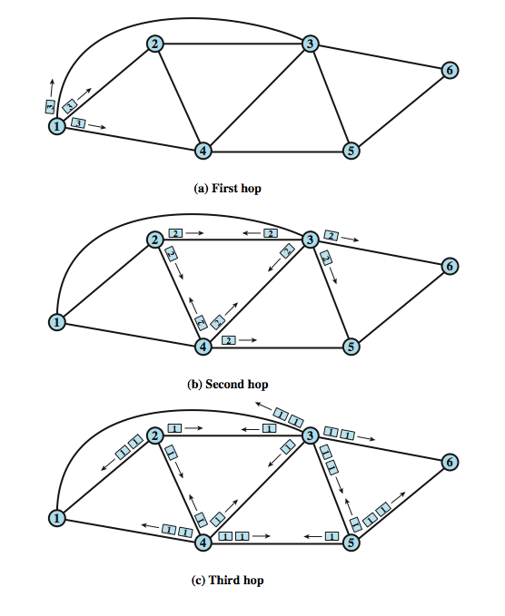
Flooding Example
Notes:
An example of the latter tactic is shown in Stallings DCC9e Figure 12.3. The label on each packet in the figure indicates the current value of the hop count field in that packet. A packet is to be sent from node 1 to node 6 and is assigned a hop count of 3. On the first hop, three copies of the packet are created, and the hop count is decrement to 2. For the second hop of all these copies, a total of nine copies are created. One of these copies reaches node 6, which recognizes that it is the intended destination and does not retransmit. However, the other nodes generate a total of 22 new copies for their third and final hop. Each packet now has a hope count of 1. Note that if a node is not keeping track of packet identifier, it may generate multiple copies at this third stage. All packets received from the third hop are discarded, because the hop count is exhausted. In all, node 6 has received four additional copies of the packet.

Slide 13
Properties of Flooding
all possible routes are tried
highly robust
can be used to send emergency messages
at least one packet will have taken minimum hop route
nodes directly or indirectly connected to source are visited
Disadvantages:
high traffic load generated
security concerns
Notes:
The flooding technique has three remarkable properties:
• All possible routes between source and destination are tried. Thus, no matter what link or node outages have occurred, a packet will always get through if at least one path between source and destination exists.
• Because all routes are tried, at least one copy of the packet to arrive at the destination will have used a minimum-hop route.
• All nodes that are directly or indirectly connected to the source node are visited.
Because of the first property, the flooding technique is highly robust and could be used to send emergency messages. An example application is a military network that is subject to extensive damage. Because of the second property, flooding might be used initially to set up the route for a virtual circuit. The third property suggests that flooding can be useful for the dissemination of important information to all nodes; we will see that it is used in some schemes to disseminate routing information. The principal disadvantage of flooding is the high traffic load that it generates, which is directly proportional to the connectivity of the network. Another disadvantage is that every node sees the routing data, which may create a security concern.

Slide 14
Routing Strategies - Random Routing
simplicity of flooding with much less traffic load
node selects one outgoing path for retransmission of incoming packet
selection can be random or round robin
a refinement is to select outgoing path based on probability calculation
no network information needed
random route is typically neither least cost nor minimum hop
Notes:
Random routing has the simplicity and robustness of flooding with far less traffic load. With random routing, a node selects only one outgoing path for retransmission of an incoming packet. The outgoing link is chosen at random, excluding the link on which the packet arrived. If all links are equally likely to be chosen, then a node may simply utilize outgoing links in a round-robin fashion.
A refinement of this technique is to assign a probability to each outgoing link and to select the link based on that probability. The probability could be based on data rate, or on fixed link costs.
Like flooding, random routing requires the use of no network information. Because the route taken is random, the actual route will typically not be the least-cost route nor the minimum-hop route. Thus, the network must carry a higher than optimum traffic load, although not nearly as high as for flooding.

Slide 15
Routing Strategies - Adaptive Routing
used by almost all packet switching networks
routing decisions change as conditions on the network change due to failure or congestion
requires information about network
Disadvantages:
decisions more complex
tradeoff between quality of network information and overhead
reacting too quickly can cause oscillation
reacting too slowly means information may be irrelevant
Notes:
In virtually all packet-switching networks, some sort of adaptive routing technique is used. That is, the routing decisions that are made change as conditions on the network change. The principal conditions that influence routing decisions are:
• Failure: When a node or link fails, it can no longer be used as part of a route.
• Congestion: When a particular portion of the network is heavily congested, it is desirable to route packets around rather than through the area of congestion.
For adaptive routing to be possible, information about the state of the network must be exchanged among the nodes. There are several drawbacks associated with the use of adaptive routing, compared to fixed routing:
• The routing decision is more complex; therefore, the processing burden on network nodes increases.
• In most cases, adaptive strategies depend on status information that is collected at one place but used at another. There is a tradeoff here between the quality of the information and the amount of overhead. The more information that is exchanged, and the more frequently it is exchanged, the better will be the routing decisions that each node makes. On the other hand, this information is itself a load on the constituent networks, causing a performance degradation.
• An adaptive strategy may react too quickly, causing congestion-producing oscillation, or too slowly, being irrelevant.

Slide 16
Adaptive Routing Advantages
improved performance
aid in congestion control
*These benefits depend on the soundness of the design and nature of the load.
Notes:
Despite these real dangers, adaptive routing strategies are by far the most prevalent, for two reasons:
• An adaptive routing strategy can improve performance, as seen by the network user.
• An adaptive routing strategy can aid in congestion control, which is discussed in Chapter 13. Because an adaptive routing strategy tends to balance loads, it can delay the onset of severe congestion.
These benefits may or may not be realized, depending on the soundness of the design and the nature of the load. By and large, adaptive routing is an extraordinarily complex task to perform properly. As demonstration of this, most major packet-switching networks, such as ARPANET and its successors, and many commercial networks, have endured at least one major overhaul of their routing strategy.

Slide 17
Classification of Adaptive Routing Strategies
on the basis of information source
local (isolated)
route to outgoing link with shortest queue
adjacent nodes
takes advantage of delay and outage information
all nodes
like adjacent
can include bias for each destination
rarely used - does not make use of available information
distributed or centralized
Notes:
A convenient way to classify adaptive routing strategies is on the basis of information source: local, adjacent nodes, all nodes. An example of an adaptive routing strategy that relies only on local information is one in which a node routes each packet to the outgoing link with the shortest queue length, Q. This would have the effect of balancing the load on outgoing links. However, some outgoing links may not be headed in the correct general direction. We can improve matters by also taking into account preferred direction, much as with random routing. In this case, each link emanating from the node would have a bias B_{i}, for each destination i, such that lower values of B_{i} indicate more preferred directions. For each incoming packet headed for node i, the node would choose the outgoing link that minimizes Q + B_{i}. Thus a node would tend to send packets in the right direction, with a concession made to current traffic delays.
Adaptive schemes based only on local information are rarely used because they do not exploit easily available information. Strategies based on information from adjacent nodes or all nodes are commonly found. Both take advantage of information that each node has about delays and outages that it experiences. Such adaptive strategies can be either distributed or centralized. In the distributed case, each node exchanges delay information with other nodes. Based on incoming information, a node tries to estimate the delay situation throughout the network, and applies a least-cost routing algorithm. In the centralized case, each node reports its link delay status to a central node, which designs routes based on this incoming information and sends the routing information back to the nodes.

Slide 18
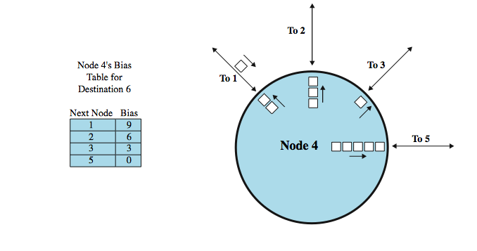
Isolated Adaptive Routing
Notes:
As an example, Stallings DCC9e Figure 12.4 show the status of node 4 of Figure 12.1 at a certain point in time. Node 4 has links to four other nodes. A fair number of packets have been arriving and a backlog has built up, with a queue of packets waiting for each of the outgoing links. A packet arrives from node 1 destined for node 6. To which outgoing link should the packet be routed? Based on current queue lengths and the values of bias (B₆) for each outgoing link, the minimum value of Q + B₆ is 4, on the link to node 3. Thus, node 4 routes the packet through node 3.

Slide 19
ARPANET Routing Strategies 1st Generation
Distance Vector Routing
1969
distributed adaptive using estimated delay
queue length used as estimate of delay
version of Bellman-Ford algorithm
node exchanges delay vector with neighbors
update routing table based on incoming information
doesn't consider line speed, just queue length and responds slowly to congestion
Notes:
In this section, we look at several examples of routing strategies. All of these were initially developed for ARPANET, which is a packet-switching network that was the foundation of the present-day Internet. It is instructive to examine these strategies for several reasons. First, these strategies and similar ones are also used in other packet-switching networks, including a number of networks on the Internet. Second, routing schemes based on the ARPANET work have also been used for internetwork routing in the Internet and in private internetworks. And finally, the ARPANET routing scheme evolved in a way that illuminates some of the key design issues related to routing algorithms.
The original routing algorithm, designed in 1969, was a distributed adaptive algorithm using estimated delay as the performance criterion and a version of the Bellman-Ford algorithm (Section 12.3). The approach used is referred to as distance-vector routing.

Slide 20
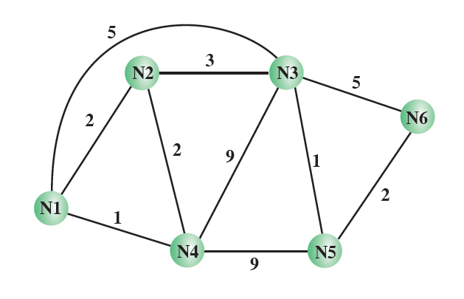
Distance Vector Routing Example

Slide 21
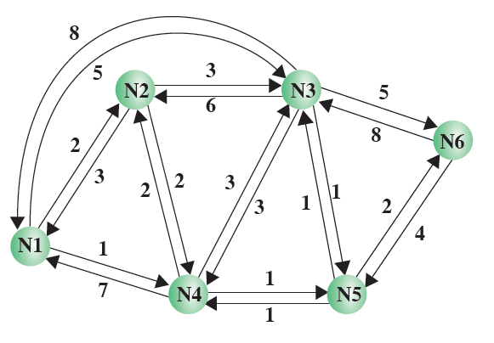
Distance Vector Example cont’d..
New delay metrics

Slide 22
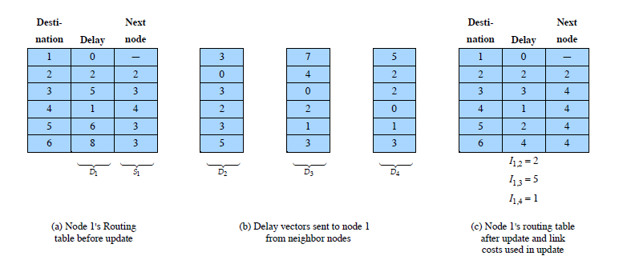
Distance Vector Example cont’d..
Node 1 updates its routing table

Slide 23
ARPANET Routing Strategies 2nd Generation
Link-State Routing
1979
distributed adaptive using delay criterion
using timestamps of arrival, departure & ACK times
re-computes average delays every 10 seconds
any changes are flooded to all other nodes
re-computes routing using Dijkstra’s algorithm
good under light and medium loads
under heavy loads, little correlation between reported delays and those experienced
Notes:
After some years of experience and several minor modifications, the original routing algorithm was replaced by a quite different one in 1979 [MCQU80]. The major shortcomings of the old algorithm were these:
The algorithm did not consider line speed, merely queue length. Thus, higher-capacity links were not given the favored status they deserved.
Queue length is, in any case, an artificial measure of delay, because some variable amount of processing time elapses between the arrival of a packet at a node and its placement in an outbound queue.
The algorithm was not very accurate. In particular, it responded slowly to congestion and delay increases.
The new algorithm is also a distributed adaptive one, using delay as the performance criterion, but the differences are significant. Rather than using queue length as a surrogate for delay, the delay is measured directly. At a node, each incoming packet is timestamped with an arrival time. A departure time is recorded when the packet is transmitted. If a positive acknowledgment is returned, the delay for that packet is recorded as the departure time minus the arrival time plus transmission time and propagation delay. The node must therefore know link data rate and propagation time. If a negative acknowledgment comes back, the departure time is updated and the node tries again, until a measure of successful transmission delay is obtained.
Every 10 seconds, the node computes the average delay on each outgoing link. If there are any significant changes in delay, the information is sent to all other nodes using flooding. Each node maintains an estimate of delay on every network link. When new information arrives, it recomputes its routing table using Dijkstra's algorithm (Section 12.3).
The second-generation routing algorithm is referred to as a link-state routing algorithm.

Slide 24
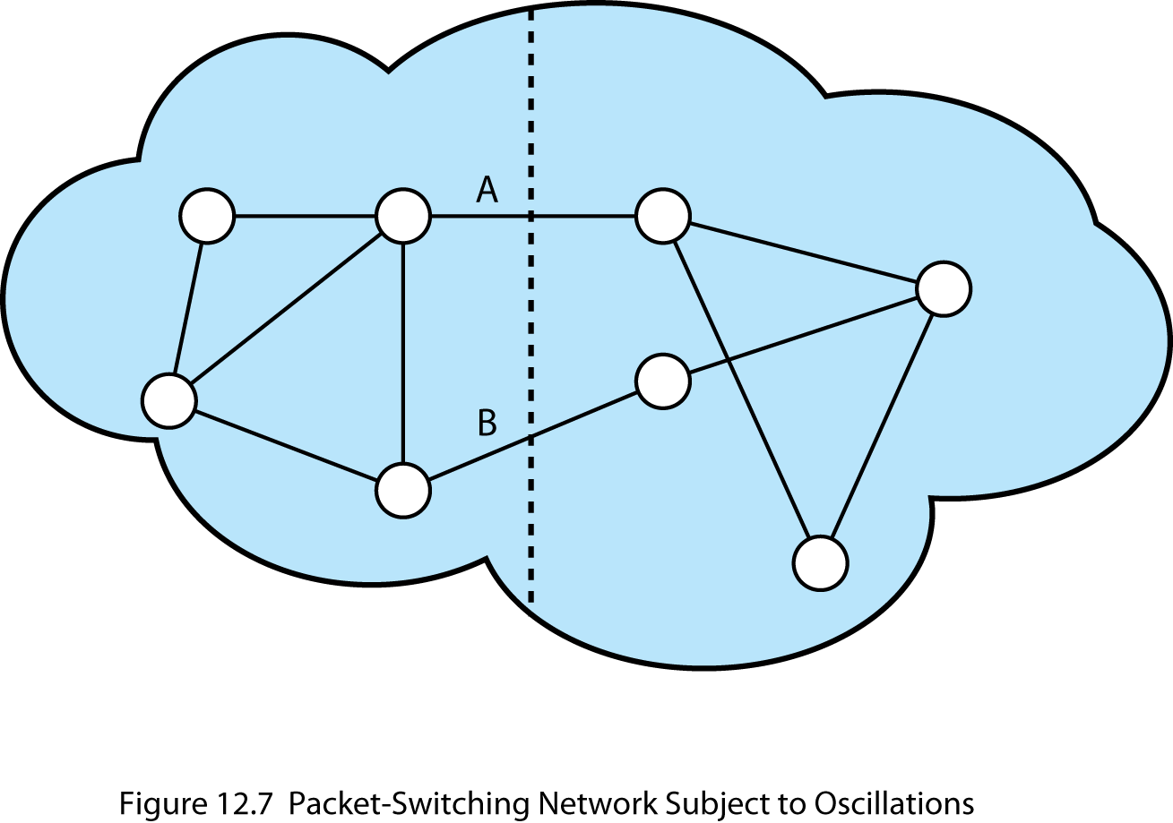
Oscillation
Notes:
As an example, consider a network that consists of two regions with only two links, A and B, connecting the two regions (Stallings DCC9e Figure 12.7). Each route between two nodes in different regions must pass through one of these links. Assume that a situation develops in which most of the traffic is on link A. This will cause the link delay on A to be significant, and at the next opportunity, this delay value will be reported to all other nodes. These updates will arrive at all nodes at about the same time, and all will update their routing tables immediately. It is likely that this new delay value for link A will be high enough to make link B the preferred choice for most, if not all, inter-region routes. Because all nodes adjust their routes at the same time, most or all inter-region traffic shifts at the same time to link B. Now the link delay value on B will become high, and there will be a subsequent shift to link A. This oscillation will continue until the traffic volume subsides.
There are a number of reasons why this oscillation is undesirable:
A significant portion of available capacity is unused at just the time when it is needed most: under heavy traffic load.
The overutilization of some links can lead to the spread of congestion within the network (this will be seen in the discussion of congestion in Chapter 13).
The large swings in measured delay values result in the need for more frequent routing update messages. This increases the load on the network at just the time when the network is already stressed.

Slide 25
ARPANET Routing Strategies 3rd Generation
1987
link cost calculation changed
damp routing oscillations
reduce routing overhead
measure average delay over last 10 seconds and transform into link utilization estimate
normalize this based on current value and previous results
set link cost as function of average utilization
Notes:
The ARPANET designers concluded that the essence of the problem was that every node was trying to obtain the best route for all destinations, and that these efforts conflicted. It was concluded that under heavy loads, the goal of routing should be to give the average route a good path instead of attempting to give all routes the best path.
The designers decided that it was unnecessary to change the overall routing algorithm. Rather, it was sufficient to change the function that calculates link costs. This was done in such a way as to damp routing oscillations and reduce routing overhead. The calculation begins with measuring the average delay over the last 10 seconds.

Slide 26
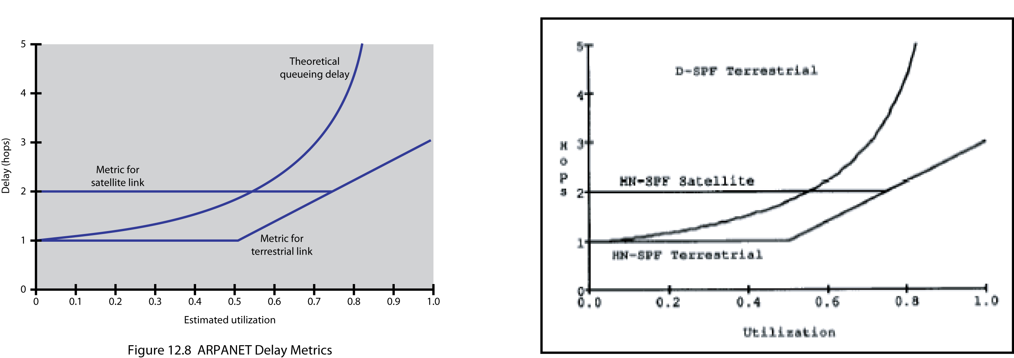
ARPANET Delay Metrics
Notes:
In Stallings DCC9e Figure 12.8, delay is normalized to the value achieved on an idle line, which is just propagation delay plus transmission time. One curve on the figure indicates the way in which the actual delay rises as a function of utilization; the increase in delay is due to queuing delay at the node. For the revised algorithm, the cost value is kept at the minimum value until a given level of utilization is reached. This feature has the effect of reducing routing overhead at low traffic levels. Above a certain level of utilization, the cost level is allowed to rise to a maximum value that is equal to three times the minimum value. The effect of this maximum value is to dictate that traffic should not be routed around a heavily utilized line by more than two additional hops.
Note that the minimum threshold is set higher for satellite links. This encourages the use of terrestrial links under conditions of light traffic, because the terrestrial links have much lower propagation delay. Note also that the actual delay curve is much steeper than the transformation curves at high utilization levels. It is this steep rise in link cost that causes all of the traffic on a link to be shed, which in turn causes routing oscillations.
In summary, the revised cost function is keyed to utilization rather than delay. The function acts similar to a delay-based metric under light loads and to a capacity-based metric under heavy loads.

Slide 27
Least Cost Algorithms
basis for routing decisions
minimize hop with each link cost 1
have link value inversely proportional to capacity
defines cost of path between two nodes as sum of costs of links traversed
network of nodes connected by bi-directional links
link has a cost in each direction
for each pair of nodes, find path with least cost
link costs in different directions may be different
alternatives: Dijkstra or Bellman-Ford algorithms
Notes:
Virtually all packet-switching networks and all internets base their routing decision on some form of least-cost criterion. If the criterion is to minimize the number of hops, each link has a value of 1. More typically, the link value is inversely proportional to the link capacity, proportional to the current load on the link, or some combination. In any case, these link or hop costs are used as input to a least-cost routing algorithm, which can be simply stated as:
Given a network of nodes connected by bidirectional links, where each link has a cost associated with it in each direction, define the cost of a path between two nodes as the sum of the costs of the links traversed. For each pair of nodes, find a path with the least cost.
Note that the cost of a link may differ in its two directions. This would be true, for example, if the cost of a link equaled the length of the queue of packets awaiting transmission from each of the two nodes on the link.
Most least-cost routing algorithms in use in packet-switching networks and internets are variations of one of two common algorithms, known as Dijkstra's algorithm and the Bellman-Ford algorithm. This section provides a summary of these two algorithms.

Slide 28
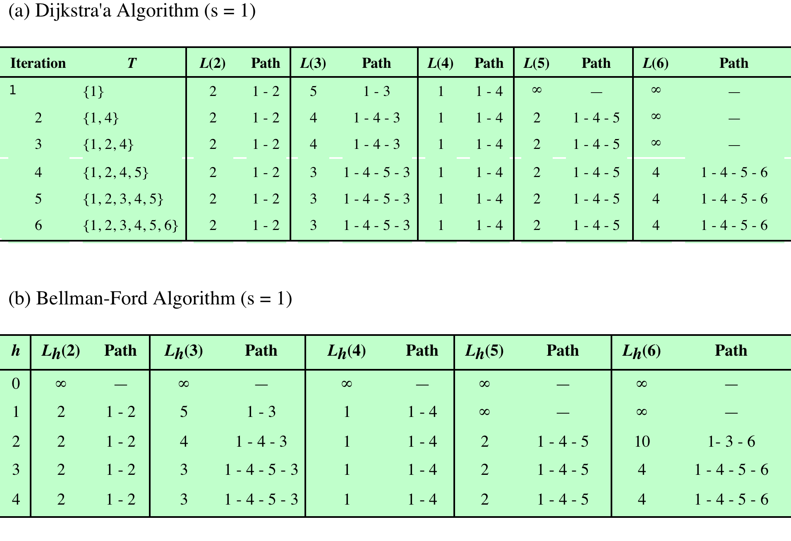
Example of Least-Cost Routing Algorithms (using Figure 12.1)
Notes:
Stallings DCC9e Table 12.2

Slide 29
Dijkstra’s Algorithm
finds shortest paths from given source nodes to all other nodes
develop paths in order of increasing path length
algorithm runs in stages
each time adding node with next shortest path
algorithm terminates when all nodes have been added to T
Notes:
Dijkstra's algorithm [DIJK59] can be stated as: Find the shortest paths from a given source node to all other nodes by developing the paths in order of increasing path length. The algorithm proceeds in stages. By the kth stage, the shortest paths to the k nodes closest to (least cost away from) the source node have been determined; these nodes are in a set T. At stage (k + 1), the node not in T that has the shortest path from the source node is added to T. As each node is added to T, its path from the source is defined.
The algorithm terminates when all nodes have been added to T. At termination, the value L(x) associated with each node x is the cost (length) of the least-cost path from s to x. In addition, T defines the least-cost path from s to each other node.

Slide 30
Dijkstra’s Algorithm Method
Step 1 [Initialization]
T = {s} Set of nodes so far incorporated
L(n) = w(s, n) for n ≠ s
Step 2 [Get Next Node]
find neighboring node not in T with least-cost path from s
incorporate node into T
also incorporate the edge that is incident on that node and a node in T that contributes to the path
initial path costs to neighboring nodes are simply link costs
Step 3 [Update Least-Cost Paths]
L(n) = min[L(n), L(x) + w(x, n)] for all n ∉ T
if latter term is minimum, path from s to n is path from s to x concatenated with edge from x to n
Notes:
Dijkstra's Algorithm has three steps; steps 2 and 3 are repeated until T = N. That is, steps 2 and 3 are repeated until final paths have been assigned to all nodes in the network. It can be formally described as shown above, given the following definitions:
N = set of nodes in the network
s = source node
T = set of nodes so far incorporated by the algorithm
w(i, j) = link cost from node i to node j; w(i, i) = 0; w(i, j) = ∞ if two nodes not directly connected; w(i, j) ≥ 0 if two nodes are directly connected
L(n) = cost of the least-cost path from node s to node n that is currently known to the algorithm; at termination, this is the cost of the least-cost path in the graph from s to n.
The algorithm terminates when all nodes have been added to T. At termination, the value L(x) associated with each node x is the cost (length) of the least-cost path from s to x. In addition, T defines the least-cost path from s to each other node. One iteration of steps 2 and 3 adds one new node to T and defines the least-cost path from s to that node. That path passes only through nodes that are in T. To see this, consider the following line of reasoning. After k iterations, there are k nodes in T, and the least-cost path from s to each of these nodes has been defined. Now consider all possible paths from s to nodes not in T. Among those paths, there is one of least cost that passes exclusively through nodes in T (see Problem 12.4), ending with a direct link from some node in T to a node not in T. This node is added to T and the associated path is defined as the least-cost path for that node.

Slide 31
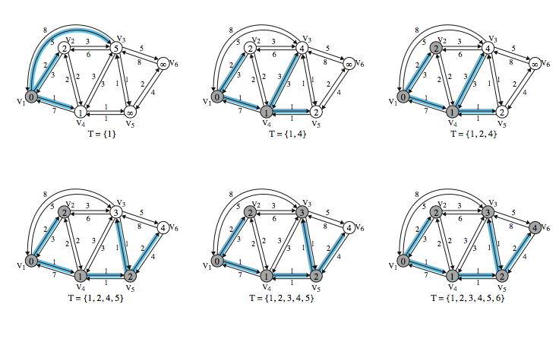
Dijkstra’s Algorithm Example
Notes:
Stallings DC9e Table 12.2a (next slide) and Stallings DCC9e Figure 12.9 show the result of applying this algorithm to the graph of Stallings DCC9e Figure 12.1, using source node s = 1. The shaded edges define the spanning tree for the graph. The values in each circle are the current estimates of L(x) for each node x. A node is shaded when it is added to T. Note that at each step the path to each node plus the total cost of that path is generated. After the final iteration, the least-cost path to each node and the cost of that path have been developed. The same procedure can be used with node 2 as source node, and so on.

Slide 32
Dijkstra’s Algorithm Example
Iter | T | L(2) | Path | L(3) | Path | L(4) | Path | L(5) | Path | L(6) | Path
1 | {1} | 2 | 1–2 | 5 | 1-3 | 1 | 1–4 | ∞ | - | ∞ | -
2 | {1,4} | 2 | 1–2 | 4 | 1-4-3 | 1 | 1–4 | 2 | 1-4–5 | ∞ | -
3 | {1, 2, 4} | 2 | 1–2 | 4 | 1-4-3 | 1 | 1–4 | 2 | 1-4–5 | ∞ | -
4 | {1, 2, 4, 5} | 2 | 1–2 | 3 | 1-4-5–3 | 1 | 1–4 | 2 | 1-4–5 | 4 | 1-4-5–6
5 | {1, 2, 3, 4, 5} | 2 | 1–2 | 3 | 1-4-5–3 | 1 | 1–4 | 2 | 1-4–5 | 4 | 1-4-5–6
6 | {1, 2, 3, 4, 5, 6} | 2 | 1-2 | 3 | 1-4-5-3 | 1 | 1-4 | 2 | 1-4–5 | 4 | 1-4-5-6
Notes:
Stallings DCC9e Table 12.2a shows the result of applying this algorithm as shown in Stallings DCC9e Figure 12.9 (previous slide).

Slide 33
Bellman-Ford Algorithm
find shortest paths from given node subject to constraint that paths contain at most one link
find the shortest paths with a constraint of paths of at most two links
and so on
Notes:
The Bellman-Ford algorithm [FORD62] can be stated as: Find the shortest paths from a given source node subject to the constraint that the paths contain at most one link, then find the shortest paths with a constraint of paths of at most two links, and so on. This algorithm also proceeds in stages.
For the iteration of step 2 with h = K, and for each destination node n, the algorithm compares potential paths from s to n of length K + 1 with the path that existed at the end of the previous iteration. If the previous, shorter, path has less cost, then that path is retained. Otherwise a new path with length K + 1 is defined from s to n; this path consists of a path of length K from s to some node j, plus a direct hop from node j to node n. In this case, the path from s to j that is used is the K-hop path for j defined in the previous iteration (see Problem 12.5).

Slide 34
Bellman-Ford Algorithm
step 1 [Initialization]
L₀(n) = ∞, for all n ≠ s
L_{h}(s) = 0, for all h
step 2 [Update]
for each successive h ≥ 0
for each n ≠ s, compute: L_{h+1}(n)=^{min}_{j}[L_{h}(j)+w(j,n)]
connect n with predecessor node j that gives min
eliminate any connection of n with different predecessor node formed during an earlier iteration
path from s to n terminates with link from j to n
Notes:
The algorithm is formally described as shown. For the iteration of step 2 with h = K, and for each destination node n, the algorithm compares potential paths from s to n of length K + 1 with the path that existed at the end of the previous iteration. If the previous, shorter, path has less cost, then that path is retained. Otherwise a new path with length K + 1 is defined from s to n; this path consists of a path of length K from s to some node j, plus a direct hop from node j to node n. In this case, the path from s to j that is used is the K-hop path for j defined in the previous iteration.

Slide 35
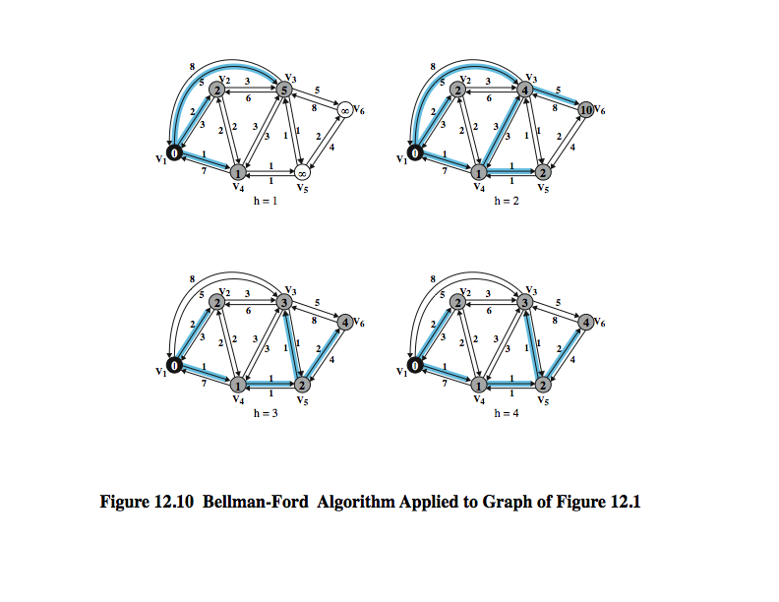
Example of Bellman-Ford Algorithm
Notes:
Stallings DCC9e Table 12.2b(next slide) and Stallings DCC9e Figure 12.10 show the result of applying this algorithm to Stallings DCC9e Figure 12.1, using s = 1. At each step, the least-cost paths with a maximum number of links equal to h are found. After the final iteration, the least-cost path to each node and the cost of that path have been developed. The same procedure can be used with node 2 as source node, and so on. Note that the results agree with those obtained using Dijkstra's algorithm.

Slide 36
Results of Bellman-Ford Example
h | L_{h}(2) | Path | L_{h}(3) | Path | L_{h}(4) | Path | L_{h}(5) | Path | L_{h}(6) | Path
0 | ∞ | - | ∞ | - | ∞ | - | ∞ | - | ∞ | -
1 | 2 | 1-2 | 5 | 1-3 | 1 | 1-4 | ∞ | - | ∞ | -
2 | 2 | 1-2 | 4 | 1-4-3 | 1 | 1-4 | 2 | 1-4-5 | 10 | 1-3-6
3 | 2 | 1-2 | 3 | 1-4-5-3 | 1 | 1-4 | 2 | 1-4-5 | 4 | 1-4-5-6
4 | 2 | 1-2 | 3 | 1-4-5-3 | 1 | 1-4 | 2 | 1-4-5 | 4 | 1-4-5-6
Notes:
Stallings DCC9e Table 12.2b and Stallings DCC9e Figure 12.10 (previous slide) show the result of applying this algorithm to Stallings DCC9e Figure 12.1, using s = 1. At each step, the least-cost paths with a maximum number of links equal to h are found. After the final iteration, the least-cost path to each node and the cost of that path have been developed. The same procedure can be used with node 2 as source node, and so on. Note that the results agree with those obtained using Dijkstra's algorithm.

Slide 37
Comparison
Bellman-Ford
calculation for node n needs link cost to neighboring nodes plus total cost to each neighbor from s
each node can maintain set of costs and paths for every other node
can exchange information with direct neighbors
can update costs and paths based on information from neighbors and knowledge of link costs
Dijkstra
each node needs complete topology
must know link costs of all links in network
must exchange information with all other nodes
Notes:
One interesting comparison can be made between these two algorithms, having to do with what information needs to be gathered. Consider first the Bellman-Ford algorithm. In step 2, the calculation for node n involves knowledge of the link cost to all neighboring nodes to node n ]i.e., w(j, n)] plus the total path cost to each of those neighboring nodes from a particular source node s [i.e., Lh(j)]. Each node can maintain a set of costs and associated paths for every other node in the network and exchange this information with its direct neighbors from time to time. Each node can therefore use the expression in step 2 of the Bellman-Ford algorithm, based only on information from its neighbors and knowledge of its link costs, to update its costs and paths. On the other hand, consider Dijkstra's algorithm. Step 3 appears to require that each node must have complete topological information about the network. That is, each node must know the link costs of all links in the network. Thus, for this algorithm, information must be exchanged with all other nodes.

Slide 38
Evaluation
dependent on
processing time of algorithms
amount of information required from other nodes
implementation specific
both converge under static topology and costs
both converge to same solution
if link costs change, algorithms attempt to catch up
if link costs depend on traffic, which depends on routes chosen, may have feedback instability
Notes:
In general, evaluation of the relative merits of the two algorithms should consider the processing time of the algorithms and the amount of information that must be collected from other nodes in the network or internet. The evaluation will depend on the implementation approach and the specific implementation.
A final point: Both algorithms are known to converge under static conditions of topology, and link costs and will converge to the same solution. If the link costs change over time, the algorithm will attempt to catch up with these changes. However, if the link cost depends on traffic, which in turn depends on the routes chosen, then a feedback condition exists, and instabilities may result.

Slide 39

Summary
routing in packet-switched networks
routing strategies
fixed, flooding, random, adaptive
ARPANET examples
least-cost algorithms
Dijkstra, Bellman-Ford
Notes:
Stallings DCC9e Chapter12 summary.

