Slide 1

Various Projects with FeliX
Ryan Tan Sustainable Service Systems Research Group Energy, Climate, and Environment Program
Keio University Talk 14 September 2026
Notes:
Flow of the Conversation:
Why Interactive Simulators
What is FeliXSim? Model + Interface
Presentation of Tool
Discussions

Slide 2
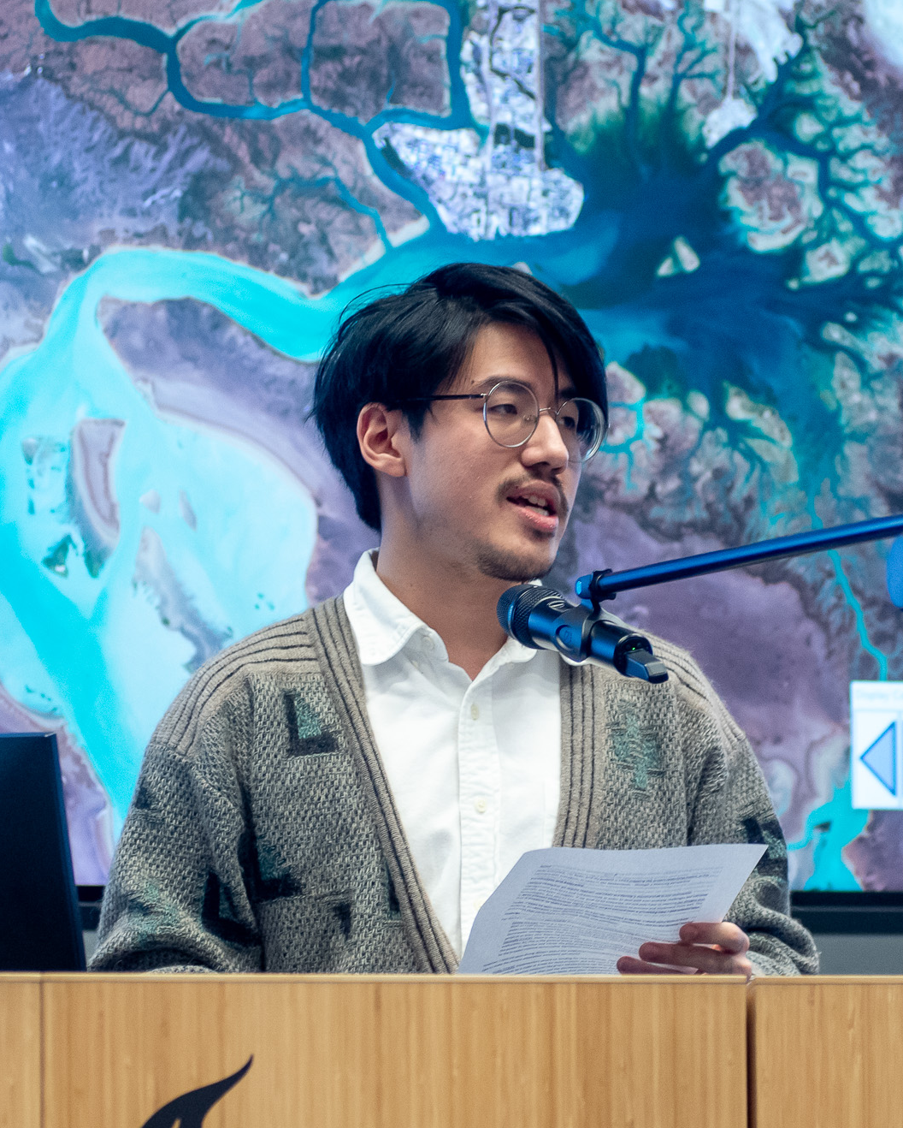
About Me!
Education National University of Singapore (NUS) Delft University of Technology (TU Delft)
Current and Past Affiliations Lee Kuan Yew School of Public Policy (LKYSPP) International Centre for Integrated Mountain Development (ICIMOD) International Institute of Applied Systems Analysis (IIASA)
Previous Work: Water Resource Management; Disaster Resilience
Interests: Human-Earth Systems Interactions; System Dynamics Deep Uncertainty; Exploratory Modelling
☺ Hobbies: Cycling, Photography, Nature

Slide 3





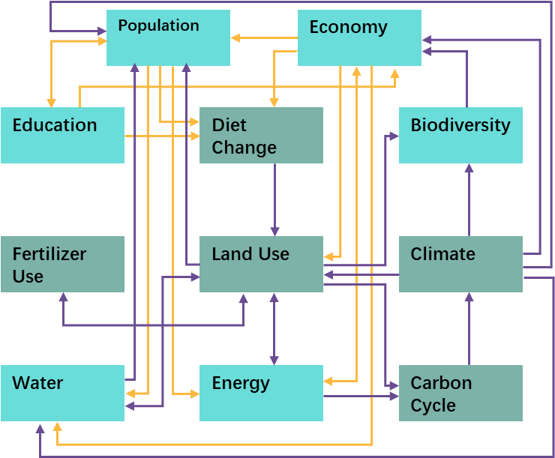

My Role in IIASA/FeliX Team
Sibel
Quanliang
Deepthi
Ryan
David
About FeliX
System dynamics-based global (+ regional) Integrated Assessment Model
Includes nine modules to represent the dynamic Earth-Human system with feedback loops within and between them
Developed at IIASA since 2013.
My Role in the Team
Maintain the global version of FeliX (v25~)
Develop and Maintain FeliXSim, FeliX’s interactive simulator
Run large-scale scenario analyses with collaborators (e.g. Model Intercomparison Projects)
Notes:
Important because of changing climate discourse.

Slide 4
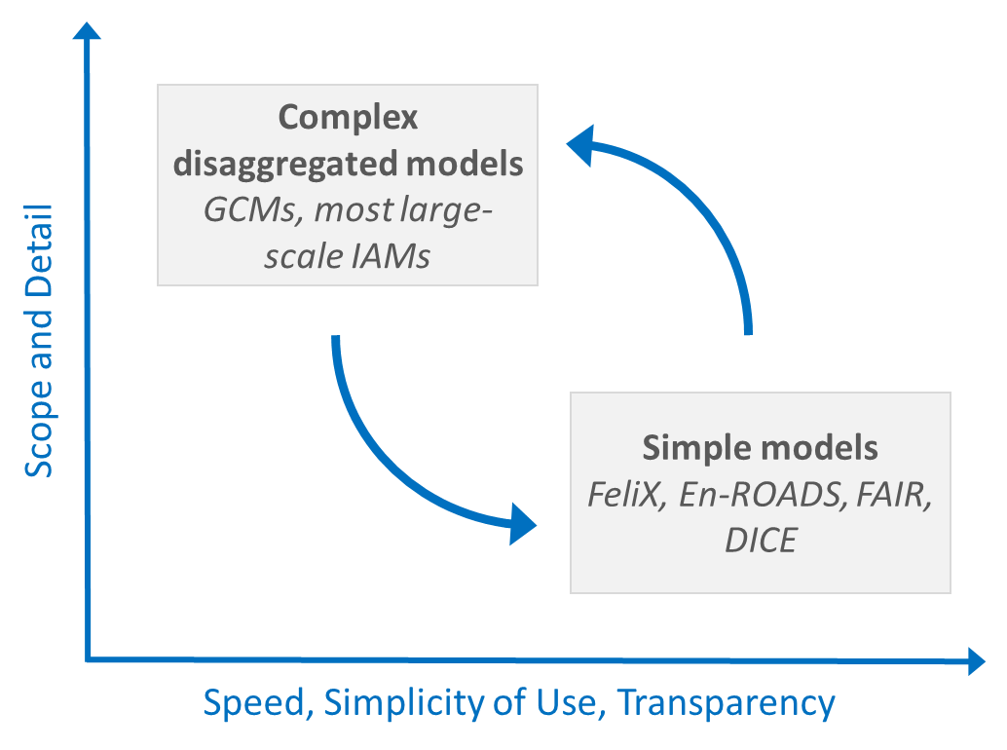
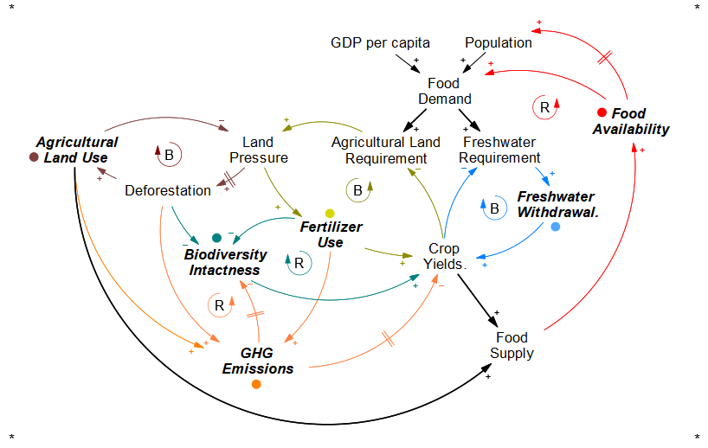
FeliX in the community of Global Models (i.e. IAMs)
Computational Efficiency (1 sec run)
Running many simulations
(1) Useful for analysing uncertainties
(2) Useful for stakeholder engagement
System Dynamics Modelling Framework
Causal-based, Explicit Feedbacks
Flexibility with “soft variables”
(3) Great potential for exploring structure

Slide 5
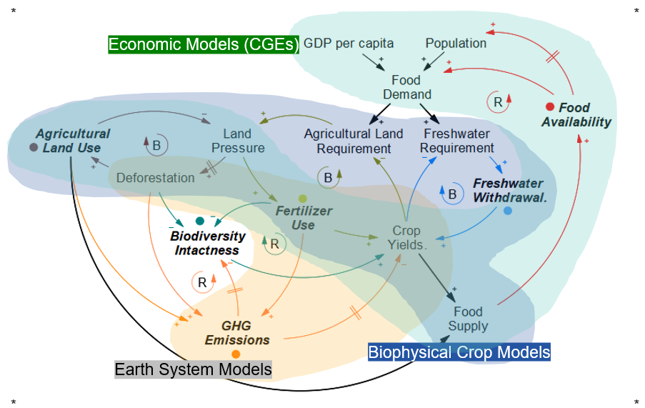
Two ongoing projects to demonstrate the use of FeliX
FeliXSim: Interactive Simulator of FeliX
(2) Useful for stakeholder engagement
Food System Feedback Uncertainties
(1) Useful for analysing uncertainties (3) Great potential for exploring structure

Slide 6
FeliXSim: An Interactive Simulation Environment for Global Systems Modeling in Climate and Sustainability Contexts International System Dynamics Conference 2026, Delft, Netherlands.
Notes:
Flow of the Conversation:
Why Interactive Simulators
What is FeliXSim? Model + Interface
Presentation of Tool
Discussions

Slide 7
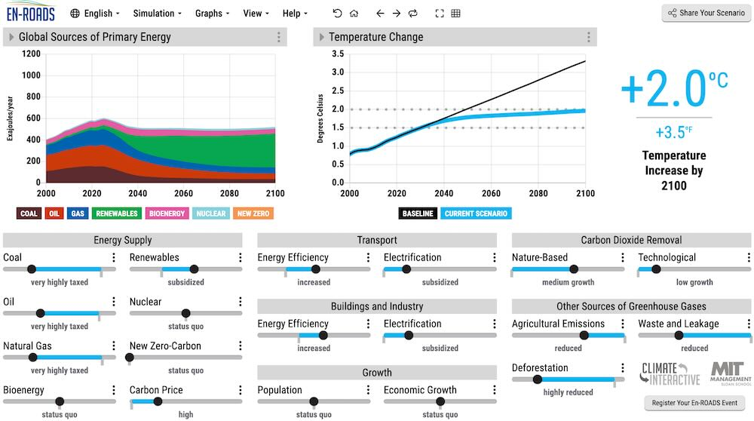
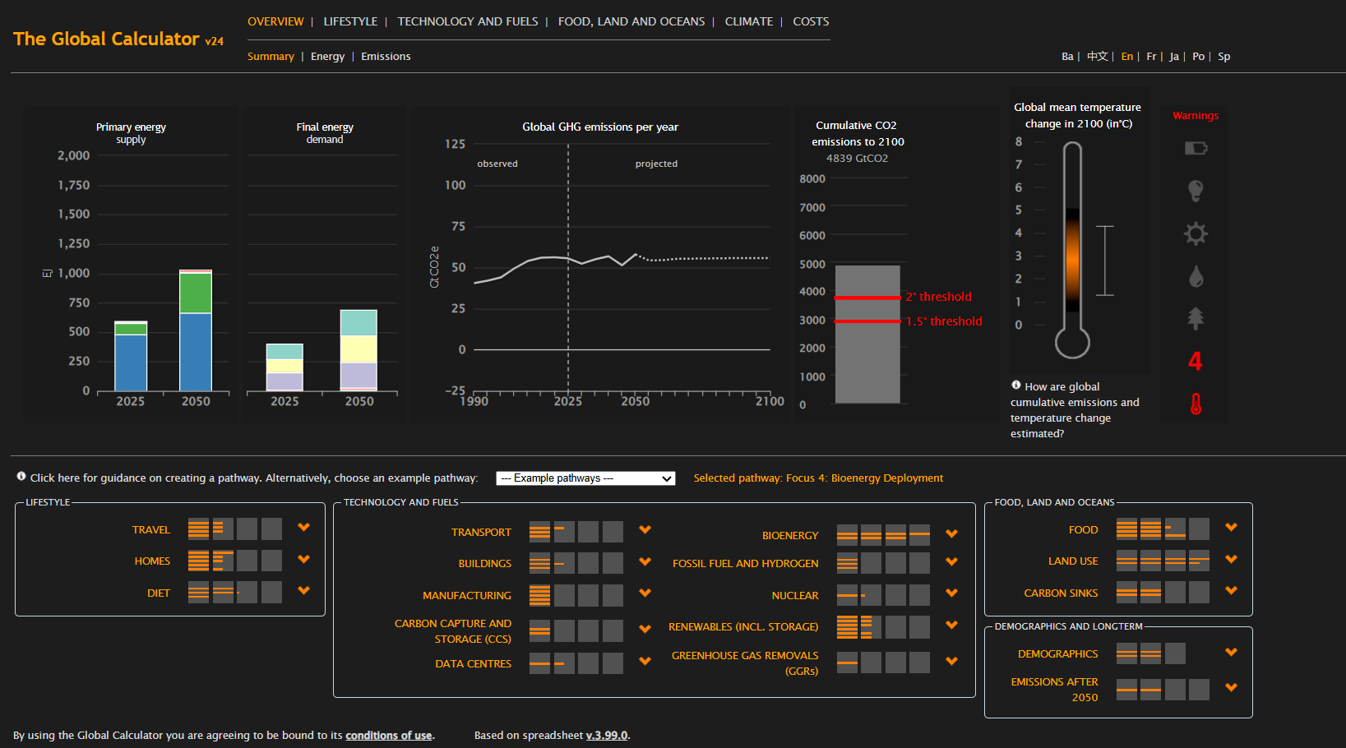
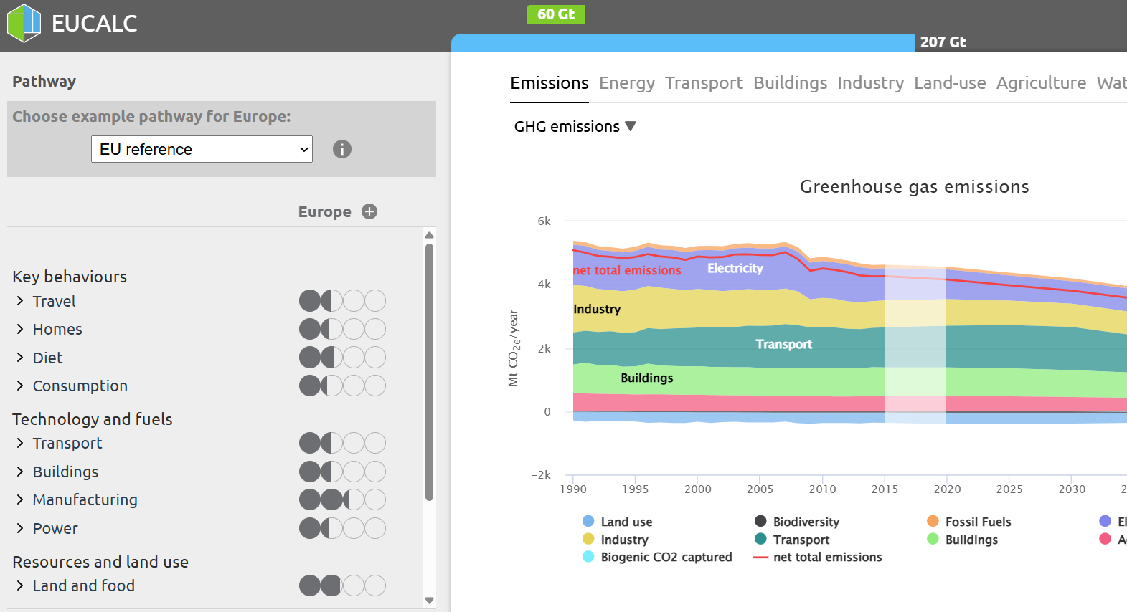
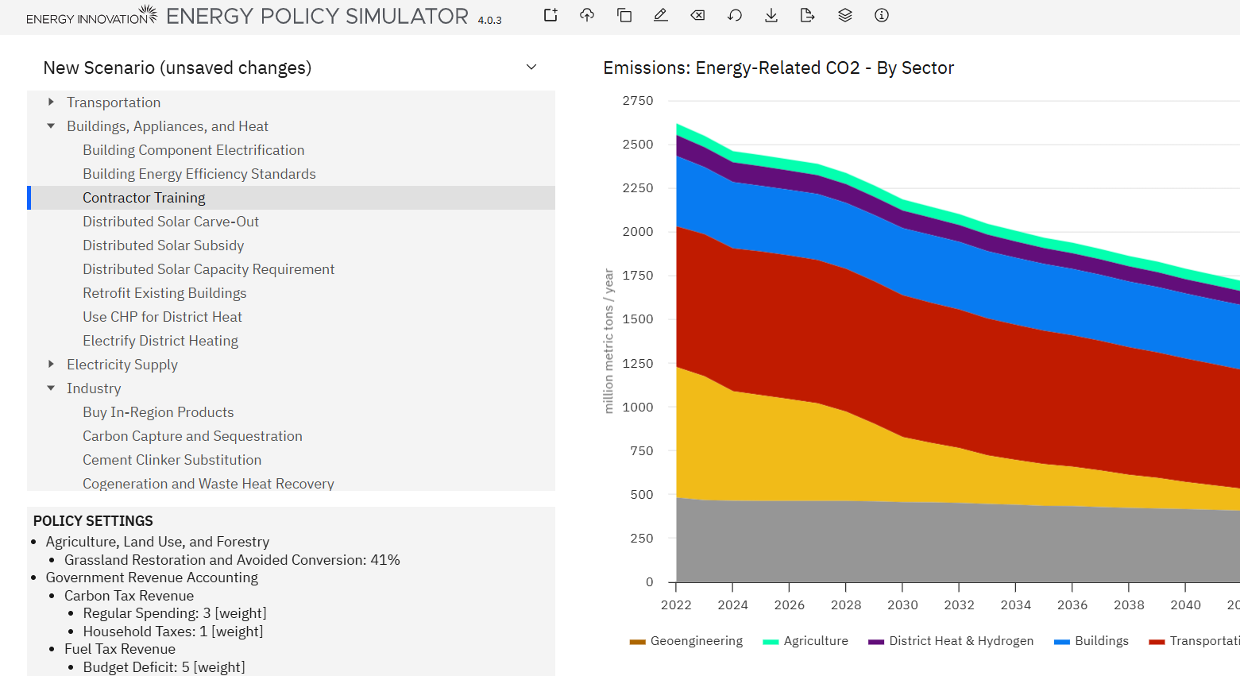
What are “Interactive Simulators”?
En-ROADS
The Global Calculator
EUCalc
Energy Policy Simulator

Slide 8
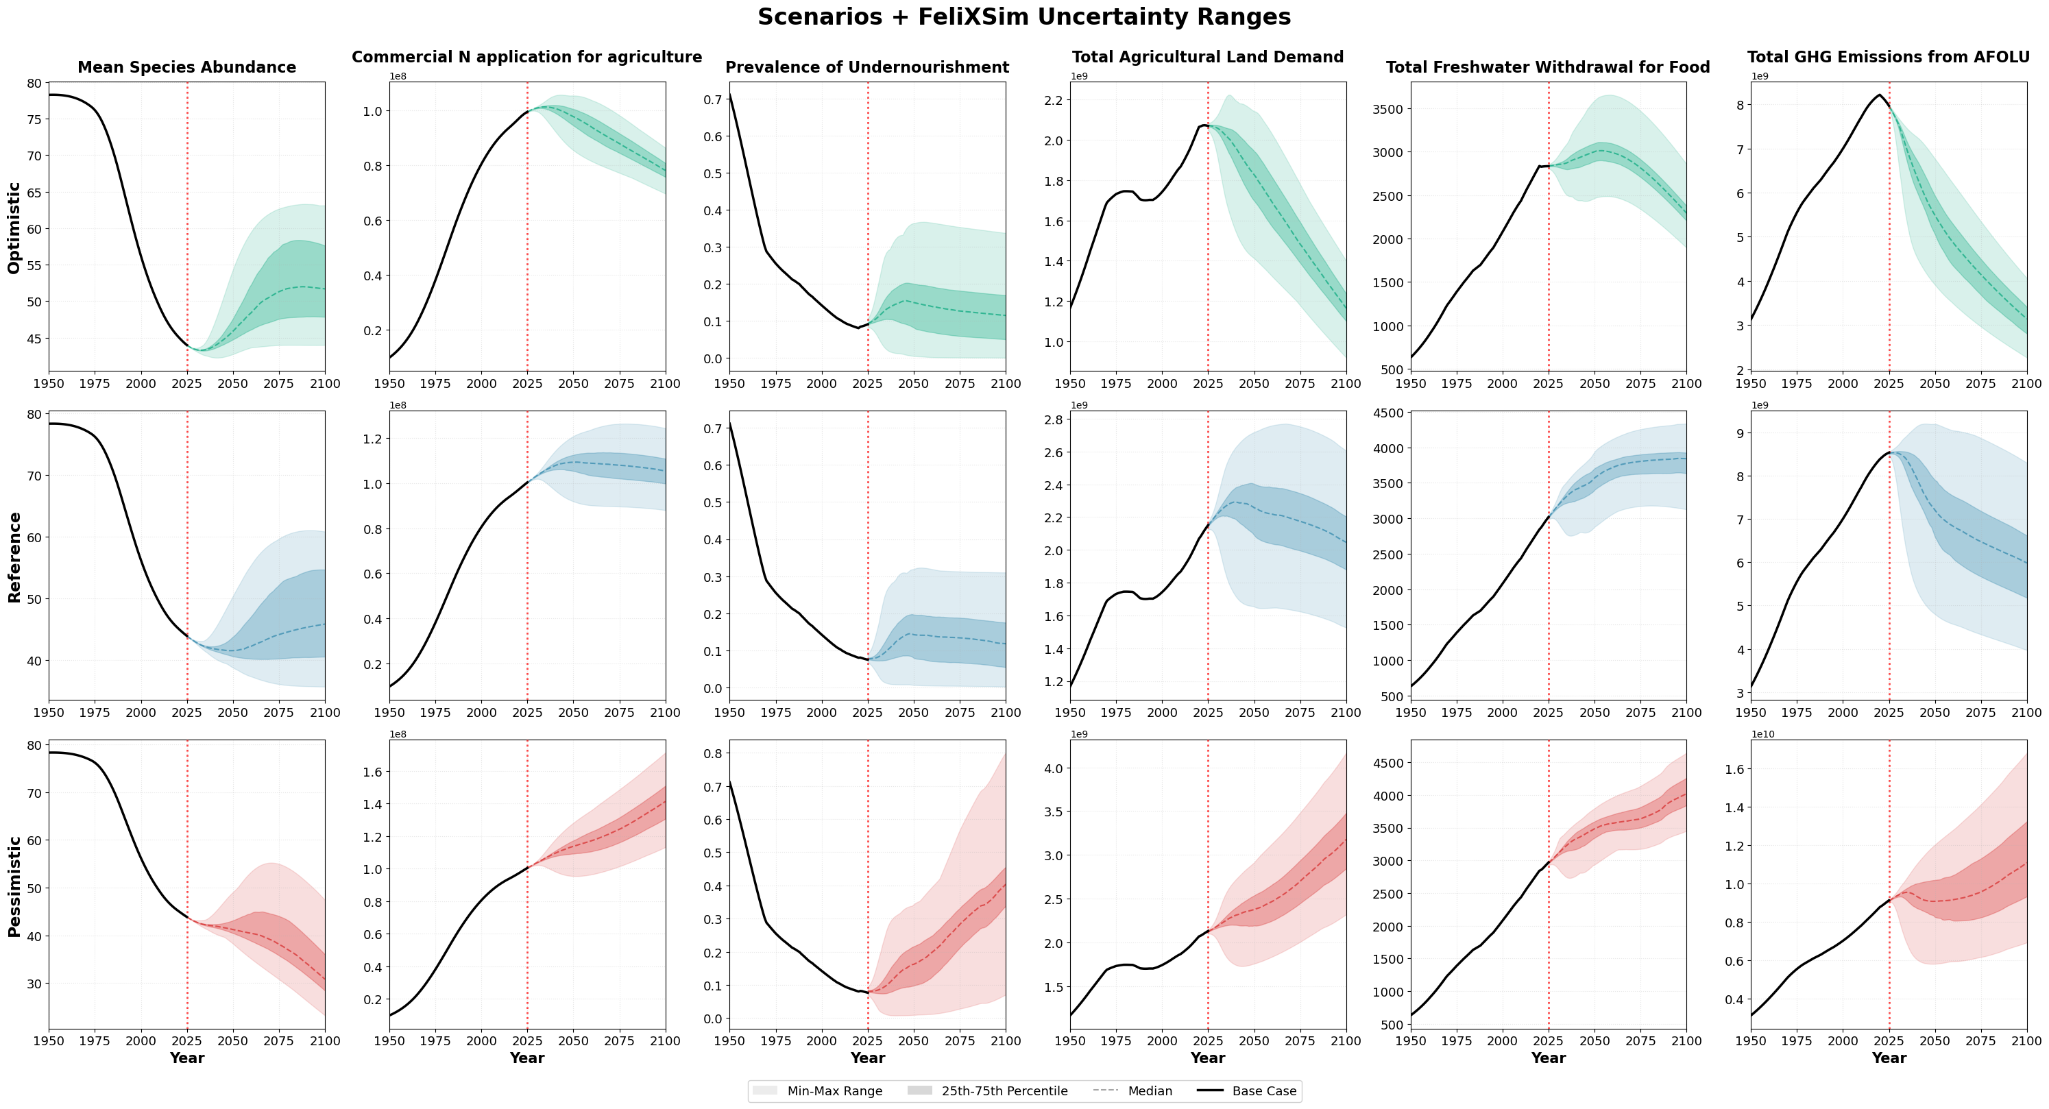
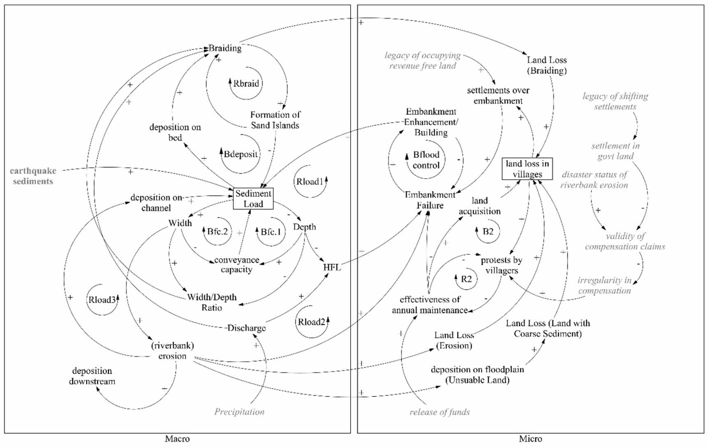
Why Interactive Simulators?
Changing Roles of (Integrated Assessment) Models (Van Beek et al., 2020)
Global models are crucial for decision-making
Implementation is a focus, and not the most inclusive due to accessibility gaps
Addressing the Intention-Action Gap (UNESDOC, 2024)
Knowledge doesn’t translate to sustained actions
Social, emotional, action-oriented learning needed
In Summary; Better Engagement!
Notes:
Important because of changing climate discourse.

Slide 9
Goal for FeliXSim
Non-expert Engagement
Accessible for non-experts to explore scenarios
Engagement on emotions, values and motivations
Scientifically Rigorous
Constantly updated to literature
Aligned to scientific/policy discourse
Interactive Simulator for the Food System
One of the largest drivers of environmental change
Consumer Perspective: Individuals hold the greatest impact-mitigation option (diet, food waste)

Slide 10

Development of FeliXSim?
FeliX v26 (Vensim Model) (IIASA, 2024)
System dynamics-based global IAM (1900 to 2100)
Includes nine modules to represent the dynamic Earth-Human system with feedback loops within and between them
FeliXSim (Web Interface)
Configure variables flexibly into an input-output format; scoped to food systems
Interactive elements for scenario exploration
Web Tech: WebAssembly, jQuery, Chart.js, etc
System Outcomes
Food
Nutrition
Land Use
Climate
Fertilizer
Biodiversity
Water
Scenario Inputs
Consumption
Production
Uncertainties
External Drivers
FeliX IAM (Simulated in Real Time)
Undergoing Development in Parallel

Slide 11
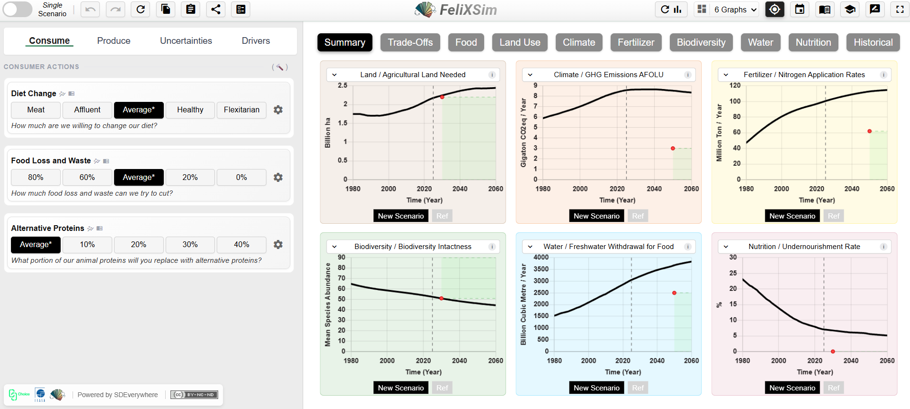

Interface Design of FeliXSim and Key Features
Notes:
Presentation – Framing of Scenarios, Trade-offs, Deeper Exploration.
Key Features – Individual, self-guided; Collective,

Slide 12
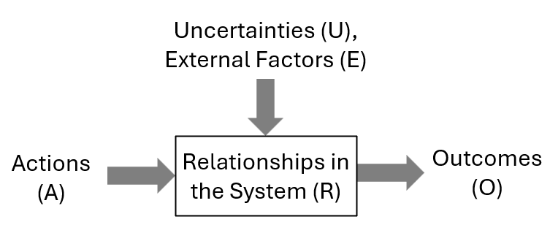
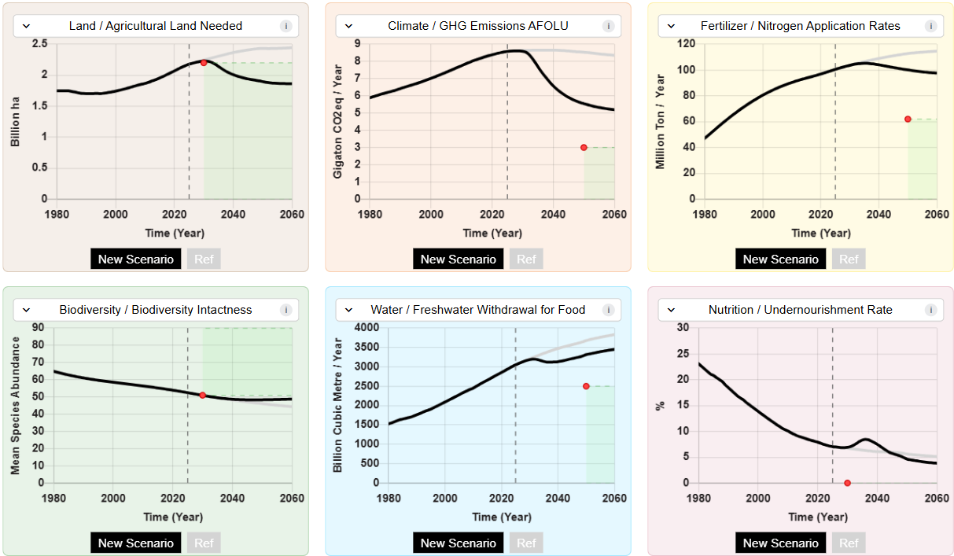
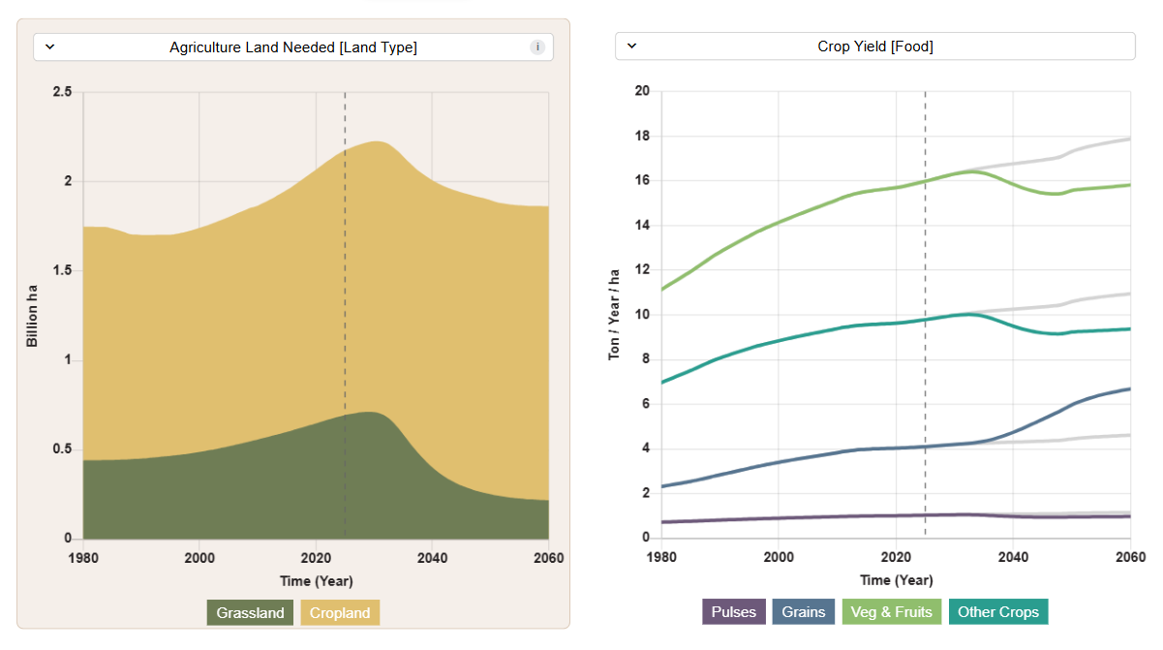
Content - Interface Design
Impact-based Scenarios
Focusing on synergies, trade-offs, and target alignments
“If I were to change my diet, how does it influence the various sustainability outcomes?
Uncertainties-based Scenarios
Focusing on impact pathways, behaviour drivers and technological change
“What are the drivers of large-scale diet change?”
Notes:
Important because of changing climate discourse.

Slide 13

Final Remarks
Interactive simulators allows the best of both worlds – 1) scientific rigour of model frameworks, but 2) non-expert engagement from interface/feature design.
FeliXSim contributes an interactive simulator for the food system.
There is always more potential to make models more engaging.

Slide 14
Influence of Feedbacks in Food System Models: Exploring the Relevance of Biodiversity and Other Cross-System Feedbacks World Biodiversity Forum 2026, Davos, Switzerland

Slide 15
Motivation to study feedbacks in Food Systems
The food system is a key policy space for both climate and biodiversity. Existing models are biased towards climate (Neumann et al. 2026).
Models should support a more integrated perspective for biodiversity and other sustainability outcomes.

Slide 16
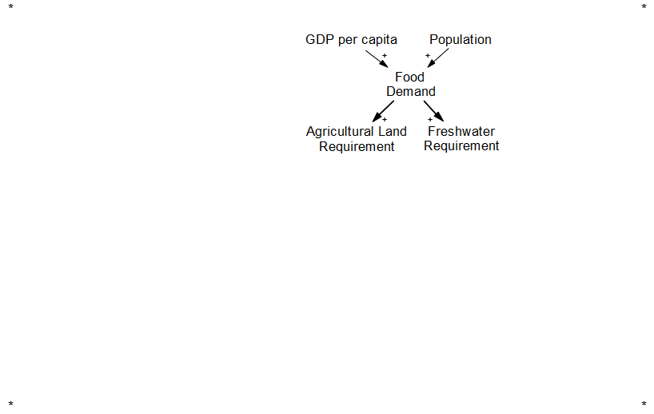
Conceptualisation of the Food System
Food Demand

Slide 17
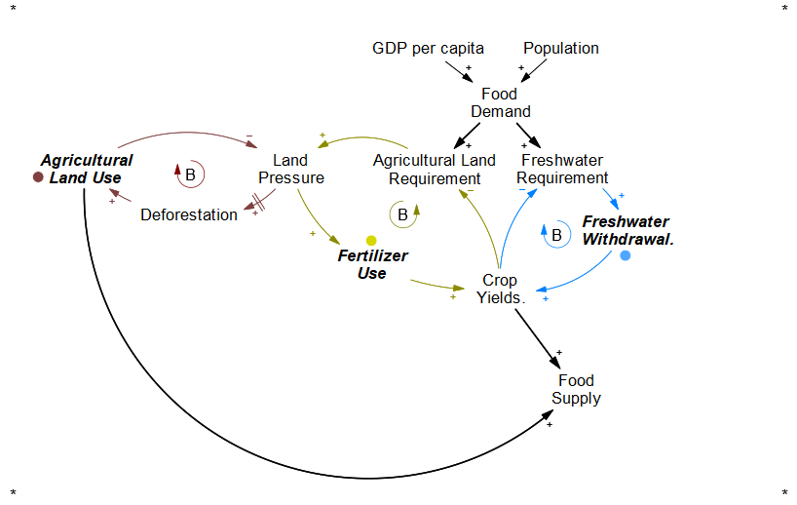
Conceptualisation of the Food System
Agricultural Resource Allocation
1) Water Stress Response ⦿
(Yield → Water Use → Yield)
2) Land Use Response ⦿
(Yield → Land Use → Yield)
3) Fertiliser Intensification ⦿
(Yield → Fertiliser Use → Yield)

Slide 18
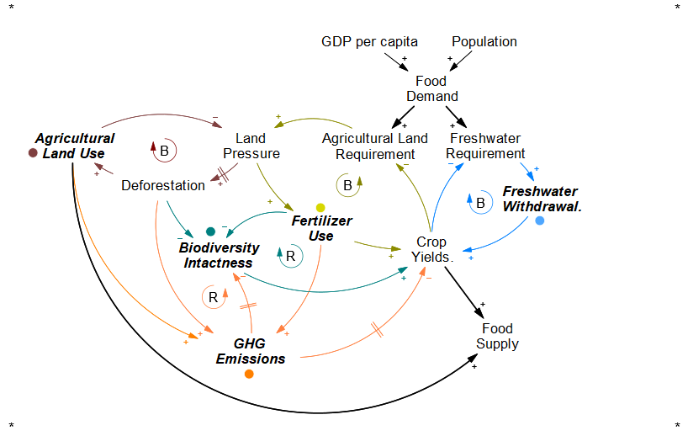
Conceptualisation of the Food System
Environmental Feedbacks
4) Biodiversity Feedback ⦿
(Biodiversity → Yields → …)
5) Climate Feedbacks ⦿
(Temperature → Yield → …)
(Carbon → Yield → …)

Slide 19
Conceptualisation of the Food System
Socioeconomic Feedbacks
6) Market Feedback ⦿
(Supply → Price → Demand)
7) Population Feedback ⦿
(Supply → Availability → Population)

Slide 20
Limitations in Model Structures and Representation
Models’ differing structures biases towards their priorities (Neumann et al., 2026)
Biodiversity is largely an endpoint, not a key driver; (Kim et al., 2025)
Limitations in model representation are a source of bias and uncertainty.
Economic Models (CGEs)
Biophysical Crop Models
Earth System Models
Notes:
Visualization of Existing Fragmentation.

Slide 21
What will we learn from having a fuller picture?
How does the inclusion/exclusion of feedbacks affect system understanding?
Notes:
We know that we have an incomplete picture because of these structural differences.
So what our work tries to do is test it out and see what can we understand system behvioru

Slide 22
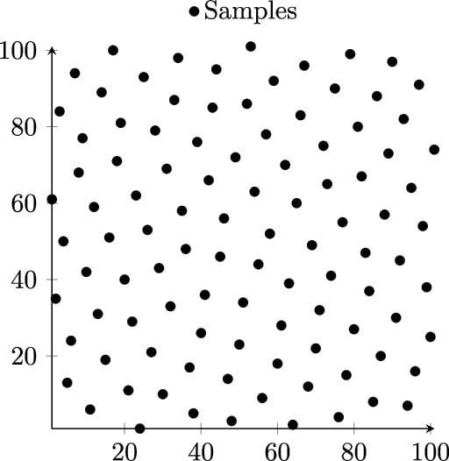
Experimental Setup
Inputs [U_x]
Biodiversity - Yield Feedback
Climate - Yield Feedback
Water - Yield Feedback
Land - Fertiliser Intensification
Food - Population Feedback
*Varying from no connection (0) to full BAU connection (1)
Outputs [O_x (t)]
(Biodiversity) Species Abundance
(Climate) GHG Emissions AFOLU
(Water) Freshwater Withdrawal
(Land Use) Agriculture Land Demand
(Fertilizer) Nitrogen Application
(Nutrition) Caloric Availability
FeliX Model
System Dynamics-based IAM. Sobol Sampling n= 100,000
Global Sensitivity Analysis (Sobol Method)
“How much variation of outcome (O) can be attributed to each feedback (U), including first-order and higher-order effects”
U1
O1
A single run
U2
time
U3,U4
Notes:
Biodiversity Feedback
Climate Feedback
3) Water Stress Feedback 4) Fertiliser Intensification 5) Population Feedback

Slide 23
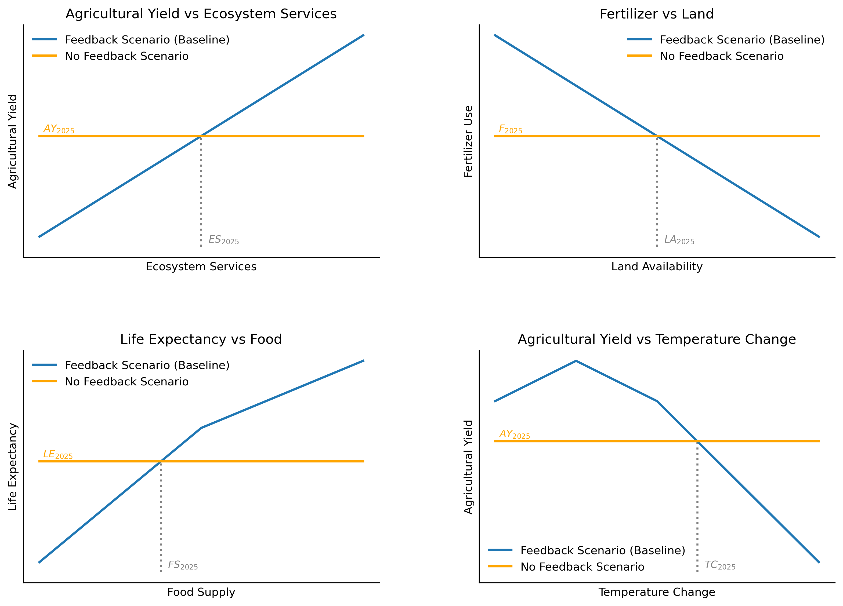
1) Biodiversity Feedback (Biodiversity** → Yield)
2) Climate Feedback (Carbon, Temp → Yield)
3) Water Stress Feedback
(Water → Yield)
4) Fertiliser Intensification (Land Pressure → Fertiliser Use) 5) Population Feedback
(Food Availability → Population)
**Biodiversity indicator is based on Mean Species Abundance (Schipper et al., 2025; Schipper et al., 2019)
1
2
3
4
Testing Feedbacks by Sensitivity Analysis

Slide 24
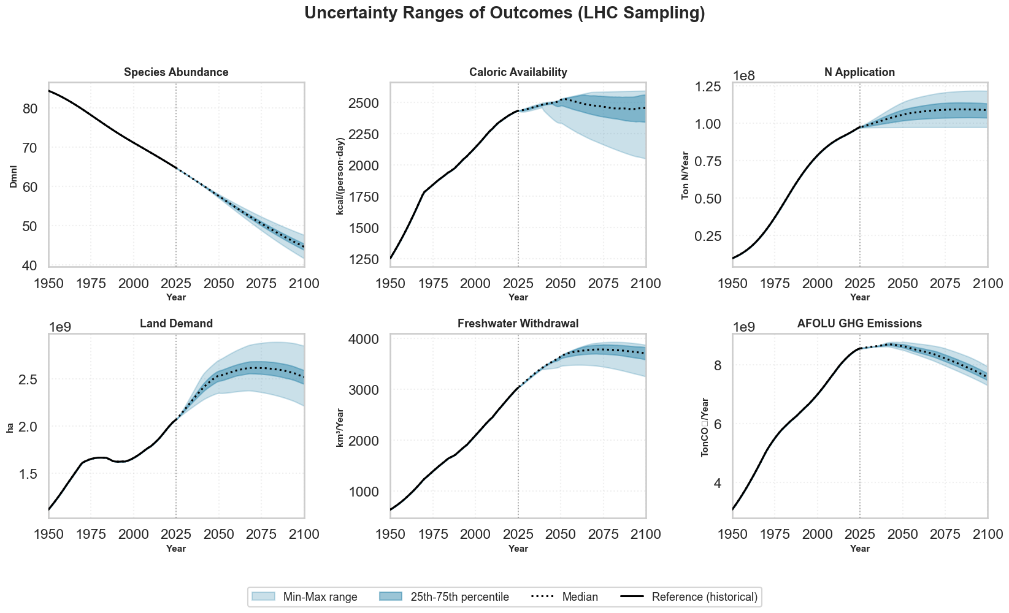
(1) Some outcomes are more “uncertain” than others
Notes:
This feedback uncertainty affects some outcomes more than others. (cus of inclusion/exclusion of feedbacks)

Slide 25
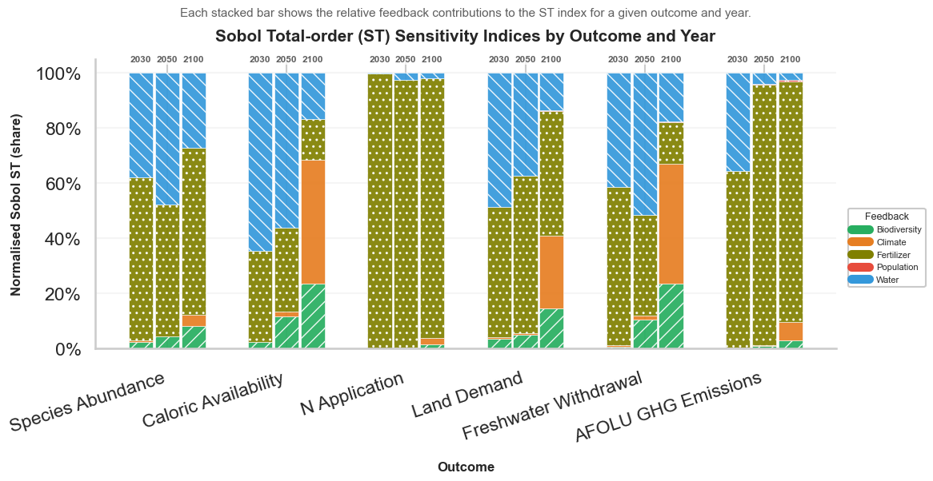
(2) Each outcome uncertainty is explained by different feedbacks
Notes:
Overall structure.
Depending on time horizon, important of feedback changes over time.
Depending on the outcome of focus, different fee
In the food system, those who have relatively lesser feedback strength impacts e.g. climate, population
Interestingly:
Fast intensification feedbacks e.g. fertilizer, water remain dominant in near term
Slow climate-resource couplings in the long term. Poulation and
Implications to Models:
Many models can get away with partial coupling, in the short term but not long term
Direct feedbacks are clearly strong (declines slightly in future)
Fertilisation intensentification is key – mainitains the balance of landuse, calories.
Water extraction increasing importance: early stage
Role of Climate feedback:
Delayed feedback. Also less than expected because emissions from AFOLU isnt realistically as big as other energy/industrial sources.
Role of Biodiversity-Ecosystem Feedback:
It’s not THE dominant feedback but steadily contributes to most objectives.
Emphasise its role as system resilience rather than immediate productivity
“Less” important Feedbacks
Population and Climate* Not because its not a driver, but the food system isnt much of a driver e.g
Interaction effects in general:
- Important in the Medium term (see s1-st divergence in 2050) especially on caloric and freshwater – related to

Slide 26
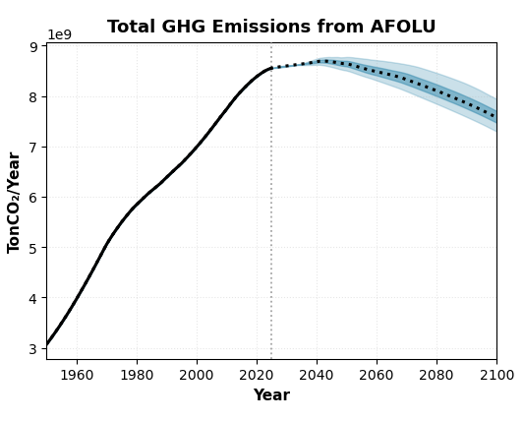
(2) Each outcome uncertainty is explained by different feedbacks
Different feedback matters for different outcomes.
(E.g. Models focused on emissions are concerned about agricultural activities, i.e. fertilizer use)
The model structure is biased to its main outcome of interest.
2030, 2050, 2100
Notes:
Overall structure.
Depending on time horizon, important of feedback changes over time.
Depending on the outcome of focus, different fee
In the food system, those who have relatively lesser feedback strength impacts e.g. climate, population
Interestingly:
Fast intensification feedbacks e.g. fertilizer, water remain dominant in near term
Slow climate-resource couplings in the long term. Poulation and
Implications to Models:
Many models can get away with partial coupling, in the short term but not long term
Direct feedbacks are clearly strong (declines slightly in future)
Fertilisation intensentification is key – mainitains the balance of landuse, calories.
Water extraction increasing importance: early stage
Role of Climate feedback:
Delayed feedback. Also less than expected because emissions from AFOLU isnt realistically as big as other energy/industrial sources.
Role of Biodiversity-Ecosystem Feedback:
It’s not THE dominant feedback but steadily contributes to most objectives.
Emphasise its role as system resilience rather than immediate productivity
“Less” important Feedbacks
Population and Climate* Not because its not a driver, but the food system isnt much of a driver e.g
Interaction effects in general:
- Important in the Medium term (see s1-st divergence in 2050) especially on caloric and freshwater – related to

Slide 27
Dominant Drivers are not static.
Fertiliser and Water are important near-term (production intensification)
Climate and Biodiversity Feedbacks are important in the long-term (environmental feedbacks)
(3) Feedback importance changes over time
Notes:
Overall structure.
Depending on time horizon, important of feedback changes over time.
Depending on the outcome of focus, different fee
In the food system, those who have relatively lesser feedback strength impacts e.g. climate, population
Interestingly:
Fast intensification feedbacks e.g. fertilizer, water remain dominant in near term
Slow climate-resource couplings in the long term. Poulation and
Implications to Models:
Many models can get away with partial coupling, in the short term but not long term
Direct feedbacks are clearly strong (declines slightly in future)
Fertilisation intensentification is key – mainitains the balance of landuse, calories.
Water extraction increasing importance: early stage
Role of Climate feedback:
Delayed feedback. Also less than expected because emissions from AFOLU isnt realistically as big as other energy/industrial sources.
Role of Biodiversity-Ecosystem Feedback:
It’s not THE dominant feedback but steadily contributes to most objectives.
Emphasise its role as system resilience rather than immediate productivity
“Less” important Feedbacks
Population and Climate* Not because its not a driver, but the food system isnt much of a driver e.g
Interaction effects in general:
- Important in the Medium term (see s1-st divergence in 2050) especially on caloric and freshwater – related to

Slide 28
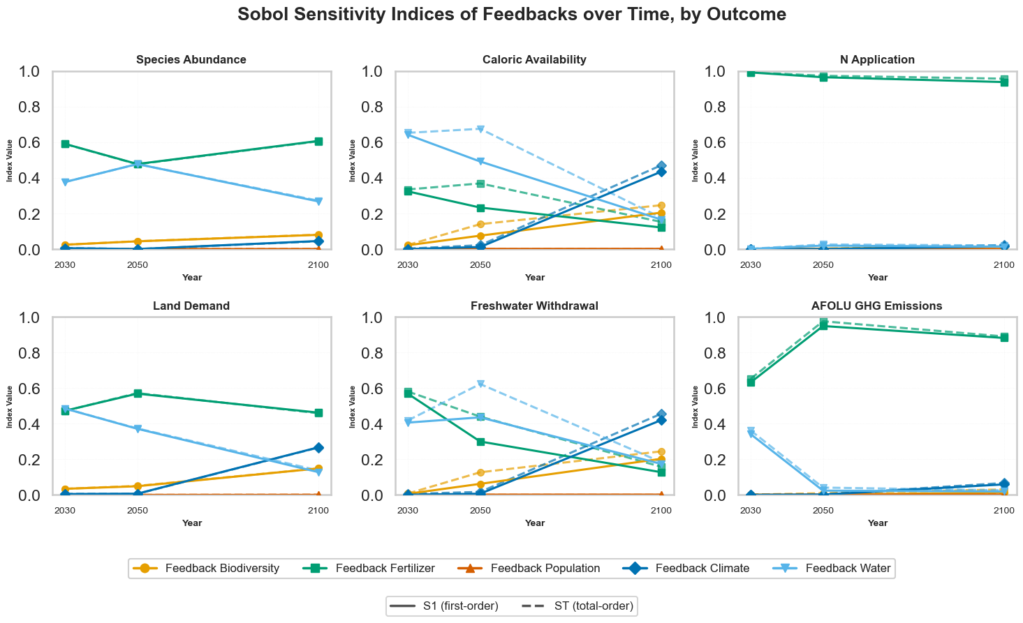
(4) Interacting Effects are important in Medium-Term
Feedback interaction effects peaks in the mid-term future.
Caloric availability involves interactions between resource constraints and environmental responses
Growing system coupling (e.g biodiversity and climate) and presence of tipping behaviours
Notes:
Overall structure.
Depending on time horizon, important of feedback changes over time.
Depending on the outcome of focus, different fee
In the food system, those who have relatively lesser feedback strength impacts e.g. climate, population
Interestingly:
Fast intensification feedbacks e.g. fertilizer, water remain dominant in near term
Slow climate-resource couplings in the long term. Poulation and
Implications to Models:
Many models can get away with partial coupling, in the short term but not long term
Direct feedbacks are clearly strong (declines slightly in future)
Fertilisation intensentification is key – mainitains the balance of landuse, calories.
Water extraction increasing importance: early stage
Role of Climate feedback:
Delayed feedback. Also less than expected because emissions from AFOLU isnt realistically as big as other energy/industrial sources.
Role of Biodiversity-Ecosystem Feedback:
It’s not THE dominant feedback but steadily contributes to most objectives.
Emphasise its role as system resilience rather than immediate productivity
“Less” important Feedbacks
Population and Climate* Not because its not a driver, but the food system isnt much of a driver e.g
Interaction effects in general:
- Important in the Medium term (see s1-st divergence in 2050) especially on caloric and freshwater – related to

Slide 29
Conclusion
Feedback complexity shape longer-term trajectories;
Biodiversity plays an increasingly prominent role as a driver.
A single objective can work with a limited structure; multiple objectives require a more holistic modelling structure.
Future Work:
Link feedback uncertainty to actions and policies to assess robustness.
More accurate formulation and process representation to explore interaction effects.
Notes:
Provides a systems thinking framework to structural explore cross-sectoral models, objectives.
Future work:
Improve representation – interacting effects
Now we think of this with

Slide 30
Thank You!
Please reach out if you have any Questions!
RYAN TAN Energy, Climate and Environment tanryan@iiasa.ac.at

