Slide 1
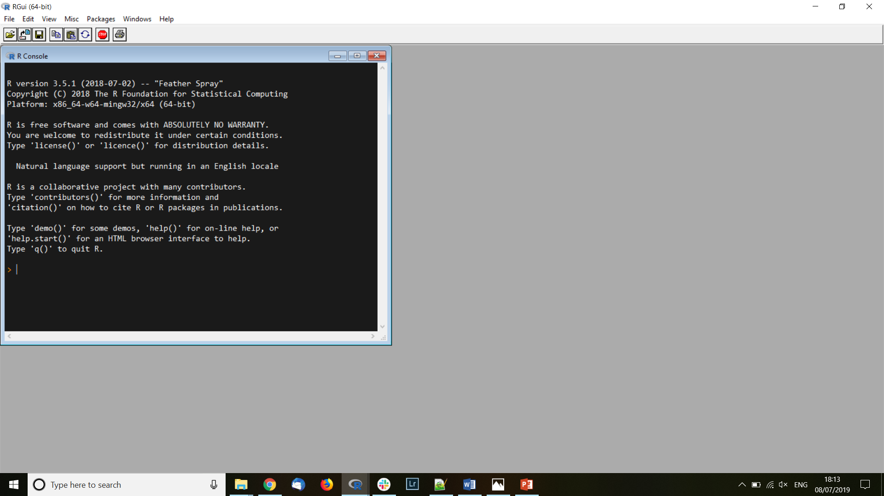
Imput
Coordinates of samples
or
Spatial extent of the study area

Slide 2
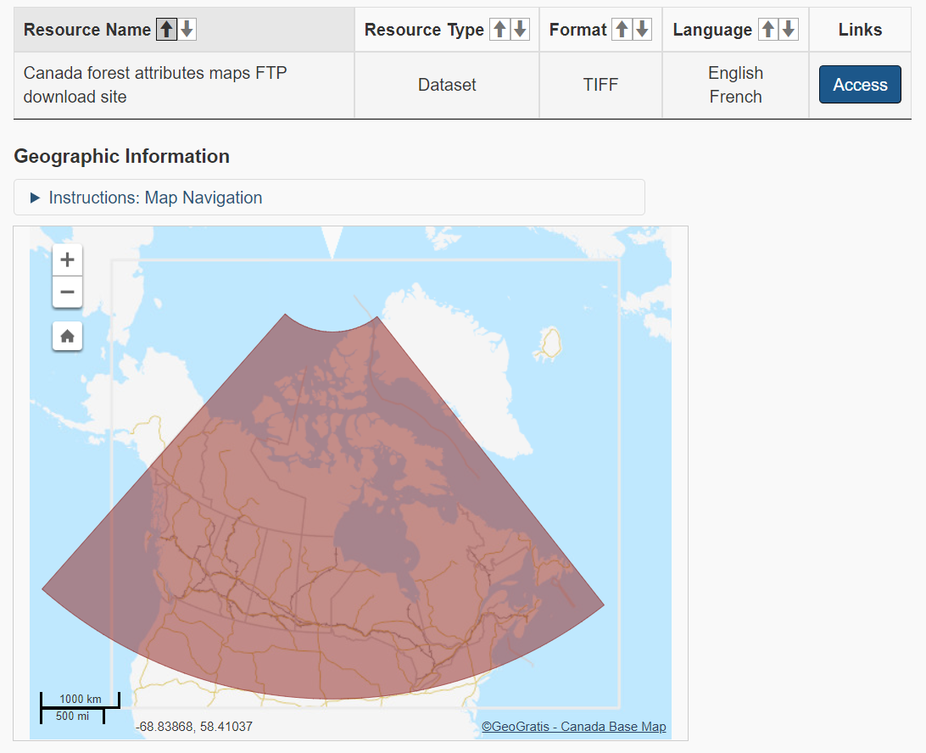

Slide 3
Available variables
Species distribution
Climate
Black fir
Wind
White spruce
Annual precipitation
Black spruce
Monthly precipitation
…
Hydrology
Elevation
Perturbations
Rivers
Fires
Lakes
Storms
…
…

Slide 4
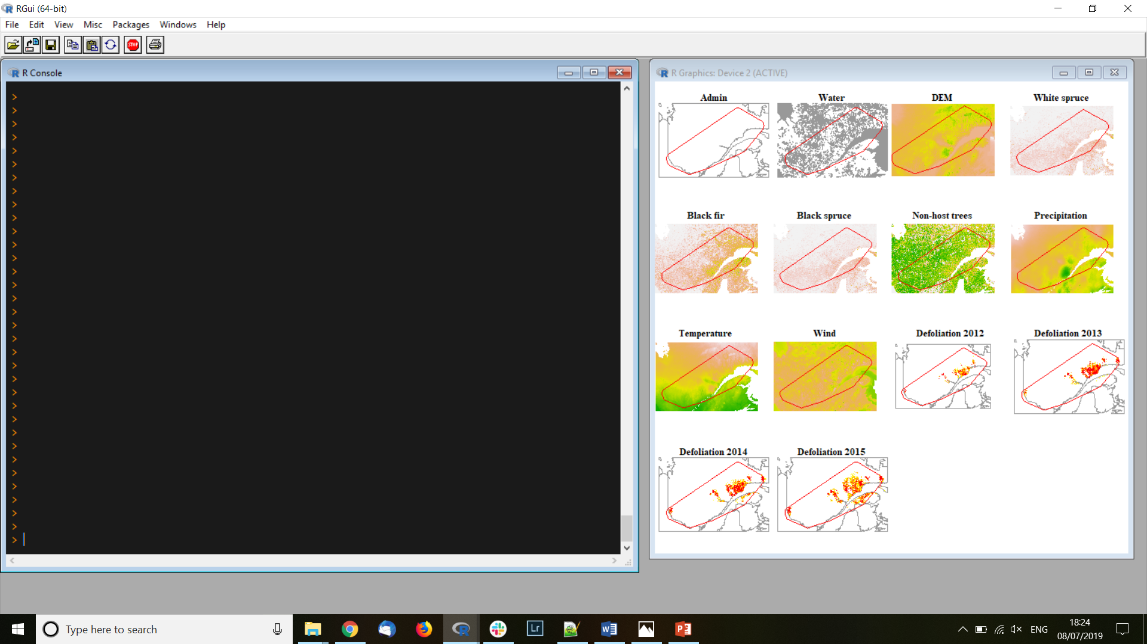
R RasterStack object

