Slide 1
Scanalyser CE291 Project
Luke Saund, Lewis Colley, Ching Hei Pang, Ryan Van Dijck
18/03/2020

Slide 2
The Task
In the task, we were required to
Build software to read Student Marks from a csv file
Display the Information
Display a graphs regarding the information
Perform statistical operations on the data

Slide 3
Main Aims
We Wanted to:
Build a quality piece of software
Cater to multiple operating systems
Make it user friendly
Create an attractive user interface

Slide 4
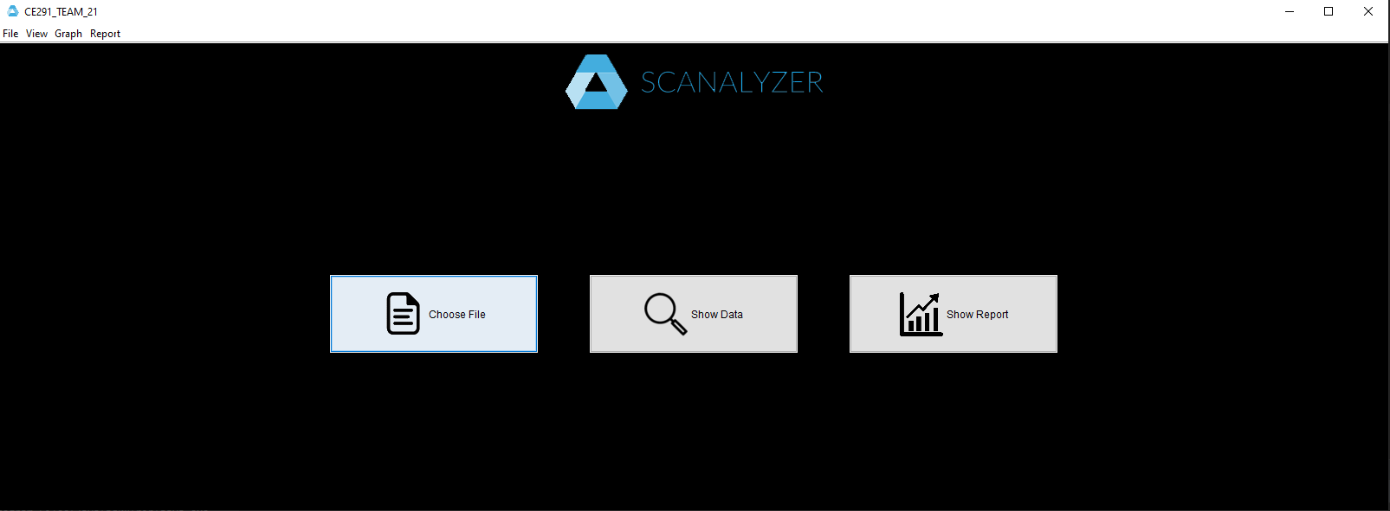
Opening Screen
Here is what the application looks like when the program is first opened

Slide 5
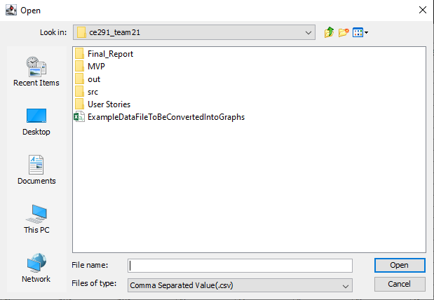
Choosing a File
When the “choose file” button is pressed or by using “file->open” (in the toolbar) this file chooser is opened
Once the file is chosen, it is loaded into the program ready to be used

Slide 6
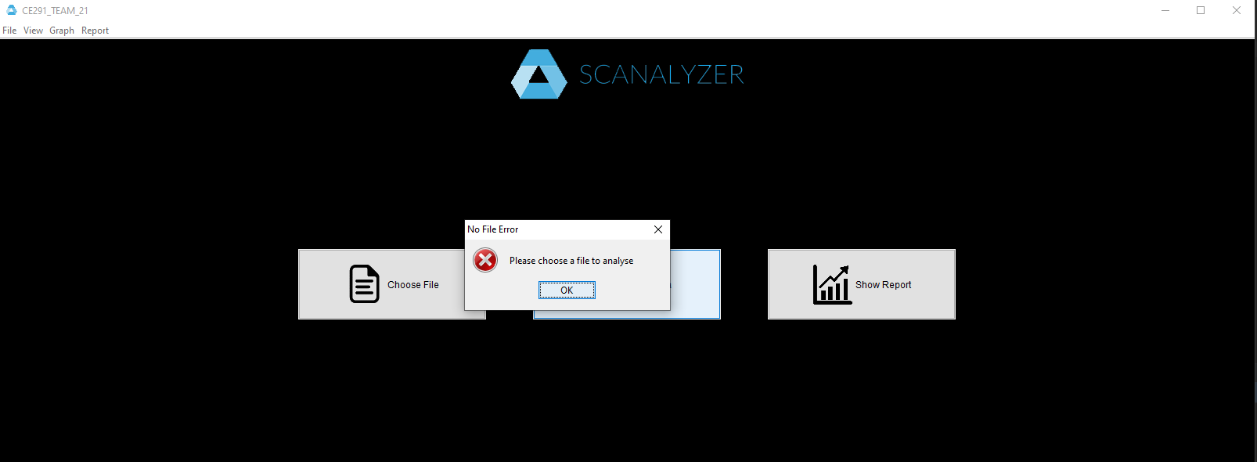
Error Handling
If a file has not yet been selected then an error pops up on the screen prompting the user to select a file before the rest of the software is functional

Slide 7
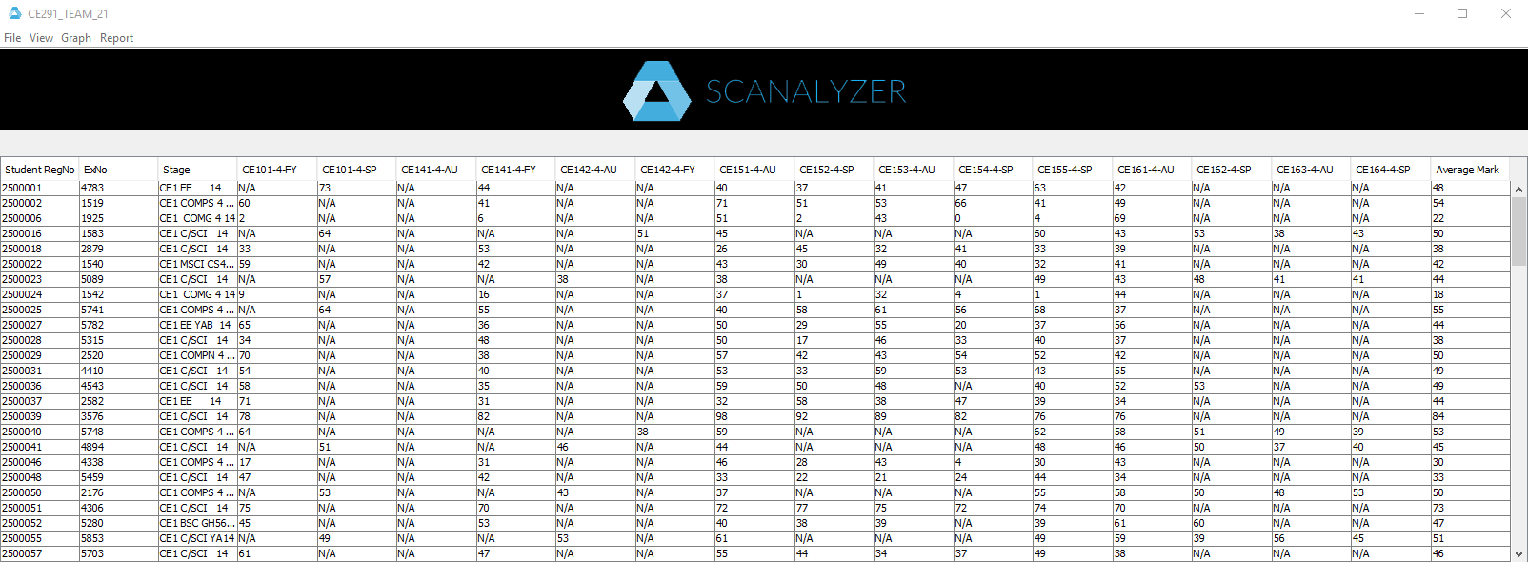
Displaying Data (table)
If the “show data” button is pressed then this table is loaded which displays all of the data from the file
The toolbar in the top left is now the only way to access all of the software’s functionalities (the 3 main buttons are gone) but you can do all the same stuff and more

Slide 8
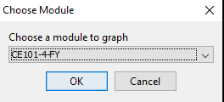
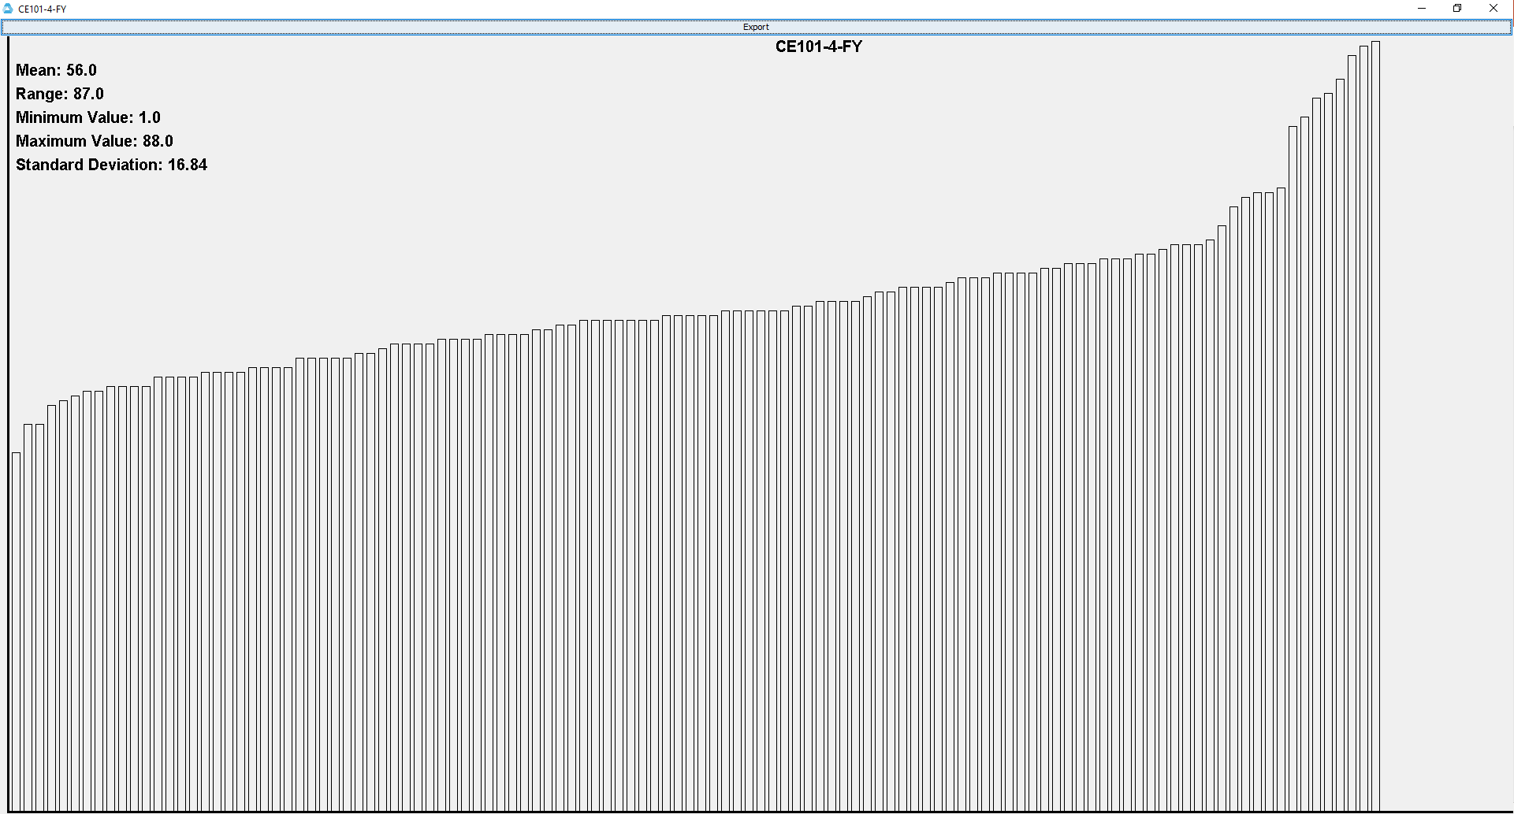
Displaying Data (module)
By clicking “graph->module” a pop up shows up with a drop down selector to select a module
Once a module is chosen a separate window with a graph and some data about the chosen module opens to be viewed by the user
This data and graph can be exported to a PDF

Slide 9
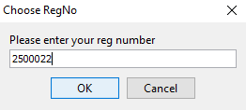
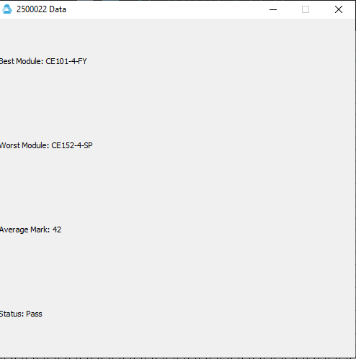
Displaying Data (student)
Likewise, a pop up allowing you to enter a student’s reg number is displayed when clicking “graph->student”
This opens another window which displays some useful data about the student

Slide 10
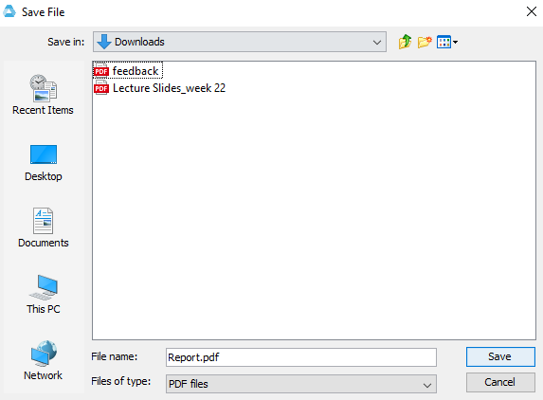
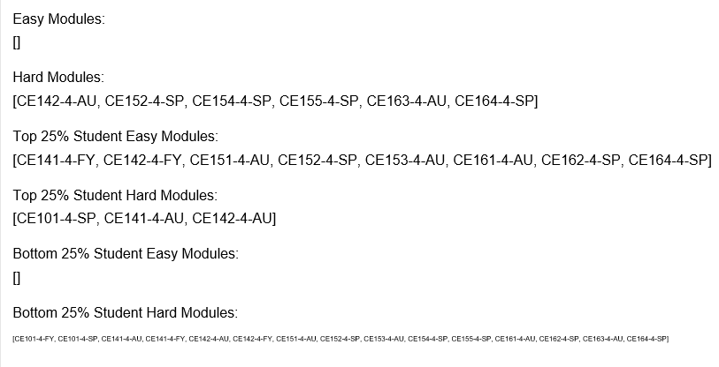
Exporting to PDF
By clicking show report or “report->module report (via the toolbar) a pop up allowing you to save the pdf file shows up allowing you to name and choose the location of the file
The front page of the report contains useful data about the easy and hard modules overall, and for both the best and worst students

Slide 11
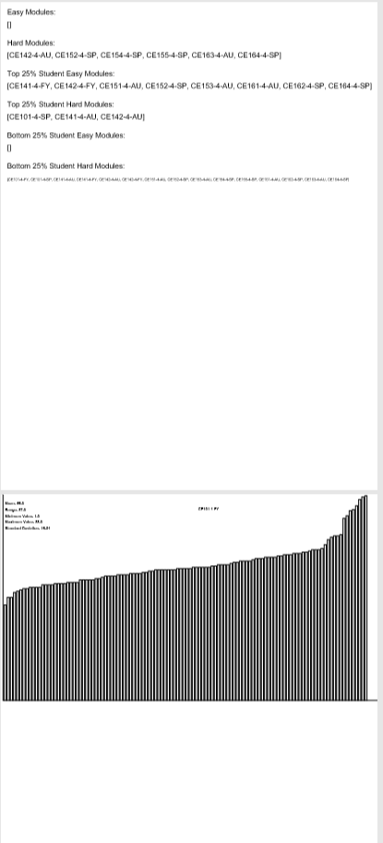
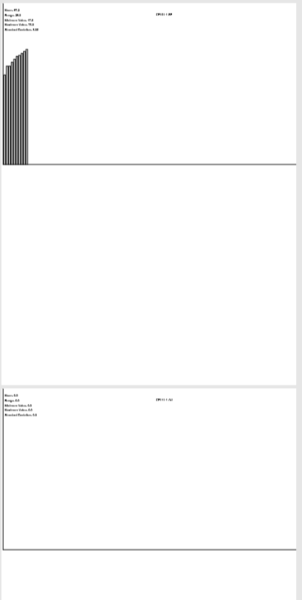
Exporting to PDF (continued)
The rest of the report shows the data and graphs of all the modules
It is the same data and graph as shown previously in this presentation but it is for all of the modules rather than just the one

Slide 12
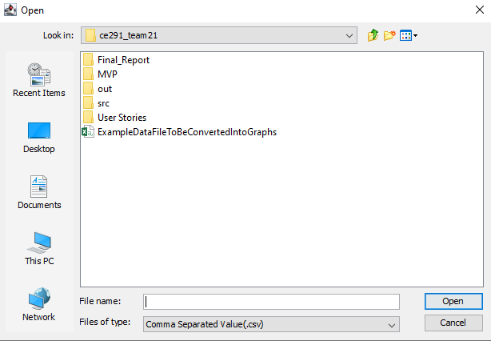
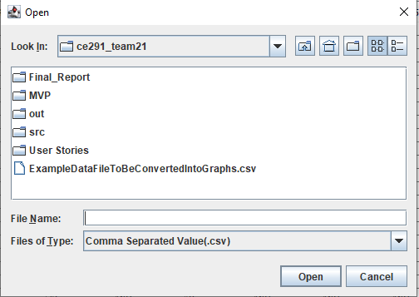
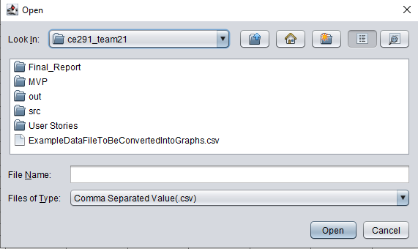
Final (niche) Feature
The final feature of this software is done by clicking “view->theme->system/metal/nimbus”
Choosing one of these 3 themes changes the look of the file chooser. It is not a functional feature but a small change can be nice every once in a while
SYSTEM
METAL
NIMBUS

Slide 13
Ching Hei Pang
Sprint | Task | Description
Sprint 1 (University Week 14) | Statistics | Adding method to find statistics for the modules
Sprint 2 (University Week 15) | Finding the best and worst student | Adding method to find best and worst for the modules
Sprint 3 (University Week 18) | Team Effort Log | Start writing team effort log
Sprint 4(University Week 19) | Statistics for students | Create functions to allow student to search information about their marks
Sprint 5(University Week 23) | Complete team effort log | Complete team effort log

Slide 14
Luke Saund
Sprint | Task | Description
Sprint 1(University Week 10) | Improve the appearance of the GUI | Improve the appearance of the interface
Sprint 2(University Week 13) | Adding a range function | Adding a range function for the modules
Sprint 3(University Week 15) | Adding Student Menu Item | Add functionality to allow a student to search for their own performance
Sprint 4(University Week 16) | Make changes to GUI | Improvements to the GUI
Sprint 5(University Week 21) | Product Context Report | Start Writing product context report
Sprint 5(University Week 21) | Product Marketing | Start doing research on the product marketing

Slide 15
Ryan Van Dijck
Sprint | Task | Description
Sprint 1(University Week 10) | Allow user to change file during running of program | User is able to choose to open another file while the program is running
Sprint 2(University Week 14) | Convert data to graphs | Write a class to draw graphs for the data
Sprint 3(University Week 15) | Output to PDF | Use an open source PDF API to output to a pdf document
Sprint 4(University Week 16) | Fix Graphs | Change the program in order to draw a bar graph and export tot a PDF
Sprint 5(University Week 17) | Create a full module report | Generate a report containing all modules
Sprint 6(University Week 18) | Adding Comments | Adding comments to the sections of code lacking them
Sprint 7(University Week 20) | Start Project Management Log | Start writing Project Management Log
Sprint 8(University Week 23) | Complete management log for the final product | Complete and check the management log

Slide 16
Lewis Colley
Sprint | Task | Description
Sprint 1(University Week 10) | Change program to use generic headings | Improve the way to get the headings and make it easier to read
Sprint 2(University Week 14) | Redesign System | Improve organise the layout of classes within the program
Sprint 3(University Week 16) | Final Demonstration Log | Planning the final demonstration log
Sprint 4(University Week 18) | Adding extra Statistics for report | More statistics added to the report to make the report has more detail
Sprint 5(University Week 23) | Restructure Code (especially GUI) | Restructure the code so it is more efficient and easier to read
Sprint 5(University Week 23) | Complete final demonstration Log | Finish the final demonstration log
Sprint 5(University Week 23) | Complete Product Implementation Log | Finish the log
Sprint 5(University Week 23) | Add extra statistics and add to report | Add more statistics so the output of the report can meet more requirements

