Slide 1
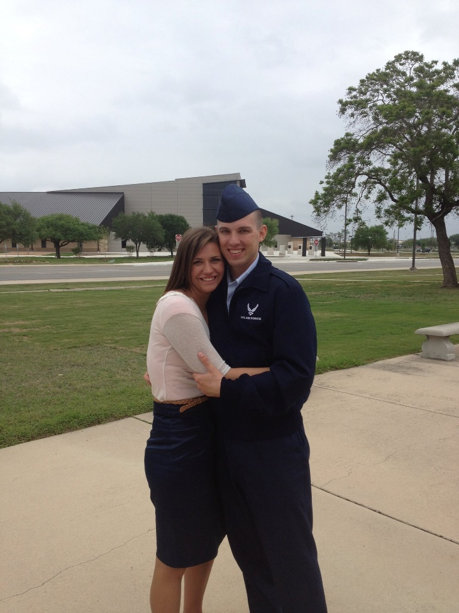
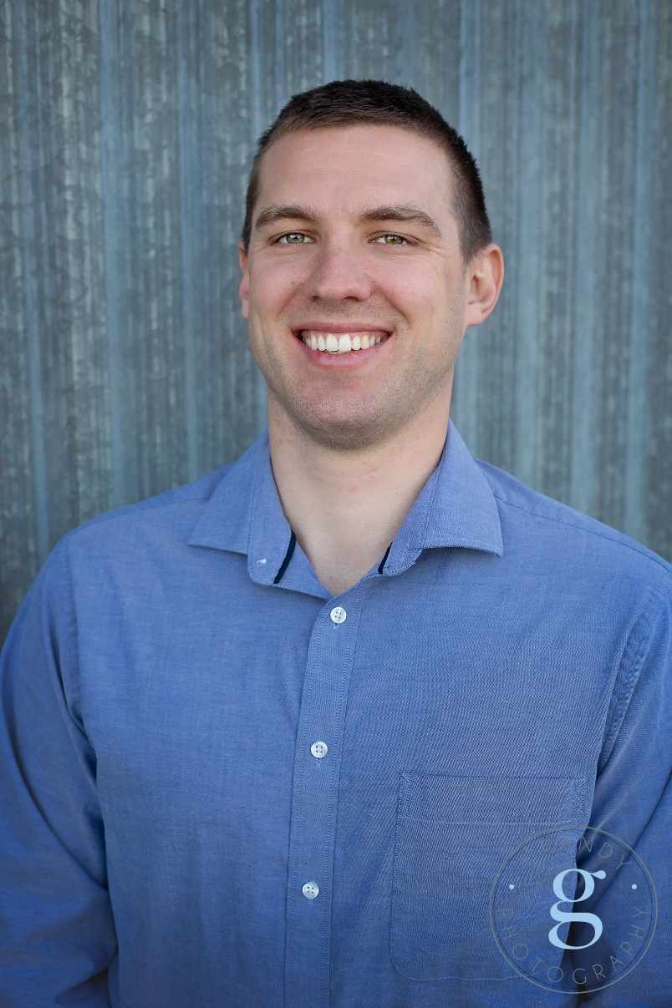
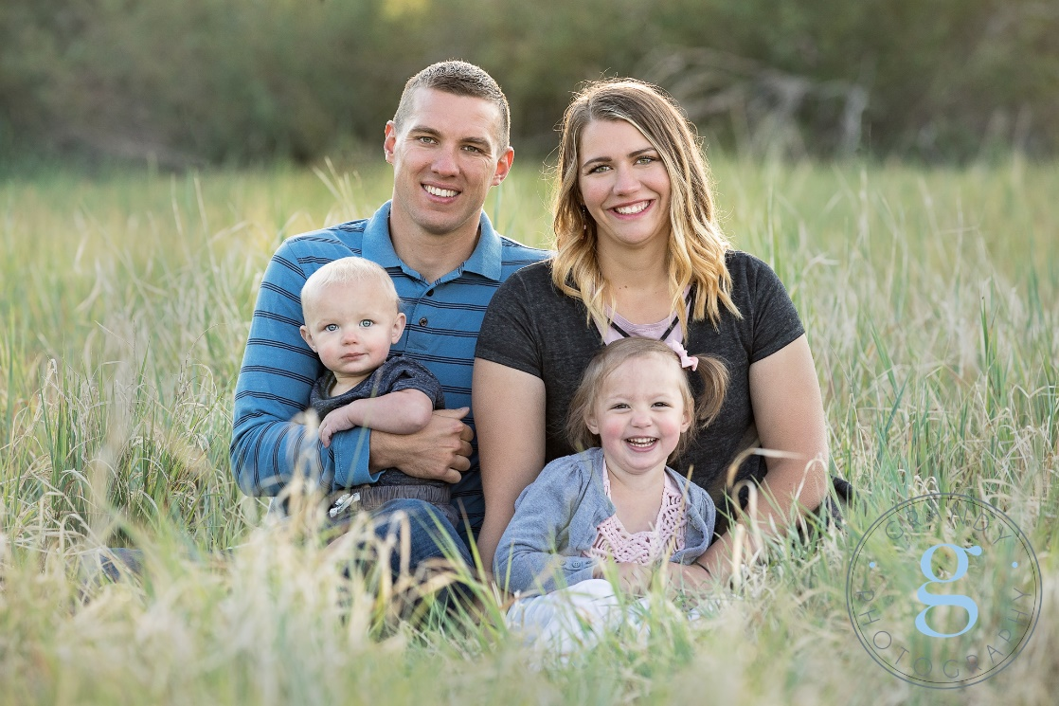
Ryan Voges

Slide 2
Current Academic Accomplishments/Pursuits
Graduated in Spring 2020, dual major in Finance & Economics
I chose finance because my wife made me realize that I love finances and the stock market. I originally wanted to do engineering.
Currently pursuing MSFE degree
I am doing the MSFE program for two main reasons; first, it is a stepping stone to a PhD; second, I want to be the first person in my family with a master’s degree.

Slide 3
Career Goals
As mentioned earlier, I want to get a PhD in finance and become a professor. I know it will be a lot of time and hard work, but I enjoy teaching and research, and the lifestyle of a professor is very appealing too i.e. pay, work to leisure ratio, etc.

Slide 4
Reason for taking this class / Rumors
The main reason I am taking this class is because it is a requirement for the MSFE program.
I was attracted to this class in my undergrad, but it never fit into my schedule.
I have researched many different programming languages (R, SAS, Python, etc.) and, at this point, have decided that python is the one in which I want to specialize.
I have heard that this class is great! I heard that Professor Brough demands a lot, but really cares about his students. I am excited for the challenge.

Slide 5
Influencing Idea
The only person you can rely on to make your life better is yourself. No one is going to hand you a wonderful life on a platter. The hard work and dedication that you put into making yourself a better person will dictate how your life turns out. Once you are willing to put in the work, it is up to you whether you want to gamble on yourself.
I never heard this from anyone, this is an idea that I first had when I was 20, and I have been molding and growing it ever since.

Slide 6
Current book I am reading / Future books
Current Book
Thinking Fast and Slow by Daniel Kahneman
This is an amazing book for anyone interested in behavioral economics & finance. I have learned about a bunch of biases that humans have.
Future Books
The Intelligent Investor by Benjamin Graham
The little SAS book by Lora Delwiche and Susan Slaughter
A Random Walk down Wall Street by Burton G. Malkiel
Flash Boys by Michael Lewis

Slide 7
FAQs
Were you in the military?
Yes, I did 4 years active duty Air Force. Stationed in Ramstein, Germany
Are you married? Kids?
Yes, and Yes. My wife’s name is Holly and we have a 5 year old girl (Macee) and a 3 year old boy (Tavin).
How old are you?
I am 28 years old; yes, you read that correctly.
Where are you from?
Grants Pass, OR
You want to get a PhD in finance, where are you applying?
See the next slide

Slide 8
School Where I am Applying for PhD School
 | School | Location | Population
1 | UT Austin | Austin, TX | 2 Million
2 | OSU | Columbus, OH | 922 Thousand
3 | Penn State | State College, PA | 42 Thousand
4 | Texas A&M | College Station, TX | 116 Thousand
5 | ASU | Tempe/Phoenix, AZ | 2 Million
6 | WSU | Pullman, WA | 35 Thousand
7 | U of U | SLC, UT | 213 Thousand
8 | Mississippi | Oxford, MS | 26 Thousand

Slide 9
Q&A
Ask away!

