Slide 1

Summary of the progress from week 8
8P320 Project Computational Biology
Ryan de Vries 1004141 Supervisor: F. Eduati
Departement of Biomedical Engineering

Slide 2
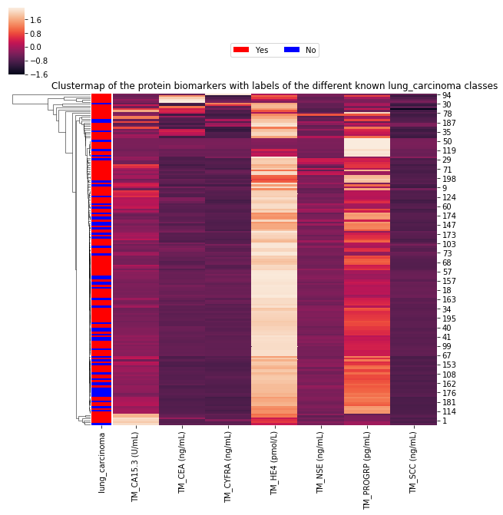
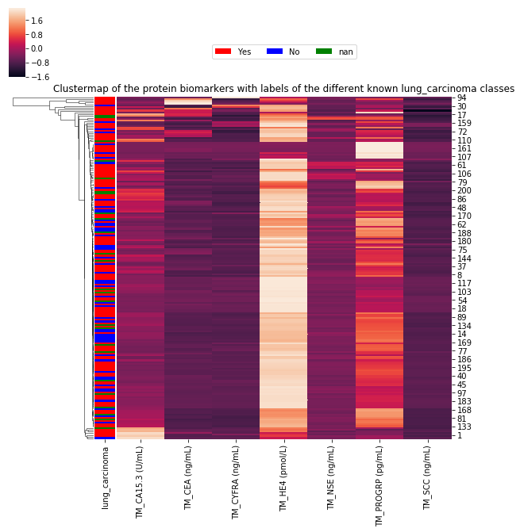
Clustermaps lung carcinoma

Slide 3
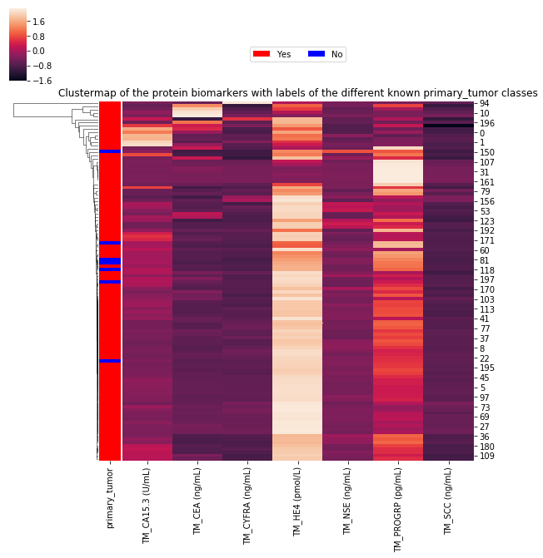
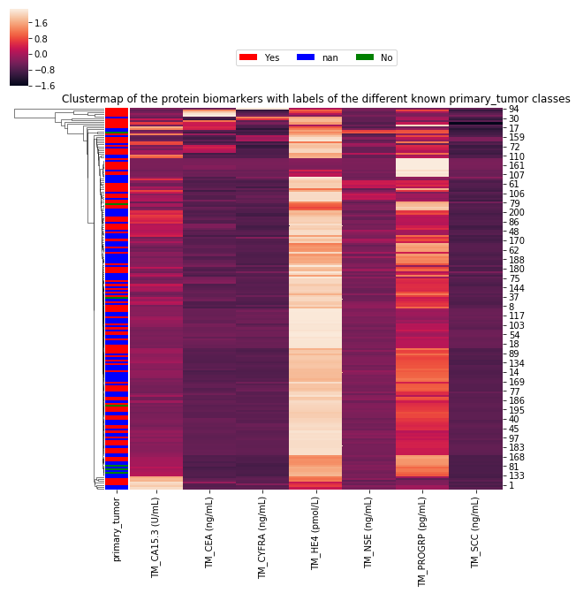
Clustermaps primary tumor

Slide 4
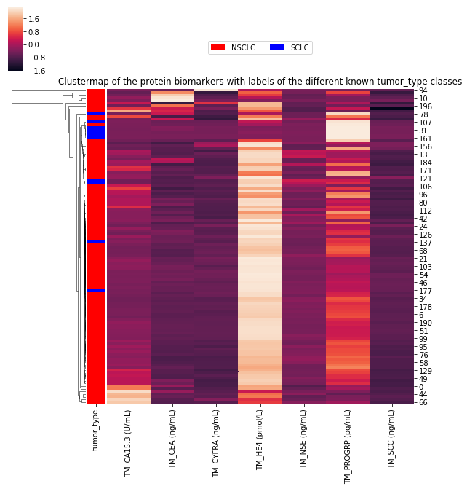
Clustermaps tumor types

Slide 5
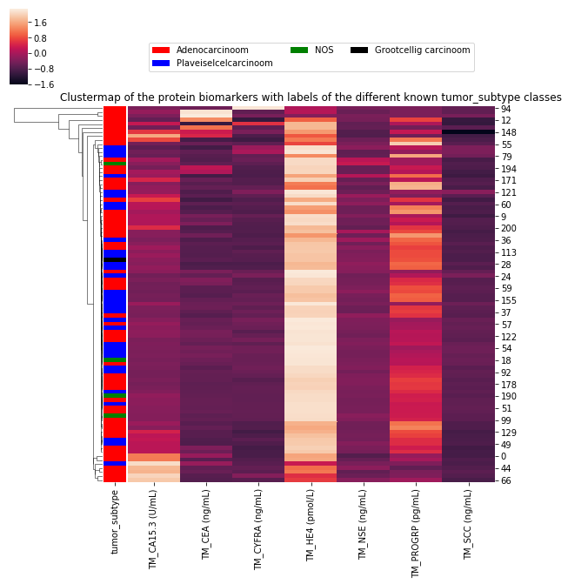
Clustermaps tumor subtypes

Slide 6
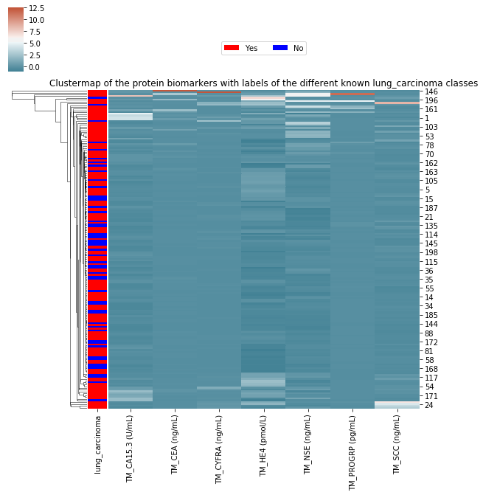
New clustermaps with normalized columns and saturated scale

Slide 7
Lung carcinoma classification with thresholds paper
Lung carcinoma
PPV (%) | NPV (%) | Sensitivity (%) | Specificity (%)
72.11 | 38.71 | 84.8 | 22.64
Primary tumor
PPV (%) | NPV (%) | Sensitivity (%) | Specificity (%)
94.74 | 13.33 | 87.38 | 28.57
Thresholds from the following paper:
R. Molina, et al. (2016). Assessment of a Combined Panel of Six Serum Tumor Markers for Lung Cancer. Am J Respir Crit Care Med, 427–437.

Slide 8
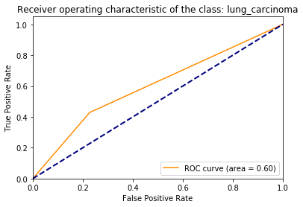
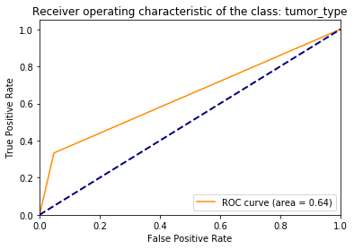
Decision Tree classifier
It must be noted that the AUC varies between every attempt due to the low number of samples
PPV (%) | NPV (%) | Sensitivity (%) | Specificity (%)
54.55 | 68.0 | 42.86 | 77.27
PPV (%) | NPV (%) | Sensitivity (%) | Specificity (%)
50.0 | 90.91 | 33.33 | 95.24

Slide 9
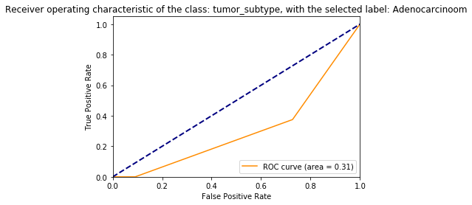
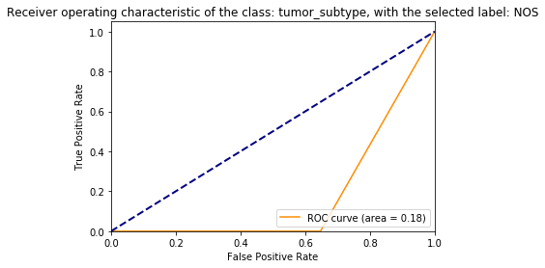
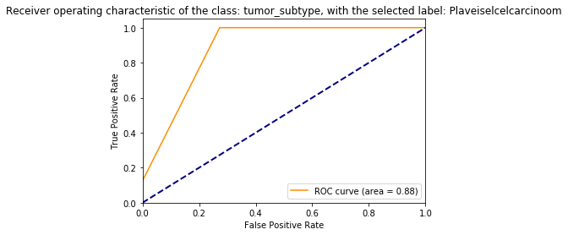
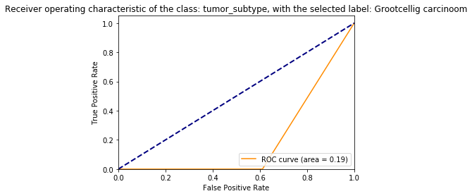

Slide 10
Tumor subtype statistics for decision tree
labels | PPV (%) | NPV (%) | Sensitivity (%) | Specificity (%)
Adenocarcinoom | 71,43 | 60 | 83,33 | 42,86
Plaveiselcelcarcinoom | 40 | 78,57 | 40 | 78,57
NOS | NaN | 94,74 | 0 | 100
Grootcellig carcinoom | NaN | 94,74 | 0 | 100

Slide 11
Proposed classification approaches
Decision Tree classifier
Logistic classifier
Random Forest classifier
Supported vector machines
Nearest neighbor classifier
Neural network with transfer learning
Naive-Bayes classifier
Principal component analysis(PCA) will also be performed on the features
Requests?

Slide 12
Questions/doubts
Class ‘primary tumor’ has 110 samples, but only 6% is ‘No’ so classification not accurate
Approach paper can be applied to primary tumor class, but not intended in paper
Which normalization is preferred in the clustermaps (within rows or columns)?
And overall normalization (this has not been applied yet)?
Logistic regression models in paper necessary?
The AUC of the decision tree classifier is fluctuating due to low number of samples
For multi-label classification what kind of roc curve/statistics is desired?
User Interface for the code required?
In what extend are comments desired in the code?

