Slide 1

Summary of the progress from week 9
8P320 Project Computational Biology
Ryan de Vries 1004141 Supervisor: F. Eduati
Departement of Biomedical Engineering

Slide 2
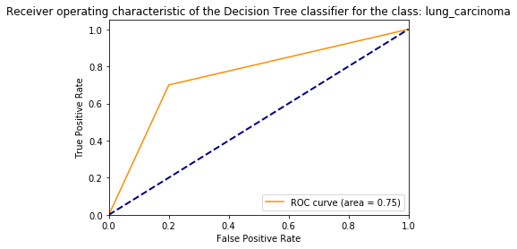
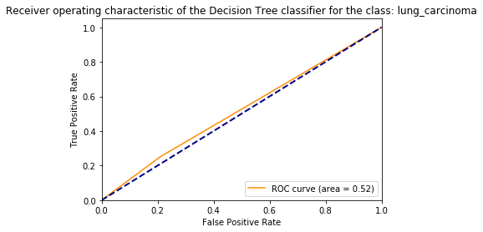
Decision Tree Classifier
With SMOTE and without normalization
Without SMOTE and normalization
positive labels | PPV (%) | NPV (%) | Sensitivity (%) | Specificity (%) | precision | recall | f1-score | support
Yes | 64.00 | 84.00 | 80.00 | 70.00 | 0.64 | 0.80 | 0.71 | 20
No | 84.00 | 64.00 | 70.00 | 80.00 | 0.84 | 0.70 | 0.76 | 30
CV: 0.51 ± 0.06 (AUC)
CV: 0.71 ± 0.07 (AUC)
positive labels | PPV (%) | NPV (%) | Sensitivity (%) | Specificity (%) | precision | recall | f1-score | support
Yes | 67.86 | 37.50 | 79.17 | 25.00 | 0.68 | 0.79 | 0.73 | 24
No | 37.50 | 67.86 | 25.00 | 79.17 | 0.38 | 0.25 | 0.30 | 12

Slide 3
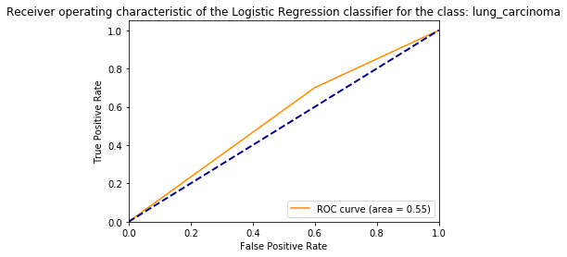
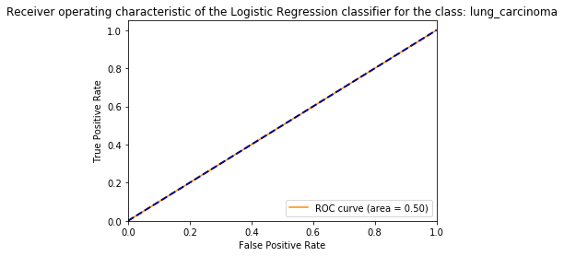
Logistic Regression Classifier
With SMOTE and with normalization
Without SMOTE and with normalization
positive labels | PPV (%) | NPV (%) | Sensitivity (%) | Specificity (%) | precision | recall | f1-score | support
Yes | 47.06 | 63.64 | 40.00 | 70.00 | 0.47 | 0.40 | 0.43 | 20
No | 63.64 | 47.06 | 70.00 | 40.00 | 0.64 | 0.70 | 0.67 | 30
CV: 0.53 ± 0.09 (AUC)
CV: 0.57 ± 0.10 (AUC)
positive labels | PPV (%) | NPV (%) | Sensitivity (%) | Specificity (%) | precision | recall | f1-score | support
Yes | 66.67 | NaN | 100 | 0 | 0.67 | 1.00 | 0.80 | 24
No | NaN | 66.67 | 0 | 100 | 0.00 | 0.00 | 0.00 | 12

Slide 4
Questions/doubts
Logistic regression classifier is unable to distinguish class ‘No’ and regularization makes this worse. (without oversampling)
Visualization of decision tree is not possible( only .dot file)
May I apply SMOTE(synthetic Minority Over-sampling Technique) to balance the data?
Scaling(normalization) of the data also brings negative concentrations. Is this a problem?
Why does scaling of the samples work better then scaling of the features for LR?
Use of random state specification for initialization of random generator beneficial?
Which solver algorithm should be used for logistic regression?

