Slide 1
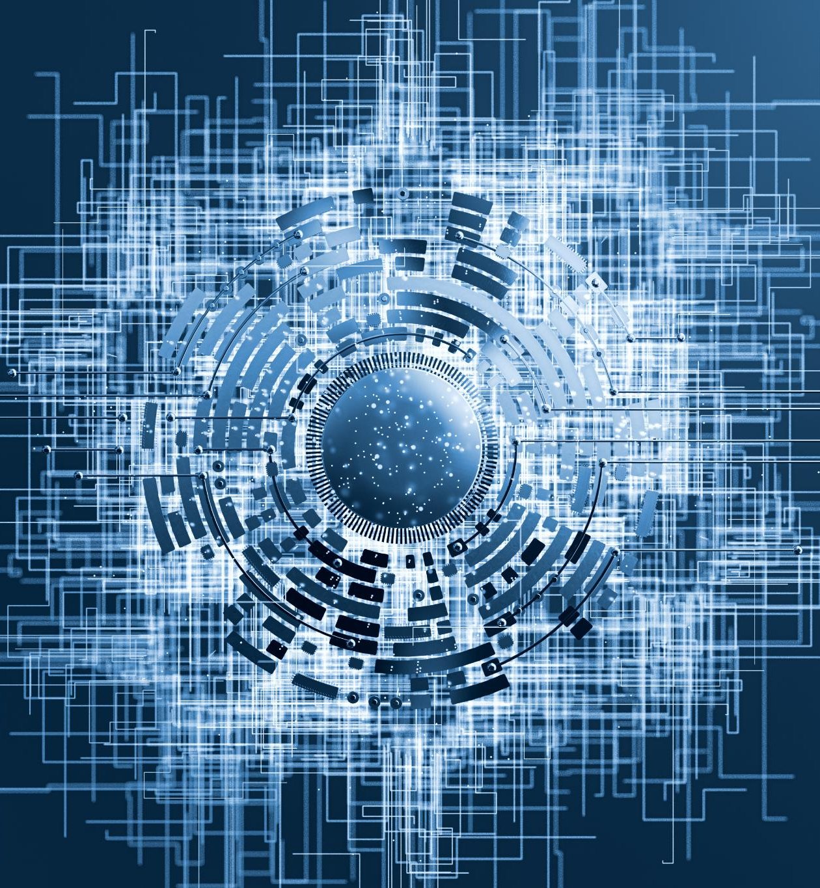
SmartArmor: Concise Research Summary
Overview of innovative protective technology research
Notes:
---

Slide 2
SmartArmor: Concise Research Summary
Notes:
---
This slide references information from the following file: https://qualcomm-my.sharepoint.com/personal/wangx_qti_qualcomm_com/Documents/Microsoft%20Copilot%20Chat%20Files/cast_submission.md,https://qualcomm-my.sharepoint.com/personal/wangx_qti_qualcomm_com/Documents/Microsoft%20Copilot%20Chat%20Files/cast_submission.pdf,https://qualcomm-my.sharepoint.com/personal/wangx_qti_qualcomm_com/Documents/Microsoft%20Copilot%20Chat%20Files/worklog.md
Title and Project Positioning, Problem / Research Question, Approach: Three-Layer Wearable AI System, Approach: Hardware and Data Capture, Approach: Signal Processing Pipeline, Innovation, Results: Prototype and Signal Validation, Results: AI Status and Evaluation Plan, Impact, Roadmap and Next Steps, One-Slide Summary, References / Source Basis

Slide 3
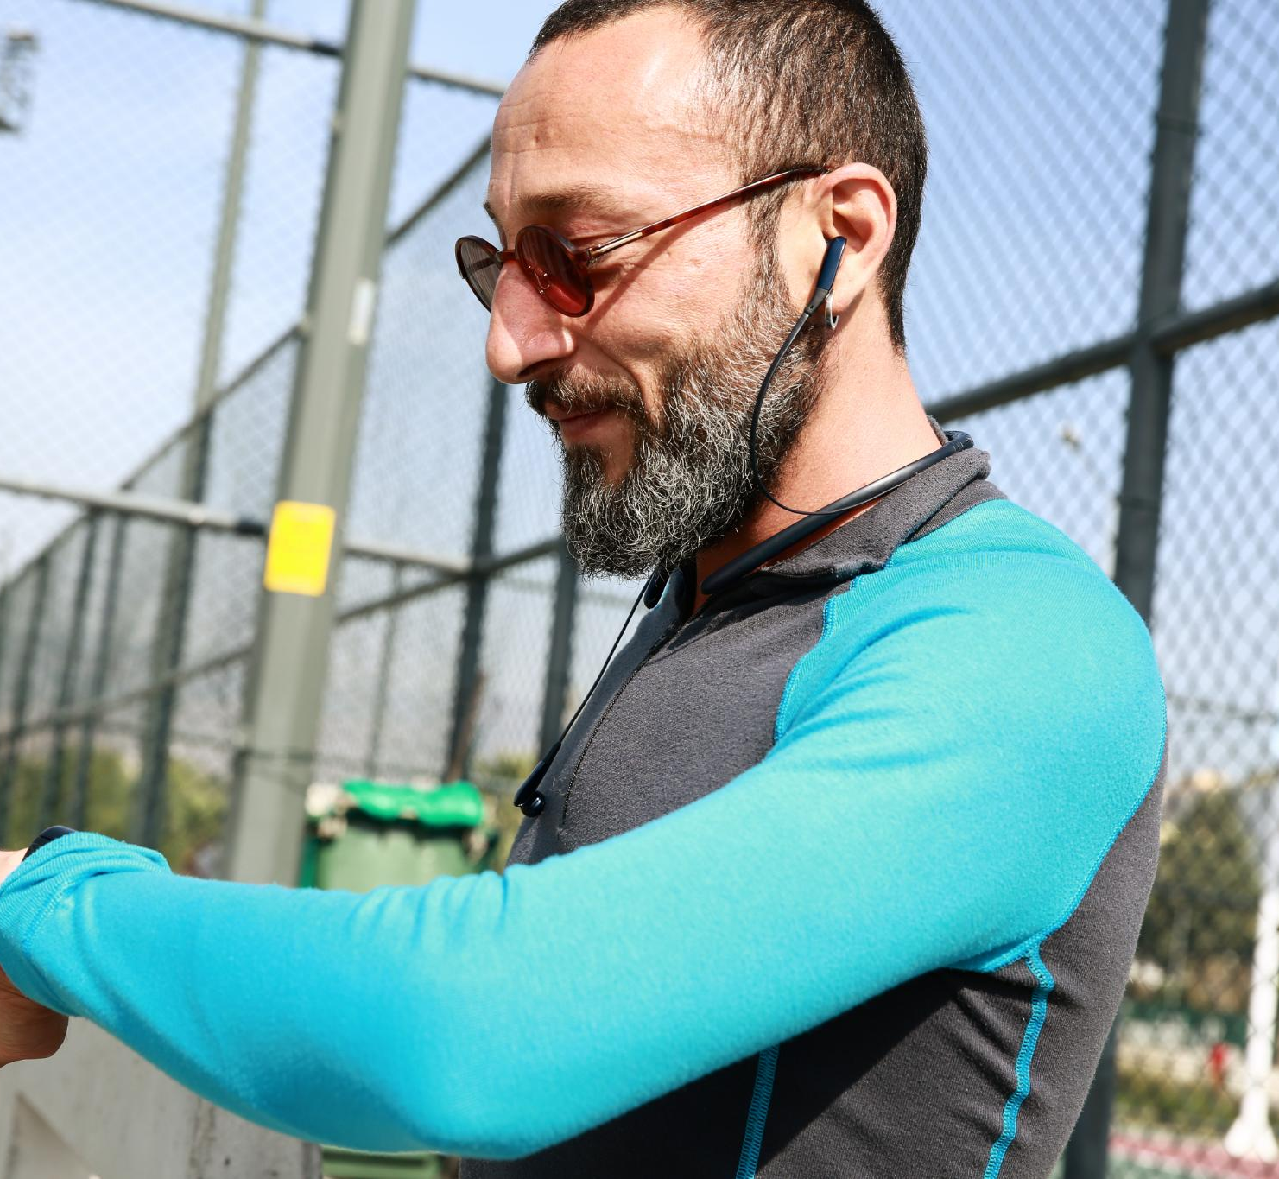
Problem / Research Question
Overuse Injury Mechanism
  Repeated arm load exceeding recovery capacity causes gradual upper-extremity overuse injuries in youth tennis players.
Limitations of Current Tools
  Professional EMG systems are costly and complex, while consumer fitness devices lack direct forearm muscle fatigue data.
Research Question Focus
  Can a low-cost, field-deployable sEMG and IMU system provide personalized forearm load biomarkers and predict soreness?
Fatigue Awareness vs Diagnosis
  SmartArmor targets early-warning signs like soreness and load spikes instead of medical injury diagnosis.
Notes:
---
This slide references information from the following file: https://qualcomm-my.sharepoint.com/personal/wangx_qti_qualcomm_com/Documents/Microsoft%20Copilot%20Chat%20Files/cast_submission.md,https://qualcomm-my.sharepoint.com/personal/wangx_qti_qualcomm_com/Documents/Microsoft%20Copilot%20Chat%20Files/cast_submission.pdf,https://qualcomm-my.sharepoint.com/personal/wangx_qti_qualcomm_com/Documents/Microsoft%20Copilot%20Chat%20Files/worklog.md
The problem slide explains why youth tennis needs a different type of monitoring system. Upper-extremity overuse issues such as tennis elbow, shoulder impingement, and wrist tendinopathy can develop gradually when repeated arm load exceeds recovery capacity over days, weeks, or months. The project documentation emphasizes that young athletes often realize their arm is overloaded only after soreness appears, which is late in the load-management timeline and may already require reduced training. Current tools are inadequate at both ends of the market. Professional EMG systems such as Delsys Trigno or Noraxon can cost thousands of dollars and require lab-style setup, making them inaccessible for most youth athletes and impractical during normal tennis practice. Consumer fitness devices such as watches or general activity trackers may report heart rate or steps, but they do not directly capture local forearm muscle fatigue, which is more relevant to tennis elbow and repeated racket-sport loading. The research question therefore asks whether a low-cost, field-deployable sEMG and IMU system can transform noisy real-practice data into objective biomarkers of forearm load and use those biomarkers to support personalized predictions of next-morning soreness and next-session readiness. This slide also clarifies the distinction between fatigue awareness and medical diagnosis. SmartArmor does not claim to diagnose injury or predict clinical injury events; instead, it focuses on practical early-warning proxies such as soreness escalation, readiness decline, unusual pain reports, and unusually high objective forearm load relative to the athlete’s own recent recovery pattern. This framing makes the problem both scientifically grounded and understandable for judges: the athlete does not need an abstract fatigue score; the athlete needs a timely answer to whether today’s or this week’s forearm load is unusually high compared with their recovery capacity. The slide presents three essential information points: the injury mechanism is cumulative load exceeding recovery, current monitoring either lacks local muscle data or is too expensive for everyday use, and the research question is centered on personalized load-to-recovery modeling rather than one-size-fits-all thresholds. This creates a direct bridge from the problem to the technical approach used in the rest of the presentation.

Slide 4
Approach: Three-Layer Wearable AI System
Layer | Role in SmartArmor | Key Outputs
Wearable sensor node | Collects local muscle and motion data during real tennis practice using MyoWare EMG, ICM-20948 IMU, ESP32 BLE streaming, and battery power. | RAW EMG, envelope EMG, acceleration, gyroscope data, timestamped practice-session logs.
Signal processing pipeline | Filters EMG, detects swing windows from gyroscope peaks, extracts per-swing features, and applies session quality scoring. | 18-feature swing vectors, swing count, load summaries, usable/questionable/reject quality flags.
Personalized AI model | Combines per-swing load proxies and cross-session workload features to model one athlete’s load-to-recovery pattern. | Late-session load depth, high-load swing fraction, predicted next-morning soreness, predicted next-session readiness.
Notes:
---
This slide references information from the following file: https://qualcomm-my.sharepoint.com/personal/wangx_qti_qualcomm_com/Documents/Microsoft%20Copilot%20Chat%20Files/cast_submission.md,https://qualcomm-my.sharepoint.com/personal/wangx_qti_qualcomm_com/Documents/Microsoft%20Copilot%20Chat%20Files/cast_submission.pdf,https://qualcomm-my.sharepoint.com/personal/wangx_qti_qualcomm_com/Documents/Microsoft%20Copilot%20Chat%20Files/worklog.md
This slide summarizes SmartArmor’s architecture as a three-layer system: wearable sensor hardware, signal processing, and personalized AI. The first layer is a sensor node built from off-the-shelf components, including a MyoWare 2.0 EMG sensor on the forearm extensor muscles, an ICM-20948 IMU for acceleration and gyroscope measurements, and an ESP32 microcontroller that streams the data through Bluetooth Low Energy. This layer is important because the project’s accessibility claim depends on practical hardware that can work during real tennis practice rather than only in a lab. The second layer is the signal processing pipeline. RAW EMG and envelope EMG are both recorded because RAW EMG is required for frequency-domain biomarkers such as median frequency, while the envelope supports activation checks and signal-quality monitoring. The IMU gyroscope is used to detect individual tennis swings using a peak threshold, allowing the system to analyze swing-level windows rather than treating the entire session as one stationary signal. This is essential because tennis swings are fast, non-repetitive, and highly non-stationary. The third layer is personalized AI. Component A creates a per-swing load index from an 18-feature vector using a Random Forest model as a weak-label load estimator. Component B is the primary AI contribution: a cross-session readiness regression model that uses session summaries, workload features, prior soreness, and recovery context to predict next-morning forearm soreness and next-session readiness. The slide also emphasizes that quality control is not an afterthought. Every session is categorized as usable, questionable, or reject based on signal completeness, contact drift, artifacts, and related metrics. This is a major differentiator because dry-electrode EMG in sports can drift with sweat and motion; allowing problematic sessions into AI training risks teaching the model electrode behavior rather than physiology. The system approach therefore combines three concrete information points: low-cost wearable data capture, processing that respects the biomechanics of tennis swings, and a personalized model that bridges within-session objective load to next-session recovery outcomes. Together, these layers support the central thesis that an affordable wearable system can produce actionable recovery guidance from real field data.

Slide 5
Approach: Hardware and Data Capture
Hardware Component | Purpose | Important Detail
MyoWare 2.0 EMG sensor | Records forearm muscle electrical activity from surface electrodes. | RAW EMG supports frequency-domain biomarkers such as median frequency.
ICM-20948 IMU | Captures acceleration and gyroscope signals for swing detection and mechanical-load estimation. | Used to identify tennis swings and estimate serve-like versus groundstroke-like load patterns.
ESP32 microcontroller | Streams synchronized sensor data using Bluetooth Low Energy. | Supports EMG at 2,000 Hz and IMU at 200 Hz in the project design.
LiPo battery | Powers the wearable node during practice sessions. | Target runtime is approximately 6–8 hours per charge.
Phone or laptop host | Receives data, runs processing, and supports AI modeling. | Not included in the sub-$50 electronics bill of materials.
Notes:
---
This slide references information from the following file: https://qualcomm-my.sharepoint.com/personal/wangx_qti_qualcomm_com/Documents/Microsoft%20Copilot%20Chat%20Files/cast_submission.md,https://qualcomm-my.sharepoint.com/personal/wangx_qti_qualcomm_com/Documents/Microsoft%20Copilot%20Chat%20Files/cast_submission.pdf,https://qualcomm-my.sharepoint.com/personal/wangx_qti_qualcomm_com/Documents/Microsoft%20Copilot%20Chat%20Files/worklog.md
The hardware and data-capture slide explains how SmartArmor creates a practical platform for real sports monitoring rather than a controlled laboratory measurement. The sensor kit uses a MyoWare 2.0 surface EMG sensor placed over the forearm extensor muscles, because those muscles are directly relevant to tennis strokes and forearm overuse mechanisms. It also uses an ICM-20948 IMU to capture acceleration and gyroscope signals, enabling objective swing detection and mechanical-load estimation. The ESP32 microcontroller streams EMG and IMU data through Bluetooth Low Energy, while a rechargeable LiPo battery supports several hours of recording. In the CAST submission, the prototype electronics bill of materials is described as under $50, excluding the host phone or laptop. This cost is central to the project’s social and practical value: the system is intended for club players, school teams, and families without access to professional sports medicine instrumentation. The slide also highlights sampling and synchronization. EMG is streamed at 2,000 Hz because muscle electrical signals require high sampling rates to preserve frequency-domain features such as median frequency. IMU is streamed at 200 Hz, which is sufficient to capture swing kinematics and rotational load patterns. Pilot sessions show EMG and IMU time alignment to within approximately 1 ms, which matters because the system analyzes each detected swing as a synchronized window of muscle and motion data. This slide also conveys the field-deployment mindset. The system is designed to work during regular practice sessions instead of asking athletes to perform isolated contractions in a lab. Wearing the hardware under or with a sleeve allows the athlete to move naturally, preserving ecological validity. Data is received by a laptop or Android phone for capture, processing, and model development. The three key takeaways are that the hardware is affordable, the sampling design supports both physiological and kinematic analysis, and the capture pipeline has already been tested in real practice conditions. Together, these details justify why SmartArmor can collect the type of longitudinal dataset needed for personalized modeling: not a single polished demonstration, but repeated quality-controlled sessions across normal training.

Slide 6
Approach: Signal Processing Pipeline
EMG Signal Preprocessing
Bandpass and notch filtering isolate physiological EMG signals and reduce interference for accurate muscle activity capture.
IMU-Based Swing Detection
Gyroscope magnitude peak detection identifies discrete high-speed tennis swings to segment meaningful analysis windows.
Quality Control Scoring
Session data is quality scored to flag usable, questionable, or reject data, ensuring reliable AI training input.
Notes:
---
This slide references information from the following file: https://qualcomm-my.sharepoint.com/personal/wangx_qti_qualcomm_com/Documents/Microsoft%20Copilot%20Chat%20Files/cast_submission.md,https://qualcomm-my.sharepoint.com/personal/wangx_qti_qualcomm_com/Documents/Microsoft%20Copilot%20Chat%20Files/cast_submission.pdf,https://qualcomm-my.sharepoint.com/personal/wangx_qti_qualcomm_com/Documents/Microsoft%20Copilot%20Chat%20Files/worklog.md
The signal processing slide explains how SmartArmor converts raw wearable streams into usable scientific features. The pipeline begins with EMG preprocessing. RAW EMG is bandpass filtered between 20 and 450 Hz to isolate the physiological EMG band, notch filtered at 60 Hz to reduce power-line interference, and envelope-extracted to support live signal-quality and activation checks. Recording both RAW and envelope channels is important because RAW signals enable frequency-domain biomarkers such as median frequency, while envelope signals are more robust for real-time monitoring and quality assessment. The IMU pipeline detects tennis swings automatically by looking for gyroscope magnitude peaks above a threshold of approximately 300°/s. This event-based design is critical because tennis is composed of discrete high-speed swings, not a stationary continuous contraction. By aligning each EMG segment to a detected swing, SmartArmor can compute per-swing features and avoid the misleading assumption that the entire practice session has constant statistical properties. Each swing yields an 18-feature vector. The features include EMG time-domain measures such as RMS, mean absolute value, and waveform length; EMG frequency-domain measures such as median frequency, mean frequency, and spectral slope; envelope statistics such as mean, peak, and activation area; and IMU kinematic measures such as peak acceleration, peak gyroscope magnitude, angular jerk, and rotational or impact impulse. The slide also stresses that every session is quality scored. Dry electrodes can drift due to sweat, motion, contact pressure, or fatigue of adhesion. SmartArmor therefore flags sessions as usable, questionable, or reject using metrics such as contact-quality drift, invalid EMG window percentage, saturation, dropout, BLE gaps, motion artifact index, and MDF confidence. This protects downstream modeling by ensuring that bad data does not become misleading AI training data. Three key information points define the slide: the EMG preprocessing preserves local muscle biomarkers, IMU-based swing detection creates meaningful analysis windows, and quality control makes the pipeline trustworthy in noisy real sports conditions. This transforms the system from a simple sensor recorder into a research-grade field pipeline for longitudinal athlete monitoring.

Slide 7
Innovation
Innovation | What SmartArmor Adds | Why It Is Distinctive
Low-cost ecological validity | Sub-$50 prototype electronics designed for real tennis practice sessions. | Makes muscle-load monitoring accessible beyond labs and elite sports medicine programs.
Quality-aware processing | Explicit usable/questionable/reject quality flags and no-QC ablation design. | Prevents electrode artifacts from being learned as fatigue or recovery signals.
Stroke-aware load accounting | Separates serve-like high-rotation load from generic swing count when possible. | Aligns the load metric with tennis-specific overuse mechanisms.
Personalized intra-to-inter session AI | Links within-session load summaries to next-morning soreness and next-session readiness. | Moves beyond current-state fatigue classification toward actionable recovery guidance.
Notes:
---
This slide references information from the following file: https://qualcomm-my.sharepoint.com/personal/wangx_qti_qualcomm_com/Documents/Microsoft%20Copilot%20Chat%20Files/cast_submission.md,https://qualcomm-my.sharepoint.com/personal/wangx_qti_qualcomm_com/Documents/Microsoft%20Copilot%20Chat%20Files/cast_submission.pdf,https://qualcomm-my.sharepoint.com/personal/wangx_qti_qualcomm_com/Documents/Microsoft%20Copilot%20Chat%20Files/worklog.md
The innovation slide organizes SmartArmor’s novelty into four concise contributions: low-cost ecological validity, quality-aware EMG processing, stroke-aware load accounting, and personalized intra-to-inter session AI. The first innovation is affordability combined with real-world validity. Most professional EMG systems are costly and are typically used in controlled environments, while SmartArmor’s prototype sensor node is built from accessible components and is designed for actual tennis practice. This matters because overuse develops across normal training, not during laboratory demonstrations. The second innovation is a quality-aware processing framework. Dry-electrode EMG in field sports can be contaminated by contact drift, sweat, motion artifacts, and signal dropout. SmartArmor does not treat all collected data as equally reliable; instead, it labels sessions as usable, questionable, or reject and plans ablations to show whether including low-quality sessions degrades downstream modeling. The project documents explicitly frame this as a named contribution rather than background preprocessing. The third innovation is stroke-aware load accounting. Generic swing count can hide the fact that serve-like motions may create greater rotational forearm load than groundstrokes. SmartArmor estimates serve-like versus groundstroke-like swings from IMU patterns and tracks high-rotation load separately, while appropriately treating named stroke classification as exploratory until video annotation validates the labels. The fourth and central innovation is personalized intra-to-inter session AI. Many fatigue systems ask whether the athlete is tired at the current moment. SmartArmor instead asks a more actionable question: given how much objective forearm load accumulated during today’s session, how sore or ready is the athlete likely to be tomorrow or before the next session? The system uses a Layer-1 Random Forest as a weak-label load estimator to generate interpretable session summaries, then focuses the main AI contribution on Layer-2 cross-session regression using elastic net or ridge models. This is suitable for a single-athlete longitudinal dataset of 40–80 valid sessions because interpretability and statistical rigor are more appropriate than deep learning in small-N settings. The three key messages are that SmartArmor is affordable enough for real athletes, robust enough for noisy field data, and novel because it links within-session objective load to next-session recovery outcomes.

Slide 8
Results: Prototype and Signal Validation
Validation Finding | Reported Evidence | Interpretation
Time alignment | EMG and IMU aligned to approximately 1 ms in pilot sessions. | Supports swing-level fusion of muscle and motion signals.
MDF fatigue-consistent trend | 63-minute session with 826 swings shows stable reference near 166 Hz and late decline toward 149 Hz. | Suggests late-session local muscle fatigue after settling, pending quality checks.
Non-stationarity | Within-session MDF coefficient of variation approximately 39–47%. | Confirms a single MDF threshold is not reliable for dynamic tennis swings.
Motion artifact check | Correlation between IMU magnitude and EMG envelope approximately r = 0.006. | Suggests EMG captures muscle activation rather than just arm motion.
Intensity-stratified trend | MDF decline persists across low-, mid-, and high-intensity swing groups. | Indicates the trend is not explained only by changing effort level.
Notes:
---
This slide references information from the following file: https://qualcomm-my.sharepoint.com/personal/wangx_qti_qualcomm_com/Documents/Microsoft%20Copilot%20Chat%20Files/cast_submission.md,https://qualcomm-my.sharepoint.com/personal/wangx_qti_qualcomm_com/Documents/Microsoft%20Copilot%20Chat%20Files/cast_submission.pdf,https://qualcomm-my.sharepoint.com/personal/wangx_qti_qualcomm_com/Documents/Microsoft%20Copilot%20Chat%20Files/worklog.md
The results slide presents the evidence that SmartArmor is already functioning as a real data-collection and validation platform. Several technical components are completed: Bluetooth streaming works, EMG and IMU data are time-aligned to approximately 1 ms, swing detection functions in real practice conditions, and session quality scoring is operational. These results are important because the project is not only proposing a future dataset; it has already demonstrated the ability to capture synchronized muscle and motion data during real tennis practice. The slide highlights a 63-minute pilot session with 826 swings and a median-frequency pattern that follows a fatigue-consistent trajectory. The documented MDF curve shows an initial settling phase, a stable reference phase around 166 Hz, and a late-session decline toward approximately 149 Hz. The interpretation is cautious: the late-session decline is consistent with muscle fatigue, and ongoing impedance and quality-control checks are needed to separate physiology from electrode settling or drift. This careful framing strengthens credibility because it does not overclaim from a single signal. The slide also reports that IMU swing intensity remains approximately stable across the phases, which suggests that the MDF decline is not simply due to the athlete reducing effort. In another analysis, per-swing MDF decline persists across low-, mid-, and high-intensity swing groups, reinforcing the idea that the time trend is not explained solely by swing intensity. The motion artifact result is also important: the correlation between IMU magnitude and EMG envelope is reported as very low, approximately r = 0.006, suggesting that the EMG signal is capturing local muscle activation rather than just arm motion contamination. Finally, the slide notes that within-session MDF coefficient of variation is approximately 39–47%, confirming that tennis swings are highly non-stationary. This supports the project’s methodological choice to avoid single-feature thresholds and instead use multifeature probabilistic load summaries. The three key results are hardware/pipeline feasibility, fatigue-consistent EMG trends in real practice, and evidence that tennis requires multifeature and quality-aware analysis.

Slide 9
Results: AI Status and Evaluation Plan
Model / Evaluation Element | Role | Planned Metric or Output
Layer 1 Random Forest load proxy | Feature-engineering step that converts per-swing features into session summaries. | Late-session load depth, high-load swing fraction, load slope, confidence, disagreement rate.
Volume-only baseline | Comparator using basic workload variables such as session duration and swing count. | Baseline prediction performance for readiness and soreness.
Sports-science baseline | Uses session-RPE × duration, consistent with Foster-style training-load monitoring. | Performance benchmark against standard subjective workload load.
Combined personalized regression | Primary Layer 2 model using objective load, self-report, and recovery context. | Correlation, RMSE, MAE, Spearman/Pearson r, and improvement over baselines.
No-QC ablation | Tests whether including low-quality sessions harms prediction. | Quantifies value of the quality-aware framework.
Notes:
---
This slide references information from the following file: https://qualcomm-my.sharepoint.com/personal/wangx_qti_qualcomm_com/Documents/Microsoft%20Copilot%20Chat%20Files/cast_submission.md,https://qualcomm-my.sharepoint.com/personal/wangx_qti_qualcomm_com/Documents/Microsoft%20Copilot%20Chat%20Files/cast_submission.pdf,https://qualcomm-my.sharepoint.com/personal/wangx_qti_qualcomm_com/Documents/Microsoft%20Copilot%20Chat%20Files/worklog.md
This slide summarizes the current AI status and the planned evaluation strategy. The project uses a two-component AI architecture. Component A is a per-swing Random Forest load-index estimator. It assigns each swing a load score based on multifeature EMG and IMU patterns, using time-in-session as a weak proxy and calibrating against post-session perceived exertion ratings. The documentation is careful not to frame this component as a standalone fatigue classifier with clinical-grade ground truth; instead, it is a feature-engineering step that produces interpretable session-level summaries such as late-session load depth, high-load swing fraction, load onset timing, load slope, EMG/IMU disagreement rate, and model confidence. These summaries are already showing early relationships with post-session forearm exertion ratings, which provides a preliminary indication that the load-index outputs are meaningful. Component B is the main research contribution: cross-session readiness regression. After 40 or more valid sessions, the system will test whether EMG and IMU load biomarkers improve prediction of next-morning forearm soreness and next-session readiness compared with simpler baselines. The model family is intentionally interpretable, emphasizing elastic net or ridge regression as the primary approach, with random forest or gradient boosting as exploratory nonlinear alternatives. This is appropriate because the planned dataset contains roughly 40–60 valid sessions, where deep learning would be data-hungry and less interpretable. The slide states success criteria derived from the project documentation: for next-morning soreness, the target is correlation greater than 0.5 and RMSE under 1.5 on a 0–10 scale; for next-session readiness, the target is a meaningful improvement over the best volume-only baseline, expressed as Delta R squared greater than 0.05. The slide also notes that stroke-aware load remains under validation: serve-like swings have shown higher rotational impulse in pilot data, but video annotation is planned before named stroke-type claims become primary. The three key takeaways are that the per-swing model is used responsibly as a load-summary generator, the main AI claim is personalized longitudinal prediction, and evaluation will compare against mandatory baseline models such as persistence, volume-only workload, session-RPE times duration, EMG-only, IMU-only, and self-report-only approaches.

Slide 10
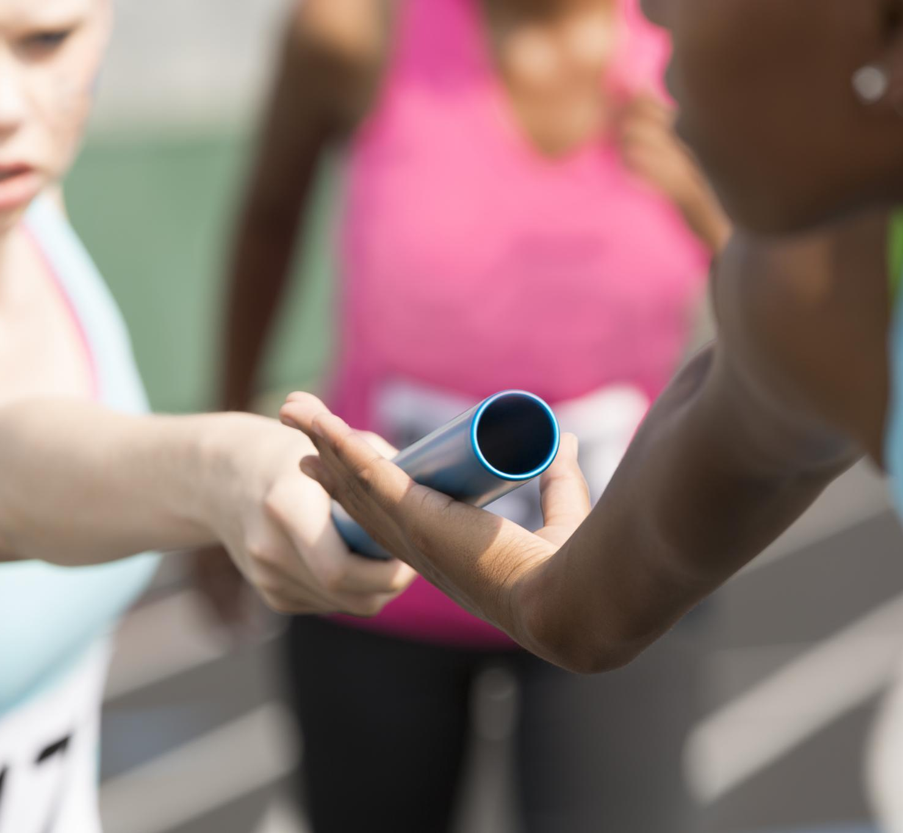
Impact
Early Warning for Athletes
  SmartArmor provides youth athletes affordable early warnings for forearm load and recovery to prevent overuse injuries.
Data-Informed Rest Decisions
  Parents can use objective session summaries to make informed rest decisions after tournaments or intense practice days.
Objective Coaching Insights
  Coaches gain objective load indicators like swing density and muscle fatigue, complementing traditional training feedback.
Research and Scalability
  The system supports research with quality-aware datasets and can adapt to multiple sports requiring sensor customization.
Notes:
---
This slide references information from the following file: https://qualcomm-my.sharepoint.com/personal/wangx_qti_qualcomm_com/Documents/Microsoft%20Copilot%20Chat%20Files/cast_submission.md,https://qualcomm-my.sharepoint.com/personal/wangx_qti_qualcomm_com/Documents/Microsoft%20Copilot%20Chat%20Files/cast_submission.pdf,https://qualcomm-my.sharepoint.com/personal/wangx_qti_qualcomm_com/Documents/Microsoft%20Copilot%20Chat%20Files/worklog.md
The impact slide translates the technical work into value for athletes, families, coaches, and sports-science research. For youth athletes, the immediate impact is the possibility of receiving an affordable early-warning signal for rising forearm load and declining recovery before soreness becomes a longer-term problem. The system’s guidance is framed in practical language: if the athlete’s forearm load is unusually high compared with recent recovery patterns, SmartArmor could recommend rest, reduced serving volume, or careful monitoring before the next session. This is especially relevant for youth players because developing tissues and growth plates make load management important, and a preventable overuse issue can affect training continuity, competition performance, and long-term athletic development. For parents, the value lies in data-informed rest decisions, especially after tournaments or repeated high-load practice days. Instead of relying only on whether the athlete complains of pain, parents could review objective session summaries and readiness predictions. For coaches, the impact is an objective complementary load signal. Coaches often track hours, drills, competition schedule, or subjective player feedback, but those signals do not reveal local forearm muscle fatigue. SmartArmor can provide session-level load indicators such as swing density, serve-like rotational load, MDF trends, and quality-confirmed EMG features. For research, the project contributes a quality-aware, field-deployed longitudinal dataset linking objective muscle load to recovery outcomes. This is important because many fatigue-detection studies are performed in controlled settings, while real overuse risk emerges across messy, repeated practice environments. The slide also shows broader applicability. The same framework—local muscle sensing, motion-load quantification, quality scoring, and personalized recovery modeling—could be adapted to baseball pitching, volleyball spiking, swimming, badminton, squash, and pickleball. Each sport would require its own sensor placement and movement-detection validation, but the underlying architecture is sport-agnostic. The three key information points are accessibility, actionable decision support, and scalability across repeated-load sports. The long-term vision is not to replace doctors, athletic trainers, or coaches, but to give everyday athletes a low-cost signal that helps them manage training load earlier and more intelligently.

Slide 11
Roadmap and Next Steps
Roadmap Step | Goal | Evidence or Output
Complete longitudinal dataset | Collect 40 valid minimum / 60 valid target / 80 valid stretch sessions. | QC-filtered session files with objective features and canonical labels.
Validate readiness model | Test whether EMG + IMU biomarkers outperform volume-only and session-RPE baselines. | RMSE, MAE, correlation, Delta R squared, calibration plots, and ablations.
Miniaturize hardware | Move from prototype node to production-ready PCB sleeve. | Wearable form factor and mobile app interface.
Run small youth-player pilot | Test generalization, usability, and signal quality across 3–5 athletes. | Replication of biomarker/QC findings and user feedback.
Open-source system | Share hardware and software pipeline with coaches, athletes, and researchers. | Public design files, processing scripts, and documentation.
Notes:
---
This slide references information from the following file: https://qualcomm-my.sharepoint.com/personal/wangx_qti_qualcomm_com/Documents/Microsoft%20Copilot%20Chat%20Files/cast_submission.md,https://qualcomm-my.sharepoint.com/personal/wangx_qti_qualcomm_com/Documents/Microsoft%20Copilot%20Chat%20Files/cast_submission.pdf,https://qualcomm-my.sharepoint.com/personal/wangx_qti_qualcomm_com/Documents/Microsoft%20Copilot%20Chat%20Files/worklog.md
The roadmap slide presents SmartArmor’s development plan in a practical sequence. The first step is to complete the longitudinal dataset. The project documentation specifies a minimum analyzable dataset of 40 valid usable sessions, a preferred target of 60 valid sessions, and a stretch goal of 80 valid sessions. These sessions should include complete EMG/IMU capture, session labels such as forearm-specific RPE and next-morning soreness, and strict quality-control flags. No model fitting is planned until at least 40 valid usable sessions are collected, which reduces the risk of premature overfitting. The second step is to validate the readiness model. This will involve comparing objective EMG and IMU biomarkers against volume-only and sports-science baselines, including session duration, swing count, persistence, and session-RPE times duration. The evaluation plan includes chronological train/test splitting, leave-one-week-out validation if enough data is available, calibration plots, case studies, and a no-QC ablation. The third step is miniaturization. Once the research pipeline is validated, the hardware can be redesigned into a smaller production PCB integrated into a sleeve, paired with a mobile app that presents load and readiness summaries in a user-friendly way. The fourth step is to expand beyond the original athlete into a small youth-player pilot, likely three to five players, to test generalization and usability. The documentation is careful to distinguish between full longitudinal modeling for one athlete and smaller validation sessions for additional athletes, which helps keep scope realistic. The fifth step is open-source development, including hardware design and software tools so that school teams, coaches, families, and researchers can reproduce or extend the system. The slide’s main message is that the project has an achievable path from research prototype to broader practical tool. It does not overpromise immediate clinical deployment; instead, it moves through data completion, model validation, form-factor improvement, small-scale pilot testing, and open-source dissemination. Three key points define the roadmap: collect enough high-quality data, validate against meaningful baselines, and translate the research pipeline into a usable athlete-facing product.

Slide 12
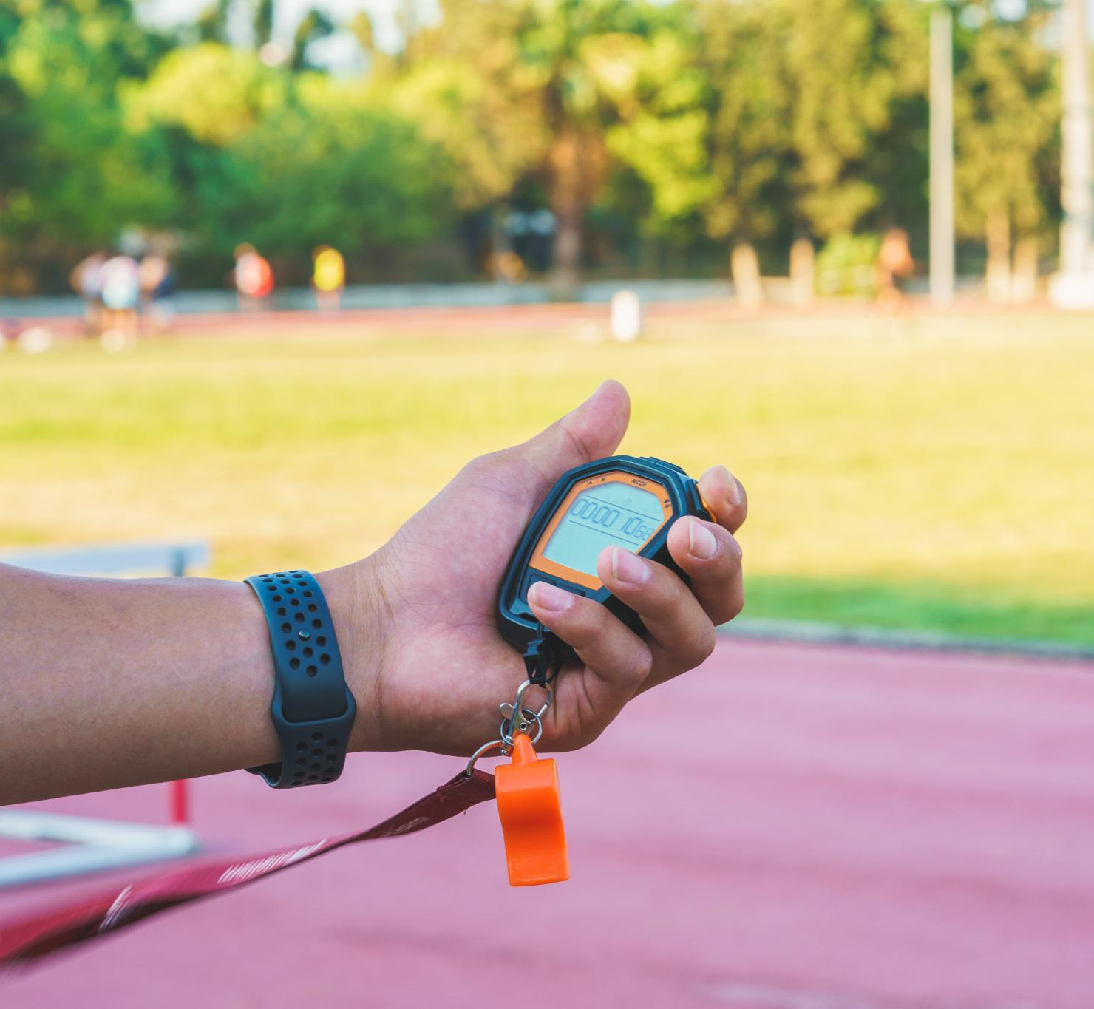
One-Slide Summary
Problem Identification
  Youth tennis overuse develops silently and current tools fail to detect local forearm fatigue effectively.
Innovative Approach
  SmartArmor uses a low-cost EMG and IMU wearable with quality-gated signal processing and per-swing feature extraction.
Key Innovations
  Incorporates quality-aware field EMG, stroke-aware load estimation, and personalized session modeling for fatigue prediction.
Results and Impact
  Prototype validated with real data; aims to provide affordable readiness guidance to athletes, parents, and coaches.
Notes:
---
This slide references information from the following file: https://qualcomm-my.sharepoint.com/personal/wangx_qti_qualcomm_com/Documents/Microsoft%20Copilot%20Chat%20Files/cast_submission.md,https://qualcomm-my.sharepoint.com/personal/wangx_qti_qualcomm_com/Documents/Microsoft%20Copilot%20Chat%20Files/cast_submission.pdf,https://qualcomm-my.sharepoint.com/personal/wangx_qti_qualcomm_com/Documents/Microsoft%20Copilot%20Chat%20Files/worklog.md
The one-slide summary condenses the full project into the five sections requested by the user: Problem, Approach, Innovation, Results, and Impact. Under Problem, the slide states that youth tennis overuse builds silently and that current tools miss local forearm fatigue. This captures the motivation without overloading the audience with clinical detail. Under Approach, the slide identifies the core system: a low-cost EMG and IMU wearable, per-swing feature extraction, and a quality-gated signal processing pipeline. This reminds the audience that the solution is not a generic AI model, but a pipeline that starts from synchronized physiological and kinematic data in real tennis practice. Under Innovation, the slide highlights the project’s distinct contributions: quality-aware field EMG, stroke-aware load estimation, and personalized intra-to-inter session modeling. This language connects directly to the project’s strongest novelty claim that SmartArmor bridges within-session load to next-session recovery. Under Results, the slide summarizes what has already been achieved: the prototype works, real practice data has been captured, MDF trends are fatigue-consistent after settling, motion artifact correlation appears low in pilot data, and longitudinal modeling is in progress. This keeps the results defensible because it separates completed validation from planned model evaluation after 40 or more valid sessions. Under Impact, the slide states that SmartArmor aims to provide affordable readiness guidance before soreness escalates. This is the practical value proposition for athletes, parents, and coaches. The slide functions as a closing executive snapshot, making it useful for judges or stakeholders who want to remember the project’s main message after only a few seconds. It also reinforces careful terminology: SmartArmor is an overuse-risk awareness and readiness-guidance system, not a clinical injury predictor. The summary creates a balanced final impression by showing that the project is ambitious but staged: hardware and signal validation are completed or underway; AI readiness prediction depends on an ongoing longitudinal dataset; product impact will come from miniaturization, pilot testing, and open-source dissemination. The three key information points are the unmet need, the quality-aware wearable-AI approach, and the pathway from current prototype results to broader youth-sports impact.

Slide 13
Selected External Research References
Existing studies supporting session load monitoring, sEMG processing, tennis fatigue, workload modeling, and wearable EMG feature design.
1
Foster et al. (2001), “A New Approach to Monitoring Exercise Training,” JSCR 15(1):109–115.
Supports session-RPE as a practical training-load measure across exercise types.
2
Merletti & Parker, eds. (2004), Electromyography: Physiology, Engineering, and Non-Invasive Applications, Wiley-IEEE Press.
Core reference for surface EMG detection, processing, interpretation, and fatigue manifestations.
3
De Luca et al. (2010), “Filtering the surface EMG signal,” Journal of Biomechanics 43(8):1573–1579.
Supports filtering choices and the need to manage movement artifact / baseline noise in sEMG.
4
Rota et al. (2014), “Influence of fatigue on upper limb muscle activity and performance in tennis,” J. Electromyography & Kinesiology 24(1):90–97.
Direct tennis-fatigue reference linking upper-limb muscle activity and performance.
5
Gabbett (2016), “The training–injury prevention paradox,” British Journal of Sports Medicine 50(5):273–280.
Supports acute/chronic workload framing and careful monitoring of training burden over weeks/months.
6
Phinyomark, Khushaba & Scheme (2018), “Feature Extraction and Selection for Myoelectric Control Based on Wearable EMG Sensors,” Sensors 18(5):1615.
Supports wearable EMG feature engineering and feature-selection rationale.
7
Lambrich & Muehlbauer (2025), “Effects of fatigue on physiological, physical fitness, and stroke performance related parameters in healthy tennis players,” Frontiers in Sports and Active Living 7.
Recent systematic review showing fatigue affects physiological, fitness, and stroke-performance measures in tennis.
How these map to SmartArmor: session-RPE and workload literature justify the longitudinal label/load design; EMG references justify RAW EMG, filtering, and feature extraction; tennis-fatigue studies justify the sport-specific problem framing.
13
Notes:
---
This slide references information from the following file: https://qualcomm-my.sharepoint.com/personal/wangx_qti_qualcomm_com/Documents/Microsoft%20Copilot%20Chat%20Files/cast_submission.md,https://qualcomm-my.sharepoint.com/personal/wangx_qti_qualcomm_com/Documents/Microsoft%20Copilot%20Chat%20Files/cast_submission.pdf,https://qualcomm-my.sharepoint.com/personal/wangx_qti_qualcomm_com/Documents/Microsoft%20Copilot%20Chat%20Files/worklog.md
The reference slide identifies the source basis used to create the concise presentation. The main project content comes from the CAST submission document and PDF, which provide the polished project title, objectives, background, method, innovations, current findings, impact, roadmap, and references. Those sources describe the low-cost hardware design, the use of MyoWare 2.0 EMG, ICM-20948 IMU, ESP32 BLE streaming, the 2,000 Hz EMG and 200 Hz IMU data streams, the 18-feature per-swing analysis, the quality-scoring framework, and the planned personalized AI model for next-morning soreness and next-session readiness. The research strategy and careful scientific framing come from the canonical Paper 3 plan, which clarifies that the core contribution is quality-aware personalized longitudinal load-to-readiness modeling rather than standalone deep-learning fatigue classification. It also establishes key boundaries: no clinical injury prediction claim, no cross-subject generalization claim from a single-athlete longitudinal dataset, and no primary deep-learning claim for a 40–80 session sample. The machine-learning method sources provide the design rationale for multifeature Random Forest load estimation, feature extraction across EMG and IMU, cross-validation concerns, and evaluation metrics. These sources explain why MDF alone is insufficient in dynamic tennis due to non-stationarity and why a multifeature model is more robust. The slide also lists literature cited in the submission: Foster et al. for session-RPE training load, Merletti and Parker for EMG physiology and median frequency foundations, Gabbett for acute-to-chronic workload concepts, Rota et al. for fatigue and recovery in tennis, and Phinyomark et al. for EMG feature evaluation and myoelectric pattern recognition robustness. These citations show that the project is connected to established sports science and EMG literature while applying those ideas in a low-cost field deployment. The reference slide’s purpose is not to be a full bibliography but to demonstrate that the deck was grounded in the uploaded project documents and known research anchors. It reinforces credibility by showing that the presentation’s concise claims are traceable to specific source materials rather than invented summary points.

