Slide 1
Modeling Patterns for C Constructs
A guide for generating popular C constructs from models using Real-Time Workshop® Embedded Coder™
Notes:
The MathWorks

Slide 2
Summary
This presentation is a reference guide for transitioning from hand coding in C to modeling with automatic code generation
For a typical C pattern:
  Different modeling methodologies are illustrated using Simulink®, Stateflow®, and Embedded MATLAB™
  Code from Real-Time-Workshop® Embedded Coder™ is shown
  The mapping of the C construct to the model and its generated code is illustrated
  All the steps involved in creating the model and generating the code are detailed in the notes page for each slide
Readers are encouraged to request or submit other patterns for future releases of this document by contacting:
  arvind.jayaraman@mathworks.com or
  tom.erkkinen@mathworks.com
Notes:
The MathWorks

Slide 3
Caveats
This document does not cover every modeling method or C construct
MathWorks Release R2008a is used and results may differ for other versions
White-spaces in the generated code snippets have been changed in some cases for clarity
Working knowledge of MATLAB and Simulink is helpful for readers but not required
Notes:
The MathWorks

Slide 4
Additional Resources
C/C++ Code Generation Web Videos
  www.mathworks.com/products/rtwembedded/demos.html
HDL Code Generation Web Videos
  www.mathworks.com/products/slhdlcoder/demos.html
Fixed Point Code Generation Web Videos
  www.mathworks.com/products/simfixed/demos.html
Fixed Point Modeling and Code Generation Tips
  www.mathworks.com/matlabcentral/fileexchange/loadFile.do?objectId=19835
Notes:
The MathWorks

Slide 5
Index
Standard Steps to prepare models
Types, Operators and Expressions
Control Flow
Functions and Program Structure
Structures
Arrays and Pointers
Notes:
The MathWorks

Slide 6
Types, Operators and Expressions
C Pattern
Data Declaration
Data-Type Conversion
Type Qualifiers
Relational and Logical Operations
Bitwise Operations
Return to Table of Contents
Notes:
The MathWorks

Slide 7
Control Flow
C Pattern
If-Then-Else
Switch-Case
For-Loop
While-Loop
Do-While Loop
Return to Table of Contents
Notes:
The MathWorks

Slide 8
Functions & Program Structure
C Pattern
Functions void-void Functions Functions returning arguments Calling external C functions
#define
Return to Table of Contents
Notes:
The MathWorks

Slide 9
Structures
C Pattern
Typedef
Structures for Parameters
Structures for Signals
Nested Structures
Bit Fields
Return to Table of Contents
Notes:
The MathWorks

Slide 10
Arrays and Pointers
C Pattern
Arrays
Pointers
Return to Table of Contents
Notes:
The MathWorks

Slide 11
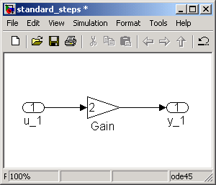
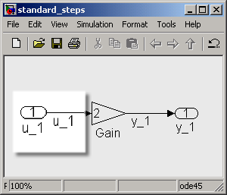
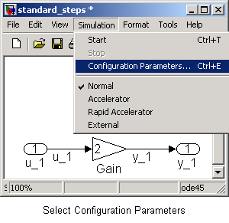
Standard Steps adopted in this document to prepare models for Code Generation
Create the model
Label Input/Output Signals
as shown
From the file menu choose
‘Simulation’ and select
‘Configuration Parameters’
Notes:
The MathWorks
Standard methods adopted to prepare models for code generation
Throughout this document the models used have the following conventions
Inputs are named as ‘u_1’, ‘u_2’, ‘u_3’ etc. Outputs are named as ‘y_1’, ‘y_2’ etc.. Parameters are named as ‘p_1’, ‘p_2’ etc. and states are named as ‘x_1’, ‘x_2’ etc.
By convention the Input Ports have also been named to reflect the names of the signals that they propagate.
Steps: Instructions for user
Create a model in Simulink
Right-click on signal lines and select “Signal Properties” to assign signal names and specify storage classes for Real-Time Workshop.
Use the Real-Time Workshop Pane to specify the storage class for the signals. This document uses models with signals that have ‘Exported Global’ Storage Class.
To Configure the model for code-generation, there are two ways to launch the Configuration Menu.
The first method is to click on the Simulation menu and then choose Configuration parameters.
The other way is to use the keyboard shortcut ctrl + E.
Steps: Configuring Input/Output Ports (optionally used)
Double Click on the Input/Output port.
In the Pop-up menu, Select the Signal Attributes tab.
Here, one can specify the input port dimensions, data type.
Steps: Initializing States and associating data-objects with them (optionally used)
The example here discusses the Unit – Delay Block. The procedure is the same for other blocks that have internal states.
Double Click on the block.
In the Pop-up menu, Select the Main tab.
Here, one can specify the Initial Conditions and the Sample Time.
Select the State-Attributes tab.
Specify the name of the states.
As part of the data-object creation process using the data-object-wizard,
the states are also picked up and the name specified in the
State-Attributes tab is used.

Slide 12
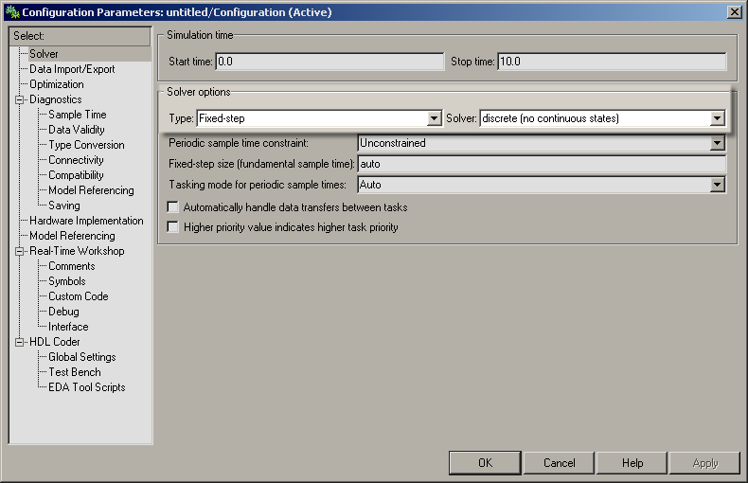
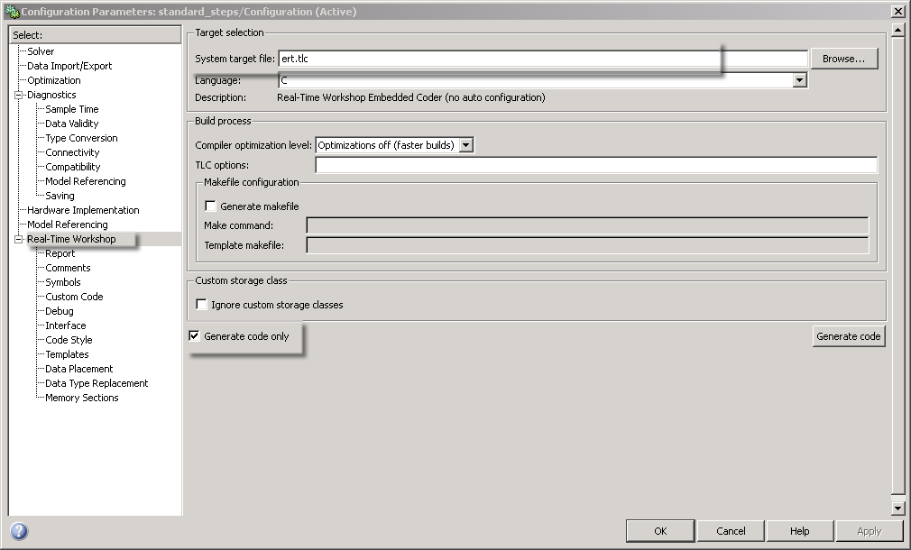
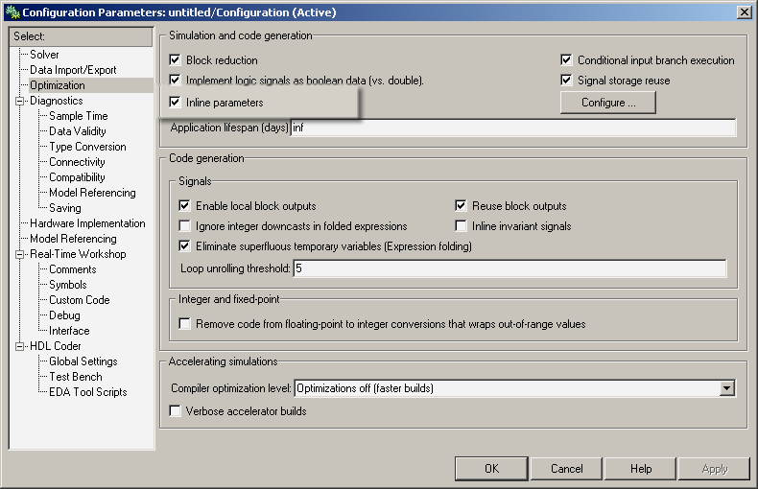
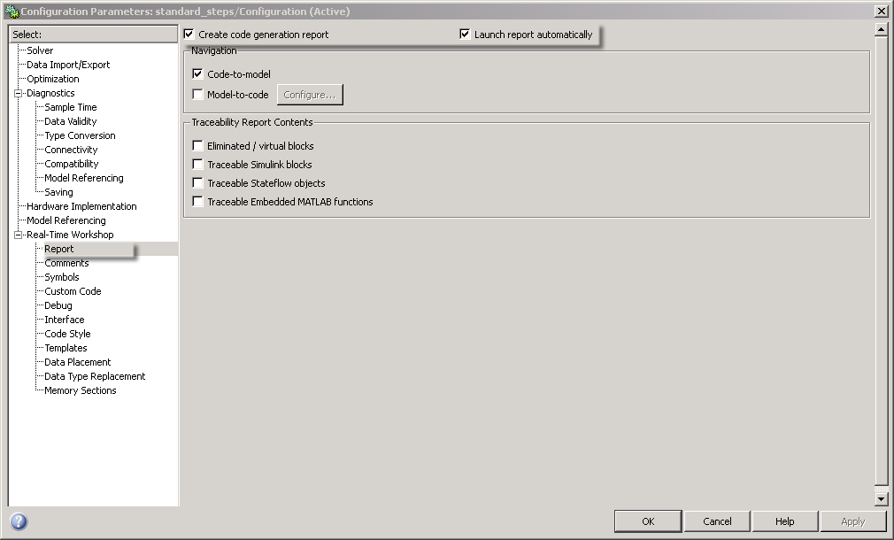
From the Solver Pane: Select Fixed Step discrete Solver
In the Real-Time Workshop Pane: Choose ert.tlc as System Target File
and check the following boxes
In the Optimization Pane: Select Inline Parameters
Enable code generation Report
Notes:
The MathWorks
Steps: Configuring Stateflow Charts (optionally used)
Stateflow charts need to initialized with input, output, local variables and parameters.
Double Click on the Stateflow Chart.
Launch the Model-Explorer (Chart Explorer in this case) by either selecting Tools -> Explore, or by ctrl + R.
To add inputs, outputs, local variables, parameters and function calls, From the “Add” menu select Data. Optionally type ctrl+D to perform the same action.
Once, the data has been added edit the name of the variable. Also to specify whether it is an input/output etc... click on the scope and choose one from the drop-down menu.
For each variable, one must specify its data-type. Generally one must either choose a built in data-type or inherit the data-type.
Click on the Apply Button at the bottom-right corner and then close the Model-Explorer.
Steps: Instructions for user to setup Configuration-Parameters
Once the Configuration Menu is launched, choose the solver pane on the left.
In the Solver options, Select “Fixed – Step” for the Solver type.
In the “Solver” pull-down menu select “Discrete (no continuous states)”
On the left side, select the “Optimization” Pane.
In this Pane, in addition to the default settings, check the setting “Inline parameters”
Choose the Real-Time-Workshop Pane on the left hand side.
Specify “ert.tlc” as the System Target File. Either type in ert.tlc + <enter key>, or click the Browse button and select Embedded Real Time Target (no auto configuration)
In addition to this uncheck the box “Generate makefile” and check the box “Generate Code Only”.
Notice that in doing so, the “Build” button changes to “Generate Code”.
One can optionally enable HTML report generation by checking the following boxes in Real-Time Workshop -> Report pane : “Generate HTML report”, “Launch report automatically”, “Code-to-block highlighting”.
Finally, click Apply and click OK to exit.

Slide 13
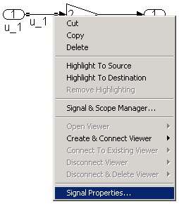
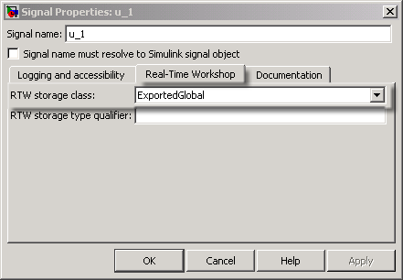
Right Click on Signal Lines and
Select “Signal Properties”
In the Real Time Workshop pane select the RTW storage class
to be Exported Global
We are now ready to generate code !
Return to Table of Contents
Notes:
The MathWorks
Steps: Instructions for user to create data objects
From the Command Prompt launch the Data Object Wizard using the command >>dataobjectwizard
Select the model by clicking on the browse button.
Click on “Find”. This populates the wizard with all the signals that have been named, as well as internal states.
Click Check-All to choose all the signals and parameters
Select the package to be applied as “mpt”.
Click on “Apply Package” to apply the package.
Click on “Create” to create data objects
By default these signals have a “Global” storage class, which can be modified as needed.

Slide 14
Glossary
CSC : Custom Storage Class
Signal : An entity whose value is expected to change during simulation. Generally a connecting wire that carries data is referred to as a ‘signal’.
Parameter : An entity whose value typically remains constant during simulation run-time. Constants, gains etc. are typical examples of parameters.
Simulink Data Object: An entity that specify values, data types, tunability, value ranges, and other key attributes of block outputs and parameters.
Virtual Subsystem: Virtual subsystems visually organize blocks but have no effect on the model's functional behavior.
Non-Virtual Subsystem: A subsystem whose algorithm is executed atomically.
Non-Virtual Bus : A Bus whose signals are copied/packed into a data-structure.
Notes:
The MathWorks

Slide 15
C Code Pattern: Data Declaration
Code Pattern, Parameter | Code Pattern, Signal
int p_1 = 3 ; Description: The aim is to obtain declarations such as the ones above in the generated code. p_1 is a parameter that has a 32 bit integer data-type. | int u_1 ; Description: u_1 is a signal that has an integer data-type. In this example the size of the data type int is 16 bits.
Return to Table of Contents
Notes:
The MathWorks

Slide 16

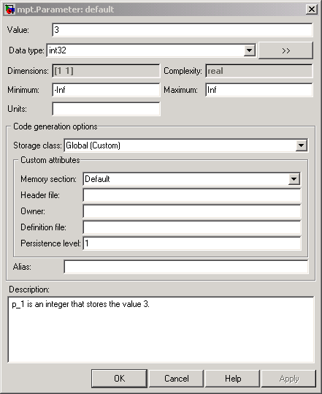
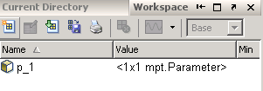
Data Declaration
Creation : Parameters
B
C- Code Pattern, Parameter
A
B
C
int p_1 = 3;
>> p_1 = mpt.Parameter
C
A
Generated Code, Parameter
A
B
C
int32_T p_1 = 3;
rtwdemo_intparam_sdo.mdl
Notes:
The MathWorks
Declare a parameter as an integer variable p_1 and assign it the value 3
One of the ways of obtaining a global definition of integer data type is to create a data object and specify a storage class.
Steps: Instructions for user
Create a model with the desired parameter ‘p_1’.
In this example, a simple model for illustration purposes is shown. This model can be recreated by dragging a “Constant” block from the “Simulink -> Most Commonly Used” library into the model.
The value of the constant block can be set by double-clicking the block and entering the parameter name ‘p_1’ in the Constant Value field.
To create a parameter data object, one can explicitly type : p_1 = mpt.Parameter at the command line.
In case of large models, or ones with many parameters, one can use the data-object-wizard to find all the parameters and create the data objects for them.
Finally, to configure the data object, double click the data object that we just created in the workspace. This launches a dialog box.
One can set the Value field to the desired value, in this case 3.
One can also specify the data-type, in this case int32 (for 32 bit integer)
In addition, one can specify the storage class, memory section, Header file, Definition file, Description etc.
Another way to configure a data object is to open the model explorer, by ctrl + H.
Within the model explorer one can add, delete, edit and configure data objects.
Finally, we need to make sure that in the Configuration-Parameters, the Inline-Parameters Option is checked. This can be done by selecting the Optimization Pane -> Checking the Box
“Inline Parameters”.
Results
The generated code produces the desired definition and initialization.
Legend
Data Type
Parameter Name
Initial Value

Slide 17
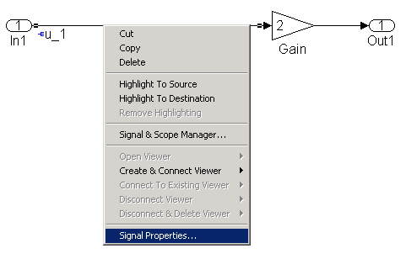
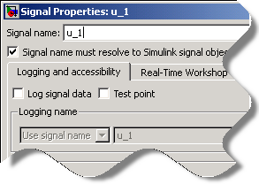
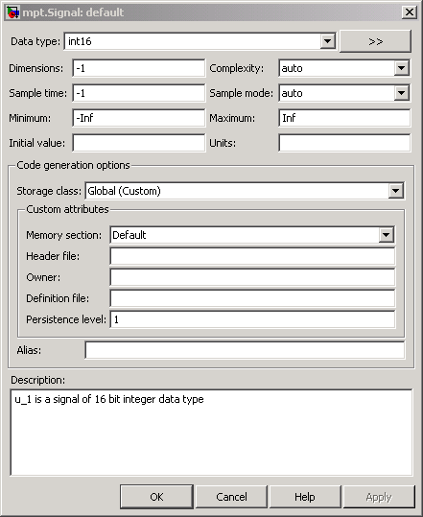
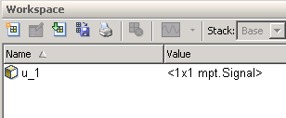
Data Declaration
Creation : Signals
C- Code Pattern, Signal
A
B
B
int u_1;
>> u_1 = mpt.Signal;
A
Generated Code, Signal
A
B
int16_T u_1;
rtwdemo_intsignal.mdl
Notes:
The MathWorks
Assign a signal to the variable ‘u_1’ and declare it as an integer
One of the ways of obtaining a global definition of integer data type is to create a data object and specify a storage class.
Steps: Instructions for user
Create a model and label the desired signal ‘u_1’.
In this example, a simple model for illustration purposes is shown.
Double Click on the desired signal and type in ‘u_1’ in the associated editable text box that appears near the signal.
To create a signal data object, one can explicitly type : u_1 = mpt.Signal at the command line.
In case of large models, or ones with many signals, one can use the data-object-wizard to find all the signals and create the data objects for them.
Finally, to configure the data object, double click the data object that we just created in the workspace. This launches a dialog box.
One can specify the data-type, in this case int16 (for 16 bit integer) from the pull down Data type menu.
In addition, one can specify the storage class, memory section, Header file, Definition file, Description etc.
Another way to configure a data object is to open the model explorer, by ctrl + H.
Within the model explorer one can add, delete, edit and configure data objects.
Results
The generated code produces the desired definition.
Legend
Data Type
Signal Name

Slide 18
C Code Pattern: Data-Type Conversion
Code Pattern | Modeling Methodology
y_1 = (double) u_1 ; Description: u_1 is a 32 bit signed integer (int32). The typecasting operation converts an int32 to a double. | Use Simulink Data-Type Conversion Block.
 | Usage within Stateflow Chart
 | Usage within Embedded MATLAB (EML) Block
 | 4. Other type conversion methods
Return to Table of Contents
Notes:
The MathWorks

Slide 19
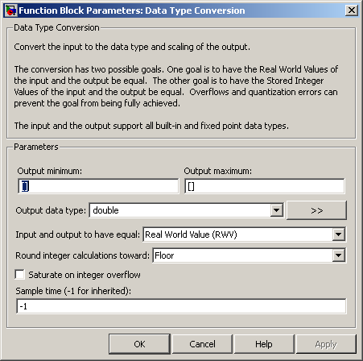
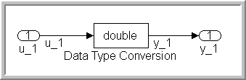
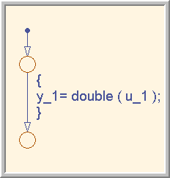
Type-Conversion
Creation
SL
SF
EML
C-Code Pattern
Simulink
y_1 = (double) u_1 ;
Stateflow
Generated Code
y_1 = (real_T)u_1;
Embedded MATLAB Function
NOTE : real_T is a Real-Time
Workshop Embedded Coder
Typedef for double.
function y_1 = typeconv(u_1)
y_1 = double ( u_1 );
rtwdemo_typeconvsl.mdl
rtwdemo_typeconvsf.mdl
rtwdemo_typeconveml.mdl
Notes:
The MathWorks
Carry out “Data-Type-Conversion” statements, in all 3 environments (Simulink, Stateflow & EML)
Simulink
Drag a “Data Type Conversion” block from the from the “Commonly used Blocks” or from the “Signal Attributes” library into the model.
Double Click on the block and select the type conversion to be effected on the input port.
Stateflow
This method can be used to effect type-conversions within a Stateflow Chart.
Carry out the action shown in the figure on the relevant transition within the chart.
Embedded MATLAB Function
This method can be used to effect a type-conversions within an embedded MATLAB block.
Carry out the statement as shown in the figure, within the EML block.
Results
The generated code produces the desired type conversion statement.
Legend
Required Data Type Conversion

Slide 20

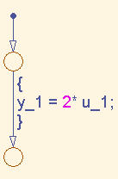

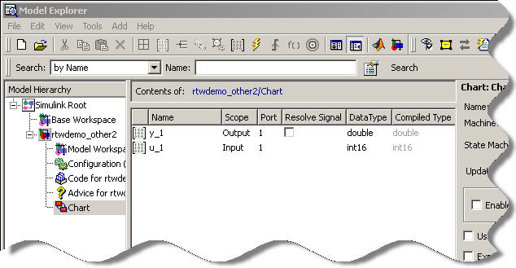
Type-Conversion
Other type-conversion mechanisms
Example 1:
Example 2:
rtwdemo_other.mdl
rtwdemo_other2.mdl
Notes:
The MathWorks
Data type Conversion
E.g. 1: Shows a model where a gain block outputs a 32 bit signed fixed point number for an input signal which is a 16 bit integer. The “inherit via internal rule” option for the Gain block governs the output signal’s data-type.
E.g. 2: Shows a type-conversion occurring at the boundary of the Stateflow chart, where the output variable ‘out’ has a specified data type of double.

Slide 21
C Code Pattern: Type Qualifiers
Code Pattern, Parameter | Modeling Methodology
const double p_1 = 9.8 ; Description: The aim is to obtain declarations such as the one above in the generated code. p_1 is a constant parameter that has a double data-type. | 1. Create a parameter in the MATLAB workspace and make it tunable.
 | 2. Create a data Object and use the Const custom storage class.
Return to Table of Contents
Notes:
The MathWorks

Slide 22

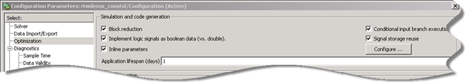
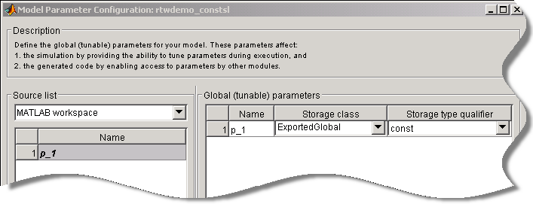
Type Qualifiers
Tunable Parameters
B
D
C- Code Pattern, Parameter
>> p_1 = double ( 9.8 ) ;
A
B
C
D
const double p_1 = 9.8 ;
C
Ctrl + E
A
Generated Code, Parameter
A
B
C
D
const real_T p_1 = 9.8 ;
rtwdemo_constsl.mdl
Notes:
The MathWorks
Make the parameter tunable and specify its storage class and storage Type Qualifier.
A tunable parameter is a block parameter whose value can be changed at run-time. The storage class property of a parameter specifies how the Real-Time Workshop product declares the parameter in generated code.
Steps: Instructions for user
Create a model with the desired parameter (‘p_1’ in this case).
In this example, a simple model for illustration purposes is shown. This model can be recreated by dragging a “Constant” block from the “Simulink -> Most Commonly Used” library into the model.
The value of the constant block can be set by double-clicking the block and entering the parameter name ‘p_1’ in the Constant Value field.
To create a parameter and specify its data-type type p_1 = (double) 9.8 at the MATLAB command prompt.
To make the parameter tunable, Open the Configuration Parameters Menu with ctrl+E and navigate to the Optimization pane.
Check the option “Inline Parameters” to activate the Configure button
Click the Configure button to open the Model Parameter Configuration dialog box.
To declare tunable parameters, you select one or more variables from the Source list, add them to the Global (tunable) parameters list, and set their storage class and Storage Type Qualifier.
9. In this example we select “Exported Global” for Storage Class and Specify “const” for Storage Type Qualifier.
10. Click on Apply to store all changes made.
Results
The generated code produces the desired type qualifier in the variable definition.
Legend
Type Qualifier
Data Type
Parameter Name
Parameter Value

Slide 23

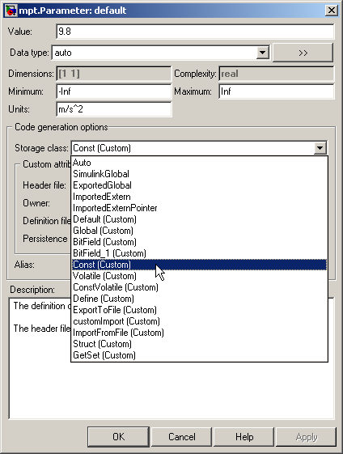
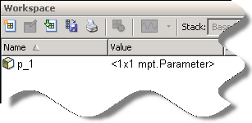
Type Qualifiers
Simulink Data Object & CSC
C
C- Code Pattern, Parameter
A
B
C
D
const double p_1 = 9.8 ;
>> p_1 = mpt.Parameter
D
B
A
Generated Code, Parameter
A
B
C
D
const real_T p_1 = 9.8 ;
rtwdemo_constsl_sdo.mdl
Notes:
The MathWorks
Specify a type qualifier for a parameter.
One of the ways of obtaining a type-qualifier is to create a data object and specify the appropriate CSC.
Steps: Instructions for user
Create a model with the desired parameter (p_1 in this case).
In this example, a simple model for illustration purposes is shown. This model can be recreated by dragging a “Constant” block from the “Simulink -> Most Commonly Used” library into the model.
The value of the constant block can be set by double-clicking the block and entering the parameter name ‘p_1’ in the Constant Value field.
To create a parameter data object, one can explicitly type : p_1 = mpt.Parameter at the command line.
In case of large models, or ones with many parameters, one can use the data-object-wizard to find all the parameters and create the data objects for them.
Finally, to configure the data object, double click the data object in the workspace. This launches a dialog box.
One can set the Value field to the desired value, in this case 9.8.
One can also specify the data-type (in this case auto for 64 bit double).
In addition, one can specify the storage class, memory section, Header file, Definition file, Description etc.
Another way to configure a data object is to open the model explorer, by ctrl + H.
Within the model explorer one can add, delete, edit and configure data objects.
Finally, we need to make sure that in the Configuration-Parameters, the Inline-Parameters Option is checked. This can be done by selecting the Optimization Pane and then checking the box
“Inline Parameters”.
13.Additionaly one can also obtain and use different type qualifiers. One can get volatile, const volatile etc. by choosing the corresponding storage class.
Results
The generated code produces the desired type qualifier in the variable definition.
Legend
Type Qualifier
Data Type
Parameter Name
Parameter Value

Slide 24
C Code Pattern: Relational & logical Operators
Code Pattern, Relational Operator | Modeling Methodology
y_1 = (u_1 > u_2) ; Description: In this example a relational-operation is shown. | Use Simulink Relational & Logical Operator Blocks.
 | Usage within Stateflow Chart (primarily for transitions)
 | Usage within Embedded MATLAB (EML) Block
Code Pattern, Logical Operator | Modeling Methodology
y_1 = ( u_1 || u_2 ); Description: u_1, u_2 are Booleans. In this example a logical-operation is shown. | Use Simulink Relational & Logical Operator Blocks.
 | Usage within Stateflow Chart (primarily for transitions)
 | Usage within Embedded MATLAB (EML) Block
Return to Table of Contents
Notes:
The MathWorks

Slide 25
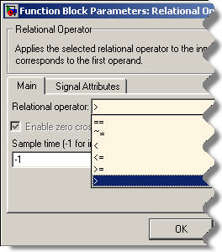
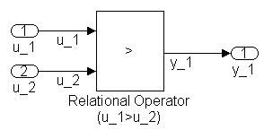
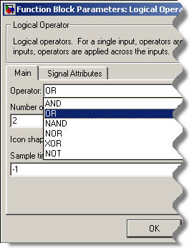
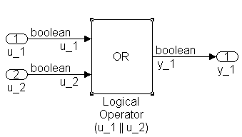
Relational & Logical Operations
Creation
SL
SF
EML
C- Code Pattern, Relational
Operator
A
y_1 = (u_1 > u_2) ;
A
C- Code Pattern, Logical
Operator
B
y_1 = (u_1 || u_2) ;
Generated Code, Relational
Operator
A
B
y_1 = (u_1 > u_2);
Generated Code, Logical
Operator
B
y_1 = (u_1 || u_2);
rtwdemo_relationalsl.mdl
rtwdemo_logicalSL.mdl
Notes:
The MathWorks
Perform “Relational-Logical” Operations using Simulink
Steps: Instructions for user
To perform a Relational Operation, drag a “Relational-Operator” block from the from the “Logic and Bit Operations” library into the model.
Double Click on the block to configure the desired Relational operation.
To perform a Logical Operation, drag a “Logical Operator” block from the “Logic and Bit Operations” library into the model
Double Click on the block to configure the desired Logical operation.
Select the desired Logical Operation. One can control the number of input arguments to the block by changing the “Number of input ports:” field.
In order to perform comparison with constants one can drag a “Compare To Constant” block from the “Logic & Bit Operations” library into the model.
Additionally one can perform comparison to zero operations with the “Compare to Zero” block in the “Logic & Bit Operations” library.
To configure the comparsion operation, double click on these blocks after dragging them into the model and select the desired comparison operation.
Specific to this example, the input ports have the data-type ‘int16’.
Wire all the blocks.
Results
The generated code produces the desired relational & logical operations.
Legend
> (Greater than) relational operator
Logical OR operator

Slide 26
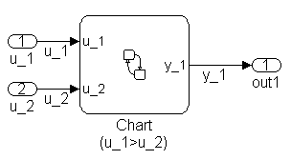
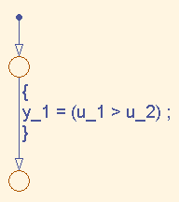
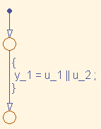
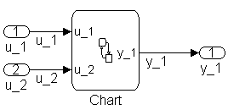
Relational & Logical Operations
Creation
SL
SF
EML
C- Code Pattern, Relational
Operator
A
y_1 = (u_1 > u_2) ;
C- Code Pattern, Logical
Operator
A
B
y_1 = (u_1 || u_2);
Generated Code, Relational
Operator
A
y_1 = (u_1 > u_2);
B
Generated Code, Logical
Operator
B
y_1 = (u_1 || u_2);
rtwdemo_relationalsf.mdl
rtwdemo_logicalORsf.mdl
Notes:
The MathWorks
Create “Relational & Logical ” statements in the generated code using Stateflow
Steps Instructions for user
Drag a “Stateflow - Chart” from the from the “Stateflow” library into the model.
Double-Click on the Chart and open the model explorer from Tools – Explore, or ctrl+R
Add the inputs and outputs to the chart and specify their data-type.
Create the stateflow diagram with the desired relational & logical -operation actions specified on the transition from one junction to another.
Here one should note that the relational & logical operators have exactly the same syntax as ‘C’.
It should also be noted that typcially such relational statements are used to specify conditions to conditionally allow a transition. In which case, these statements should be within ‘[ ]’ (square brackets).
Wire all the connections as shown in the figure.
Results
The generated code produces the desired Relational & logic operations.
Legend
> (Greater than) relational operator
Logical OR operator

Slide 27
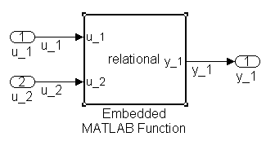
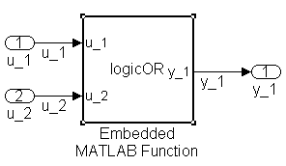
Relational & Logical Operations
Creation
SL
SF
EML
C- Code Pattern, Relational
Operator
A
y_1 = (u_1 > u_2) ;
C- Code Pattern, Logical
Operator
B
function y_1 = relational(u_1,u_2)
y_1 = (u_1 > u_2) ;
y_2 = (u_1 || u_2) ;
A
Generated Code, Relational
Operator
A
y_1 = u_1 > u_2;
Generated Code, Logical
Operator
B
function y_1 = logicOR (u_1,u_2)
y_1 = u_1 || u_2 ;
if ((!u_1) && (!u_2)) {
y_1 = 0U;
} else {
y_1 = 1U;
}
B
rtwdemo_relationaleml.mdl
rtwdemo_logicalOReml.mdl
Notes:
The MathWorks
Create “Relational & Logical” Statements in the generated code using Embedded MATLAB Function :
Steps Instructions for user
Drag an “Embedded- MATLAB - Function” block from the from the “Simulink-> User-Defined Functions” library into the model.
Connect the data inputs and outputs to the block.
Double-Click on the block and edit the function as shown.
The syntax for specification of relational & logical operations within the EML block should be the same as M-script.
Wire the blocks as shown.
Results
The generated code produces the desired relational & logical statements.
The || (Logical OR) operation has been transformed into an equivalent && (Logical AND) operation that is present within an If-Else Statement.
Legend
> (Greater than) relational operator
Logical OR operator

Slide 28
C Code Pattern: Bitwise-Logic operations
Code Pattern, AND operation | Modeling Methodology
y_1 = u_1 & 0xD9 ; Description: u_1 is an 8 bit unsigned integer. In this example, a Bitwise-logical operation with a bit-mask is shown | Use Simulink Bitwise-Operator Block.
 | Use Stateflow Chart
 | Use Embedded MATLAB (EML) Block
Code Pattern, OR operation | Modeling Methodology
y_2 = u_2 | u_3; Description: u_2, u_3 are 8 bit unsigned integers. In this example a Bitwise-logical operation between two numbers is shown. | Use Simulink Bitwise-Operator Block.
 | Use Stateflow Chart
 | Use Embedded MATLAB (EML) Block
Return to Table of Contents
Notes:
The MathWorks

Slide 29
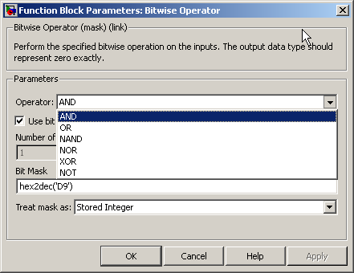
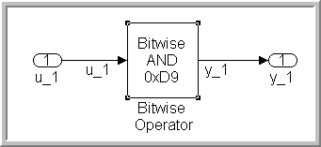
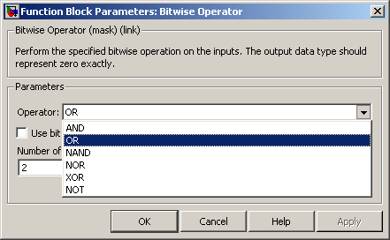
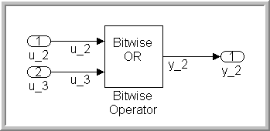
Bitwise-Logic
Creation
SL
SF
EML
C- Code Pattern, AND
A
B
y_1 = u_1 & 0xD9 ;
A
C- Code Pattern, OR
C
B
y_2 = u_2 | u_3;
Generated Code, AND
A
B
y_1 = (uint8_T)(u_1 & 217U);
C
Generated Code, OR
C
y_2 = (uint8_T)(u_2 | u_3);
rtwdemo_logicANDsl.mdl
rtwdemo_logicORsl.mdl
Notes:
The MathWorks
Create “Bitwise-Logic” statements in the generated code using Simulink
One way to create Bit-wise statements is to use a “Bitwise Operator” block.
Steps: Instructions for user
Drag a “Bitwise-Operator” block from the from the “Logic and Bit Operations” library into the model.
Double Click on the block to open the subsystem.
In order to perform Bitwise operations with a desired bit-mask, make sure that the “Use bit mask” box is checked
In the Bit Mask Field enter the bit mask as a decimal number. Use bin2dec and hex2dec if conversions from binary or hexadecimal are needed.
If Bitwise operations are to be performed with another input, uncheck the “Use bit mask” box and enter the number of input ports.
Select the bitwise operation needed.
Wire all the blocks.
Additionaly, to perform Shift operations use a “Shift-Arithmetic Block” from the “Logic & Bit Operations” Library.
By Double-Clicking on the block and edit the number of bits to be shifted. One can specify a left shift by entering a negative number. eg: -2 would mean shift left by 2 bits
Results
The generated code produces the desired bitwise logical operation.
Legend
Bitwise AND operation
Mask
Bitwise OR operation

Slide 30
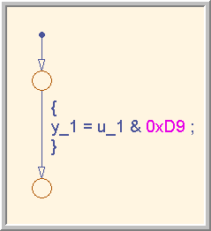
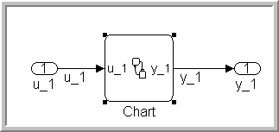
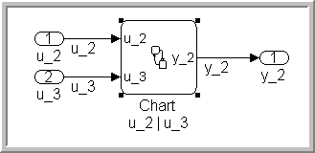
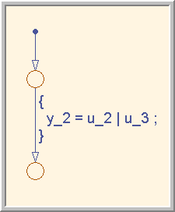
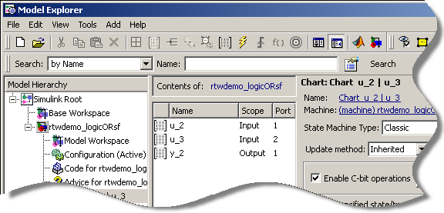
Bitwise-Logic
Creation
SL
SF
EML
C- Code Pattern, AND
A
y_1 = u_1 & 0xD9 ;
A
C- Code Pattern, OR
B
y_2 = u_2 | u_3;
Generated Code, AND
A
y_1 = (uint8_T)(u_1 & 0xD9);
Generated Code, OR
B
B
y_2 = (uint8_T)(u_2 | u_3);
rtwdemo_logicANDsf.mdl
rtwdemo_logicORsf.mdl
Notes:
The MathWorks
Create “Bitwise-Logic” statements in the generated code using Stateflow
One way to create Bitwise statements is to use a “Stateflow Chart”.
Steps Instructions for user
Drag a “Stateflow - Chart” from the from the “Stateflow” library into the model.
Double-Click on the Chart and open the model explorer from Tools – Explore, or ctrl+R
On the right-hand side, Check the Box “Enable C-bit operations” as shown in the figure. If this box is not checked Stateflow treats Bitwise operations as logical operations.
Add the inputs and outputs to the chart and specify their data-type. As seen in this case, if input signals are uint8, then set the input data-type to Inherited.
Create the Stateflow diagram with the desired bitwise-operation action specified on the transition from one junction to another.
Wire all the connections as shown in the figure.
Results
The generated code produces the desired bitwise logic operations.
Legend
Bitwise AND statement
Bitwise OR statement

Slide 31
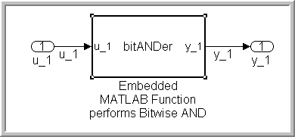
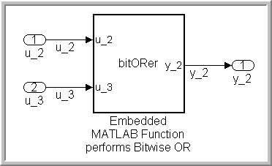
Bitwise-Logic
Creation
SL
SF
EML
C- Code Pattern, AND
A
y_1 = u_1 & 0xD9 ;
C- Code Pattern, OR
function y_1 = bitANDer (u_1)
y_1 = bitand (u_1,217) ;
B
A
y_2 = u_2 | u_3;
Generated Code, AND
A
y_1 = (uint8_T)(u_1 & 217);
Generated Code, OR
B
y_2 = (uint8_T)(u_2 | u_3);
function y_2 = bitORer(u_2,u_3)
y_2 = bitor (u_2,u_3);
B
rtwdemo_logicANDeml.mdl
rtwdemo_logicOReml.mdl
Notes:
The MathWorks
Create “Bitwise-Operations” in the generated code using Embedded MATLAB Function :
One way to create “Bitwise-Operation” statements is to use an “Embedded- MATLAB” Block.
Steps Instructions for user
Drag an “Embedded- MATLAB - Function” block from the from the “Simulink-> User-Defined Functions” library into the model.
Connect the data inputs and outputs to the block.
Double-Click on the block and edit the function as shown.
To generate bitwise operations other than the ones mentioned here, please refer to the embedded MATLAB help section for more operations.
Wire the blocks as shown.
Results
The generated code produces the desired bitwise logic operations.
Legend
Bitwise AND statement
Bitwise OR statement

Slide 32
C Code Pattern: If-Then-Else
Code Pattern | Modeling Methodology
if (u_1 > u_2) { y_1 = u_1; } else { y_1 = u_2; } | Use Simulink Switch Block
 | Use Stateflow Chart
 | Use Embedded MATLAB (EML) Block
Return to Table of Contents
Notes:
The MathWorks

Slide 33
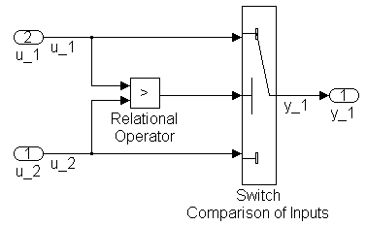
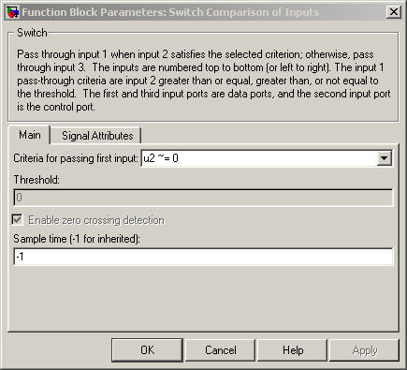
If-Then-Else
Creation
B
SL
SF
EML
C- Code Pattern
A
A
if ( u_1 > u_2 )
{
y_1 = u_1;
}
else
{
y_1 = u_2;
}
C
B
C
Generated ode
if (u_1 > u_2)
{
y_1 = u_1;
}
else {
y_1 = u_2;
}
A
B
C
rtwdemo_ifelse.mdl
Notes:
The MathWorks
Create “if” / “else” statements in the generated code using Simulink
One way to create “if” / “else” statements is to use a “Mulitport Switch” block.
Steps: Instructions for user
Drag a “Switch” block from the from the “Signal Routing” library into the model.
Connect the data inputs and outputs to the block.
Drag a “Relational Operator” block from the “Logic & Bit Operations” library into the model.
Connect the signals to be compared to the block. The order of connection depends on the comparison being made.
Configure the Relational Operator Block to be “>”.
Connect the controlling input to the middle input-port of the “Switch” block.
Double Click on the Switch Block and select the “Criteria for passing first input” to u2~=0. This ensures that (u_1) is selected if u2 is TRUE otherwise Input3 (u_2) is passed.
NOTE: There is also a “Multiport Switch” block present in the “Signal Routing” Library. The purpose of this block is to serve as a selection switch. The usage should not be confused with the “Switch” block.
Results
A conditional statement corresponding to the controlling input of the block.
The upper data input “u_1” is the output if the input u_1 is greater than input u_2.
The lower data input “u_2” is the output if the input u_1 is less than input u_2.
Legend
Condition for If statement
Action if condition is true
Action if condition is false
ifelse_sdo.mdl
ifelse.mdl

Slide 34
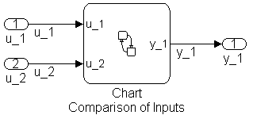
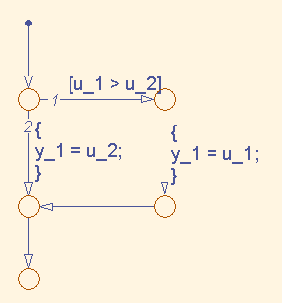
If-Then-Else
Creation
SL
SF
EML
C- Code Pattern
A
if ( u_1 > u_2 )
{
y_1 = u_1;
}
else
{
y_1 = u_2;
}
B
C
A
Generated Code
B
C
A
if (u_1 > u_2) {
y_1 = u_1;
}
else
{
y_1 = u_2;
}
B
C
rtwdemo_iselsesf.mdl
Notes:
The MathWorks
Create “if” / “else” statements in the generated code using Stateflow
One way to create “if” / “else” statements is to use a “Stateflow Chart”.
Steps Instructions for user
Drag a “Stateflow - Chart” from the from the “Stateflow” library into the model.
Connect the controlling input, data inputs and outputs to the block.
Double-Click on the Chart and open the model explorer from Tools – Explore, or ctrl+R.
Add the inputs and outputs to the chart and specify their data-type.
Create the Stateflow logic as shown in the figure.
Results
A conditional statement corresponding to the controlling input of the block.
The upper data input “u_1” is the output if the input u_1 is greater than input u_2.
The lower data input “u_2” is the output if the input u_1 is less than input u_2.
Legend
If condition
Action if condition is true
Action if condition is false
iselsesf_sdo.mdl
iselsesf.mdl

Slide 35
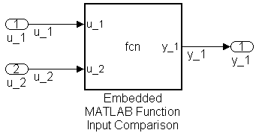
If-Then-Else
Creation
SL
SF
EML
C- Code Pattern
A
if ( u_1 > u_2 )
{
y_1 = u_1;
}
else
{
y_1 = u_2;
}
B
C
Generated Code
function y_1 = fcn(u_1,u_2)
if (u_1 > u_2)
y_1 = u_1 ;
else
y_1 = u_2 ;
end
A
if (u_1 > u_2) {
y_1 = u_1;
}
else {
y_1 = u_2;
}
A
B
B
C
C
rtwdemo_ifelseeml.mdl
Notes:
The MathWorks
Create “if” / “else” statements in the generated code using Embedded MATLAB Function
One way to create “if” / “else” statements is to use an “Embedded- MATLAB” Block.
Steps Instructions for user
Drag an “Embedded- MATLAB - Function” block from the from the “Simulink-> User-Defined Functions” library into the model.
Connect the data inputs and outputs to the block.
Double-Click on the block and edit the function as shown.
Results
A conditional statement corresponding to the controlling input of the block.
The upper data input “u_1” is the output if the input u_1 is greater than input u_2.
The lower data input “u_2” is the output if the input u_1 is less than input u_2.
Legend
Condition for If statement
Action if condition is true
Action if condition is false
ifelseeml_sdo.mdl
ifelseeml.mdl

Slide 36
C Code Pattern: Switch-Case
Code Pattern | Modeling Methodology
switch (u_1) { case 2: y_1 = u_2; break; case 3: y_1 = u_3 ; break; default: y_1 = u_4; break; } | 1. Use Simulink Switch-Case Block
 | 2. Use Embedded MATLAB (EML) Block
Return to Table of Contents
Notes:
The MathWorks

Slide 37



Switch-Case
Creation
C- Code Pattern
SL
EML
switch (u_1)
{
case 2:
y_1 = u_2;
break;
case 3:
y_1 = u_3 ;
break;
default:
y_1 = u_4;
break;
}
A
B
A
B
Generated Code
switch (u_1) {
case 2:
y_1 = u_2;
break;
case 3:
y_1 = u_3;
break;
default:
y_1 = u_4;
break;
}
A
B
rtwdemo_switchsl.mdl
Notes:
The MathWorks
Create “Switch Case” statements in the generated code using Simulink
One way to create “Switch Case” statements is to use an “Switch Case” block.
Steps: Instructions for user
Drag a “Switch Case” block from the from the “Ports & Subsystems” library into the model.
Double Click the block to Specify Case Conditions as a cell array. In this example the two cases are {2,3}.
Make sure the “Show default case” block is checked to include default case as well. If the ‘default case’ is not required, the box should be left unchecked.
Connect the condition input ‘u’ to the input-port of the Switch block.
Drag as many “Switch-Case-action-subsystem” blocks from the “Ports & Subsystems” library into the model, as necessary.
Configure the subsystems.
Use the “Merge” block from the “Signal Routing” Library to merge all the outputs together.
Since the switch-case block takes an integer input, the input signal “u” has been type-casted to int32.
Results
The generated code produces the following output [List of tangible outputs resulting from construct]:
A switch statement corresponding to the controlling input of the block.
Output is dependent on the value of the input to the switch-block.
The Default Case is Generated from the model.
Legend
Regular Cases
Default Case

Slide 38

Switch-Case
Creation
C- Code Pattern
SL
EML
switch (u_1)
{
case 2:
y_1 = u_2;
break;
case 3:
y_1 = u_3 ;
break;
default:
y_1 = u_4;
break;
}
Generated Code
function y_1 = fcn(u_1,u_2,u_3,u_4)
switch u_1
case 2
y_1= u_2;
case 3
y_1 = u_3;
otherwise
y_1 = u_4;
end
switch (u_1) {
case 2U:
y_1 = u_2;
break;
case 3U:
y_1 = u_3;
break;
default:
y_1 = u_4;
break;
}
rtwdemo_switcheml.mdl
Notes:
The MathWorks
Create “Switch Case” statements in the generated code using Embedded MATLAB
One way to create “Switch Case” statements is to use an “Embedded MATLAB Function” block.
Steps Instructions for user
Drag an “Embedded- MATLAB - Function” block from the from the “Simulink-> User-Defined Functions” library into the model.
Connect the data inputs and outputs to the block.
Double-Click on the block and edit the function as shown.
Results
A switch statement corresponding to the controlling input of the block.
Output is dependent on the value of the input to the switch-block.
The Default Case is Generated.

Slide 39
C Code Pattern: For - Loop
Code Pattern | Modeling Methodology
y_1 = 0; for(inx = 0; inx < 10; inx++) { y_1 = u_1 [ inx ] + y_1 ; } Description: for-loop for summing up elements of an array. In this example, u_1 is a vector with dimension 10. | Use Simulink For-Iterator Block
 | Use Stateflow Chart
 | Use Embedded MATLAB (EML) Block
Return to Table of Contents
Notes:
The MathWorks

Slide 40



For-Loop
Creation
SL
SF
EML
C- Code Pattern
y_1 = 0;
for(inx = 0; inx < 10; inx++)
{
y_1 = u_1 [ inx ] + y_1 ;
}
A
B
B
A
Generated Code
A
B
x_1 = 0.0;
for (s1_iter = 0; s1_iter < 10; s1_iter++) {
y_1 = u_1[s1_iter] + x_1;
x_1 = y_1;
}
rtwdemo_forsl.mdl
Notes:
The MathWorks
Create for-loop statements in the generated code using Simulink
One way to create for-loop statements is to use a “for-Iterator-Subsystem” block.
Steps: Instructions for user
Drag a “For-Iterator” block from the from the “Ports and Subsystems” library into the model.
Connect the data inputs and outputs to the block. In this case the input-port dimension is set to be 10.
Double Click on the block to open the subsystem.
Drag an “Index-Vector” block from the “Signal-Routing” library into the model.
Set the Index-mode of For-Iterator Block to “zero-based”.
Set the Iteration-Limit field to 10.
Connect the controlling input to the top-most input-port of the “Index-Vector” block, and the other input to the second port.
Drag an “Add” block from the “Math-Operations” library.
Drag a “Unit-Delay” block from “Commonly-Used-Blocks” library
Double Click the Unit-Delay block and set the Initial Condition of the state to 0, to initialize the state to zero.
Connect the blocks as shown in the figure
Results
A For-Loop that iterates the exact number of times, as specified by the user.
The desired Summing operation.
A unit Delay operation on the output variable.
Legend
Initialization of Index to 0
Iteration Limit is set to 10
forsl_sdo.mdl
forsl.mdl

Slide 41


For-Loop
Creation
SL
SF
EML
C- Code Pattern
y_1 = 0;
for(inx = 0; inx < 10; inx++)
{
y_1 = u_1 [ inx ] + y_1 ;
}
A
B
A
B
Generated Code
A
B
for (sf_inx = 0; sf_inx < 10; sf_inx++)
{
y_1 = u_1[sf_inx] + y_1;
}
rtwdemo_forloopsf.mdl
Notes:
The MathWorks
Create “for loop” statements in the generated code using Stateflow
One way to create for-loop statements is to use a “Stateflow Chart”.
Steps Instructions for user
Drag a “Stateflow - Chart” from the from the “Stateflow” library into the model.
Connect the data inputs and outputs to the block.
Double-Click on the Chart and open the model explorer from Tools – Explore, or ctrl+R
Add the inputs and outputs to the chart and specify their data-type. Specify ‘inx’ as a variable with local scope.
Within the Model Explorer initialize the variable “out” to 0.
Create the stateflow logic as shown in the figure.
Results
A For-Loop that iterates the exact number of times, as specified by the user.
The desired Summing operation.
forloopsf_sdo.mdl
forloopsf.mdl

Slide 42

For-Loop
Creation
SL
SF
EML
C- Code Pattern
y_1 = 0;
for(inx = 0; inx < 10; inx++)
{
y_1 = u_1 [ inx ] + y_1 ;
}
A
B
function y_1 = fcn(u_1)
y_1 = 0;
for inx=1:10
y_1 = u_1(inx) + y_1 ;
end
Generated Code
A
B
y_1 = 0.0;
for (eml_inx = 0; eml_inx < 10; eml_inx++)
{
y_1 = u_1[eml_inx] + y_1;
}
rtwdemo_forloopeml.mdl
NOTE: In M-Script, the index
is One-based
Notes:
The MathWorks
Create “for loop” statements in the generated code using Embedded MATLAB Function
One way to create “for” statements is to use an “Embedded- MATLAB” Block.
Steps Instructions for user
Drag an “Embedded- MATLAB - Function” block from the from the “Simulink-> User-Defined Functions” library into the model.
Connect the data inputs and outputs to the block.
Double-Click on the block and edit the function as shown.
Results
A For-Loop that iterates the exact number of times, as specified by the user.
The desired Summing operation.
for_loop_eml_sdo.mdl
for_loop_eml.mdl

Slide 43
C Code Pattern: While - Loop
Code Pattern | Modeling Methodology
while( flag && (num_iter<=100) ) { flag = func ( ); num_iter ++ ; } Description: A while loop used to ensure that a function returns “TRUE”. The Number of iterations allowed is fixed and set to 100 | Use Simulink While Block
 | Use Stateflow Chart
 | Use Embedded MATLAB (EML) Block
Return to Table of Contents
Notes:
The MathWorks

Slide 44



While-Loop
Creation
SL
SF
EML
C- Code Pattern
A
B
while ( flag && (num_iter<= 100) )
{
flag = func ( );
num_iter ++;
}
A
B
Generated Code
A
B
while (loopCond && (s1_iter <= 100))
{
func();
loopCond = flag;
s1_iter++;
}
NOTE: ‘flag’ is a global variable
updated by the function func ( )
rtwdemo_whilesl.mdl
Notes:
The MathWorks
Create “while” statements in the generated code using Simulink
One way to create while-loop statements is to use a “While-Iterator-Subsystem” block.
Steps: Instructions for user
Drag a “While-Iterator” block from the from the “Ports and Subsystems” library into the model.
Connect the data inputs and outputs to the block. In this case set the Initial Condition. It is not always necessary to set the initial condition to FALSE. The initial condition can be made dependent on the input to the block as well.
Double Click on the block to open the subsystem.
Place a Subsystem block that contains a function. In this example this function func( ) has an output “flag” that is set to either 0 or 1 by the algorithm within func( ).
Right click on the Subsystem and select “Subsystem Parameters”. Configure the subsystem to generate a function, by checking the box “Treat as atomic unit”.
Select “Function” from the drop-down menu for the “Real-Time Workshop system code” field. Click Apply to apply all the changes.
Double Click the While Iterator block to set the maximum number of iterations. If this number is unlimited set the field to -1.
Wire all the inputs as shown.
Results
A While loop that iterates till the conditions are violated.
The function call within the while-loop.
Updating the loop flag and number of iterations flag.
If the ‘number of iterations’ is set to -1, then an equivalent for-loop may be generated.
Legend
flag condition
Maximum number of iterations

Slide 45


While-Loop
Creation
SL
SF
EML
C- Code Pattern
while ( flag && (num_iter<= 100) )
{
flag = func ( );
num_iter ++;
}
Generated Code
while (flag && (num_iter <= 100))
{
func();
num_iter = num_iter + 1;
}
NOTE: ‘flag’ is a global variable
updated by the function func ( )
rtwdemo_whilesf.mdl
Notes:
The MathWorks
Create “while” statements in the generated code using Stateflow
One way to create “while” loop statements is to use a “Stateflow Chart”.
Steps Instructions for user
Drag a “Stateflow - Chart” from the from the “Stateflow” library into the model.
Connect the data inputs and outputs to the block.
Double-Click on the Chart and open the model explorer from Tools – Explore, or ctrl+R
Add the inputs, function-calls and outputs to the chart and specify their data-type.
Initialize the variable “out” to 0.
Create the Stateflow logic as shown in the figure.
For producing a while loop the loop-condition must be checked for first before executing the body of the while-loop.
Place a Subsystem block that contains a function into the top-level model. In this example this function func( ) has an output “flag” that is set to either 0 or 1 by the algorithm within func( ).
Right click on the Subsystem and select “Subsystem Parameters”. Configure the subsystem to generate a C function, by checking the box that says “Treat as atomic unit”.
Select “Function” from the drop-down menu for the “Real-Time Workshop system code” field. Click Apply to apply all the changes.
Note that in some cases an equivalent for-loop may be generated instead of a while loop.
Wire the blocks as shown.
Results
A While-Loop that iterates till the loop-conditions are violated.
The Desired Function Call to update the flag.
Legend
While loop condition

Slide 46

While-Loop
Creation
SL
SF
EML
C- Code Pattern
while ( flag && (num_iter<= 100) )
{
flag = func ( );
num_iter ++;
}
function fcn(func_flag)
flag = true; num_iter = 1;
while flag && (num_iter<=100))
func;
flag = func_flag;
num_iter = num_iter + 1;
end
Generated Code
for (eml_num_iter = 1; eml_flag && (eml_num_iter <=100); eml_num_iter++)
{
func();
eml_flag = eml_func_flag;
}
NOTE: The function func ( ) updates
the flag
rtwdemo_whileeml.mdl
Notes:
The MathWorks
Create “while-loops” in the generated code using Embedded MATLAB Function :
One way to create “while” statements is to use an “Embedded- MATLAB” Block.
Steps Instructions for user
Drag an “Embedded- MATLAB - Function” block from the from the “Simulink-> User-Defined Functions” library into the model.
Connect the data inputs and outputs to the block.
Double-Click on the block and edit the function as shown.
To generate a function call from the Embedded MATLAB function block, add a function call output from the Model-Explorer.
One can initialize data before beginning the while loop.
Place a Subsystem block that contains a function. In this example this function func( ) has an output “flag” that is set to either 0 or 1 by the algorithm within func( ).
Right click on the Subsystem and select “Subsystem Parameters”. Configure the subsystem to generate a C function, by checking the box that says “Treat as atomic unit”.
Select “Function” from the drop-down menu for the “Real-Time Workshop system code” field. Click Apply to apply all the changes.
Wire the blocks as shown.
Note that in some cases an equivalent for-loop may be generated instead of a while loop.
Results
An equivalent for-loop that iterates till the conditions are violated.
The function within the while-loop that updates the flag.
The flag is updated each time the loop executes.
“num_iter” is incremented each time the loop executes.
Legend
Condition for while loop

Slide 47
C Code Pattern: do-while Loop
Code Pattern | Modeling Methodology
num_iter = 1; do { flag = func ( ); num_iter++ ; } while( flag && (num_iter<=100)) ; Description: A do-while loop used to ensure that a function returns “TRUE”. The Number of iterations allowed is fixed and set to 100. | Use Simulink While Block
 | Use Stateflow Chart
Return to Table of Contents
Notes:
The MathWorks

Slide 48



do while loop
Creation
SL
SF
C- Code Pattern
num_iter = 1;
do {
flag = func( ) ;
num_iter++ ;
}
while (flag && (num_iter<=100)) ;
A
C
B
C
B
A
Generated Code
s1_iter = 1;
do {
func();
s1_iter++;
}
while (flag && (s1_iter <= 100));
A
B
C
NOTE: ‘flag’ is a global variable
updated by the function func ( )
rtwdemo_dowhilesl.mdl
Notes:
The MathWorks
Create “do-while” statements in the generated code using Simulink
One way to create do-while statements is to use a “While-Iterator-Subsystem” block.
Steps: Instructions for user
Drag a “While-Iterator” block from the from the “Ports and Subsystems” library into the model.
Double Click on the block to open the subsystem.
Place a Subsystem block that contains the desired function. This function has an output “flag” that returns either 0 or 1.
Right click on the subsystem that contains your function and select “Subsystem Parameters”. Configure the subsystem to generate a C function, by checking the box that says “Treat as atomic unit”.
Select “Function” from the drop-down menu for the “Real-Time Workshop system code” field. Click Apply to apply all the changes.
Double Click the While Iterator block to set the maximum number of iterations to 100. If this number is unlimited set the field to -1.
Modify the “While loop type” to ‘do-while’.
Wire all the inputs as shown.
Results
The generated code produces the following output
A do-while loop that iterates till the conditions are violated.
The function call within the do-while-loop.
A counter that increments by 1 each time the loop is executed.
Legend
Do-While Construct
Condition for do-while loop execution
Maximum number of iterations

Slide 49


do while loop
Creation
SL
SF
C- Code Pattern
A
num_iter = 1;
do {
flag = func( ) ;
num_iter++ ;
}
while (flag && (num_iter<=100)) ;
B
C
A
Generated Code
A
sf_num_iter = 1;
do {
func();
sf_num_iter++;
} while (flag && (sf_num_iter <= 100));
B
B
C
C
NOTE: ‘flag’ is a global variable
updated by the function func ( )
rtwdemo_dowhilesf.mdl
Notes:
The MathWorks
Create “do-while” statements in the generated code using Stateflow
One way to create do-while statements is to use a “Stateflow Chart”.
Steps Instructions for user
Drag a “Stateflow - Chart” from the from the “Stateflow” library into the model.
Double-Click on the Chart and open the model explorer from Tools – Explore, or ctrl+R
Add the inputs and outputs to the chart and specify their data-type.
The output func is set to be a function call event.
Create/Drag your function subsystem into the model.
Right click on the subsystem that contains your function and select “Subsystem Parameters”. Configure the subsystem to generate a C function, by checking the box that says “Treat as atomic unit”.
Select “Function” from the drop-down menu for the “Real-Time Workshop system code” field. Click Apply to apply all the changes.
Create the Stateflow logic as shown in the figure.
For generating a do-while loop, the body of the loop should execute at least once before loop-conditions are checked for.
Wire all the connections as shown in the figure.
Results
A do-while statement that iterates till conditions are violated.
The Desired Function Call to update the flag.
A counter that increments by 1 each time the loop is executed.
Legend
Maximum number of iterations allowed
Body of do-while loop
Condition of do-while loop

Slide 50
C Code Pattern: Functions
Code Pattern, void <fcn> (void) | Modeling Methodology
void adder (void) { y_1 = u_1 + u_2; } Description: Obtain functions in the generated code that operate on global variables. Here u_1, u_2 and y_1 are all global variables. | Create a subsystem and treat as atomic unit.
Return to Table of Contents
Notes:
The MathWorks

Slide 51




functions
Creation with Atomic Subsystem
C- Code Pattern
void adder (void)
{
y_1 = u_1 + u_2;
}
Generated Code
<function>.c
void adder(void)
{
y_1 = u_1 + u_2;
}
rtwdemo_voidvoidfcn.mdl
Notes:
The MathWorks
Obtain a function call in the generated code.
This code pattern reflects use of a function to interact with a global pool of variables. Thus its prototype will be void <function> (void).
Steps: Instructions for user
Create a model that contains the desired operations. In this case the model has a single subsystem that adds the two inputs and returns the output.
Make sure that the portion of model that needs to made into a function is grouped together into a subsystem.
Right Click on the subsystem and select ‘Subsystem Parameters’. This opens up a dialog box where one can specify whether the subsystem is virtual or non-virtual.
Check the box that corresponds to “Treat as atomic unit”. This option would ensure that the operations within the subsystem will execute in an atomic manner (i.e. in one go)
Select the option “Function” from the drop down menu of the Real-Time Workshop system code option.
To name the function select the option “User specified” in the Real-Time Workshop function name options.
In addition, one can specify the file name in which this function needs to be defined. This can be used to control the names of the header file that contains the function prototype and the source file that contains the body of the function.
The model is ready to build.
Result
The generated code contains a function in the file-name adder.c and is externed through the adder.h file.

Slide 52
C Code Pattern: Function Prototyping
Code Pattern | Modeling Methodology
double adder (double u_1, double u_2) { return u_1 +u_2 ; } Description: Obtain functions in the generated code, that take input arguments and return an output. In most cases Simulink Subsystems do not generate function signatures which return values. However, pointers to the function outputs can be passed in as arguments. The function prototype can be controlled for the top-level of a model. | 1. Use a Stateflow graphical function and export the function globally.
 | 2. Create a model and control the function prototype of the <model>_step function
Return to Table of Contents
Notes:
The MathWorks

Slide 53




functions
Creation with Graphical Function
Generated Code
real_T adder(real_T sf_in1, real_T sf_in2)
{
return sf_in1 + sf_in2;
}
rtwdemo_graphical.mdl
Notes:
The MathWorks
Obtain a function call in the generated code using graphical functions.
This code pattern shows usage of graphical functions to obtain function calls within generated code. One of the advantages of this method is that it allows us to create functions with Stateflow logic.
Steps: Instructions for user
Drag a Stateflow chart into the model.
Edit input and output ports for the chart using the chart explorer.
Connect input and output signals.
Double Click on the Stateflow chart to edit it as shown.
In order to create a graphical function click on the icon “f( )” and drag and drop a graphical function into the Stateflow chart.
Edit the graphical function’s signature:- output = adder(in1, in2)
This indicates to the graphical chart that within any Stateflow chart action, the function may be called with two input arguments and a single output is to be returned.
Double click on the graphical function block (this causes the boundary lines to become thick).
Now one can edit the graphical function block and carry out statements typical to Stateflow. In this example a simple transition action has been specified which contains our desired function operation.
The graphical function can be called from anywhere within the Stateflow chart. As an example a simple transition is shown where the “adder” function is called with two inputs and the output is stored in the signal “out”.
In order to generate a function within the generated code, use the model explorer to select the graphical function “f( ) adder”. Edit the function inline option and select ‘Function’.
To make the function available globally to the entire model (and code), check the box “Export Chart Level Graphical Functions (Make Global)” option from the chart explorer menu.
We are now ready to generate code.
Result
The generated code contains the desired function in the <model>.c file

Slide 54



functions
Top-level function prototype control
Configuration wizard (ctrl + E)
C- Code Pattern
A
B
C
D
double adder (double u_1, double u_2)
{
return u_1 + u_2;
}
B
Generated Code
C
D
A
B
C
D
A
A
void adder(real_T u_1, real_T u_2, real_T *y_1)
{
(*y_1) = u_1 + u_2;
}
rtwdemo_stepfunction.mdl
Notes:
The MathWorks
Control the function prototype of the <model>_step function.
Real-Time Workshop Embedded Coder generates three main functions for each model out of which the <model>_step function typically contains the code for the entire algorithm executed within the model.
One can control the function prototype of <model>_step function and pass in input and output arguments to it either by value or by reference.
Steps: Instructions for user
Create a model that contains the desired operations. In this case the model has a subsystem that adds the two inputs and returns the output.
Launch the configuration wizard (ctrl + E) and perform the routine configuration steps detailed on slide 11.
To configure the model’s step function which contains the major operations performed in a model, click on the Real-Time Workshop -> Interface pane.
Click on the “Configure Functions” button to launch a new dialog box.
In the Function-Specification Tab select “Model Specific C prototype” and then click on “Get Default Configuration”.
This populates the Window Pane below with the list of input and output arguments.
To make the function pass a pointer to the output value as one of its arguments, specify the category of the output port to be “Pointer”.
In addition to these steps one can also control the order and type qualifiers for the step function’s arguments.
Click on “Validate” to make sure that no errors have occurred and then click on “Apply” to apply these changes to the model.
We are now ready to generate code from the model.
Result
The generated code has the desired step function prototype
The two input arguments are passed in by value and the output is passed in as a pointer.
The step function name has also been changed to “adder”
Legend
Output/Return argument of the function
Function Name
First Input argument
Second Input argument

Slide 55
C Code Pattern: Calling external C functions
Code Pattern, Custom Function | Modeling Methodology
Description: Integrate custom/legacy functions in the generated code. | Use the Legacy Code Toolbox to create an S-function
 | Use Stateflow Target to call external code.
 | Use Embedded MATLAB Function to call external code.
/* filename: add.h */
#ifndef _ADD_H
#define _ADD_H
extern double add(double,double);
#endif
/* EOF */
/* filename: add.c */
#include "add.h"
double add(double u_1, double u_2)
{
double y_1;
y_1 = u_1 + u_2;
return (y_1);
}
/* EOF */
Return to Table of Contents
Notes:
The MathWorks

Slide 56

Calling External C functions
Creation
/* filename: add.h */
#ifndef _ADD_H
#define _ADD_H
extern double add(double,double);
#endif
/* EOF */
SL
SF
EML
%% Initialize legacy code tool data structure
def = legacy_code('initialize') ;
%% Specify Source File
def.SourceFiles = {'add.c'};
%% Specify Header File
def.HeaderFiles = {'add.h'};
%% Specify the Name of the generated S-function
def.SFunctionName = 'Adder';
%% Create a c-mex file for S-function
legacy_code('sfcn_cmex_generate', def);
%% Define function signature and target the Output method
def.OutputFcnSpec = ['double y1 = add(double u1, double u2)'];
%% Compile/Mex and generate a block that can be used in simulation
legacy_code('generate_for_sim', def);
%% Create a TLC file for Code Generation
legacy_code('sfcn_tlc_generate', def);
%% Create a Masked S-function Block
legacy_code('slblock_generate', def);
/* filename: add.c */
#include "add.h"
double add(double u_1, double u_2)
{
double y_1;
y_1 = u_1 + u_2;
return (y_1);
}
/* EOF */
Generated Code
<model>.h
#include "add.h"
<model>.c
y_1 = add( u_1, u_2);
rtwdemo_leg_code_model.mdl
Notes:
The MathWorks
Obtain a function call in the generated code.
This code pattern illustrates the use of custom/legacy functions in the generated code. There are multiple ways to integrate custom functions into the generated code. However, all of these methods involve creating an S-Function.
The method illustrated in this slide uses the legacy code tool to create an S-function and also generate a tlc file that is used by Real-Time workshop to generate code from this S-Function. The primary advantage of this method over some of the other methods is that the code generated is fully inlined and does not need any wrapper functions to access the custom code.
Steps: Instructions for user
Create a “C” header file that contains the function signature.
Create a “C” source file that contains the function body.
Run the following script or execute each of these commands to build an S-Function that can be used in both simulation and code generation.
def = legacy_code('initialize') ;
def.SourceFiles = {'add.c'};
def.HeaderFiles = {'add.h'};
def.SFunctionName = 'Adder';
legacy_code('sfcn_cmex_generate', def);
def.OutputFcnSpec = ['double y1 = add(double u1, double u2)'];
legacy_code('generate_for_sim', def);
legacy_code('sfcn_tlc_generate', def);
legacy_code('slblock_generate', def);
4.The output of this code will produce an S-Function block, a tlc file, an S-function source file and a mexw32 dll file that Simulink uses while simulating the S-Function.
5.The block is ready to be wired to inputs and outputs.
6.We are now ready to generate code from the model.
Result
The generated code contains a call to the legacy/custom function.
The model’s header file contains a #include to the legacy/custom header file.
Note
It is possible to generate a variety of function signatures. One can learn more about the legacy code tool from the MATLAB/Simulink help menu.

Slide 57




Calling External C functions
Creation
SL
SF
EML
/* filename: add.h */
#ifndef _ADD_H
#define _ADD_H
extern double add(double,double);
#endif
/* EOF */
/* filename: add.c */
#include "add.h"
double add(double u_1, double u_2)
{
double y_1;
y_1 = u_1 + u_2;
return (y_1);
}
/* EOF */
Generated Code
<model>.h
#include "add.h"
<model>.c
y_1 = (real_T)add(u_1, u_2);
rtwdemo_stateflow_leg_code.mdl
Notes:
The MathWorks
Obtain a function call in the generated code.
This code pattern illustrates the use of custom/legacy functions in the generated code. There are multiple ways to integrate custom functions into the generated code. However, all of these methods involve creating an S-Function.
The method illustrated in this slide uses the Stateflow Chart to create an S-function.
Steps: Instructions for user
Create a “C” header file that contains the function signature.
Create a “C” source file that contains the function body.
Drag a Stateflow chart into the model and edit the chart as shown.
Place the call to the function within a transition action.
From the Tools menu select “Open Simulation Target”
In the Custom Code - > Include Code tab, specify the header file include statement (in this case, #include “add.h”).
In the Custom Code - > Source File tab, specify the name of the source file (in this case, add.c).
Use ctrl + E to open Simulation Configuration and in the Real Time Workshop -> custom code pane, add the header and C files.
Press ctrl + D to update the model.
The block is ready to be wired to inputs and outputs.
We are now ready to generate code from the model.
Result
The generated code contains a call to the legacy/custom function.
The model’s header file contains a #include to the legacy/custom header file.

Slide 58




Calling External C functions
Creation
SL
SF
EML
#ifndef _ADD_H
#define _ADD_H
#include "tmwtypes.h"
extern double add(double,double) ;
#endif
/* EOF */
/* filename: add.c */
#include "add.h"
double add(double u_1, double u_2)
{
double y_1;
y_1 = u_1 + u_2;
return (y_1);
}
/* EOF */
Generated Code
{
real_T eml_y_1;
eml_y_1 = add(u_1, u_2);
y_1 = eml_y_1;
}
rtwdemo_eMLcallsC.mdl
Notes:
The MathWorks
Obtain a function call in the generated code.
This code pattern illustrates the use of custom/legacy functions in the generated code. There are multiple ways to integrate custom functions into the generated code. However, all of these methods involve creating an S-Function.
The method illustrated in this slide uses the Embedded MATLAB Block to create an S-function.
Steps: Instructions for user
Create a “C” header file that contains the function signature.
Create a “C” source file that contains the function body.
Drag an Embedded MATLAB block into the model from the Simulink->User Defined Functions library.
Create a function within the Embedded MATLAB block as shown.
From the Tools menu select “Open Simulation Target”
In the Custom Code - > Include Code tab, specify the header file include statement (in this case, #include “add.h”).
In the Custom Code - > Source File tab, specify the name of the source file (in this case, add.c).
Press ctrl + D to update the model.
Use ctrl + E to open Simulation Configuration and in the Real Time Workshop -> custom code pane, add the header and C files.
Wire all inputs and outputs to the block.
We are now ready to generate code from the model.
Result
The generated code contains a call to the legacy/custom C function.
The model’s header file contains a #include to the legacy/custom header file.

Slide 59
C Code Pattern: #define
Code Pattern for Parameters | Modeling Methodology
#define p_1 9.8 Description: Use #define macros for constant parameters. | 1. Create a Data Object for the parameter and use the ‘Define’ CSC. 2. Import the parameters from a custom header file with the ImportFromFile CSC.
Return to Table of Contents
Notes:
The MathWorks

Slide 60



#define
Creation with Define CSC
C- Code Pattern
B
A
B
C
#define p_1 9.8
>> p_1 = mpt.Parameter;
C
A
Generated Code
<model>.h
A
B
C
#define p_1 9.8
rtwdemo_pound_define.mdl
Notes:
The MathWorks
Use a #define macro to inline parameters
Steps: Instructions for user
In the model, specify the constant parameter to be used. In this model, the constant block uses a parameter ‘gravity’.
Type p_1 = mpt.Parameter at the command prompt to create a data object.
Double click on the data-object in the workspace. This opens a dialog box.
Within this dialog box, specify the value of the parameter (9.8 in this case), Units (optional) etc.
Specify the Storage Class as Define(Custom).
Finally, the inline parameters option must be checked. This option can be found in the Configuration parameters (ctrl +E) -> Optimization Pane.
Additionally one can direct Real-Time Workshop Embedded Coder to place this #define statement within a specified header file by typing in the name of the header file in the Custom Attributes section.
Result
1.The <model>.h file contains the desired #define statement.
2.The constant 9.8 is replaced with p_1.
Legend
#define statement
Parameter name
Parameter value

Slide 61



#define
Creation with ImportFromFile CSC
A
C- Code Pattern
A
B
#define p_1 9.8
>> p_1 = mpt.Parameter
Generated Code
B
<model>_private.h
C
#include "external_params.h"
Custom Header File
external_params.h
C
#ifndef __EXTERNAL_PARAMS__
#define __EXTERNAL_PARAMS__
#define p_1 9.8
#define p_2 1.633
#endif
A
B
rtwdemo_pound_define2.mdl
Notes:
The MathWorks
Use a #define to inline parameters
This method can be used to inline parameters by importing their #define macros from a custom header file.
Steps: Instructions for user
In the model, specify the constant parameter to be used. In this model, the constant block uses a parameter ‘gravity’.
Type p_1 = mpt.Parameter at the command prompt to create a data object.
Double click on the data-object in the workspace. This opens a dialog box.
Within this dialog box, specify the value of the parameter (9.8 in this case).
Specify the Storage Class as ‘ImportFromFile’. This option allows us to define the constant parameter either with #define macros or any other manner. In addition, a #include statement is generated for the specified header file.
Create a custom header file. In this case a sample header file external_params.h is shown
#ifndef __EXTERNAL_PARAMS__
#define __EXTERNAL_PARAMS__
#define p_1 9.8
#define p_2 1.633
#endif
Finally, the inline parameters option must be checked. This option can be found in the Configuration parameters (ctrl +E) -> Optimization Pane.
Result
1.The <model>_private.h file contains a #include to the file “external_params.h”
2.The <model>.c file contains a #include to the ”<model>_private.h” file and is thus able to link in and use the parameter in the generated code.
3.The constant 9.8 is replaced with p_1 wherever specified within the model.
Legend
Parameter name
Parameter value
Header File containing the #define macros for the Parameter.

Slide 62
C Code Pattern: typedef
Code Pattern | Modeling Methodology
typedef double float_64 ; Description: Obtain and use a typedef data type in the generated code. | Use Simulink AliasType data object.
Return to Table of Contents
Notes:
The MathWorks

Slide 63




typedef
Creation with Data Object
B
Step 1:
>> float_64 = Simulink.AliasType
C- Code Pattern
A
B
typedef double float_64 ;
Step 2:
Create Simulink Data objects to signals/Parameters if necessary
A
Step 3:
Specify
Base Type
Generated Code
<model>_types.h
A
B
Step 4:
typedef real_T float_64;
Specify usage of
alias data type
NOTE: real_T is the Real-Time
Workshop Embedded Coder
typedef for double
rtwdemo_get_type_def.mdl
Notes:
The MathWorks
Obtain and use a typedef for a default data-type.
Steps: Instructions for user
(A simple model that contains an input port signal u_1 passed through a gain block to the output, is used to illustrate Alias Types)
Create a Simulink Alias Type data object for the alias type by entering the following at the command prompt.
<New_Alias_Datatype> = Simulink.AliasType
2. Create objects to other signals and parameters that you wish to declare globally and control data types.
3. Double click the object for the alias type float_64 in the workspace, to open a dialog box.
4. Specify the Base Type. This is the original type for which the alias type will be used.
5. Specify the data type for signals and parameters that need to be declared as float_64, by configuring their data-object’s Data type.
6. One may also specify the new Alias type as an output signal data type for Simulink blocks.
7. Additionally one can also choose to import the AliasType typedef from a custom header file. This maybe useful if users want to import all the typedefs from a specific C header file.
Results
The generated code contains the desired typedef within the <model>_types.h file. These typedef’s are declared within #ifdef #define and #endif statements.
The Simulink Data Objects of this data type are declared as float_64 <signal_object>. In this example we obtain the definition as :-
float_64 u_1;
Legend
The Base/Original Data type
The New Alias Data type

Slide 64
C Code Pattern: Structures
Code Pattern, Parameters | Modeling Methodology
typedef struct{ double p_1; double p_2; double p_3; }my_struct_type; my_struct_type my_struct={1.0,2.0,3.0}; Description: Define a data-type structure and create an object to that data-type to initialize parameters. | Use Simulink Data-Objects with Struct CSC (Custom Storage Class)
Return to Table of Contents
Notes:
The MathWorks

Slide 65


Structure typedef for Parameters
Creation with Struct CSC
C- Code Pattern, Parameters
Create Data Objects for Parameters in the Workspace
A
>> p_1 = mpt.Parameter ;
>> p_2 = mpt.Parameter ;
>> p_3 = mpt.Parameter ;
typedef struct{
double p_1;
double p_2;
double p_3;
}my_struct_type;
my_struct_type my_struct ={1.0,2.0,3.0};
B
Generated Code, Parameters
<model>_types.h
A
typedef struct my_struct_tag {
real_T p_1;
real_T p_2;
real_T p_3;
} my_struct_type;
<model>.c
B
A
my_struct_type my_struct = {
/* p_1 */
1.0,
/* p_2 */
2.0,
/* p_3 */
3.0
};
B
rtwdemo_structparam.mdl
Notes:
The MathWorks
Define and Initialize a structure that contains 3 fields.
One of the ways of obtaining a structure is by creating data objects and using the “Struct” CSC.
Steps: Instructions for user
Create a model with the desired parameters ‘p_1’, ‘p_2’ and ‘p_3’.
In this example, a simple model for illustration purposes is shown. This model can be recreated by dragging a “Constant” block from the “Simulink -> Most Commonly Used” library into the model.
The value of the constant block can be set by double-clicking the block and entering the parameter name in the Constant Value field.
To create a parameter data object, one can explicitly type : p_1 = mpt.Parameter at the command line.
To configure a data object, double click the data object in the workspace. This launches a dialog box.
One can set the Value field to the desired value.
One can also specify the data-type (in this case auto for 64 bit double).
In addition, one must specify the storage class “Struct”.
In the Custom attributes tab, specify the struct name to be the name of the structure that needs to be declared (in this case, “my_struct”).
Another way to configure a data object is through the model explorer (ctrl + H). Within the model explorer one can add, delete, edit and configure data objects in the ‘Base Workspace’ pane.
Finally, we need to make sure that in the Configuration-Parameters, the Inline-Parameters Option is checked. This can be done by Opening the Configuration Wizard (ctrl + E) and selecting the Optimization Pane and then checking the box “Inline Parameters”.
Results
The generated code produces the desired typedef for the structure
An object to this data type is created and initialized with the desired values.
Legend
Create a type definition for a structure.
Specify name of structure object.

Slide 66
C Code Pattern: Structure typedef for Signals
Code Pattern, Signals | Modeling Methodology
typedef struct { double u_1; double u_2; double u_3; }MySignals; Description: Define a structure containing signals. | Use Simulink Data-Objects with Struct CSC (Custom Storage Class)
 | Use Simulink Non-Virtual Bus Objects.
Return to Table of Contents
Notes:
The MathWorks

Slide 67


Structure typedef for Signals
Creation with CSC
Create Simulink Data Objects
C- Code Pattern, Signals
typedef struct {
double u_1;
double u_2;
double u_3;
}MySignals;
>> u_1 = mpt.Signal;
>> u_2 = mpt.Signal;
>> u_3 = mpt.Signal ;
Generated Code, Parameters
<model>_types.h
typedef struct MySignals_tag {
real_T u_1;
real_T u_2;
real_T u_3;
} MySignals_type;
NOTE : real_T is a Real-Time
Workshop Embedded Coder
Typedef for double.
rtwdemo_structsignal.mdl
Notes:
The MathWorks
Define a structure that contains 3 fields.
One of the ways of obtaining a structure for signals is by using a custom storage class.
Steps: Instructions for user
In your model label all the desired signals that need to be within a structure, by double clicking on the signal wire and editing the name in the textbox that appears by the signal.
In this example, a simple model for illustration purposes is shown. This model can be recreated by dragging a “Gain” block from the “Simulink -> Most Commonly Used” library into the model.
The signals need to be resolved to data objects. This can be enforced by right clicking on the desired signals, selecting ‘Signal Properties’ and checking the box ‘Signal name must resolve to Simulink signal object’.
To create a signal data object, one can explicitly type : x = mpt.Signal at the command line.
In case of large models, or ones with many signals, one can use the data-object-wizard to find all the signals and create the data objects for them.
Finally, to configure each of the data objects, double click on each one of them in the workspace. This launches a dialog box.
One can specify the data-type of the signals, in this case “auto” for (64 bit double).
In the code generation options menu, specify the storage class as “Struct” and type in the name of the structure object.
Additionally other parameters such as Dimensions, Complexity etc. can also be specified.
Another way to configure a data object is through the model explorer (ctrl + H). Within the model explorer one can add, delete, edit and configure data objects.
We can now generate code from the model.
Results
The generated code contains the desired structure typedef within the <model>_types.h file
The <model>.c file has the declaration of an object to that structure.

Slide 68



Structure typedef for Signals
Creation with Bus Objects
C- Code Pattern, Signals
typedef struct {
double u_1;
double u_2;
double u_3;
}MySignals;
Generated Code, Signals
<model>_types.h
typedef struct {
real_T u_1;
real_T u_2;
real_T u_3;
} MySignals;
rtwdemo_structsignal2.mdl
Notes:
The MathWorks
Define a structure type for signals.
One of the ways of obtaining a structure for signals is by using a Non-Virtual bus object.
Steps: Instructions for user
Label all the desired signals that need to be within a structure, by double clicking on the signal wire and editing the name in the textbox that appears by the signal.
The signals that have to be grouped into a structure need to be passed through to a bus creator. Drag a “Bus Creator” block from the “Simulink”->”Commonly Used Blocks” library.
In case there are more than 2 signals at the input, specify the number of inputs, by double clicking on the “Bus Creator” block and entering the number of inputs.
Connect the signals to input of the “Bus-Creator”.
Double click the bus creator to open up a dialog box. This box should display the signals that are connected to the bus.
Check the box corresponding to “Specify properties via bus object”.
Enter the name of the Bus Object in the empty field below.
Click on the “Edit” button to open up the Bus Editor.
Create the bus object using this graphical user interface and specify the signal names and properties for the bus object.
Exit out of the bus editor and check the box corresponding to “Output as nonvirtual bus”. This ensures that bus signals are grouped into a structure in the generated code and not passed through as individual signals.
One can now see a Bus Object in the workspace, and can now generate code for the model.
Results
The generated code contains the desired structure typedef within the <model>_types.h file.

Slide 69
C Code Pattern: Nested Structures
Code Pattern, Signals | Modeling Methodology
typedef struct { real_T u_1; real_T u_2; real_T u_3; }My_Signals_123; typedef struct { real_T u_4; real_T u_5; real_T u_6; }My_Signals_456; typedef struct { My_Signals_123 y_1; My_Signals_456 y_2; } Nested_Signals; Description: Define a nested structure. | Use Simulink Non-Virtual Bus Objects.
Return to Table of Contents
Notes:
The MathWorks

Slide 70


Structure typedef for Signals
Creation with Bus Objects
C- Code Pattern, Signals
typedef struct {
real_T u_1;
real_T u_2;
real_T u_3;
}My_Signals_123;
typedef struct {
real_T u_4;
real_T u_5;
real_T u_6;
}My_Signals_456;
typedef struct {
My_Signals_123 y_1;
My_Signals_456 y_2;
} Nested_Signals;
rtwdemo_nestedstructure.mdl
continued ...
Notes:
The MathWorks
Define a data-type that contains nested structures
One of the ways of obtaining a nested structure for signals is by using bus objects.
Steps: Instructions for user
Label all the desired signals that need to be made into fields within a structure, by double clicking on the signal wire and editing the name in the textbox that appears by the signal.
The signals need to be passed through to a bus creator. Drag a “Bus Creator” block from the “Simulink”->”Commonly Used Blocks” library.
In case there are more than 2 signals at the input, specify the Number of Inputs, by double clicking on the “Bus Creator” block and entering the number of inputs.
Connect the signals to input of the “Bus-Creator”.
Double click the bus creator to open up a dialog box. This dialog box should display the signals that are connected to the bus.
Check the box corresponding to “Specify properties via bus object”.
Enter the name of the Bus Object in the empty field below.
Click on the “Edit” button to open up the Bus Editor.
Create the bus object using this graphical user interface and specify the signal names and properties for the bus object.
Exit out of the bus editor and check the box corresponding to “Output as nonvirtual bus”. This ensures that bus signals are grouped into a structure in the generated code and not passed through as individual signals.
Repeat steps 1-10 for each structure.
Finally, “Drag a Bus Creator” that takes in signals from different buses (and/or signals) and create a bus object.
Specify a bus object in the bus editor, that contains the signals of Data/Bus Type.
One can nest signals and buses to any depth.
Finally, exit out of the bus editor and in the bus creator dialog box, check the box corresponding to “Output as nonvirtual bus”.
It needs to be noted that either all buses must be virtual or non-virtual. We cannot have one as virtual and the other as non-virtual while nesting buses.
18. We are now ready to generate code from the model.
Results
The generated code contains the desired structure within the <model>_types.h file that contains the signals in the bus objects present in the workspace.
The nested structure as well as the other structures within this nested structure are all defined within #ifdef, #endif statements.

Slide 71
Generated Code, Signals
#ifndef _DEFINED_TYPEDEF_FOR_My_Signals_123_
#define _DEFINED_TYPEDEF_FOR_My_Signals_123_
typedef struct {
real_T u_1;
real_T u_2;
real_T u_3;
} My_Signals_123;
#endif
#ifndef _DEFINED_TYPEDEF_FOR_My_Signals_456_
#define _DEFINED_TYPEDEF_FOR_My_Signals_456_
typedef struct {
real_T u_4;
real_T u_5;
real_T u_6;
} My_Signals_456;
#endif
#ifndef _DEFINED_TYPEDEF_FOR_Nested_Signals_
#define _DEFINED_TYPEDEF_FOR_Nested_Signals_
typedef struct {
My_Signals_123 y_1;
My_Signals_456 y_2;
} Nested_Signals;
#endif
Notes:
The MathWorks

Slide 72
C Code Pattern: Bit-Fields
Code Pattern | Modeling Methodology
typedef struct { unsigned int p_1 : 1; unsigned int p_2 : 1; unsigned int p_3 : 1; }My_Struct_type; Description: Define a structure containing bit fields. | Use Simulink Data-Objects with Bitfield CSC (Custom Storage Class)
Return to Table of Contents
Notes:
The MathWorks

Slide 73



Bit Fields
Creation with Bitfield CSC
C- Code Pattern
typedef struct {
unsigned int p_1 : 1;
unsigned int p_2 : 1;
unsigned int p_3 : 1;
}My_Struct_type;
Create Data Objects for Parameters in the Workspace
>> p_1 = mpt.Parameter ;
>> p_2 = mpt.Parameter ;
>> p_3 = mpt.Parameter ;
rtwdemo_bitfield.mdl
Generated Code
<model>_types.h
typedef struct My_Struct_tag {
uint_T p_1 : 1;
uint_T p_2 : 1;
uint_T p_3 : 1;
} My_Struct_type;
NOTE: unit_T is the Real-Time Workshop Embedded Coder
typedef for unsigned int
Notes:
The MathWorks
Define a structure that contains 3 fields.
One of the ways of obtaining a structure for signals is by creating a bus object and making it Non-Virtual.
Steps: Instructions for user
Label all the desired signals that need to be within a structure, by double clicking on the signal wire and editing the name in the textbox that appears by the signal.
The signals need to be passed through to a bus creator. Drag a “Bus Creator” block from the “Simulink”->”Commonly Used Blocks” library.
In case there are more than 2 signals at the input, specify the Number of Inputs, by double clicking on the “Bus Creator” block and entering the number of inputs.
Connect the signals to input of the “Bus-Creator”.
Double click the bus creator to open up a dialog box. This box should display the signals that are connected to the bus.
Check the box corresponding to “Specify properties via bus object”.
Enter the name of the Bus Object in the empty field below.
Click on the “Edit” button to open up the Bus Editor.
Create the bus object using this graphical user interface and specify the signal names and properties for the bus object.
Exit out of the bus editor and check the box corresponding to “Output as Non-Virtual bus”. This ensures that bus signals are grouped into a structure in the generated code and not passed through as individual signals.
One can now see a Bus Object in the workspace, and can now generate code for the model.
Results
The generated code contains the desired structure typedef within the <model>_types.h file, that mirrors the signals in the bus object present in the workspace.

Slide 74
C Code Pattern: Arrays
Code Pattern, Signal Variables | Code Pattern, Parameter Constants
int u_1[5]; int y_1[5]; for (inx=0;inx<5;inx++) { y_1[inx] = 5 * u_1[inx] ; } Description: The aim is to obtain arrays such as the ones above in the generated code. u_1 and y_1 are signal arrays with integer data type. An example operation on arrays is also shown. | int params[5]= {1,2,3,4,5} ; Description: params is a constant array of parameters.
Return to Table of Contents
Notes:
The MathWorks

Slide 75



Arrays
Creation : Signals
A
C- Code Pattern, Signal
A
B
int u_1 [5];
int y_1 [5];
for (inx=1;inx<5;inx++){
y_1[inx] = 5 * u_1[inx] ;
}
Generated Code, Signal
A
B
int16_T u_1[5];
int16_T y_1[5];
for (i = 0; i < 5; i++) {
y_1[i] = (int16_T)(5 * u_1[i]);
}
rtwdemo_array_signals_sdo.mdl
rtwdemo_array_signals.mdl
Notes:
The MathWorks
Define signal arrays and perform an operation on them
Steps: Instructions for user
Create a model and label the desired signals (in this case ‘u_1’, ‘y_1’).
Ensure that the input port signal ‘u_1’ is a signal of Dimension 5 by setting the dimensions of the input port
Right Click on the signal line and select ‘Signal Properties’.
In the Real-Time Workshop Tab select the ExportedGlobal Storage Class
Repeat steps 3 and 4 for the output signal ‘y_1’.
Alternatively Simulink Data Objects can be used on signals to specify the storage class and Dimensions as needed.
In order to carry out specific operations on certain elements of the vector, please refer to the slide on for-loop (Simulink) on how to use the index vector block to iterate over specific elements of the array.
Results
The generated code produces the desired definition for the two signals.
A for-loop is implicitly generated to carry out the gain operation on all the elements of the input signal.
Note that a for-loop may not always be generated for array operations. If the dimension is less than a threshold value (typically 5).
Legend
Signal Name
Signal Dimension
array_signals_sdo.mdl
array_signals.mdl

Slide 76



Arrays
Creation : Parameters
B
C- Code Pattern, Parameter
A
B
C
int params [5]= {1,2,3,4,5} ;
>> params = [1 2 3 4 5];
C
A
Generated Code, Parameter
A
B
C
int16_T params [5] = { 1, 2, 3, 4, 5 } ;
rtwdemo_array_params_sdo.mdl
rtwdemo_array_params.mdl
Notes:
The MathWorks
Define and initialize an integer array of parameters.
Steps: Instructions for user
Create a model with the desired parameter ‘params’.
In this example, a simple model for illustration purposes is shown. This model can be recreated by dragging a “Constant” block from the “Simulink -> Most Commonly Used” library into the model.
The value of the constant block can be set by double-clicking the block and entering the parameter name ‘params’ in the Constant Value field.
To create a parameter data object, one can explicitly type : param = mpt.Parameter at the command line.
In case of large models, or ones with many parameters, one can use the data-object-wizard to find all the parameters and create the data objects for them.
Finally, to configure the data object, double click the data object that we just created in the workspace. This launches a dialog box.
One can specify a MATLAB array to set the Value field to the desired value.
One can also specify the data-type, in this case int16 (for 16 bit integer)
In addition, one can specify the storage class, memory section, Header file, Definition file, Description etc.
Another way to configure a data object is to open the model explorer, by ctrl + H. Within the model explorer one can add, delete, edit and configure data objects.
Finally, we need to make sure that in the Configuration-Parameters, the Inline-Parameters Option is checked. This option can be found in the Configuration Menu -> Optimization Pane.
14. Note that the Dimensions field for mpt Parameters cannot be changed manually, however upon compilation, it reflects the actual dimensions depending on the number of elements in the value field.
Results
The generated code produces the desired array definition.
Legend
Data Type
Parameter Name
Initial Values
array_params_sdo.mdl
array_params.mdl

Slide 77
C Code Pattern: Pointers
Code Pattern | Modeling Methodology
extern double *u_1 ; Description: Import a pointer to a signal/parameter in the generated code. | Use the Imported Extern Pointer Storage Class for signals. Eliminates need for data objects.
 | 2. Create a data object for the signal/parameter and use the imported Extern Pointer Storage Class.
Return to Table of Contents
Notes:
The MathWorks

Slide 78



Pointers
Creation with Imported Extern Storage Class
C- Code Pattern
extern double *u_1 ;
Generated Code
<model>_private.h
extern real_T *u_1;
NOTE: real_T is the Real-Time Workshop Embedded Coder
typedef for double
rtwdemo_pointer_signal.mdl
Notes:
The MathWorks
Import and use a pointer into the generated code
NOTE: This method is possible only for signals. The data type cannot be controlled by the user and is decided by the model compilation process. However, it is a quick way to obtain pointers in the generated code.
Steps: Instructions for user
Label the signal that needs to be imported as a pointer.
Right click on the signal wire and select the signal properties.
Select the Real-Time Workshop tab.
Specify the RTW Workshop storage class to be ‘ImportedExternPointer’.
Click OK to save changes.
Results
The generated code contains the desired extern declaration for the pointer within the <model>_private.h file.
The <model>_private.h file is used to import the pointer into the generated code. In order to compile this code, one must declare and define the pointer in the main program.
The operations on this signal are performed by dereferencing the pointer to the signal.
Legend
A. Data Type
pointer_signal.mdl

Slide 79


Pointers
Creation with Data Objects
C- Code Pattern
A
extern double *u_1 ;
>> u_1 = mpt.Signal
A
Generated Code
<model>_private.h
A
extern real_T *u_1;
NOTE: real_T is the
Real-Time Workshop Embedded Coder
typedef for double
rtwdemo_pointer_signal_sdo.mdl
Notes:
The MathWorks
Import and use a pointer in the generated code
NOTE: This method can be used for both signals and parameters and allows the user to control the data type of the signal/parameter. In order to use the method with parameters, the only difference is that in step 3 , use mpt.Parameter instead of mpt.Signal
Steps: Instructions for user
In the model, double click on the signal that need to be used in the generated code as a pointer.
Specify the name of the signal in the text box that appears.
Create a data object to the signal. Type u_1 = mpt.Signal at the command prompt.
Double click on the data object in the workspace. This opens a dialog box.
Specify the data type, dimensions etc.
Under the Code generation options, specify the storage class to be ImportedExternPointer.
Results
The generated code contains the desired extern declaration for the pointer within the <model>_private.h file.
The <model>_private.h file is used to import the pointer into the generated code. In order to compile this code, one must declare and define the pointer in the main program.
The operations on this signal are performed by dereferencing the pointer to the signal.
Legend
A. Data Type
pointer_signal_sdo.mdl

