Slide 1
Model-Based Design for IEC62304 A Workflow to Facilitate the Development of Software for Medical Devices
MathWorks

Slide 2




High-Integrity Applications
Software-based systems that are designed and maintained such that they have a high probability of carrying out their intended function
cf. Buncefield Investigation Glossary www.buncefieldinvestigation.gov.uk/glossary.htm
Development of high-integrity applications is regulated by industry standards and guidelines (IEC 61508, ISO26262, IEC62304, DO-178, ...)
Additional requirements on development processes
Confidence in the tools used
Conformance demonstration
Notes:
Original definition:
High integrity systems
Systems that are designed and maintained so that they have a high probability of carrying out their intended function. Safety instrumented systems having safety integrity levels in the range SIL1 to SIL4 are regarded as high integrity systems

Slide 3


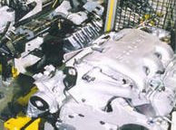

Industries and Standards
MathWorks solutions and services support a variety of different regulated industries and standards:
Civilian Aircraft
DO-178C ‘Software Considerations In Airborne
Systems And Equipment Certification’
Industrial Automation and Machinery
IEC 61508 'Functional Safety of Electrical / Electronic / Programmable Electronic Safety-Related Systems’
Automotive
ISO 26262 'Road Vehicles - Functional Safety‘
Railway
EN 50128 'Railway Applications - Software for Railway Control and Protection Systems'
Notes:
Here are some of the standards MathWorks support directly for software development and has certification kits for. This does not include other and indeed as we will see there are many other standards building on top
We support IEC 62304 since this refer to 61508 as a relevant functional safety standard.

Slide 4
Industries and Standards, cont’d
Code of Federal Regulation
Guidance Documents (SW specific)
21 CFR - Quality Systems Regulation (QSR)
Guidance for the Content of Premarket Submissions for Software Contained in Medical Devices (CDRH 337)
Part 7 – Design / Development / Manufacturing
Off-the-Shelf Software Use in Medical Devices
(CDRH 585)
Section 820.30 – Design Controls
General Principles of Software Validation
(CDRH 938)
Part 11 - Documentation
Computerized Systems Used in Clinical Trials
Cybersecurity for Networked Medical Devices Containing Off-the-Shelf Software
Additional/International Standards
ANSI/AAMI/IEC 62304: Software Life Cycle Processes
ISO 13485:2003
Quality management systems
ISO 14971:2007 Application of Risk Management to Medical Devices
AAMI TIR 36:2007
Validation of software for regulated processes
AAMI TIR 36:2007 Validation of software for regulated processes
IEC 60601-1
Medical Electrical Equipment (Requirements for Safety)
Notes:
Describe the landscape for the Quality Systems Regulation and the relation to standards such as IEC62304
[Need Help here]

Slide 5
Industries and Standards, cont’d IEC 62304 : Annex C.7: Relationship to IEC 61508
”IEC 61508 addresses 3 main issues:” … ”3) recommendation of techniques, tools and methods for software development” … ” Issue 3) is not addressed by this standard. Readers of the standard are encouraged to use IEC 61508 as a source for good software methods, techniques and tools, while recognising that other approaches, both present and future, can provide equally good results.”
Notes:
IEC62304 itself does not go into the details of software development but refer to other standards, naming IEC61508 as one such good source. With Simulink being providing a good workflow for certifying according to IEC 61508 this is something we can refer to for the verification for medical devices.
Our certification kit include these references
---
Quote from Annex C (Informative) Relationship to other standards
“C.7 Relationship to IEC 61508
The question has been raised whether this standard, being concerned with the design of
SAFETY-critical software, should follow the principles of IEC 61508. The following explains the
stance of this standard.
IEC 61508 addresses 3 main issues:
1) RISK MANAGEMENT life cycle and life cycle PROCESSES;
2) definition of Safety Integrity Levels;
3) recommendation of techniques, tools and methods for software development and levels of
independence of personnel responsible for performing different TASKS.
Issue 1) is covered in this standard by a normative reference to ISO 14971 (the MEDICAL DEVICE
sector standard for RISK MANAGEMENT). The effect of this reference is to adopt ISO 14971’s
approach to RISK MANAGEMENT as an integral part of the software PROCESS for MEDICAL DEVICE
SOFTWARE.
For issue 2), this standard takes a simpler approach than IEC 61508. The latter classifies
software into 4 “Safety Integrity Levels” defined in terms of reliability objectives. The reliability
objectives are identified after RISK ANALYSIS, which quantifies both the severity and the
probability of HARM caused by a failure of the software.
This standard simplifies issue 2) by disallowing consideration of probability of software failure
prior to classification. Classification into 3 software safety classes is based only on the severity
of that HARM caused by a failure. After classification, different PROCESSES are required for
different software safety classes: the intention is to further reduce the probability of failure of
the software.
Issue 3) is not addressed by this standard. Readers of the standard are encouraged to use
IEC 61508 as a source for good software methods, techniques and tools, while recognising that
other approaches, both present and future, can provide equally good results. This standard
makes no recommendation concerning independence of people responsible for one software
ACTIVITY (for example VERIFICATION) from those responsible for another (for example design).
In particular, this standard makes no requirement for an independent safety assessor, since
this is a matter for ISO 14971.”

Slide 6
High-Integrity Applications
Software-based systems that are designed and maintained such that they have a high probability of carrying out their intended function
cf. Buncefield Investigation Glossary www.buncefieldinvestigation.gov.uk/glossary.htm
Development of high-integrity applications is regulated by industry standards and guidelines (IEC 62304, IEC 61508, ISO26262, DO-178, ...)
Additional requirements on development processes
Confidence in the tools used
Conformance demonstration
Notes:
Original definition:
High integrity systems
Systems that are designed and maintained so that they have a high probability of carrying out their intended function. Safety instrumented systems having safety integrity levels in the range SIL1 to SIL4 are regarded as high integrity systems

Slide 7
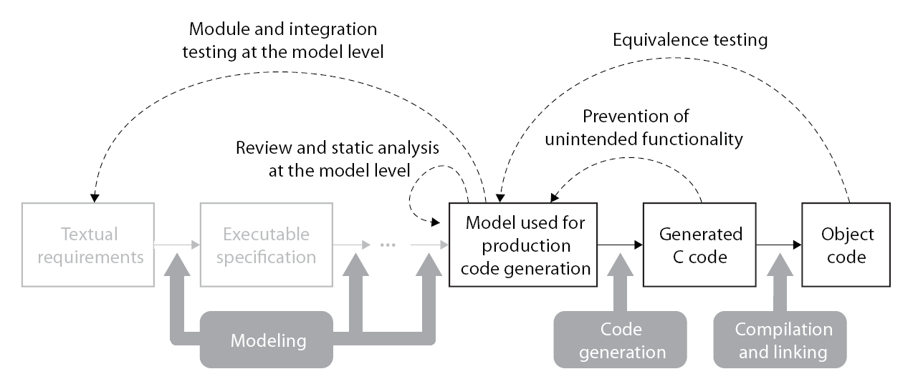
High Integrity Reference Workflow
Focusses on systematic verification and validation of models and generated code
Reviewed and approved by TÜV SÜD certification authority for IEC 61508
Notes:
Quality comes from the process not from the tools
„certifiable workflow“ that also improves the quality
Tool qual improves confidence but not neccessarily quality
- Tool Chain example (not all steps/tools are mandatory)
- Integrated tool chain, covering both Software development as well as verification and validation)

Slide 8
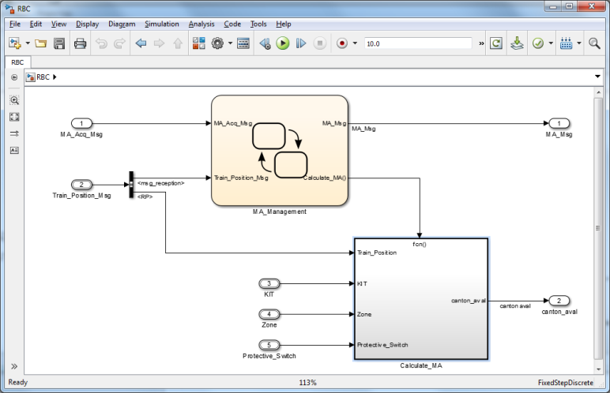
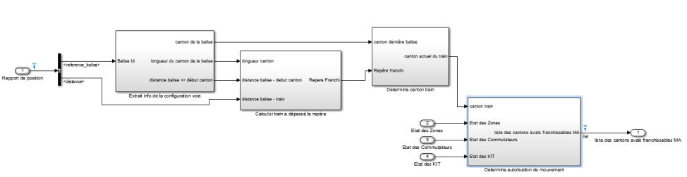
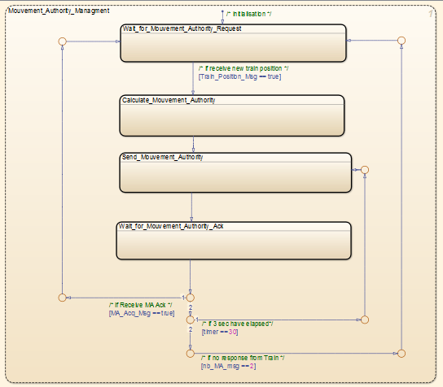
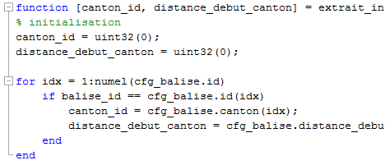

High Integrity Reference Workflow Software Lifecycle – Development Activities
Simulink / Stateflow / Simulink Fixed Point

Slide 9
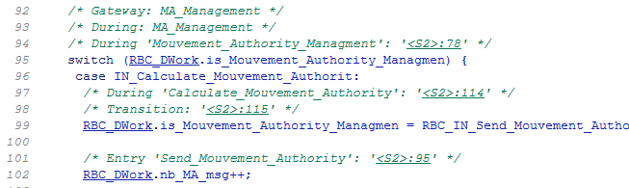
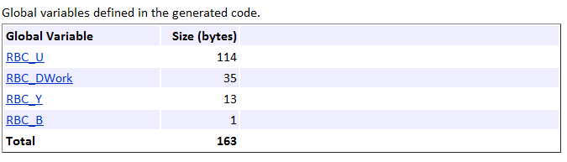
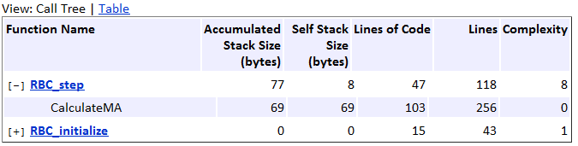
High Integrity Reference Workflow Software Lifecycle – Development Activities
Simulink / Stateflow / Simulink Fixed Point
MATLAB Coder / Simulink Coder / Embedded Coder

Slide 10
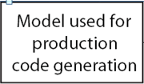
High Integrity Reference Workflow Software Lifecycle - V&V Activities
Design Verification
Code Verification
Discover design errors at design time
Gain confidence in the generated code

Slide 11
High Integrity Reference Workflow Software Lifecycle - V&V Activities
Golden Model
Design Verification
Code Verification
Carry out verification and validation – as much as feasible - at the model level
Automate implementation and code verification after "golden model" has been established

Slide 12

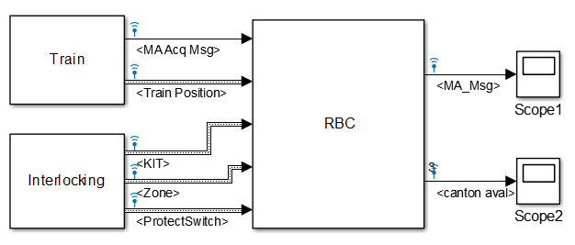
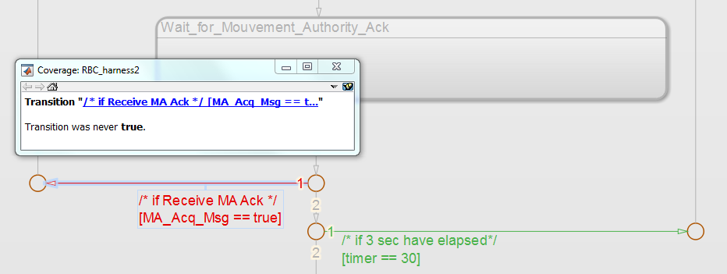
High Integrity Reference Workflow Software Lifecycle - V&V Activities
simulation
Simulink
Simulink VV
Model coverage
Design Verification

Slide 13
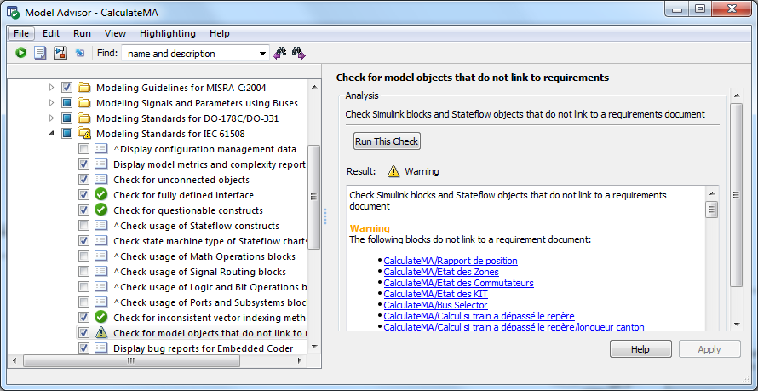
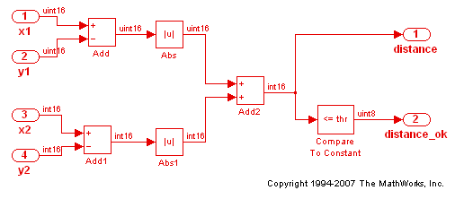
High Integrity Reference Workflow Software Lifecycle - V&V Activities
Simulink VV
Standard Conformance checking
Design Verification

Slide 14
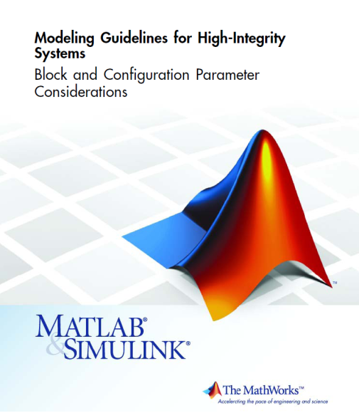
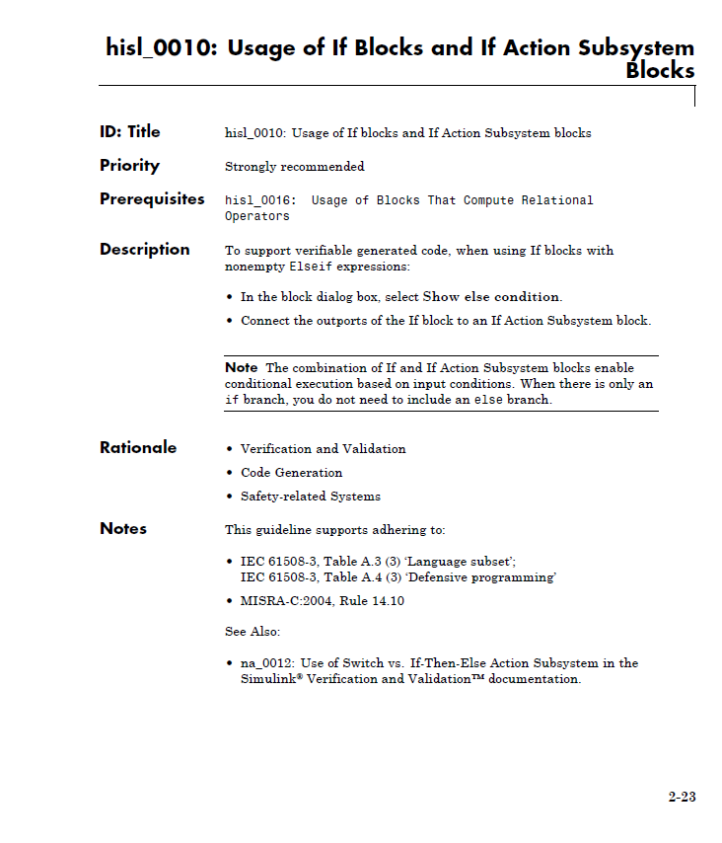
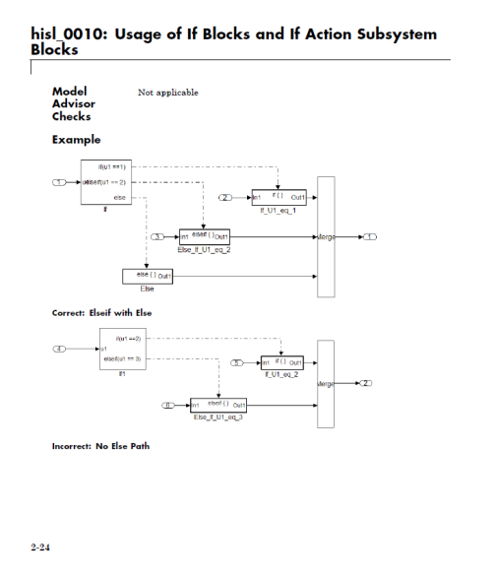
Modeling Guidelines for High-Integrity Systems
Challenge: Customers generating code for high-integrity systems often asked for modeling best practices; MAAB guidelines don‘t cover functional safety aspects.
Solution: Set of guidelines that leverage industry best practices and MathWorks tool expertise.
Improve integrity of models
Facilitates modeling standard / guidelines requirement of IEC 61508

Slide 15
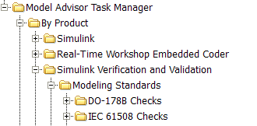
Modeling Guidelines Checking
Quickly identify issues at the model level that impede deployment in high-integrity applications or limit traceability
Benefits
Automated design reviews
Enhanced traceability
Seamless use of Embedded Coder and V&V products
Arbitrary Simulink / Stateflow models
Models for high-integrity aplications
Requires: Simulink Verification and Validation
Notes:
Motivations
A variety of requirements imposed by safety standards such as IEC 61508 (automotive, IAM, …) and DO-178B (aerospace) can be checked statically at the model level. Simulink Verification and Validation comes with a set of Model Advisor checks that facilitate compliance with these standards.
See press release http://www.mathworks.com/company/pressroom/articles/article17335.html
Doc Reference
See “IEC 61508 Checks Overview” and “DO-178B Checks Overview” sections in the Simulink Verification and Validation documentation
<New checks are not yet added to the product doc>
Demo
rtwdemo_iec61508.mdl; rtwdemo_iec61508_script.m
Limitations
Checks can only ensure partial compliance with the safety standards (some properties cannot be checked automatically, some checks don't cover all edge cases). Some language subsets such as Embedded MATLAB are uncovered.
Usage Restriction fields definitions
“ " remove restriction once release shipping
“only for prerelease end users" at prerelease
"confidential per NDA" - for any use prior to pre-release

Slide 16
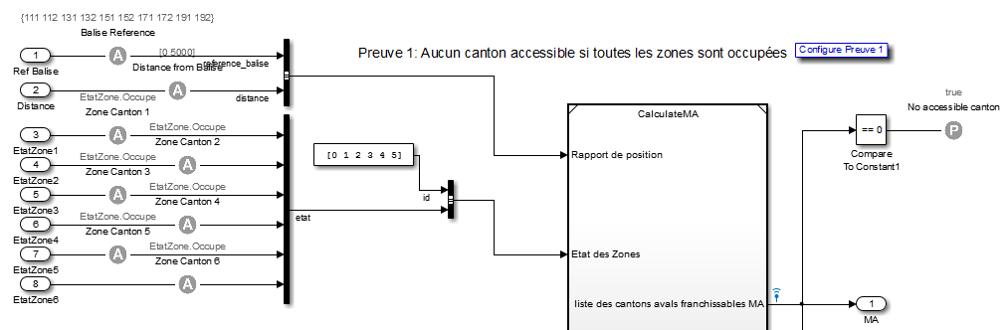
High Integrity Reference Workflow Software Lifecycle - V&V Activities
Simulink VV
Simulink Design Verifier
Prove
Design Verification

Slide 17
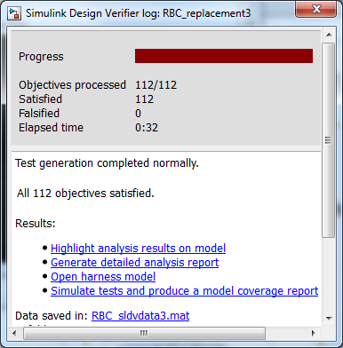
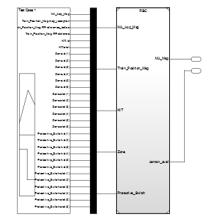
High Integrity Reference Workflow Software Lifecycle - V&V Activities
Test Generation for 100% model coverage
Simulink Design Verifier
Code Verification

Slide 18
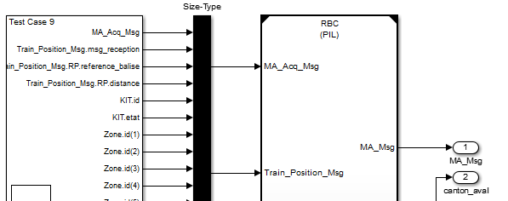
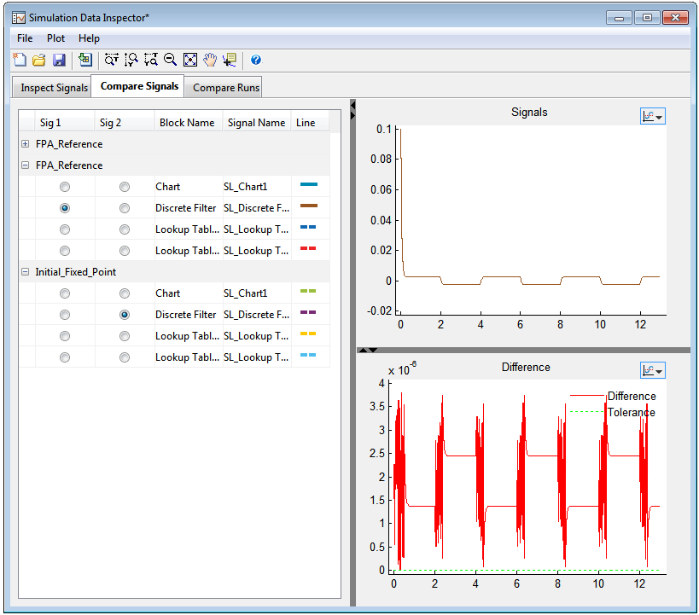
High Integrity Reference Workflow Software Lifecycle - V&V Activities
Simulink Design Verifier
Embedded Coder
SIL/PIL Testing
Code Verification
Numerical equivalence

Slide 19
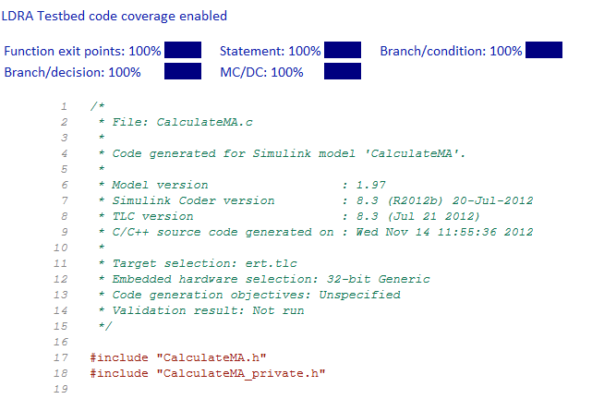
High Integrity Reference Workflow Software Lifecycle - V&V Activities
Simulink VV
Embedded Coder
Assess Code Coverage
Code Verification

Slide 20
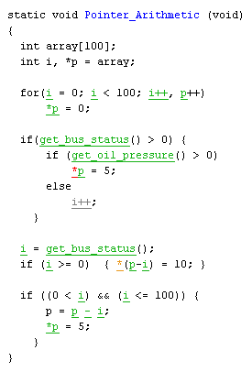
High Integrity Reference Workflow Software Lifecycle - V&V Activities
Simulink VV
Embedded Coder
Prove absence of run-time error
Green: reliable
Polyspace
Proven
Red: faulty
Grey: dead
Code Verification
Orange: unproven

Slide 21
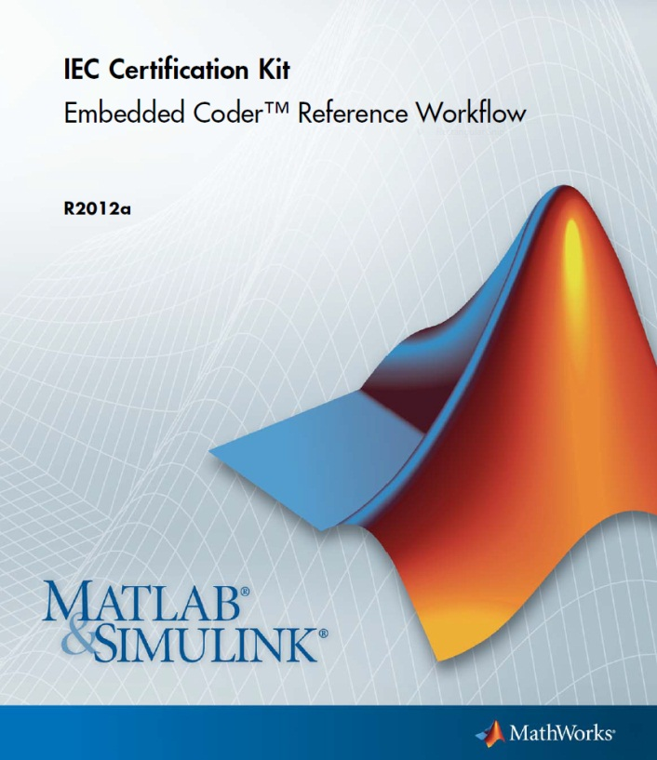
High Integrity Reference Workflow Documentation
Reference workflow document ships with the IEC Certification Kit product

Slide 22
High-Integrity Applications
Software-based systems that are designed and maintained such that they have a high probability of carrying out their intended function
cf. Buncefield Investigation Glossary www.buncefieldinvestigation.gov.uk/glossary.htm
Development of high-integrity applications is regulated by industry standards and guidelines (IEC 62304, IEC 61508, ISO26262, DO-178, ...)
Additional requirements on development processes
Confidence in the tools used
Conformance demonstration
Notes:
Original definition:
High integrity systems
Systems that are designed and maintained so that they have a high probability of carrying out their intended function. Safety instrumented systems having safety integrity levels in the range SIL1 to SIL4 are regarded as high integrity systems

Slide 23
EN 50128 Support Tools and Languages (Clause 6.7)
Objectives
Provide evidence that potential failures of tools do not adversely affect the integrated toolset output in a safety related manner that is undetected by technical and/or organizational measures outside the tool.
When tools are being used as a replacement for manual operations, the evidence of the integrity of tools output can be adduced by the same process steps as if the output was done in manual operation. These process steps might be replaced by alternative methods if an argumentation on the integrity of tools output is given and the integrity level of the software is not decreased by the replacement.
Notes:
Refer to 61508-3 and/or the QSR – Quality System Regulations, part of the entire lifecycle rather than just SW development
This is TBD

Slide 24

Certification of MathWorks Products
Embedded Coder, Simulink Design Verifier, Simulink Verification and Validation, and Polyspace are certified by TÜV SÜD as suitable for use to develop safety-related software acc. to IEC 61508
☑
Simulink Design Verifier
☑
Simulink Verification and Validation
☑
PolySpace Verifier for C/C++
Embedded Coder
☑
Note: Embedded Coder, Simulink Design Verifier, Simulink Verification and Validation, and Polyspace products for C/C++ were not developed using certified processes
Notes:
Reefernce weorkflow can be utilized as use case documentation

Slide 25
IEC 61508 Tool Classification of MathWorks Products
Product | IEC 61508 Tool Class | Definition
Embedded Coder | T3 | Tool generates outputs which can directly or indirectly contribute to the executable code (including data) of the safety related system
Simulink Verification and Validation | T2 | Tool supports the test or verification of the design or executable code, where errors in the tool can fail to reveal defects but cannot directly create errors in the executable software
Simulink Design Verifier
Polyspace Client for C/C++ Polyspace Server for C/C++

Slide 26
High-Integrity Applications
Software-based systems that are designed and maintained such that they have a high probability of carrying out their intended function
cf. Buncefield Investigation Glossary www.buncefieldinvestigation.gov.uk/glossary.htm
Development of high-integrity applications is regulated by industry standards and guidelines (IEC 62304, IEC 61508, ISO26262, DO-178, ...)
Additional requirements on development processes
Confidence in the tools used
Conformance demonstration
Notes:
Original definition:
High integrity systems
Systems that are designed and maintained so that they have a high probability of carrying out their intended function. Safety instrumented systems having safety integrity levels in the range SIL1 to SIL4 are regarded as high integrity systems

Slide 27
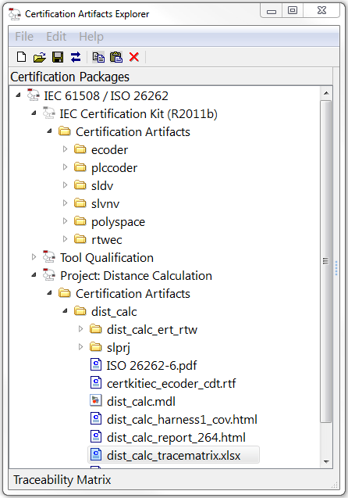
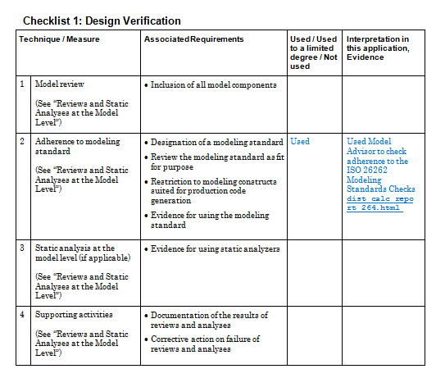
Compliance Demonstration
Notes:
Put in here a mapping of the stages of the development process and artifacts gathered. Finalize with a table of all of the artifacts proving the evidence of running it.

Slide 28
Compliance Demonstration Coverage of IEC61508 Techniques / Measures
Table A. 4 Software Design and Development – Detailed Design
 | Technique/Measure | SIL 1 | SIL 2 | SIL 3 | SIL 4 | Applicable Model-Based Design Tools and Processes | Comments
1a. | Structured methods | HR | HR | HR | HR | Simulink – Subsystems, model blocks | Simulink supports software detailed design using structured methods. Subsystem blocks and Model blocks can be used to structure such models.
1b. | Semi-formal methods | R | HR | HR | HR | Table B. 7
1c. | Formal design and refinement methods | - | R | R | HR | Simulink – Model Verification block library | Model Verification blocks can be used to formalize software safety requirements and other model properties.
2. | Computer-aided design tools | R | R | HR | HR | Simulink product family | The Simulink product family supports computer-aided specification and design.
3. | Defensive programming | - | R | HR | HR | Simulink Stateflow Simulink - Modeling Guidelines for High-Integrity Systems | Defensive programming can be implemented in Simulink and Stateflow. Modeling Guidelines for High-Integrity Systems guidelines facilitate defensive programming at the model level.
4. | Modular approach | HR | HR | HR | HR | Table B. 9
5. | Design and coding standards | R | HR | HR | HR | Table B. 1
6. | Structured programming | HR | HR | HR | HR
Notes:
Example of the mapping that is provided in the cert kit for all of the tables of the IEC61508 standard.

Slide 29
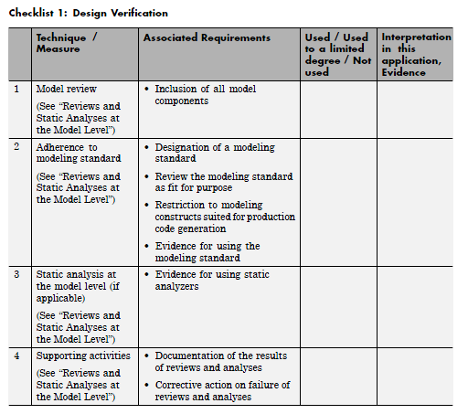
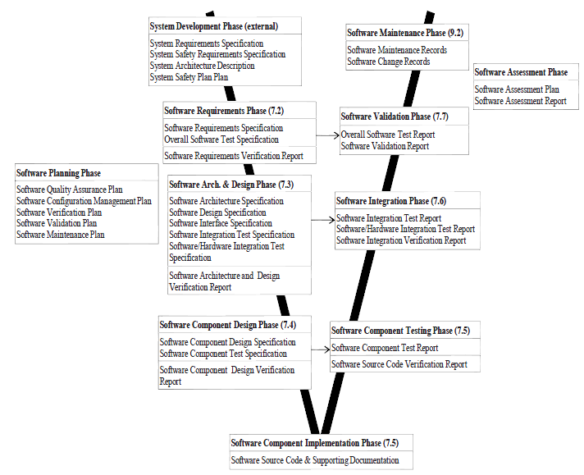
Compilation of Safety Case
Progressively compile documents and work products generated during the safety lifecycle
Checklists
Safety Case
Safety Case Artifacts
Notes:
System certification involves/requires a compliance demonstration
All documents generated together compiles the completed safety case

Slide 30
Conclusion
IEC61508 provides a good source for developing to IEC62304
Development of high-integrity applications with Model-Based Design that need to be compliant with IEC 61508 requires:
Additional requirements on development processes
Addressed by a Reference workflow for models & generated code
Confidence in the tools used
Addressed by tools certified by TÜV SÜD that are suitable for use to develop safety-related software acc. to IEC 61508
Conformance demonstration
Addressed by the IEC Certification Kit with templates and artifacts that support standard conformance demonstration
Workflow, tools and Certification Kit artifacts have been accessed by the independent authority TÜV Süd

Slide 31

MathWorks
Thank you!
Change the world by
Accelerating the pace
of discovery, innovation, development, and learning
in engineering and science

