Slide 1
Using Simulink for Software design
Kristian Lindqvist

Slide 2
Agenda
Project and configuration management
Simulink and software architecture
Automated documentation and report generation

Slide 3
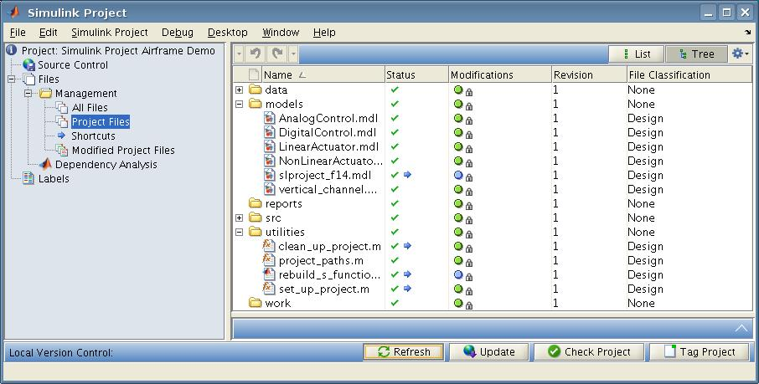
Project and Configuration Management with Simulink Projects
Source Control
Repository
Adapter
New feature for collaborative work
Defining project and activities
Using Simulink for configuration management
Integrating version control systems
Notes:
Simulink project allow defining of the project files including dependency analysis
Common activities can be shown easily as shortcuts simplifying a common workflow
Project files can have classifications and review status allowing to use Simulink for configuration management
External version control systems are supported through adapters, Subversion is supported in 11b, other can be developed through a SDK.

Slide 4
Project and Configuration Management in Model-Based Design
Single User
Single Model
Notes:
The very centre of this diagram is where we started. A single user doing stuff. Not many files, probably not a huge model. People now use the tools in ways and in environments unimagined when Simulink was first created. Our tools have to continuously evolve to meet the ever-changing needs of the people who use them.
Technology wise, we think this is pretty well understood…

Slide 5
Project and Configuration Management in Model-Based Design
Advanced Single User
Single User
Multiple Models
Environment
settings
Data Files
Libraries
Single Model
Path
Export
Revision Control
Utilities
Reproducibility
Notes:
Show the next layer – “advanced single user”; “single user perhaps in a production environment”. I’m going to show you some new stuff here that we think makes the issues in this ring a lot easier to handle. Anything that the single user requires is sub set of the features that the advanced user requires – aim not to break the work flow of the inner part with features for the outer part.
New features have to be optional
Not break workflow of less complex set-ups
ALWAYS HAVE TO MINDFUL OF THE USER WHO JUST WANTS TO QUICKLY TRY SOMETHING OUT
Talk through each item, cross-linking. A good flow is single model became multiple models, probs libs, environment ML path cos care abt reproducibiity, so probs also using RC. Working alone but ultimately have to export…
Features required by single-user & small teams
Well understood
Mature technology in MathWorks tools
So what happens when a set of single users becomes a team?

Slide 6
Project and Configuration Management View in Model-Based Design
Advanced Single User
Large Projects
Single User
Model
Sharing
Team
Multiple Models
Reuse
Interface
Definition
Environment
settings
Data Files
Project
Sharing
Shared
Libraries
Libraries
Single Model
Path
Export
Revision Control
Configuration
Management
Variants
Utilities
Common
Environments
Reproducibility
Requirements
Parallel
Development
Notes:
So what happens when a set of single users becomes a team?
as you might imagine, more technologies become important. Still building, not replacing features inside the onion
RC has become CM
Export has become model sharing, parallel developing, reuse
For those we need to worry about interface definition, shared libraries, common environments…
Features for Teams
Believe many large organization operate at this level
Requirements understood
Various states of maturity
Some off-the-shelf within MathWorks tools
All have been implemented via customization/add-ons to MathWorks tools
But the world doesn’t stop at the level of a single team…

Slide 7
Multiple Teams
Advanced Single User
Team
Change Request
Management
Single User
Corporate
Database
Large Projects
Model
Sharing
PLM
Multiple Models
Reuse
Interface
Definition
Environment
settings
Data Files
Project
Sharing
Shared
Libraries
Libraries
Single Model
Path
Export
Revision Control
Configuration
Management
Variants
Utilities
Common
Environments
Reproducibility
Requirements
Parallel
Development
Notes:
We can keep expanding this diagram…
BUT… HERE’S OUR APPROACH TO THIS AREA
We’re aiming to walk before we try to run. If we can’t make things work ok for a single user then we can’t hope to solve the team problem. We’re not going to make life hard for the single user.
That’s not to say we’re going to only focus on things in the Single Team ring – e.g. CM – only once everything in the single user ring in complete. Not at all. And you can influence the prioritization with voting and feedback during MAB. If you just want us to work on a slice, then tell us, but remember that we’re unlikely to start on an interface to PLM before getting the single team stuff working unless you can show us a strong need.
Features for Multiple Teams
Requirements not yet fully understood

Slide 8
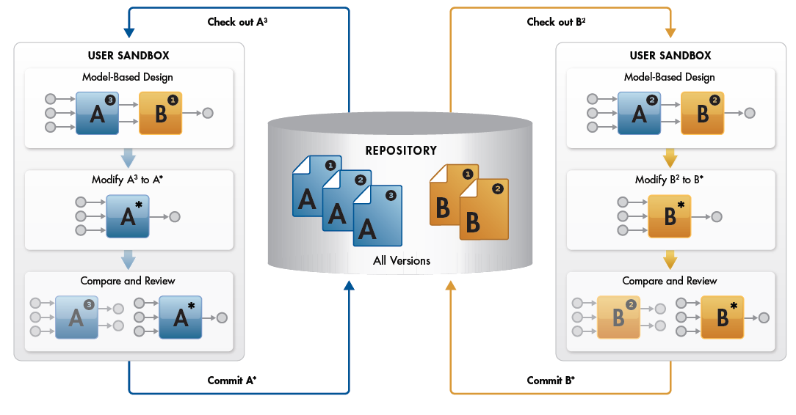
Collaborative Workflow in Model-Based Design
Notes:
Another view; with Simulink Projects, we can stay within a common tool chain to complete all activities of a collaborative workflow. With this, we can increase productivity
We standardize the environment for the project

Slide 9
Demo: Introduction to Door Lock System
Notes:
-Open project
-Show projects view
-Show the requirements document
-Open DLS_Controller_SW
-Open up to show submodels

Slide 10
Simulink and software architecture - Architecture Component Management
Subsystems
Libraries
Atomic systems
Model Reference (Model Block)
Buses
Variants
Notes:
Todo: Add section on positioning for model reference and libraries

Slide 11
Demo: Model architecture
Modules/Units: Referenced Models
Integration model: Top Model
Requirements based unit tests
Integration test
Variants: Variant Models
Notes:
Go back to DLS_Controller_SW
Open up the units and their test harnesses
Show the integration test on the highest level
Show Variants using the Airbag variant parameter

Slide 12
Model Reference
Table 3 − Principles for Software Architectural Design
Methods |  | ASIL |  |  |  | Applicable Model-Based Design Tools and Processes
 |  | A | B | C | D
1a | Hierarchical structure of software components | ++ | ++ | ++ | ++ | Simulink – Model block, Ports & Subsystems block library Stateflow
 |  |  |  |  |  | Simulink – Model Dependency Viewer
 |  |  |  |  |  | Embedded Coder
1b | Restricted size of software components | ++ | ++ | ++ | ++ | Simulink Stateflow Embedded Coder
 |  |  |  |  |  | Simulink Verification and Validation – ISO 26262 checks
Notes:
NOTE An appropriate compromise of the methods listed in Table 4 is to be selected since the methods are not
necessarily mutually exclusive.
7.4.4 The software architectural design shall be developed down to the level where the software units,
which are to be treated as indivisible, are identified.

Slide 13
Model Reference cont’d
Table 3 − Principles for Software Architectural Design
Methods |  | ASIL |  |  |  | Applicable Model-Based Design Tools and Processes
 |  | A | B | C | D
1c | Restricted size of interfaces | ++ | ++ | ++ | ++ | Simulink Verification and Validation – ISO 26262 checks
1d | High cohesion with software components | + | + | + | +
1e | Restricted coupling between software components | + | ++ | ++ | ++
Notes:
Using Simulink with a suitable Modeling Standard can be a very efficient way of implementing a good software architecture.
Interface size can be checked
High Cohesion (Encapsulated Functionality) is very natural in Simulink since the couping via e.g. global data is restricted.
Restricted Coupling is natural since all global interfaces has to be declared and could be avoided to a large extent (modeling standard could say these should be minimized/avoided).

Slide 14
Model Reference
Model block lets you specify a model name and parameters
Model is in a separate file – good for Configuration Management
Double click to open / edit model similar to an atomic subsystem
Incremental loading, update diagram, and code generation. Change contents of one model, generate code for just that model.
Includes a conversion tool for decomposing existing models
Permits multiple users to work on application in modular partitioning tied to models
Each model reference component is locked down regarding data types, dimension, scaling, etc
Permits each module to be individually verified and locked down

Slide 15
Automated Documentation – Report Generation
Use model to handle documentation information
DocBlock
ModelInfo
Generate documentation from model
Custom reports using Simulink Report Generator
Example: System Design Description
Notes:
The model can be used to maintain design information, using DocBlocks and ModelInfo. This can then be used to generate documentation as a combination of the natural text and high-level block information
The System Design Description is a generic example that ships with the product

Slide 16
Doc Block & Model Info block
Table 2 − Notations for Software Architectural Design
Methods |  | ASIL |  |  |  | Applicable Model-Based Design Tools and Processes
 |  | A | B | C | D
1a | Informal notations | ++ | ++ | + | + | Simulink – Model Info and DocBlock blocks Simulink Verification and Validation – System Requirements block
 |  |  |  |  |  | Simulink Verification and Validation – Requirements Management Interface (RMI)
1b | Semiformal notations | + | ++ | ++ | ++ | Simulink Stateflow
Notes:
Informal notations should be used to capture design information, these can be contributed using ModelInfo and DocBlocks.
Semiformal notations are provided using modeling architecture elements such as bus objects, model reference blocks and atomic subsystems.
A complete compiled system model could potentially consistute a formal description of the software architecture.
7.4 Requirements and recommendations
7.4.1 To ensure that the software architectural design captures the information necessary to allow the
subsequent development activities to be performed correctly and effectively, the software architectural design
shall be described with appropriate levels of abstraction by using the notations for software architectural
Design listed in Table 2.

Slide 17
DocBlock & Model Info block
Table 7 − Notations for Software Unit Design
Methods |  | ASIL |  |  |  | Applicable Model-Based Design Tools and Processes
 |  | A | B | C | D
1a | Natural language | ++ | ++ | ++ | ++ | Simulink – Model Info block, DocBlock block Simulink Verification and Validation – System Requirements block
 |  |  |  |  |  | Simulink Verification and Validation – Requirements Management Interface (RMI)
1b | Informal notations | + | ++ | ++ | ++ | Simulink – Model Info block, DocBlock block Simulink Verification and Validation – System Requirements block
 |  |  |  |  |  | Simulink Verification and Validation – Requirements Management Interface (RMI)
1c | Semiformal notations | + | ++ | ++ | ++ | Simulink Stateflow
Notes:
For unit design, docblocks should be used to enter design information in natural language into the model.
Additionally, Informal notations can be contributed by adding traceability information through the RMI.
Semiformal notations are contributed using Simulink and Stateflow design elements.
8.4 Requirements and recommendations
8.4.1 To ensure that the software unit design captures the information necessary to allow the subsequent
development activities to be performed correctly and effectively, the design shall be described using the
notations listed in Table 8.

Slide 18
Report Generation
Table 6 − Methods for Verification of Software Architectural Design
Methods |  | ASIL |  |  |  | Applicable Model-Based Design Tools and Processes
 |  | A | B | C | D
1a | Walkthrough of the design | ++ | + | o | o | Simulink Simulink Report Generator™ − Web View, System Design Description (SDD) report
1b | Inspection of the design | + | ++ | ++ | ++ | Simulink Simulink Report Generator™ − Web View, System Design Description (SDD) report
 |  |  |  |  |  | Simulink Verification and Validation – Model Advisor checks
Notes:
Report Generation can also be used heavily to support review activities, more focus on model review in the following section

Slide 19
Summary:
We have seen:
Simulink projects for
Collaborative design
Configuration management
Dependency analysis
Model reference for architectural components
Automated documentation

