Slide 1
Design verification
Kristian Lindqvist

Slide 2
Agenda
Model Review
Modeling Standards
Static analysis
Module and Integration Testing
Requirements traceability
Model Coverage
Notes:
We will go through the steps in the design verification process, show how automation can be applied and how information can be collected to show evidence of the activities.

Slide 3
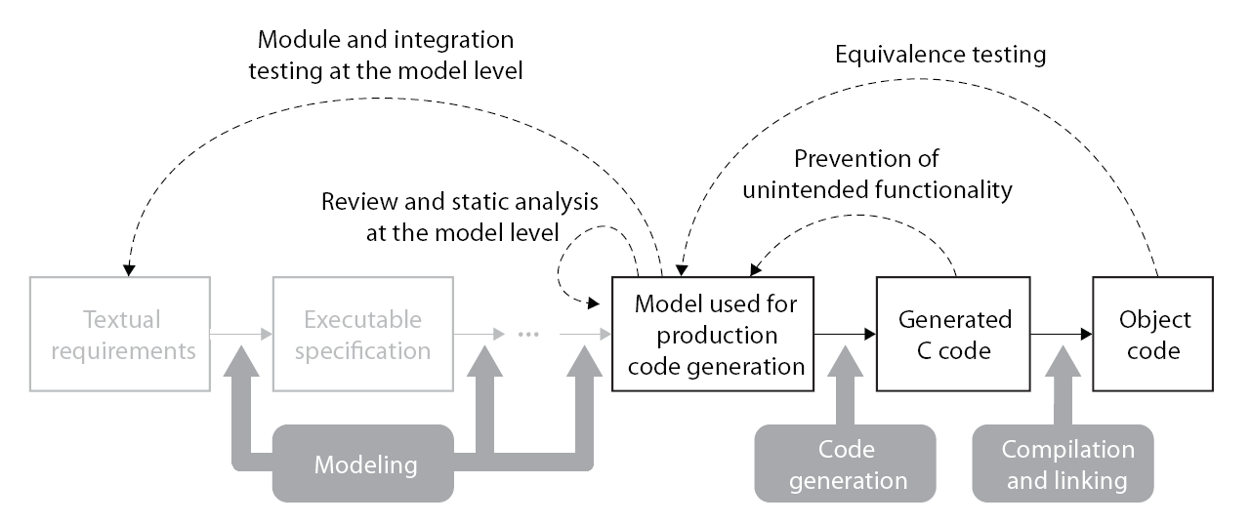
ISO 26262 Reference Workflow Model Review
Model Verification
Code Verification
Discover design errors at design time
Gain confidence in the generated code
Notes:
We will start with the Review and Staic analysis part.

Slide 4
Model Review
We can support the review activity with
Report generation
Static analysis
Modeling standards

Slide 5
Model Review
Table 6 − Methods for Verification of Software Architectural Design Table 9 − Methods for Verification of Software Unit Design and Implementation
Methods |  | ASIL |  |  |  | Applicable Model-Based Design Tools and Processes
 |  | A | B | C | D
1a | Walkthrough of the design | ++ | + | o | o | Simulink Simulink Report Generator™ − Web View, System Design Description (SDD) report
1b | Inspection of the design | + | ++ | ++ | ++ | Simulink Simulink Report Generator™ − Web View, System Design Description (SDD) report
 |  |  |  |  |  | Simulink Verification and Validation – Model Advisor checks
1c | Semiformal verification | + | + | ++ | ++ | Simulink
Notes:
Within ISO26262 this is related to tables 9 and 6, which are very similar
Walkthrough for lower integrity levels and
Inspection for higher levels.
Tables 6 and 9 directly appreciate the model level as a fully approriate review level.
Tables 6 and 9 has further implications on the code side which we will discuss in the section on verification of generated code.

Slide 6
System Design Description
Report generation can be used to report on:
Added text description
Graphical modeling elements
Model and block settings
Properties of data being used
…
Demo: s1_createSDD

Slide 7
Web View
Simulink Report Generator generates an SVG representation of the model
Demo: s2_createWebView
Notes:
This can be both valuable to facilitate modeling review activities but it is also a way to store a mdoel in a readable format that does not require MATLAB to ocmpute. E.g. for long term maintenance requirements.

Slide 8
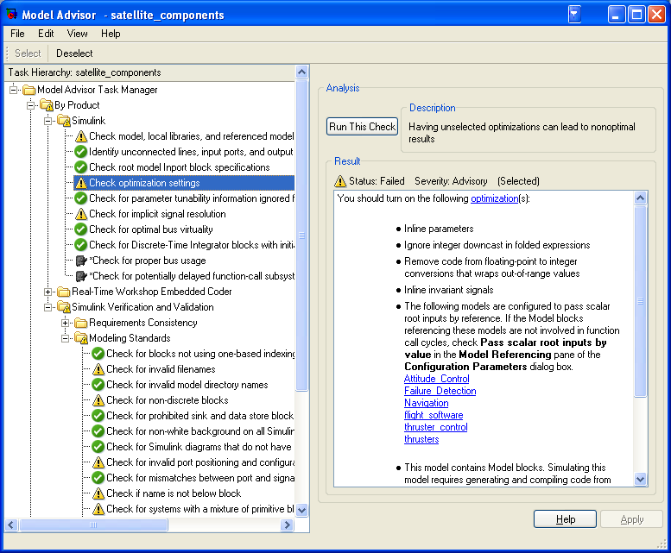
Modeling Standards Checking Overview
Static analysis of models against a set of checks
Checks for simulation
Checks for code generation
Checks for Modeling Standards
Simulink Verification And Validation
Set of checks for a group of MAAB Style Guidelines
Set of checks for DO-178B and ISO 26262
Extensibility API
Demo: s3_runMAChecks
Model Advisor Interface
Notes:
Modeling Standards are key to maintaining high quality models. It can be enforced by automation using the Model Advisor.
There are specific checks for standards available through Simulink Verification and Validation.
Run the demo and also show the configuration of checks using the standard MA gui.

Slide 9
Model Review Demo
A model review is a manual step!
But should be supported by automation
Demo: s4_createModelReviewReport
Notes:
The model review itself is manual still, we should review the generated artifacts if non qualified tools are used.
The review can be facilitated by generation of the review protocol, in this example we generate a summary of the available reports hyperlinked.

Slide 10
Conformance Demonstration Model Review
Checklist 1: Design Verification
Technique / Measure |  | Associated Requirements | Used / Used to a limited degree / Not used | Interpretation in this application, Evidence
1 | Model review (See “Reviews and Static Analyses at the Model Level”) | Inclusion of all model components | Used | Model Inspection Reviews conducted using System Design Description reports and SL Web View reports. This is done for component and system models. The reports on the system level models reference all sub-components included in the design, ensuring a trace across all components. Reports stored at: $(ProjectRoot)\iso26262package\WorkProducts\ModelReview Review records not developed for this example.
Notes:
Now, what have we provided?
We are now able to fill in the first part of the CDT, we have provided the SDD and the web view to use in inspection.
We will fill in the CDT throughout this and the following section to have it completed at the end of the workshop!

Slide 11
Conformance Demonstration: Adherence to Modeling standard
Checklist 1: Design Verification
Technique / Measure |  | Associated Requirements | Used / Used to a limited degree / Not used | Interpretation in this application, Evidence
2 | Adherence to modeling standard (See “Reviews and Static Analyses at the Model Level”) | Designation of a modeling standard Review the modeling standard as fit for purpose Restriction to modeling constructs suited for production code generation Evidence for using the modeling standard | Used | MAAB Guidelines and High-Integrity Guidelines both designated as modeling standards for this project. <Link> <Link> Modeling standard review record not developed for this example. Modeling constructs restricted by the Model Advisor check “By Task > Modeling Standards for ISO 26262 > Check for questionable constructs” Model advisor reports accessible via link in $(ProjectRoot)/ModelReview/*_mrd.html
Notes:
We have automatically checked for the modeling standard

Slide 12
Conformance Demonstration: Adherence to Modeling standard
Checklist 1: Design Verification
Technique / Measure |  | Associated Requirements | Used / Used to a limited degree / Not used | Interpretation in this application, Evidence
3 | Static analysis at the model level (if applicable) (See “Reviews and Static Analyses at the Model Level”) | Evidence for using static analyzers | Used | Model advisor configuration used as described in IEC Certification Kit.
Notes:
We have also used the Model Advisor to run static analysis on the model

Slide 13
Agenda
Model Review
Modeling Standards
Static analysis
Module and Integration Testing
Requirements traceability
Model Coverage
Notes:
Now lets move on towards testing

Slide 14
ISO 26262 Reference Workflow Module and Integration Testing
Model Verification
Code Verification
Discover design errors at design time
Gain confidence in the generated code
Notes:
- Tool Chain example (not all steps/tools are mandatory)
- Integrated tool chain, covering both Software development as well as verification and validation)
TODO: Fix color schemes

Slide 15
Module and Integration Testing Test Scenario
Open-loop module tests
Coverage measurement
Closed-loop integration tests
Requirements-based testing using the signal builder block
Notes:
In testing, we have focused on testing of modules as the formal activity using requirements based testing and measuring coverage.
The integration tests are closed-loop and focus on integration and non-functional requirements
We will see how the signal builder block can be used to trace requirements to tests

Slide 16
Module Testing
Table 10 − Methods for Software Unit Testing
Methods |  | ASIL |  |  |  | Applicable Model-Based Design Tools and Processes
 |  | A | B | C | D
1a | Requirements-based test | ++ | ++ | ++ | ++ | Simulink Verification and Validation − Requirements Management Interface (RMI) IEC Certification Kit − Traceability matrix Simulink − Signal Builder block Stateflow – Dynamic test vector charts Simulink Verification and Validation − Component testing capabilities
1b | Interface test | ++ | ++ | ++ | ++ | Simulink Design Verifier − Test case generation
1c | Fault injection test | + | + | + | ++ | Simulink Stateflow Simulink Design Verifier − Test case generation
Notes:
Table 10 show that tests can have multiple sources,
Some should be derived from analysing the requirements, others may be generated from the interface specification or be based on fault injection.

Slide 17
Module Testing
Table 11 − Methods for deriving test cases for software unit testing
Methods |  | ASIL |  |  |  | Applicable Model-Based Design Tools and Processes
 |  | A | B | C | D
1a | Analysis of requirements | ++ | ++ | ++ | ++ | Simulink Verification and Validation − Component testing capabilities
1b | Generation and analysis of equivalence classes | + | ++ | ++ | ++ | Simulink Design Verifier − Test case generation
1c | Analysis of boundary values | + | ++ | ++ | ++ | Simulink Design Verifier − Test case generation
Notes:
Table 11 further indicate where the tests should be derived from, analysis of requirements and generation of tests according to the model interface are straightforward use cases.
SLDV model Test Objective block could be used to analyse equivalence classes (invariant properties in the model) that could be satisfied by test generation.

Slide 18
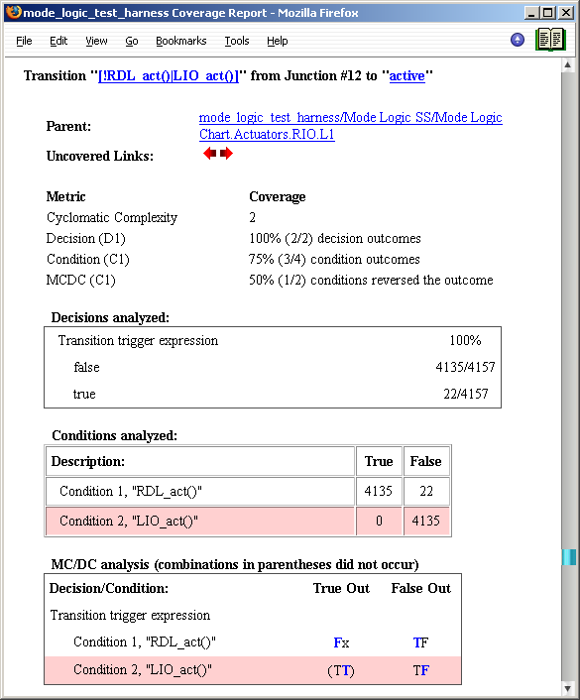
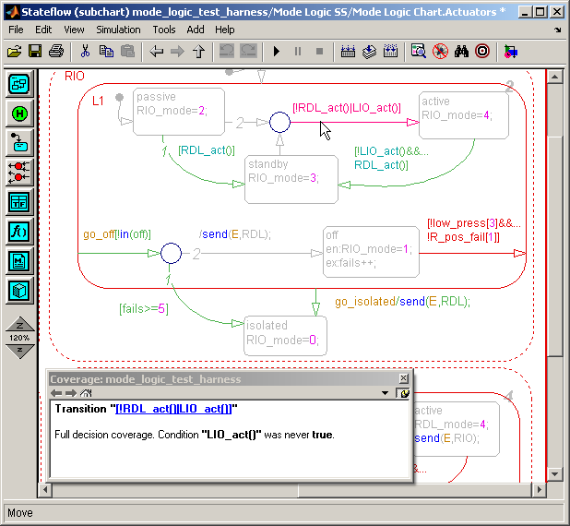
Model Coverage Measure of test completeness
Execution analysis
Based on the model structure
Dynamic – data collected during simulation
Coverage results
Displayed directly in the model
Available in a separate html report linked with the model objects
Supports:
Simulink
Stateflow
Embedded MATLAB
Decision coverage
Condition coverage
MC/DC
Lookup table coverage
Signal range coverage
Supported coverage types
Notes:
For model based design, ISO26262 directly appreciate analysis of model coverage using analoguous measures of structural coverage

Slide 19
Module Testing
Table 12 − Structural Coverage Metrics at the Software Unit Level
Methods |  | ASIL |  |  |  | Applicable Model-Based Design Tools and Processes
 |  | A | B | C | D
1b | Branch coverage | + | ++ | ++ | ++ | Simulink Verification and Validation − Model coverage analysis Simulink Design Verifier − Test case generation
Notes:
During model testing, Simulink Verification and Validation can collect decision coverage (also known as branch coverage) at the model level.
Simulink Design Verifier can generate test cases that satisfy decision coverage at the model level.

Slide 20
Demo: s5_runModelTests
Module Testing
Notes:
Run the module test short-cut for the modules in the F_Actuator_Ctrl

Slide 21
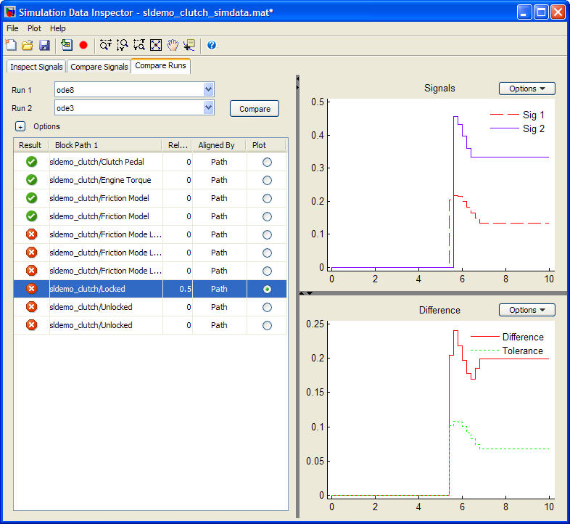
Tool highlight: Simulation Data Inspector
Quickly compare results for multiple simulation runs and create reports
View and compare data from multiple simulations
Validate the generated code against simulation
Import external data for comparison with simulation data
Notes:
Lets go back and have

Slide 22
Requirements Traceability Simulink Verification and Validation
Traceability analysis of models relative to
System requirements
Design descriptions
Interface specifications
Change requests
Defect reports
Standards and Certification
CMMI / SPICE
DO-178B
IEC 61508 / ISO 26262
In product
Link editor
Support for DOORS, Word, Excel, PDF, URL
Model highlighting
Reporting
Customization API
Notes:
With the requirements management interface, we can simply lnking of requirement and support standard activities such as report generation. Requirements may be traced to design or test cases.
In ISO26262, one main activity is to

Slide 23
Software Integration Testing
Table 13 − Methods for Software Integration Testing
Methods |  | ASIL |  |  |  | Applicable Model-Based Design Tools and Processes
 |  | A | B | C | D
1a | Requirements-based test | ++ | ++ | ++ | ++ | Simulink Verification and Validation − Requirements Management Interface (RMI)
 |  |  |  |  |  | IEC Certification Kit − Traceability matrix
 |  |  |  |  |  | Simulink Signal Builder block Stateflow − Dynamic test vector charts
 |  |  |  |  |  | Simulink Verification and Validation − Component testing capabilities
1b | Interface test | ++ | ++ | ++ | ++ | Simulink Design Verifier − Test case generation
1c | Fault-injection test | + | + | ++ | ++ | Simulink Stateflow
Notes:
This is very similar to the module level testing, only here it is higher level testing.

Slide 24
Software Integration Testing
Table 14 − Methods for deriving test cases for Software Integration Testing
Methods |  | ASIL
 |  | A | B | C | D
1a | Analysis of requirements | ++ | ++ | ++ | ++
1b | Generation and analysis of equivalence classes | + | ++ | ++ | ++
1c | Analysis of boundary values | + | ++ | ++ | ++
Table 15 − Structural Coverage Metrics at the Software Architectural Level
Methods |  | ASIL |  |  |  | Applicable Model-Based Design Tools and Processes
 |  | A | B | C | D
1a | Function coverage | + | + | ++ | ++ | Embedded Coder − Code coverage collection
1b | Call coverage | + | + | ++ | ++ | Embedded Coder − Code coverage collection
Notes:
Structural coverage metrics are different at the integration level, here the focus is on function and call coverage.
Completeness of the testing should be evaluated towards the metrics in table 15
During SIL simulation, Embedded Coder can collect function coverage information by using the third-party tool BullseyeCoverage.
During SIL simulation, Embedded Coder can collect procedure/function call coverage information by using the third-party tool LDRA Testbed.

Slide 25
Demo: RunIntegrationTest DoorLockTraceabilityReport
Notes:
Integration testing can be applied for DLS_Controller_SW
The traceability to requirements can be evaluated by the analysis done through a custom report as seen in this example…

Slide 26
Conformance Demonstration: Module and Integration Testing
Checklist 1: Design Verification
Technique / Measure |  | Associated Requirements | Used / Used to a limited degree / Not used | Interpretation in this application, Evidence
5 | Module and integration testing at the model level (See “Module and Integration Testing at the Model Level”) | Inclusion of all model components Consideration of intended and possible unintended functions ´ Systematic design of test vectors Inclusion of test vectors being derived from the specification according to established criteria Consideration of model integration stages Consideration of correct interaction of modules | Used | Module and integration testing links to components with the model referencing. This hierarchy is replicated in the integration model review reports $(WorkProducts)/ModelReview/I_*.html Intended and unintended functions considered in FMEA / FTA / HAZOP. Not developed for this example. Test vectors are explicitly traced to functional requirements in the signal builder. Requirements coverage report shows that each requirement has test(s) associated. This is stored at TBD Documented in unit and integration test reports. Integration tests cover multiple modules, showing correct interaction.

Slide 27
Conformance Demonstration: Module and Integration Testing
Checklist 1: Design Verification
Technique / Measure |  | Associated Requirements | Used / Used to a limited degree / Not used | Interpretation in this application, Evidence
6 | Supporting activities (See “Module and Integration Testing at the Model Level”) | Documentation of the results of module and integration tests, including test results and achievement of test objectives and criteria Corrective action on failure of module and integration tests Impact analysis | Used | Function test reports <function>_testreport.html Integration test report <integration>_testreport.html Failure cases and impact analysis not considered for this example.

Slide 28
Summary
We have seen:
Modeling standards and automated checking
Simulink APIs and techniques for automation of unit and integration testing and reporting of results
Model coverage measurements
Requirements traceability to tests and design

