Slide 1
Code Verification
By Author

Slide 2
Agenda
10:00 - 11:00 Model-Based Design for ISO 26262
11:00 - 11:15 Coffee Break
11:15 - 12:30 Using Simulink for Software Design
12:30 - 13:30 Lunch
13:30 - 15:00 Design Verification
15:00 - 15:15 Coffee Break
15:15 - 16:15 Code Verification
16:15 - 16:30 Summary and Close

Slide 3
Agenda: Code Verification
Equivalence Testing Model Versus Code
Equivalence test vector generation
Equivalence test execution with Processor-In-the-Loop
Signal Comparison for equivalence testing
Prevention of unintended functionality
Model and code coverage comparison
Traceability review
Report generation

Slide 4
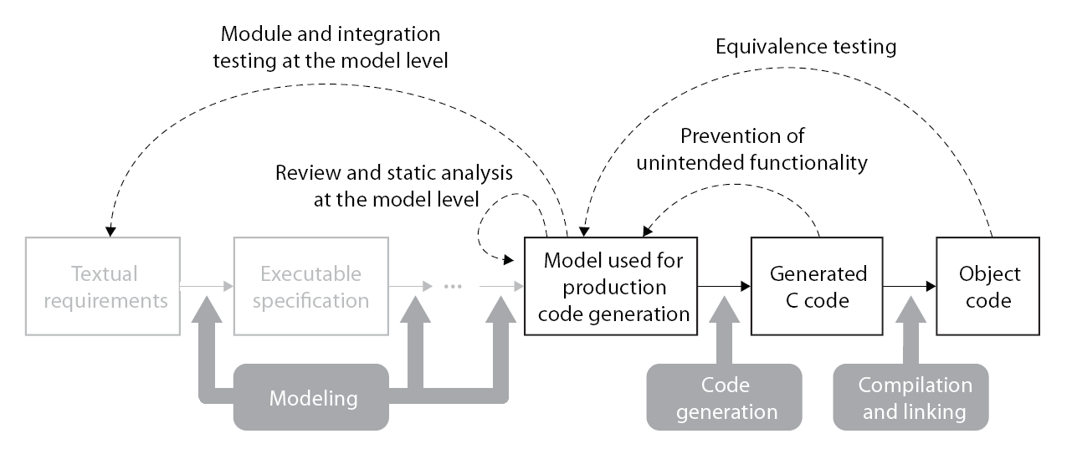
ISO 26262 Reference Workflow Equivalence Testing
Model Verification
Code Verification
Discover design errors at design time
Gain confidence in the generated code
Notes:
- Tool Chain example (not all steps/tools are mandatory)
- Integrated tool chain, covering both Software development as well as verification and validation)

Slide 5
Equivalence Test Vector Generation
Equivalence testing is a core verification principle
Model and code have same numerical behaviour over defined ranges.
Completeness of equivalence checking measured via requirements and code coverage
Unit testing … ... but test design is at the model level
Test generation, execution and checking is fully automated

Slide 6
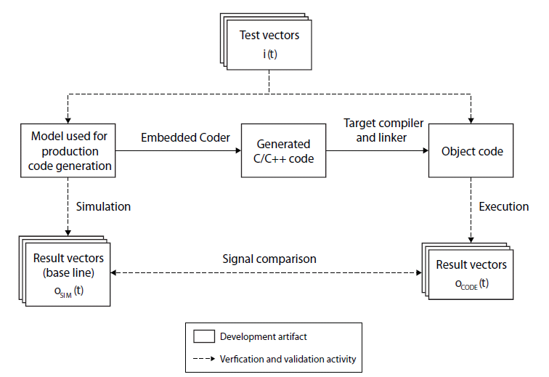
Basic Principle
Model and final implementation must show exactly the same behaviour:

Slide 7
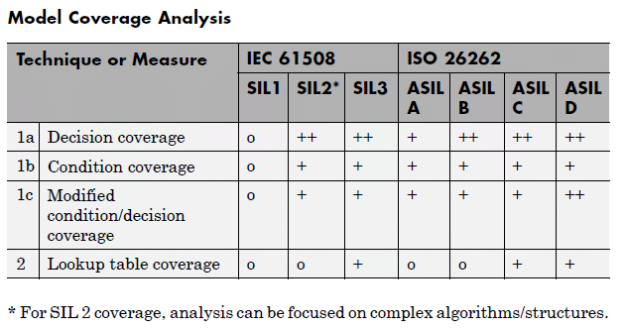
Test Completeness
Coverage target varies with integrity level

Slide 8
Recent Product Features
Test generation (for structural coverage) with Simulink Design Verifier
Model Block SIL / PIL modes
Coverage measurement integrated with SIL / PIL and code generation reports
Simulation Data Inspector for run to run comparison

Slide 9
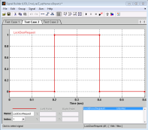
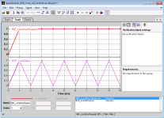
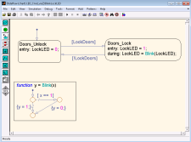

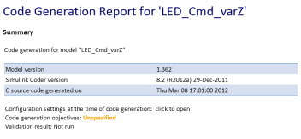
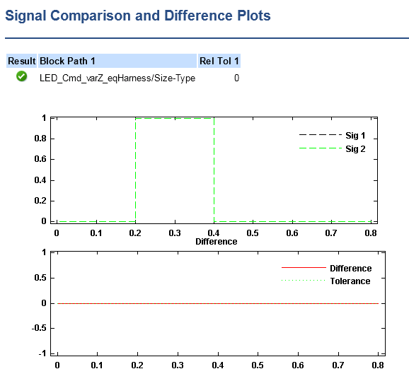
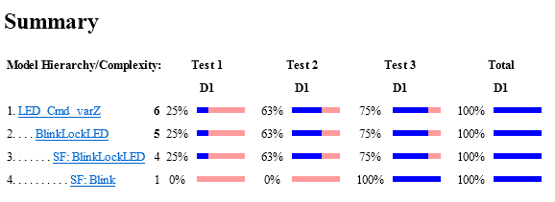
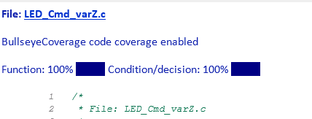
Shortcut: s7_runEquivalenceTests
Structural coverage tests generated by Simulink Design Verifier from the production model
Functional tests, linked to requirements
SIL / PIL modes
Production model
Results and coverage comparison

Slide 10
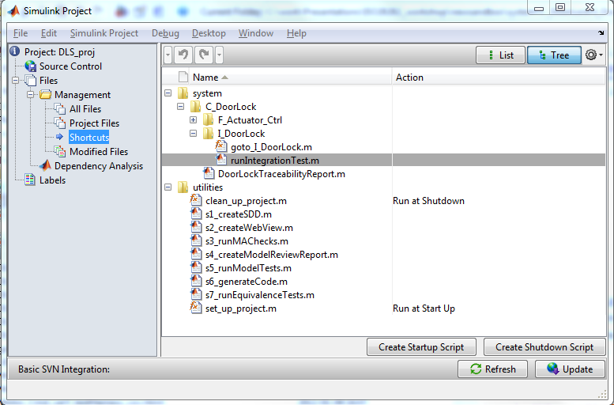
Shortcut: s7_runEquivalenceTests

Slide 11
Conformance Demonstration Template: Code Verification
Technique / Measure |  | Associated Requirements | Used / Used to a limited degree / Not used | Interpretation in this application, Evidence
7 | Equivalence test vector generation (See “Equivalence Test Vector Generation”) | Sufficient structural coverage with respect to the model coverage metrics (SIL 2 and above); see table “Model Coverage Analysis” Creation of additional test vectors (if necessary) Assessment of or justification for uncovered model parts | Used | 100% Model Coverage

Slide 12
Conformance Demonstration Template: Code Verification
Technique / Measure |  | Associated Requirements | Used / Used to a limited degree / Not used | Interpretation in this application, Evidence
8 | Equivalence test execution (See “Equivalence Test Vector Generation”) | Stimulation of the model used for production code generation Stimulation of the executable derived from the generated code Test execution in a target-like environment or analysis of the differences between testing and the target environment Assessment of model parts used for simulation but not for code generation | Used
SIL / PIL modes

Slide 13
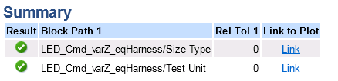
Conformance Demonstration Template: Code Verification
Technique / Measure |  | Associated Requirements | Used / Used to a limited degree / Not used | Interpretation in this application, Evidence
9 | Signal comparison (See “Signal Comparison”) | Designation of a suitable comparison algorithm and acceptance threshold Comparison of simulation results and execution results | Used

Slide 14
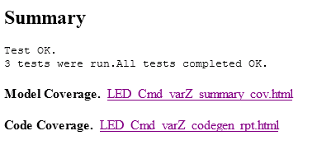
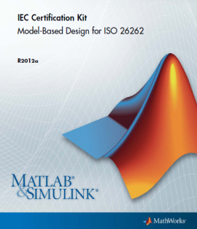
Conformance Demonstration Template: Code Verification
Technique / Measure |  | Associated Requirements | Used / Used to a limited degree / Not used | Interpretation in this application, Evidence
10 | Supporting activities (See “Equivalence Testing Model Versus Code”) | Documentation of the results of equivalence tests Corrective action on failure of equivalence tests Evidence for using automated equivalence testing tools Evidence for validation of equivalence testing tools | Used

Slide 15
ISO 26262 Reference Workflow Prevention of Unintended Functionality
Model Verification
Code Verification
Discover design errors at design time
Gain confidence in the generated code
Notes:
- Tool Chain example (not all steps/tools are mandatory)
- Integrated tool chain, covering both Software development as well as verification and validation)

Slide 16
Prevention of Unintended Functionality
Review of Model Coverage vs Code Coverage (see example)
Alternatively: generation and review of traceability matrix
Notes:
The purpose of this is to ensure that there is no undesired or unintended functionality introduced during the code generation, nor from the compilation or linking phase. The object code should be tested to contain the very same functionality as the model.
The equivalence test was the first phase of this.
This step then ensures that there is no new functionality by reviewing the coverage of the model to code. Alternatively or additionally a review of the traceability could be performed to ensure that all code maps to the corresponding model element.

Slide 17
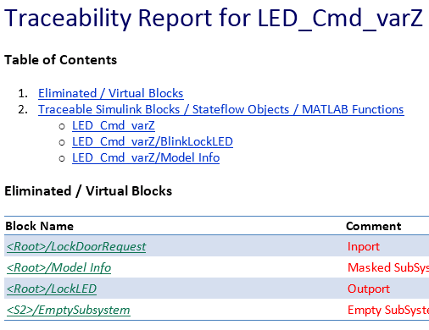
Conformance Demonstration Template: Code Verification
Technique / Measure |  | Associated Requirements | Used / Used to a limited degree / Not used | Interpretation in this application, Evidence
11 | Prevention of unintended functionality (SIL 2 and above) (See “Prevention of Unintended Functionality”) | Model and code coverage comparison or traceability review, see table “Prevention of Unintended Functionality” Assessment of or justification for issues revealed | Used

Slide 18
MathWorks Support for ISO 26262 Summary
Development Process and Tool Chain
Integrated Model-Based Design tool chain for ISO 26262
Simulink, Stateflow
Real-Time Workshop Embedded Coder
Model V&V tools, PolySpace code verification products
IEC Certification Kit
ISO 26262 reference workflows
ISO 26262 utilities (ISO 26262 checks, trace matrix generation)
Tool Qualification
Additional confidence in MathWorks tools by tool qualification according to ISO 26262
We look forward to collaborating with you

Slide 19
Agenda
10:00 - 11:00 Model-Based Design for ISO 26262
11:00 - 11:15 Coffee Break
11:15 - 12:30 Using Simulink for Software Design
12:30 - 13:30 Lunch
13:30 - 15:00 Design Verification
15:00 - 15:15 Coffee Break
15:15 - 16:15 Code Verification
16:15 - 16:30 Summary and Close

