Slide 1
Hands-On Workshop: Introduction to Simulink
Grab a thumb drive & copy simulink_workshop directory to your desktop (or some other directory where you have write permission)

Slide 2
From MathWorks
Sales Rep
Account Manager for xxx
Presenter
Application Engineer
Teaching Assistant
Title

Slide 3
What is a Workshop?
3 hours of hands-on experience with Simulink
Focuses on the how, not the why
Sufficient information to get you started
Lead-in to MathWorks Training and/or Consulting
Simulink for Aerospace System Design
Simulink for System and Algorithm Modeling
Integrating Code with Simulink
Model Management and Verification in Simulink

Slide 4
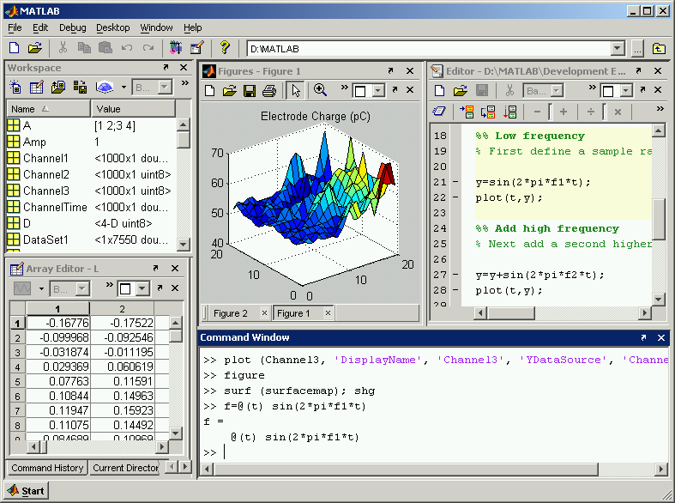
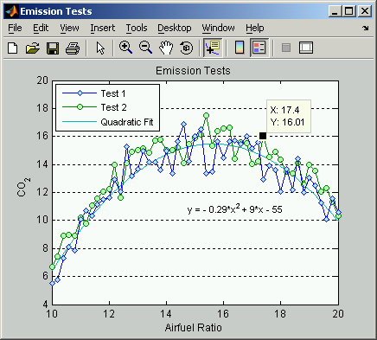
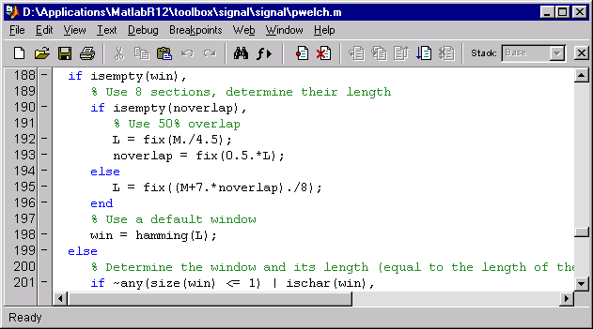
MATLAB: The Leader in Technical Computing
Interactive development environment
Technical computing language
Data analysis and visualization
Algorithm development
Notes:
MATLAB is an
Interactive development environment and
Technical computing language
That allows you to perform data analysis, data visualization,
algorithm development and application deployment tasks.

Slide 5
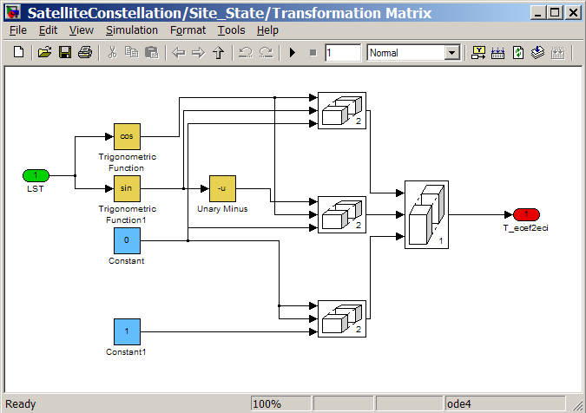

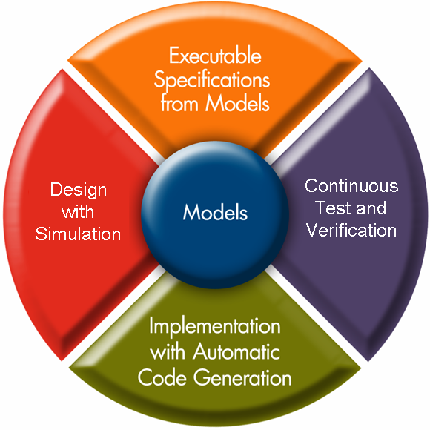
What is Simulink?
Simulink is Time and Event Domain Simulation
Simulink is Graphical Modeling
Simulink is Model-Based Design
Notes:
The MathWorks MATLAB and Simulink products work together to provide the foundation for Model-Based Design.
They help you develop system-level models, design algorithms, simulate your complete design, analyze results, create user interfaces, the list goes on and on…

Slide 6

What are we Building Today?
We need to simulate the dynamics of an object under a controlled fall.
We need to:
Model the falling body.
Develop a system to automatically control the fall.
Provide a reusable simulation architecture.

Slide 7
Working with the Demo & Script
Copy the “Class” folder onto your desktop
Open MATLAB and navigate to the “Class” directory
Run the “start_slWorkshop.m” file
Files are copied from the “source” to “work” directory
If you modify the files in the “work” directory, you always have the “source” files as a backup.
MATLAB changes into the “work” directory & opens an HTML script.
The HTML script provides instructions on how to go from one step to another & provides a fail-safe in case you don’t complete a step.

Slide 8
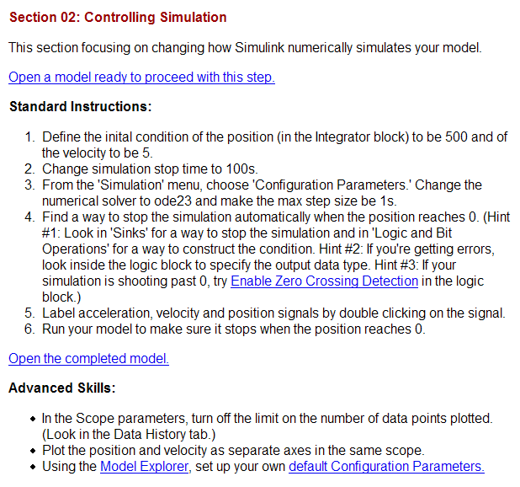
Getting around the Workshop Script
Section title and brief description of what will be covered.
If you didn’t complete the previous step, you can open a model that’s ready to go for this step.
These are the tasks we’ll be completing in this section. Hyperlinks take you to the help documentation.
If you couldn’t complete the tasks, or just need a hint, you can open the completed model.
If you are an experienced Simulink user, or finish the standard tasks early, try some of the advanced tasks.

Slide 9
Enough with the slides already, let’s see some Simulink!

Slide 10
Summary
For more information
<Rep’s Name>
<First.Last@mathworks.com>
(508) 647-xxxx
http://www.mathworks.com/products/simulink/
Support
(508) 647-7000
support@mathworks.com
MathWorks training courses
http://www.mathworks.com/services/training
Demos & Webinars
http://www.mathworks.com/products/simulink/demos.html

