Slide 1
Model-based Verification introduction
MathWorks Japan 2012/12/21 Yasumitsu Ito

Slide 2
Error inclusion and detection
Source: “Migration from Simulation to Verification with ModelSim®” by Paul Yanik. EDA Tech Forum, 2004 Mar 11, Newton MA
Errors included in the early development process are detected in the later development process.
Notes:
So, why is it important to get the specification correct and complete early in the process? Here is a study from the EDA industry that shows the challenge in more detail. It shows that most errors are introduced early in the development process, in fact 60% are introduced in the specification, while most are not found until late in the development process. The economic impact of this late detection has been well documented in multiple studies. It costs a lot of time and effort (and $$!) to go back to the design to fix an error introduced in the specification stage.
Across the industries we deal with, what we hear repeatedly is the need to verify design work early, so that designs can iterate and converge on the spec (get the spec right) instead of being corrected late in the process.
(Describe the chart above)

Slide 3
The image of the early verification introduction effect
Source: The MathWorks, Early Verification presentation
An early verification and validation is carried out by an upstream specification Preferences phase, and fault is corrected in advance. Development efficiency improves and it leads also to a development cost reduction.
Notes:
This is what the report SHOULD look like. What development groups want is to find the errors as soon as they are introduced .They want to verify their specifications and designs early in the developmentprocess. And this is one of the benefits of Model-Based Design, the ability to do early verification.

Slide 4
Model-based verification workflow
Verifying equivalency between requirement and model
Requirement specification
Modeling
Executable specification
Model reviewing
Verifying equivalency between model and code
Implementation model
Code Generation
Code verification
C code
Compile & link
Object code

Slide 5
Verifying equivalency between requirement and model
Verifying equivalency between requirement and model
Requirement specification
Modeling
Executable specification model
(1) Simulation testing
(2) Property proving
(3) Setting traceability between requirement and model
Implementation model
Details of (1) Simulation Testing
Importing test vectors into Simulink
Model coverage measurement
Automatic test case generation
Equivalency checking between model and expected output
Automatic report generation

Slide 6
Reviewing model
Requirement specification
Modeling
Executable specification model
Reviewing model
Implementation model
(4) Static checking and Reporting
C code

Slide 7
Verifying equivalency between model and code
Verifying equivalency between model and code
Requirement specification
(5) Verifying equivalency between model and code by SILS/PILS
(6) Setting traceability between model and code
(7) Code coverage measurementment
Executable specification model
Implementation model
Code Generation
C code
C code verification
(8) Verify that there is no run-time error by Polyspace R.
Object code

Slide 8
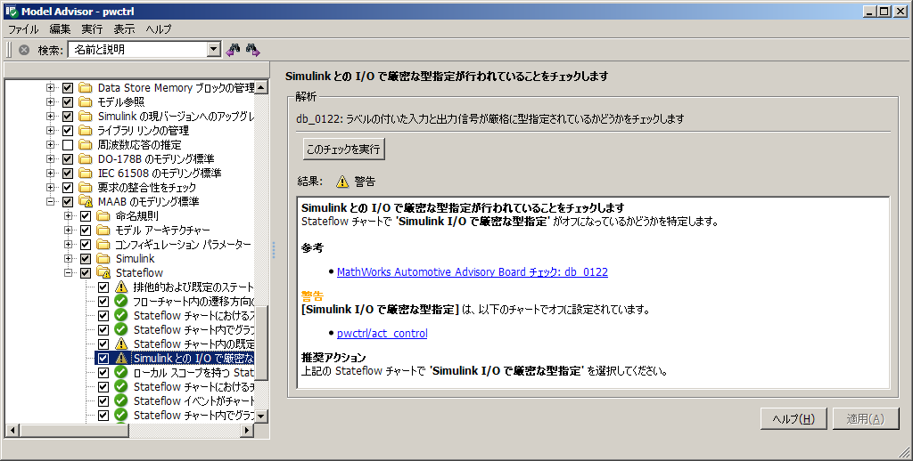
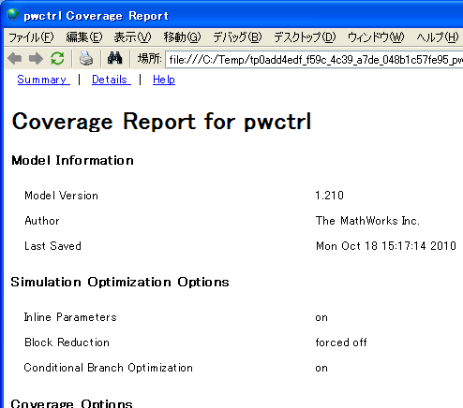
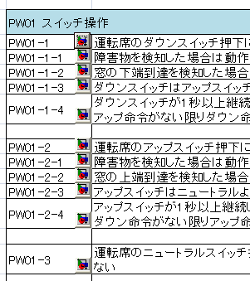
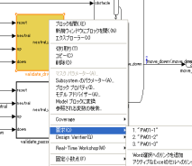

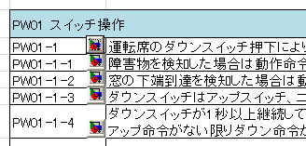
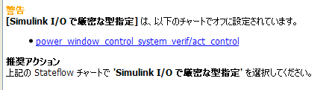
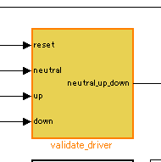
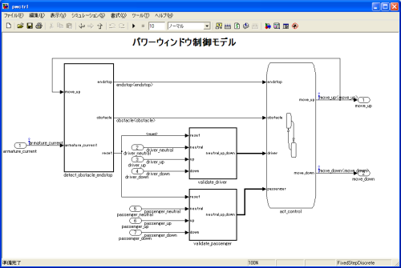
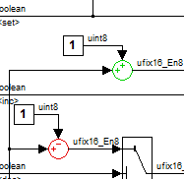
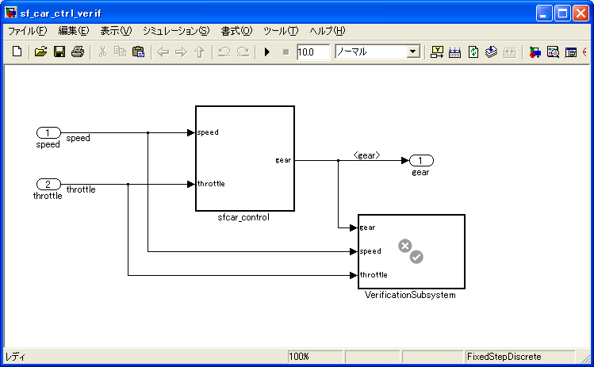
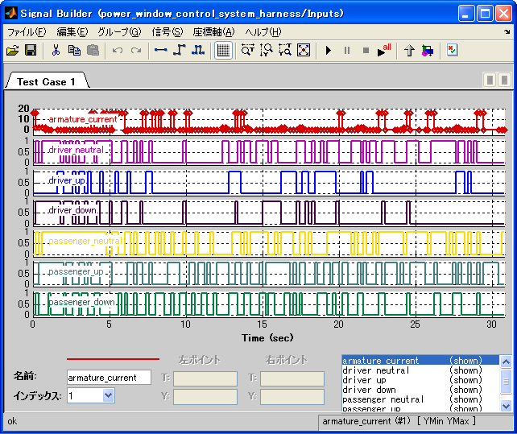
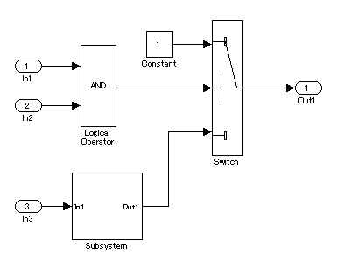
V&V related products in MATLAB/Simulink product families
Simulink Verification and Validation TM (SLVnV)
Model coverage measurementment
Traceability setting between requirement and model
Model Advisor
TT,TF,FT
Model to requirement specification
Model Advisor GUI
Automatic correction
Report generation
Authoring Custom Checks
Word
Excel
DOORS
MKS Integrity
任意
Model coverage
report
Decision
Condition
MC/DC
Requirement to model (Word/Excel/DOORS/MKS Integrity )
Controller model
Simulink Design Verifier TM (SLDV)
Automatic Test Generation
Property Proving (Formal verification)
Design Error Detection
Controller model
Req. spec.
Formally detects
Division-by-zero
Range overflow
Design overflow
Verification model
Verif.
Spec.
Analysis
Controller model
Test vectors to meet model coverage objectives
Mathematically prove that there is no inequivalency between controller and verification models
If overflow can be occurred, counter example will be created.
Notes:
8

Slide 9
V&V related products in MATLAB/Simulink product families #2
Embedded Coder
A traceability setting of a model and a code
Back-to-Back test
SILS (BullsEye, code coverage measurement by cooperation with LDRAR)
PILS (various emulator and ISS(s) for microcomputers)
MATLAB/Simulink Report Generator TM
Model validation report automatic generation
IEC Certification Kit for ISO 26262 and IEC 61508
Reference workflow
Traceability matrix generation
A tool certificate of attestation and an attestation report (Embedded Coder, SLVnV, SLDV, Polyspace)
Polyspace ^{R}
Run-time error detection (a zero rate and an overflow, access range outside of an array, etc.)
Simulink Code Inspector TM
Automatic code review
Notes:
9

Slide 10

J-MAAB guideline for verifying controller specification
Through 2 years activity at the J-MAAB V&V workgroup (WG), the WG published the guideline for verifying controller specification. (August, 2009)
http://jmaab.mathworks.jp/
Reference: Requirement development guideline http://jmaab.mathworks.jp/yokyu_dev_guideline/redirect.php

Slide 11
Verifying equivalency between requirement and model
Verifying equivalency between requirement and model
Requirement specification
Details of (1) Simulation Testing
Importing test vectors into Simulink
Model coverage measurement
Automatic test case generation
Equivalency checking between model and expected output
Automatic report generation
Modeling
Executable specification model
Implementation model
C code
Object code

Slide 12
Verifying equivalency between requirement and model 1.1 Importing test vectors into Simulink
To verify the correctness of your controller model against test vectors and expected outputs defined in the outside of Simulink, you need to import them into Simulink environment.
Type of external data
Excel, CSV
Original binary file
Type of holding test vectors in Simulink
Workspace data
(A vector, a structure with time, Simulink.TimeSeries)
SignalBuilder block
From WorkSpace block
Simulink

Slide 13
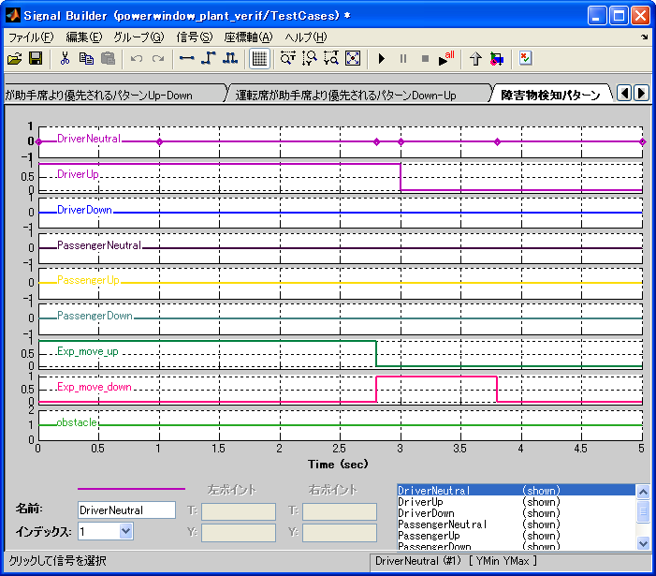
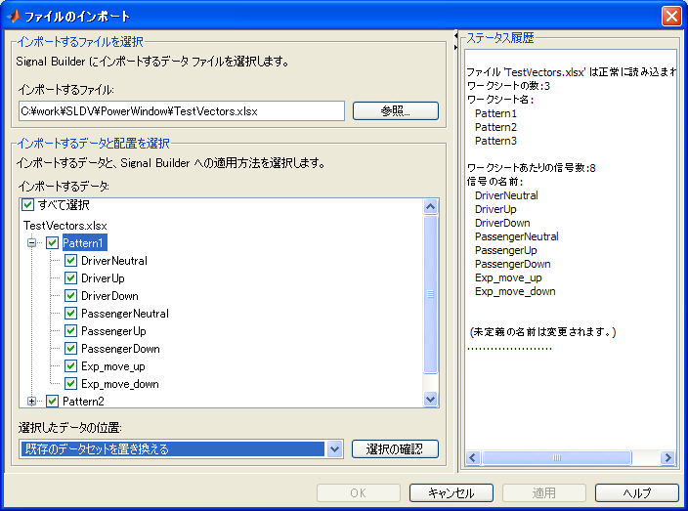
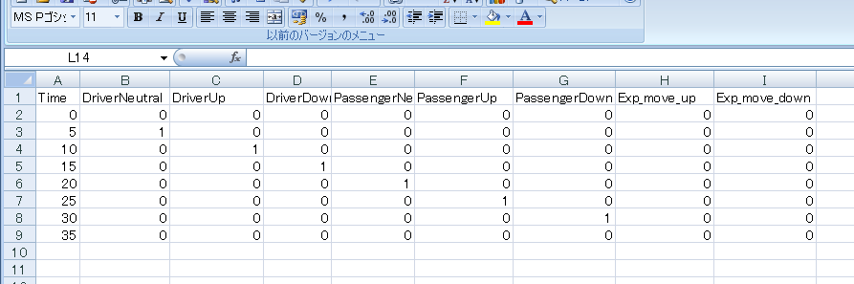
Verifying equivalency between requirement and model 1.1 Importing test vectors into Simulink #2
Test vectors in Excel spread sheet can be imported into Signal Builder block easily.
New feature introduced in R2010b
Excel
Simulink

Slide 14
Verifying equivalency between requirement and model 1.2 Model coverage measurement #1
Coverage can be measured in model-level.
test1
1
1
1
0
test2
1
0
0
0
test3
1
test4
Branch in a model The degree of completness is measured.
Test vectors
Simulink Verification and Validation

Slide 15
Verifying equivalency between requirement and model 1.2 Model coverage measurement #2
Measurable coverage criteria
Decision coverage
Was each output pattern performed?
Condition coverage
Was each input pattern performed?
MC/DC coverage
Does each input affect an output independently?
Signal range coverage
The maximum and the minimum of a block output
Look-up table coverage
Was the table value used?
Simulink Verification and Validation

Slide 16
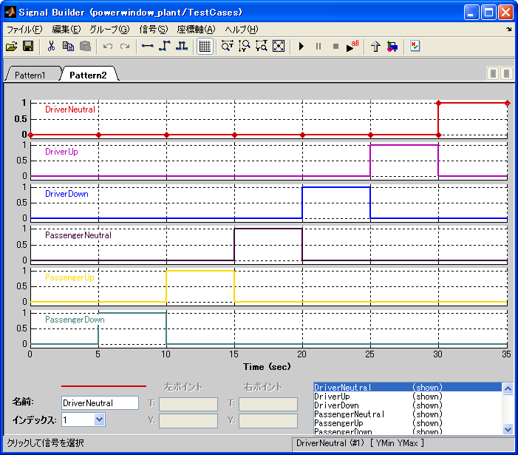
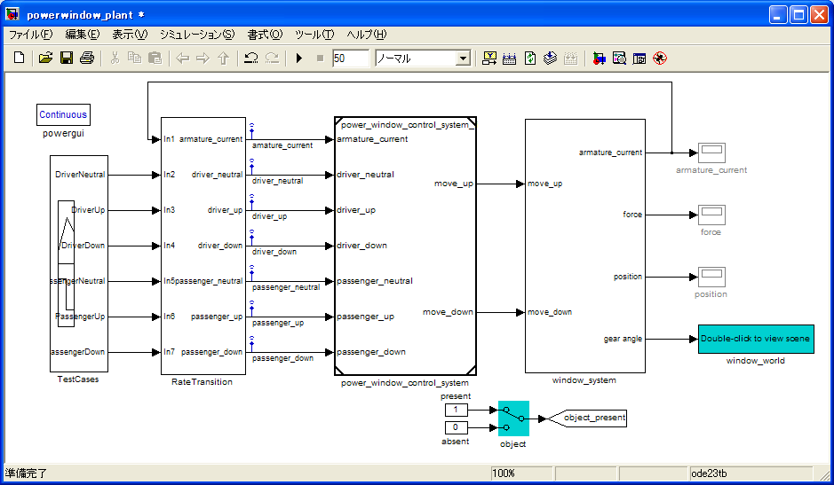
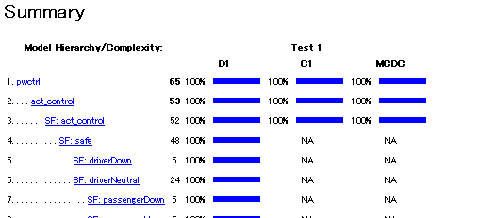
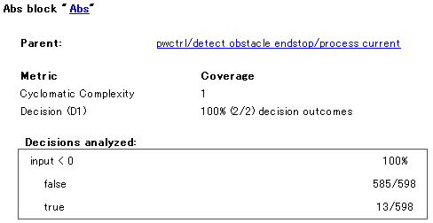
Verifying equivalency between requirement and model 1.2 Model coverage measurement #3
(1) Perform a simulation to each test pattern.
(2) Generate a coverage report.
The coverage result of the whole model / subsystem
The coverage result for every block and Stateflow object
Simulink Verification and Validation

Slide 17
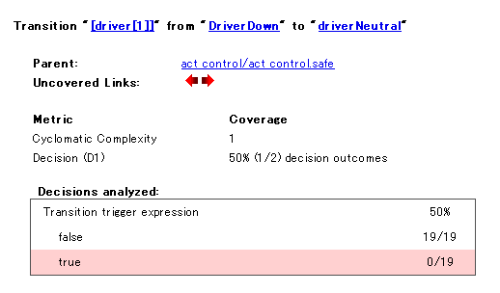
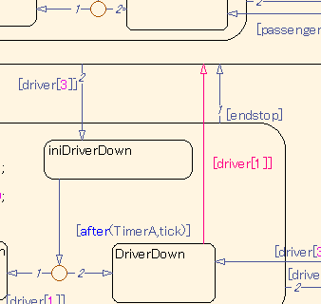
Verifying equivalency between requirement and model 1.2 Model coverage measurement #4
This indicates that a test pattern for Driver's switch is missing.
Coverage report example
A click will highlight an applicable model.
Completeness of test coverage can be measured in model-level
Simulink Verification and Validation

Slide 18
Verifying equivalency between requirement and model 1.3 Automatic Test Vector generation #1
Test vectors are generated automatically to meet the following coverage criteria:
Decision coverage
Condition coverage
MC/DC coverage
User definition (a value or conditions are specified to a specific signal)
Detection of a dead path
The element which cannot be performed on the structure of a model
Generating test cases for missing coverage objectives
Simulink Design Verifier

Slide 19
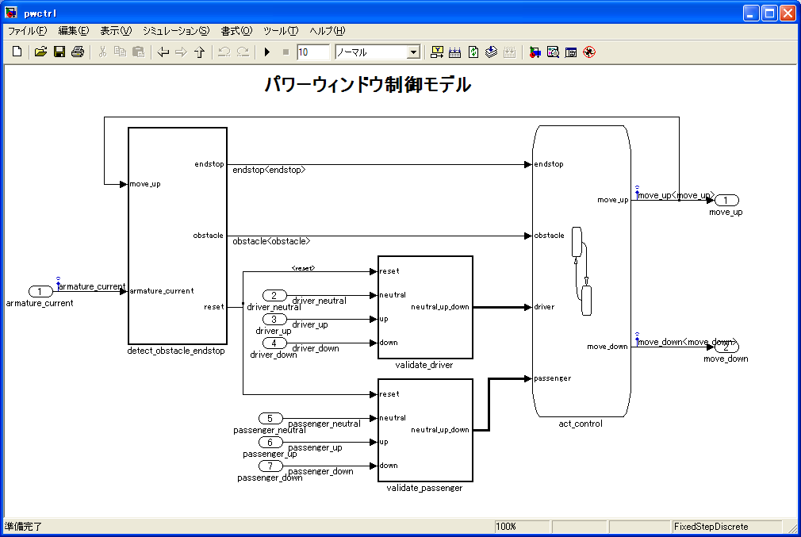
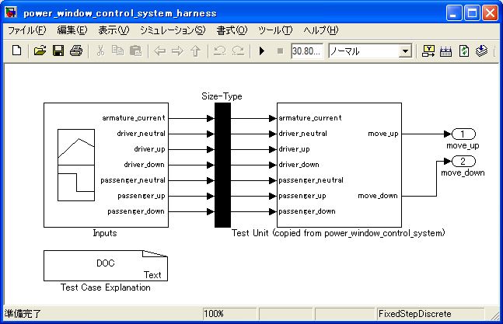
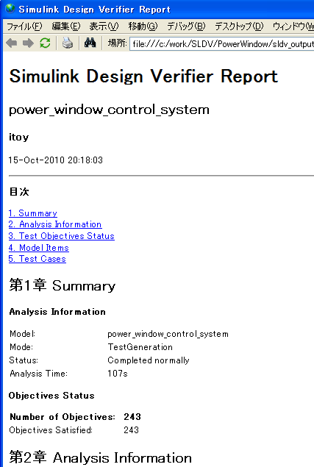
Verifying equivalency between requirement and model 1.3 Automatic Test Vector generation #2
Control model
Harness model
Test generation
SignalBuilder block
Analysis report
The test vector which fills coverage
The MAT file containing a test vector
Simulink Design Verifier

Slide 20
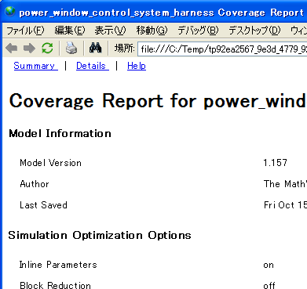
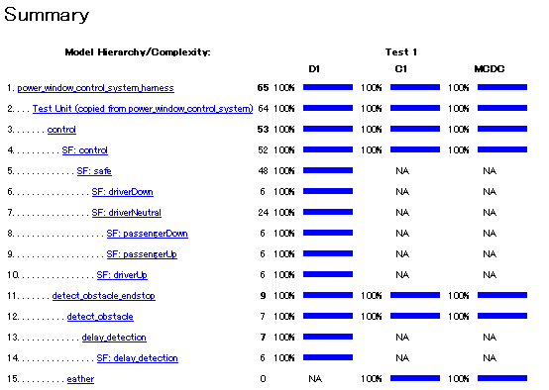
Verifying equivalency between requirement and model 1.3 Automatic Test Vector generation #3
A harness model is performed and model coverage is measured with a simulation.
It is a simulation about the generated test and operation confirming.
Simulink Design Verifier

Slide 21
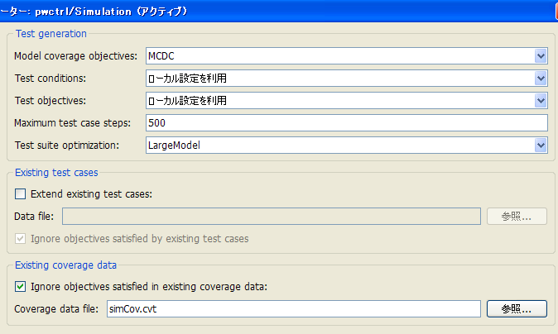
Verifying equivalency between requirement and model 1.3 Automatic Test Vector generation #4
If there is missing coverage objectives that are not covered by existing tests, SLDV can generate supplemental test vectors.
Effort of test vector creation
Configuration parameter
Coverage rate
The MAT file containing the existing test vector is specified.
Automatic testing tool can help this effort.
Coverage data is specified.
Effort
Simulink Design Verifier

Slide 22
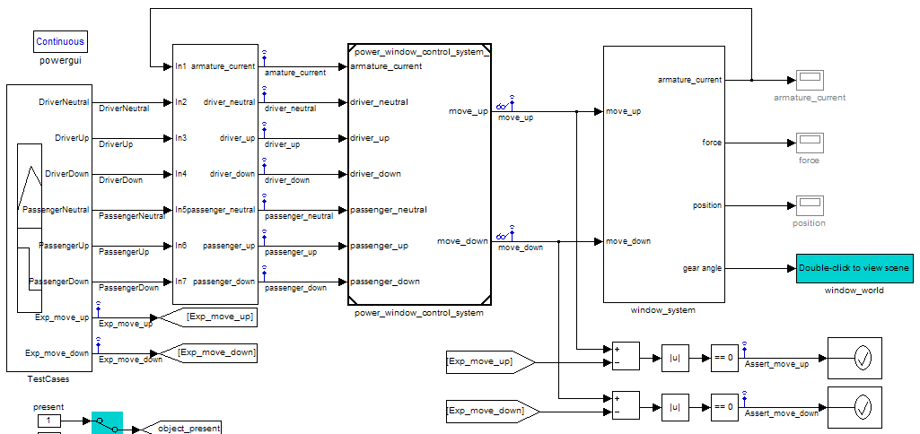
Verifying equivalency between requirement and model 1.4 Comparison of Expected Value and Simulation Result
The example of an expected-value comparison model
Test vectors
Control model
Plant model
Assertions are thrown if failed.
Expected outputs are also given
Comparing model's outputs and expected outputs

Slide 23
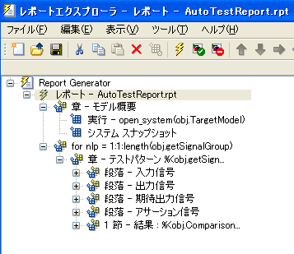
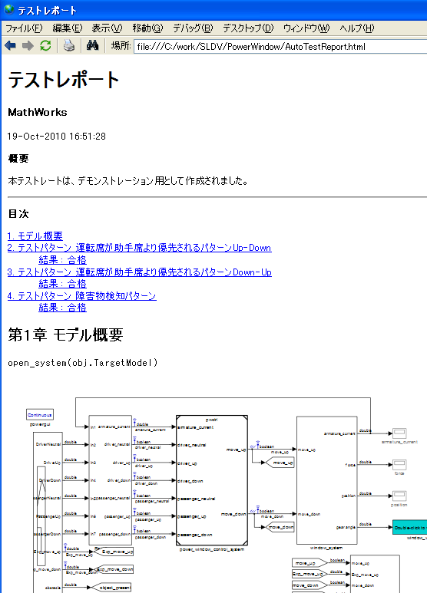
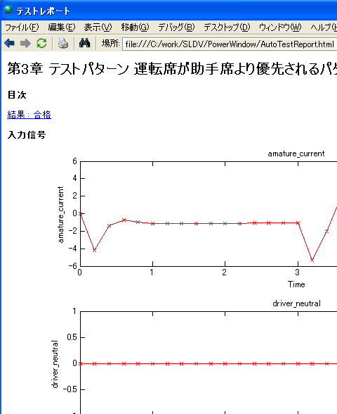
1. Conformity Verification and Validation of Model and Specification 1.5 Automatic Generation of Test Report
Report Generator can be used for automatic report generation.
Report Generator
The report by HTML, PDF, Word, and etc
Model
Input output signal
Simulink Report Generator

Slide 24
1. Effect of Simulation Testing
By performing coverage testing in Simulink model, you can achieve high quality in upstream process.
Requirement-based-testing can be achieved in model level to meet with certification requirements.
By automatic test generation, test vector creation effort can be reduced.
A reduction of unnecessary manual operation is possible by an automatic report.

Slide 25
Verifying equivalency between requirement and model
Verifying equivalency between requirement and model
Requirement specification
Details of (1) Simulation Testing
Importing test vectors into Simulink
Model coverage measurement
Automatic test case generation
Equivalency checking between model and expected output
Automatic report generation
Modeling
Executable specification model
Implementation model
C code
Object code

Slide 26
Verifying equivalency between requirement and model
Requirement specification
Verifying equivalency between requirement and model
Modeling
Executable specification model
(2) Property proving
(3) Setting traceability between model and code
Implementation model

Slide 27
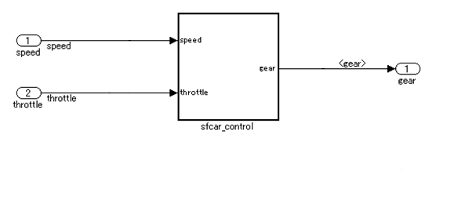
2.1 Property proving
The functionality to prove that logical expression(s) in the verification model is always meet with the controller model
Controller model
Requirement specification
verification specification
Is the controller model always meet with logical expression(s) in the verification model?
Verification model
Automatic equivalency checking between requirement and model
Simulink Design Verifier

Slide 28
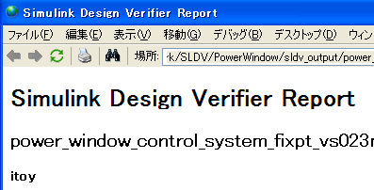

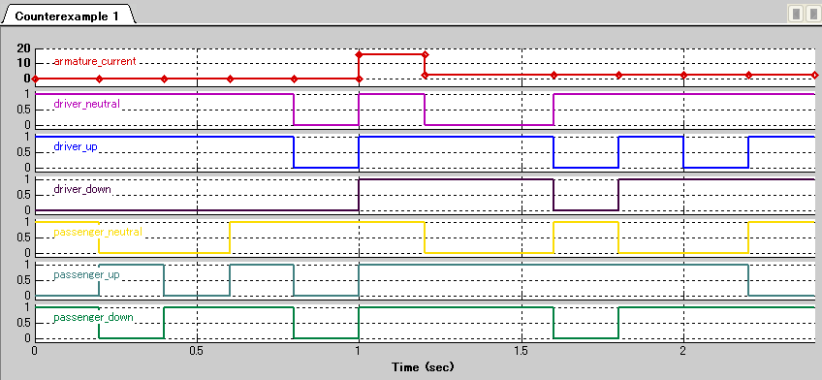
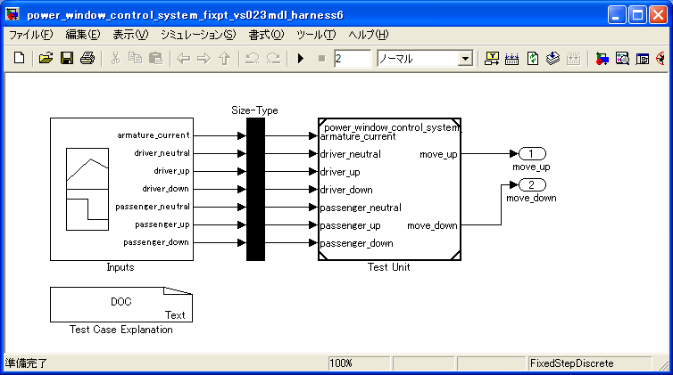
2.2 Analysis result by Property proving
The analysis result:
Proof report
Truth:
It is proved for infinite time period or specified time period.
-> a proof report is generated.
False
Counter example(s) will be generated as evidence(s).
A model containing counter example
Simulink Design Verifier

Slide 29
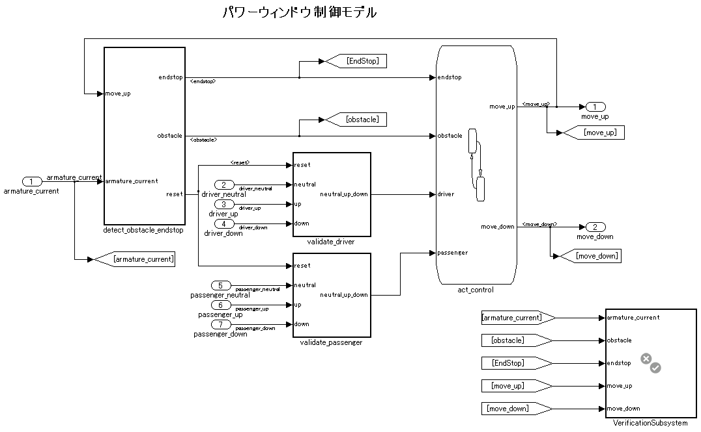
2.3 Property proving Model example
Verification Subsystem
The signal relevant to the properties

Slide 30
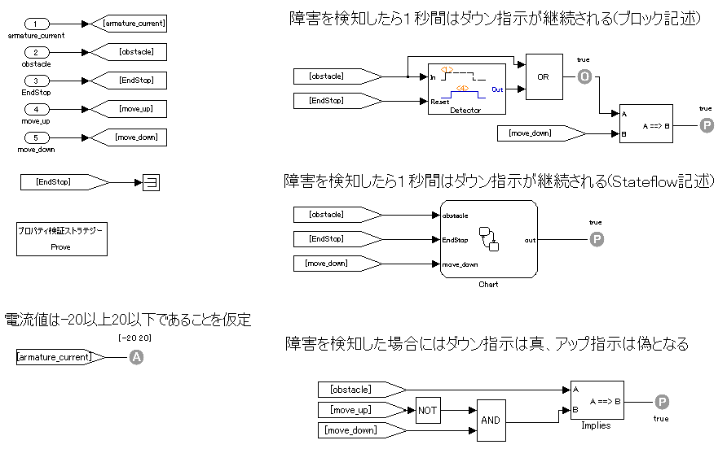
2.4 Property proving - Example of property Description
Down signal shall be continued at least 1 sec if an obstacle is detected.
Down signal shall be continued at least 1 sec if an obstacle is detected. (Stateflow representation)
Prove that input of P block is always true
Assumption
Simulink Design Verifier

Slide 31
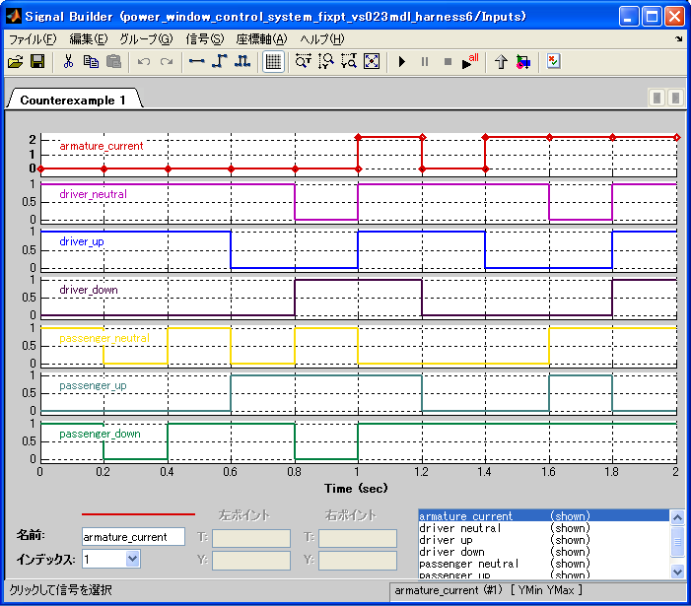
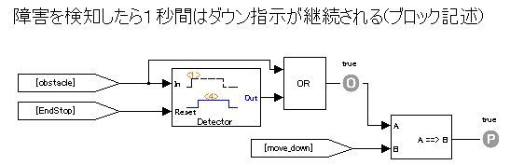
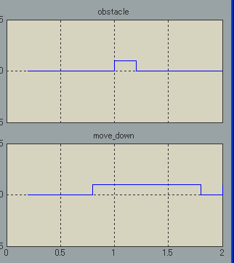
2.6 Property proving - Debugging counter example
If a property is falsified, you can debug it by simulating the harness model. The cause is included among requirement specification, controller model, verification specification, or verification model.
Only human being can justify the correctness.
This property is falsified.
Down signal shall be continued at least 1 sec if an obstacle is detected.
Counter example
Harness model
Down signal is finished in 0.8 sec.
Simulation
Simulink Design Verifier

Slide 32
2.7 Effect of Property proving
It is possible to check the equivalency of requirement specification and a verification specification, and a model.
Applying formal verification in model level without learning formal verification language.
Quality of requirement specification, a verification specification, and a model can be improved.
You cannot specify properties with ambiguous specification.
Debugging against counter example increase the quality.

Slide 33
3.1 Traceability #1 of Specification and Model
The functionality enables to trace from/to requirement specification document to/from Simulink model.
Supported document type:
Word / Excel / DOORSR/MKS Integrity (bidirectional link)
A text, PDF, arbitrary file : (one-way link)
Simulink Verification and Validation

Slide 34

3.1 Traceability #2 of Specification and Model
From a model to a document
A corresponding section is highlighted.
Click
From document to model (Word/Excel/DOORS/Integrity)
The model part linked is highlights.
The ActiveX button
Simulink Verification and Validation

Slide 35
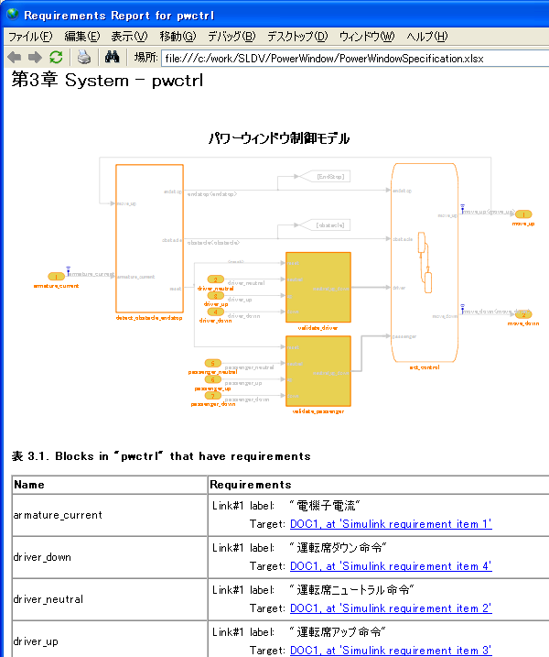
3.2 Automatic Traceability Report Generation
Traceability information between the document and model is reported.
The contents of a report
A list of blocks or objects that have traceability link.
A list of documents that are referred by the model.
Simulink Verification and Validation

Slide 36
3.3 Effect of Setting Traceability between requirement specification and model
Ensure that objects in the model is described in the requirement specification.
Ensure that items in the requirement specification is described in the model.
The above check can be done by a simple operation.

Slide 37
Verifying equivalency between requirement specification and model
(1) Simulation testing
(2) Property proving
(3) The traceability of a model and a specification
Requirement specification
Modeling
Executable specification model
Implementation model
Code Generation
C code
Compile & link
Object code

Slide 38
Model Reviewing
Requirement specification
Modeling
Executable specification model
Model reviewing
4. Model Static Check Execution and a report
Implementation model
Code Generation
C code
Compile & link
Object code

Slide 39
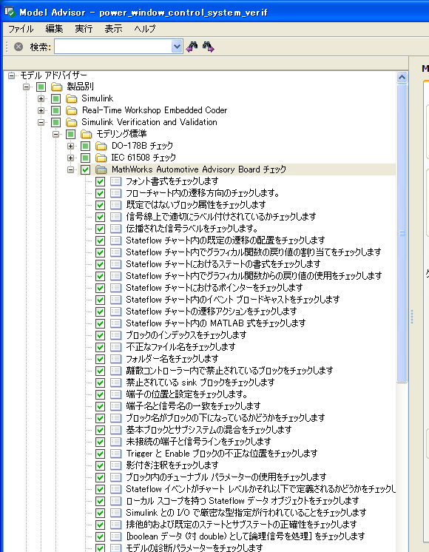
4.1 Model Static Check and Report
Model Adviser :
A guideline checker
The modeling standards
MAAB style guideline checks
IEC61508 / ISO26262 / DO-178B
plus
Traceability checking
Simulink Verification and Validation

Slide 40
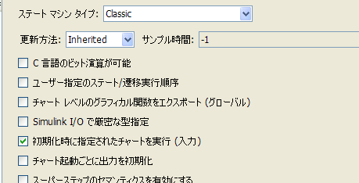
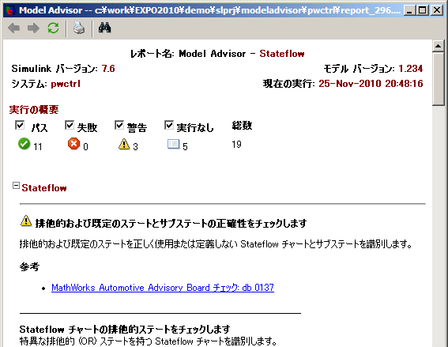

4.2 How Model Adviser works
(1) Perform a check by model adviser GUI.
(2) Make correction
Click to highlight
Stateflow Preferences
The check is not contained.
(4) Report
(3) Check again after correction
Simulink Verification and Validation

Slide 41
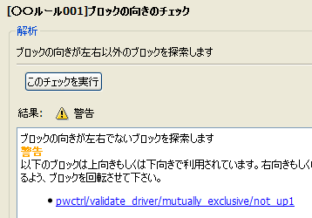
4.3 Authoring custom Model Advisor checks
It is possible to create a user's original custom-made check by using model adviser API.
The customization structure
A function to detect deviations using Simulink API - find_system
- get_param
A custom check example
A function of Model Advisor registration
A function to display check results using Model Advisor API - Pass message - Fail message
Simulink Verification and Validation

Slide 42
4.4 Effect of Model Static Check and Report
The modeling based on the unified rule
Improvement in a readability
Improvement in reusability
Improvement in quality
It is a reduction of a reviewing effort because of a machine check.

Slide 43
The conclusion of a review of a model
Requirement specification
Modeling
The review of a model
Executable specification model
4. Model Static Check Execution and Report
Implementation model
Code Generation
C code
Compile & link
Object code

Slide 44
Verifying equivalency between model and code
Verifying equivalency between model and code
(5) Verifying equivalency between model and code by SILS / PILS
(6) Setting traceability between model and code
(7) Code coverage measurement
Requirement specification
Modeling
Executable specification model
Implementation model
Code Generation
C code verification
C code
(8) Verify that there is no run-time error in a code by Polyspace.
Compile & link
Object code

Slide 45
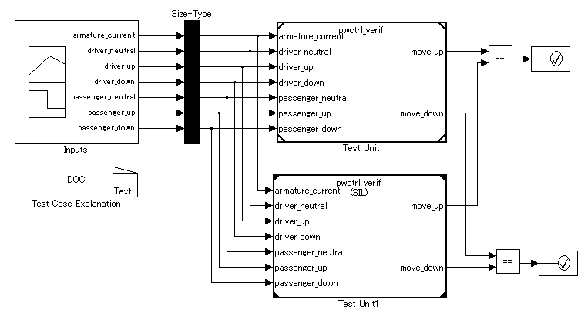
5.1 Verifying equivalency between model and code by Simulation-in-the-loop (SILS)
By constructing the following model, model and code can be compared with enough coverage.
Test vectors used at the up stream process can be reused.
Test vectors generated by automatic test generation can be used.
Model
Assertion is thrown if there is mismatch.
Test vectors with Model coverage 100%
Code (S-function)
Embedded Coder

Slide 46
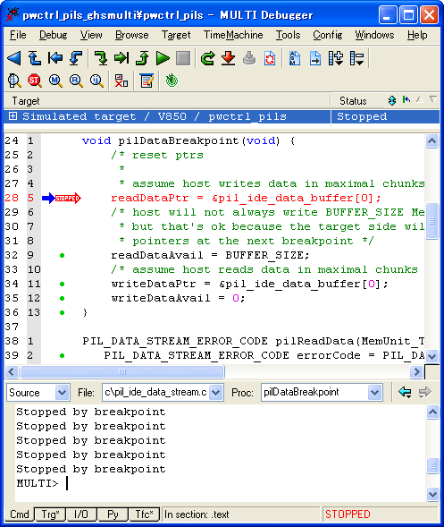
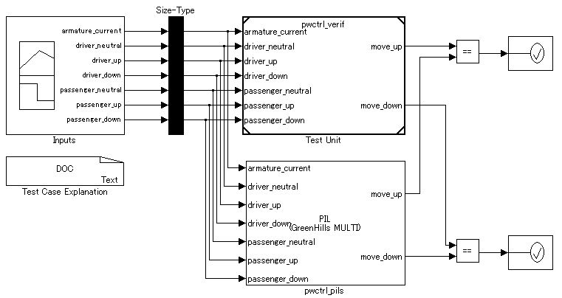
5.2 Verifying equivalency between model and code by Processor-in-the-loop (PILS)
Generated codes are evaluated in Emulator (ICE) or simulator (ISS) and compared with model.
IDE - Green Hills MULTI - Eclipse IDE - TI Code Composer Studio - etc
Embedded Coder

Slide 47
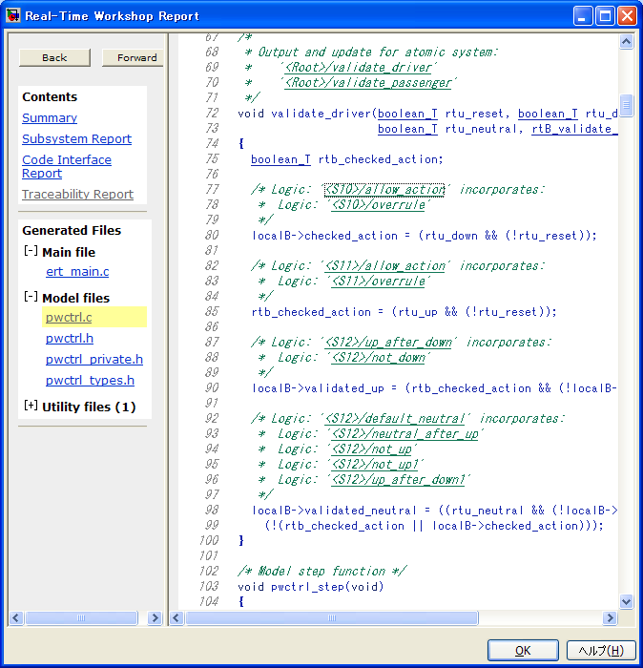
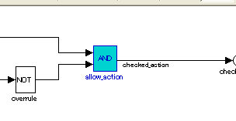
6. Traceability setting between Model and Code From code to model
Corresponding model is highlighted if you click a comment line.
Embedded Coder

Slide 48


6. Traceability setting between Model and Code From model to code
Corresponding code is highlighted.
The line of code applicable to a move_up block
Embedded Coder

Slide 49

6. Traceability setting between Model and Code Traceability report
Traceability Report lists a relation between model and code
Block path
Line of code
Embedded Coder

Slide 50


7. C Code Coverage measurement
C code coverage achieved during simulation can be measured by using 3rd party code coverage tools:
BullseyeCoverage (R2010a~)
LDRA Testbed (R2011b~)
Configuration parameter Code-Generation Preferences
Code coverage attained by SILS :
Embedded Coder

Slide 51
The effect of Verifying equivalency between model and code
You can verify the equivalency between model and code systematically.
Reusing the test cases used in upstream.
Back-to-back testing at model-level
Microcomputer-level verification with PILS.
(Arithmetic precision, memory consumption, execution time)
Easy to set and review traceability between model and code.
Interactive
Report as evidence.

Slide 52

8.1 Static Code Verification by Polyspace
Polyspace proves absence of the following run-time errors:
Read access to non-initialized data
Out-of-bounds array access
Concurrent access on shared data
Dereferencing through null or out-of-bounds pointers
Incorrect computation
Overflow, underflow
Division by zero
Square root of negative value
Illegal type conversion
Unreachable code
Green: reliable
Red: faulty
Gray: dead code
Orange: unproven
Poyspace

Slide 53




8.2 Example of Run-time Error Parse by Polyspace
Looking at line 18:
y range:
x range
Overflow?
Analysis result of x/(x-y)
By Polyspace, it is proven that there is no run-time error in this function.
Zero rate?
Poyspace

Slide 54
8.3 Effect of Code Verification by Polyspace
Applying formal verification in C code
Automatic generated code
Specification of a run-time error with detection difficult in a model
Hand code
The existing code (S-function), an I/O driver, etc.
Proving the correctness of C-code
This is not a bug finder.
Improvement in productivity
Reducing debugging effort
Reducing reviewing effort

Slide 55
Conclusion
Verifying equivalency between requirement and model
Taking in of a test vector
Model coverage measurement
Test vector automatic generation
Automatic report generation
Property proving
The traceability of a model and a specification
The review of a model
Model adviser
Verifying equivalency between model and code
SILS
PILS
The traceability of a model and a code
Code coverage measurement
Code verification
It is in a code by Polyspace R.
It verifies that there is no run-time error.
Requirement specification
Modeling
Executable specification model
Implementation model
Code Generation
C code
Compile & link
Object code

Slide 56
Support documentation

Slide 57



Blocking of the C code by S-function block
A S-function block is generated.
From a model to automatic code generation
A generated code is built. Formation of a mex file (DLL)
Simulink

Slide 58

The existing C code is taken in as a S-function block.
Taking in is possible considering the existing code as S-function by Legacy Code Tool at easy operation.
The S-function generated code by Legacy Code Tool
Existing code
% When the input/output of the sample % algorithm which takes in the existing code using Legacy Code Tool as S-function is described by argument delivery def = legacy_code('initialize'); def.SFunctionName = 'lc_argument_sfcn'; def.OutputFcnSpec = 'void lc_argument_wrap(uint8 u1, uint8 u2, uint8 y1[1], uint8 y2[1])'; def.InitializeConditionsFcnSpec = 'void lc_argument_initialize(void)';def.HeaderFiles = {'lc_common.h'}; def.SourceFiles = {'lc_argument.c','lc_argument_wrap.c'}; def.IncPaths = {'Include'}; def.SrcPaths = {'Src'}; Generation legacy_code of %% C-MEX S-Function ('sfcn_cmex_generate', def); Compile option -DLC1 is specified by %% mex execution. legacy_code('compile',def); Generation legacy_code('sfcn_tlc_generate', def);legacy_code of a %% TLC file ('rtwmakecfg_generate', def) Generation of a %% S-Function block legacy_code('slblock_generate', def);
#include "lc_common.h" static BO pastORval; void lc_argument(U8 *SigA, U8 *SigB, U8 *OutA, U8 *OutB) { -- -- } void lc_argument_initialize(void) { -- -- }
S-function block
C-MEX S-function which mediates the existing code and Simulink is made by execution, and a S-function block and a TLC file are generated as a result.
Simulink Coder

Slide 59




The design error specific function of Simulink Design Verifier
MATLAB R2011a-
Specific [ in a design error ] by the static analysis of a model
Zero rate
An overflow of an integer and a fixed point number
The check of a result
A harness model including the input used as proof is generated.
A More-About report is generated.
The input which causes a design error
Harness model
Report
Red: The block which a design error generates
Green: The block which a design error does not generate
Simulink Design Verifier

Slide 60




Traceability matrix preparation function
Requirement specification
Model
The function which generates the traceability matrix (Excel) which displays the traceability information between a model, requirement specification, and an automatic generated code by list. API function : iec.ExportTraceReport ('model name') Or from an automatic code generation report top Generation is possible.
Code
Excel file
IEC Certification Kit , Embedded Coder

Slide 61
Simulation, Code generation, V&V are based on Compiled Information
Model validation
Model parse
Code Generation
Modeling
Simulation
.mdl .slx
Load and Compile
Compiled model information (Simulink, Stateflow, MATLAB Function, --)
Graphical model
Simulink Design Verifier, It cooperates with the basis portions of Simulink, Stateflow, and MATLAB Function products seamlessly, and performs on a uniform interpretation (the execution sequence of a block, the inherited data type, execution sampling time, and etc.).

Slide 62



Importance of IR
Two or more parses and optimization
Simulink
Code Generation
Analysis/ Transform
C
IR
Stateflow
Analysis/ Transform
TLC
Target Language Compiler (TLC) Code
C++
Internal expression : Intermediate Representation (IR)
HDL
PLC
Extensible TLC stage
SLDV analytic engine
MATLAB Function
It is a domain two or more.

Slide 63
The difference of a process from the tool chain of the other company Tool chain of the other company
It is set to big V and hand return cost is large.
Requirement specification
Since disagreement may occur in a simulation and a generated code, not a model but a code serves as truth.
Block substitution is needed.
It has not corresponded to the format verification of a floating point model, and the verification and validation after fixed-point-izing is needed.
Unless a Code Generation is carried out, format verification execution is impossible.
A verification process is a post process.
A Code-Generation product license is necessity (cost size) to a verification and validation.
Since it is premised on the fixed-point model, analysis cost is held down at the time of format verification use.
?
Format verification
HILS
The fixed-point model for Code Generations
Code coverage test automatic testing generation SILS
C code
PILS
Object code

Slide 64
The difference of a process from the tool chain of the other company MathWorks tool chain
Formation of small V is possible. In the early stage of development, fault is detectable.
Requirement specification
Demand link (V&V) Format verification (SLDV)
A model and a code have high conformity and the simulation result of a Simulink model serves as truth.
Since it corresponds to the parse of a floating point model, model validation is possible at a last process.
Customizability is high as the whole tool chain, and it is easy to fix to environment suitable for a lot of people development.
Specification of the fault of an object code is easy by PILS which synchronized with the simulation.
A complicated floating point model has the comparatively high analysis cost at the time of format verification use.
Executable specification model
Model guideline check (V&V) model coverage test (V&V) automatic testing generation (SLDV) automatic report generation (Report Generator)
The fixed-point model for Code Generations
SILS Run-time error specification (Polyspace)
C code
PILS (EC)
Object code

