Slide 1


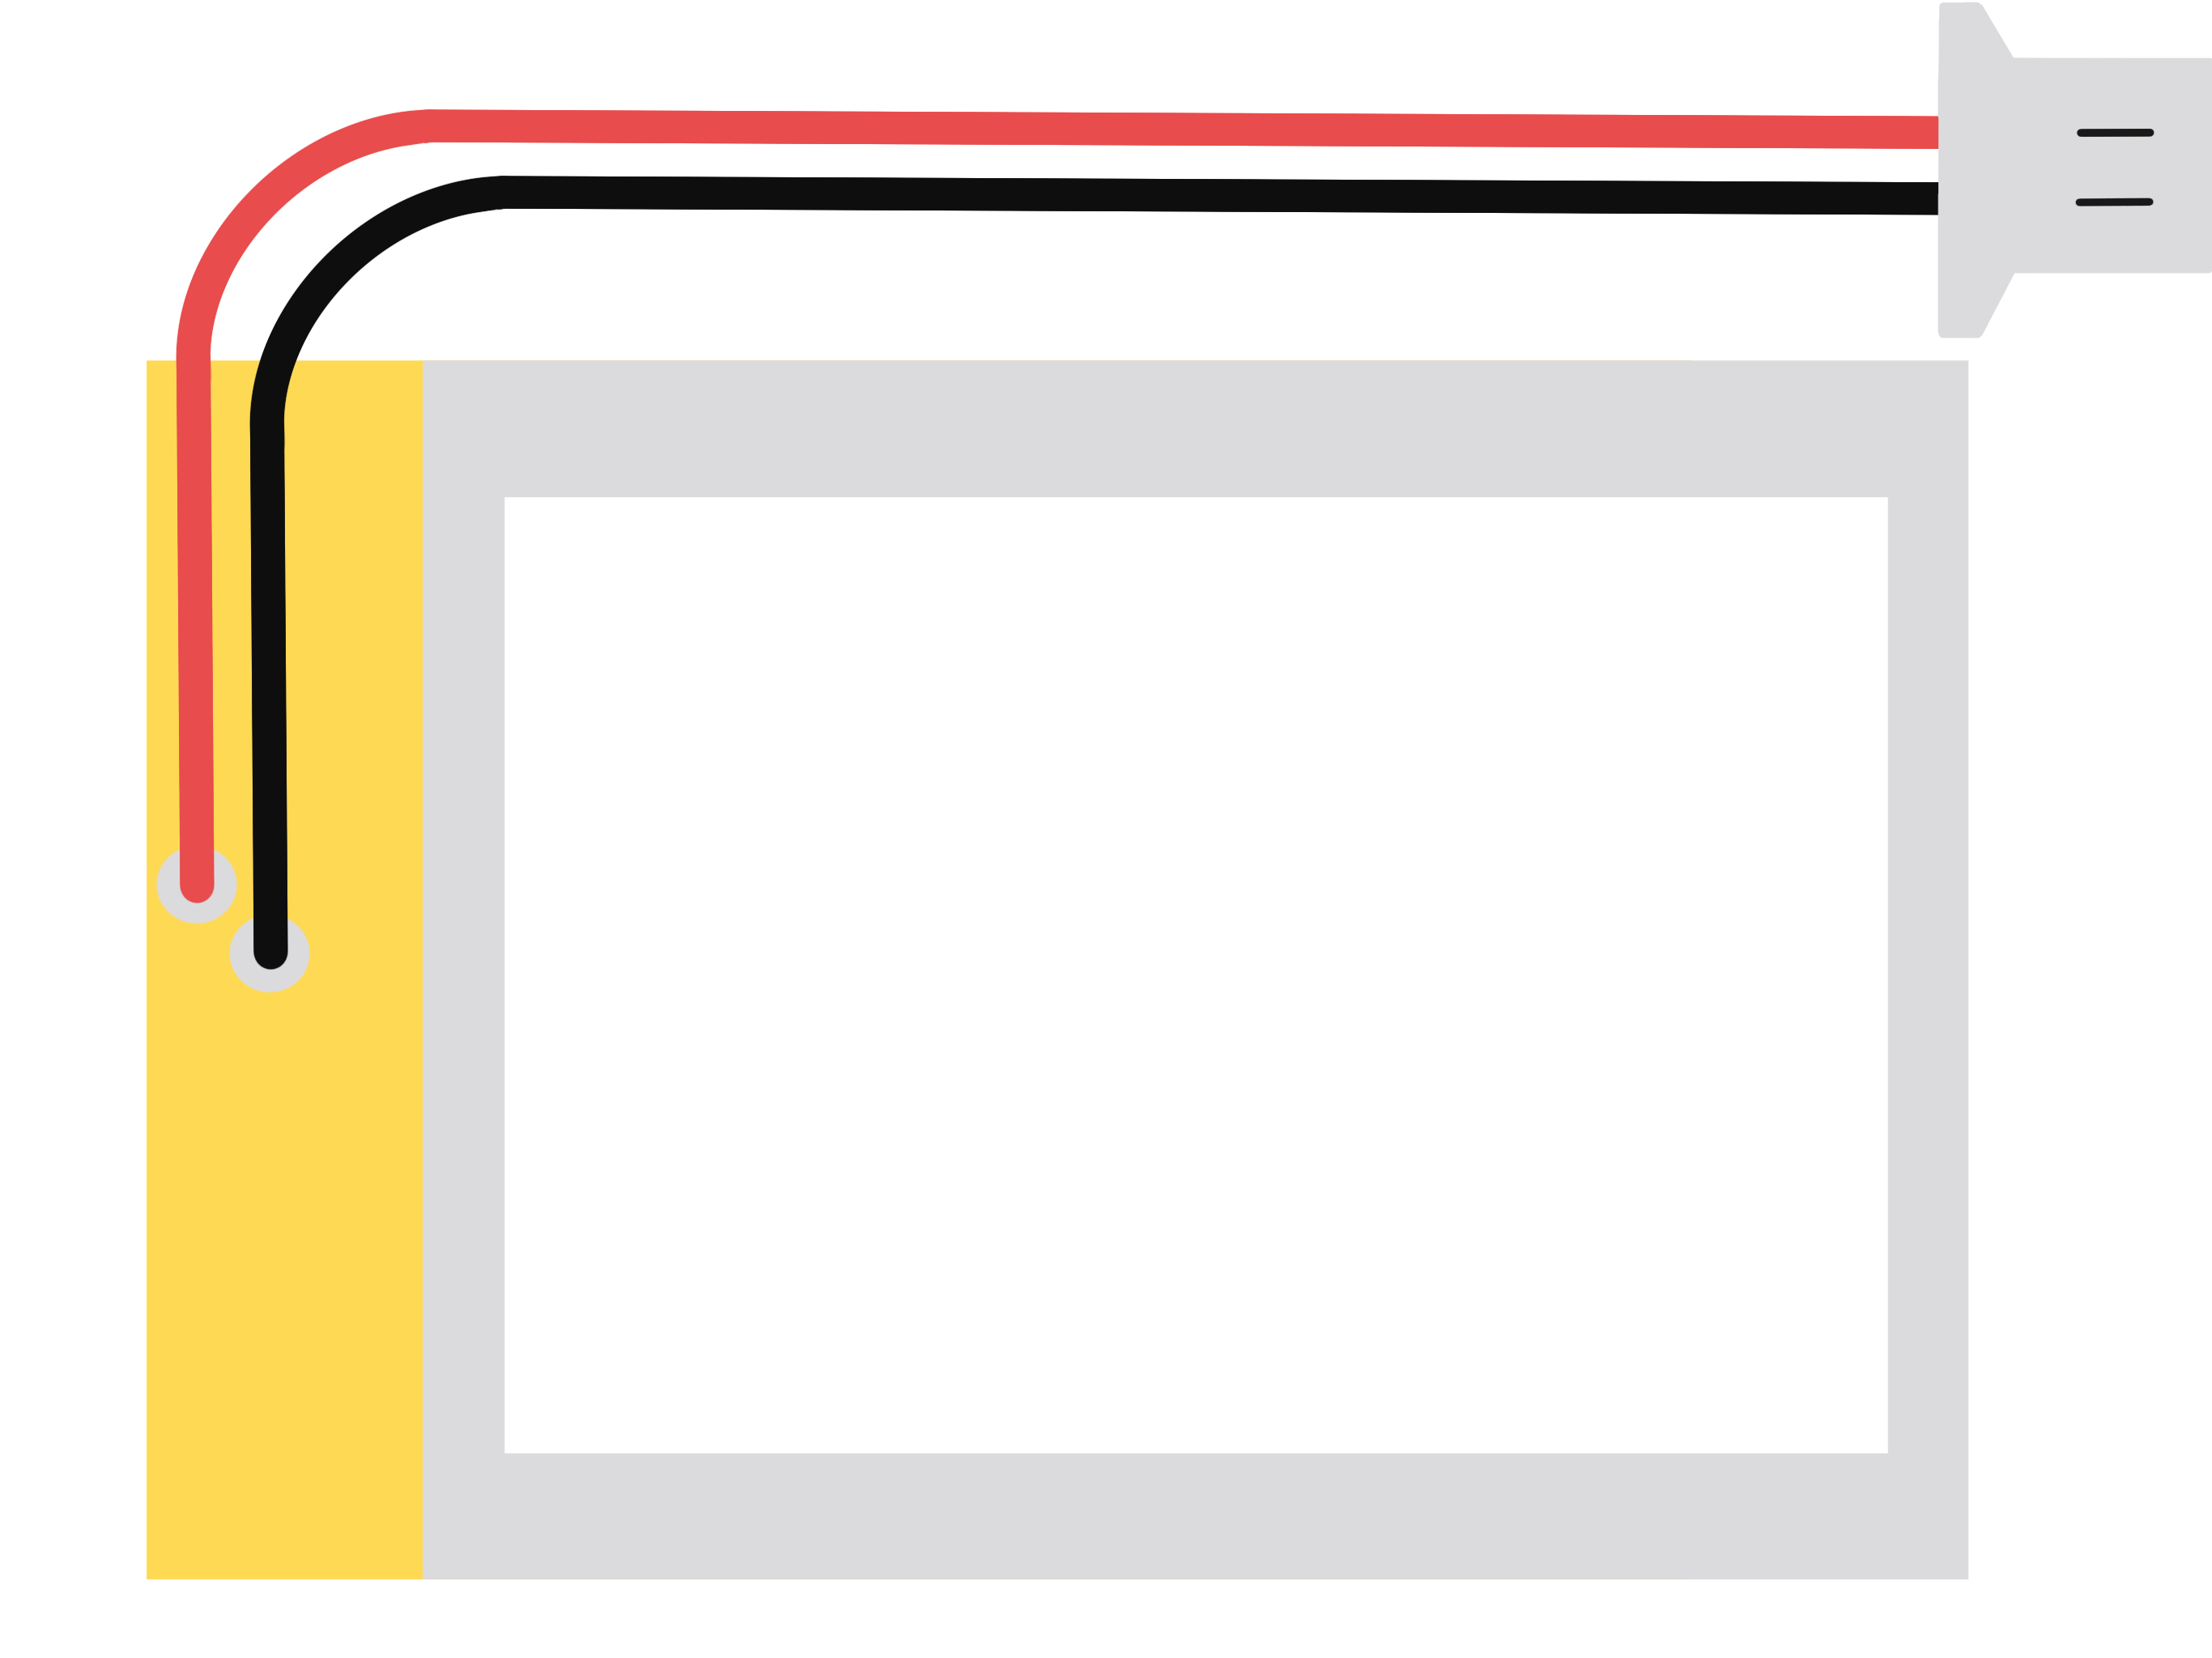
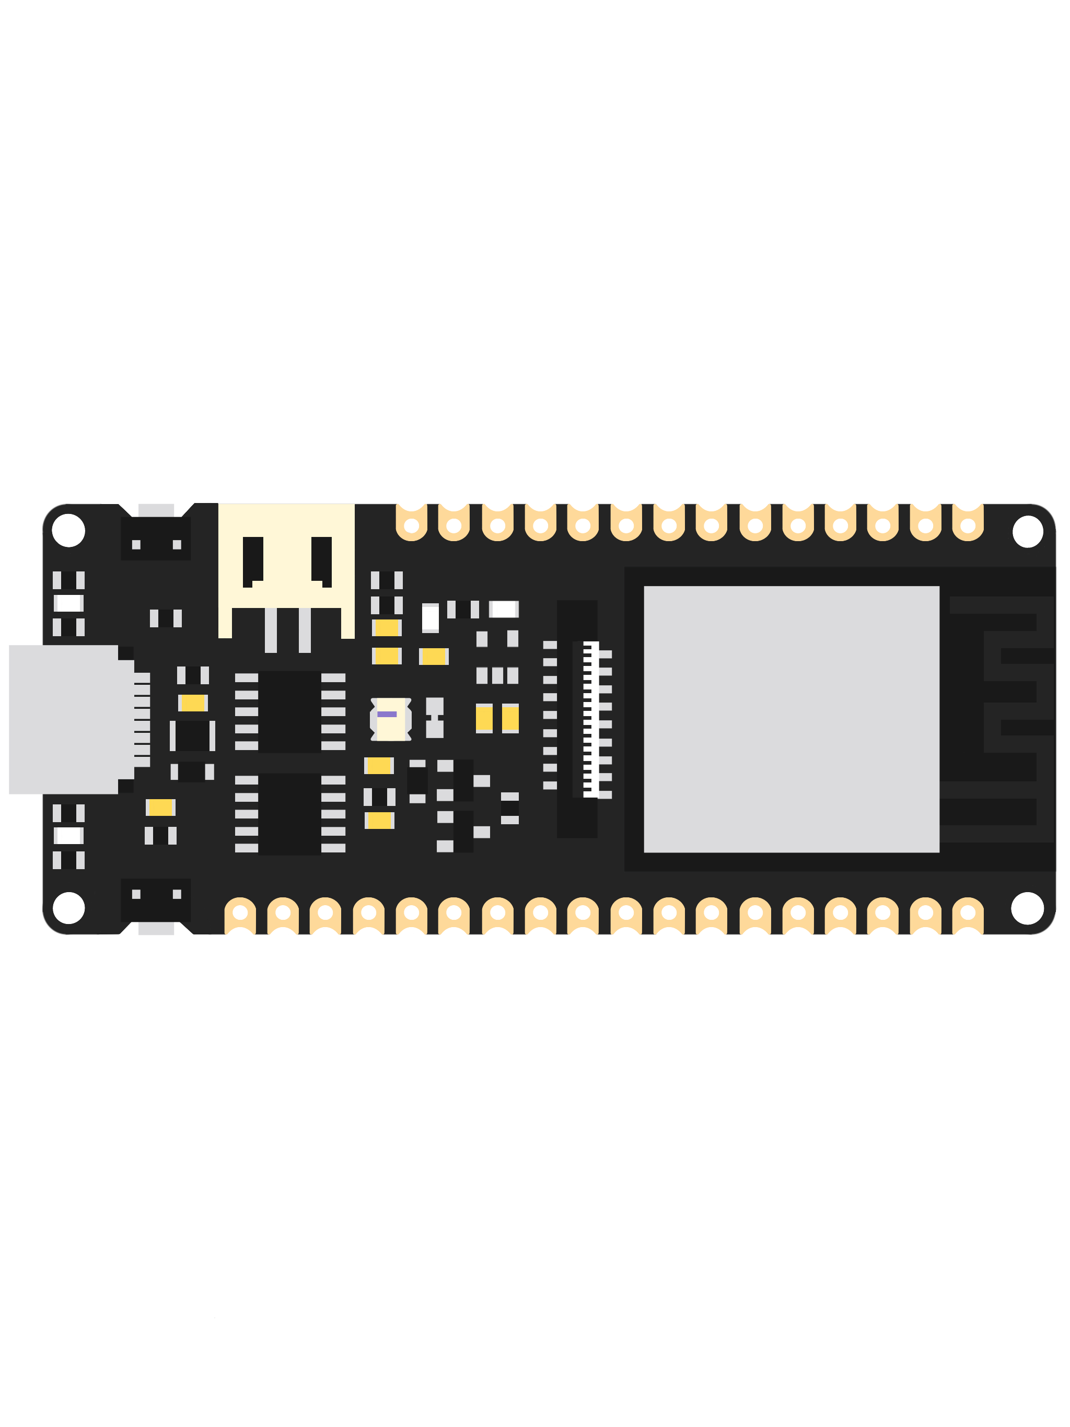
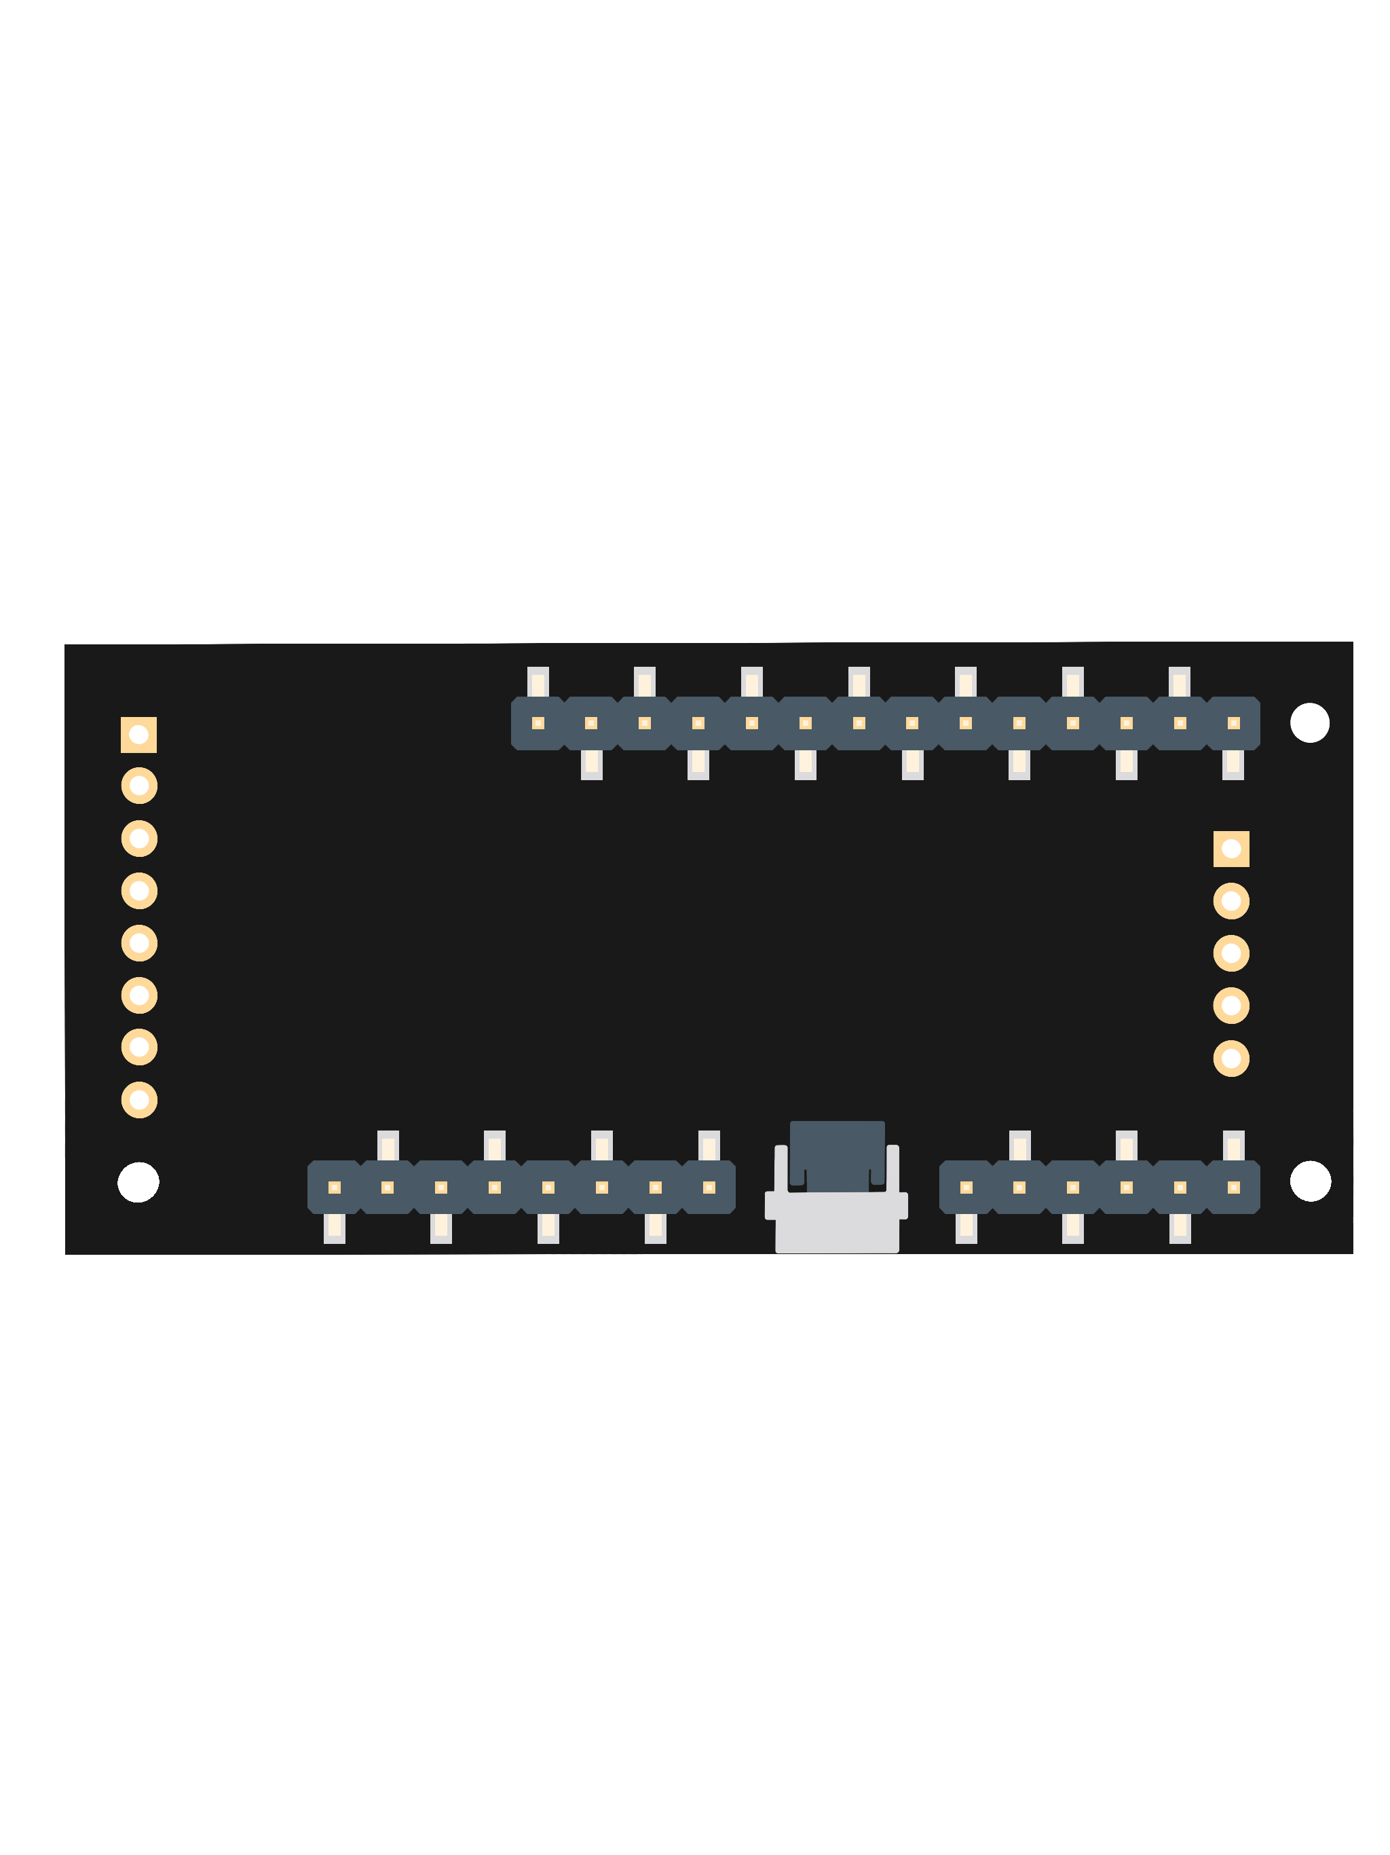



Unidentified flying mouse
ECE Team S10 – George Gill, Luke West, Ryan Xu, Matthew Yu
Objective
Components Breakdown
Design a computer mouse for those with limited hand dexterity or who are lacking a hand. Here is an an example of text with important words or things we want to highlight. Use this as a guide for what paragraphs of text will look like on the poster. Here are more highlighted words, like comfort, or battery life.
Existing Solutions
Our Solution
What Does it Do?
Design a computer mouse for those with limited hand dexterity or who are lacking a hand. Here is an an example of text with important words or things we want to highlight.
Design a computer mouse for those with limited hand dexterity or who are lacking a hand. Here is an an example of text with important words or things we want to highlight.
Design a computer mouse for those with limited hand dexterity or who are lacking a hand. Here is an an example of text with important words or things we want to highlight.
How Does it Work?
References
[1] Use IEEE Referencing Style. This is an example of a reference. Here is some more example text.
[2] Use IEEE Referencing Style. This is an example of a reference with multiple lines. Here’s more text so that I can fill this paragraph out.
[3] Use IEEE Referencing Style. This is an example of a reference with multiple lines. Here’s more text so that I can fill this paragraph out. More text lol.
[4] Use IEEE Referencing Style. This is an example of a reference with multiple lines. Here’s more text so that I can fill this paragraph out.
[5] Use IEEE Referencing Style. This is an example of a reference. Here is some more example text.
[6] Use IEEE Referencing Style. This is an example of a reference with multiple lines. Here’s more text so that I can fill this paragraph out.
[7] Use IEEE Referencing Style. This is an example of a reference with multiple lines. Here’s more text so that I can fill this paragraph out. More text lol.
[8] Use IEEE Referencing Style. This is an example of a reference with multiple lines. Here’s more text so that I can fill this paragraph out.

