Slide 1
CS 35L
LAB 8,
TA: Sucharitha Prabhakar
EMAIL ID: prabhakarsucharitha@gmail.com

Slide 2
Outline
Compilation process
Make
Automake
Applying a patch

Slide 3
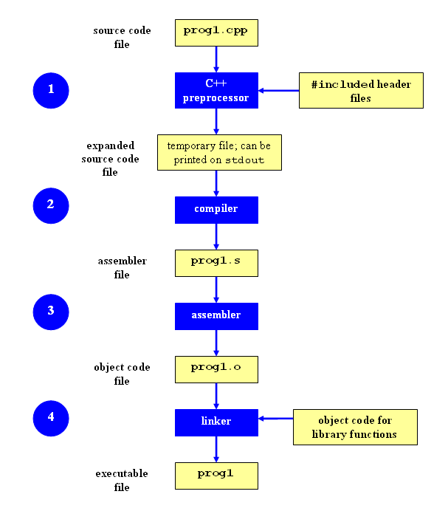
Compilation process

Slide 4
Compilation process
Preprocessing:
cc -E hello_world.c
Compilation:
cc -S hello_world.c
Assembly:
cc -c hello_world.c
hexdump hello_world.o
Linking
cc -o hello_world hello_world.c

Slide 5
Compilation
shop.cpp
#includes shoppingList.h and item.h
shoppingList.cpp
#includes shoppingList.h
item.cpp
#includes item.h
How to compile?
g++ -Wall shoppingList.cpp item.cpp shop.cpp –o shop

Slide 6
What if ?
We change one of the header or source files?
Rerun command to generate new executable
We only made a small change to item.cpp?
not efficient to recompile shoppinglist.cpp and shop.cpp
Solution: avoid waste by producing a separate object code file for each source file
g++ -Wall –c item.cpp… (for each source file)
g++ item.o shoppingList.o shop.o –o shop (combine)
Less work for compiler, saves time but more commands

Slide 7
What if ?
We change item.h?
Need to recompile every source file that includes it & every source file that includes a header that includes it. Here: item.cpp and shop.cpp
Difficult to keep track of files when project is large
Windows 7 ~40 million lines of code
Google ~2 billion lines of code
MAKE

Slide 8
Make
GNU Make is a tool which controls the generation of executables and other non-source files of a program from the program's source files.
Make gets its knowledge of how to build your program from a file called the makefile, which lists each of the non-source files and how to compute it from other files.

Slide 9
Advantages of Make
Make enables the end user to build and install your package without knowing the details of how that is done
Make figures out automatically which files it needs to update, based on which source files have changed. It also automatically determines the proper order for updating files, in case one non-source file depends on another non-source file.
As a result, if you change a few source files and then run Make, it does not need to recompile all of your program.

Slide 10
Advantages of Make
Make is not limited to any particular language. For each non-source file in the program, the makefile specifies the shell commands to compute it. These shell commands can run a compiler to produce an object file, the linker to produce an executable, ar to update a library, or TeX or Makeinfo to format documentation.
Make is not limited to building a package. You can also use Make to control installing or uninstalling a package, generate tags tables for it, or anything else you want to do often enough to make it worth while writing down how to do it.

Slide 11
Build Process
Configure
Script that checks details about the machine before installation
Dependency between packages
Creates ‘Makefile’
make
Requires ‘Makefile’ to run
Compiles all the program code and creates executables in current temporary directory
make install
make utility searches for a label named install within the Makefile, and executes only that section of it
executables are copied into the final directories (system directories)

Slide 12
Automake
GNU Automake is a tool to automate parts of the compilation process.
It eases usual compilation problems. For example, it points to needed dependencies.
It automatically generates one or more Makefile.in from files called Makefile.am.
Each Makefile.am contains, among other things, useful variable definitions for the compiled software, such as compiler and linker flags, dependencies and their versions, etc.

Slide 13
Automake
GNU Automake is a tool to automate parts of the compilation process.
It eases usual compilation problems. For example, it points to needed dependencies.
It automatically generates one or more Makefile.in from files called Makefile.am.
Each Makefile.am contains, among other things, useful variable definitions for the compiled software, such as compiler and linker flags, dependencies and their versions, etc.
Notes:
Makefile.am is a programmer-defined file and is used by automake to generate the Makefile.in file (the .am stands for automake). The configure script typically seen in source tarballs will use the Makefile.in to generate a Makefile.

Slide 14
Automake
Makefile.am in <tests/project>
SUBDIRS = src
Makefile.am in <tests/project/src>
bin_PROGRAMS = helloworld
AM_CXXFLAGS = $(INTI_CFLAGS)
helloworld_SOURCES = main.cc helloworld.cc helloworld.h
helloworld_LDADD = $(INTI_LIBS)
Notes:
You must provide a Makefile.am file for each directory in your source tree. Makefile.am for the top-level directory is simple. Create a new text file called Makefile.am in the <tests/project> directory. Add the following line to the file and save it:
SUBDIRS = src
The SUBDIRS variable is used to list the subdirectories that must be built.
Next, in the <tests/project/src> subdirectory create another text file called Makefile.am. Add the following lines to the file and save it:
bin_PROGRAMS = helloworld
AM_CXXFLAGS = $(INTI_CFLAGS)
helloworld_SOURCES = main.cc helloworld.cc helloworld.h
helloworld_LDADD = $(INTI_LIBS)
The bin_PROGRAMS variable specifies that we want a program called helloworld to be built and installed in the bin directory when make install is run.
The AM_CXXFLAGS macro sets the compiler flags. You should not use CXXFLAGS in Makefile.am because it's unsafe. CXXFLAGS is a user variable that users expect to be able to override.
The helloworld_SOURCES variable specifies the source files used to build the helloworld target. Note that the SOURCES variable for a target is prefixed by the name of the target, in this case helloworld.
The last variable, helloworld_LDADD, specifies the libraries that must be passed to the linker to build the target. This variable is only used by programs and libraries. Note that LDADD uses the same naming rule as the SOURCES variable.

Slide 15
Lab Assignment

Slide 16
Installing Software
Windows
Installshield
Microsoft/Windows Installer
OS X
Drag and drop from .dmg mount -> Applications folder
Linux
rpm(Redhat Package Management)
RedHat Linux (.rpm)
apt-get(Advanced Package Tool)
Debian Linux, Ubuntu Linux (.deb)
Good old build process
configure, make, make install

Slide 17
Decompressing files
Generally, you receive Linux software in the tarball format (.tgz) or (.gz)
Decompress file in current directory:
$ tar –xzvf filename.tar.gz
Option –x: --extract
Option –z: --gzip
Option –v: --verbose
Option –f: --file

Slide 18
Problem
Coreutils 7.6 has a problem
Different users see different date formats
$ ls –l /bin/bash
-rwxr-xr-x 1 root root 729040 2009-03-02 06:22 /bin/bash
-rwxr-xr-x 1 root root 729040 Mar 2 2009 /bin/bash
Why?
Different locales
Want the traditional Unix format for all users
Fix the ls program

Slide 19
Setup
Download coreutils-7.6 to your home directory
Use ‘wget’
Untar and Unzip it
tar –xzvf coreutils-7.6.tar.gz
Make a directory ~/coreutilsInstall in your home directory (this is where you’ll be installing coreutils)
mkdir ~/coreutilsInstall

Slide 20
Setup
Go into coreutils-7.6 directory. This is what you just unzipped.
Read the INSTALL file on how to configure “make”, especially --prefix flag
Run the configure script using the prefix flag so that when everything is done, coreutils will be installed in the directory ~/coreutilsInstall
Compile it: make
Install it: make install

Slide 21
Reproduce bug
Reproduce the bug by running the version of ‘ls’ in coreutils 7.6
If you just type ls at CLI it won’t run ‘ls’ in coreutils 7.6
Why? Shell looks for /bin/ls
To use coreutils 7.6: $ ./ls -lrt
This manually runs the executable in this directory (ls is in src directory)

Slide 22
Patch
A patch is a piece of software designed to fix problems with or update a computer program
It’s a diff file that includes the changes made to a file
A person who has the original (buggy) file can use the patch command with the diff file to add the changes to their original file

Slide 23
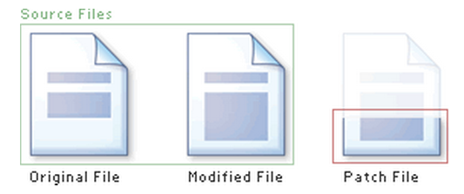
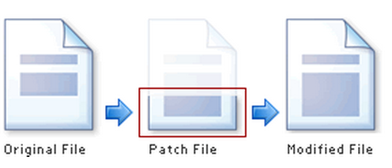
Applying a Patch

Slide 24
diff Unified Format
diff –u original_file modified_file
--- path/to/original_file
+++ path/to/modified_file
@@ -l,s +l,s @@
@@: beginning of a chunk
l: beginning line number
s: number of lines the change chunk applies to for each file
A line with a:
- sign was deleted from the original
+ sign was added to the original
stayed the same

Slide 25
Patching and Building
cd coreutils-7.6
vim or emacs patch_file: copy and paste the patch content
patch –pnum < patch_file
‘man patch’ to find out what pnum does and how to use it
cd into the coreutils-7.6 directory and type make to rebuild patched ls
Don’t install!!

Slide 26
Testing fix
Test the following:
Modified ls works
Installed unmodified ls does NOT work
Test on:
A file that has been recently modified
Make a change to an existing file or create a new file
A file that is at least a year old
touch –t 201401210959.30 test_file

