Slide 1
CS 35L
LAB 8,
TA: Sucharitha Prabhakar
EMAIL ID: prabhakarsucharitha@gmail.com

Slide 2
Outline
Multiprocessing
Parallelism
Multithreading

Slide 3
Multiprocessing
The use of multiple CPUs/cores to run multiple tasks simultaneously

Slide 4
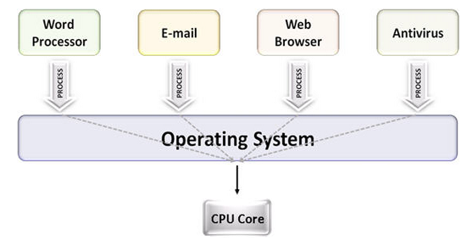
Uniprocessing

Slide 5
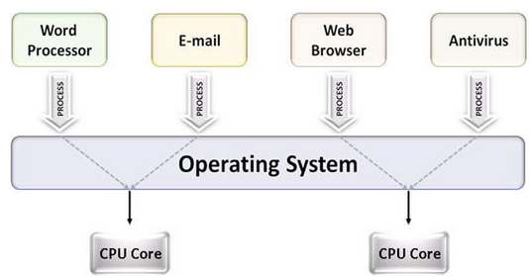
Multiprocessing

Slide 6
Parallelism
Executing several computations simultaneously to gain performance
Different forms of parallelism
Multitasking
Several processes are scheduled alternately or possibly simultaneously on a multiprocessing system
Multithreading
Same job is broken logically into pieces (threads) which may be executed simultaneously on a multiprocessing system

Slide 7
What is a thread?
A flow of instructions, path of execution within a process. The smallest unit of processing scheduled by OS. A process consists of at least one thread
Multiple threads can be run on:
A uniprocessor (time-sharing)
Processor switches between different threads
Parallelism is an illusion
A multiprocessor
Multiple processors or cores run the threads at the same time
True parallelism

Slide 8
Multitasking

Slide 9
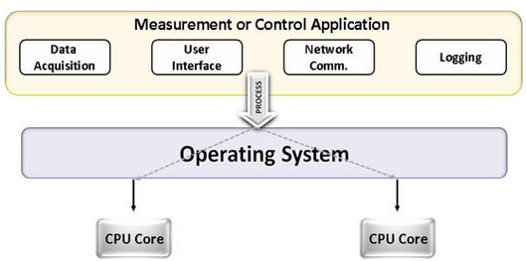
Multithreading

Slide 10
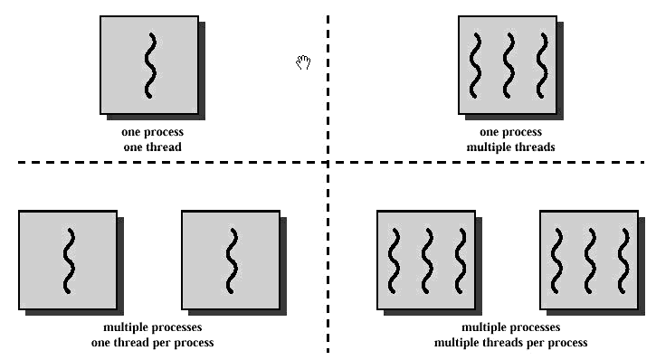
Multitasking and Multithreading

Slide 11
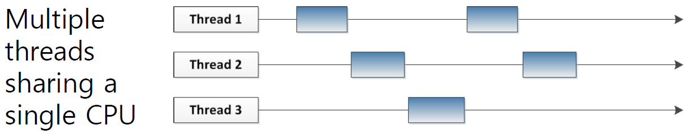
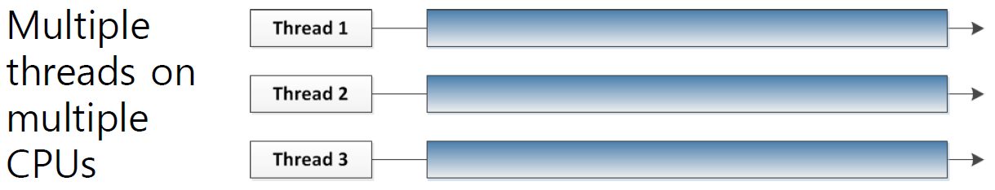

Slide 12
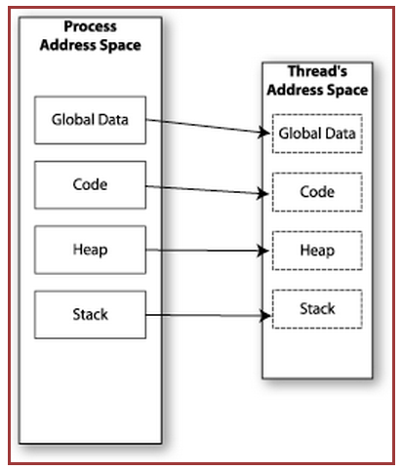

Memory Layout: Single-Threaded Program

Slide 13
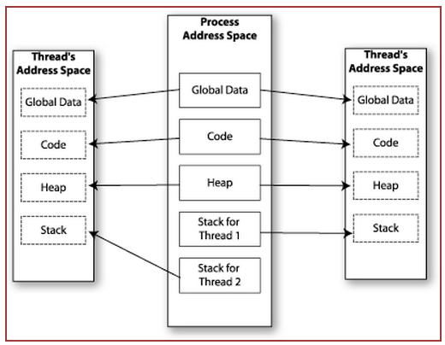

Memory Layout: Multithreaded Program

Slide 14
Multithreading & Multitasking: Comparison
Multithreading
Threads share the same address space
Light-weight creation/destruction
Easy inter-thread communication
An error in one thread can bring down all threads in process
Multitasking
Processes are insulated from each other
Expensive creation/destruction
Expensive IPC
An error in one process cannot bring down another process

Slide 15
Communication in Multitasking
tr -cs 'A-Za-z' '[\n*]' | sort -u | comm -23 – words
Process 1 (tr), Process 2 (sort), Process 3 (comm)
Each process has its own address space
How do these processes communicate?
Pipes/System Calls

Slide 16
Communication in Multithreading
Threads share all of the process's memory except for their stacks
=> Data sharing requires no extra work (no system calls, pipes, etc.)

Slide 17
Shared memory
Makes multithreaded programming
Powerful
Can easily access data and share it among threads
More efficient
No need for system calls when sharing data
Thread creation and destruction less expensive than process creation and destruction
Non-trivial
Have to prevent several threads from accessing and changing the same shared data at the same time (synchronization)

Slide 18
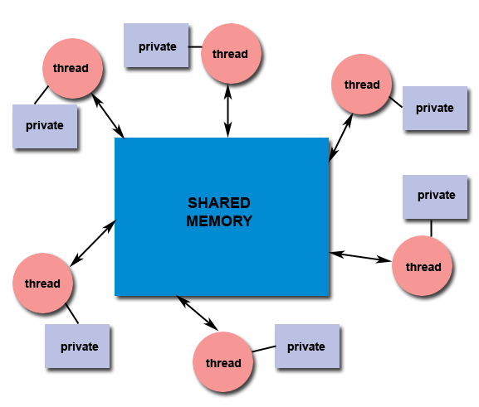
Shared memory

Slide 19
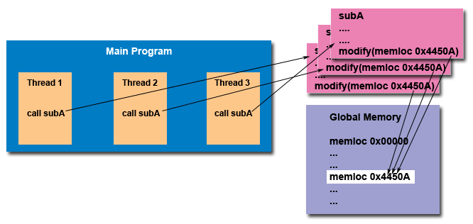
Thread safety

Slide 20
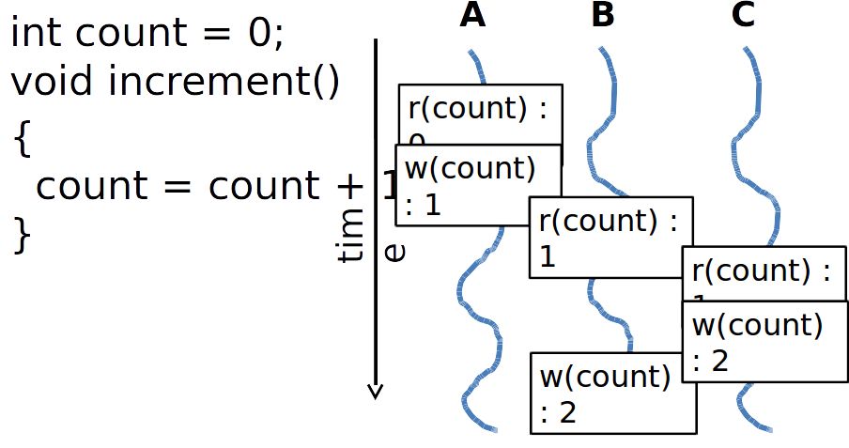
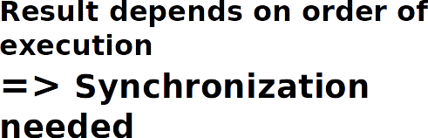
Race Condition

Slide 21
Mutex
mutexes - Mutual exclusion lock: Block access to variables by other threads. This enforces exclusive access by a thread to a variable or set of variables.
Mutexes are used for serializing shared resources.
Anytime a global resource is accessed by more than one thread the resource should have a Mutex associated with it.
When a mutex lock is attempted against a mutex which is held by another thread, the thread is blocked until the mutex is unlocked.

Slide 22
POSIX Threads
The POSIX thread libraries are a standards based thread API for C/C++.

Slide 23
PThread Creation
int pthread_create(pthread_t * thread, const pthread_attr_t * attr,
void * (*start_routine)(void *), void *arg);
Arguments:
thread - returns the thread id. (unsigned long int defined i bits/pthreadtypes.h)
attr - Set to NULL if default thread attributes are used. void * (*start_routine) - pointer to the function to be threaded. Function has a single argument: pointer to void.
*arg - pointer to argument of function. To pass multiple arguments, send a pointer to a structure.

Slide 24
Pthread exit
void pthread_exit(void *retval);
Arguments:
retval - Return value of thread.
This routine kills the thread.
Note: the return pointer *retval, must not be of local scope otherwise it would cease to exist once the thread terminates.

Slide 25
Pthread join
int pthread_join(pthread_t thread, void **value_ptr);
The pthread_join() function suspends execution of the calling thread until the target thread terminates, unless the target thread has already terminated.

Slide 26
Mutex
int pthread_mutex_lock(pthread_mutex_t *mutex); int pthread_mutex_unlock(pthread_mutex_t *mutex);
The mutex object referenced by mutex is locked by calling pthread_mutex_lock(). If the mutex is already locked, the calling thread blocks until the mutex becomes available. This operation returns with the mutex object referenced by mutex in the locked state with the calling thread as its owner.

Slide 27
Lab
Evaluate the performance of multithreaded sort
Add /usr/local/cs/bin to PATH
$ export PATH=/usr/local/cs/bin:$PATH
Generate a file containing 10M random double-precision floating point numbers, one per line with no white space
/dev/urandom: pseudo-random number generator

Slide 28
Lab
od
Write the contents of its input files to standard output in a user-specified format
Options
-t f: Double-precision floating point
-N <count>: Format no more than count bytes of input
sed, tr
Remove address, delete spaces, add newlines between each float

Slide 29
Lab
Use time -p to time the command sort -g on the data you generated
Send output to /dev/null
Run sort with the --parallel option and the –g option: compare by general numeric value
Use time command to record the real, user and system time when running sort with 1, 2, 4, and 8 threads
$ time –p sort –g file_name > /dev/null (1 thread)
$ time –p sort –g --parallel=[2, 4, or 8] file_name > /dev/null
Record the times and steps in log.txt

