Slide 1


Slide 2
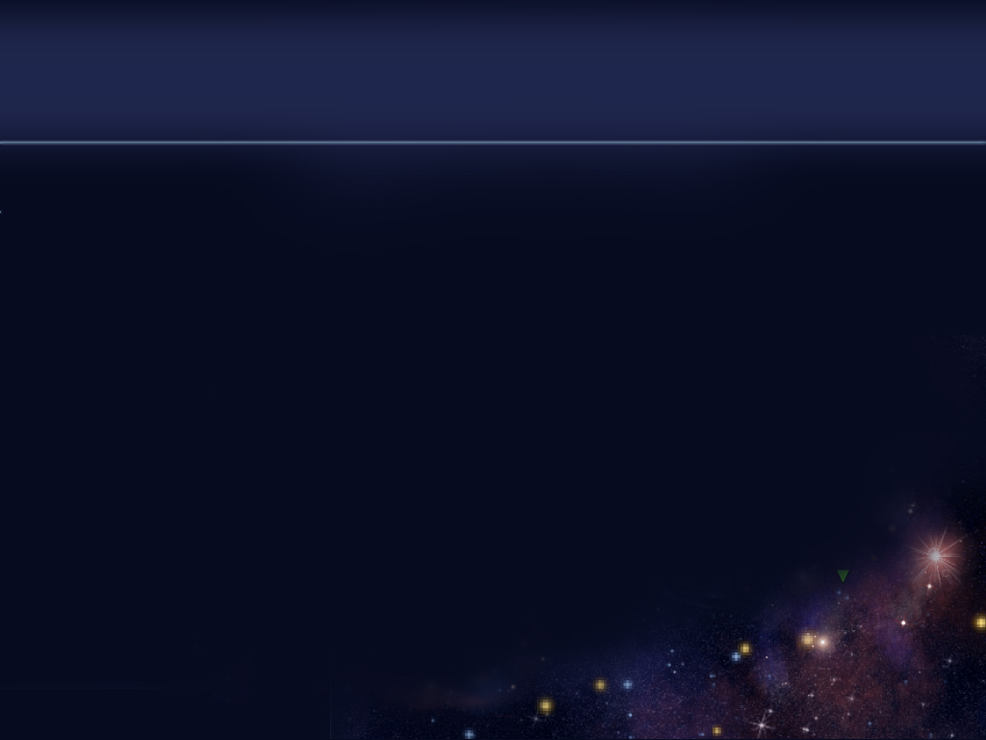
Introduction
The player’s ship suffers a failure in the drive systems during intergalactic travel
The player:
Needs to navigate through the galaxy to obtain necessary materials to rebuild the warp drive
Should analyze the local economies to determine where to buy and sell commodities
Can trade commodities between various ports in the galaxy where commodities and prices are pseudo-randomly generated
Starts with $500
The player dies if he/she runs out of fuel
The player wins by acquiring the necessary materials to repair the ship and leaving the galaxy

Slide 3
Outline
Interface
Main Menu
Options Menu
Navigating through the Galaxy
Trading
Viewing Current Inventory
Game
Random Generation of the Game World
Trading Commodities for Profit
Obtaining Necessary Materials to Win the Game

Slide 4
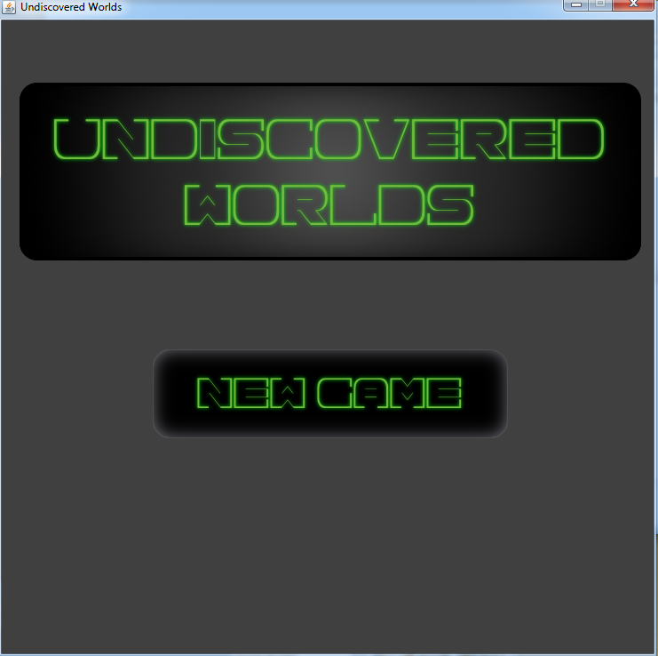
Interface: Main Menu

Slide 5
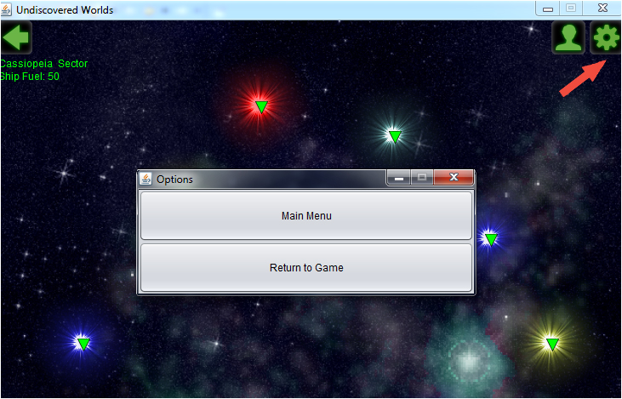
Interface: Options Menu

Slide 6
Interface: Navigating through the Galaxy
Current location is displayed under the Back arrow
Can also hover over the Back arrow to see the current location
The Back button can be pressed to see up a level when the player is not at the galaxy
Navigation markers are used to navigate above the Star System level

Slide 7
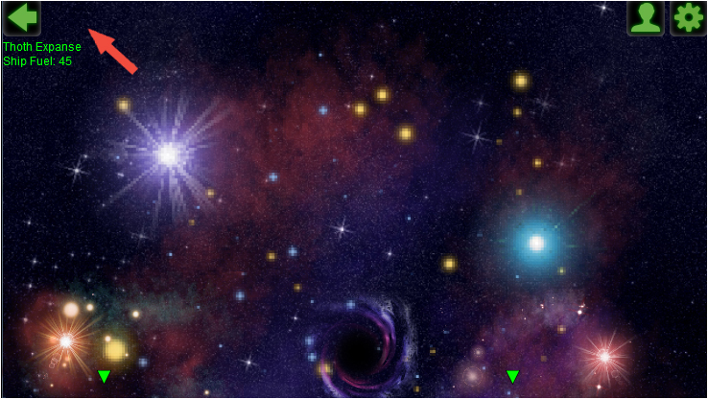
Interface: Navigating through the Galaxy (Cont.)

Slide 8
Interface: Trading
Trading Menu is displayed when a navigation marker is pressed
Can also hover over the Back arrow to see the current location
Trading menu contains:
List of a merchant’s inventory
List of a player’s inventory
Buy, Sell, Leave Buttons

Slide 9
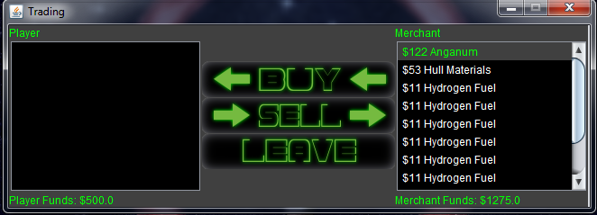
Interface: Trading (Cont.)

Slide 10
Interface: Viewing Current Inventory
Click on the Inventory icon to access current inventory
Click on items in the inventory list to see their descriptions
Current funds are displayed
Buttons:
Use
Drop
Back

Slide 11
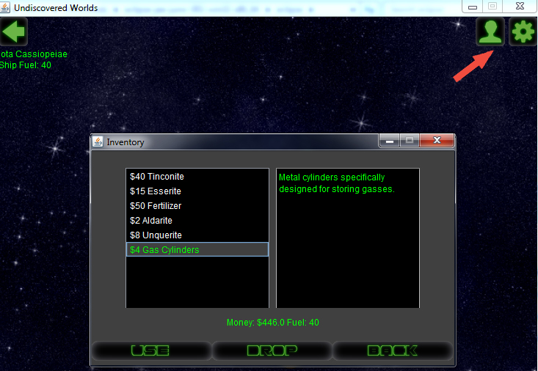
Interface: Viewing Current Inventory

Slide 12
Game: Random Generation of the Game World
Algorithm generates the galaxy pseudo-randomly using seed values
When a cluster is accessed, it is generated on-the-fly using its seed value
Each element references static information to determine specific attributes

Slide 13
Game: Trading Commodities for Profit
Buy low, sell high
A merchant’s inventory is generated as needed
Prices vary based on availability and location

Slide 14
Game: Obtaining Necessary Materials to Win the Game
Necessary materials required:
Phlebotinum
Unobtainium
Diamonds
Use a player’s inventory to repair drive
Press the Back button to win the game after repairs are completed
The payer dies if he/she runs out of fuel

Slide 15
Undiscovered Worlds
Necessary materials required:
Phlebotinum
Unobtainium
Diamonds
Use a player’s inventory to repair drive
Press the Back button to win the game after repairs are completed
The payer dies if he/she runs out of fuel

