Slide 1

ALTO New Transport draft-ietf-alto-new-transport-03 draft-schott-alto-new-transport-pull-00 (TO DO) draft-schott-alto-new-transport-push-00
Presenter: Roland Schott
November 11, 2022
IETF 115
Notes:
https://datatracker.ietf.org/doc/draft-ietf-alto-new-transport/
https://datatracker.ietf.org/doc/draft-schott-alto-new-transport-push/

Slide 2
Outline
Recap of discussions and WG decisions
Major changes from IETF 114
Discussions and remaining issues to finalize

Slide 3
Review References
Four excellent, early-HTTP-expert/AD reviews
[MT] Martin Thompson (July 11)
https://mailarchive.ietf.org/arch/msg/alto/sa1Pv7jmTfBF3TbGuJr_PffIjXg/
[SD] Spencer Dawkins (July 15)
https://datatracker.ietf.org/doc/review-ietf-alto-new-transport-01-artart-early-dawkins-2022-07-15/
[MN] Mark Nottingham (July 17)
https://mailarchive.ietf.org/arch/msg/alto/D84S0qLbgtpL0-jf93gNPS3NUJE/
[MD]
Comments by AD Martin Duke at IETF 114

Slide 4
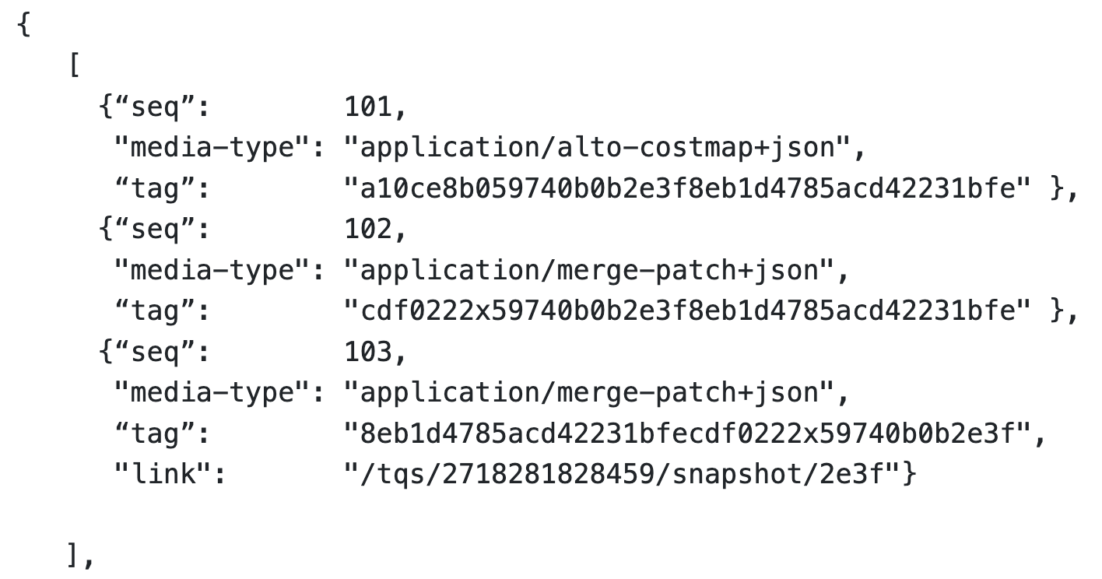
Recap: IETF 114 Reviews/Discussions: Finalizing Op Mode(s)
Four potential operational modes to transfer updates to a resource from the ALTO server to the ALTO client:
Client pull
Client long pull
Blocking in HTTP/1.x
Allow request on next seq number
Server push
PUSH_PROMISE (HTTP/2-3)
Server put
ALTO server as HTTP client
Notes:
Benefit:
Avoid “awkward” promise (current spec: MUST NOT cancel push promise)
Issue: semantics
Client conceptually is only a cache, not a persistent state replica

Slide 5
Recap: How Much to Specify Ordering Control: Transport-Aware of App Semantics [MN, MT, SD reviews]
App/ALTO
network map 1
network map 1 patch 1
R1
R2
Design 1:
ALTO specifies only: mapping each Ri to an independent HTTP/2-3 stream; HTTP does scheduling.
Issue: HTTP could schedule R4, then R3, then R2 and then R1 in transmitting order
R3
R4
cost map 1
cost map 1 patch 1
Design 2:
ALTO specifies that server submits to the HTTP transport in DAG order: submit Ri only when what Ri depends on are finished: R1; R2/R3, R4
Issue: Sliding window is large and transport can fit R1/R2/R/R4 into a single window
HTTP/2-3 server
R1
R2
Design 3:
ALTO indicates the dependencies to HTTP
Issue: HTTP client can indicate a parent in req header, but this is signaling from client to server; what we need are (1) app signaling to HTTP server, (2) multiple dependencies
R3
R4

Slide 6
Recap: How/Whether to Specify Settings
IETF 114 version allows client to specify two (HTTP/2) control knobs on server behaviors
0x02 SETTINGS_ENABLE_PUSH (a BCP14 “MUST”)
0x03 SETTINGS_MAX_CONCURRENT_STREAMS (a BCP14 “must”)
HTTP/3 changed these settings (RFC9114) [SD review]
SETTINGS_ENABLE_PUSH (0x02):This is removed in favor of the MAX_PUSH_ID frame, which provides a more granular control over server push. Specifying a setting with the identifier 0x02 is HTTP/3 error.
SETTINGS_MAX_CONCURRENT_STREAMS (0x03):QUIC controls the largest open stream ID as part of its flow-control logic. Specifying it is HTTP/3 error
Suggestion: (1) remove them in the spec and discuss them in operations; (2) specify generic requirements statement

Slide 7
Recap: Other Issues
Style guide recommends using HTTP/1.1 to specify examples
Introduce media type detail [IANA spec]

Slide 8
Outline
Recap of discussions and WG decisions
Major changes from IETF 114
Discussions and remaining issues to finalize

Slide 9
Major Structure Changes from IETF 114
Split the single document into multiple documents
Principle: decompose HTTP version independent components (work across HTTP/1.x-2-3); if dependent on a version, make the component a specific document
Main change: 3 documents
Doc 1: Specify common model supporting incremental updates
Doc 2: Specify client pull, client long pull (realistic only HTTP/2-3)
Still part of Doc 1, need to move to a sep doc if WG agrees
Doc 3: Server push (HTTP/2-3)
leave server put as future work (because additional complexity such as NAT)

Slide 10
High-Level Dependency of Documents
ALTO Client
ALTO Server
CRD incremental-updates-queue (Doc 1)
pull/long pull to elements of the queue in the same connection (Doc 2)
Push to client of elements in the queue in the same connection (Doc 3)
Server put to client of elements in the queue it needs a new connection

Slide 11
Base Document (Doc 1): Transport Data Structure
HTTP version independent and operational model independent specification
Foundation:
Transport of an information resource organized as a sequence of incremental updates (operational log in distributed computing), called an information updates queue
The ALTO server is the master of the updates queue
CRD operations:
The information update queue must first be created by an ALTO client at an ALTO server
The ALTO client can read/delete the queue status at the ALTO server
The close of the connection from the ALTO client to the ALTO server results in the deletion of the queue (no persistency)
Sequence:
Only the ALTO server can write to it; client can issue commands sequential or in parallel
The structure of the queue is an array of elements, where each element has the basic fields:
Sequence number
Must be incremental, no gap, up to 64 bits; if reach limit, wrap to 0
Media-type
Tag

Slide 12
Client Pull Document (Doc 2): Client Read Updates
Client -> server: Very simple design, only GET method on <updates-queue-uri>/<seq>
Allow caching and content distribution to large scale, for future extension
Server -> client
Long poll support: fetch the next seq
Transfer scheduling (at the server/client)
Pull design allows client to issue concurrent pull requests, but the results can have dependency => specify the scheduling will lead to version specification; we specify them as only operational considerations
Transfer processing (at the client) requirements
Specify (SHOULD include) tag to enforce correctness
Specify that other HTTP transport control (e.g., concurrency control) should be honored, but is transparent to ALTO transport (discuss in WG)

Slide 13
Server Push Document (Doc 3): Server Push Updates to Clients
Client -> server:
Indicate acceptance by setting up state (join receiver-set)
Start: put self into <updates-queue>/rs
Stop: delete self from the receiver set
Different from early doc: join when creating the updates queue, but this causes coupling of Doc 1 and Doc 3.
Server -> client
Specify as PUSH_PROMISE in HTTP/2-3
Transfer scheduling
Specify only operational considerations on transfer scheduling of dependent updates as performance optimization
Specify that other HTTP transport control (e.g., concurrency control) should be honored, but is transparent to ALTO transport

Slide 14
Server Put Document (Potential Doc 4): Defer
Can be an excellent tool for server-to-server communications
Leave Server PUT (i.e., replicated operational log) as future work

Slide 15
Next Step
The latest documents in WG git
Will upload the latest documents to data tracker by the weekend
Seek WG reviews

Slide 16
Backup Slides

Slide 17
Service | Type (Out if not labeled) | Core Information Structures | Main Size Var | Stability Expectation | Incremental Changes
Information Resource Directory [RFC7285] | application/alto-directory+json | Key-value store; Delegation | #resources | Stable | Add/delete resources
Network Map [RFC7285] | application/alto-networkmap+json | Key-value store: pid -> addrType -> array | #CIDRs | Stable | Add/delete CIDR from pid
Cost Map [RFC7285] | application/alto-costmap+json | Key-value store: srcPID -> dstPID -> value Depend on network map | #SRCPID * #DSTPID | More dynamic than network map | Update cost map entries
Filtered Map Services [RFC7285] | In: application/alto-networkmapfilter+json Out: application/alto-costmapfilter+json | In: selected srcPID, dstPID Key-value store: srcPID -> dstPID -> value Depend on network map | Filtered #SRCPID * #DSTPID | More dynamic than network map | Update cost map entries
Endpoint Property Service [RFC7285] | In: application/alto-endpointpropparams+json Out: application/alto-endpointprop+json | In: addr + prop Key-value store: addr -> prop -> value | #addr * #prop | Depend on property, can be dynamic or stable | Update property value
Endpoint Cost Service [RFC7285] | In: application/alto-endpointcostparams+json Out: application/alto-endpointcost+json | In: srcAddr x dstAddr Key-value store: srcAddr -> dstAddr -> value | #src * #dst | Can be more dynamic than cost map | Update cost value
Cost Calendar [RFC8896] | Extension to CostType | Calendar array | Previous * #num_intervals | Can be dynamic | Calendar window moves
Unified Property | In: application/alto-propmapparams+json; Out: application/alto-propmap+json | In: addr, prop Key-value store: addr -> prop -> value | #addr * #prop | Depend on property, can be dynamic or stable | Update property value
Path Vector | In: see costmap; Out: multipart/related;type=application/alto-costmap+json, | Cost map + unified property map | #src * #dst * #vec size | Depend on metric, can be dynamic or stable | Update path vector
CDNi Cap & Footprint | application/alto-cdni+json | Array; {capability-type: capability-value} | #footprint * #capability | Can be dynamic, bursty | Update capabilities

Slide 18
Performance and Effectiveness of Current Transport
Infrastructures | Basic Workload (ALTO SPEC) | Transport | Collecting metrics
Benocs is fully open to use its infrastructure as an evaluation environment Greater Bay Network is also fully open to use its infrastructure as an evaluation environment | (Filtered) Cost map: distribute inter-site performance metrics and calendar; routing changes + link dynamics => updated metrics Endpoint/unified property service: endpoint access status query/updates/bwe CDN node footprint & capability Flow direction (pointing to CDN nodes) using ECS Path vector providing available reservable bandwidth | HTTP/1.x per request full retrieval keep alive pipelining HTTP/2, HTTP/3 per request, full retrieval ALTO/SSE RFC8895 (on HTTP/1.x) | ALTO Server processing load ALTO client processing load Transport load (bytes) Transport latency Throughput Scalability

Slide 19
General Space of Network->App Information Transport
Protocol/Base Reference | What information | How transported | Frequency
ALTO/RFC7285, RFC8895 | Network map, cost map, unified property, … | HTTP/1.x client/server | Request/response; ALTO/SSE incremental push
ECN/RFC3168 | Congestion notification | 2 bits in IP Traffic Class header; ECN-Echo/CWR flags in TCP header | Per packet marking
NEF, SCEF<->AS/3GPP, … | Network capabilities/events -> AF | HTTP | Request/response
…

Slide 20
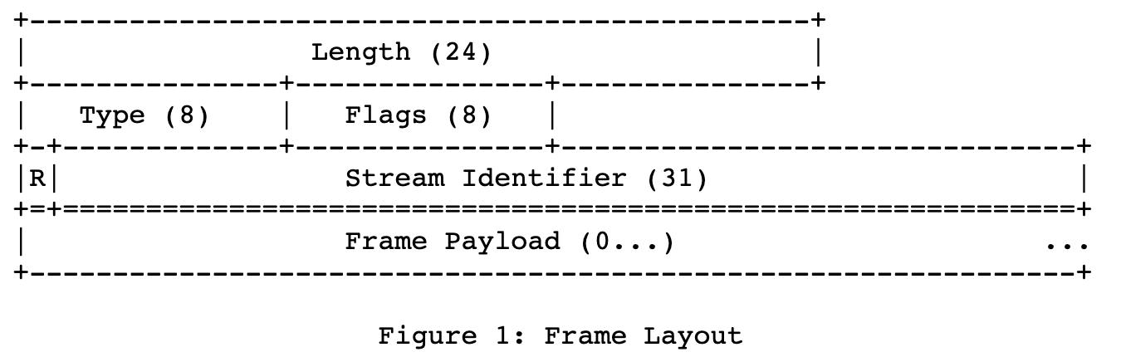
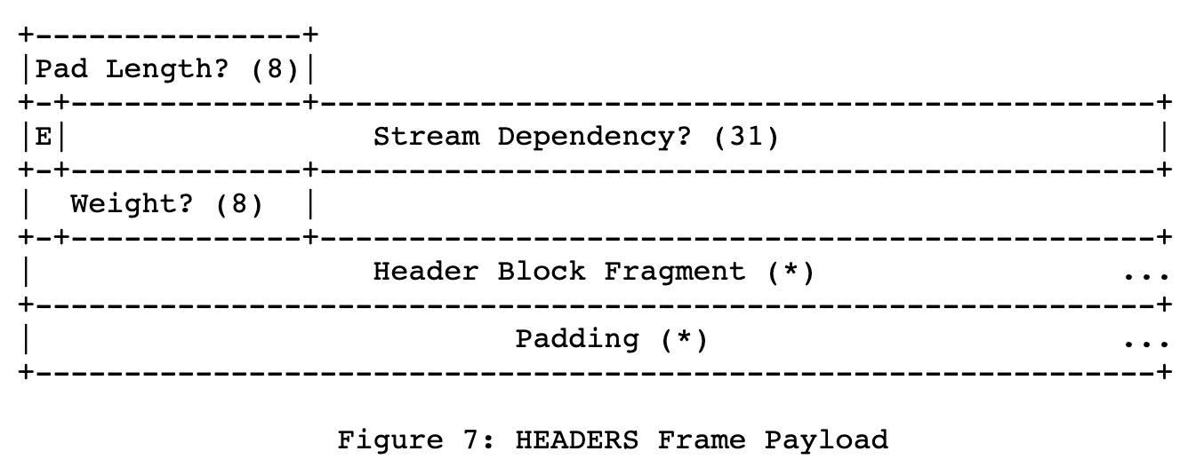
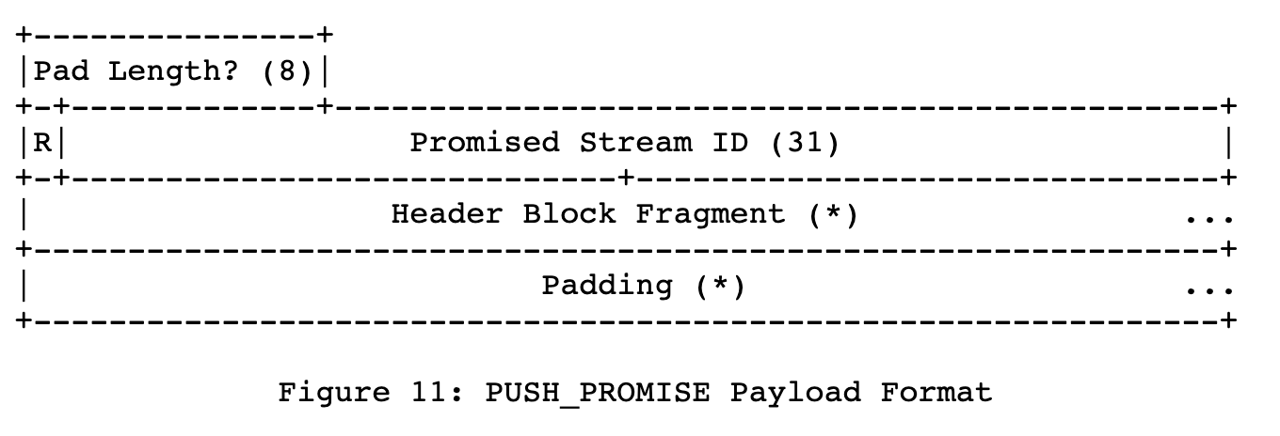
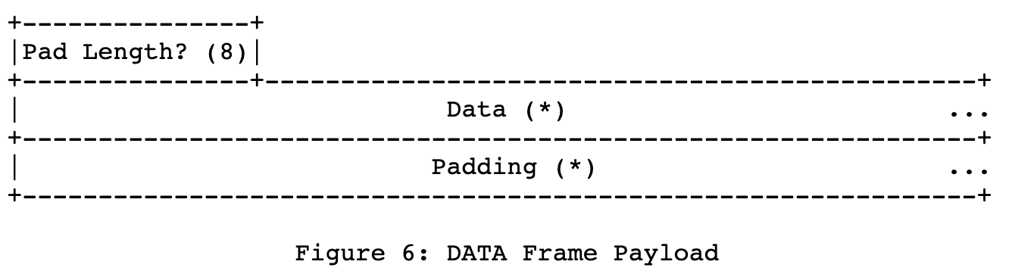
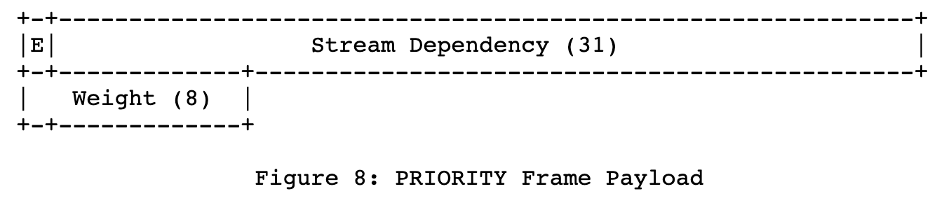
The value 0x0 is reserved for frames that are associated with the connection as a whole as opposed to an individual stream.

Slide 21
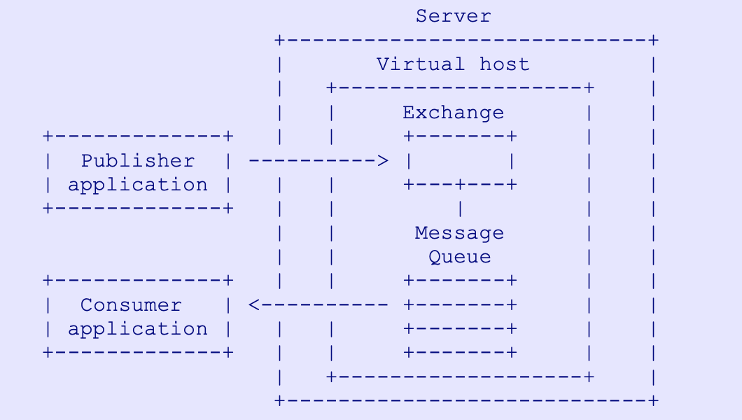
Transport and Pub/sub
What is missing
The design does not allow creation of generic message queues
Only the server can be the publisher
Clients publish info to be shared with other client
The design does not have the capability of Exchange (message router)
Way forward: Keep simple
Broker for further discussion
https://www.rabbitmq.com/resources/specs/amqp0-9-1.pdf

Slide 22
Additional Information about Transport Queue
Calendar semantics
Tell the client ALTO information (e.g., cost) for a future time point
Tell the client when the next information will be released, it is the time that the info is released is distributed, not the value [support]

Slide 23
Negotiation
Task: to fully specify the complete set of negotiation parameters
Use HTTP/2 (default), HTTP/3
Incremental updates queue encoding
Chosen by server, but must be specified as HTTP Accept header of client
Initial connection setup: client sends list of incr update mime types, and server returns the subset which it can use (Vary header in response)
Concurrency level (e.g., Rucio controller need to monitor info for a large number of clients) stream control

