Slide 1
ALTO Re-charter (IETF 110): Multi-domain
Sebastian Kiesel (U. Stuttgart)
Ingmar Poese (Benocs) Y. Richard Yang (Yale U.)
To Confirm:
Chin Guok (esnet)
Harvey Newman (CalTech, CERN)
Feb. 21, 2021

Slide 2
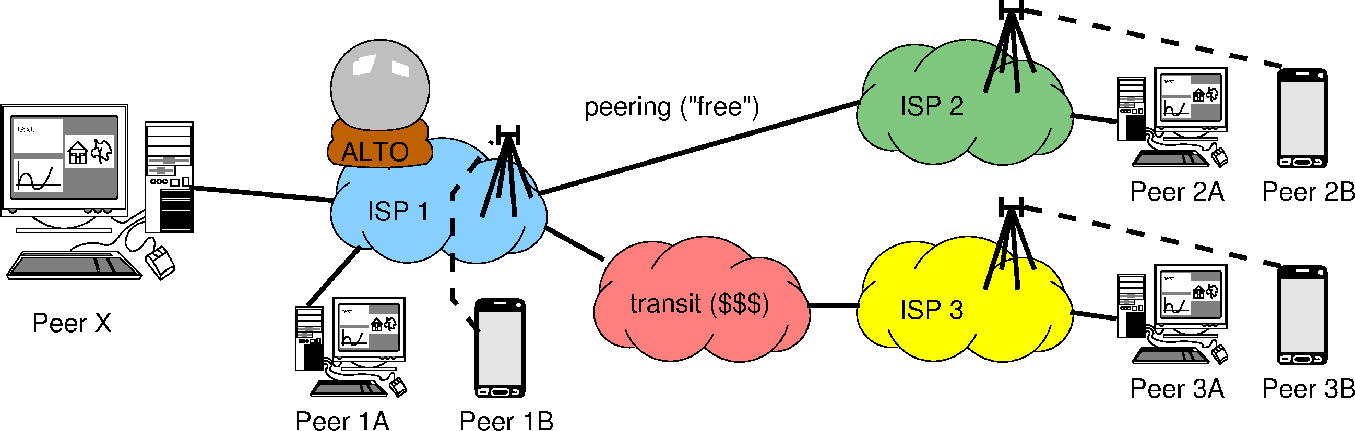

Use Case: Multi-domain Ranking (Cost Map)
Which guidance should ALTO (ISP 1) give to Peer X (based on relative preference)?
Peer 1A
Peer 1B
Peer 2A, 2B (*)
Peer 3A, 3B (*)
Peer 1A
Peer 2A, 2B (*)
Peer 1B
Peer 3A, 3B (*)
(*) = ?A and ?B are on the same level of preference, because ISP1 might not know that they are wireline vs. wireless, doesn’t care (monetary cost is the same for ISP1), and/or wouldn’t dare to tell even if they knew
Is “all within my domain” or “not in my
wireless network” more preferable?

Slide 3
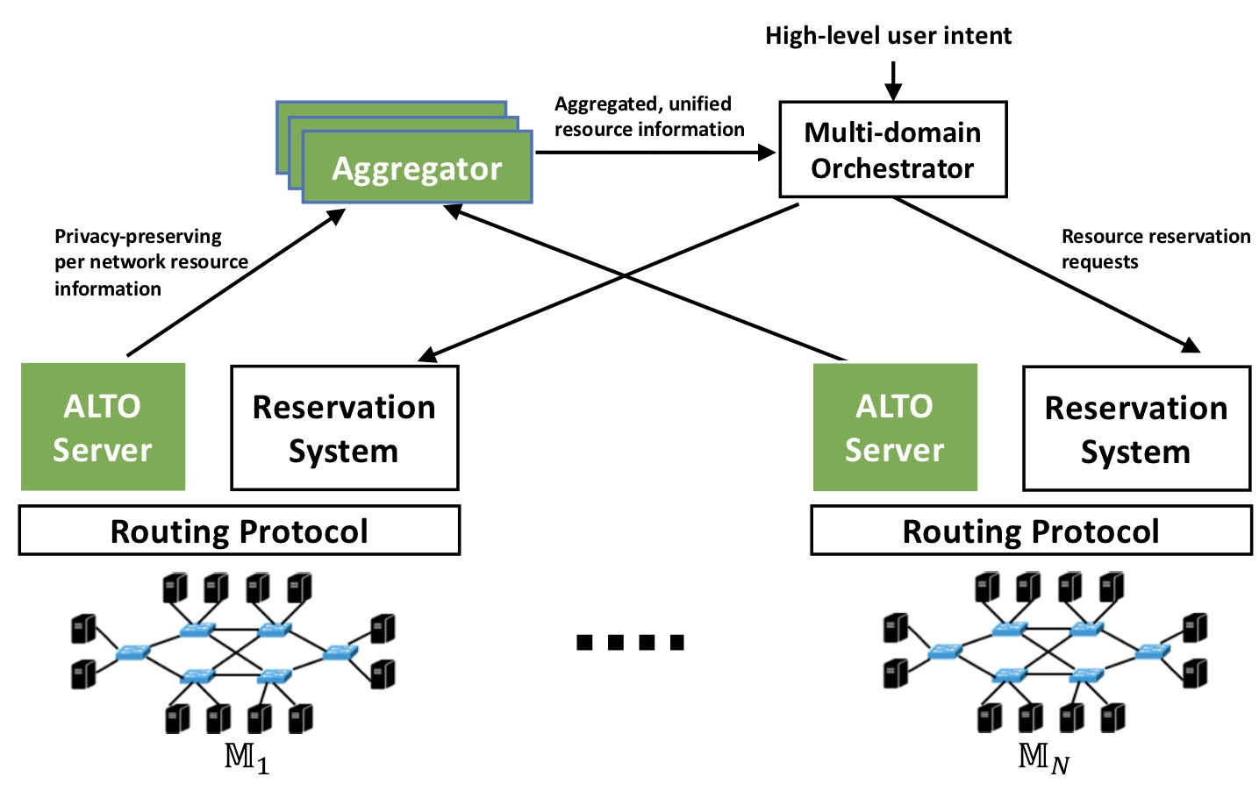
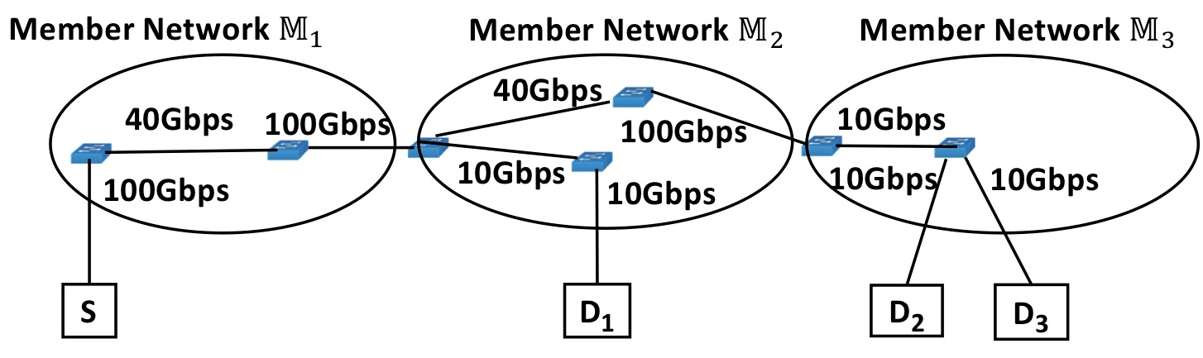
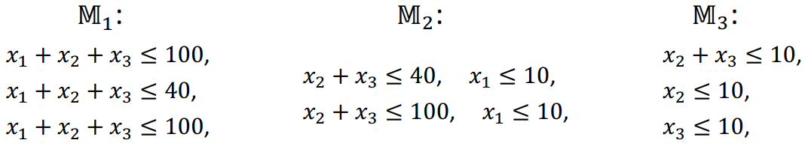
Use Case: Multi-domain Huge Data Co-Flow Resource Discovery
Large-scale data analytics (e.g., CERN LHC) span multiple networks.
Bottlenecks can come from multiple networks
Ideally, the networks collaborate but operate independently as much as possible.
Source: Xiang, et al. "Fine-grained, multi-domain network resource abstraction as a fundamental primitive to enable high-performance, collaborative data sciences." ACM/IEEE Supercomputing 2018.
Notes:
The multi-domain networking abstraction is used to solve application-layer optimizations across multiple domains.
Typically, previous uses cases ca be modeled as an optimization problem F(x, y) where the F is an objective function based on two types of variables.

Slide 4
Re-charter Text
“Extensions to ALTO services to support multi-domain settings. The current ALTO framework has made clear how to provide network information from a single ALTO server for a single network (administrative domain), but a deployment may consist of multiple domains and the potential information sources may not be limited to a certain domain. The working group will investigate extending the ALTO framework to (1) specify multi-ALTO-server protocol flow and usage guidelines when an ALTO service involves network paths spanning multiple domains with multiple ALTO servers, and (2) extend or introduce ALTO services allowing east-west interfaces for multiple ALTO server integration and collaboration. The specifications and extensions should use existing services whenever possible. The specifications and extensions should consider realistic complexities including incremental deployment, dynamicity, and security issues such as access control, authorization (e.g., an ALTO server provides information for a network that the server has no authorization), and privacy protection in multi-domain settings.”

Slide 5
Details

Slide 6
Simple Candidate Design: AMDA
Proposal starts with a simple architecture called ALTO Multi-Domain Abstractions (AMDA)
The path of a flow from a src to a dst consists of a sequence (vector) of segments from multiple networks
src -> net₁-e -> net₂-i -> … -> net_{i}-e -> net_{i+1}-i -> … -> net_{n}-e -> dst
The cost of a path is a vector corresponding to the vector of segments
The paths of a set of flows form a flow graph
Constructed by merging shared egress or ingress nodes of the segments
net1-e
net2-i
netn-e
src
dst

Slide 7
ALTO Extensions to Realize AMDA
Ext 1: Segment discovery
<flow, netid:ingress> -> <netid:egress, netid:next-ingress; [Sebastian proposal: next-alto-server-uri; handle blackhole…]>
Ext 2: Path cost discovery (extend ECS/cost map service, …)
<segment-set, metric> -> <cost/metric>
Operation models for extensions [mechanisms, not policies]
iterative (client aggregation)
recursive (network helped aggregation)
hybrid

Slide 8
Some Technical Details
A vector of path cost may no longer define a total order; define guidelines to applications on how to utilize partial ordering, and the consequences (i.e., operations considerations)
Leverage SIGCOMM’20 multi-criteria routing design
Incremental deployment: the chaining of domains may be broken due to incremental deployment (e.g., domain sequence is S -> A -> B -> C -> D, but C does not provide ALTO server)
Need to fix broken chains (e.g., proxy server based on BGP observation)
Need to discuss incentive for missing networks to deploy
To handle the prediction use case, need networks to exchange model parameters --- define an ALTO east-west interface

Slide 9
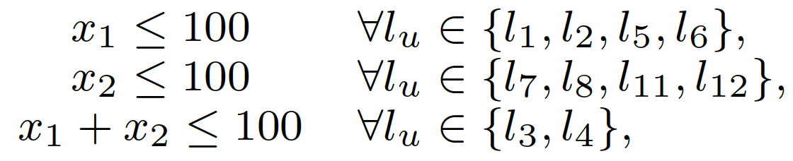
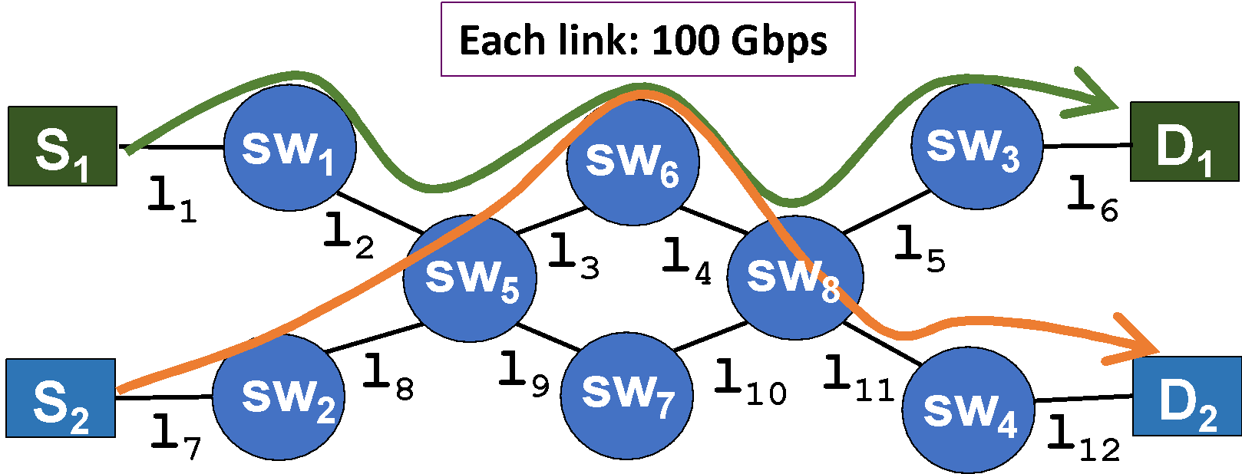


(R)PV: Mathematical Programming as Abstraction Representation
GOAL: Use mathematical programming constraints to provide a compact representation of the available bandwidth of flows through a network.
100
100
Redundant inequalities can be removed via a polynomial-time, optimal algorithm.
Remaining bottlenecks represented as abstract network elements (ANE).
Notes:
Our idea: on-demand, partianl-instantiation

Slide 10
The Reverse View: Mathematical Constraints as Virtual Network Representation
Aggregate the abstraction in multiple networks into a unified, single, virtual representation:

