Slide 1

ALTO Transport Information Publication Service draft-ietf-alto-new-transport-05
Presenter: TBD
Feb. 23, 2023
IETF 116 Interim
Notes:
https://datatracker.ietf.org/doc/draft-ietf-alto-new-transport/
https://datatracker.ietf.org/doc/draft-schott-alto-new-transport-push/

Slide 2
Reviews
Four excellent, early-HTTP-expert/AD reviews
[MT] Martin Thompson (July 11)
https://mailarchive.ietf.org/arch/msg/alto/sa1Pv7jmTfBF3TbGuJr_PffIjXg/
[SD] Spencer Dawkins (July 15)
https://datatracker.ietf.org/doc/review-ietf-alto-new-transport-01-artart-early-dawkins-2022-07-15/
[MN] Mark Nottingham (July 17)
https://mailarchive.ietf.org/arch/msg/alto/D84S0qLbgtpL0-jf93gNPS3NUJE/
[MD]
Comments by AD Martin Duke at IETF 114
Four excellet, post 115 reviews
Adrian Farrel
Luis
Jordi
Qin

Slide 3
Outline
Major changes from IETF 115

Slide 4
0
Network resource data represented as a DAG
Node is a version, where tag identifies content of version
Edge is transport data
Edge from i to j is the <op, data> to transition version from i to j
Node content is path independent (different paths arrive at the same content)
101
102
Basic Data Model: Incremental REpresentational State Transfer
103
Invariants of network resource data (integrity)
Continuity: n1 -> n2, anything in between n1 and n2 also exists
There is always a direct link to n1
Extension of interval only: A client requests and gets [n1, n2] at time t, and then requests at time t’ > t and get [n1’, n2’] then n1’ >= n1, n2’ >= n2
104
105
106

Slide 5
R1: frontend/open
R2: Directory
R3: data
Client
POST query
transport-state-view-uri
Design S: all 3 types at same, single server (relative reference)
Design M: all 3 types can be at its own, multiple server (absolute reference)
Design Mixed: mixed

Slide 6
URI Location Schema (Design S)
<transport-state-view-uri>
uq
meta // list of directory
0
101 // full 101 content
103
105
101
102 // 101 -> 102 patch
102
103
push
…
uq/<i> := uq/<i>/<i>+1
uq/<i>/<j> := patch from <i> to <j>

Slide 7
Read Example
GET <transport-state-view-uri>/uq/meta show dir of update queue
{ 0 : { 101 : {media-type, tag}, 103: {…}, 105: {…}},
101 : {102: {media-type, tag}, …}
GET <transport-state-uri>/uq/<seq> //<seq>-<seq+1> delta
GET <transport-state-uri>/uq/0/<seq> //full content of <seq>

Slide 8
Initial Client View
if match client POST tag at a node
return init-seq = match-node id
else
RECOMMENDED the initial view is the last snapshot, e.g., init-seq = 105
server does not keep state (that it selects 105), unless server push

Slide 9
Processing Client Read: Server Processing
uq/<i> := uq/<i>/<i>+1
uq/<i>/<j> := patch from <i> to <j>
Server
if uq/<i>/<j> exists
return content using encoding
else
return 400
Client
If error retry or re-read directory

Slide 10
State Management
DELETE <transport-state-view-uri>
Remove the view
Close of connection
Remove all views (ephemeral state)

Slide 11
Backup Slides

Slide 12
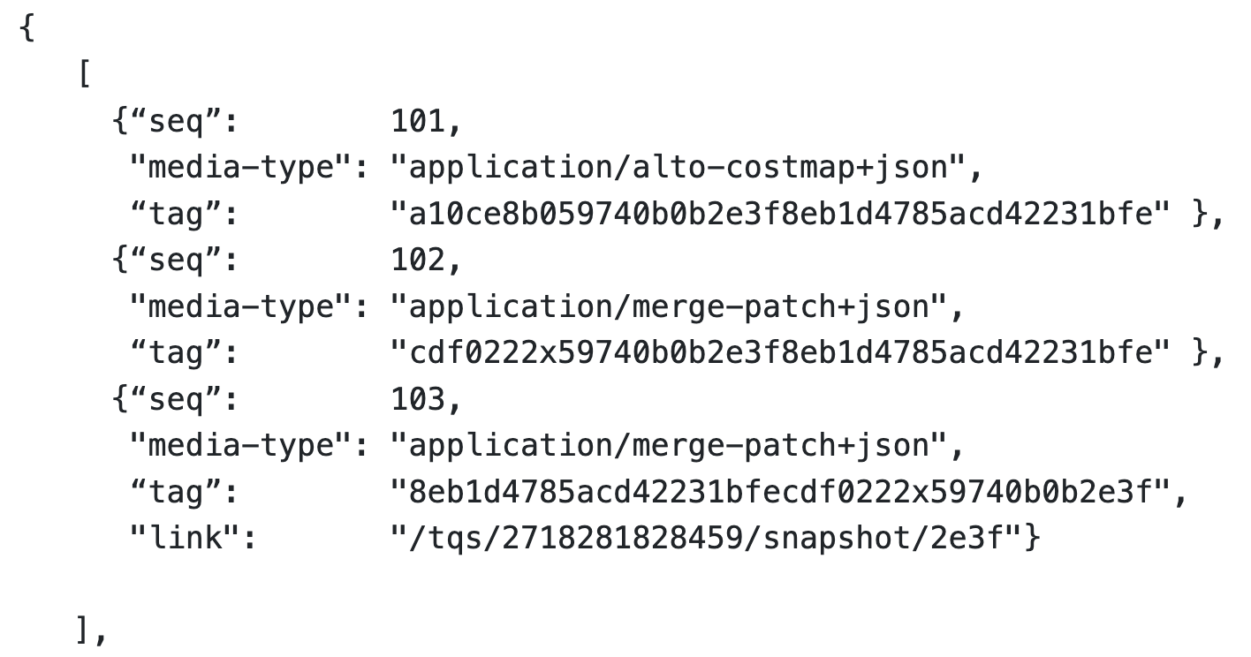
Recap: IETF 114 Reviews/Discussions: Finalizing Op Mode(s)
Four potential operational modes to transfer updates to a resource from the ALTO server to the ALTO client:
Client pull
Client long pull
Blocking in HTTP/1.x
Allow request on next seq number
Server push
PUSH_PROMISE (HTTP/2-3)
Server put
ALTO server as HTTP client
Notes:
Benefit:
Avoid “awkward” promise (current spec: MUST NOT cancel push promise)
Issue: semantics
Client conceptually is only a cache, not a persistent state replica

Slide 13
Recap: How Much to Specify Ordering Control: Transport-Aware of App Semantics [MN, MT, SD reviews]
App/ALTO
network map 1
network map 1 patch 1
R1
R2
Design 1:
ALTO specifies only: mapping each Ri to an independent HTTP/2-3 stream; HTTP does scheduling.
Issue: HTTP could schedule R4, then R3, then R2 and then R1 in transmitting order
R3
R4
cost map 1
cost map 1 patch 1
Design 2:
ALTO specifies that server submits to the HTTP transport in DAG order: submit Ri only when what Ri depends on are finished: R1; R2/R3, R4
Issue: Sliding window is large and transport can fit R1/R2/R3/R4 into a single window
HTTP/2-3 server
R1
R2
Design 3:
ALTO indicates the dependencies to HTTP
Issue: HTTP client can indicate a parent in req header, but this is signaling from client to server; what we need are (1) app signaling to HTTP server, (2) multiple dependencies
R3
R4

Slide 14
Recap: How/Whether to Specify Settings
IETF 114 version allows client to specify two (HTTP/2) control knobs on server behaviors
0x02 SETTINGS_ENABLE_PUSH (a BCP14 “MUST”)
0x03 SETTINGS_MAX_CONCURRENT_STREAMS (a BCP14 “must”)
HTTP/3 changed these settings (RFC9114) [SD review]
SETTINGS_ENABLE_PUSH (0x02):This is removed in favor of the MAX_PUSH_ID frame, which provides a more granular control over server push. Specifying a setting with the identifier 0x02 is HTTP/3 error.
SETTINGS_MAX_CONCURRENT_STREAMS (0x03):QUIC controls the largest open stream ID as part of its flow-control logic. Specifying it is HTTP/3 error
Suggestion: (1) remove them in the spec and discuss them in operations; (2) specify generic requirements statement

Slide 15
Recap: Other Issues
Style guide recommends using HTTP/1.1 to specify examples
Introduce media type detail [IANA spec]

Slide 16
Client Pull Document (Doc 2): Client Read Updates
Client -> server: Very simple design, only GET method on <updates-queue-uri>/<seq>
Allow caching and content distribution to large scale, for future extension
Server -> client
Long poll support: fetch the next seq
Transfer scheduling (at the server/client)
Pull design allows client to issue concurrent pull requests, but the results can have dependency => specify the scheduling will lead to version specification; we specify them as only operational considerations
Transfer processing (at the client) requirements
Specify (SHOULD include) tag to enforce correctness
Specify that other HTTP transport control (e.g., concurrency control) should be honored, but is transparent to ALTO transport (discuss in WG)

Slide 17
Server Push Document (Doc 3): Server Push Updates to Clients
Client -> server:
Indicate acceptance by setting up state (join receiver-set)
Start: put self into <updates-queue>/rs
Stop: delete self from the receiver set
Different from early doc: join when creating the updates queue, but this causes coupling of Doc 1 and Doc 3.
Server -> client
Specify as PUSH_PROMISE in HTTP/2-3
Transfer scheduling
Specify only operational considerations on transfer scheduling of dependent updates as performance optimization
Specify that other HTTP transport control (e.g., concurrency control) should be honored, but is transparent to ALTO transport

Slide 18
Server Put Document (Potential Doc 4): Defer
Can be an excellent tool for server-to-server communications
Leave Server PUT (i.e., replicated operational log) as future work

