Slide 1
Project 5 - Can we predict whether a Hotel Booking will be canceled?
Ryan Chen 113200236

Slide 2

The Hotel Booking Dataset (Kaggle)
Hotel Booking records for city and resort hotels
Data collected from July 1, 2015 to August 31, 2017
Dataset Size
119390 rows
36 columns

Slide 3
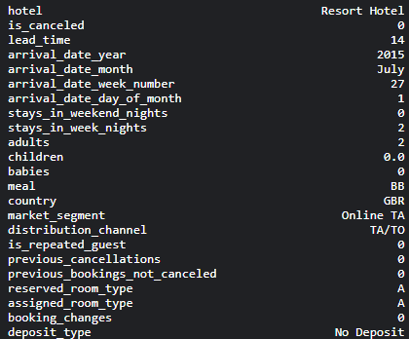
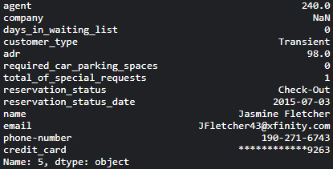
An Example Booking

Slide 4
Exploratory Data Analysis
(Pandas, Numpy, Matplotlib)

Slide 5

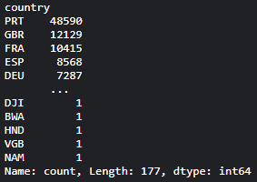
Which country saw the most hotel bookings?
df.country.value_counts()
PRT = Portugal
accounts for 40.7 % of all bookings in the data

Slide 6
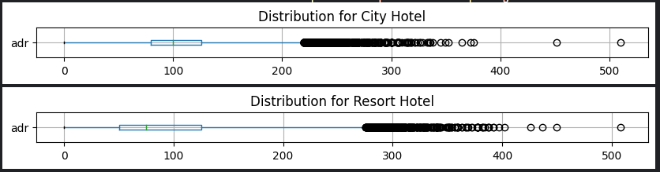
What is the distribution like for both hotels with respect to the price of a room per night?
column of interest = Average Daily Rate (adr)

Slide 7
Which months are most busy for both hotels?
City Hotel
May
July
August
Resort Hotel
April
July
August
df[df.hotel==h_type]
.arrival_date_month
.value_counts().
head(3).index

Slide 8
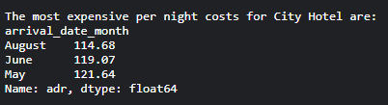
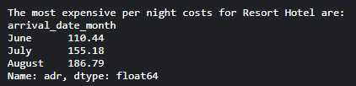
Which months see the most expensive per night costs?
df[df.hotel==h_type]
.groupby('arrival_date_month')
['adr']
.mean().sort_values()
.tail(3)

Slide 9
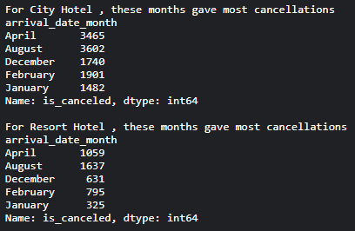
Which months see the most cancellations for both hotel types?
df[df.hotel == h_type]
.groupby('arrival_date_month')
['is_canceled']
.sum().head()

Slide 10
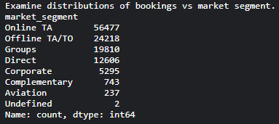
Examine distributions of bookings vs market segment
df.market_segment.value_counts()

Slide 11
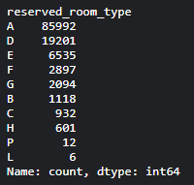
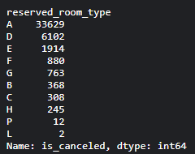
Which room type was most commonly booked? Most commonly cancelled?

Slide 12

What percentage of the data recorded cancellations for each hotel?
df[df.hotel==h_type]
.is_canceled.sum() *100
/ df[df.hotel==h_type].shape[0]
Result
City Hotel bookings
41.73 % of bookings cancelled
Resort Hotel bookings
27.76 % of bookings cancelled

Slide 13
Machine Learning

Slide 14
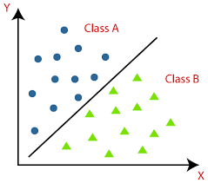
What models to consider?
Hotel Booking Cancellation is a classification task!
A booking can be
canceled (1)
not canceled (0)

Slide 15
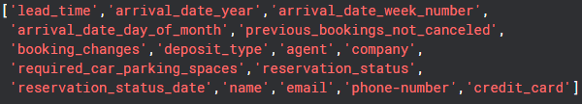
Data Cleaning (1)
We have an overwhelming amount of features (36)
Must eliminate some columns, initial dropping shown

Slide 16
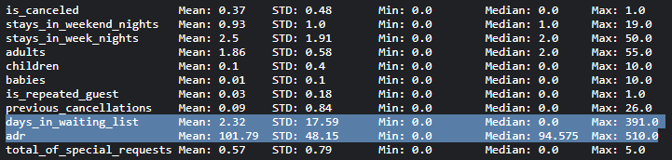
Data Cleaning (2) - numerical cols
for col in ['adr', 'days_in_waiting_list']:
df[col] = np.log(df[col] + 0.000001)

Slide 17
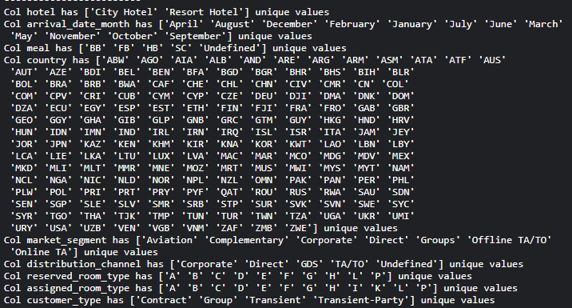
Data Cleaning (3) - categorical vars

Slide 18
How to deal with categorical data?
Many ML models can only accept numerical data
Solution = use encoding techniques
One Hot Encoding
Ordinal Encoding

Slide 19
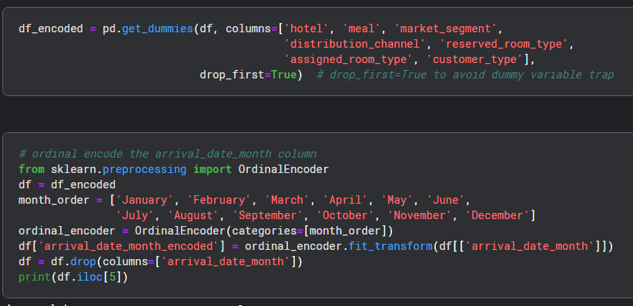

Slide 20
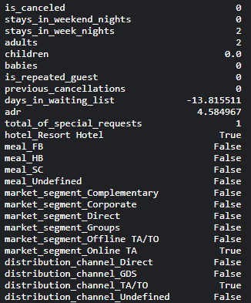
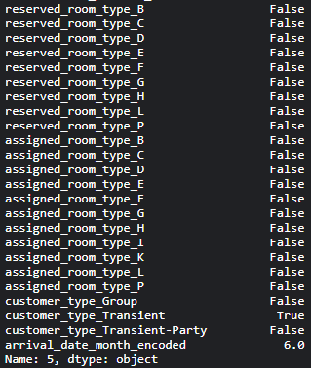
The resulting columns shown

Slide 21
Which classifiers should we choose?
Logistic Regression
Decision Tree
Gradient Boosting Classifier
* sklearn is our library of choice here!

Slide 22
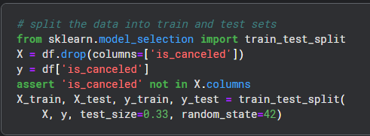
But first …. Train Test Split

Slide 23
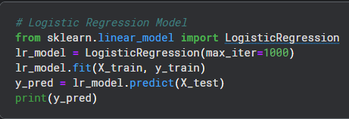
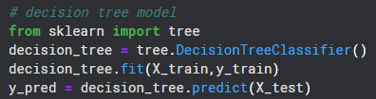
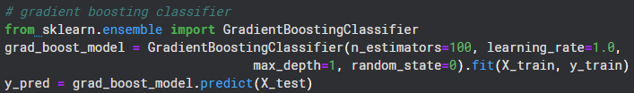
Model Training

Slide 24
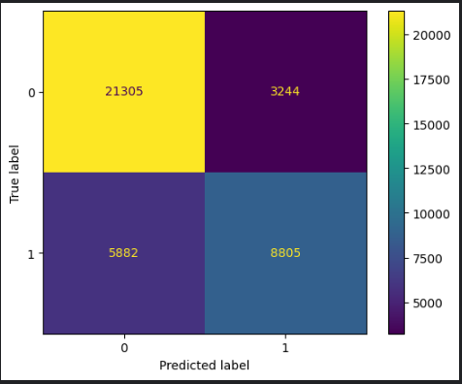
Classification Performance

Slide 25
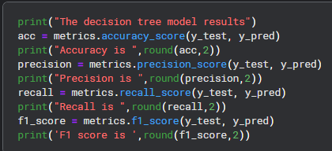
How to compute these measures?

Slide 26
Overall results + Winner!!
Model | Accuracy | Precision | Recall | F1 Score
Log Reg | 0.77 | 0.73 | 0.6 | 0.66
Decision Tree | 0.79 | 0.72 | 0.72 | 0.72
Grad Boost | 0.78 | 0.75 | 0.59 | 0.67

Slide 27
Additional Considerations….
Additional Feature Reduction
More models to consider
Consideration of hyperparameter tuning for each model

Slide 28


