Slide 1
Employee Reimbursement
Ryan Crnich
James Todd
Lucy Stapleton

Slide 2
The problem
The current system relies solely on email communication, requiring manual lookups of available funds
there is no way to record and report on reimbursements awarded
to identify highly-invested courses that could be developed to be offered in-house.

Slide 3
Our solution
Easy to use system that allows for application to been completed in less than a minute
The status of application in the click of the button
Allows for mangers and chairman to approved or deny the application while viewing all the information needed to base their decisions on
Emails the user when the application has completed the review process

Slide 4
Tec used
HTML
CSS
Javascript
Java => Servlets
Postgres
Maven
JDBC
Postman => testing

Slide 5
Materialized css
Professional design
Speed of development
Modern
Keep css on the same page as html: limits human error
Fun Fact: Google uses it

Slide 6
database
Postgresql db housed on AWS
Contains form info, employee info, event info
JDBC connection

Slide 7
connection
Connect uses a singleton design method
Allows for connection to the database
Prevents user from having many different connections at once

Slide 8
Login html
Landing page
All users will login with a single form
Will receive username and password

Slide 9
Login js
Takes all of the user’s information from the login and assembles it into a json object
Will allow for the servlet to reach the login information
Sends json through an xhrhttpresponse object

Slide 10
Login servlet
Will search though all the different types of user tables
Will start the session
Will set session attributes that will be used in hidden input fields inside of forms
Will identify which type of user they are a store it in the session to be used in decision making

Slide 11
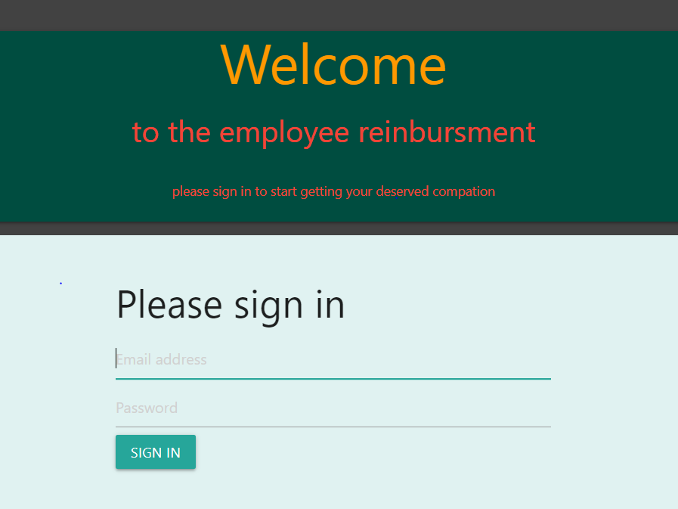
Login page

Slide 12
Application html
This is where the user enter the information needed to receive reimbursement
Pulls session attributes to auto complete parts of the form
These auto filled fields are hidden from the user to prevent tampering

Slide 13
Application js
Form data restructured into JSON
Sends to servlet via XMLHttpRequest
Grabs the session variables and inserts these values into the form

Slide 14
Application servlet
this servlet will insert a new form into the database

Slide 15
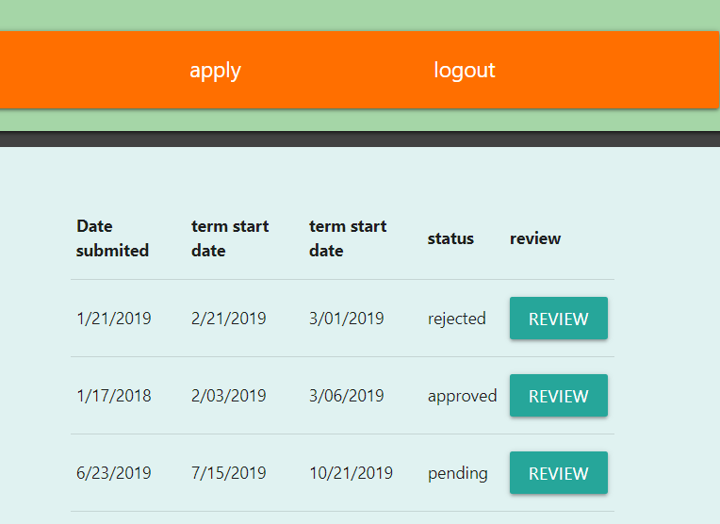
Apps page employee

Slide 16
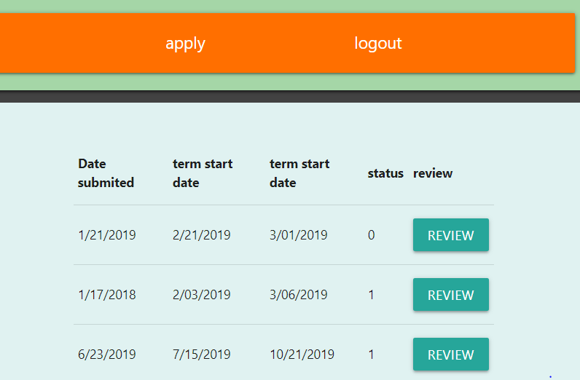
Apps page for manager/chairman

Slide 17
Viewing previous applications
Will display the previously submitted applications submitted by that user
Each application will have a row displaying a couple attributes and a submit button to view the application on the review html file
The form will have the application id as it’s only input field

Slide 18
Review js
The table will be fed by an array of application objects sorted by end date of the courses.
The submit button will send the application id to the servlet.
single application to view the application

Slide 19
Review servlet
Receives a single id
Gets a single application from the database and sends it to the review page to be seen by the user

Slide 20
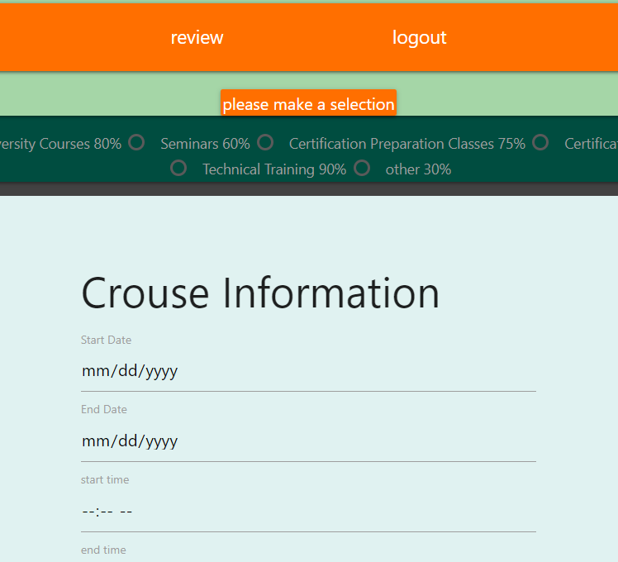
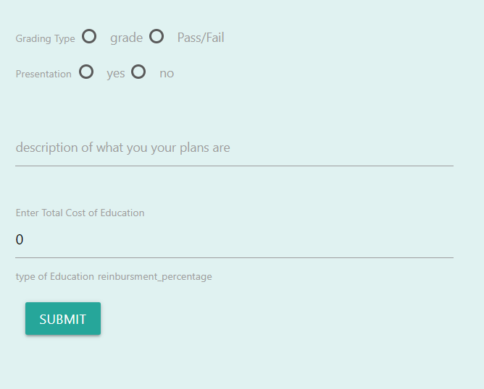

Slide 21
Review html
Displays content of the form that the employee has selected to view.
Has a form for a user to submit the remaining required fields to update their application
Has a form for the chairman to adjust the reimbursement amount, determine whether the app is approved or denied, and can send a message to the user if needed

Slide 22
Review js
Receives the form from apps servlet
places the form variables to be displayed to view

Slide 23
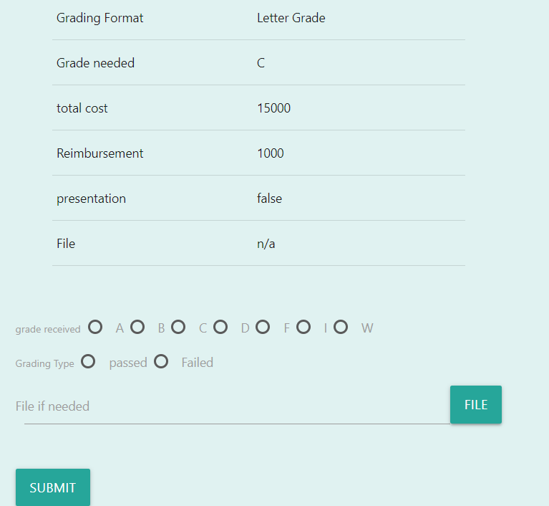
Review app for employee

Slide 24
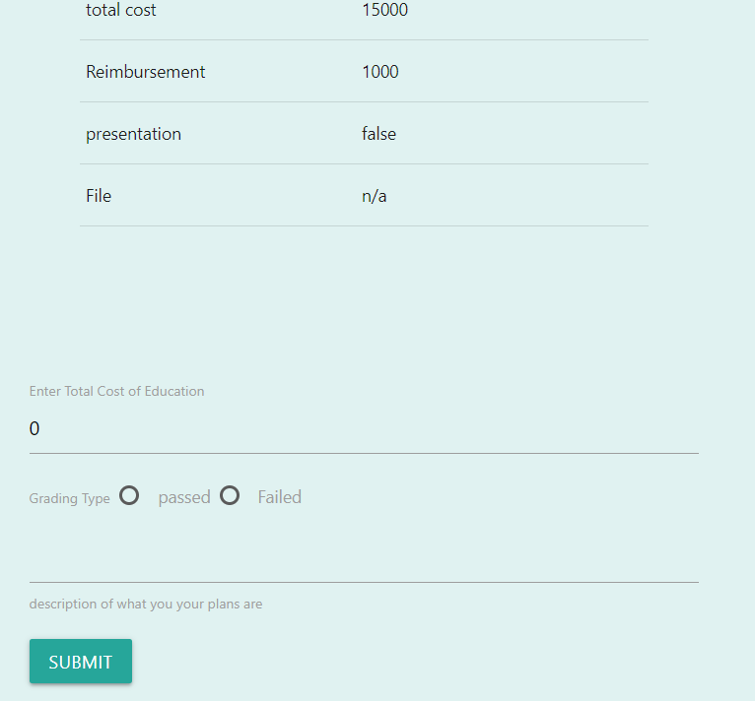
Review app for Chairman

Slide 25
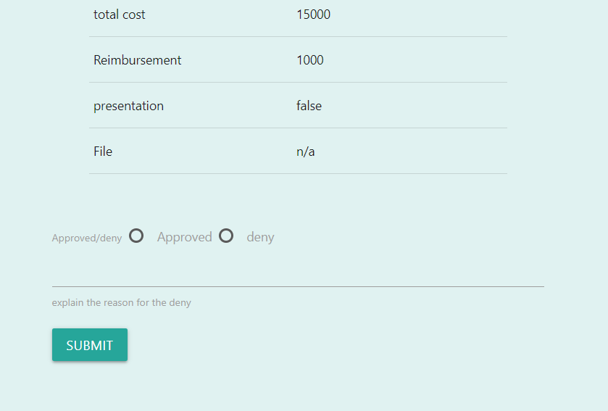
review managers and dept head

Slide 26
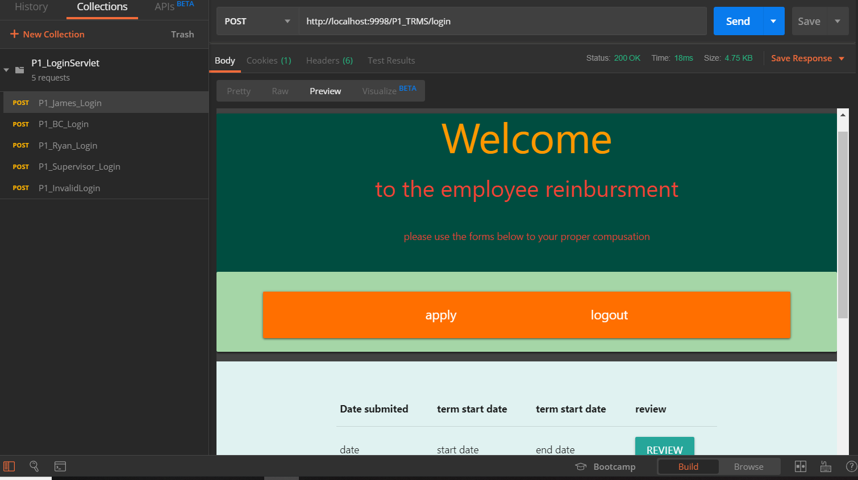
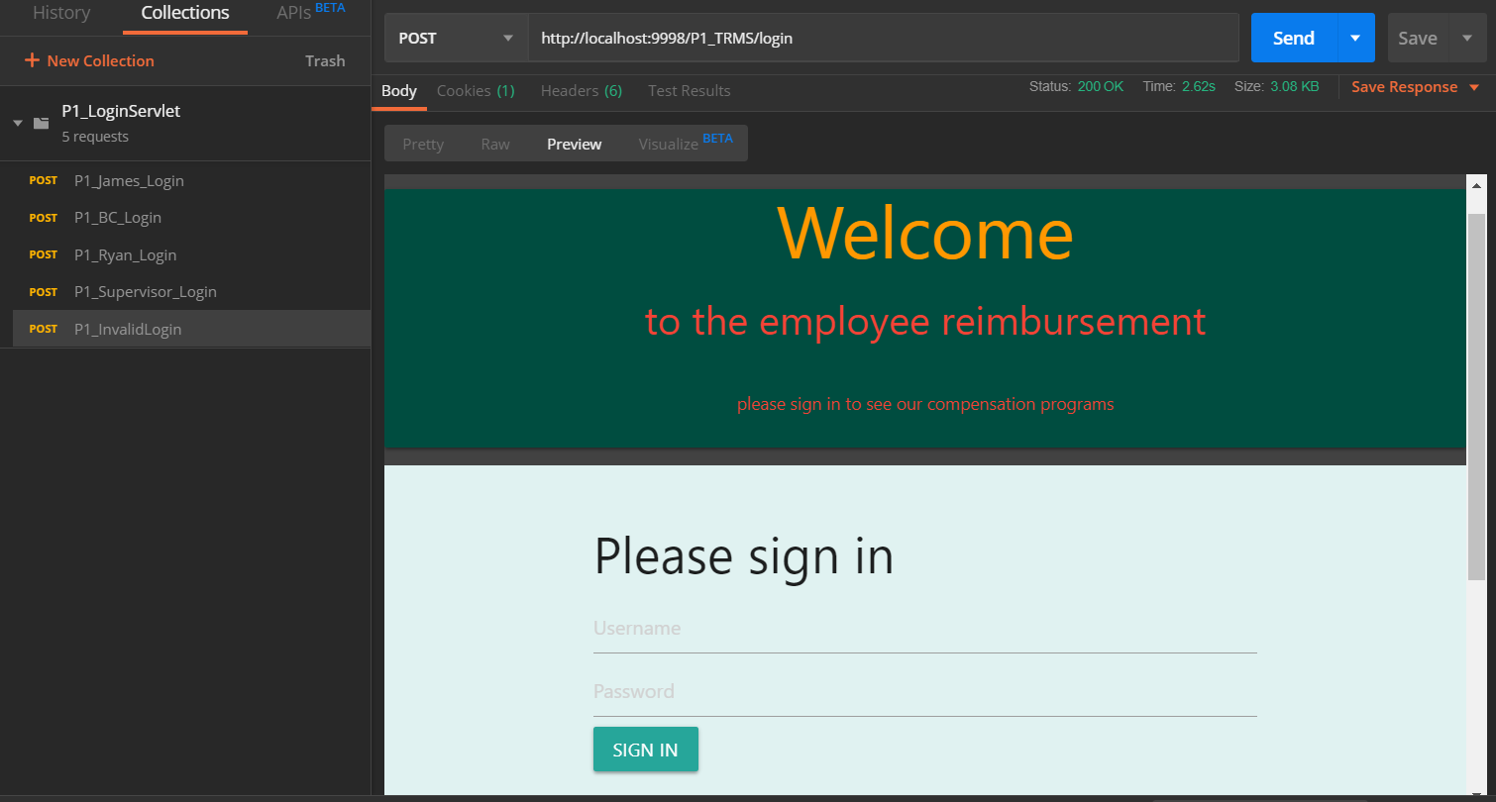
Valid Credentials Invalid Credentials
testing

Slide 27
Visions for future
By Next Sprint
Finish Servlets
Assemble working demo
Future Prospects
Add email functionality
Reset reimbursements on new year

Slide 28
Questions?

