Slide 1
AI Club Project
Maze Solver
Group Members: David Heintz, Ryan Hildebrant

Slide 2
What we are trying to do...
We want to create a random maze generator that can create 2-D maze puzzles.
Once we have generated a puzzle, we want to write the puzzle to a file so someone can solve it on their own. Additionally, we want to have an agent solve the puzzle.
To solve the puzzle, we project the randomly generated maze onto a GUI and implement Breadth-First Search and Depth-First Search. Once the algorithms are finished, we display the shortest possible path to solve the maze.

Slide 3
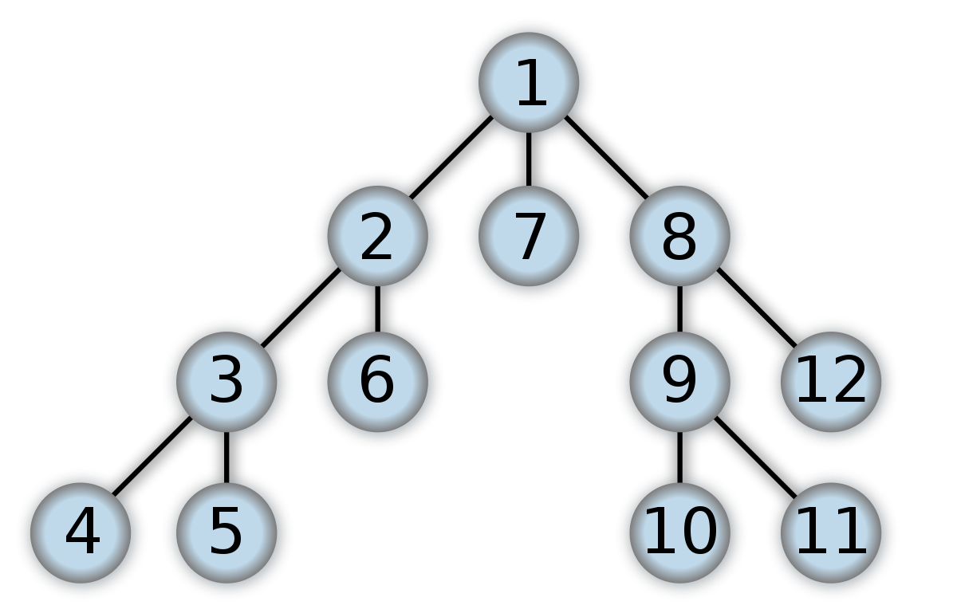

Algorithm Comparison
Depth First Search
Transverses through one path all the way to leaf node before backtracking and attempting new path
Breadth First Search
Transverses through all nodes in one level before continuing to the next level

Slide 4
How we built our maze solver
We incorporated two different sets of python maze solvers into one to create a program that could both generate the maze and solve it.
Reference code for maze writer: https://scipython.com/blog/making-a-maze/ Reference code for maze solver: https://github.com/tonypdavis/BFS-Maze-Solver
In addition to these reference points, we incorporated the Python Turtle graphics library
Lastly, we created a DFS search from scratch and incorporated it into the code base.

Slide 5
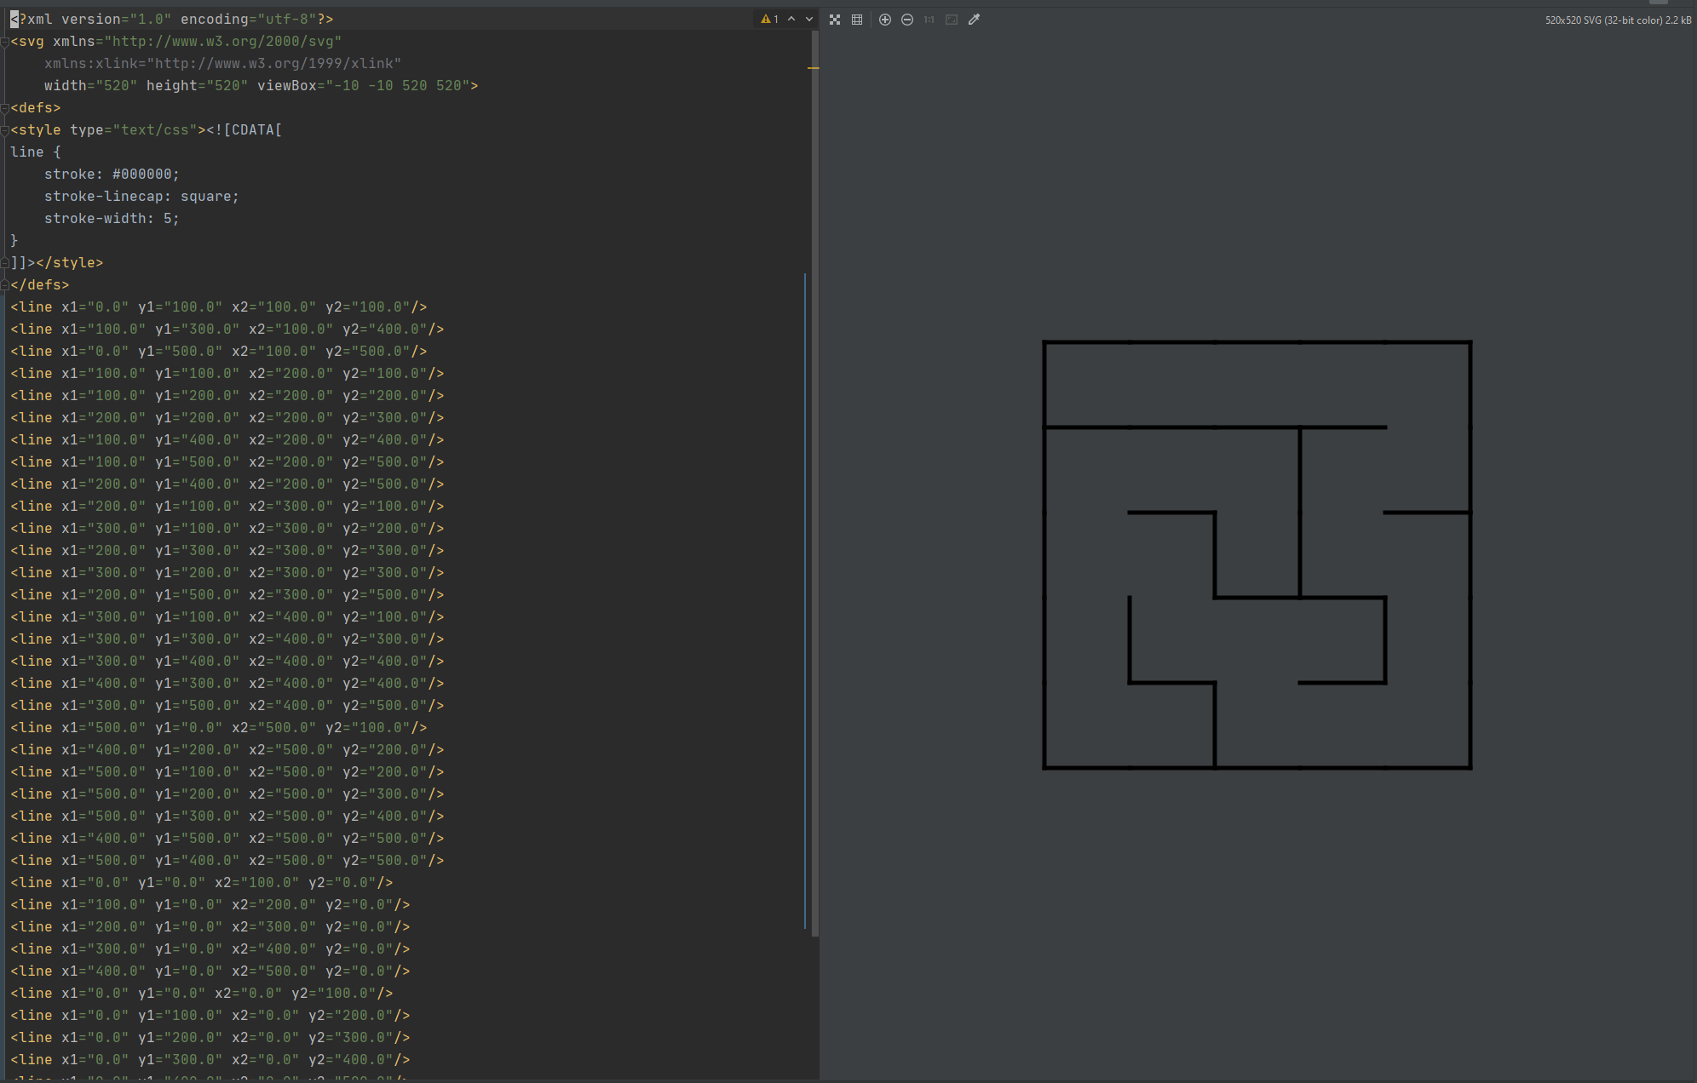
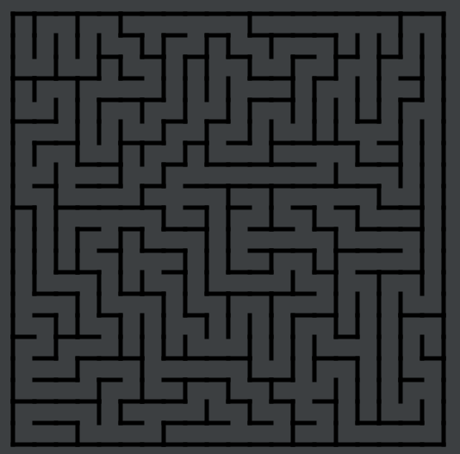
How do we represent an image of the maze?

Slide 6
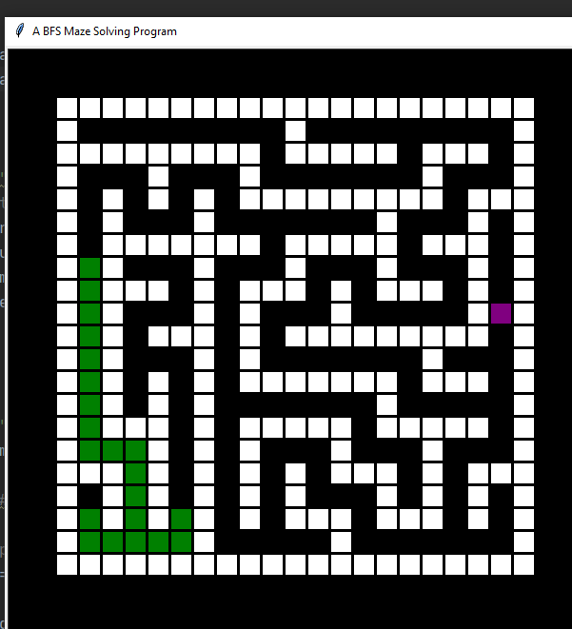
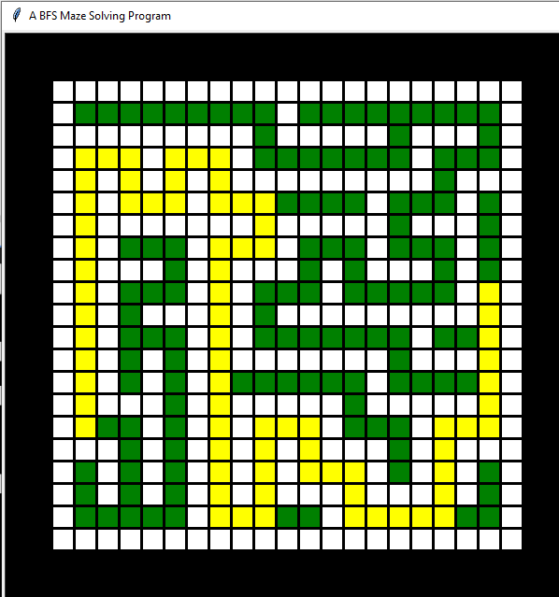
How do we represent the maze graphically?

Slide 7
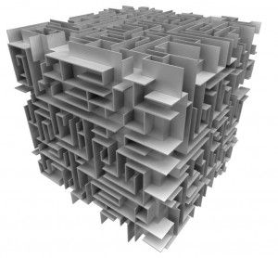
What we would like to do moving forward…
Expand our usage of search algorithms to A* search and Trémaux's algorithm so that we can deal with larger mazes much more efficiently.
Add additional obstacles to the environment (pac-man or maze digger).
Add necessary points to pass through and find optimum path hitting all.
Eventually, we would like to expand to higher dimensional mazes.

Slide 8
So, lets see the Maze Solver in action!

