Slide 1

FEMA Emergency Management Institute
National Incident Management System (NIMS) 2017
Learning Materials

Slide 2
NIMS 2017 Learning Materials Purpose
In October 2017 FEMA published a revision of the National Incident Management System (NIMS).
The 2017 NIMS document replaces the 2008 NIMS.
This content is to provide information to emergency management practitioners on the key changes contained in the new NIMS 2017 document.
These learning materials are provided as a “bridge” to deliver interim NIMS 2017 document refresh information until updated NIMS courses are available.
This is not intended as stand-alone training on NIMS. This content is designed as a supplement to be used in conjunction with existing legacy NIMS/ ICS course materials in order to provide students with additional information on key NIMS 2017 changes.

Slide 3
NIMS 2017 Update Training Topics
NIMS 2017 History
NIMS 2017 Overview
NIMS 2017 Changes
NIMS Fundamentals and Concepts of NIMS
Resource Management
Command and Coordination
Communications and Information Management
NIMS Course Updates
Sources of Additional NIMS Information

Slide 4
NIMS 2017 – Update History
FEMA led, whole community effort to update NIMS
Retains key concepts and principles from 2004 and 2008 NIMS
Incorporates policy updates from lessons learned from exercises and real-world incidents and disasters
National engagement to review the NIMS document produced thousands of comments from whole community stakeholders
Input from local, state, tribal and Federal subject matter experts
Comments were adjudicated by an interdisciplinary panel
Approved changes were incorporated into NIMS published in 2017

Slide 5
NIMS 2017 – Overview (1 of 2)
NIMS 2017 strengthens guidance for effective incident management:
Reflects and incorporates policy updates from lessons learned from exercises and real-world incidents and disasters
Clarifies the processes and terminology for qualifying, certifying, and credentialing incident personnel, building a foundation for the development of a national qualification system
Removes the Preparedness component of NIMS to avoid redundancy with the National Preparedness System and Goal
Clarifies that NIMS is more than just Incident Command System (ICS), and that it applies to all incident personnel, from the incident command post to the National Response Coordination Center
Demonstrates the applicability of NIMS to all five mission areas (Prevention, Protection, Mitigation, Response and Recovery)
Adds guidance on the Intelligence and Investigations function

Slide 6
NIMS 2017 – Overview (2 of 2)
Refines the model for the Operational Period Planning Cycle
Provides expanded EOC guidance based on input from local, state, tribal and territorial EOC leaders
Describes common functions and terminology for staff in Emergency Operations Centers (EOC), while remaining flexible to allow for differing missions, authorities, and resources of EOCs across the Nation
Explains the relationship among Incident Command Structure (ICS), Emergency Operation Centers (EOCs), and senior leaders/ policy groups (Multiagency Coordination Group)
Enhances guidance on information management processes

Slide 7
NIMS 2008-2017 Comparison
NIMS | 2008
Com-ponent | Contents
1 | Preparedness
2 | Communications and Information Management
3 | Resource Management
4 | Command and Management
 | Incident Command System (ICS)
 | Multiagency Coordination System (MACS)
 | Public Information
5 | Ongoing Management and Maintenance
Elements of both the structure and content of NIMS have been changed in the NIMS 2017 update
NIMS | 2017
Com-ponent | Contents
1 | Fundamentals and Concepts of NIMS
2 | Resource Management
3 | Command and Coordination
 | Incident Command System (ICS)
 | Emergency Operations Centers (EOC)
 | Multiagency Coordination Group (MAC Group)
 | Joint Information System (JIS)
4 | Communications and Information Management

Slide 8
NIMS 2017 Component 1: Fundamentals and Concepts
Component includes:
High-level summary of NIMS
Brief history of NIMS
NIMS guiding principles:
Flexibility
Standardization
Unity of Effort (new NIMS Guiding Principle)
Overview of the NIMS components
2008 NIMS
Flexibility
Standardization
2017 NIMS
Flexibility
Standardization
Unity of Effort

Slide 9
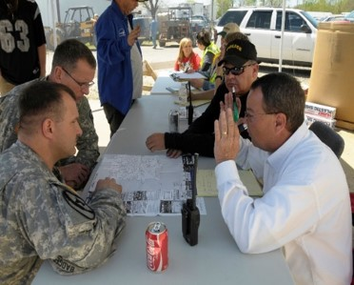
NIMS Guiding Principles – Unity of Effort
Flexibility and Standardization should be familiar to you from NIMS 2008.
Unity of Effort is a third NIMS Guiding Principle added in NIMS 2017.
Unity of effort means coordinating activities among various organizations to achieve common objectives. Unity of effort enables organizations with specific jurisdictional responsibilities to support each other while maintaining their own authorities.

Slide 10
Overview of NIMS Components (1 of 2)
NIMS 2008 defined five NIMS Components: Preparedness, Communications and Information Management, Resource Management, Command and Management, and Ongoing Management and Maintenance.
NIMS 2017 defines three NIMS framework components which enable diverse organizations to integrate capabilities and achieve shared goals:
Resource Management
Command and Coordination
Communications and Information Management

Slide 11
Overview of NIMS Components (2 of 2)
Definitions of the three NIMS framework components:
Resource Management describes standard mechanisms to systematically manage resources, including personnel, equipment, supplies, teams, and facilities, both before and during incidents in order to allow organizations to more effectively share resources when needed.
Command and Coordination describes leadership roles, processes, and recommended organizational structures for incident management at the operational and incident support levels and explains how these structures interact to manage incidents effectively and efficiently.
Communications and Information Management describes systems and methods that help to ensure that incident personnel and other decision makers have the means and information they need to make and communicate decisions.

Slide 12
NIMS 2017 Component 2: Resource Management
Reorganizes key resource management activities to address resource planning (pre-incident) resource management activities (during incidents), and mutual aid
Establishes a foundation for a national qualification system by clarifying processes for qualifying, certifying and credentialing incident personnel
Emphasizes the role of the Authority Having Jurisdiction (AHJ)
2008 NIMS
Concepts and Principles
Managing Resources
2017 NIMS
Resource Management Preparedness
Resource Management During an Incident
Mutual Aid

Slide 13
Resource Typing
Resource typing establishes common definitions for capabilities of personnel, equipment, teams, supplies, and facilities. Typing definitions include the following information:
Capability: the core capability for which the resource is most useful
Category: the function for which a resource would most likely be used such as firefighting, law enforcement, health and medical, etc.
Kind: a broad classification such as personnel, teams, facilities, equipment and supplies
Type: a resource’s level of minimum capability to perform its function; based on size, power, capacity (for equipment) or experience and qualifications (for personnel or teams)
The Resource Typing Library Tool (RTLT) is an online catalog of NIMS resource typing definitions and job titles/position qualifications available through the FEMA website (link provided at the end of this presentation).

Slide 14
Credentialing
Qualifying, certifying and credentialing are essential steps, led by an Authority Having Jurisdiction (AHJ) to help ensure that deploying emergency management personnel can perform their assigned role.
Qualification: personnel meet minimum established criteria - training, experience, physical and medical fitness, capability – to fill specific positions
Certification/Recertification: recognition from an AHJ or a third party stating that an individual is qualified for a specific position
Credentialing: documentation from an AHJ or a third party, usually in the form of an identification card or badge, that identifies personnel and verifies their qualifications for a particular position

Slide 15
Authority Having Jurisdiction (AHJ)
The AHJ is a public or private sector entity that has the legal authority to establish and administer processes to qualify, certify, and credential personnel for incident-related positions.
The AHJ may be a state or Federal agency, training commission, NGO, private sector company, or a tribal or local agency such as a police, fire, or public health department.
The AHJ derives authority to credential from the elected official or, in the private sector, from the senior executive.

Slide 16

NIMS Qualification, Certification and Credentialing Process
The NIMS qualification, certification and credentialing process supports sharing of personnel resources for mutual aid.
Nationally standardized criteria and minimum qualifications for positions provide a consistent baseline for qualifying and credentialing the incident workforce.
This is a decentralized process that relies on Authorities Having Jurisdiction (AHJ).
Each jurisdictional authority develops, implements, maintains, and oversees the qualification, certification, and credentialing process within its organization or jurisdiction.

Slide 17
Resources - Preparedness Activities
Before an incident jurisdictions and organizations develop resource plans.
This resource planning includes identifying resource requirements based on an assessment of threats and vulnerabilities and developing strategies to obtain the needed resources.
Resource management strategies include stockpiling resources, establishing mutual aid agreements to obtain resources from neighboring jurisdictions, determining approaches to reassigning resources from non-essential tasks, and developing contracts to rapidly acquire resources from vendors when needed.
A resource inventory is used to track resource availability and enables organizations to acquire resources promptly when needed for an incident.

Slide 18
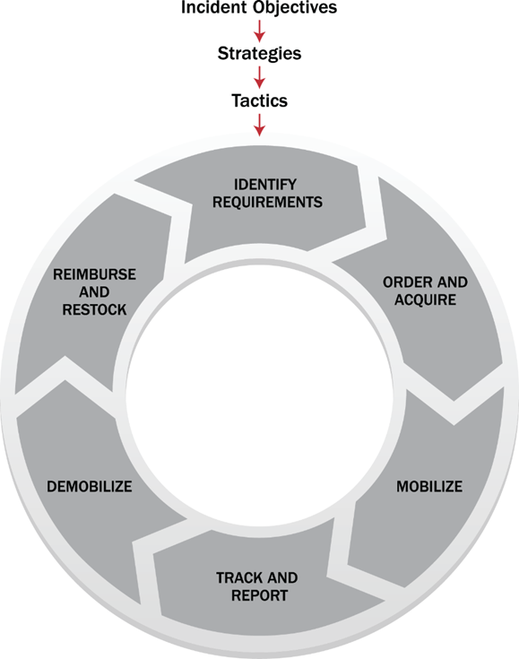
Resources - Activities During an Incident
The resource management process is the six resource management tasks performed in an incident.
The resource management process includes methods to identify requirements, order and acquire, mobilize, track and report, demobilize and reimburse and restock resources in an incident.

Slide 19
Mutual Aid
Mutual Aid Agreements and Compacts
Establish the legal basis for two or more entities to share resources
Address issues including liability, compensation and procedures
Exist between communities, tribal governments non-governmental organizations and the private sector, within a state, between states, between Federal agencies, and internationally
Mutual Aid Process
A request for resources is received from requesting jurisdiction.
The request is evaluated by the providing jurisdiction to determine if they can accommodate a temporary loss of the resource.
If the providing jurisdiction can accommodate the request, they deploy the resource to the requesting jurisdiction.

Slide 20
NIMS 2017 Component 3: Command and Coordination
Defines the fourteen NIMS Management Characteristics
Describes four NIMS Command and Coordination structures:
Incident Command System (ICS)
Emergency Operations Centers (EOCs)
Multiagency Coordination Group (MAC Group)
Joint Information System (JIS)
2008 - Command and Management
Incident Command System (ICS)
Multiagency Coordination System (MACS)
Public Information
2017 – Command and Coordination
Multi-Agency Coordination Systems (MACS):
ICS
EOCs
MAC Group
JIS

Slide 21
NIMS Management Characteristics
NIMS bases incident management and coordination on fourteen NIMS Management Characteristics (formerly called ICS Management Characteristics)
Common Terminology
Modular Organization
Management by Objectives
Incident Action Planning
Manageable Span of Control
Incident Facilities and Locations
Comprehensive Resource Management
Integrated Communications
Establishment and Transfer of Command
Unified Command
Chain of Command and Unity of Command
Accountability
Dispatch/ Deployment
Information and Intelligence Management
The name is new but the 14 characteristics remain the same

Slide 22
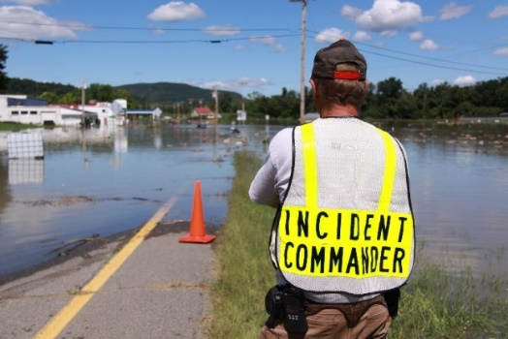
NIMS Command and Coordination Structures – Incident Command System (ICS)
The Incident Command System (ICS) is used for on-scene Management of Incidents
When an incident occurs or threatens, local emergency personnel manage response using ICS

Slide 23
Incident Command System Changes
Revised description of the Intelligence/ Investigations function
Revised “Manageable Span of Control” guidance
Made revisions to the incident planning process to align with processes in use within the emergency management community
Consistent use of the term “Incident Management Team” to refer to pre-rostered teams that may be assigned to an incident.
Includes list of possible command advisors, including Legal Counsel, Medical Advisor, and Access and Functional Needs Advisor.
Added “resource team” as an alternative law enforcement term for a “strike team”.

Slide 24
Manageable Span of Control
NIMS 2008 states that “in ICS, the span of control of any individual with incident management supervisory responsibility should range from 3 to 7 subordinates, with 5 being optimal. During a large-scale law enforcement operation, 8 to 10 subordinates may be optimal.“
NIMS 2017 adjusts this guidance to provide more flexibility and allow for factors such as supervisory experience and the nature of the work.
“The optimal span of control for incident management is one supervisor to five subordinates; however, effective incident management frequently necessitates ratios significantly different from this. The 1:5 ratio is a guideline, and incident personnel use their best judgment to determine the actual distribution of subordinates to supervisors for a given incident or EOC activation.”

Slide 25
Incident Command System Structure
INCIDENT COMMANDER
ICS still includes five major functional areas:
Command
Operations
Planning
Logistics
Finance/Administration.
PUBLIC INFORMATION OFFICER
SAFETY OFFICER
LIAISON OFFICER
OPERATIONS SECTION CHIEF
PLANNING SECTION CHIEF
LOGISTICS SECTION CHIEF
FINANCE/ ADMINISTRATION SECTION CHIEF

Slide 26
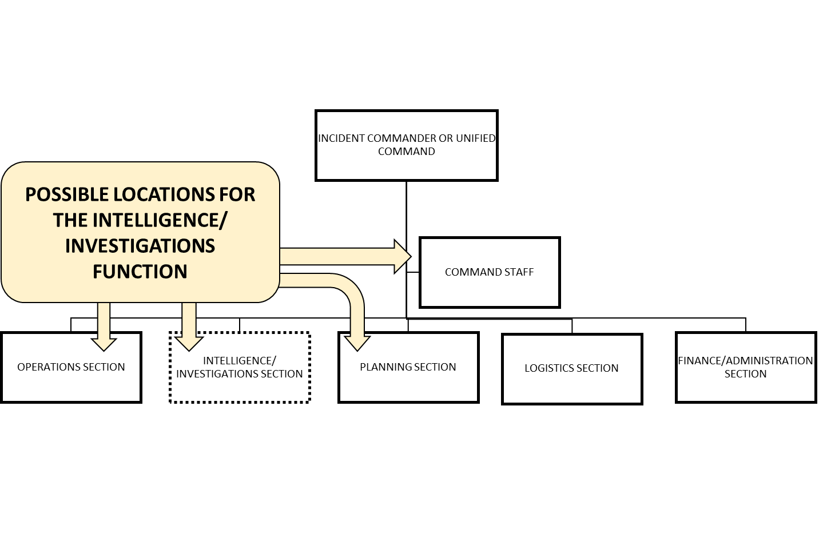
Intelligence/ Investigations Placement in ICS
The Intelligence/ Investigations (I/I) function may be used for incidents involving intensive intelligence gathering and investigative activities. The IC/UC can place the I/I function in multiple locations within the incident command structure based on factors such as the nature of the incident, the level of I/I activity, and the relationship of I/I to other incident activities. The I/I function can be placed in the Planning Section, in the Operations Section, within the Command Staff, as a separate General Staff section, or in some combination of these locations.

Slide 27
Incident Management Team (IMT) Incident Management Assistance Team (IMAT)
IMT: IMTs are rostered groups of ICS-qualified personnel, consisting of an Incident Commander, other incident leadership, and personnel qualified for other key ICS positions. IMTs exist at local, regional, state, tribal, and national levels and have formal notification, deployment, and operational procedures in place. IMTs can be delegated the authority to act on behalf of the affected jurisdiction or organization.
IMAT: Some IMTs are referred to as Incident Management Assistance Teams (IMAT) to clarify that they support on-scene personnel and/or the affected jurisdiction(s). IMATs exist at various levels of government and within the private sector. As an example, FEMA IMATs deploy to incidents to help identify and provide Federal assistance, and coordinate and integrate inter-jurisdictional response in support of an affected state or tribe.

Slide 28
Incident Action Planning
The Operational Period Planning Cycle is a formal planning cycle with established meetings and deliverables for an operational period.
NIMS 2017 Planning “P” Changes:
Adds “Agency Administrator Briefing (If Appropriate)”
Adds “Strategy Meeting/ Command and General Staff Meeting (if necessary)”
Adds “Understanding the Situation (Ongoing)” to the center of the graphic

Slide 29
Operational Period Planning Cycle The Planning “P”

Slide 30
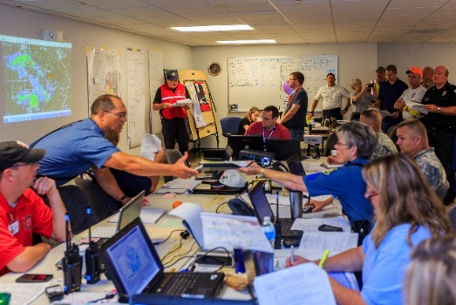
NIMS Command and Coordination Structures – Emergency Operations Centers (EOCs)
Emergency Operations Centers (EOCs) are used for the offsite support to on-scene ICS operations.
If the incident is large or complex, local Emergency Operations Centers activate.
NIMS 2017 provides expanded guidance on EOC structures and activation levels.

Slide 31
Emergency Operations Centers (EOCs)
NIMS 2017 EOC content was developed with input from EOC leaders across the nation.
NIMS 2017 describes common functions, examples of organizational structure and terminology for staff in EOCs.
ICS is used to manage on-scene, tactical-level response; EOCs are used to manage off-scene support to ICS.
Common EOC functions include information management, resource management, and communicating policy decisions.

Slide 32
Emergency Operations Centers (EOCs) – Expanded NIMS 2017 EOC Content
Jurisdictions and organizations across the Nation use EOCs
EOCs are locations where staff from multiple agencies assemble to provide coordinated support to incident command, on-scene personnel, and/or other EOCs.
The purpose, authorities, and composition of the teams that staff EOCs vary widely, but generally, the teams consolidate and exchange information, support decision making, coordinate resources, and communicate with personnel on scene and at other EOCs.
NIMS 2017 identifies three common ways of organizing EOC Teams:
ICS or ICS-like structure
Incident Support Model structure
Departmental structure

Slide 33
EOC Structures (1 of 3)
ICS or ICS-like EOC Structure
EOC DIRECTOR
PUBLIC INFORMATION OFFICER
OPERATIONS COORDINATION SECTION
PLANNING COORDINATION SECTION
LOGISTICS COORDINATION SECTION
FINANCE/ ADMINISTRATION COORDINATION SECTION
Many jurisdictions/organizations configure their EOCs using the standard ICS organizational structure. The structure is familiar to many people, and it aligns with the on-scene incident organization.

Slide 34
EOC Structures (2 of 3)
Incident Support Model (ISM) EOC Structure
EOC DIRECTOR
PUBLIC INFORMATION OFFICER
SITUATIONAL AWARENESS SECTION
PLANNING SUPPORT SECTION
RESOURCES SUPPORT SECTION
CENTER SUPPORT SECTION
Jurisdictions/organizations that focus their EOC team’s efforts on information, planning, and resource support may choose to separate the situational awareness function from planning and combine operations and logistics functions into an incident support structure.

Slide 35
EOC Structures (3 of 3)
Departmental EOC Structure
Emergency Manager
Department of Natural Resources
Department of Health & Human Services
Department of Public Works
Department of Public Safety
Department of Administration
Department of Education
Jurisdictions/organizations may opt instead to use their day-to-day departmental/agency structure and relationships in their EOC. By operating in the context of their normal relationships, department/agency representatives can function in the EOC with minimal preparation or startup time.

Slide 36
EOC Activation and Deactivation
EOCs are activated for various reasons based on the needs of a jurisdiction, organization, or Incident Commander; the context of a threat; the anticipation of events; or in response to an incident.
EOCs frequently have multiple activation levels to allow for a scaled response, delivery of the needed resources, and a level of coordination appropriate to the incident.
The next slide outlines the three activation levels in NIMS 2017:

Slide 37
EOC Center Activation Levels
Level | Activation Level Title | Description
3 | Normal Operations/ Steady-State | Activities that are normal for the center, when no incident or specific risk or hazard has been identified, are underway. This includes routine watch and warning activities if the center normally houses this function.
2 | Enhanced Steady State/ Partial Activation | Certain EOC Team members/ organizations are activated to monitor a credible threat, risk or hazard and/or to support the response to a new and potentially evolving incident.
1 | Full Activation | EOC team is activated, including personnel from all assisting agencies, to support the response to a major incident or credible threat.

Slide 38

NIMS Command and Coordination Structures – Multiagency Coordination Group (MAC Group)
Multiagency Coordination Groups (MAC Group) are composed of agency administrators, executives or their designees.
Also referred to as policy groups
MAC Groups provide offsite support of ICS and EOC organizations through:
High level strategic policy guidance
Scarce resource allocation

Slide 39
Describing the MAC Group
Multi Agency Coordination (MAC) Groups are part of the off-site incident management structure of NIMS.
MAC Group members are typically agency administrators or senior executives from stakeholder agencies impacted by and with resources committed to the incident.
The MAC Group may also include representatives from non-governmental organizations.
During incidents MAC Groups act as a policy-level body, support resource prioritization and allocation, make cooperative multi-agency decisions and enable decision making among elected and appointed officials with those managing the incident (IC/UC).
MAC Groups do not perform incident command functions.
MAC Groups do not replace the primary functions of operations, coordination, or dispatch organizations.

Slide 40
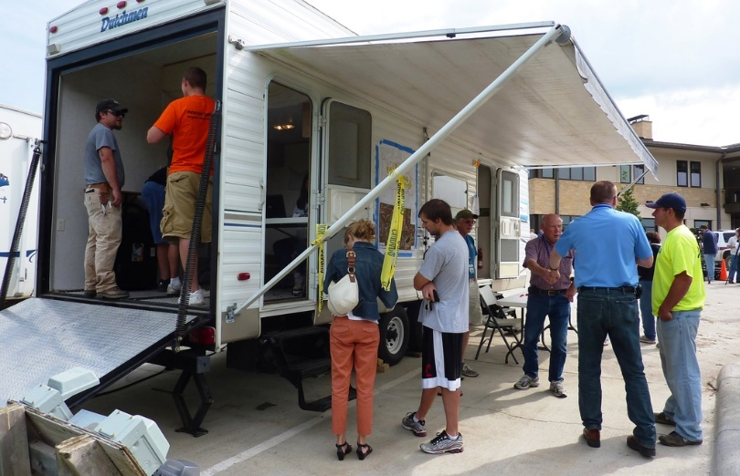

NIMS Command and Coordination Structures – Joint Information System (JIS)
The Joint Information System (JIS) is the fourth NIMS Command and Coordination structure.
JIS integrates incident information and public affairs to provide consistent, coordinated, accurate, accessible, timely and complete information to the public and stakeholders during incident operations.
JIS operates across and supports the other NIMS structures: ICS, EOCs and MAC Group

Slide 41
JIS Activities
JIS activities include:
Coordinating interagency messaging
Developing, recommending and executing public information plans and strategies
Advising the Incident Commander or Unified Command, MAC Group and EOC director on public affairs issues
Addressing and managing rumors and inaccurate information
A Joint Information Center (JIC) manages these JIS activities

Slide 42
What Happened to Multiagency Coordination Systems (MACS)?
NIMS 2008 defined MACS as “the architecture to support coordination for incident prioritization, critical resource allocation communications systems integration and information coordination.” EOCs and MAC Groups were elements of MACS.
NIMS 2017 defines MACS as “an overarching term for the NIMS Command and Coordination systems: ICS, EOCs, MAC Group/ policy groups and JISs.”
This broadens the definition of MACS to include the Command and Coordination architecture for tactical coordination (ICS), operational support coordination (EOCs), policy level coordination (MAC Group) and their support through coordinated information (JIS).

Slide 43

NIMS 2017 Component 4: Communications and Information Management
2008 NIMS
Concepts and Principles
Management Characteristics
Organization and Operations
2017 NIMS
Communications Management
Incident Information
Communications Standards and Formats
Enhances information management processes:
Expands guidance on data collection plans
Integrates social media considerations
Highlights the use of geographic information systems (GIS)

Slide 44
Communications and Information Management
NIMS 2017 adds “Security” as a fourth key principle of communications and information systems.
The four key principles are now (1) Interoperability; (2) Reliability, Scalability, and Portability; (3) Resilience and Redundancy; and (4) Security.
Security: Some information is sensitive… Incident personnel should work with IT and security experts to incorporate data, network, and systems protection best practices into incident communications and data sharing.
NIMS 2017 provides enhanced guidance on information management processes to improve data collection plans, social media integration and the use of geographic information systems.

Slide 45
NIMS Training Updates
Core EMI NIMS, ICS and EOC courses are in revision based on the NIMS 2017 publication
Current NIMS/ ICS courses will remain active until revised courses are available
EMI courses affected by changes in the NIMS 2017 are scheduled for revision during 2018

Slide 46
Sequence of NIMS Course Updates
The first three EMI courses with updated NIMS content will be:
IS 0100: ICS-100 Incident Command System (ICS)
IS 0700: National Incident Management System (NIMS)
IS 0800: National Response Framework (NRF)
Revision of additional courses for ICS and EOCs will follow.

Slide 47
Incident Command System (ICS) Training
Recommended Sequence of ICS Training
All Emergency Management Practitioners
IS 0100: Introduction to the Incident Command System, ICS 100
IS 0700: National Incident Management System (NIMS), An Introduction
Emergency Management Supervisors add
IS 0200: Incident Command System for Single Resources and Initial Action Incidents
IS 0800: National Response Framework, An Introduction
Advanced NIMS Training for ICS Leaders/ Supervisors
G 0191: ICS/EOC Interface
E/L/G 0300: Intermediate ICS for Expanding Incidents
E/L/G 0400: Advanced ICS for Command and General Staff
NIMS ICS All Hazards Position Specific Courses (E/L/G 0949-0991)

Slide 48
Emergency Operations Center (EOC) Training
Recommended Sequence of EOC Training
All Emergency Management Practitioners
IS 0100: Introduction to the Incident Command System, ICS 100
IS 0700: National Incident Management System (NIMS), An Introduction
Emergency Management Supervisors add
IS 0775 or IS 2200 (in development) Basic EOC Management and Operations
IS 0800: National Response Framework, An Introduction
Advanced NIMS Training for EOC Leaders/ Supervisors
G 0191 ICS/EOC Interface Workshop
E/L/G 0775 or E/L/G 2300 (in development) Intermediate EOC Management and Operations

Slide 49
LEARN MORE ABOUT NIMS
FEMA National Incident Management System
The Resource Typing Library Tool (RTLT)
The Intelligence and Investigations Guide
NIMS Reusable Learning Objects
NIMS/ ICS Resources and Section 508 Compliant NIMS Forms
FEMA NIMS Training
Questions? Send us e-mail: FEMA-NIMS@fema.dhs.gov
Stay informed! Sign up for NIMS Alerts

Slide 50
Extended Alt Text slides for 508 Compliance

Slide 51
Alternative Text Slide 18
The graphic depicts the NIMS Resource Management process. The Resource Management Process defines the six resource management tasks performed in an incident. At the beginning of the cycle incident objectives, strategies and tactics are used to identify resource requirements. In the second step these resource requirements are ordered and acquired. In the third step the resources are mobilized. In the fourth step these resources are tracked and reported on during utilization. In the fifth step the resources are demobilized when no longer required for the incident. Finally, the cost of using the resource is reimbursed to the resource’s owner, and any depleted items are restocked for future requirements.
Return to Previous slide

Slide 52
Alternative Text Slide 29
The graphic depicts the Planning “P” chart. The Planning “P” process begins with the initial response and the information gathering and sharing. The steps in these processes are incident/threat, notification, initial response and assessment, agency administrator briefing (if appropriate), incident briefing ICS 201, initial UC meeting (if Unified Command), IC/UC sets initial incident objectives, and initial strategy meeting and information sharing. After this initial step the process moved to being a cycle of tactics meeting, preparing for planning meeting, planning meeting, IAP preparation and approval, operational period briefing, begin operational period, execute plan and assess progress, IC/UC validate or adjust objectives, strategy meeting if objectives adjusted, and then back to tactics meeting to begin the cycle over again. Information gathering and sharing is happening continuously throughout this process.
Return to Previous Slide

