Slide 1
TOURISM PRODUCT, MotivES & TYPOLOGIES
SADEKE SMITH
COLBOURNE COLLEGE

Slide 2
Objectives
Characteristics of the Tourism Industry
Tourist motivations for travel
Pull and Push Factor Theory & typologies

Slide 3
The Tourism Product
“Also known as the Service Industry”
Overview
Open 365 days a year, 24 hours a day
Longer hours than some other industries
Holiday work – Every Holiday/Seasonal employment (open)
Shift work
Guest satisfaction
Labour intensive

Slide 4
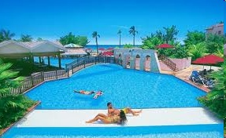
The Tourism Product
Characteristics

Slide 5
What is the difference between a good and a service?
A good is something tangible, something with mass and takes up volume, it is something that you can physically touch, see and store.
A service on the other hand is very different. In that you can’t touch the service, you can’t hold on to it, smell it or taste it, in essence it is intangible. You can’t save up or store something that you can see and touch hence it is perishable.

Slide 6
Understanding Service
A service is any act or performance that one party can offer to another that is essentially intangible and does not result in ownership of anything. Its production may or may not be tied to a physical product.
Because services are generally high in experience and credence qualities, there is more risk in their purchase.

Slide 7
NATURE OF SERVICE
INTANGIBLE
INSEPARABLE
VARIABLE
PERISHABLE

Slide 8
Intangibilty
Cannot be touched, cannot test service before experiencing it.
Cannot be inspected by prospective purchasers before they purhase
You can just feel
Given in the form of service, atmosphere and hospitality

Slide 9
Intangible Example
The person booking a room for the first time does not know the service he/she will actually receive until it is received. People will infer quality from the people, place, equipment, communication material, symbols and price that they see

Slide 10
VARIABILITY
Vary in standard
Vary in quality over time and under different circumstances
Not consistently uniformed, for example a package tour or even a flight on an aircraft cannot be consistently uniformed; a bumpy flight or a long technical delay can change an enjoyable experience into a nightmare, a hoilday at a seaside can be ruied by a prolonged rainy situation.

Slide 11
Variability Example
Because services depend on who provides them, and when and where they are provided, services are highly variable

Slide 12
Inseparability
Customers cannot be separated from the product
Product cannot be brought to the customer, customers must be brought to the product.
Place of production and consumption

Slide 13
Inseparability Example
Services are typically produced and consumed simultaneously. If a person renders the service then the provider is part of the service. Because the customer is present when the service is produced ,the client-provider interaction is a special feature of service marketing

Slide 14
Perishability
Products cannot be stocked
If not used up, leads to revenue loss
For example 1800 rooms are available , however 800 rooms were sold, what is it that we do with the unsold 1000 rooms? Nothing !
There is a permanent loss of 1000 rooms.

Slide 15
Perishability Example
Services cannot be stored, once a flight takes off, any unsold seats cannot be held for future sales. However, firms do not have to readily deal with this issue if demand for the service is steady.

Slide 16
Motivation
Motivation arises out of the felt wants or needs of an idividual.

Slide 17
The Motivation for a Trip
Motivation identifies first the purpose of a visit.
Leisure: Holidays ( visits to friends, relatives i.e VFR travel)
Business ( meetings, conferences etc.)
Other ( education, religious pilgrimages, sport, health etc.)
Emergencies (Special cases such as a death in the family.

Slide 18
QUESTION
How does business travel differ from leisure travel?

Slide 19
Answer
little discretion on choice of destination and timing of trip
Business trips arranged on short notice and for specific periods of time, hence buisness travlers needs the convenience of frequent regular transport, efficient service and good facilities.
Less concerned with cost of travel
Higher or less price of travel does not deter business travel. ( Price inelastic)

Slide 20
Answer
Hoilday travlers in comparison to business travelers are more price elastic, lower prices for holidays leads to more guests travelling

Slide 21
Why People Tavel ( Purpose)
Visiting friends and relatives
Health
Education
Beauty, nature and national parks
Religion
Indulgence
Sports
Festivals
Adventure
Heritage
Ecotourism
Attractions
Etc.

Slide 22
Why people Travel
Two Broad Categries/ Reasons:
Pleasure
Business

Slide 23
Motivation vs. Purpose of Travel
Motivation and purpose are closely related, Purpose speaks about the general reason why people travel however motivation highlights the specific reasons why people travel, that is it speaks about their needs and wants.
E.g.. Boy, I'm tired and stressed, I need time off (Purpose)
Motivation is specific; e.g.. I must attend the conference

Slide 24

Motivation Theories

Slide 25
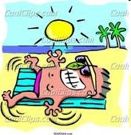
Motivation for Pleasure Travel
This can be compared to Maslow’s hierachy of needs.
Physiological needs: food, water, oxygen, sex, etc
Safety Needs: Security, stability, order, protection
Love needs: affection, identification, belonging ( family and friends)
Esteem needs: Self respect, prestige, sucess and achievement
Self-actualization needs: self fulfillment

Slide 26
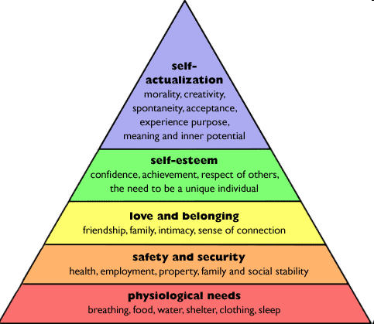
Maslow’s Hierachy of Needs
Depending on where you are (STAGE OF NEEDS) your motivation for travel will differ.

Slide 27
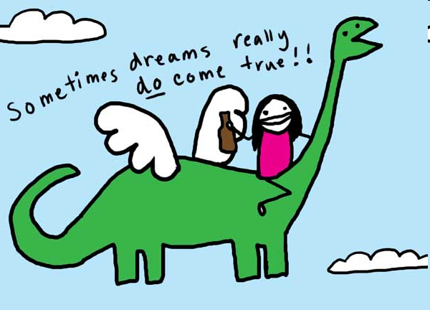
McIntosh and Goeldner
Travel motivators can be divided into:
Physical motivators: Physical rest, sporting, beach activities, healthful and relaxing entertainment
Cultural motivators: the desire for knowledge of other countries, music, art, folklore, dances, paintings and religion
Interpersonal Motivators: The desire to meet new persons, visit friends and relatives, to escape from routine, the family, to make new friends
Status and Prestige motivators: the desire for recognition, attention, appreciation and good reputation.

Slide 28

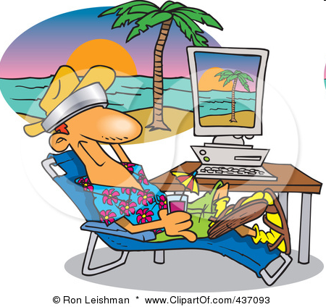
The Increase of Travel
Longer life span
Flexible work hours
Early retirement
Greater ease of travel
Tendency to take shorter more frequent trips
Increase in the standard of living

Slide 29
Plog’s Theory
Travellers can be separated into two extremes:
Psychocentrics
Allocentrics

Slide 30
Plog’s Theory
The personality typology of Stanley Plog is widely cited within tourism studies. According to Plog, a “normal” population, represented as a bell curve can be divided into several categories based on personality dimensions, intermediate categories are provided to recognize the continual rather than discrete nature of these dimensions.

Slide 31
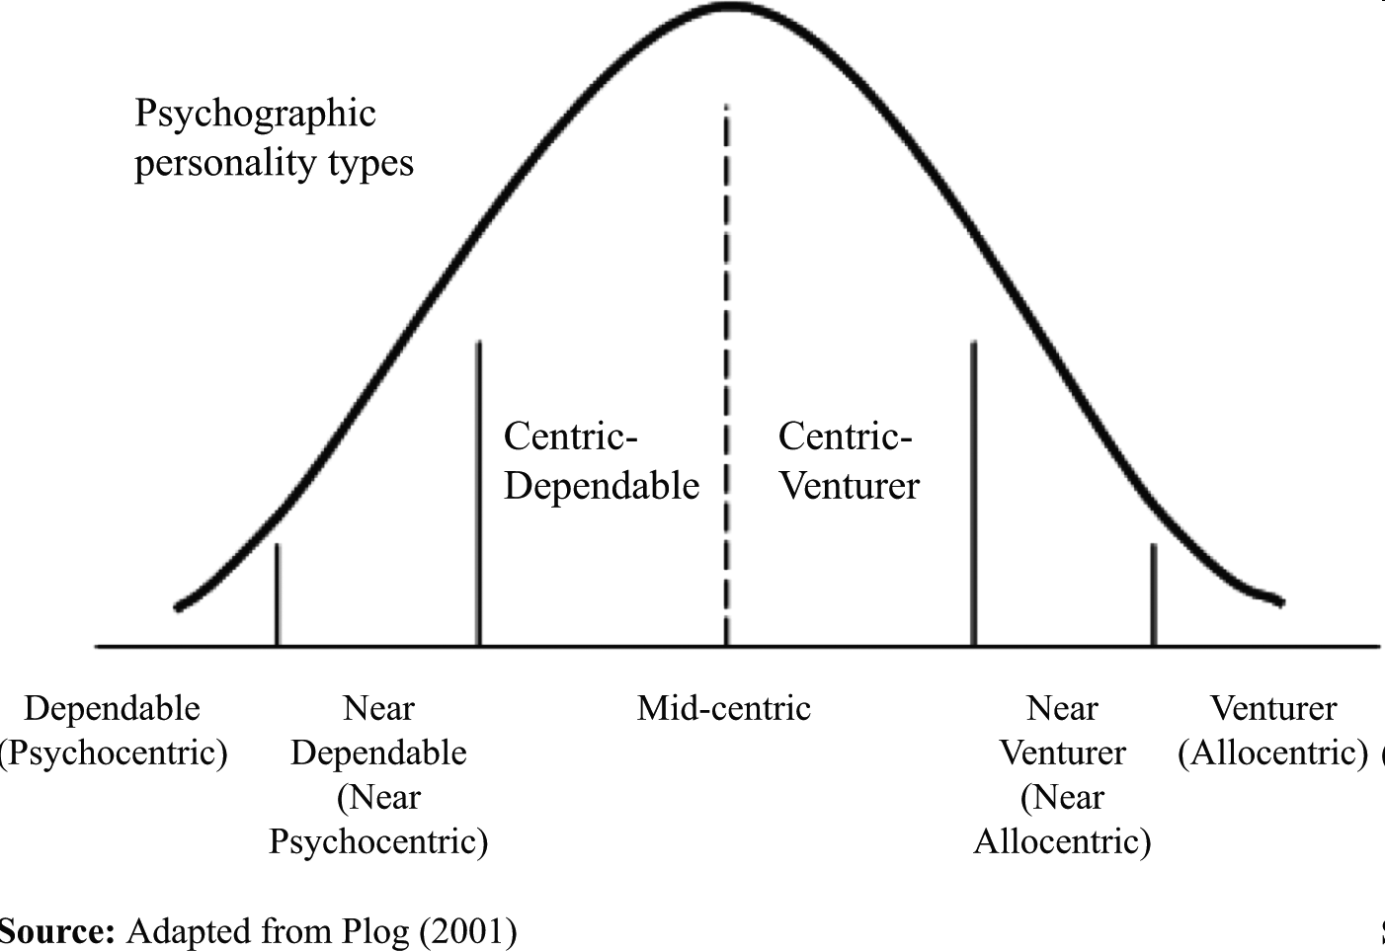
Plog’s Theory

Slide 32

Plog’s Theory
Allocentrics perfer new and different destinantions
More adventurous, curious, energetic, and outgoing
Example: Africa, South Africa, Egypt etc.
Allocentrics: according to Plog’s typology, ‘other-centered’ tourists who enjoy exposing themselves to other cultures and new experiences, and are willing to take risks in this process

Slide 33

Plog’s Theory
Psychocentrics: ‘self-centered’ tourists who prefer familiar and risk averse experiences
Example: las Vegas, Atlantic City

Slide 34
Plog’s Theory
Midcentrics: ‘average’ tourists whose personality type is a compromise between allocentric and psychocentric traits
In sum, Plog’s model is best utilized as a useful indicator of personality dimensions, but not as a definitive predictor of personality distribution or tourist behavior
Example: Miami Beach, Florida, Hawaii

Slide 35
Cohen’s Model (1972) Erik Cohen
The organised mass tourist
These are the least adventurous tourists, who on buying their package holiday remain encapsulated in an ‘environmental bubble’, divorced from the host community as they remain in the hotel complex. They adhere to an itinerary fixed by the tour operators, and even their trips out of the complex are organised tours. They make few decisions about their holiday.

Slide 36
Cohen’s Model (1972)
The explorer
The explorers arrange their own trip alone, and attempt to get off the beaten track. Yet they will still have recourse to comfortable tourist accommodation. However, much of their travel will be prompted by a motivation to associate with the people, and they will often speak the language of the host community. Nonetheless, the explorers retain many of the basic routines of their own life style.

Slide 37
Cohen’s Model (1972)
The drifter
The drifters will shun contact with the tourist and tourist establishment, and identify with the host community. They will live with the locals and adopt many of the practices of that community. Income is generated by working within the community, but often through low-skilled work, which creates a tendency to mix with the lower socio-economic groups.

Slide 38
Cohen’s Model (1972)
The individual mass tourist
They are similar to the organised mass tourist in that they utilise the facilities made available by the tour operator, but they have some control over their own itinerary. They may use the hotel as a base and hire a car for their own trips. However, many will tend to visit the same places as the mass organised tourist in that they will visit the ‘sights’.

Slide 39
Push and Pull Model
An interesting way of modelling travel motivations is to divide them into factors that are called pull and push
Developed by Arlin Epperson (travel consultant)

Slide 40
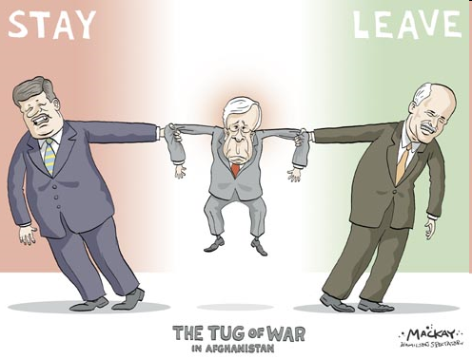
Pull Factors
Pull factors are in terms of the attractions.
People are pulled to make a decison based on the attraction type

Slide 41

Push factors
They are based on personal feelings
For example a vacation at a caribbean Island to relax is a PUSH factor.

Slide 42
Business Travel
An airline study shows that the business- Leisure mix varies widely according to desination
Good portion of business travel mixes with leisure.
Business travel accounts for at least half of the travel in the United States and is 156 billion in the industry.
At least half of the airline industry is undertaken by business travel.

Slide 43

Business Travelers
Meetings
conventions
Trade shows
Expositions
Eg. Montego Bay Convention Center
Many hotels offer meeting and convention space, especially in Kingston

Slide 44
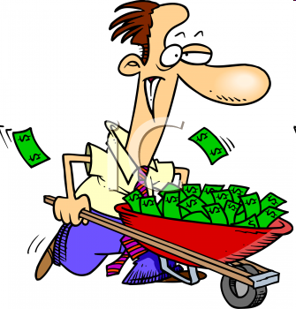
COMPARATIVE ADVANTAGE
Business travel when compared to leisure travelers:
Younger
Spend more money
Travel in smaller groups
Travel further

Slide 45

Business Travel
Business travel has increased in recent years due to the growth of convention centers in several cities. As a result, business travelers have given a boost to hotels, restaurants, and auto rental companies.

Slide 46
Reference
Cohen, Eric. (1974). A Conceptual Phenomenology of Tourists Experience
Maslow, H. Abraham. (1943). A Theory of Human Motivation
Mc Intosh & Goeldner, (1968). Tourism Principles, Practices & Philosophies
Plog, Stanley. (1973). Tourism Typology on Prezi

