Slide 1

ELISA Disease Detection
Modeling Antigen and Antibody Detection

Slide 2
Note to Teachers
STOP: Read this slide before proceeding, then delete it.
This activity is designed for students to work though on their own. Please adapt it to fit the needs of your course.
Make it relevant — pick a disease that is of particular interest to your students, and have students model the use of ELISA for its detection. A coronavirus scenario is presented in the antibody detection ELISA slides.
Make it accessible — instead of printing and cutting out shapes, students can click and drag the shapes to create a digital model; they may also choose to draw their own model.
Add an assessment — students can record and narrate their models using Flipgrid or Stop Motion Studio apps. Assessment question slides have a green border along the top edge.
Copyright 2020 Bio-Rad Laboratories, Inc. All content and images contained in this presentation may be used for educational purposes only and may not be distributed. Bio-Rad is a trademark of Bio-Rad Laboratories, Inc. in certain jurisdictions. All trademarks used herein are the property of their respective owner.

Slide 3
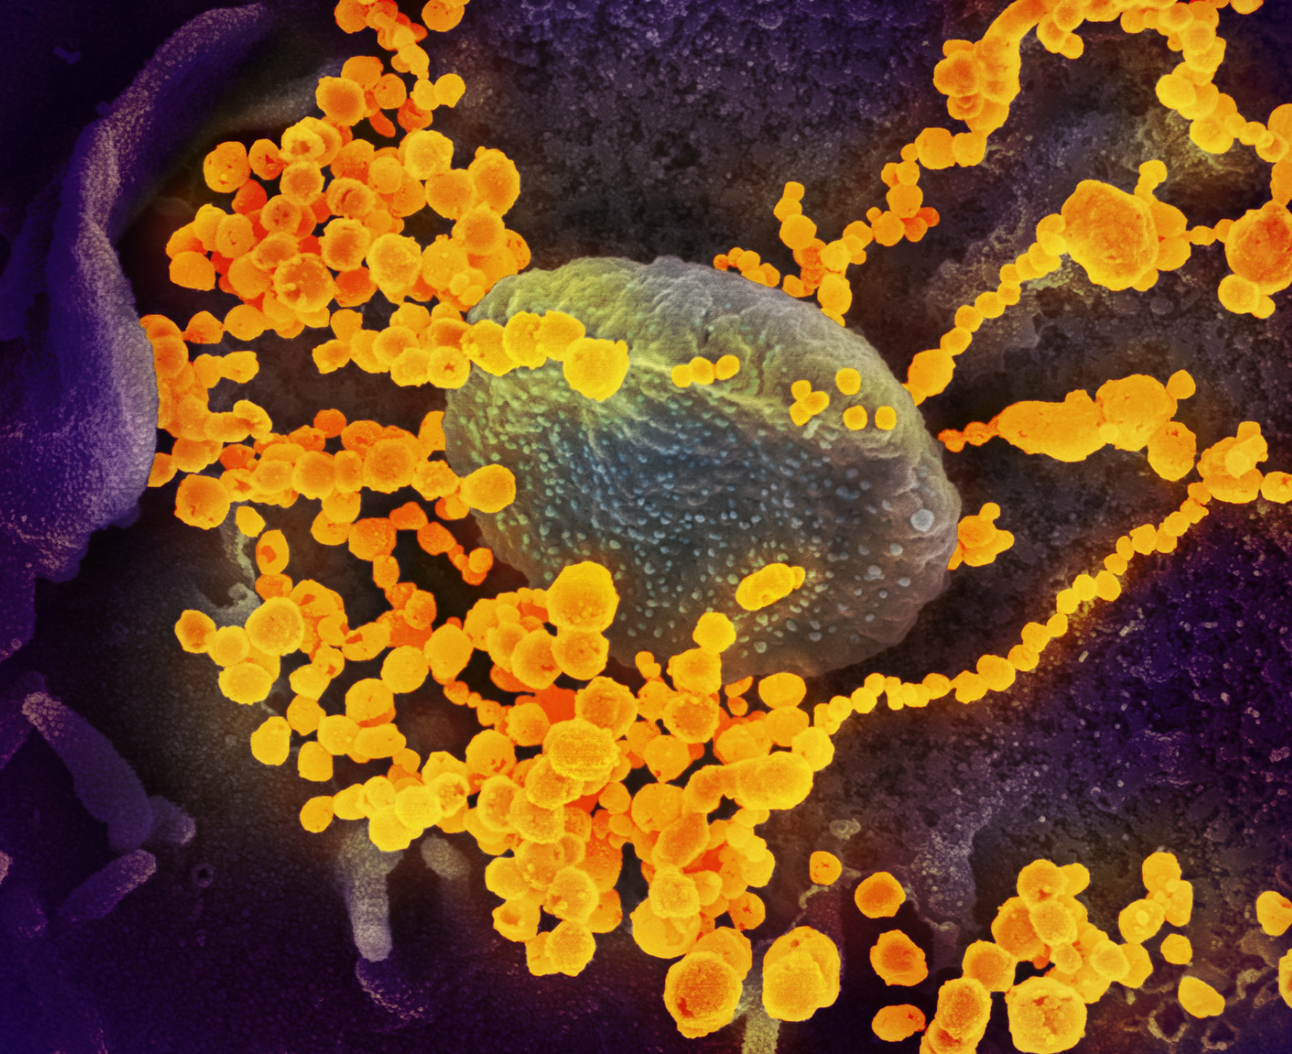
Enzyme-Linked ImmunoSorbant Assay (ELISA)
ELISAs use antibodies to detect proteins in a patient’s sample.
Many diseases and conditions can be detected and diagnosed with ELISAs, including:
Influenza
HIV
SARS
Zika virus
West Nile virus
Lyme Disease
Researchers are also developing ELISAs that can be used to diagnose current or past coronavirus (SARS-CoV-2) infection.
Novel Coronavirus SARS-CoV-2
This scanning electron microscope image shows SARS-CoV-2 (round gold objects) emerging from the surface of cells cultured in the lab. SARS-CoV-2, also known as 2019-nCoV, is the virus that causes COVID-19. The virus shown was isolated from a patient in the U.S. Credit: NIAID-RML

Slide 4

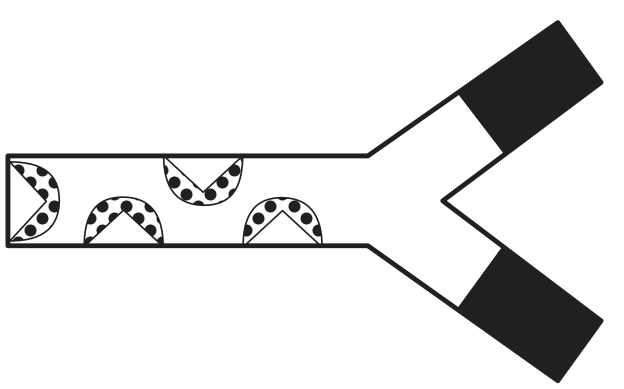
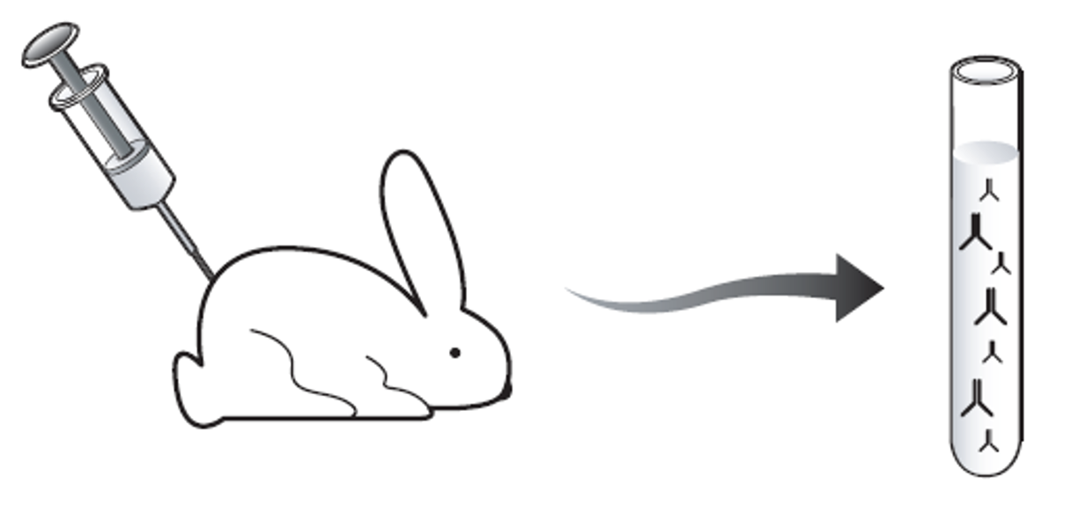
Antigen-Antibody Interactions
Antigen
Pollen, bacteria, viruses, and other foreign molecules are seen by your body as invaders, and they create an immune response. These foreign invaders are called antigens.
Your immune system makes antibodies in response to antigens. The antibodies bind antigens, flagging them for destruction by immune cells.
Antibodies have two regions: variable and constant. Each tip of the “Y” in the variable region is highly specific and binds to only one particular antigen. The constant region is the same for every antibody of the same type (there are 5 different types of antibodies).
Antibodies can also be produced by injecting an animal with antigen - disease agents or even antibodies from a different type of animal.
Variable Region
Constant Region
Antibody

Slide 5
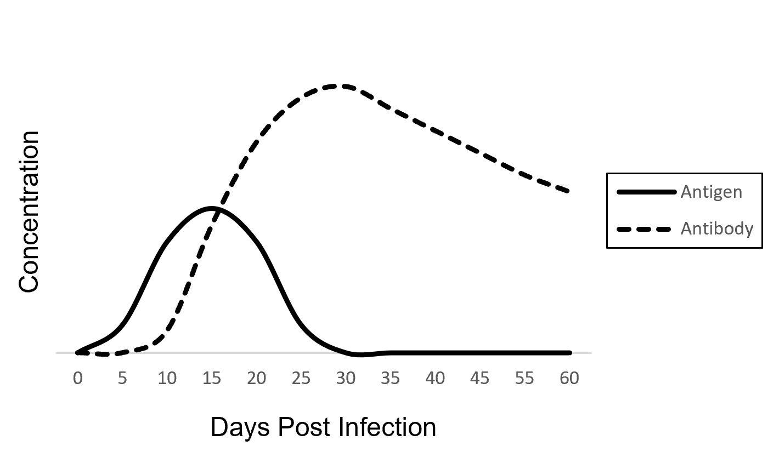
Infection Timeline — Antigens and Antibodies
After infecting a person, a virus multiplies in the body and the concentration of viral antigens increases.
Soon after infection, the immune system kicks in and starts producing antibodies.
As the antibody concentration increases, antibodies bind to viruses and target them for destruction by the immune system.
Eventually, the viral antigen concentration drops, the infection is cleared, and the person recovers.

Slide 6



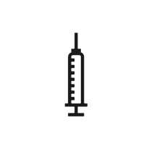

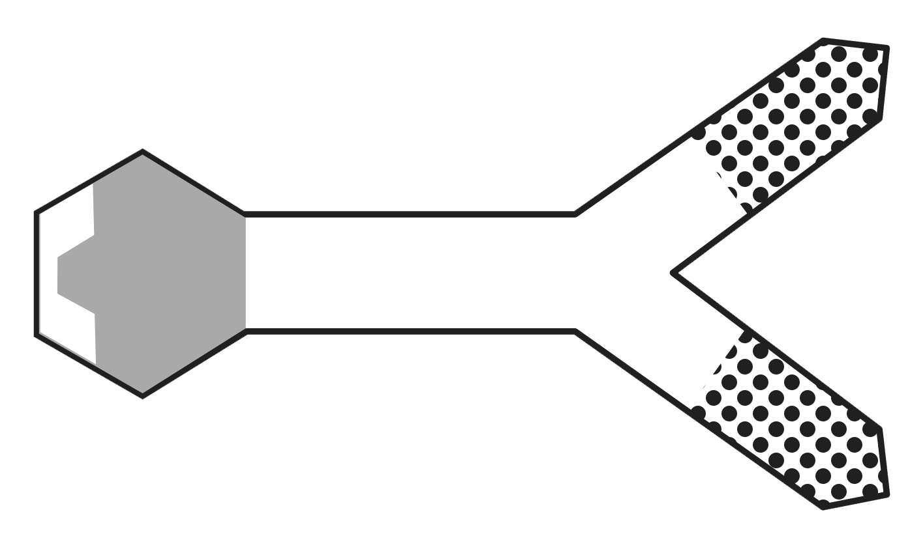

Antigen Detection ELISA Components
Antigen — in an antigen detection ELISA, the patient sample is tested for the presence of antigens from viruses, bacteria, etc.
Primary antibody — binds to the antigen
can be produced in a lab by injecting the target antigen into an animal and then harvesting the serum
Secondary antibody — binds to the constant region of the primary antibody
made by injecting the primary antibodies from one animal into a different animal
secondary antibodies are attached to an enzyme which catalyzes a color change when substrate is added
Substrate — changes color in the presence of the enzyme, indicating a positive result
Antigen
(virus)
Primary
Antibody
(rabbit anti-virus)
Secondary Antibody
(goat anti-rabbit)
Enzyme
Substrate

Slide 7
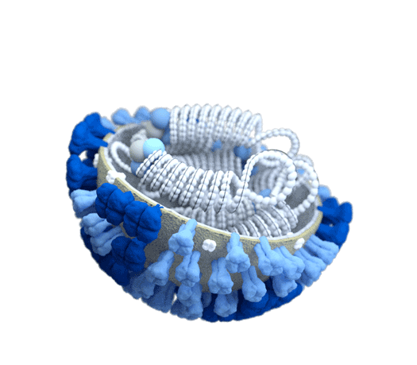
Influenza Antigen Detection
Influenza binds to target cells via the hemagglutinin glycoprotein, HA. Scientists can create antibodies that detect and bind to influenza by injecting HA into an animal.
Antigen
(influenza HA)
Primary
Antibody
(rabbit anti-influenza HA)
Secondary Antibody
(goat anti-rabbit)
cross-section of influenza virus https://www.cdc.gov/flu/resource-center/freeresources/graphics/images.htm
Hemagglutinin
(HA)
Enzyme
Substrate

Slide 8
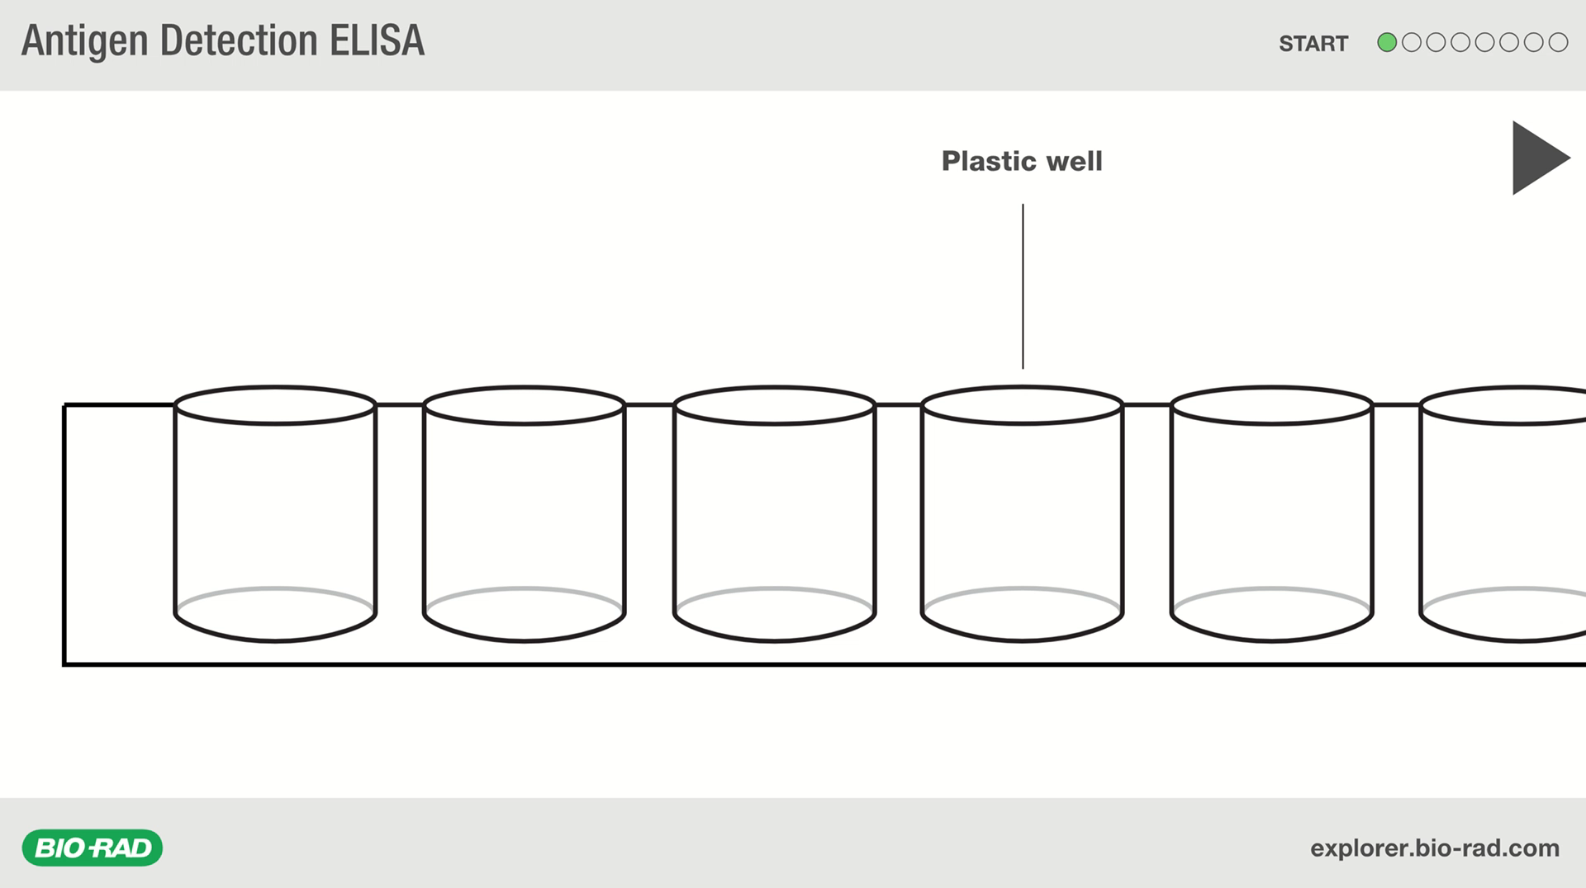
Antigen Detection ELISA Animation
Antigen Detection ELISA Animation
(click on link to view animation, or use presentation mode to play the embedded video)

Slide 9
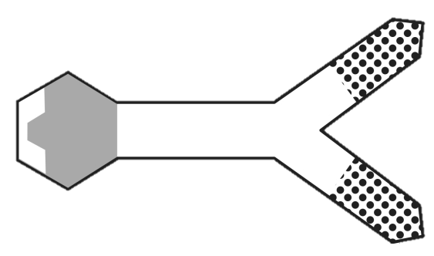
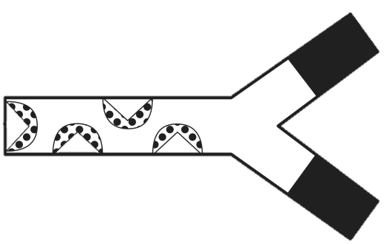



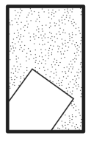
Model an Antigen Detection ELISA
Print out the paper model shapes on the LAST slide in this presentation (click on the last slide, then go to File > Print, and change Print All Slides to Print Current Slide).
Cut out each shape.
Grab one more blank sheet of paper.
Gather the following shapes for the first activity:
2 x primary antibodies with solid black variable region
5 x secondary antibodies
1 of each antigen shape (triangle, circle, rectangle)
6 x substrate
-OR-
Go to the second to last slide (Digital ELISA Model) and build your model digitally: click and drag to move the shapes into the well.
Primary Antibody
Secondary Antibody
Antigens
Substrate

Slide 10



Model an Antigen Detection ELISA
Note: the pattern on the ends of the primary antibodies match specific patterns on the antigens.
The pattern and shape of the secondary antibodies matches the pattern and shape on the constant region of the primary antibody.
These patterns and shapes represent both the specificity and location of antigen-antibody, and antibody-antibody binding.

Slide 11
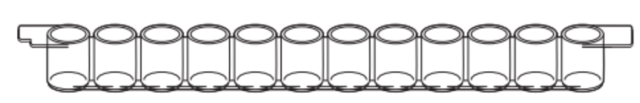
Antigen Detection ELISA Model – Setup
An ELISA is typically performed in a plastic microstrip plate that has 12 wells.
Each strip has wells for a positive control, a negative control, and two patient samples, each done in triplicate (4 samples x 3 wells each = 12 wells).
The blank sheet of paper represents a well in a microstrip plate. You will model an ELISA on your paper well.
As you read through the steps in an ELISA, use your paper shapes to model the steps. The actual ELISA steps are explained at the top, and the model steps are explained underneath.
The blank paper represents one well in the microstrip plate

Slide 12
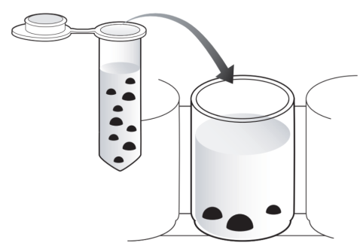



Antigen Detection ELISA – Step 1
Assay Step 1 — Bind antigen to the well
Add the patient sample to the well. This sample contains many different proteins that may or may not contain the antigens that you are trying to detect. These proteins bind non-specifically (adsorb) to the plastic well, due to hydrophobic interactions.
Incubate the sample for 5 minutes, then tap out the fluid.
Add wash buffer to the well to rinse out anything that isn’t bound, and to block the inner surface of the well. This prevents anything from binding non-specifically in future steps.
Repeat the wash step.
Model Step 1
Add the antigens around the bottom edge of your blank paper “well”. These represent the proteins / antigens that might be present in any given patient sample.

Slide 13
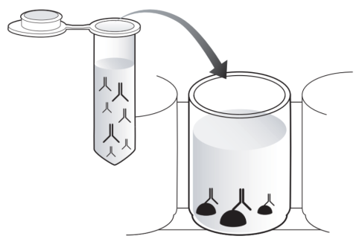
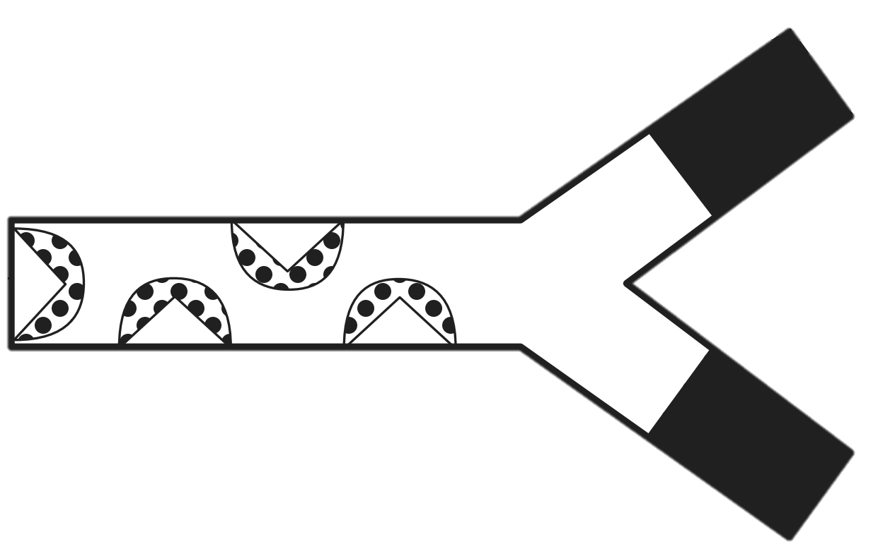
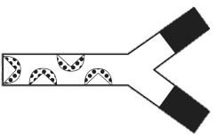
Antigen Detection ELISA – Step 2
Assay Step 2 — Bind primary antibody to antigen
Add the primary antibodies to the well. The antibodies bind only to a specific antigen out of the many that may be bound to the well. For example, an anti-HIV antibody would only bind to HIV antigen. This antigen-antibody interaction is specific and strong.
Incubate the sample for 5 minutes, then tap out the fluid.
Add wash buffer to the well to rinse out anything that isn’t bound. If the primary antibody did not bind to any antigen, then it will be washed away in this step.
Repeat the wash step.
Model Step 2
Add the primary antibodies into your well. Overlay the antibody so that the black regions align. This represents specific antibody-antigen binding.
Model the wash step by removing the unbound primary antibody.

Slide 14
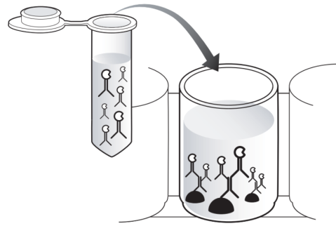
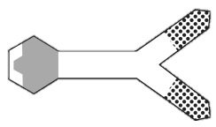
Antigen Detection ELISA – Step 3
Assay Step 3 — Bind secondary antibody
Add the enzyme-linked secondary antibodies to the well. These antibodies bind tightly to any primary antibodies that are present. The secondary antibodies are covalently linked to an enzyme, horseradish peroxidase, which will catalyze a reaction with a substrate to produce a color change.
Incubate the sample for 5 minutes, then tap out the fluid.
Add wash buffer to the well to rinse out any secondary antibodies that did not bind.
Repeat the wash step 2 more times (3 times total).
Model Step 3
Add the secondary antibodies into your well. Overlay the secondary antibody so that the patterns align with the primary antibody.
Model the wash step by removing the unbound secondary antibody.

Slide 15
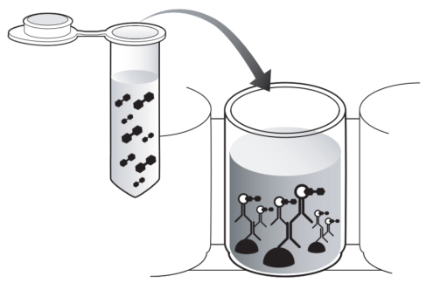

Antigen Detection ELISA – Step 4
Assay Step 4 — Add enzyme substrate for detection
Add the substrate to the well, wait 5 minutes, and evaluate results. If the antigen was present, then the primary and secondary antibodies bound and the well will turn blue. If there was no antigen, then no primary or secondary antibodies bound, so the well will remain clear.
Model Step 4
Add the substrate into your well. Align the substrate with the enzyme on the secondary antibody.
At this point, the enzyme catalyzes a reaction where the substrate turns blue - a positive result.

Slide 16
Questions — Antigen Detection ELISA
In a typical ELISA, lab technicians use separate wells for positive controls, negative controls, and patient samples. You modeled the well of a positive patient sample.
Use your shapes to model a positive control. Describe the necessary components and steps.
Use your shapes to model a negative patient sample. Describe the necessary components and steps.
Examine this graph of antigen and antibody concentrations over time.
Could you use an antigen detection ELISA to accurately diagnose a patient on day 35? Explain your answer.
Antigen detection ELISAs detect viral proteins. Viral DNA or RNA can be detected using a different technique called PCR (polymerase chain reaction). Using the graph, explain when a viral PCR test would be most useful.

Slide 17
Questions — ELISA Design
Refer to the diagram, and notice where the primary antibody binds antigen and secondary antibodies.
Could goat anti-rabbit secondary antibodies be used to detect two different types of rabbit antibodies? Explain your answer.
If HIV antigen was injected into the rabbit instead of influenza, could the same secondary antibodies (goat anti-rabbit) be used to detect both rabbit anti-influenza antibodies AND rabbit anti-HIV antibodies? Explain your answer.
Antigen
(Influenza HA)
Primary
Antibody
(rabbit anti-influenza HA)
Secondary Antibody
(goat anti-rabbit)
Enzyme
Substrate

Slide 18
Question — ELISA Design
You modeled an indirect ELISA, which uses enzyme-linked secondary antibodies. In a direct ELISA, the enzyme is linked to the primary antibody instead, so no secondary antibody is required.
Look at your model and think about what might happen if the enzyme was attached to the primary antibody directly, so that a secondary antibody was not needed.
Would you still get a blue color change when the substrate was added? Explain your answer.
How might the signal intensity (amount of color change) compare to the indirect ELISA that you modeled first?
What might be one advantage to using an enzyme-linked secondary antibody?

Slide 19
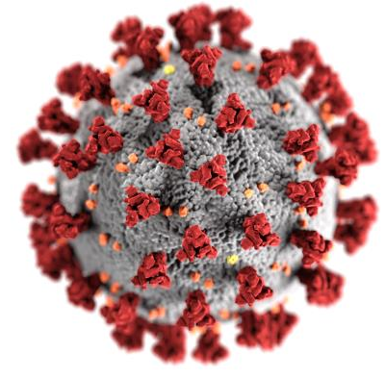
Antibody Detection ELISA Overview
ELISAs can also use purified antigen to detect antibodies in a patient’s serum. The presence of viral antibodies in a patient sample indicates a current or previous infection.
Coronavirus (SARS-CoV-2) binds to target host cells via its spike glycoprotein, S. When someone is infected with coronavirus, their immune system makes antibodies to viral proteins, including S protein.
Scientists are developing ELISAs that use purified S protein as the antigen to detect the presence of coronavirus antibodies in a patient’s serum. ELISAs that detect other viral proteins are being researched as well.
Spike Glycoprotein
(S)

Slide 20


Coronavirus Antibody Detection ELISA
Coronavirus Antibody Detection ELISA
Antigen
(lab-purified coronavirus S protein)
Coronavirus Infection
Coronavirus infects person
Patient Sample
(anti-coronavirus antibodies
will be present in sample if patient was infected)
Person makes antibodies against coronavirus
Secondary Antibody,
goat anti-human
(binds if anti-coronavirus human antibodies are present in the sample)
Enzyme
Substrate

Slide 21
Questions — Antibody Detection ELISA
In an antibody detection ELISA, lab-purified antigen (coronavirus S protein, for example) is added to the wells first. Model this step using the solid black circles to represent the coronavirus S protein antigens. How is this step different than the first step in an antigen detection ELISA?
After antigen is added, the wells are washed. Why is the wash step important? Give two reasons.
Next, the patient sample is added. Patient samples contain a variety of antibodies. If the patient has been infected with coronavirus, the sample will also contain antibodies to the coronavirus S protein. Model this step for a patient who has antibodies to coronavirus. Describe the necessary components and steps.
An enzyme-linked secondary antibody is added next. Model this step and describe the necessary components and steps.
Finally, the substrate is added. Model this step. If the sample turns blue (a positive result) the patient sample contains antibodies to coronavirus. Does this necessarily indicate an ongoing infection? Explain your answer.
Patient C

Slide 22
Questions — Antibody Detection ELISA
Use your shapes to model the following for an antibody detection ELISA:
The positive control
The negative control
A negative patient sample
According to this graph, could you use an antibody detection ELISA to accurately diagnose a patient 35 days after exposure? Explain your answer.
Patient C

Slide 23
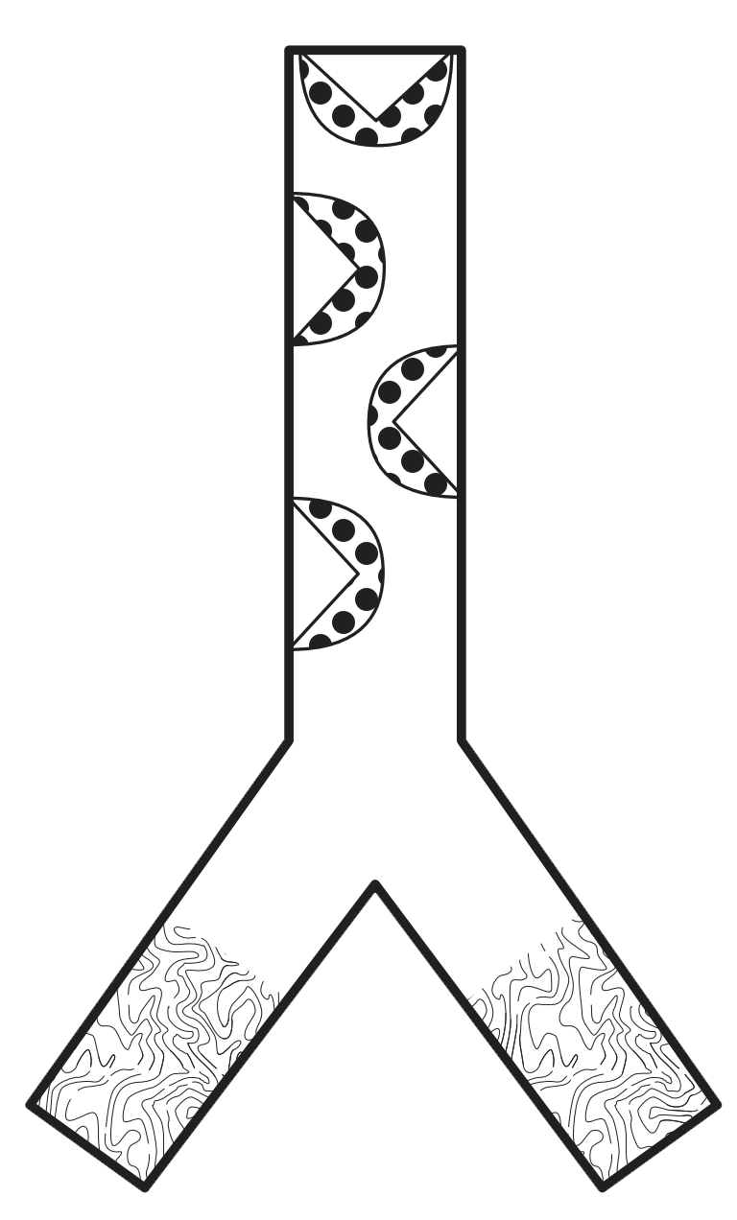
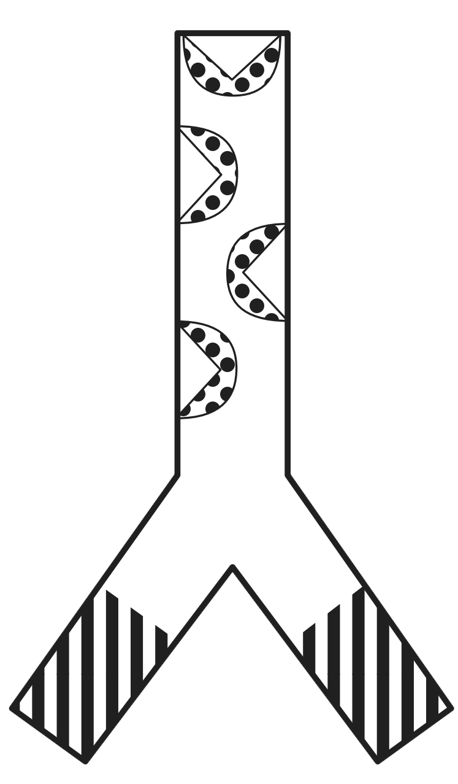
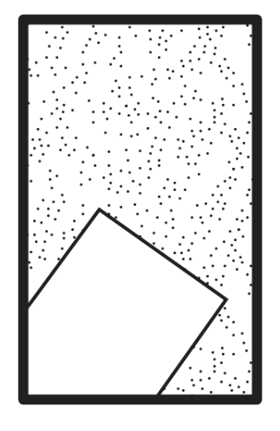
Digital ELISA Model
ELISA well

