Slide 1
Project Update 1
Cricket Chirp Investigation

Slide 2
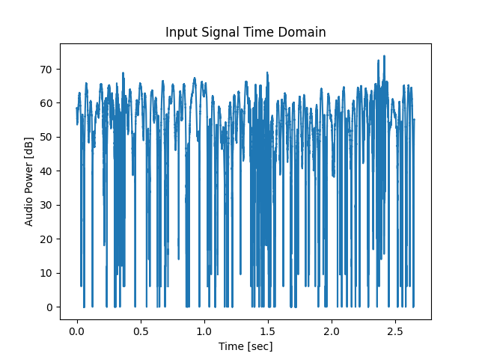
Original Time Domain
The time domain plot is counter intuitive. The signal power seems to be drowned out by noise and is difficult to see. Despite how distinct the audio comes through while listening, filtering is required to find the signal

Slide 3
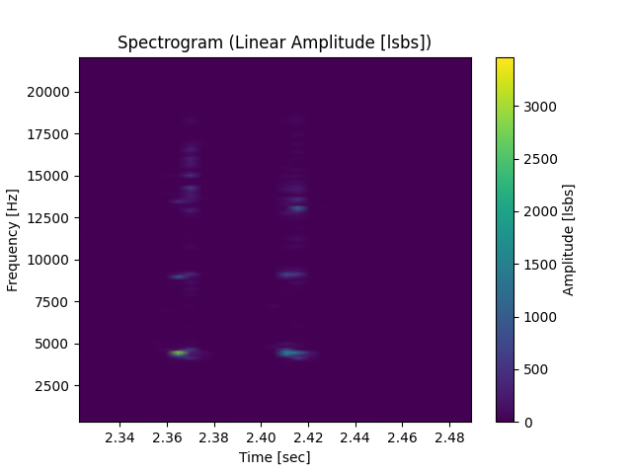
Magnitude Spectrogram (Linear Amplitude)
There are distinct peaks in the audio. There appears to be a main signal and additional harmonics. Source of these harmonics is not yet determined.
Third Harmonic
Second Harmonic
Main Signal

Slide 4
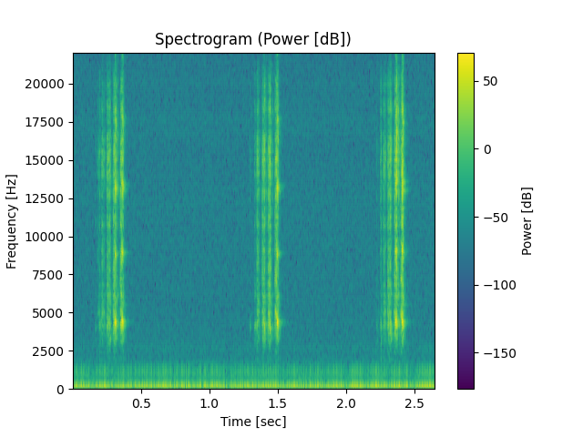
Power Spectrogram (dB)
When plotted in dBs, the signal can be seen to span the entire instantaneous bandwidth of the microphone.
When I filtered for each portion, only the main harmonic sounds like a real cricket chirp. Experiments need to be run to determine which section of this spectrum is actually important for crickets.

Slide 5


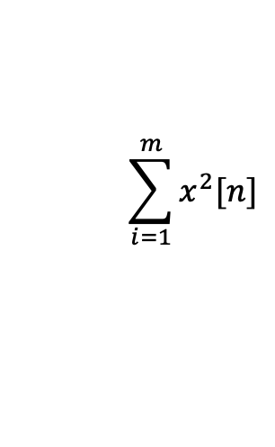

Filtering Approach
Full signal bandwidth
1kHz
Without knowing the true cause of the wideband nature of the signal, the assumption is made that the information is useful. This is very likely true as non-linear product energy is “stolen” from the main signal. Therefore, including it should “return” the energy to that emitted by the cricket.
The process for isolating the signal is now to channelize the entire frequency band (>2kHz) into 1kHz bands. These bands are then combined incoherently to form a well shaped pulse pattern.
Time
…
$$x_{1}^{2}[n]$$
$$x_{2}^{2}[n]$$
$$x_{m}^{2}[n]$$
$$\sum_{i=1}^{m}{x^{2}[n]}$$
Output Signal

Slide 6
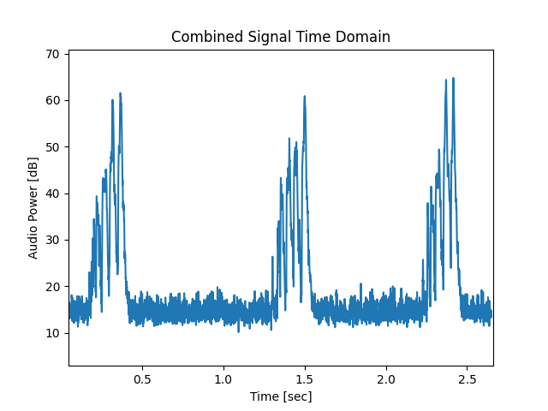
Combined Time Domain
This process appears to clean up the signal pretty substantially. We can now isolate bursts.

Slide 7
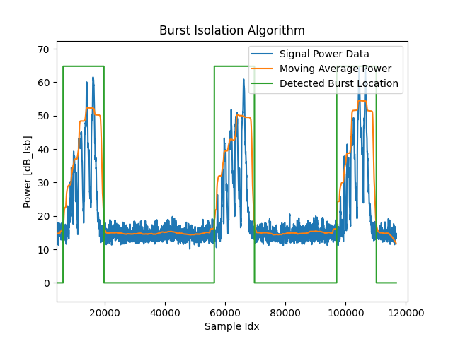
Burst Isolation
By using a moving average filter, we can combine the power across multiple pulses to find the location of bursts. This also makes noise far less prominent and we can set a lower detection threshold.
  The moving average window is set to 5k samples
  Detection threshold is set to 3dB above noise floor (3dB SNR)
From here we can now snippetize the bursts and inspect the individual pulses.

Slide 8
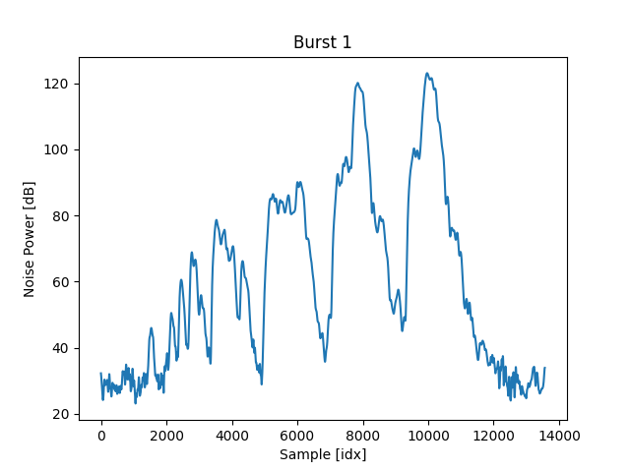
Burst Snippet
We now must create a consistent definition of a pulse. This burst can be smoothed by a smaller moving average window, but do we want to do that?
  These extra peaks may be usable information or they may be noise.
  Further research is needed to determine how useful these are.
Is this 1, 3, or 4?

Slide 9
Next Steps
Once we create consistent definitions of pulses, we can then generate statistics for each wave file.
Common data points worth tracking are
  # of pulses
  Pulse repetition interval (PRI)
  Burst repetition interval (BRI)
  Total pulse power
Putting these into a CSV file consisting of large amounts of recordings will allow us to analyze the data statistically and determine correlations between species.

